Slide 1

Disaster Tweets
Philip Ayazi
Daniel Viassolo
March 21, 2020

Slide 2
Motivation
Twitter has become an important tool as a communication channel
Media, Government, and other agencies monitor twitter real time
NLP models required but certain pitfalls can exist
Words can have multiple meaning
Context can be lost
Examples
“She’s a natural disaster the last of the American girls ??”
“Twilight’s encore wounded hearts book 3 jacquie biggar http t znptdicqxe amazon kindlecountdown sale mfrwauthor mgtab”

Slide 3
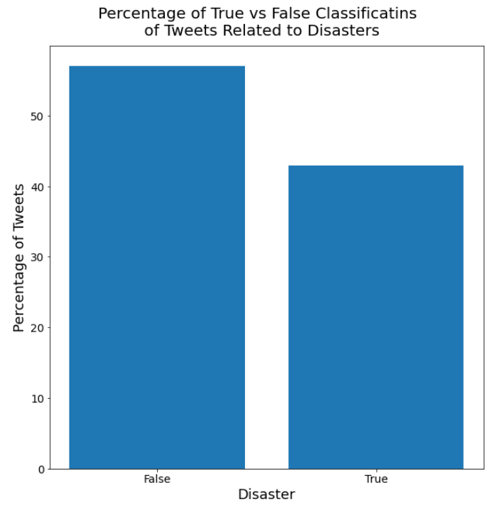
Tweet Data

Slide 4
Process Steps & Tools used
Tweets
Remove Upper Case, Punctuation, Stop-words, … etc.
List of words
Training & Testing Lists
From Words to Numbers
Training & Testing Matrices
Classify Testing Tweets
Train/Tune Classifiers
True or False Tweet
Accuracy
Precision and Recall Rates
Split into Training & Testing sets
Cleaning: gensim
Feature creation:
CountVectorizer
TF-IDF
Word2Vec
GloVe
Classification
Logistic Regression
Random Forest
XGBoost
Deep Neural Network
Hyperparameter Tuning
Grid Search
Randomized Search
Hyperas

Slide 5
Classification Accuracy Tuned Hyperparameters
 | Logistic Regression | Random Forest | XGBoost | Deep NNet
CountVectorizer | 80% | 79% | 79% | X
TF-IDF | 80% | 79% | 77% | X
Word2Vect | 79% | 80% | 82% | 79%
GloVe | 80% | 82% | 82% | X

Slide 6
Classification F1 score Tuned Hyperparameters
 | Logistic Regression | Random Forest | XGBoost | Deep NNet
CountVectorizer | 75% | 71% | 74% | X
TF-IDF | 75% | 72% | 69% | X
Word2Vect | 75% | 74% | 78% | 79%
GloVe | 76% | 76% | 78% | X

Slide 7
Classification Precision/Recall rates TUNED Hyperparameters
PRECISION RATE % | Logistic Regression | Random Forest | XGBoost | Deep NNet
CountVectorizer | 81% | 82% | 79% | X
TF-IDF | 79% | 82% | 80% | X
Word2Vect | 77% | 84% | 82% | 79%
GloVe | 78% | 86% | 82% | X
RECALL RATE % | Logistic Regression | Random Forest | XGBoost | Deep NNet
CountVectorizer | 69% | 82% | 69% | X
TF-IDF | 71% | 82% | 60% | X
Word2Vect | 73% | 84% | 75% | 79%
GloVe | 73% | 86% | 75% | X

Slide 8
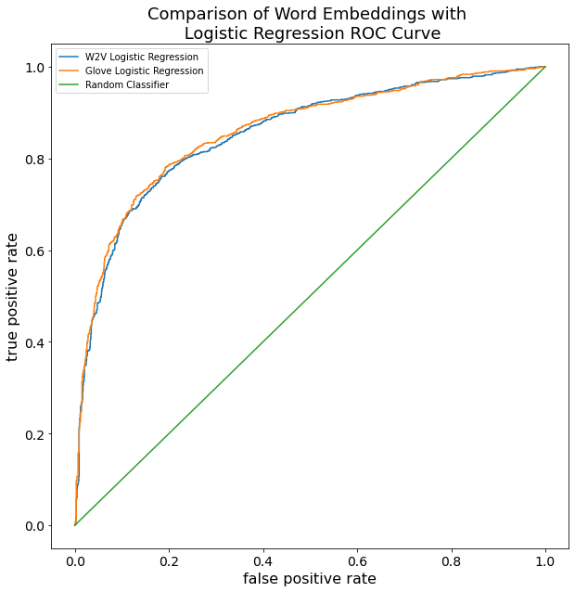
Roc Curve

Slide 9
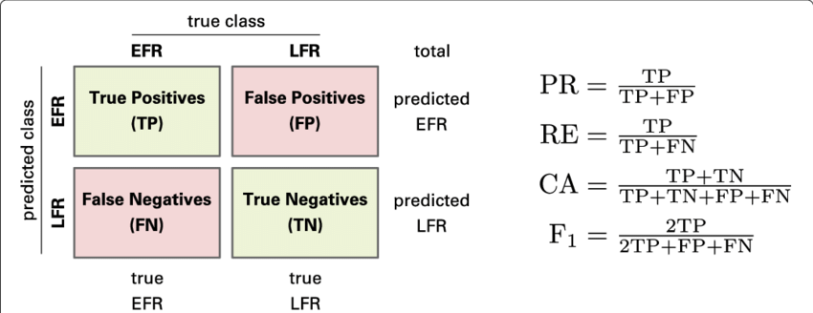
Confusion matrix
Example: TF-IDF Features & XGBoost Classifier
 | Actual TRUE Tweets | Actual FALSE Tweets
Tweets classified as TRUE | 584 | 142
Tweets classified as FALSE | 382 | 1176
Accuracy = (1176+584)/(1176+142+382+584) = 0.77
TPR = 584/(584+382) = 0.60

Slide 10
Conclusions
Best Classification performance (measured by accuracy and F1-score) is obtained for: Features via Embeddings (either Word2Vec or GloVe) and XGBoost Classifier
Accuracy = 82%
F1-score = 78%
Precision Rate = 82% & Recall Rate = 75%
Tuning hyperparameters give improvements in accuracy of ~2%
For our use case, Recall Rate can be considered more important that Precision Rate – prefer not to miss disaster tweets, accepting few more false alarms
Potential improvements (future work)
Out of vocabulary words – e.g., typos
Create vectors for each word in each tweet – i.e., 2D array (tweet) as input to Classifier

Slide 11
APPENDIX

Slide 12
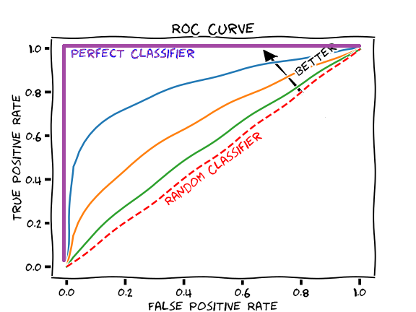
ROC curve

Slide 13
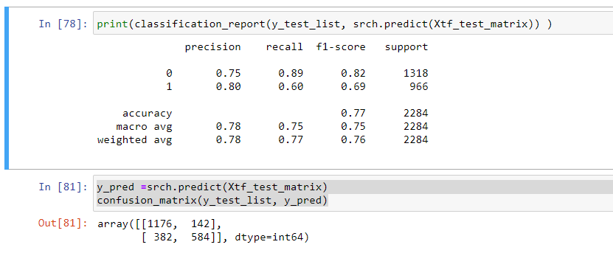

Slide 14
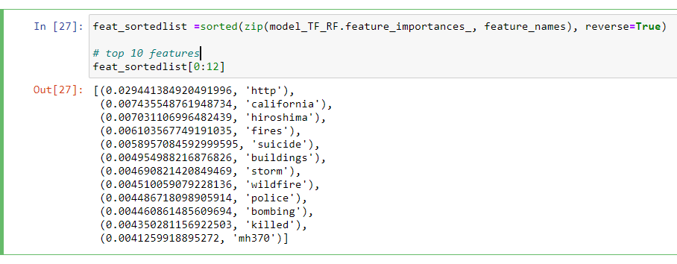
TOP FEATURES (for TF-IDF + RF)
NOTE: mh370 → Malaysia Airlines Flight 370 was a scheduled international passenger flight operated by Malaysia Airlines that disappeared on 8 March 2014 while flying from Kuala Lumpur International Airport to its destination, Beijing Capital International Airport

