Slide 1
Generic Programming via Modules and Functors

Slide 3
Modular Programming

Slide 4
The readability, development, finding of errors, robustness and adaptability of a program depends mainly on its organization into its dependent parts and hierarchies
Without the adoption of boundaries
Development quickly proves difficult to manage
Maintenance proves a burden
Additionally, a program often relies on parts that are more general than it
Distinguishing parts:
Permits reuse in other settings
Aids in the realization of other programs
Structuring, hierarchization and partitioning are the essential ingredients of programs ambitious in size and life-time

Slide 5
The possibility of building environments protected from each other is already provided for in functional programming through the notion of closures
This sub-spacing favors some of the properties mentioned above
Nevertheless, functions are limited to values and the protection they impose uniform and not leading easily to certain adaptions or extensions
Similarly, type structures such as records are likely to generate sub-spaces of names for encapsulation purposes
However, these sub-spaces are equally as limiting as function closures

Slide 6
It is natural therefore to offer a more general means of construction for encapsulation : modules
This new form of encapsulation:
Allows for the construction of sub-spaces of names that do not impose restrictions on the elements of the language : modules can contain values, the definition of types, exceptions, other modules, etc.
Allows control over the visibility of each of the elements encapsulated

Slide 7
Modules are certainly not an original construction of ML languages
They exist in most current programming languages (in some form)
However, ML modules possess specifics:
The type system includes them in their own right
Each module possesses a unique type: it is an instance of this type and recognized as such by the type system
From this point of view, a module resembles a typed value like an integer or a character string
The typing system can thus extend to the global properties of a program and intervene in the elaboration and validation of a software architecture

Slide 8
Modules : A general encapsulator
Modular Programming

Slide 9
Modules : A general encapsulator
Defining modules
Accessing module elements
The modular form of datatypes
Remarks on the rules of module definitions
Local modules

Slide 10
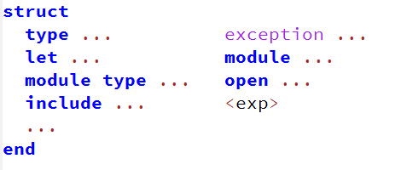
Defining modules
Module syntax is a series of definitions and expressions between the keywords struct and end:

Slide 11

The encapsulation mechanism alone does not define a value, it is necessary to associate it with a name. To do this, one uses the module keyword and the chosen name must start with a capital letter:

Slide 12
Rules of a module definition
All the elements enclosed by a struct-end are compiled and evaluated sequentially in the order they appear: Each new element can use the previously defined elements and is strictly associated with the module. The overall result is bound to the identifier <name>.

Slide 13
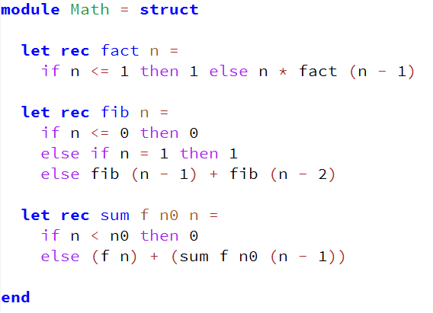
Example

Slide 14
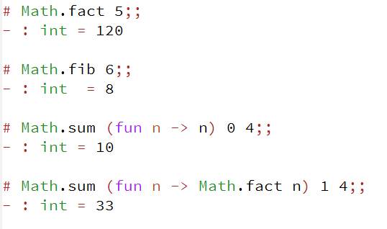
Accessing module elements
By default, elements are accessible from the exterior using “member selection” notation : <Module>.<element>

Slide 15
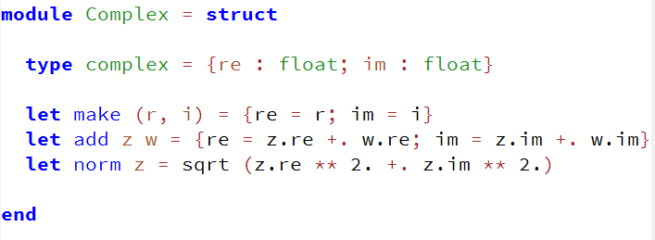
The modular form of datatypes
Modules used to organize sets of functions can include definitions of types and therefore serve as a means of encapsulation of datatypes.

Slide 16
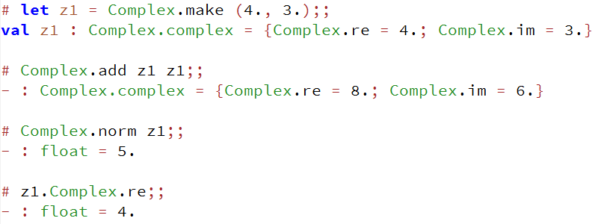
All elements are public and can be used directly

Slide 17
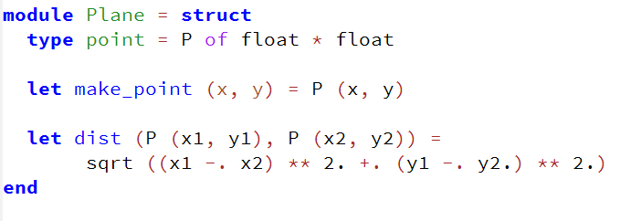
More examples of datatypes in modular form.
A type that represents a point in a plane with the usual Euclidean distance function.

Slide 18
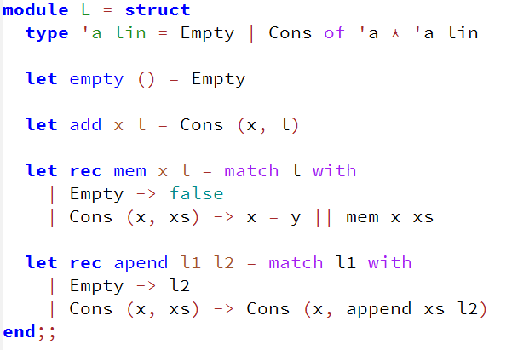
Lists

Slide 19
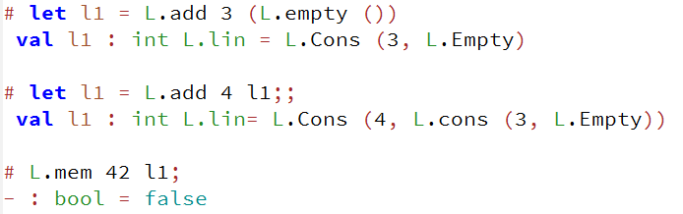

Slide 20
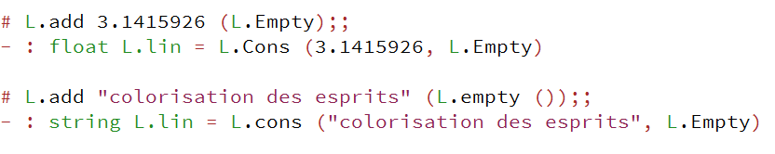
The type of the container is naturally generic since the representation of ‘a lin values is:
Most datatypes defined in the OCaml standard library are implemented using this technique

Slide 21
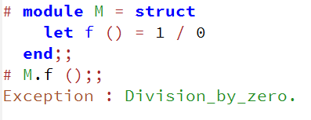
Remarks on the rules of module definitions
The evaluation of elements in a module follow their individual evaluation rules. E.g.
It is only when f is applied that an exception is thrown

Slide 22
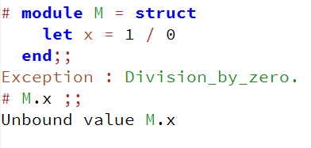
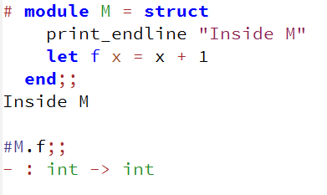
Contrast this with the construction of a value:
The evaluation of the body of a let occurs during the construction of the module
Similarly for simple expressions

Slide 23
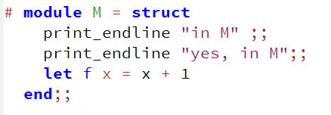
In the case where such expressions are followed, you need separators; you can use ‘;;’ for that
However, the tradition in OCaml is to stick with let bindings
Evaluations that occur during the construction of a module are really only useful in some edge cases
The type of these expressions is unit and the following form is also possible:

Slide 24
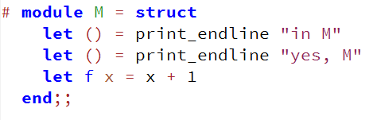
Thus the form let () = … in a module invariably indicates an expression that will be evaluated during construction of the module
Dependence on the placement of elements in a module
The evaluation of a module is sequential
A definition may not use a definition that follows it

Slide 25
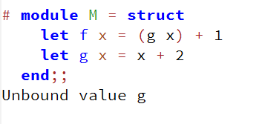
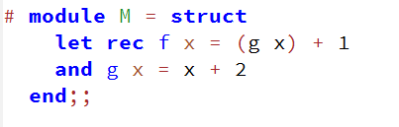
To override this rule, use a let rec construction
Internal module state
It is possible to define variables in a module
These constitute internal state

Slide 26
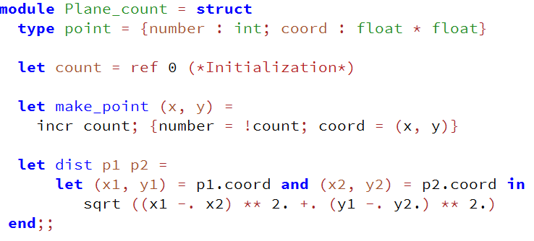
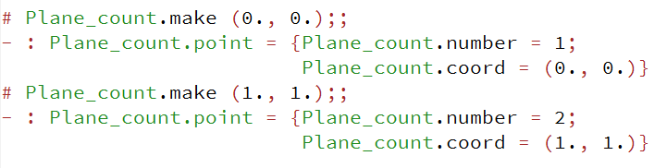
E.g.

Slide 27
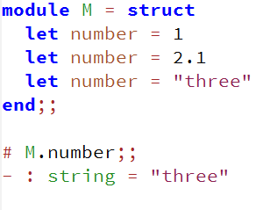
Multiple definitions and redefinitions in a module
If an association is defined multiple times in a module, only the last definition will be taken into account

Slide 28

Local modules
Modules can emerge in local environments by way of a new let construction where the name of the module is usuable is <exp>

Slide 29
The main value of local modules is to remedy the limitations of environments defined by let-in that can not include certain entities; local modules are not subjected to these restrictions
Local modules may contain types and exceptions;
For example, inductive types can clarify code and can sometimes be considered as a local and specific aid

Slide 30
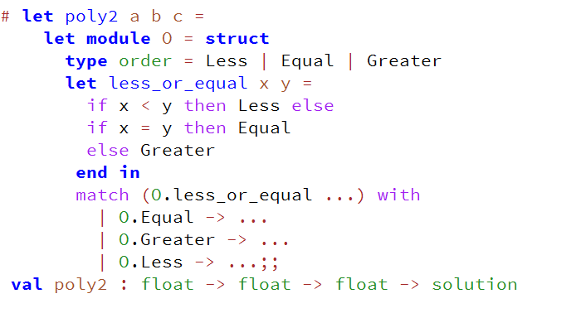
Example (polynomials of degree 2)
The type order resides privately and solely in the function poly2

Slide 31
Signatures : The type of modules
Modular Programming

Slide 32
Signatures : the type of modules
Inferred signatures
Defining signatures
Abstract types
Elements implemented in signatures
Signatures for explicitly typing modules
The instantiation relationship between modules and signatures

Slide 33
Inferred signatures
The behavior of modules is similar to that of values in may ways
In particular, each module possess a type that is integrated with and used by the type system
The type of a module can be computed by inference from the module’s definition
The types of modules are called signatures

Slide 34
Property (1) of signatures : A signature can be inferred from the definition of a module.

Slide 35
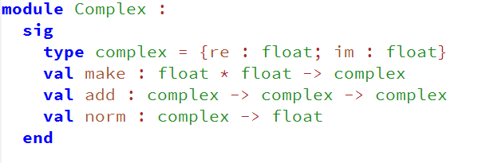
Recall the module corresponding to the implementation of a type for complex numbers
The resulting signature obtained by type inference is
A signature is essentially a summary of the elements contained by the module to which it corresponds

Slide 36
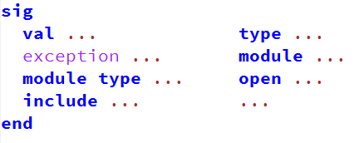
Defining signatures
It is possible to define signatures independently of modules
A signature then consists of a simple suite of definitions and declarations enclosed in the keywords sig and end

Slide 37
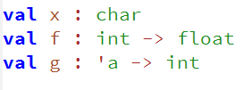
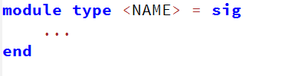
Note that identifiers must be declared with the keyword val (rather than let)
As for modules, it is necessary to link a signature to a name using the keywords module type

Slide 38
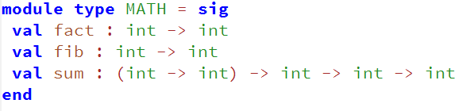
There are no syntactic constraints regarding the names of signatures with respect to enforcing upper or lower case characters
That said, to distinguish signatures from other kinds of identifiers, a common convention is to spell them entirely in capital letters

Slide 39
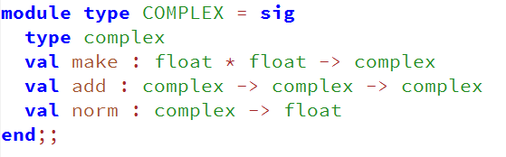
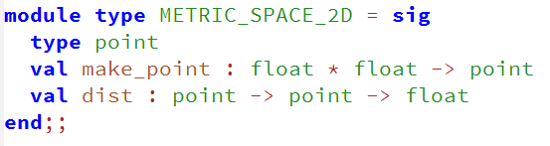
Examples
Signature of Complex
Signature of Plane

Slide 40
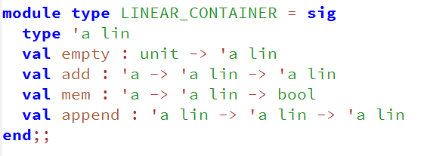
Signature of L (the module associated with lists)

Slide 41
The fundamental interest of signatures : They express certain characteristics of modules without including implementation.

Slide 42
Abstract types
The signatures of the last section shows that it is possible to use the keyword type without necessarily associating it with an explicit definition
E.g.
type complex
type point
type ‘a lin

Slide 43
Definition: In a signature, a simple declaration of a name of a type is called an abstract type.
This name is justified because these types allow for an abstraction of the existence of particular types

Slide 44
The interest of abstract types and the coherence of a signature :
The abstract type of a signature S declares the names of types which are usable for the types of other elements in S. They thus impose a global coherence to typing other elements of S and this without dependence on the definitions of these types.

Slide 45

Moreover, when parameters are abstract types, this makes possible expressions of typing patterns. E.g.
So, for example, the type ‘a -> ‘a lin -> ‘a lin describes a generic operation of adding an element of type ‘a to an ‘a lin containing other elements of the same type
In the implementation, the typing consistency will be ensured

Slide 46
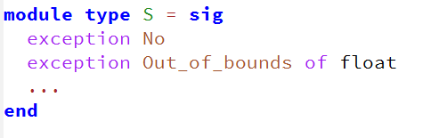
Elements implemented in signatures
Even if the main part of a signature is constituted merely of simple declarations, some of the elements can be implemented.
It is possible to define exceptions:

Slide 47
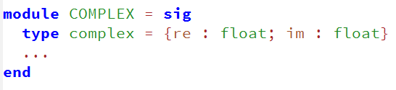
Types can also be defined:
Such types are called “concrete types” or “manifest types” to distinguish them from abstract types

Slide 48

Signatures for explicitly typing modules
Signature definitions only make sense if they can be linked to modules
As for simple values, it is possible to explicitly ascribe a signature to a module. The syntax is similar:

Slide 49
The first application of this is to add explicit typing information to the definition of a module
Type inference can put this into correspondence with its own calculation
We can thereby check by inference that a module corresponds to its signing
For example, if we use the module L associated with lists we can explicitly type it to the signature LINEAR_CONTAINER

Slide 50
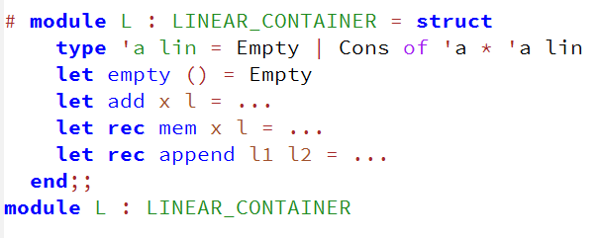
Here we get a terse response from the type system indicating acceptance that L can be typed as a LINEAR_CONTAINER

Slide 51
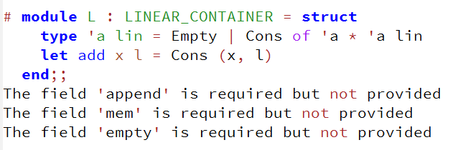
Consider the situation where a module doesn’t implement all the elements of the signature LINEAR_CONTAINER

Slide 52
Rule of explicit typing by signature : The explicit typing of a module M by a signature S is valid only if the elements defined and declared in S are implemented in M (with exactly the same names). The elements of M must be equal, consistent with or more general than those indicated in S.

Slide 53
Some examples to help explain the rules:
Independence from the order of definitions. The order of appearance of the elements of the module is not important as long as its type corresponds with the signature
The effect of explicitly typing on individual elements Signing by explicit typing acts to explicitly type each individual element of the module

Slide 54
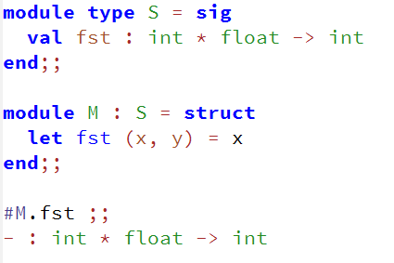

Here the function fst given by the explicit typing to the signature S is equivalent to

Slide 55
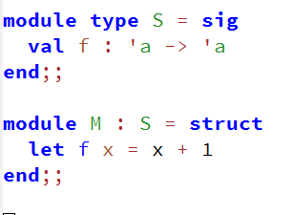
An occasional error is to implement an element of a module that is less general than its declaration E.g.
The above is an error
Parametric abstract types An implementation of an abstract type can make use of type variables

Slide 56
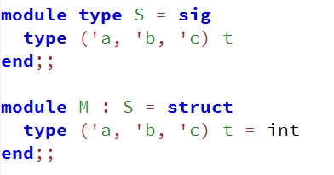

One can restrict the genericity of a type parameter of an abstract type, the inverse is not possible

Slide 57
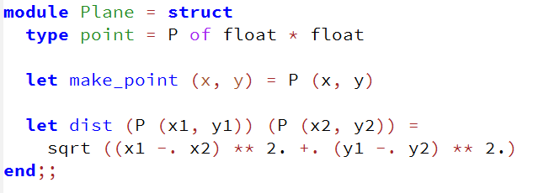
Global coherence of the type of a module Using abstract types in a signature permits expressing the overall coherence between the elements of a signature. For example, reconsider the module Plane

Slide 58
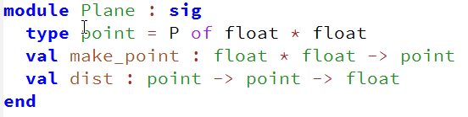
The inferred signature is
The use of the simple inductive type permits the use of the type in the type of the functions make_point and dist

Slide 59
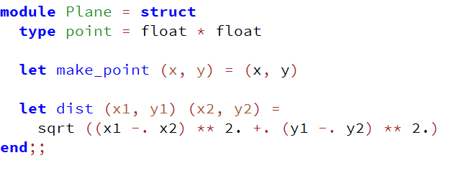
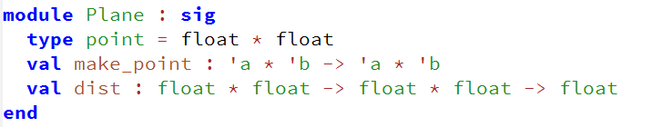
But here, another version of the module that uses a type alias
The inferred signature of this is

Slide 60
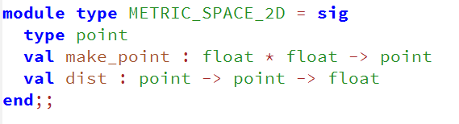
The type point here is a priori without manifest utility and the associated functions don’t use it (the type inference possesses no evidence to connect them with the type point )
Explicit typing remedies the situation

Slide 61
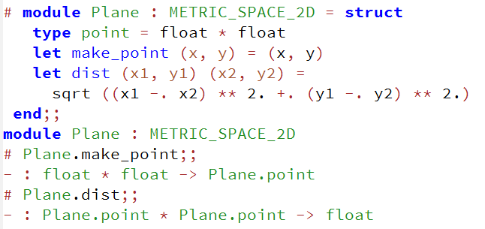
Then,
The types of the functions here become specific. The explicit typing has had an effect on the collection of types of the elements of the module

Slide 62
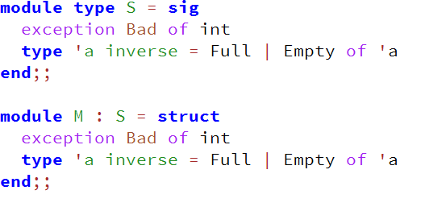
Concrete types and exceptions If a signature S contains concrete types of exceptions, the modules that implement it must necessarily contain the same definitions

Slide 63
The instantiation relationship between modules and signatures
A signature may be inferred by the type system for a particular module
On the other hand a module may correspond to a signature by explicit typing
It is then said that the module implementation satisfies that signature
To leave it at that though would be to forget an important and original characteristic of the module system:

Slide 64
Property (2) of signatures: The same signature may be implemented by multiple distinct modules. Definition :
A module that satisfies a signature, we say is an instance.

Slide 65
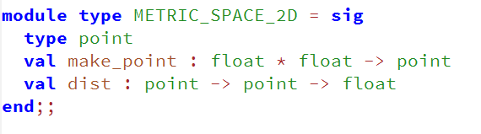
A new signature that describes a two-dimensional space equipped with a distance metric

Slide 66
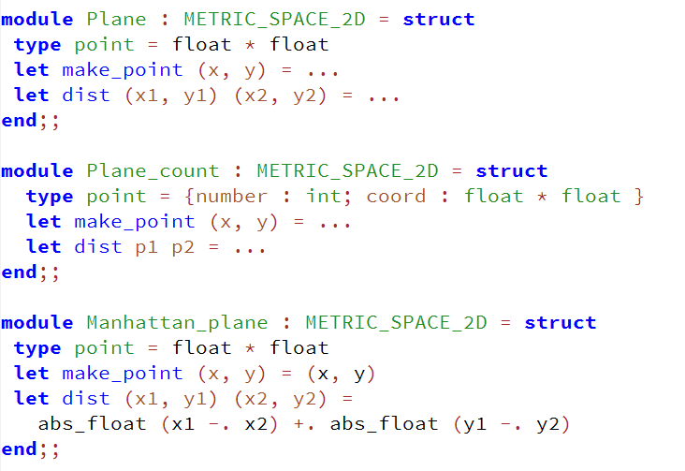
It is possible to instantiate it in a variety of ways

Slide 67
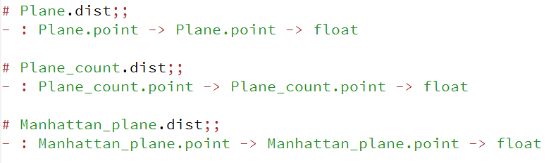
These three spaces can coexist in the same program
Interface and multiple instantiation are absent from most languages
Multiple instantiation increases signature reuse and turns out we will see later to be natural in defining “functors”

Slide 68
Techniques for writing signatures
Modular Programming

Slide 69
Techniques for writing signatures
Signatures as a means of specification and interface
The limitations of signatures as specifications
Mitigation of the limitations of specification via signatures
The generalization of signatures
Signatures and the functional or imperative style

Slide 70
Signatures as a means of specification and interface
Explicit typing of modules showcases signatures as a means of interface specification
Formal description: The prior elaboration of signatures permits the design of programs without having to face the practical problems of implementation
Focus on organization of name spaces, relations and constraints

Slide 71
Only in the 2nd phase we undertake implementation
The implementation of a program is then based on the collection of pre-existing signatures
Transmission of documentation.
Signatures lend themselves to the transmission of an abridged form of possibilities their bodies offer the potential user
These links between signatures and modules thus induce a method of production of programs that is both measured and thoughtful. This method applied during program development takes a certain thoroughness.

Slide 72
The limitations of signatures as specifications
Signatures can only include properties whose verification can be established by the type-system
Reconsider METRIC_SPACE_2D
The declaration dist there is deemed to specify a function of distance
The declaration describes a binary function acting on the point type and computing a float

Slide 73
Weakness in the implementation
The programmer can not rely on the type-system to check the character of an implementation of dist
Weakness of use
A user of an instance of METRIC_SPACE_2D can not be sure of the character of the distance function provided by dist

Slide 74
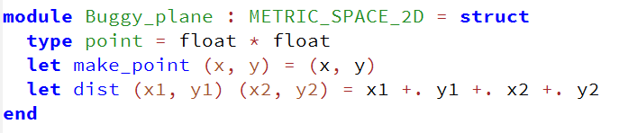
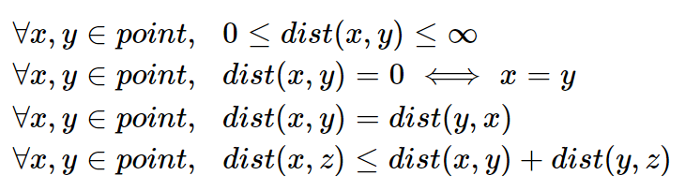
For example, this module satisfies METRIC_SPACE_2D but its function dist is not a distance function
For a complete description of a metric space, the axioms of distance would be specified:

Slide 75
Verification of these properties here is out of reach of the type system
Languages that include such specification possibilities require production of mathematical evidence adapted case by case
In OCaml we resort to verification of implementations via assertions and tests

Slide 76
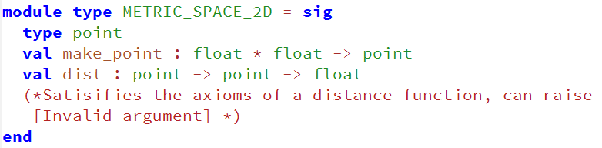
Mitigation of the limitations of specification via signatures
Simplest and most traditional method of mitigating the limitations is to associate signatures with documentation in comments

Slide 77

Later we will see that sometimes OCaml offers more effective means by nesting signatures in other modules or, the use of functors
Also, technically, a specification can combine the type system. For example in MATH we have
While it defines the form of the function, we are guessing that the first parameter is the operation that defines the sum, on the other hand the role of the remaining parameters is not clear

Slide 78
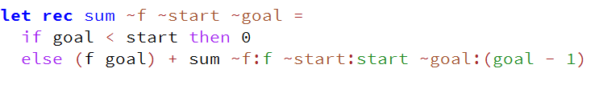
OCaml provides the feature labeled parameters for this kind of problem. We can use this feature in the signature to clarify the roles
Satisfying modules will have these types labeled providing coherence

Slide 79
Labeling then permits an enriched signature and is verifiable by the type system during instantiation

Slide 80
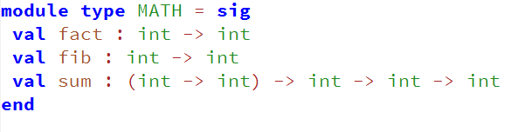
The generalization of signatures
The existence of abstract types in signatures permits a new technique of generalization. Once again consider the signature MATH
This signature restricts the declarations to numbers of type int
We can replace occurrences of type int with an abstract type

Slide 81

We have obtained a generalization of MATH over the type int
Principle of generalization of a signature : Replace the specific type in the signature with an abstract type

Slide 82

Signatures and the functional or imperative style
A signature can induce a programming style
In particular, those operations with result type unit indicate an imperative program

Slide 83
The functions add and append have return type unit which imposes the requirement of an implementation necessarily of imperative character
Items specified by a signature may overall lead one to adopt an imperative rather than a functional style
For example, consider a new version of the preceding signature:

Slide 84

A priori this signature specifies an implementation of a functional character
Suppose we have at our disposal such a representation and suppose we want a function that runs through the elements of ‘a lin instances

Slide 85
Here, as the only access function is nth, it would be tempting to go the way of imperative loops adapted to the management of indices
Thus, a signature that specifies a data structure have functional character that lends itself to recursive decomposition should also specify directly generalized processing functions like iterators or folds

Slide 86
Public and private modules
Modular Programming

Slide 87
Public and private modules
Public
Private
Compatibility of signatures
Public exceptions
Public types
Private and abstract types

Slide 88
Public and private modules
The mechanisms of encapsulation induce rules about the visibility of elements in a structure
An element that is public is usable from outside of the encapsulation
An element that is private is not
So, for example, the local bindings of a function are private while the fields of a record are public

Slide 89
Modules offer a mechanism more nuanced where it is possible to explicitly render elements public or private
This control of visibility allows us to apply techniques of information hiding and precise control of the links between modules

Slide 90

Public
Rule (1) of the visibility of modules :
The contents of a module without an explicit signature are public.
For example, recall the implementation of a datatype for lists:

Slide 91

Without explicit signing, the module exposes all its contents and is directly usable

Slide 92
Private
When presenting the rules of explicit typing via signatures, we did not highlight an important point : the explicit typing of a module M by a signature S remains valid if at least all of the elements of S are defined in M. The rule that follows is the natural complement of the behavior of explicit typing since the signature acts as interfaces between modules:

Slide 93

Rule (2) of the visibility of modules : The elements of a module M typed explicitly with a signature S are public only if they appear in S (except for abstract types). All other elements in M are private.
For example, reconsider the module Plane_count. This one possesses the signature

Slide 94

The internal state count appears in the signature. In the original rendition of METRIC_SPACE_2D this variable was absent

Slide 95
It is not possible to access the variable denoted by count
Notice that Plane_count can be considered an instantiation of both signatures METRIC_SPACE_2D and METRIC_SPACE_2D_COUNT
Explicit typing implies which properties are important and underlies the independence of signatures relative to modules

Slide 96
Property (3) of signatures : The same module may instantiate multiple distinct signatures.

Slide 97
Compatibility of signatures
Compatibility between signatures : Suppose S₁ is compatible with the signature S₂ and M₁ is an instance of both. Then if:
S₁ includes S₂ in terms of its set of elements
The types of elements of S₁ are respectively equal to, compatible with or more general than those of S₂
Certain concrete types in S₁ are abstract in S₂

Slide 98
In this case we say the signature S₁ is compatible with the signature S₂ and M₁ is an instance of both.
So, METRIC_SPACE_2D_COUNT is compatible with METRIC_SPACE_2D
The definition is in general accord with the general definition of the compatibility of types
It can also be described as structural : it only depends on the form of signatures, it does not need to be made explicit by the programmer

Slide 99

The compatibility between signatures must be associated with another possibility of modules which brings them closer to the usual behavior of values : a module may be bound to an arbitrary number of distinct identifiers. It is indeed possible to construct new bindings of modules to existing modules
Here P is made to be a reference to the same implementation of the module Plane_count

Slide 100

It is similar to the effect to that which governs the definition of new bindings by let : a new copy of the module Plane_count is not produced (in this imperative example, the internal counter of the Plane_count points will be shared)
Construction of such module links can be accompanied by explicit typing and under the notion of compatibility

Slide 101

Or, in an equivalent manner
The explicit typing here authorizes multiple visibilities of the same module : the module P₂ exports all the elements of Plane_count whereas P₁ just those elements that appear in METRIC_SPACE_2D
Such multiple views can make sense in many situations

Slide 102
For example:
Distinguishing between access levels. More or less of complete access is granted to users of a module.
Note that this explicit typing via signatures can be phrased in terms of the classical type-transformation term of an “up-cast”, a term which denotes the transformation of the type of an element in the sense of a compatibility relation. A restriction on the “window of visibility” of a module by becoming the instance of a more general signature

Slide 103

The reverse, that is a type transformation of the form of a “down-cast” is not allowed
There are in fact no more traces of the initial shape of a module after an up-cast
For example, if we now reconsider the previous example:
It is not possible to retrieve the initial module by an a posteriori retyping to its complete signature

Slide 104

Public exceptions
In the context of explicit typing, exporting of exceptions requires passing their definitions in the signature

Slide 105

Conforming to the rules of explicit typing by signatures, an instantiation of the signature FACT includes necessarily the exception Neg
This double definition is a mark of exporting an exception and makes it usable outside the module
The point in exporting them of course is to make possible processing them from outside the module

Slide 106
Their appearance in the signature gives more opportunity to specify the character of the functions like to raise them
Their commentary can thus help prepare for the treatment of errors
Note though that some exceptions need not be exported
Sometimes they can be restricted to exploitation by the private implementation of the module

Slide 107
Recall also that in OCaml there exists a fairly large collection of predefined exceptions that are global

Slide 108
Public types
With explicit typing by signatures, as for exceptions, to export types from a module requires their implementation in the signature
That is, the types must be concrete and not abstract if they are to be exported
For example, consider complex numbers again but this time with a representation in the form of records which integrate both the real and imaginary parts and their pre-calculated norm

Slide 109

The definition of the type complex within the signature renders it public for any instantiation
In particular, the fields of the record are directly usables

Slide 110


Slide 111
However, the interest in exporting types is questionable
For example, one observes here an interaction between the field norm and the function norm assumes an equivalence
The relationship between the declared norm and the calculated norm can nevertheless take a more sophisticated turn

Slide 112
Private and abstract types
A final development is necessary regarding visibility and the explicit typing of modules
As stated in the “rule (2) of the visibility of modules”, there is a particular case:
When explicitly typing modules with signatures, an abstract type is not rendered public
The abstract character of such types is maintained
Modifying the previous example:

Slide 113


Slide 114
The responses of the type inference hide here the representation of the type mentioning only that it is <abstr>
Specific accessors are now indispensable
It is possible to extend the signature COMPLEX with a general accessor, here we’ll name it show which returns a complex number in the form of a pair of float

Slide 115


Slide 116

The type complex is henceforth hidden, instantiable and exploitable:
Certain types of data lend themselves to the hiding of their representation better than others
For example, those data-structures that naturally provide accessors and constructors of empty structures or of particular sizes

Slide 117

Let us recall the following example:

Slide 118
The universal type parameter ‘a can be equally instantiated with a hidden type as with a public type
In other words, the responsibility of masking the values contained by the containers is left in the hands of the users
For example, it is possible to insert a hidden complex number in the container of type ‘a lin

Slide 119


Of course, the application of the show accessor is required if it is desired to obtain the explicit values
We therefore have the ability to implement controlled visibility of the elements which make up a module

Slide 120
In the case of the implementation of datatypes, this complete mastery of visibility permits us to define abstract data types where details of the representation are hidden (and therefore based on abstract types in the corresponding signatures)

Slide 121
Abstract datatypes
Modular Programming

Slide 122
Abstract datatypes
The reasons for hiding and substitution
How to evolve datatypes
Optimizing datatypes by “memoization”
Hiding and generating predefined predicates
Hiding and imperative optimizations
The need for individual hiding of abstract types
Individual hiding and type constraints
The conceptual generalization of signatures

Slide 123
Tactics for naming abstract datatypes
Universal type parameters and abstract types

Slide 124
The reasons for hiding and substitution
Implementation hiding is an import tool for the production of modular programs of quality
Hiding in effect assures independence between modules
For example, implementation dissemination can make it difficult to make subsequent changes to a program and adaptions and extensions tedious to carry out

Slide 125
Hiding is based on signatures, that is, elements that describe the program without fixing on or revealing an implementation
Signatures contain the abstractions, the interfaces, a screen over the particulars of a program
However, signatures also indicate the organization of a program composed of distinct modules
They represent by themselves the logical architecture of a program

Slide 126
If the properties sought through modular programming have so far been expressed in a very general way, what has just been said allows us to establish a principle that more concretely characterizes a good modular organization
The principle of modular substitutivity : Let S be the set of signatures that specify a modular program Prog and let M be a component of Prog that satisfies a signature S ∈ S. Then, any component that also satisfies S may be substituted for M without any other modifications of Prog.

Slide 127
This principle expresses what is meant “to be independent” in the case of a set of modular components
It gives rise to a similar virtue of the notion of referential transparency in functional programming, that is to say, a strict localization of the effects of an action on the program
Under the aegis of the “principle of substitutivity”, a program can be first specified and its realization and development brokend down component by component.

Slide 128
How to evolve datatypes
A representative situation for evolution in modifying programs consists of adaptions in the interest of performance improvements in time and space
Optimization is often performed after an operation is revealed to be complex and tedious
It is therefore economic in the early phases of development of a program to make it easy to return thereafter and substitute more efficient code

Slide 129
In the context of abstract data types, these modifications lead generally to representations that are very far removed from those that seem natural at the outset
In effect, the implementations then carry technical information which contributes to the optimization of their associated functions
For example, consider the case of the specification of a datatype for queues:

Slide 130


The signature could be directly implemented with a list and without too much regard to the effects of the persistent nature resulting from being of a functional character

Slide 131

The signature however equally allows for an implementation optimized for queues:
This change of representation is transparent to any user who is restricted to the signature FIFO_CONTAINER : the module Q_burton may be directly substituted for Q_list even though the representations are quite different

Slide 132

Here’s another classic example for the structure of association tables. These tables may initially be specified in a minimal way:
The signature is easily implemented as a list

Slide 133


Slide 134

When the elements of an association table are frequently accessed, it is normal to organize the table in order that accessing elements is of logarithmic complexity
For this we can utilize balanced binary search trees e.g. red-black trees:

Slide 135


Slide 136

Again, the optimization can be used transparently due to the conformance to the ASSOC_TABLE signature
One obtains the same behavior as for the preceding implementation

Slide 137
Optimizing datatypes by “memoization”
Here are other examples of abstract datatypes using a particular optimization technique
Recall complex numbers with a pre-calculated norm
If this value is not used, this calculation becomes useless
One remedy is to calculate it on first use
This implementation applies this technique and equally well satisfies the signature COMPLEX

Slide 138

This optimization is transparent from the point of view of using complex numbers through the signature COMPLEX:

Slide 139

There are cases where memoization of all calculations proves to be unsuitable or too heavy
For example, successive searches into a data structure can not all be transformed into immediate access

Slide 140
The idea is rather to put in place “caches” which provide direct references only for the most recent searches
These caches act as a set of opportunities to take “shortcuts”
A problem then arises when one modifies the data structure:
Elements that are deleted are nevertheless referenced by a cache and are not recoverable by the garbage collector
They remain referenced by their shortcuts but can’t be utilized as they no longer exist

Slide 141
A solution to this paradox is offered by the notion of a weak reference, that is a reference to an element the garbage collector is entitled to recover
As long as these elements exist, these references make it possible to reach them
If these elements are to be destroyed, these references do not impede the garbage collector in harvesting them

Slide 142
The Weak module in the OCaml standard library provides an implementation of a table of weak references
We can integrate the technique of memoization by caches with an implementation of a table of associations:
Each will have an individual cache that will allow for directly reaching the elements previously accessed
The association function will therefore give priority to the cache and then in the case of failure on the table of assocations

Slide 143
This operation will also be responsible for updating the cache
Here is an implementation based on binary search trees that satisfies the signature ASSOC_TABLE:

Slide 144


Slide 145


Slide 146
Obviously, this implementation is much more complex and only really justified for very large trees
However, the optimization is still transparent to the user
These examples show that improvement of a datatype could include radical changes in the form of its instances
Exporting of the representation of these types would be very bad if they had to be modified after dissemination into the code

Slide 147
This work could prove to be not only laborious but problematic
Indeed, the user might find herself in the necessity of managing the creation, the coherence and the processing in the module associated with the datatype
That said, implementation hiding is a technique not without difficulties and traps
We will develop some of them in the following

Slide 148
Hiding and generating predefined predicates
The multiple implementations of the last few slides have established the framework of the “principle of module substitutivity”
Optimized versions have replaced non-optimized versions transparently
This is only possible if we take care to avoid transmitting implicitly something concealed between the components in spite of their adherence to their respective signatures

Slide 149

There exists a case in OCaml which is particularly representative of this difficulty
For example, reconsider Complex_memo
The representation of values of the type is:
Recall that the predefined equality operator “=“ over records, compares each field
Under these conditions the equality function is no longer valid on such a lazy representation

Slide 150

The origin of this behavior may be even more difficult to discover when comparison predicates are used by other functions
For example:

Slide 151

Implementation of the function List.mem utilizes the default equality function
Thus, the contribution of these comparison predicates puts in peril the independence of modular components

Slide 152
The earlier example shows that moving from a trivial implementation of complex numbers to an implementation with memoization induces noticeable differences in behavior
Constraint (1) of substitutivity : The principle of module substitutivity is not strictly applicable in OCaml when abstract types are used by functions that use comparison functions of their instances.

Slide 153

In particular, a signature for complex numbers must include an explicit specification of functions to compare them to work around the problems just discussed:

Slide 154
Hiding and imperative optimizations
We have seen examples using imperative features while ensuring partitioning of this style : nothing was visible outside of the module
The values were simply associated with modifiable information that optimized their evaluation
The only noticeable effect in this case is “evaluation sharing” which does not alter referential transperancy

Slide 155
The last section illustrates the problem of comparing values by means of the default predicates but this difficulty was related only to an interaction between hiding and restrained genericity of the predicates
It would be possible to envisage transformations of the implementation of a module integrating more fully the imperative style
For example, here is a signature for the type of sets:

Slide 156


It is possible first of all to utilize a functional representation of sets:

Slide 157

So,
The purely functional style allows here a terse and not conductive to errors program
On the other hand, the time and space complexities are high
Consequently, several possibilities of optimization might be contemplated

Slide 158
Association tables for example might be considered for exploiting an ordering of the elements of the set and thereby inducing a tree like structure
One could also contribute a hash table of imperative character such as the Hashtable module of the standard library
Note that tables are presented as asssociation tables
In order to use them as simple tables, the usual tactic is so systematically associate keys with constants

Slide 159
The former can then correspond to elements of the set
Here is a new implementation that satisfies SET:

Slide 160


Slide 161


Then, in the same manner as Set_func:
Due to the use of hash tables, accessing the elements of the set is fast
However, it should be noted this implementation preserves the functional character of the specification of add, that is

Slide 162

The implementation of add in Set_h causes the sets to be persistent: each insertion implies a complete copy of the hash table
We could of course override this property of add so as to camouflage its imperative behavior:

Slide 163
We refer here to the table h1 after modification
However doing so gives rise to the problems of referential transparency and delicate errors may result
This example illustrates the necessity of reflecting clearly the intent of the style of a signature and conforming to it

Slide 164
Constraint (2) of substitutivity : The principle of modular substitutivity is not strictly applicable in a functional framework if imperative features are not strictly compartmentalized.
In other words, the preservation of the substitution principle justifies what is illustrated in:
Indication of imperative features in the specification : In signatures, those operations with imperative behavior appear as procedure declarations (results are of type unit).

Slide 165


For example, if full use were to be made of a table of imperative style, the signature SET should reflect this:
The function for adding an element exhibits an imperative character

Slide 166
This example shows again the difficulties of preventing propagation of the imperative style
If its application gives rise to behavioral changes which escape a specification, they will surprise and demand consequent work of a search for errors : an expected effort when the principle of substitutivity applies only in pretense
The strict partitioning of styles here though lead to a multiplication of signatures : the ones in a style purely functional, the others in the imperative style

Slide 167
Optimizations via imperative constructs is not directly applicable
It is however possible to unify signatures by application of a generalization of the return types of functions
Indeed, in the framework of implementing abstract data types, these types characterize the style alone. For example:

Slide 168

The type ‘a result can be instantiated either by the same type as ‘a set or by unit

Slide 169
The need for individual hiding of abstract types
Our current knowledge of the control of type visibility is summarized in the following alternative when a signatures S is used to explicitly type a module M:
A concrete type in S is public
A type abstract in S is private to M
These possibilities lack a little nuance
We might sometimes want to export an abstract type of S after its implementation in M

Slide 170
But what are the situations that engender the need to derogate from type abstraction?
Here is the representative case:
When the representation of values is to be hidden but there is a need to use its constructors and accessors
The constructors must then have arguments whose types are public and the accessors must also have results whose types are public
For example, the signature COMPLEX declares functions in the following form:

Slide 171

Here the respective types of the parameters and the result are based on the predefined type float
This constraint is probably acceptable for conventional use but will prevent certain implementations
Suppose we wished to obtain a type for “big complex numbers” using the standard library module Num, that is to say:

Slide 172

These complex number posses real and imaginary parts that are arbitrarily large and precise

Slide 173


It is observed that the types of the parameters of the constructor and the accessor of the module Complex_num have undergone a transformation
The exterior representation of large numbers from Num uses strings instead of floating point numbers

Slide 174
The module Complex_num does not satisfy the signature COMPLEX
We can nevertheless generalize the signature with respect to the types of the constructors and accessors
Technique of generalization of constructors/accessors for external types : If t is the representation of values of a datatype, we associate a type extern_t which constitutes an external view of an instance of t.

Slide 175

Thus, in COMPLEX we replace the type float * float with a new abstract type extern_complex:
The definition of the type extern_complex can then be added to Complex_num:

Slide 176


This implementation becomes compliant to the signature COMPLEX_MASK:
However, the types complex and extern_complex are now both made private by this explicit typing
The functions make and show have become unusable:

Slide 177
This technique of generalization has augmented the possibilities of instantiation of a signature but necessarily requires exporting certain types after their implementation
This situation finds itself in connection with the signature SET_GEN whose definitions of the generalized type ‘a result will also have to be exported

Slide 178
In another words, we need a new rule of visibility of individual hiding of abstract types
The more careful control of the visibility of the types will be possible thanks to a new construction which will be described next.

Slide 179
Individual hiding and type constraints
Signatures can be supplemented by explicit type constraints
The constraints are capable of associating a posteriori with definitions of abstract types and are expressed through the construction with type:

Slide 180

In the above, <type i> denote types in <SIGNATURE> and the <expression of type i> is a valid type definition in the environment at the moment of application of the type constraint

Slide 181

For example:
Thanks to this constraint, the type t is abstract in S1 and made concrete in S2

Slide 182
Making types concrete with the with type construction : Type constraints can make concrete types of types that were not originally so. These types then become exportable.
A signature can thus see some of its abstract types become concrete. This transformation resolves the problem posed by the signature COMPLEX_MASK:

Slide 183

The constructor make becomes accessible from outside the module:

Slide 184
Here are some remarks to help with the usage of type constraints:
Necessary duplication. The syntax imposed by the construction with type sometimes seems somewhat fastidious since it requires a flagrant duplication between the type constraints and the definitions in the module.
The implementation of the module must be consistent with the signature transformed by the addition of the type constraint
The duplication of code is the same as that which occurs in the relationship between signatures directly containing concrete types and their instantiations

Slide 185

Irreversibility of hiding. A type which is hidden may not become revealed by the addition of a type constraint
For example:
The system can not make the link here between int and M1.t
Indeed, the name of a hidden type is definitely associated with its module : the name of the int type hidden in M1 is M.t. It is no longer equivalent to int

Slide 186
Type constraints are the last ingredient needed to systematically implement abstract datatypes and more generally, modules whose implementations are systematically masked even in the case where it is necessary to export abstract types

Slide 187
Modular programming with rigorous hiding:
No type definition is given in the signatures (no type definitively fixed as concrete)
All modules are explicitly typed with a signature. with type constructions are applied on those types that need to be exported
Note that the first point above does not prohibit making use of global types (like e.g. the predefined types) and, the generalization of types in signatures is not an obligation.

Slide 188
The conceptual generalization of signatures
Generalization renders signatures adaptable without having to redefine them, rename them and thus to organize their variations
Additionally, the possibilities offered by type constraints make it possible to not fear the effects of the rules of visibility
If the preceding examples reveal essential techniques, it is important to remark that generalization can also extend conceptually the field of description of a signature

Slide 189

For example, consider a new signature of the notion of a bi-dimensional space with a distance:
The number of dimensions of the space is fixed by the type of the constructor make_point
Applying the external type technique it is possible to work around this constraint and propose a more general specification of spaces:

Slide 190


Here’s an instance adapted from one previously presented:

Slide 191

But, it is equally possible to define spaces with different dimensions:
It is also possible to envisage instantiations of the signature METRIC_SPACE with a dramatically different nature
For example,

Slide 192
Recognition and compression of alphanumeric character strings are based generally on quantitative comparisons and their representations as binary numbers
The functions of distance can be put into contribution in order to structure the set of recognized characters and the characters to be recognized
The simplest of these functions is to count the number of pixels different from the respective representations
Here is a possible implementation of this novel space also satisfying METRIC_SPACE:

Slide 193


Slide 194
Tactics for naming abstract datatypes
The implementation of abstract datatypes by modular means is dependent on the relationship maintained by three elements:
The signature of the datatype
The type of the data itself
The representation of values included in the datatype
These 3 elements must of course bear names and their choice is not so innocent of that

Slide 195
The names participate in the quality of the abstraction and they predispose more or less to compatibility
One point in particular distinguishes many “naming tactics” :
Homogenous naming tactics The distinctions between the 3 elements are reduced by names which are as similar as possible. For example :

Slide 196

The homogeneity of naming expresses here that there is only one element that counts : the type of complex numbers
Algebraic naming tactics. The distinctions between the 3 elements are emphasized by giving them distinct names

Slide 197

The “algebraic” character of the datatype is also made apparent : a datatype is indeed a set of values structured by associated operations
Strong distinction. We assert the difference between the type of data and its representation of values by different and descriptive names. For example: The representation of values here bears the particular name of point to which is added a distance generating by itself a particular space, that is to say, the Plane.
Weak distinction. The characteristics of the representation of values are eluded by giving it a formal name and the most general possible (classically, t). For example:

Slide 198

In contrast to the “homogeneous” naming technique, an attempt is made here to diminish the distinctions between the datatype and the representation of values altering the role of the latter. The full name of the type in effect becomes Complex.t
The tactic of algebraic naming permits expression of a distinction between a datatype and the containing signature : the instances of the signature can themselves form a characteristic group. For example:

Slide 199

Here, Plane is a particular instance of a metric space, that is to say METRIC_SPACE
The same tactic can be applied to complex numbers but it requires a generalization of the signature

Slide 200

It is sufficient in doing this to recognize that complex number are only one instance of a structure that makes it possible to “make calculations under favorable conditions”
For example:
The type of complex numbers can then become an instance

Slide 201

Let us compare these naming tactics
The tactic of “homogenous” naming permits economic generality while making declarations explicit within a signature. For example:
This tactic generates redundancies however since the complete name of the complete type is Complex.complex

Slide 202
It also hinders the generalization of a signature since a particular name is associated with the representation of values
For example, a generalized signature such as ARITH must not display a name such as complex
In contrast, the “strong algebraic” naming tactic remedies the redundancies and does not interfere with the generalization of a signature
Additionally, this tactic favors compatibility between signatures when for example, the representation of values is systematically named t

Slide 203

Nevertheless, this induces a loss of precision
For example, in the case of complex numbers, the function for addition is specified as
This imprecision can become annoying when a number modules interact with each other or when representation of values utilizes multiple distinct types
It also sometimes reduces the possibility of pooling types
Finally, the “weak algebraic” tactic proposes to make a more explicit distinction between names

Slide 204
This also engenders some imprecision but reduces the barriers to compatibility between signatures
No naming technique is therefore perfect
As a compromise, the “weakly algebraic” tactic is used in practice
This for example, is applied to many types in the OCaml standard library
We will see later that there exists a technique to rename the elements of a module that can be applied in good conditions

Slide 205
Universal type parameters and abstract types
It is necessary to be careful of the level of genericity which is explained in a signature
Consider for example the case of a function f specified in a signature and whose type T makes use of type parameters ‘a, ‘b etc.
The implementation of f must be compatible with T, at least as generic as imposed by T
Experience shows that this evidence is not so easy to apprehend

Slide 206

Here for example is a signature which might seem to specify in a very general manner, types for ordered sets:
The signature requires production of an implementation of less_or_equal that is completely generic
Any function whose implementation is more specific would not satisfy

Slide 207

Recall that only the predefined predicates are able to offer such genericity
The signature that specifies ordered sets is therefore of the form:
In this signature, the indicated implementation of less_or_equal is dependent on the instantiation of the abstract type t

Slide 208
The specification possesses a certain level of genericity as in ORDER_GEN but only through the utilization of the abstract type
The implementation here is not required to be totally generic and the function less_or_equal may exploit the characteristics of the concrete type t
Here is an example of ordered strings for the value of their interpretation in base 256 according to the ASCII code of their characters

Slide 209
For example, “eol” corresponds to the code cod (e) * 256² + cod (o) * 256¹ + cod (l) * 256⁰
This implementation applies a memoization of the sum and illustrates a new case where hiding and specification are useful:

Slide 210


Slide 211
There exist situations when the choice between type parameters and abstract types proves more delicate than the above especially when these two kinds of parameters combine
For example, consider the problem of specifying a datatype for a “production line”
That is, processes that generate sequentially and on demand, random numbers, events of inputs/outputs, quotes etc.

Slide 212

Here is the first specification:
At first glance, nothing seems suspect in the signature which resembles those proposed for sequential containers
Nevertheless, it is observed that the constructor make must be generic even though it is rather to provide a production line of particular elements

Slide 213


Indeed, here is an example of a production line in the form of a stream that generates random binary sequences:
This module does not satisfy PRODUCTION_LINE_GEN since its constructor is obviously not generic being of type

Slide 214

The type is less general than specified
Nevertheless, as in the case of ordered types, we can replace the type variable with an abstract type:
The Rand_bin module satisfies this signature

Slide 215

The signature PRODUCTION_LINE uses here an abstract type ‘a product_line so as to be able to indicate a strict relationship between the production lines and the data they produce
Indeed, in this signature, the type is explicitly in the expression data product_line

Slide 216

Here is an alternative:
The link between data and product_line gives more latitude : the representation of data in the link to the product isn’t necessarily the same as that seen from the outside

Slide 217

For example, here is a case where the definition of the type product_line permits modifiable data:
Thus, the elaboration of signatures gives the programmer choices to make between universal parameters and abstract types
These should in fact be considered as two kinds of parameters in signatures

Slide 218
Difference between type parameters in signatures :
Universal type parameters impose generic implementations. Their instantiation is performed automatically by the type system
Abstract types do not impose generic implementations. Their instantiations are established explicitly case by case

Slide 219
This distinction makes it possible to specify the level of genericity of programs in signatures
In this respect, the preceding examples illustrate the general technique
Mastering the genericity of a signature : Suppose a universal type ‘a in a signature imposes a generic implementation. This parameter is replaced or controlled by a new abstract type.

Slide 220
Module inclusion relationships
Modular Programming

Slide 221
The inclusion of modules in signatures
Inclusion for inheritance
Inclusion for adaption

Slide 222

The inclusion of modules in signatures
Reuse of a module in a module is expressed directly by the inclusion of one module in the other
This construction is established by the following syntax
The elements of the module <Module> are then defined in their entirety in the including module

Slide 223



For example, consider the following module:
The module can be included in another:
This is equivalent to the following module definition:

Slide 224


Signatures can also include others with the same construction:
As for modules, the elements of <SIGNATURE> are declared and defined as part of the signature that includes them
For example, consider the signature of the module Increm above:

Slide 225


The definition of the signature for the module More_than_increm can include the signatures S:
This definition is equivalent to the signature:
The modules previously defined can be typed against these signatures:

Slide 226

The interest in module inclusion : Inclusion facilitates the reuse of modules. Also, inclusion of modules can reflect the inclusion of signatures and in the same way, inclusions of signatures can be concretely realized by the inclusion of modules.

Slide 227
On the other hand, it can be remarked that the version of MORE_THAN_S with inclusion expresses explicitly the link with the signature S which is not the case without inclusion. In other words:
The interest in signature inclusion : Inclusion facilitates reuse of signatures. Also, inclusion of signatures allows for the specification of links between reutilized modules.

Slide 228

Inclusion for inheritance
Inclusion offers a direct means to extend and specialize modules and signatures. For example, consider a new implementation of complex numbers:

Slide 229

The module can easily be extended by inclusion:
Multiple inheritance is implemented by inclusion : One includes globally a module in another module and then extends, specializes or adapts.

Slide 230


On the other hand, here is a possible signature of the COMPLEX module:
A signature for the module Complex_ext can be directly derived by inclusion:

Slide 231

Observe that the signature COMPLEX_EXT is compatible with COMPLEX:
The behavior of module inheritance by inclusion : One includes a signature S1 in another signature S2 to extend, specialize or adapt. Additionally, S2 is compatible with S1 (assuming no re-declarations).

Slide 232

Evidently, in the context of information hiding, the extending module cannot change the access privilege of the modules it includes; it will use the constructors and accessors previously defined
So, for example, let us suppose there is a module Complex that satisfies the following signature:

Slide 233

An extension can be written using the accessors make and show:
The example shows that we can begin to examine the question of “the dimensions of extensibility of types” for the case of abstract types

Slide 234
In particular, inclusion makes it easy to extend functions associated with a type and in a module framework with rigorous information hiding
We treat later the case of the extension of representation of values
For now, we just comment that “functors” are able to make these extensions generic

Slide 235

Inclusion for adaption
Inclusion also allows us to adapt existing modules and signatures : one redefines, one renames, one sometimes transforms module elements as necessary to obtain the extension
For example, let us reconsider the signature ARITH:

Slide 236
Certain modules of the OCaml standard library are not far off being instances of this signature
However the modules make use of the “weak algebraic” naming tactic and do not apply the same conventions with respect to information hiding
We can use inclusion to make it easy to remedy this situation
Consider the case of the module Int64 which implements a datatype associated with whole numbers modulo 2⁶⁴ (i.e. numbers in the range [-2⁶³, 2⁶³ -1])

Slide 237

Here is how to adapt it such that it satisfies the ARITH signature:
Note that it is quite possible to include modules and revise some of their definitions

Slide 238
Adaption by inclusion can also benefit redefinitions of values and functions
However, there is a limit to such redefinitions : if there are mutual uses between functions contained in the module, if a redefinition is applied between one of them, there will be no automatic update of their relation
In other words, the redefinitions do not incorporate a “delayed link” mechanism. For example:

Slide 239


The redefinition of f does not affect the definition of g:

Slide 240
The programmer is charged with assuring the cohesion of elements from the point of view of any redefinition
On the other hand, redefinitions may induce errors when they are not deliberate
The situation is all the more likely when modules are large and inclusions numerous
Generally, inclusions imply a pooling of definitions which provides opportunities for incoherencies
We next examine another means of expressing importations of modules and signatures that is more constrained and structured

Slide 241
Module containment relations
Modular Programming

Slide 242
Containment of modules
Opening of modules
Embedding in signatures : abstract sub-modules
The link between signatures and abstract sub-modules
Abstract sub-modules and inclusion constraints
Hiding the types of sub-modules
Flattening the nesting of modules

Slide 243
Modular aggregation of datatypes
Modular associations of datatypes
A complete example : “apple-men”

Slide 244

Containment of modules
Modules may embed other modules
We call this containment of modules and the “parent-module” which contains others and those contained “sub-modules” of the parent module
Recall, the earlier example:

Slide 245

A new module emerges from a sub-module in the other:
Contrary to inclusion of modules, containment respects the partitioning of the modules
It does not put all the definitions at the same level and they therefore do not imply unqualified redefinitions

Slide 246
Opening of modules
Containment must be compared to another construction that acts equally within the framework of module links
Using contained modules implies indirections using “member selection” notation
Sometimes this constraint seems to excessively increase the verbosity of programs especially so when module names are very explicit

Slide 247


So, the language provides the means to “open” a module so that the names of the elements are directly accessible
It suffices to make this happen with the syntax:
For example, consider a new module Increm opened in another module:

Slide 248

This is equivalent to the module definition:
Contrary to inclusion and containment, opening of modules does not produce any new definitions : it only operates on the space of identifiers
However, suppose there is an x valid at the point of application of an open directive of a module M; if x is also the name of an element of M, the open implies an irreversible redefinition of x

Slide 249
Consequently, as for inclusion, opens may involve name complications delicate to organize
For example, the modules, List, Array and Stack from the standard library have in common a certain number of functions with the same name
In the module following, the opening of these three modules will define a function last that gives rise to a type error:

Slide 250

Indeed, the function nth is provided by the List module, but length has come from the Array module
The technique of openings transformed into sub-modules : Any opening of a sub-module M can be replaced by an explicit import of M as a sub-module

Slide 251

Note that there exists a derivative of this technique
If utilization of a module can be restrained to a simple expression such as a function body, it is possible to consider a local module
For example:

Slide 252
On the other hand, opening a module possesses another important inconvenience : they are not representable at the level of the specification

Slide 253

Embedding in signatures : abstract sub-modules
Signatures also lend themselves to the embedding of modules
A signature can declare modules by aid of the following construction:
The notation is similar to the declaration of values in a signature e.g. val <name> : <type>

Slide 254

For example, here is a signature for the module More_than_increm:
These declarations of sub-modules in signatures are reminiscent of abstract types
We will therefore name them here in accordance of this recollection:

Slide 255
Definition : In a signature, a simple type declaration of the name of a sub-module is called an abstract sub-module.

Slide 256
The link between signatures and abstract sub-modules
As in the case of inclusion in signatures, an abstract sub-module permits the declaration of a link between modules at the level of a specification
The embedding also makes possible description of the particular relationships between elements of the sub-module and the parent-module

Slide 257

Consider this example derived from the one preceding:
Here the links between the instances of S and those of MORE_THAN_S concretely expresses the way types are used : the function g is based on a type provided by Sub

Slide 258
We have increased the precision of the signature MORE_THAN_S such that the function must be linked to an abstract type described by S
Therefore a function g can always be based on a function f associated with its type by S. Generalizing:
Interest in abstract sub-modules : Abstract sub-modules of a signature S declare the names of modules whose elements are usuable for the types of other elements in S. They also specify links of reutilization between modules, and this without being dependent on the particulars of implementations of modules.

Slide 259

We also talk sometimes of abstraction composition. Here is an example less formal than the preceding:
One proposed implementation, the module Set_H, makes use of a hash table from the standard library

Slide 260

Suppose such hash tables are specified by means of the signature HASH_TABLE
It is then possible to give oneself a new signature which imposes on the representation of sets that they have an implementation based on HASH_TABLE:

Slide 261
This constraint in the specification indicates that any implementation SET_HASH benefits a priori the properties of hash tables
In particular, access to the elements of the sets has constant complexity
On the other hand, variations of the instantiation of the type ‘a set’s masking conventions will be delegated to the sub-modules H

Slide 262
This example illustrates how use of abstract sub-modules may remedy some of the limitations we spoke of earlier of signatures : thanks to them, it is possible to integrate greater precision into a specification
On the other hand, note the signature SET_HASH is compatible with the signature SET : any module that satisfies SET_HASH equally well satisfies SET
As in the case of signature inclusion, we specified here very naturally, compatible specializations

Slide 263
Here is an abstract of the technique just presented:
Technique of specification of a signature by abstract sub-modules : Any module M with signature S using modules M₁, M₂, …, M_{N} may induce a specialized signature S_PLUS:
In S_PLUS we declare M₁, … M_{N} as abstract sub-modules
The elements of S_PLUS rely on the elements of the signatures of the abstract sub-modules.
The signature S_PLUS is rendered compatible with S.

Slide 264
This technique permits also systematic expression of links between modules at the level of signatures
The advantages of this follow:
Help refining type inference, enriched analysis of the module components to give information to the programmer;
Aid to the programmer in understanding the logical architecture since the relevant signatures are already part of the interactions between components

Slide 265

Abstract sub-modules and inclusion constraints
The specialization of signatures facilitates the possibility of directly constraining an inclusion by the following syntax:
Recalling the last section, suppose a general signature SET with a pre-existing specialization

Slide 266

It is possible to obtain that specialization directly with an inclusion constraint:
The type constraint here is particular : it deals only with abstract types
Indeed, the type constraints before now always used a term on the right denoting a type duly defined
While being abstract, the type ‘a H.t is nevertheless part of the environment and may therefore contribute to the definition of a type

Slide 267
Definition : When a type constraint consists entirely of abstract types, these types are called sharing types.

Slide 268
Hiding the types of sub-modules
The existence of module embedding necessitates a clarification of the effect of explicit typing by signature. The rule is:
Rule (3) of visibility of a module (precision) : The effects of a valid explicit typing of M apply individually to the sub-modules of M.
In consequence, suppose a module M1 contained in a module M2 : while the type of M2 is explicit and valid the implementation of the abstract types of M1 are hidden

Slide 269

For example:

Slide 270

The explicit typing of M2 by S2 implies it is the parent of a sub-module Sub – and so M1 – is also subject to the rule of hiding:
The type of the constant contained in Sub is hidden even though it would come from the module M1 which exported its initial definition

Slide 271

So, individualized masking is sometimes established on the elements of sub-modules by using the with type construction. For example:
In the case of sub-modules possessing multiple types, and for additional clarity, there exists an equivalent construction with module:

Slide 272

In the above <module i> denotes a sub-module within the signature <SIGNATURE> and the <expression of module i> are the valid definitions of modules in the environment at the moment of application of the type constraint
This construction is in fact only an abbreviation of constraints with type associated with all of the types appearing in the expressions <expression of module i>

Slide 273

So, the following version of the module M2 is equivalent to the one from before:
Masking together with structuring in sub-modules therefore requires a certain rigor under pain of lots unnecessary type errors

Slide 274
Recall the example where explicit typing of a module by a signature may be rendered unusable if there has been no masking preparation in the form of constructors and accessors not having been foressen
In fact, a systematic approach to masking simplifies the reasoning
Thus, here is a precise statement concerning modular programming with “rigorous masking”:

Slide 275
Modular programming with rigorous masking (precision) : Any module is explicitly typed by a signature. The construction with module is applied to the sub-modules whose export is required.
As masking is irreversible, a construction with module on hidden types will only have influence on its public elements
By applying a rigorous masking it is sufficient to ask at the level of each module whether its types or sub-modules must be exported or not

Slide 276
The complexity of its embeddings will not affect the complexity of the decisions to be taken concerning exports

Slide 277
Flattening the nesting of modules
Despite their simplicity, the preceding examples illustrate again a phenomenon which may become inconvenient when module embeddings are numerous
For example, the complete name of the type t in the module M2, that is to say, M2.Sub.t reflects the complete embedding structure of the modules

Slide 278

In order to mitigate this effect, one redefines certain elements of abstract sub-modules to the level of the signature. It this then possible to “flatten” the level of embedding in a manner visible from the exterior of the module. For example:

Slide 279
Here, the type t of Sub is replaced at the level of the signature S2
That signature includes from there on the type as part of its entirety
This technique permits therefore establishing a partial inclusion of another module
It is crucial for making an intuitive structuring of sub-modules

Slide 280
Modular aggregation of datatypes
The use of sub-modules gives us leave to consider datatypes whose representation of values depend directly on other datatypes
We have applied this idea in the signature SET_HASH
Here is another example in the same vein
We propose a generalized version of an event loop capable of processing a set of graphic computations

Slide 281

This set will be structured in terms of association tables specified by the signature ASSOC_TABLE
The precise specification of the datatype adapted to graphics interactions is:

Slide 282
The form of the datatype is classic except for the fact that the representation of values of behaviors is a type directly dependent on the abstract sub-module T
A requirement on implementations is thus clearly expressed in this signature:
Graphics environments are necessarily association tables
To instantiate a GRAPHIC_ENVIRONMENT, we’ll assume an implementation of a module for events called Graphics and combine it with the Assoc_rbtree module for association tables

Slide 283


Slide 284

It is then possible to create specific graphics interaction loops:
The relation between the graphics environments and association tables here illustrates a particular point

Slide 285
No use of module Assoc_rbtree is required from the outside :
The module G_env alone creates and manipulates the association table provided by T
The relation between the two datatypes may be summarizes by the following:
Definition : Suppose that M_sub and M describe abstract datatypes and that M_sub is a sub-module in M. We say M is an aggregation module if it manages completely the instances of the type provided by M_sub.

Slide 286
Modular associations of datatypes
The notion of module aggregation that we have just described has a less binding version:
Definition : Suppose that M_sub and M describe abstract datatypes and that M_sub is a sub-module of M. We say that M is an association module if the management of the instances of the type provided by M_sub are not completely under the charge of M.

Slide 287

Another way of saying this, the exploitation of the module M_sub remains explicit (at least in part) for use of module M
For example reconsider a version of the signature COMPLEX:

Slide 288

Next, a specialization which describes a type associated with functions of complex numbers:
Apart from nesting an implementation of COMPLEX, the signature specifies a priori any function which would be likely to create or manage complex numbers for themselves

Slide 289
Consequently, these will necessarily come from the instance of the sub-module C
Another way of saying this is the use and the management of complex numbers is not transparent to the use of the functions of a module that satisfy COMPLEX_FUN : we are indeed in one case of a module association
For example, here first of all an implementation based on a simple instance of COMPLEX:

Slide 290


Slide 291

The use of the module CFuns can be carried out through the use of the module Complex_F1:
The utilization may equivalently be carried from the sub-module C of CFuns:

Slide 292

However, the user is still in the situation of having to create and manage complex numbers
On the other hand, the type constraint with module C = Complex_F1 … necessarily associates with CFuns
The distinction between module aggregation and association is characterized by the module headers during the application of rigorous masking:

Slide 293
Criterion for the use of type constraints : A module aggregation does not require a type constraint with module with regards to sub-module embedding. In contrast, a module association generally requires one.
Here is another implementation of COMPLEX_FUN which illustrates how the signature may be instantiated differently under the same module association conditions

Slide 294
The functions on complex numbers can be specialized to polynomials
We will represent them here by lists of pairs (coefficient/powers of the indeterminate)
So for example, is represented as:

Slide 295


Slide 296

So, for example:

Slide 297



A more complete example : “apple-men”
An abstract datatype may involve several types in its representation of values
For example an “apple-man” set (a kind of Mandelbrot set) associates a function of complex numbers and consists of all values c such that the iterations , do not diverge to infinity. In more precise terms, this set is defined as:

Slide 298

To implement a program that permits the study of these “apple-men” sets makes natural use of three datatypes : complex number, their functions and their sets

Slide 299
By reconsidering the signature COMPLEX_FUN and the signature SET, a minimal signature which specifies a type for an “apple-men” set follows (we utilize here labeled parameters for the precision of the constructor ):

Slide 300

The principle type apple_man described here is an “apple-man” set according to the definition depending on the signature SET

Slide 301
The constructor make takes a function parameter f_c = f (c, .), and the divergence will be established experimentally by observing the values after max_iter iterations of f_c (0) : if a value obtained exceeds diverg_ball, then the function is assumed to have diverged
The parameters size and start will make it possible to define the discretization of the complex plane where the analysis will take place, that is to say a grid of points of the size of the square [-start, start] X [-start, start]

Slide 302
Given this specification, we can thus for example, reuse the polynomials of CPolynom and the sets of Set_H in an imperative version
Thus, the implementation of the signature APPLE_MEN signature made possible is provided in the following

Slide 303


Slide 304
In the header of the module, the two constraints with module = … indicate each module association from the point of view of CF and S
The constraint with type set_elements = … of the principle abstract type of the “apple-man” sets set_elements are represented externally as coordinate indices (implicitly derived from a regular discretization of a square domain of the plane)

Slide 305


Here for example, the expression which constructs one “apple-man” of for a 300 x 300 grid of the domain [-1.5, 1.5] X [-1.5, 1.5]:

Slide 306
Masking of types in question
Modular Programming

Slide 307
The choice to mask
Module records
Masking a posteriori
Masking and module associations
The limitations of type constraints
Extension of the representation of values

Slide 308
The choice to mask
In OCaml, the attraction of exporting types is great
Their instances are directly visible and accessible, the constructors, sum types and the field accessors of records are available
Instances of these types may benefit from pattern recognition and filtering at any point in the program
Moreover, no difficulties of masking need to be overcome and no type constraints are required in signatures

Slide 309
However, the definitions of types constitute entirely a choice of implementation
Made public they are likely to be diffused throughout the program breaking the partitioning between components and by the same token, most of the expected qualities of a modular architecture
After the preceding examples, we can in fact express how masking remedies this and summarize the discussion with full knowledge of the facts:

Slide 310
Advantages of masking : Masking stops the dissemination of implementation choices. Refactoring, extensions and testing is facilitated, circumscribed and localized. The “principle of module substitutivity” may apply in these conditions.
Masking is also good general programming practice:
Masking and programming : A program with rigorous masking requires global and fine use of signatures. It is the reflection of a precise work of analysis of the partitions between components, their links and the types they contribute. In OCaml this work can be partially verified by the type system.

Slide 311
We have shown how to obtain a rigorous masking while preserving the possibilities of specifying and realizing a network of relations between modular components. Of course, its implementation induces requirements that are not neglible:
Inconveniences of masking : Masking imposed written burdens (such as for example, the use of accessors, constructors, make-up types, type constraints) is now without impact on the speed of execution of a program (in particular, data access passes through at least one indirection).

Slide 312
These disadvantages explain why it is not so easy to systematically subscribe to the rules of rigorous masking
As for the “dense typing style” or the functional/imperative choice to apply, it depends on the situation
For example, the elaboration of an optimized program or prototype may sometimes be satisfied with approximate masking
On the other hand, when the reuse of code and subsequent modifications are certain, the effort required by rigorous masking will take on its full meeting.

Slide 313
The example of “apple-man” sets was therefore a representative implementation of what could be said
External modules are reused there without imposing any choice of implementation
Certain important characteristics (such as the representation of complex numbers, their functions and sets) are thus directly modifiable in a localized way
Also, the set of signatures contributes rich information and offers a global vision which includes the description of the links between the different component modules

Slide 314
Finally, the program itself is reusable since it is essentially a specific form of a datatype associated with sets
Obviously, it is more complicated and probably slower than a realization using different notions and dire melees
In this respect, if the argument for program speed seems often decisive for renouncing the quality of a modular structure, accelerating a program can often be achieved by other means

Slide 315
The indirect effects due to partitioning induce in effect a latency which is in general very marginal compared to the principal calculation
On the other hand, the partionings may be poorly positioned or dependent on poor functionalities
For example, a type associated with images will need not limit access to their individual points but instead provide accessors to their lines, their columns and sub-images
This type may also benefit from iterators or generalized functions of composition which will naturally limit the need for external access
The quality of a partition is sometimes in question and not the intrinsic notion of partitioning

Slide 316

Module records
Masking seems to be inhibitive when applied to short modules
Recall the example of the specification of ordered sets with masking:

Slide 317

This signature is rather intimidating when compared against another that does not prepare for masking:
However, a module which satisfies this signature necessarily implies that its type t be public:
No way is possible to manage the proceedings if its masked

Slide 318
The form of the signature can therefore be considered as a construction of types that lies between the specification of abstract types and the definition of types of records
In fact, it contains elements with distinct names, does not impose or authorize masking and its instances are adapted to the modular framework
We call these instances module records

Slide 319
These constructions obviously have simplifying virtues
They allow us to express a datatype without having to worry about its abstraction
For example, in the framework of modules where only basic types and predefined functions are used, masking may be superfluous and module records well adapted
They consist only of modular formatting of elements defined at the global level

Slide 320

Here for example, an instance of the signature ORDER:
Apart from the general disadvantages of non-masking, here are more specific counterparts of such a type construction:
Difficulties when explicitly typing A signature like ORDER which is not predisposed to masking may not be used for explicit typing with type constraints. We will see on the other hand that certain types cannot appear in a type constraint

Slide 321

Of the associated implementation The construction and management of the coherence of instances of type t must necessarily be set up outside of the modules that satisfy ORDER. However, if the structure of these instances becomes complex, these operations can’t take place outside the module under penalty of being considered private functions if a typing by ORDER intervenes
For example, here is an implementation of the signature ORDER for sets of characters where the order relation is inclusion (that is to say ) implemented with the aid of a hash table:

Slide 322

The only way to exploit this implementation consists of constructing sets outside of the module as predefined hash tables taking into account their specific storage contract

Slide 323
The non-masking of the implementation here is seriously defaulted
That said, we will show how such an approximate partitioning tactic sometimes leads to minimal consequences and even, on rare occasions, justified use of module records

Slide 324
Masking a posteriori
Approximate masking is not irreversible
It is possible to apply techniques we already know
Masking a posteriori by inclusion : A module may be made by inclusion to integrate type abstractions, constructors and accessors. A datatype can thus become abstract a posteriori.

Slide 325
Resuming the example, we can first obtain a signature derived from ORDER which prepares for masking the representation of values:

Slide 326


Slide 327

Not only is the representation of values masked, but usage is made easier as the user does not have to manage hash tables:
In conformance with what has already been noted, the extended signature is compatible with the initial version : the module satisfies not only ORDER_MASK but also ORDER

Slide 328
Masking and module associations
We must now speak of a case where masking does not necessarily need to be imposed : that of certain specifications of module associations between datatypes
In fact, in such a relationship, it sometimes happens that a datatype does not create or access instances of the type it uses
For example, reconsider the specification of the types of functions of complex numbers:

Slide 329

In its simplicity, the signature COMPLEX_FUN does not describe a priori any function likely to create or manipulate only complex numbers

Slide 330
Also, for example, the functions make and show were not utilized in the implementations of CFuns and CPolynom
In other words, the implementation of COMPLEX_FUN does not depend on a particular masking convention
The modular association specification could therefore have been simplified by using a signature that does not prepare for masking, that is to say, a signature of a module record:

Slide 331

It will be noted moreover that COMPLEX can be assumed compatible with COMPLEX_NOMASK
As a consequence an instance of COMPLEX could also be used in the context of this simplification

Slide 332
Masking and module associations : Consider the specification S of a modular association between M and a module it imports, M_sub. Then, S may not impose masking on M_sub when the instances originating from M_sub are not likely to be created or accessed in M.
Thus, even in the case with the requirement of rigorous masking, it may be advantageous to have at our disposal both versions of a specification : that which prepares for rigorous masking and that which does not.

Slide 333

The limitations of type constraints
Limitations of the use of type constraints : Constraints of the form with type may not include (inline) inductive types or records
For example, the following header will be flagged as an error

Slide 334
That is, an inductive or record type cannot be made concrete a posteriori
There exist some possibilities to remedy this situation:
Global types Inductive and record types can be defined at the global level
That solution is in conflict with masking but sometimes justified in the rare cases where the types are deliberately considered as constants of an implementation
These constants are often gathered into a particular module that exports all it contains

Slide 335
Semi-global types Modules can contain modules and their signatures. In other words, for embedding, a module is able to play the role of a “package”
Inductive and record types that we want to be able to share among several are then defined outside of these but in one package. We’ll develop this idea further later
Polymorphic variants In contrast to classic inductive types, polymorphic variant types are able to be rendered public by the construction with type
For example:

Slide 336

Since then, the constructor of a polymorphic variant is directly usable:

Slide 337

Recall however that the typing abilities with this variety will be less than with classical inductive types

Slide 338
Extension of the representation of values
We have seen previously how extension of the processing of a datatype was made relatively easy by the use of module inclusions
Consider now extensions of the representation of values of a datatype
In fact, in the case of abstract datatypes, the problem is simply in contradiction to masking
The representation of data is private by definition, it cannot a priori be extended

Slide 339
Consider however the particular situation in which element of the representation of values possess its own constructor and accessor
In this case, techniques for extending the types of records and inductive types are applicable
For example, suppose that we have at our disposal a module M of a signature S which contains a type t which we wish to extend
Here is a general module possible for its extension:

Slide 340

Note here the implementation shows a module embedding even though the signature utilizes an inclusion
In fact, remember that types can not be multiply defined in the same module, it is necessary to prevent it

Slide 341
The type t of M_ext will be defined by explicit adaptions of the sub-module M_old
Furthermore, the functions inherited from M will also have to be explicitly adapted to the extended t
Here is a concrete illustration of this model:

Slide 342

Now, here is an extension for the representation of rational functions:

Slide 343


Slide 344
It is therefore possible sometimes to benefit from code reuse when extending a representation of values that are masked
In the case of inductive types as above, the technique corresponds to external adaptation of an abstract datatype whose role is related to emulation – an overload
Note the use of polymorphic variants may somewhat simplify this extension
Update : Extensible variant types were introduced in OCaml 4.02. With these, we can rewrite the example as:

Slide 345


Slide 346
Modules in files and separate compilation
Modular Programming

Slide 347
We have established how modules allow us to structure programs into distinct components
Nevertheless, as these components become numerous, it is necessary to store them, transmit them and to compile them in an organized way
For this purpose a classic technique consists of producing the modules and their compilations in the form of external files of the host system
Module components can then be assembled according to the means of this system through tree branches of directories, archives and version management tools

Slide 348
The OCaml language provides two mechanisms which make it possible to utilize external files:
Direct interaction of source files into the top-level by recopying and recompiling them;
Separate compilation of source files and their integration either into compiled files or the top-level
This section is concerned with these mechanisms

Slide 349
Modules in files and separate compilation
Loading of modules into the top-level
Separate compilation of modules
Precompiled modules and the top-level
Precompiled modules and side effects
The technique of parent modules : packages

Slide 350

Loading of modules into the top-level
The top-level offers a simple means for importing external files via the command where <name.ml> is a character string which designates the complete name of a file in the file-system
All the lines contained in this file are then copied and compiled in this top-level

Slide 351


For example, consider the file distance.ml consisting of the following definitions:
Given this:

Slide 352

As in the top-level, the order of loading files must be subordinate to the order resulting from the dependencies between the definitions they contain
For example, here is a file geometric_forms.ml which utilize the definitions of distance.ml:

Slide 353

In the top-level, the loading of distance.ml must therefore precede that of geometric_forms.ml:
Note that #use commands can also take place in external files and thus constitute “load files” capable of reflecting the overall structuring of available module components

Slide 354
This mechanism of integrating files directly into the top-level is a simple one which lends itself well to medium sized programs
However, it presents a major disadvantage when the size of the program is important
The files are recompiled each time a #use is evaluated and for each top-level session

Slide 355
Separate compilation of modules
There exists an alternative to the preceding method
The compilation of external files more specifically, the separate compilation of modules
We say, “unit of compilation” for the pair of files formed by the following:
An implementation file which is capable of containing everything that can be contained in a module. The file is given the suffix “.ml”

Slide 356
An interface file which consists of the declarations associated with the definitions of the implementation. The name of the file is the same as the implementation file but given the extension “.mli”
For example, if the two files are respectively named name.ml and name.mli (the first letter may equally be captialized, e.g Name.ml and Name.mli), the unit of compilation associated is equivalent to the following module definition:

Slide 357

Units of compilation can be compiled external to the top-level and also separately
To do so, one uses the external commands ocamlc or ocamlopt
During this compilation “object files” will be produced – the mark of separate compilation – and will bear the following names:

Slide 358
The result of compiling an implementation file name.ml will have the name name.cmo (byte-code; compiled module object) or name.cmx (native code; compiled module executable [code])
The result of compiling an interface file name.mli will invariably have the name name.cmi (compiled module interface)
Note that if there is no interface file .mli, it will automatically be generated by type inference
This will correspond to the complete signature of the implementation file which amounts to exporting everything it contains

Slide 359

Here is an example of the preceding section adapted for conformance to the definition of a unit of compilation
Consider the file distance.mli following:
The file distance.ml then contains a possible implementation of this implicit signature
These two files form a unit of compilation equivalent to the definition of the following module:

Slide 360


The compilation of the interface file must be carried out before the compilation of the implementation file
For example, in the case of generating byte-code from these files:

Slide 361
The commands result in the generation of the files distance.cmi and distance.cmo
Note that the ocamlc and ocamlopt commands accept more than one argument :
Thy can be files with extensions “.mli”, “.ml”, “.cmi” and “.cmo” (respectively “.cmx”)
We may therefore write:

Slide 362

Let us now continue the adaption of the example of the preceding in composing the following files:
The compilation of this new unit must integrate information that makes it possible to establish links with the unit distance
As in the top-level an element used in a unit must have been defined in an earlier unit

Slide 363

The arguments of a compilation command reflect therefore this order
For example, if distance.ml has not already yet been compiled:
But also – and this is one of the interests of separate compilation -, if distance.ml has already been compiled, the object files may be included directly:

Slide 364

Another advantage of separate compilation consists of the ability to organize by means of tools external to the language (for example, make)
These tools take into consideration the links between the different units and allow selective recompilation that depends on what modifications have been carried out

Slide 365
Further, units of compilation can be grouped into libraries
This compilation can be effected with the option “-a” (the extension of the object file of a library is “.cma” (byte-code, respectively “.cmxa” for native code)
By default, the name of the library is “library.cma” but by means of the “-o” option, you can choose any name desired
For example:

Slide 366

This command will create a library “metrics.cma” which assembles the modules Distance and Geometric_form
Thus, compilation units completely remedy the shortcomings of direct loads via the command #use

Slide 367

Precompiled modules and the top-level
Units compiled to byte-code can be integrated into the top-level
The following command will be used for this purpose (instead of #use which only applies to files that have not been compiled): where <name>.cmo is a string designating the compiled name of a file in the file-system

Slide 368

The consequences of this command are similar to #use
If the file name.cmo exists, it is loaded into the top-level in the form of a module Name (without having to compile it)
Consider a new form of the earlier example:
It should be noted that this load can be established from the launch of the top-level:

Slide 369
Just call ocaml with the corresponding “.cmo” files
For example:
There also exists a command ocamlmktop which provides for building a top-level which contains the compiled units automatically
These new possibilities induce a general technique for development:

Slide 370
Program development by extension of the top-level: Any implemented module can be compiled and definitively integrated into the top-level interaction loop. It becomes more specialized, evolving in concert with the program being developed
This technique offers a new form of “incremental programming” which applies at the modular level
The evolution of the top-level becomes an integral part of global development

Slide 371

For example, it is easy to provide the set of elements provided by default in the top-level
Consider a file ocaml_plus.ml including the generic constructors of lists which are not part of the module List and a definition of a binary tree type:

Slide 372


The following commands generate a top-level which contains these definitions:
Then:

Slide 373
Precompiled modules and side effects
We have passed over silently in the preceding discussion that compilation by ocamlc or ocamlopt generates not only object files corresponding to each compilation unit but also an executable
By default, the name of that executable is a.out and it may be renamed by the option –o
Evidently, its execution can have consequences only by interposed side effect

Slide 374


For example, consider the file fact.ml:
Then:
How do we reconcile this observation with what we have just introduced about separate compilation?

Slide 375

First of all, the above file alone constitutes a compilation unit (the interface fact.mli is automatically generated)
That compilation unit then describes a module named Fact which exports all its contents
That is to say:

Slide 376
Recall the rules associated with the construction of a module :
Evaluation of the elements are in the order in which they occur
A module is in fact only a particular space of definitions and nothing prevents the evaluation/execution of expressions
The executable produced by separate compilation of a unit M corresponds to the series of evaluations/executions associated with the construction of M

Slide 377
The fact command above thus effectively summarizes to the calls of the two Fact display programs

Slide 378
The technique of parent modules : packages
During the development of a modular program, there are several general techniques for the compilation units
The simplest is the following:
Modular programming (C language style) : Each module is associated with a unit of compilation of its own. The external file structure is then similar to the structure of modules in the program.

Slide 379
The application of this technique implies the relationship between the .mli and .ml files is very similar to the relationship between header files .h and implementation files.c in the C programming language
However, this technique demand also renouncing certain important possibilities offered by the module language system:

Slide 380
Anonymous signatures.
Interface files .mli do not name the signatures they describe
These signatures can therefore have no other role than to explicitly type their corresponding implementation file
Thus for example, all techniques related to inclusions and abstract sub-modules become unusable since they depend in part on the names of signatures
Similarly, constraints of the form with type no longer find a place in programs and hence a masking of the abstract types is no longer conceivable
We will see moreover that functors also require the use of named signatures

Slide 381
Uniqueness of the implementation.
The univocal link between the interface .mli and implementation .ml files imposes a priori that each signature may have only one implementation in a program
Yet, one of the peculiarities of the ML module system is to not only consider signatures as interfaces but also as types that can be instantiated in multiple ways
That said, the technique of modular programming “C style” is not at all a fatality in OCaml because modules may contain other modules
Consequently, compilation units may themselves contain signatures and modules and thus forming packages

Slide 382

For example, consider the implementation file metric_space.ml:

Slide 383


In the framework of compilation units, the file can be considered equivalent to the following module:
A corresponding interface file metric_space_unit.mli could be:

Slide 384

Then, this compilation unit compiles like the others:
Its use further shows that masking of types has been applied as expected:
An immediate advantage of this structuring into packages is to restore the possibilities of signatures

Slide 385

For example, in the other unit, we may integrate an implementation of plane which equally satisfies the signature METRIC_SPACE as the module LINE
Indeed, here is a new implementation file metric_space_plane_unit.ml:

Slide 386
Compilation can be directly obtained with:
This structuring of packages implies a new supplemental level of embedding and thus some heaviness in the form of names
As above, aliases can be employed in order to alleviate that or even consideration of open directives
In this framework, openings are less likely to result in inappropriate redefinitions or to weaken the global software architecture

Slide 387
So, in considering compilation units as a base for the idea of packages, it is possible to give an alternative technique for modular programming in the C style
In order to clearly identify the files, one could always suffix the names with “_unit” and their general form would consist of three parts:

Slide 388

General form of packages : (.ml parent modules)
We will replace here the expressions module MI_i = Mi_unit with the expressions open Mi_unit in the case where one would be satisfied with simple openings of the packages Mi_unit

Slide 389
Modular programming with packages : The nominated modules and signatures are contained in packages that constitute implementation .ml files. The structuring of external files induces then a new supplementary level of description connected to the structure of modules in the program.
Implementation masking becomes once again fully controllable and the techniques of inclusion of modules and abstract sub-modules again available

Slide 390
It should also be noted that one of the consequences of this structuring is to make the need for specific interface .mli files rather rare (remember, these files are generated if they are not provided)
It is not very common to hide signatures and modules
Interface files can be useful when defining “locally global” elements that are only shared by the components of the same package

Slide 391
Note also that in the case of explicit interface files, the above technique induces duplication of signatures between the .ml and .mli files
On the other hand, the notion of interface files is equally related to the possibility of describing and transmitting a program without implementation
Package structuring can then be refined:
Modular programming with packages (precision) : Packages can be separated into two species : those that contain only signatures and those that contain only modules. We thus obtain packages of specification and packages of implementation.

Slide 392


Adapting the previous example gives a new form of organization
Firstly, here is the file that contains the signature (metric_space_spec.ml):
Next, the implementation is provided in another file (metric_space_impl.ml):

Slide 393
Combination of the ensemble is then obtained with the command:
In order to distinguish them, specification packages and implementation packages can systematically employ suffixes as in the example, that is, respectively “_spec.ml” and “_impl.ml”

Slide 394
Generic modular programming : Functors

Slide 395
The preceding section show why and how to decouple a program into separate distinct components, how to partition components and how to specify them before implementation
In particular, when we discussed the availability of implementation hiding techniques, the main quality criteria being precision and shows, namely in the situation of being able to modify and replace modules locally as related but autonomous elements

Slide 396
The substitution principle is in effect the essential characteristic of organization and module reuse
There remains at least one point to improve : the conditions that allow us to express and exploit this substitutivity
Generic programming allowing the full participation of modules
So, in these sections first of all we introduce the notion of “functions of modules”, that is functors, which will be the principal tools of modular genericity

Slide 397
We present them some conceptual models associated with their use
A thorough discussion will be provided about various types of signatures
Highlighting their features, we will find functors:
Can be compiled independently
Possess more than one parameter
Can be typed by signatures of their own
Allow their arguments to also be functors
We will then discuss the advantages and inconveniences of generic modular programming based on functors
Finally, we introduce a graphical representation for functors and examples illustrating usage

Slide 398
Functors
Generic modular programming

Slide 399
Functors
The idea of “functions of modules”
Defining functors
Using functor parameters
Functor application
Explicit typing of the results of functors
Shared types and transmission of types
Non-module parameters
Functors : a generic modular programming type

Slide 400

The idea of “functions of modules”
We have seen that modules and signatures offer a simple means of adaption and extension
Recall the example based on the type of complex numbers with the following signature:

Slide 401

So now supposing Complex is a module that satisfies the COMPLEX signature, an extension can be easily obtained by inclusion:
This extension is however specific to the module COMPLEX
Yet it turns out it is structurally independent of the details of the implementation of the module :

Slide 402

Nothing in the body of the new function mul alludes to anything particularly specific to Complex
Consider the effect on a different implementation of COMPLEX, for example, Complex_memo:

Slide 403
The substitution principle applies here but is embodied by an explicit operation on the code : Complex is replaced by hand by the module Complex_memo
This situation is similar in fact to not knowing the concept of function but only that of constants!
So, very naturally, ML languages offer a construction related to that of functions which solves the problem:

Slide 404

The operation F takes a module parameter C of type the signature COMPLEX
The application simply returns a module integration of the argument transmitted as a parameter
So, for example, the two extensions of complex numbers discussed earlier can be obtained by direct applications of F:

Slide 405

This new kind of operation constitutes a means to facilitate substitution of modules
It can express abstractions on modules through its parameters and therefore new forms of generalization and genericity

Slide 406
Defining functors
A “function of modules”, that is to say, a parameterized module, or more specifically a functor, permits the passing of modules as arguments to construct other modules on which they depend
The basic syntax of a functor in OCaml naturally resembles that of anonymous functions:

Slide 407

In the above, it is indicated that <Parameter> necessarily satisfies <SIGNATURE>
As a functor computes a module, the body of the functor is enclosed in the keywords struct and end
On the other hand, this construction does not itself define a value

Slide 408


We use a new module keyword to link to a name:
Such a definition can be abbreviated like so:
We obtain here a syntax similar to functions
The underlying rule of the definition of functors is given next:

Slide 409
Functor definition rule : All the elements enclosed in the struct-end are compiled sequentially in the order they appear. Each new binding may use the bindings that precede it and are strictly associated with the body of the functor. However, there are no evaluations. The overall result is bound to the identifier <Name>.
As for functions, evaluation of the body of the functor is effected on application and conforms to the rules of a simple module
Despite the similarities between functions and functors the following important difference should be noted:

Slide 410
The explicit typing of parameters is mandatory : In contrast to functions, functors require explicit typing of their parameters
In effect, the feature of type inference in ML languages does not extend to calculating the signatures of functor parameters (it is generally “undecidable”)

Slide 411

Using functor parameters
The parameters of functors denote modules which are usually used in the body of the functor using indirection (member-selection notation). For example:

Slide 412
The type t and the function f of the parameter M appear in the implementation of the body of the functor F
The parameters of a functor define a local environment but this time consisting of modules
The same rules of information hiding for simple values apply to the names of modules

Slide 413
Functor application
The syntax of functor application is also similar to that of function application, and the result must be bound to the name of a module:
<Argument> is a module satisfying the signature of parameter of <Functor>
For example, here is an instance of the signature S from earlier:

Slide 414



It is then possible to apply the functor F:
The use of the module M1 is as usual:
Here are some precise illustrations of two points relating to the rule of definition and application of a functor:

Slide 415

The evaluation of the elements of a functor takes place at the moment of application. For example:
Each application of a functor produces a new distinct module. In particular, if a functor produces modules with internal state, those states are distinct. For example:

Slide 416


Slide 417

Explicit typing of the results of functors
As functors are part of the operation of language types it is naturally possible to render explicitly the signature of their results
For this purpose, we use the same notation as for functions
Consider for example the following signature:

Slide 418

We can then reconsider an earlier example and explicitly type the result for the functor F in two different ways:
Explicit typing induces information hiding of the elements contained in the body of the functor

Slide 419
The rules are the following and reflect directly those which apply to modules:
Rule (1) : the visibility of the result of a functor : The result of a functor unless explicitly typed by a signature has public contents.
Rule (2) : the visibility of the result of a functor : The result of a functor explicitly typed by a signature S has public contents limited to those defined in the definition of S (with the exception of abstract types).

Slide 420

We can verify the safe application of the functor F_explicit above:
The abstract type s of M1 (from t of Increm) has become private since the result is explicitly typed
Evidently, individual masking of abstract types and abstract sub-modules by the constructions with adapt too to the case of the results of functors

Slide 421
One may than apply rigorous masking when programming with functors:
Modular programming with functors and rigorous masking :
Every functor sees its result explicitly typed by a signature;
The constructions with type (resp. with module) are applied to the types (resp. sub-modules) as necessary.

Slide 422
Shared types and transmission of types
If the explicit typing of the result of a functor can also benefit from type constraints, a new one appears however here : these constraints are able to be established between the types of the parameters of a functor and the types that appear in the body of this same functor
One may recreate the example from the last section in the manner following:

Slide 423

The result signature S_RESULT depends here on M which is permissible since it is part of the environment of the constraint
The type s is systematically rendered concrete by the relationship to the type t of the argument M
Therefore, the application of the functor makes it possible to export a type without having to know a priori the identity:

Slide 424

Contrary to the example of the preceding section, the type of the result module remains public thanks to the type constraint
The type has been transmitted and made concrete through application of the functor
In fact, functors offer the opportunity to use constraints which are concerned with such “type sharing”

Slide 425
Non-module parameters
It is sometimes desirable to parametrize a functor by not only modules but also simple values
OCaml does not directly allow this mixing of genres
It suffices however to encapsulate the value to be transmitted in a module to obtain the desired effect. For example:

Slide 426

Here is a less formal example
It is about matrices on integers of a certain size (without masking and reduced to a simple operation):

Slide 427


For example:

Slide 428
By means of a functor, we remedy here the fact of not being able to define “dependent types”
In fact, it is not possible in OCaml to give a type parameter on values such that: # type (n : int, α) matrix = … with n instantiated by an integer

Slide 429
Functors : a generic modular programming type
Functors constitute in ML, the principal tools of generic modular programming
That is to say, the expression of abstractions over modules
It is necessary to remark however that modular genericity is not a possibility exclusive to ML languages and that it does not necessarily take this form:

Slide 430
C++ offers “parametric classes” or “class templates”
The parameters of these constructions are not however types but simply instantiable by a rewriting mechanism proceeding compilation.
The parametrized components therefore are not completely compilable without being instantiated and type control can only be established when they are actually used
On the other hand, for reasons of optimization, each instantiation generates independent code distinct from the others

Slide 431
The languages Eiffel and Java 1.5 offer generic constructions with standard parameters
One speaks here of “genericity constraints”
However these type constraints do not allow a fine analysis of typing in all situations
In these languages, the instantiation of parameters is often dependent on the inclusion polymorphism which benefits the objects
In Ada, genericity over modules may equally be constrained and is strictly typed
That genericity is however somewhat obstructed by cumbersome writing an use
This rapid inventory leads us to highlight the advantages of modular genericity of the ML languages:

Slide 432
The specification of generic modular programming in ML : Functors are autonomous components, individually compilable, easy to use, strictly typed and genericity constrained. As modular components they are integrally integrated into the type system
Let us develop the last point of the above
We saw earlier that the relationship between signature/module is similar to the relationship of type/value:

Slide 433
value ↔ module
type ↔ signature
function ↔ functor
Modules are defined and indeed typed like other values in the language, and signatures may have multiple instantiations
From now on, we also know that functors allow to pass modules as arguments and return modules as results
We shall see later that they have their own signatures and they accept other functors as arguments

Slide 434
Thus very clearly, functors extend the parallel between the world of typical values and the world of modules
Generic modular programming is similar to a language with typical functions which favors a functional style

Slide 435
Techniques for using functors
Generic modular programming

Slide 436
Use of functors is expressed in terms of natural and recurring forms
It is also possible to extract “conceptual models”
We present some of them here which consist for the most part in generalizations of modular programming techniques of which we have already spoken
Generic inheritance
Generic adaption
Generic decoration
Generic composition
Types of generic data
We will also develop the model of “control of genericity”

Slide 437
Techniques for using functors
Generic modular inheritance
Generic modular adaption
Generic modular decoration
Generic modular composites
Types of generic data

Slide 438
Generic modular inheritance
Functors permit inclusion of modules to be generic and with them, the techniques with which they are associated
We had for example earlier pointed out that inclusion is like inheritance
Definition : Generic module inheritance is inheritance expressed by inclusion of modules and generalized to functors.

Slide 439

The extension of the type of complex numbers earlier illustrated an example of generic inheritance. First of all, recall a signature for simple sequential data:
Suppose we wished to add functions that return the first and last element of a container

Slide 440


The resulting signature would then be defined by inheritance of LINEAR_CONTAINER:
So, the operation of extending an instance of LINEAR_CONTAINER can be summed up by a functor:

Slide 441
One notes here a property which echoes the case of modules
Functors do not have privileged access to their arguments
They must therefore use the available constructors and accessors
Here are two implementations of LINEAR_CONTAINER, one based on lists, the other on arrays:

Slide 442


Slide 443

By application of only the one functor Lin_ext it is then possible to obtain two distinct implementations that satisfy LINEAR_CONTAINER_EXT:
The extension of an instance M of LINEAR_CONTAINER does not therefore depend on the implementation of M
The extension is the result of the application of the functor Lin_ext

Slide 444
Specificity of the link defined by generic modular inheritance : The link between two modules is not established by their two signatures, but between a signature and a functor. Application of an “inheritance functor” solely realizes the particular implementation inheritance between the two modules.

Slide 445
Generic modular adaption
One of the most common forms of inheritance is that of adaption of modules by inclusion
This form of reutilization may equally be rendered generic:
Definition : Generic module adaption is a form of inheritance in which it is not necessary to extend or specialize.
For example, let us discuss a datatype for “structured arithmetic” which needs to be adapted form the point of view of the naming of its elements and masking conventions

Slide 446

We can generalize this example to generic adaption
Recall first of all the signature we have been using:
This is very similar to a signature that could be used for the datatypes Int32 and Int64 of the OCaml standard library

Slide 447

For example:
An “adaption functor” from one to the other can therefore be:

Slide 448

We have generalized here the adaption of names and masking conventions of all modules that satisfy ARITH_STRING
Assuredly, this genre of manipulation is important for remedying those situations where signatures are incompatible for reasons benign
The reusing of modular components is in its favor

Slide 449
Generic modular decoration
One particular case of generic adaption occurs sufficiently often to be distinguished from the others:
Definition : Generic module adaption which consists of plunging the elements of one module into another in order to add new traits of behavior without changing the signature.

Slide 450
For example, such a “decoration” may systematically transform calculated values into rendered viewable graphics or generally enrich their appearance
A decoration may equally well permit rapid verification, saving to a memory device, validation of their associated exceptions or assertions or tests
Additionally, as the signature is held fixed, it is possible to compose decorations and attain a superposition of their respective behaviors
Reconsider the example of a two-dimensional space with a distance:

Slide 451

One may wish to obtain a trace of the calculations when using an instance of the signature
For example, here is a generic decoration which provides display of such information on the standard output device:

Slide 452

All of the implementations of planes we have introduced are then transformable into impenitent chatter
For example:

Slide 453

Here is another important example of generic decoration
Recall firstly that the means of specification in ML languages are limited as they can only describe algorithmic properties

Slide 454
The function dist of the signature above is far from specifying what is a function of distance in the mathematical sense
Reconsider the example of the module Bugged_plane which satisfies the signature METRIC_SPACE_2D with a function dist which is not a distance
It is possible to remedy the situation there and directly associate checks and link tests to the relevant properties
This can be done independently of any particular implementation
It is natural therefore to employ a generic program

Slide 455

Here is a generic decoration that checks the axioms of distance over all instances that satisfy METRIC_SPACE_2D:

Slide 456

The idea of this functor then is to enforce checks over the distance function on each calculation
Obviously, it is not a question here of formal verification or exhaustiveness of an implementation but to ensure at least a bit that it is well founded. So, for example:

Slide 457
Conforming to the definition of decoration, the modules issued from Metric_test satisfy Metric_space_2D
The modules are then substitutable in all circumstances
Additionally, such a test functor may pre-exist any instance module of METRIC_SPACE_2D : it may then be made part of the specification
Finally, we remark that the two preceding functors may be chained to superimpose their respective decorations:

Slide 458


Slide 459
Generic modular composites
Generic modular programming

Slide 460
Generic modular composites
There exists another characteristic case of generic adaptions, namely those that are related to generic decorations of datatypes:
Definition : A generic composition is a generic adaption which transforms a datatype T into a datatype on sets of instances.
For example, consider a type for graphical elements of which here is one possible signature:

Slide 461


The adaption functor following permits obtaining a type of lists of graphical elements from any implementation of a type of graphical element which satisfies GRAPHIC_ELEM:

Slide 462


Here is a simple instantiation of GRAPHIC_ELEM suitable for application of this functor:
For example,

Slide 463

We can also create a type consisting of sets of sets and thus describe easily a graphical element of a more substantial complexity:
We reused here the list of coordinates coord_list above as a set of translations of the graphical elements

Slide 464
We note that the modular framework in OCaml limits the possibilities of generic composites since the different types obtained are not directly compatible with each other : it is not because two types of data are derived from modules of the same signature that these types are compatible

Slide 465
Types of generic data
Relationships between modules defined by inclusion are also well suited to generalization by interposing a functor
For example, module aggregation and module association between types of data may be rendered generic
That idea motivates the following definition:
Definition : A generic module datatype is one such that the representation of its values is generalized by functor.

Slide 466

Conforming to the idea of genericity, only the application of a generic datatype will make it possible to produce a particular datatype
Reconsider the example of graphical environments according to the “data-driven” programming technique:

Slide 467

The type may be rendered generic by replacing the explicit link of T with the parameter of a functor:
The functor permits then construction of modules adapted to each implementation of association tables we have at our disposal, for example, one based on lists or, one based on red-black trees:

Slide 468

More generally, if a signature of a datatype is declared by inclusion, as in the case of the signature GRAPHIC_ENVIRONMENT, one may expect its implementations to take on the form of generic datatypes:
Abstract sub-modules and genericity : An abstract sub-module in a signature is generally translated into a functor parameter.

Slide 469
Functors and the control of genericity of signatures
Generic modular programming

Slide 470
Functors and the control of the genericity of signatures
Signatures and universal type parameters
Signatures and abstract types
How to switch from one type of genericity to another?

Slide 471
Signatures and universal type parameters
Universal parameters and abstract types may be seen as two distinct species of parameters for signatures
They are very different
Indeed, if universal parameters benefit from an automation of their instantiation, they impose on the other hand the implementation itself being generic

Slide 472

Consider for example the specification of general containers which utilize a universal parameter ‘a for describing the types of elements they contain:
This signature imposes on the modules that instantiate it as consisting of generic functions valid for any type
The implementation of these functions may not make use of particular properties of these types

Slide 473
In other words, implementation can only be established on “functions of structure”
The elements of a container satisfying UNIV_CONTAINER are not thus a priori comparable, measurable, etc.
They can only be in a way that will be ignred by an implementation of UNIV_CONTAINER
The universality of types associated with the parameter ‘a imposes a neutrality on the implementation of UNIV_CONTAINER

Slide 474

Evidently, the predefined OCaml comparison predicates given as =, < or > offer a default genericity that might suggest the opposite
For example, here is a type of binary search trees which satisfy UNIV_CONTAINER which are ordered over their data:

Slide 475
However, this implementation is hampered by the genericity of predefined comparison predicates
For example, this implementation does not permit the elements contained by Tree to be function values:
Not only can simple functions not be placed but more generally any representations that make use of functions such as frozen values
On the other hand, serious problems will arise when values possess in them modifiable information such as due to “memoization”
The evolution of their internal representation will in fact lead to complete incoherence of the search trees

Slide 476

Signatures and abstract types
The control of the genericity of a signature and its instances is established by the use of abstract types
For example, the signature UNIV_CONTAINER may be transformed into the following signature:
Therefore, the implementation no longer has a duty to be generic

Slide 477

It may make use of properties of the type instantiated as the abstract type elt
Moreover, this type can be specified and constrained by means of abstract sub-modules integrated into the signature
For example, in the case that it is desired to specify that the elements of a container are ordered, here is how to get at it:

Slide 478
We have thus indicated a dependence of the type elt to the properties specified by ORDER:
The genericity in this signature is precise and constrained
On the other hand, the relationship between the containers and their elements is generally a modular association where the latter are neither created nor accessed
This typing constraint can therefore be satisfied with a signature of module records as ORDER and this, even in the framework of rigorous masking

Slide 479

That said, the counterpart of this technique is real : the instantiation of an abstract type (or abstract sub-module) must be made explicit at the time of implementation
Functors play an important role in facilitating this instantiation. For example:

Slide 480
Such a functor permits instantiation of elt to be carried out without modification of existing code
The signature ORDERED_CONTAINER would indeed not be really acceptable without functors since one can expect a frequent variation of the type of the elements of these containers
If we were left with the modular programming techniques we covered earlier, this replacement of universal parameters with abstract types would have been rather disadvantageous:
Any new instantiation would have required an explicit operation on the code
In these examples we deliberately used links between modules that were less susceptible to variants than in the case of containers

Slide 481
Thus, we can specify the difference between the type parameters within signatures:
Differences between type parameters in signatures (precise) :
Universal type parameters impose an implementation be generic
Their instantiation is performed automatically by the type system
Nevertheless, no property can be associated with them (except those related to predefined predicates)
Abstract types do not impose an implementation be generic
They lend themselves to the setting up of constraints and control of genericity
Nevertheless, their instantiation must be established explicitly, case by case, facilitation depending on the utilization of functors

Slide 482
How to switch from one type of genericity to another?
In light of the distinctions between universal and abstract types one could easily admit the following criterion:
We will use universal parameters to represent types without specific properties and abstract types for the the others.
However, things are not so simple as it is often necessary to consider all the signatures available, their compatibility and their future evolution

Slide 483


Take again the earlier example of containers:
Let us reconsider the specialized ordered elements version:
These two signatures are incompatible

Slide 484

From the point of view of software design, it would be desirable for an implementation of ORDERED_CONTAINER to be seen as an implementation of UNIV_CONTAINER
The differing power of genericity here offers an irreducible resistance
For example, the following adaption will not be enough to reduce all the genericity specified in UNIV_CONTAINER
Indeed the declaration of add of has the type ‘a -> ‘a t -> ‘a t
This declaration remains generic here because it uses an isolated instance of ‘a out of reach of an explicit instantiation (whose result is the type ‘a -> T.t C.t -> T.t C.t)

Slide 485


In fact, the specialization capable of generalizing the signature ORDED_CONTAINER is rather the following:
The signature ORDERED_CONTAINER is this time obviously compatible
It can be rewritten more directly as:

Slide 486

The signature CONTAINER here has a particularity that it is necessary to underline:
Its type elt is an abstract type without it nevertheless associated with properties
Its instantiation can assuredly be established by a functor but it is then necessary to use the signature of a trivial datatype, that is to say a signature that consists of an abstract type:

Slide 487
The idea of “trivial datatype” must be compared to that of “non-module parameters”
This form of type definition corresponds to which appears very naturally in any language offering a share of generic modular programming and which would have at its disposal only abstract types (that is, without universal type parameters)
The consequences of this example can be dealt with as summarized:

Slide 488
Distinct signature hierarchies : The two kinds of parameters induce distinct hierarchies of compatibility between signatures : those that utilize universal type parameters and those that utilize abstract types.
Universal parameters make it possible to quickly obtain generic components which benefit from automatic instantiation of their types but they cannot be associated with properties nor transmitted and used to give properties to other types
Only hierarchies of signatures with abstract types offer real control of the types accuracy as to their reciprocal links

Slide 489
The technique of explicit generic modular programming : Only abstract types are used as parameters in signatures. Functors become the essential means of instantiations of type parameters.
It should be noted that since the genericity of universal parameters is more powerful than that of abstract types, it is sometimes possible to reuse the associated implementations
The instantiation of the types will remain explicit and one can realize this reuse by means of generic adaptions

Slide 490
Functors and their separate compilation
Generic modular programming

Slide 491
Functors and their separate compilation
Functors are modular components in the same way as others
They integrate equally with the means of separate compilation
However, they do not lend themselves directly to structuring in compilation units

Slide 492

Let us recall that the general form of these units is the following:
Units of compilation are then necessarily modules without parameters
As a consequence, separate compilation of functors is achieved by the technique of parent modules in the form of packages

Slide 493


For example, reconsider the type of sequential containers and transform it in such a way that it lends itself to separate compilation
Here first of all is the package specifying the content of the signatures (linear_containers_spec.ml):
Next the implementation package (linear_containers_impl.ml):

Slide 494

The extending functor can be placed in another package (linear_containers_ext_impl.ml):
A compilation of these unites will be obtained with:

Slide 495

With this, in the top-level, the functor Lin_ext can be provided as will the modules Simple_list and Simple_array:

Slide 496
There is on the other hand a structuring of units associated with functors which makes them somewhat resemble the case of simple modules and thus to apply a modular program in the “C language” style:
The compilation unit is name for the functor it contains;
We place the necessary signatures for the functor;
We put the functor there and we bind it to a neutral name like F or Make.
The preceding example may then be adapted to use a file like this (lin_ext.ml):

Slide 497

The functor now possesses the name Lin_ext.Make
This structuring is close to the “weakly algebraic” naming tactic for datatypes
We try to reduce the distinction between the two modular levels contributed by giving a neutral name to the functor

Slide 498
This construction technique of compilation units is sometimes utilized in the OCaml standard library
Consider the Set module for example which defines a type for ordered sets of elements
The type is generic from the point of view of the ordering of the elements which is specified by a signature of a module record
The file set.ml in the standard library contains essentially the following two definitions:

Slide 499


Thus it is possible to instantiate this generic representation through a functor whose name is Set.Make:

Slide 500
Within the OCaml standard library the modules Hashtbl, Map and Weak (hash tables with weak pointers) each implement datatypes that conform to this code structure
Nevertheless, as described herein, it induces duplications of signatures
It is possible to employ the idea of signature packages in order to remedy this

Slide 501
N-ary functors
Generic modular programming

Slide 502
N-ary functors
Defining n-ary functors
Applying n-ary functors
A more complete example : generic graphs
Constraints over the parameter of functors
Type sharing between functor parameters
A difficulty : shared types and masking
The technique of “type nurseries”

Slide 503

Defining n-ary functors
Functors may have more than one parameter
It is thus possible to render a module generic from the point of view of multiple signatures
The base syntax of n-ary functors is an immediate extension of the unary functors:

Slide 504

For example, reconsider the functor associated with matrices over the integers of a certain size which we recall here with the important lines:
Despite a representation of the values based on the type parameter of ‘a array array, the genericity is not saved at the level of the type of matrices

Slide 505
The parameter ‘a is in fact instantiated as int by the addition operation “+” which is explicitly utilized in the implementation
Indeed, the genericity of matrices can be established only through properties of their coefficients:
The latter must constitute sets of structures with internal laws
In other words, the specification of a generic type of matrices must necessarily be precise

Slide 506

Here is such a specification:
One notices accordance with the idea that once one can make matrices, MATRIX is compatible with OP : it is only a specialization

Slide 507

Here follows an implementation by means of a binary functor:
This new implementation of matrices thus proposes a complete genericity

Slide 508
Applying n-ary functors
The syntax for application of an n-ary functor is equally an extension for the unary case:
The parentheses around each of the arguments in the n-ary functor call are required
The arguments cannot be separated by commas as for functions :
There is no notion of tuples of modules

Slide 509

So, with the functor Matrix of the preceding example:
We obtain here matrices of dimension 2 of real coefficients and matrices of dimension 3 of complex coefficients

Slide 510

The definition of n-ary functor is under a curried form
This permits partial application
For example, the functors above may be specialized by partial applications:
A property of functors : The result of application of a functor may be a functor.

Slide 511
Here is another example of an n-ary functor
Consider an optimization process
The idea here is to construct a type for spaces in which it is possible to search for a minimum according to the following strategy:
Starting at point p₀, observe the set of points a fixed distance from p₀
Calculate or approximate the minimum of values associated with this set of points
If this value is smaller than that for p₀, transport there and recommence
In the case where p₀ is the minimum value, consider a local minima found
This search strategy is general and may be specified by the following signatures some of which have already been discussed:

Slide 512


Slide 513
The specification of the signature OPTIMISATION thus makes use of two structures : one describing the search space which must be provided with a distance (in order to define what is the neighborhood of a point)
The other describes the set of values of points of the space which must be ordered (in order to be able to determine the minimum of one of its sub-spaces)
An implementation lends itself naturally to the form of a binary functor:

Slide 514


Slide 515

The type constraints of the form with module indicate here is a double module association which can also be satisfied with module records
Here a use is based over the space of integers with the usual distance, that is to say, a discretized line:

Slide 516

This discretized line will be such that each point will carry a floating point number:
Thenceforth, the search for a minimum over a function of that line in floats may be obtained by partial application of the functor Optimis:

Slide 517


Here is a test over the function with a neighborhood of radius 2 and a starting point of 0:
So the genericity of the implementation makes it possible to search for minima in a variety of spaces
It is sufficient to have at its disposal instances of METRIC_SPACE and ORDER to apply the functor OPTIMIS

Slide 518
Let us add that there are techniques for the generalization of algorithms that can be applied here in order to make the implementation of Optimis even more flexible
For example, from the point of view of the search for a minimum in a neighborhood

Slide 519
A more complete example : generic graphs
Directed graphs, labeled such that their vertices can be reachable by keys can be made generic over their constituents
Here first of all is a specification (with the number of functions deliberately constrained for the objective of an example illustrating type constructions):

Slide 520


Slide 521
Observe that we have specified keys and labels as types with an equality function
On the other hand, the type of vertex data is not assumed to posses any particular properties
It is an abstract type : the technique of “explicit generic modular programming”
On the other hand, the specification of update announces an imperative implementation by way of its return type which is unit

Slide 522
Here is a functor that constructs modules that satisfy the signature GRAPH
It is based on an adjacency list representation of graphs
The type extern_graph corresponds to an adjacency list and the internal representation graph is composed of that adjacency list and a list of vertices (the second list permits simplifying the implementation of certain operations):

Slide 523


Slide 524

And here is an example of application of the functor which consists of constructing a graph where the keys are integers, the data are strings and the edges are distances in kilometers:
Here is a graph of cities labeled with distances and represented as an instance of a graph derived from Geo:

Slide 525


Represented graphically:

Slide 526
We have thus realized here a data structure in the framework of complete and controlled genericity

Slide 527

Constraints over the parameters of functors
The body of a functor sometimes induces more constraints on types that the signatures of its parameters suggest
For example, consider the following functor:

Slide 528
This functor is misleading : it effectively announces itself as applicable to a module M that satisfies OP
However, in the implementation, the operation M.op is applicable only to floating point numbers
In other words, the functor is unable to produce good modules over types M.t that are legal for anything other than floats
If the form were accepted, type errors could be detected at the time of application of the functor, that is to say, too late
Recall that a functor is compile and the result must be ensured not to generate type errors

Slide 529


The remedy to this situation is to add a type constraint to the parameter of the functor in its signature:
Here is an example use of PAIR embedded in another functor:

Slide 530

Type inference here can ensure the validity of the functor F1 even if the F1 is not applied
This will be done when it is confirmed that F1 conforms to the rules of definition of a functor
To illustrate the fact:

Slide 531

Type inference is here capable of statically detecting the incoherence of the Pair call on an argument based on the type int
Situations similar to the preceding one occur when an explicit typing on a functor result is more constrained than it should be:

Slide 532

The functor is incorrect in a new way
Indeed, the operation transmitted through M.op must be applied over floating point numbers by virtue of explicit typing by FLOAT_PAIR. The remedy is thus the same as before:

Slide 533
Type constraints over a functor : Consider S_{F} the set of signatures associated with the parameters of a functor F. Then, any use or typing in F more specific than what is described in S_{F} will have to be reflected by type constraints associated with S_{F}.
This use of type constraints may seem tedious
It nevertheless finds its place within the usual framework of static verification of the type links between modular components
Signatures are adapted to the needs of the good typing of a program

Slide 534

Let us give examples more formal than the one above and let us first take the case of complex numbers with a generalization on the external type:
Generic inheritance will then require a type constraint on its parameter since it applies exclusively to pairs of floating point numbers:

Slide 535

Consider also the transformation to a functor of the example of “apple men”
The implementation proposed made explicit use of a constructor type of complex numbers of the form float * float
It is thus a type more specific than announced by the signature COMPLEX_FUN

Slide 536

Consequently, the complete header of this functor requires that this signature must be constrained:
This functor thus describes a generic version of “apple men” able to integrate an implementation of complex numbers (with an external representation extern_complex equal to float * float) an implementation of functions on these complex numbers and an implementation of the notion of a set
This example shows that the functor header can become very rich in type related information

Slide 537
The rules to be applied are summarized in two points:
Construction of functor headers :
Adaptions : Each signature of a parameter of a functor F must be adapted according to the constraints issued by the implementation of F
Individual masking : The explicit type of a functor result follows the same rules of visibility control as those for a simple module

Slide 538

The general form of a functor header : The adaption of signatures and the techniques of rigorous masking induce on functor headers the following general form:

Slide 539

Type sharing between functor parameters
Since n-ary functors are defined by the nesting of unary functors their respective environments are also nested
So, type constraints on the signature of a parameter may use the types of parameter signatures that precede it
For example:

Slide 540
The second parameter of the functor is constrained by means of a type which comes from the first parameter
It is a new case of “type sharing” this time over the parameters of functors
Observe first of all in this example the type constraint is not essential, it only provides a precise specification
There are however situations when explicit sharing of types is required for the system to type correctly

Slide 541

As in the case of the preceding section, the implementation of a functor may make use of compositions of types which impose constraints on the parameters
For example, consider the following functor:
The functor is incorrect when the function f applies a composition between the elements of M1 and M2
Their respective types t must be equivalent under pain of error

Slide 542


In other words, this implementation of Compos possesses specifics which are not reflected in the signatures of the parameters
An exact version is thus the following:
So:

Slide 543
Here is a less formal example concerning the implementation of a set type whose elements are quantifiable according to thickness, depth, age, etc. then associated with an order such that this quantification can be refined to become itself an order
For example, one may consider books according to their publication date and when that date is equal ordered then alphabetically on their title
We can also consider horses ordered according to the speed of their gallop and then according to the brilliance of their coats

Slide 544

Here is one possible generic implementation:

Slide 545
The explicit indication of the sharing of types in the functor header is here obligated because the function less_or_equal uses Val.eval and Ord.less_or_equal on the same parameters x1 and x2
Other than books and horses, the most classic example applies to words in an order called “shortlex” : x ≤ y if x is a shorter word than y and in the case their lengths are equal, if x is ordered before y lexicographically
This order can be expressed by application of the functor Val_ordered:

Slide 546


Slide 547
A difficulty : shared types and masking
The functors of the preceding examples make use of parameters in the form of module records
Their types were therefore not meant to be masked
We could therefore think of transforming them to integrate rigorous masking
The situation is however more delicate here since type sharing can only be concretely established between types considered equivalent by the system

Slide 548
Remember that a masked type is definitely distinguished and named through the module that contains it
This type is incompatible with all types except itself
There is thus an obvious difficulty in the direct composition of two abstract types:
Their representation of values being masked, the type system would not be able to a priori verify and validate

Slide 549

For example, reconsider the Compos functor applied to modules with masked implementations:

Slide 550
Although the respective abstract types t of the two modules passed in as arguments appear equal, masking renders them as incomparable:
Simple_float1.t is not equivalent to Simple_float2.t
The direct composition of representations of values of abstract types is thus generally impossible
This property could appear as a tautology
Yet, in order to grasp it properly it is necessary to distinguish which is the order of the type abstractions and what is the order of masking:
The functor Compos preceding uses abstraction over the types of the parameters, that is to say M1.t and M2.t
By the type constraint “OP with type t = M1.t” it is required that these be equivalents but masking of the types Simple_float1 and Simple_float2 make them different

Slide 551
There exists however sometimes a case where an equality may be established over masked types
For example, the functor Compos can be applied with success if the parameters are instances of the same argument:
This equality between masked types is also possible when they come from the same chain of application of functors

Slide 552

For example:
In fact, it will be observed here that in the full name of the type t, the name of the applied functor makes an appearance;
This is what makes it comparable to other occurrences of the same name
In this capacity, it is said that functors in OCaml are applicative

Slide 553
The functionality simplifies the transmission of types for functor interposition but it also permits abstract data types to maintain relationships through their masked representations
These distinguished relations sometimes prevent full application of the “principle of substitutivity” and particularly when imperative programming intervenes within the modular components
There does not seem to be a perfect solution to this ambivalence due to the existence of generic abstract types and their possibility of integrating imperative traits
The mix of styles could have reached a point where their respective characteristics are no longer wholly compatible

Slide 554
The technique of “type nurseries”
The preceding section has shown that it is rather rare to be able to compose abstract datatypes under good conditions
That sais, module records are a construction in the language and functors apply to them very well
One may thus imagine situations where at the outset of the first phase of building a program we would only manipulate datatypes without masking (for example, int the body of the same package)
In this situation, the types may be considered as “basic seeds” permitting the construction of datatypes additionally elaborated through the application of composition functors, combinations, transformations etc.
The types thus formed will then be will then be able to benefit from masking a posteriori and then become abstract datatypes in their own right

Slide 555
There exists a particular generic combination of datatypes which are conceived only for types without masking
The most important is that of a union of properties of the two datatypes
Here is an illustration in the form of a functor which generates datatypes which present at the same time the properties of order and quantity over integers:

Slide 556

Note that the indication of type sharing is not required here because the two inclusions are independent (there are no compositions between the types)

Slide 557

It is however from the point of view of what one wishes to express, that is to say, a sole datatype integrating the two properties at one time. For example:

Slide 558

The union of the two types is realized and the representation of values of the result is public
We remain within the framework of the “nursery”
Masking can be applied a posteriori using the following signatures:

Slide 559
Let us add two remarks about this combination of types technique:
Possible type name conflicts. Inclusion of multiple signatures and the preceding functors are only possible because the abstract types of VALUED and ORDERED are named differently. In the case name conflicts could occur, there will therefore be functors of adaption
It is a consequence of the “weakly algebraic” naming technique
Effects of the limitation of the construct with type
In the preceding example, we used the predefined type string
This type then directly lends itself to the constraint VALUED with type elt = Ord.t
In the case of record or sum types, it would be necessary to define them outside the modules. For example:

Slide 560


Slide 561
Functor signatures
Generic modular programming

Slide 562
Functor signatures
Types for functors
Specification of functor signatures

Slide 563
Types for functors
The parameters of a functor have to be explicitly typed by signatures and on the other hand, the result of a functor may equally be typed by a signature
The linking of these signatures forms a functor type (one speaks here of the signature of functors by a somewhat abusive but convenient extension)
The case is evidently closer to that of types of functions
A fact that until now has passed in silence, type inference produces functor types

Slide 564

For example:
We see thus the usual form of a functional type based on the operator “->” and this in the modular framework

Slide 565

The definition of new signatures of functors is established in a natural syntax as follows:
Such a functor signature thus describes a “functional type between two signatures”
For example:
The global explicit typing of a functor is also possible

Slide 566

However, to avoid a conflict with explicit typing of the result of a functor, it is necessary to return to its non-abbreviated notation, namely:
We type here the name of the functor and associate it with a “functor value”
As usual, explicit typing induces a masking of the elements contained in the body of the functor:

Slide 567
Rule (3) of the visibility of a functor result : When a valid explicit typing of a functor F by a signatures S₁ → S₂, the masking applied is similar to the explicit typing of it’s result by S_{2.}
It is not thus far possible in OCaml to add a type constraint by with to a signature for functors
Type constraints must be part of the definition of the signature
For example, we may specify a systematic sharing between the types of the argument and the result of the functor:

Slide 568

As for simple signatures, explicit typing for functor signatures is dependent on their compatibility
Compatibility between signatures of functors : The signature SF : S₁ → S₂ is compatible with SF’ : S₁’ → S₂’ if S₁ is compatible with S₁’ and S₂ is compatible with S₂’. In this case, if the functor F is an instance of SF, it is equally with an instance of SF’.

Slide 569

We illustrate this rule by the aid of a formal set of signatures:
Here, S_LARGE is evidently compatible with S which is compatible with S_SMALL
But what about the signatures of functors?

Slide 570

Consider the following functor which is assuredly an instance of the signature SF1:
Without danger, it is possible to type the body of the functor F1 by a signature computed to be compatible with S which is in this case S_SMALL
In other words, SF1 is compatible with SF2 and the functor F1 is an instance of SF2:

Slide 571



On the other hand, the body of the functor may not be treated as an instance of S_LARGE, that is it is merely an S and thus:
Secondly, the parameter M is not instantiable for a module which doesn’t satisfy S_SMALL because the body of F1 would no longer be coherent with its parameter
Finally, the parameter M may be instantiated for a module that satisfies S_LARGE, that is, a module richer than necessary:
This compatibility rule thus provides a rigorous framework for the reuse of functors with respect to a fixed specification

Slide 572
Specification of functor signatures
In the framework of explicit typing, functor signatures somewhat duplicate with simple signatures
We can therefore limit ourselves to one of these means and prefer the explicity typing of functor results since it allows adaptions a posteriori for the type constraints
However:

Slide 573
Signatures of functors and specification : The signatures of functors may take place in global specification so that no modular components are presented without an associated signature.
On the other hand, signatures of functors permit sometimes to replace a specification expressed by simple signatures
Indeed, type constraints within a signature may often be direct “reportees” over the signature of the corresponding functor

Slide 574


Reconsider the example of the specification of a container:
Here, first of all, is a derived signature for containers of ordered elements according to the classical technique:

Slide 575
And here is a functor signature that imposes directly a link between the instances of ORDER and CONTAINER:
It is then possible to use this functor signature for explicitly typing an implementation
The functor Ord_list is also directly implementable:

Slide 576

We note nevertheless that such a specification by functor signature is not entirely equivalent to a specification obtained by simple signatures
It imposes necessarily a construction via an interposed functor
In the example above, ORDER_CONTAINER_F imposes that containers with ordered elements are all issued from the application of a functor
The derived signature ORDER_CONTAINER does not

Slide 577
Functors of functors
Generic modular programming

Slide 578
Functors of functors
A first use of functors of functors
Constraints over functorial parameters
Control of genericity of functors of functors
Remarks about generalization for functors
Almost first class modules and functors
The choice of generic modules

Slide 579
A first use of functors of functors
We have shown in the preceding that functors offer a complete means of specification
But the signatures are also justified equally by another natural possibility of the language : the passing of functors as arguments to other functors
Functors of functors (called also “higher order functors”) are in fact a construction available in OCaml

Slide 580
The signatures of functors here take on all their importance because as in the case of simple module parameters, it is necessary to explicitly type “functorial parameters”
Here first of all is an example of the formal manipulation of functors
Recall that n-ary functors are currified
One may thus partially apply and so specialize
As for functions, this operation depends on the order in which the parameter arguments appear
We could then argue on this order

Slide 581


Reconsider the example of the binary functor Optimis
The signature follows:
A functor to invert these parameters is :
Evidently, in the bodies of functors, this inversion may not be as generic as in the case of functions
It can only be on implementations that satisfy the functorial parameter F to be inverted
The functor Optimis is one such and is made partially applicable on the second parameter:

Slide 582


Slide 583
Constraints over functorial parameters
The signatures of functorial parameters necessarily have the same precision as those of module parameters:
They have to integrate all the type constraints necessary to specify the implementation
For example, consider the following situation:

Slide 584

The functor F is incorrect because the function less_than_origin imposes the function Pair.make_pair produce pairs of integers

Slide 585

Consequently, the functor PAIR_FUNCTOR must be made precise:
Based over this signature, the functor F above will type fine
In order to make it really usable it would be preferable to consider the following signature:
The type of the parameter M of the functor is indeed the thing that will probably affect the type of the function less_than_origin
The signatures of functors can also contribute to the proper transmission of types

Slide 586
Control of genericity of functors of functors
A common situation in the use of functors is to simplify functors which are overly generic
For example, the implementation of graphs proposed a genericity over its elements : the keys, the data and the edge
That exhaustive genericity is not always desirable
To remedy this, it is sometimes possible to use a partial instantiation of parameters of such a functor
But we may equally pass the functor an argument to be applied as a second step according to the following model:

Slide 587
Control of the genericity of a functor : A functor F₁ is passed an argument of another functor F₂ in a manner that the body of F₂ applied to F₁ in a specific environment.
The genericity expressed here thus is over the functor F₁ and not over the different parameters
That situation was given in the preceding example
In the case of graphs, one may want focus on the genericity from the point of view of construction of the graphs and not the keys, the data or the edges

Slide 588
Here is an example based on the notion of finite automata which are directed graphs, the vertices representing states and the edges transitions between those states
These automatons are very useful for example in compilers and communication protocols or, more generally, for describing discrete dynamic systems which have a finite number of states
For example, consider the automaton describing the life of beasts consisting of two states:

Slide 589

Automatons thus are above all graphs of specific behaviors
Here we now consider them according to two simplifications:
The vertices do not contain data
Identification of vertices is with simple integers

Slide 590

Here first of all is a set of signatures associated with these automatons which suggests their genericity will therefore mainly be expressed on the labels of their arcs:

Slide 591

Here too a signature of functors associated with graphs and which integrate type constraints linked with masked implementation (it will be noted that they are a recap of the header of the graph functor; their necessity is explained in the preceding section):

Slide 592
With this, an automaton constructor functo4 may use an argument of signature GRAPH_F and apply it in order to specialize:

Slide 593


Slide 594
In the functor, on application of the argument Graph_F to the private modules Dummy_data and State we fix the particular form of the graphs under the identifier G (which corresponds to our simplifications)
The constructor make is based over an application of the specialized constructor G.make and the search function on a path of edges makes use of the extraction function of a neighborhood G.nexts
So a functor permits making an abstraction over the representation of graphs not passing certain arguments

Slide 595

Here is an example of the construction of an automaton type with edges strings and the functor passed as an argument is Graph:
One may test using the life of a beast example:

Slide 596

Remarks about generalization for functors
As in the case of functions, generalizations established from functors of functors can sometimes be exaggerated
It is always possible to transform a simple parameter M1 into a functor parameter capable of generating M1
More precisely consider a functor such as:

Slide 597

The above can always be transformed into a functor of functors:
A functor may effectively encompass a part of the applications of susceptible functors and generate the arguments
This avoids the user having to construct themselves as was the case in the preceding example
This form provides little benefit if it is applied in a systematic way adding much complexity to the technique of realization
A generalization is obviously not justified just for its own sake

Slide 598
Almost first class modules and functors
Modules and functors are elements of a language whose behaviors resemble the usual values
In their own world, modules and functors are manipulated as typeable elements which are not far from being first class
One may pass arguments to a functor and they can be the result of application of a functor
However there are substantial differences between simple values and modular components

Slide 599
Recall the fact that functions have types that can be completely inferred whereas for functors, it is necessary to explicitly type their parameters
The limits of the reach of type inference is shown here
In OCaml, the two worlds of values remain thus essentially parallel
The gap is all the more tangible in that modules cannot appear in expressions such as the classic if-then-else:

Slide 600

In fact, modules in OCaml do not meet the third condition for being first class, that is, “storable in a data structure”
A data structure is a purely dynamic element
In contrast modules and functors in OCaml are elements of a static nature
Nevertheless, that restriction is not inherent to the ML languages
It is a choice of the OCaml language designers and in this situation could quite possible be made to evolve in the future (first class modules were introduced in OCaml 3.12)
In this respect, local modules already allow to make it possible use modules in a dynamic framework

Slide 601

For example, consider the following functor:
With the combination of local modules and imperative traits, it is possible to effect a dynamic choice of module code during evaluation:

Slide 602

Only one of the two applications of F_add is effected when the function dynamic_module_choice is called

Slide 603
The choice of generic modules
The preceding sections have illustrated how functors are the effective tools of generic modular programming
They permit inheritance, adaption, links of association and aggregation of types in general environments and offer a mechanism to control instantiation of type parameters
Nevertheless, two properties deserve further development:

Slide 604
“Functorial development”. Functors make possible a modular incremental programming in the same fashion as functions make possible an incremental functional programming
The setting for a means of specification. Functors highlight the importance and the benefits of a language means of specification on which their implementation can depend in a manner both explicit and effective
These two points express to what extent functors are able to play a role at the level of development of programs, that is software engineering

Slide 605
Further, they show how by functors it is possible to profit fully from the type system which extends its action in the modular framework and take part tangibly in the elaboration of a valid logical architecture
Understanding of these points is thus important for precisely these advantages of generic modular programming

Slide 606
Functors : another form of functional programming

Slide 607
Functors induce conditions of development of programming which are similar to functional programming
In particular, it is possible to practice “modular incremental programming” in favorable conditions
Functors and “functorial programming”:
Localization of effects. Functors may constitute total functions on modules
They can be implemented in the manner of a “black box” such that their behaviors are independent of the environment and the conditions of their applications
Interactive development. The development of a set of functors may be realized in an interactive environment, that is, under the same conditions as functions.

Slide 608
This “functorial programming” is established in a principally static framework
In other words, functors participate mostly in the construction of programs
We can also envisage functors as a tool of “edition of links” between modular components
Their specificity consists however between direct integration in the language and the type system
Thus, we no longer delegate implementations of the relations of the different components to an external process

Slide 609
Functors : a software engineering tool
Functors : another form of functional programming

Slide 610
Functors : another form of functional programming
Functors : a software engineering tool
Generic modular programming in question
Representing a generic architecture

Slide 611
Functors : a software engineering tool
Functors must be located in the global context of modular programming if one wishes to be able to appreciate the full scope
First of all, recall that modular programming induces an essential difficulty:
It must separate without isolating
The relative complexity of the preceding slides is a definite reflection of this
It is not surprising therefore to find the links between the modular components takes on multiple forms

Slide 612
We summarize them here:
Links of direct utilization : We draw directly on the public elements of the available modules
Opening of modules make these links even more direct
Links of utilization by inclusion : Elements of signatures and modules are included by the directive include and they take their place at the same level as the other elements
Links of utilization by sub-modules : Signatures and modules are included by embedding as sub-signatures and sub-modules
Links of generic utilization (links by functors) : The use of modules is not specified; it is made effective only at the very last extremity, that is, on the applications of functors

Slide 613
The links are distinguished essentially by their tendency to fix their elements, either at the level of implementation or, at the level of specification
To illustrate that idea and make a fair synthesis of what it covers, we will combine the same example according to each of them
Reconsider first of all a version of the signature ARITH which specifies a very general type of values:

Slide 614


Here’s one instance provided by a simple adaption of the module Int64 of integers from the standard library:

Slide 615

Consider now the problem of using the module I64 for numerical calculations in another module, for example in a module which resembles the mathematical functions module of an earlier example
Here first of all is a solution based on the “links by direct use”:

Slide 616
In this example, the module MATH and the signature MATH1 integrate directly the elements of the implementation I64 (the case is similar to using the global type int)
Such “links of direct use” are those found in most of the languages which posses an elementary modular layer (e.g. C)
This technique requires little effort on the part of the programmer since it consists of exploiting that which is public
The relationships between components are based on a simple pooling of elements at our disposal
If this technique is immediate and easy to implement, its disadvantages are far from being neglible:

Slide 617
Difficult substitutions
The use of the module I64 is definitely fixed in the implementation
The replacement by another module must thus be achieved by an explicit modification of the code or a reutilization of the name I64
In this case, in addition to the obvious management difficulties, the multiple implementations cannot co-exist in the same program
“Soft dependencies”
By reason of the pair formed by Math and MATH1, we are not obliged to use an implementation which satisfies the signature ARITH

Slide 618
The module Math and the signature MATH1 constitute disparate elements derived from various modules whose coherence would then be appropriate
Analysis of the set of elements of I64 uses falls on the programmer
However, a good definition for a module client depends on the stability of the imported modules
The direct use of simply what is available leads to a weakening of coherence and intelligibility of the partitioning put in place between the components
Fixed scheduling of the implementation
The direct links impose which modules must be implemented ahead of the modules which use them

Slide 619

The “links of using by inclusion” induce a significant improvement over direct links and offer an explicit and effective place to put the signatures and modules uses:

Slide 620
In this variation, the signature ARITH appears in the signature MATH2
The dependence between Math and ARITH can be expressed and verified by explicit typing by MATH2
On the other hand, the module Math depends always on the implementation I64
Also, the inclusions involve extensions of multiple modules to establish usage links, because everything included is defined newly at the level of the inclusion
The modules and signatures can then become voluminous, upon which, even this pooling is not always justifiable

Slide 621

The “usage links by sub-structures” equally make apparent the signatures and modules used, but, retain their individual properties (contrary to inclusion):

Slide 622
The signature MATH3 makes apparent here the link to the signature ARITH
The implementation Math may make use of a module verified compatible with ARITH, but this time without mixing it with other definitions
However this technique gives rise again to dependence on a definite implementation I64

Slide 623

The “links by use of functor” definitively frees the code of a module from its dependence on an existing implementations whether in the form of sub-modules or in the form of signatures of functors:

Slide 624
Here the use of the module I64 does not emerge in Math
It only intervenes when it is applied (Math is now a functor)
On the other hand, the signature ARITH makes its appearance in the implementation of Math which makes it possible to verify the adequacy of its use
The “usage links by functor” abstracts in effect the essence of generic modular programming

Slide 625
Generic links : Setting a usage link between two modular components so that it no longer depends on a particular implementation.
We can also gather here the arguments in favor of this extra level of abstraction which remedies effectively the disadvantages of direct usage links:
Substitutions are facilitated
In the example above, it is now easy to obtain an implementation of Math based on another instance of the signature ARITH
Validation of dependencies and substitutions
By virtue of the type system, the links between modules can be specified by interposed signatures then concretized by functors without the above using any particular implementation
Also, the type system may validate these links with the parameter signatures and functor applications

Slide 626
The “principle of substitutivity” is thus verifiable in as much as the means of specification permits
Freed scheduling of implementation :
Functors are implementable and compilable and this even though only even part of their code has been specified
The order of implementation may then adapt according to the contingencies of program development
Functors and software engineering : The control exhibited by the type system and the existence of functors permit techniques of software engineering to find their place in the very heart of the language to be integrated, assisted and promoted.

Slide 627
Generic modular programming in question
The advantages due to the use of functors are obviously now without counterparts:
Program complexity. Functors make programming more complicated and more technical
Applications of functors. Functors must be applied to generate modules. These applications are added to the program and a spot must be found for them
Dependency of functors on the set of existing signatures : The types of parameters of functors make necessary the use of available signatures
Nothing however prevents the body of a functor to use only a very small part of what is specified in those signatures
In this case, to implement modules that satisfy these requirements may require a much greater effort than is a priori necessary

Slide 628
The third point is in fact an old problem common in all programming languages which include a means of specification
It corresponds to the counter impact of the treatment of “soft dependencies” by dependencies expressed by explicit specialization
The relations between modules may in fact be “over specified”
For example, reconsider the case of a signature that describes the behaviors of an association table
In a realistic situation of software development, this signature could quickly take on important proportions:

Slide 629


Slide 630
Thus, any module that indicates a link to this signature would be required to include the full implementation
For example, consider the signature GRAPHIC_ENVIRONMENT which specifies a type of adaptable graphic environment tables, precisely the signature ASSOC_TABLE
Its implementation in the form of the functor G_env exploited only four functions
It remains the case that the module imported must satisfy the full signature
In other words, there is sometimes a disproportion between the content of a signature and the actual use of its implementations

Slide 631

Here are several concrete elements in response to the problem:
Complete implementations. The implementation of a complete module is always justified in anticipation of possible future developments
Falsely complete implementations. The implementation of a complete module may be obtained “by shortcut” by replacing all the function not used with ellipses as in for example:
Decompositions and recompositions of signatures and modules. Signatures may be decomposed into sub-signatures , modules into sub-modules
The decompositions are then exploited by generic inclusions and embeddings to reconstruct instances appropriate to the particular development situation

Slide 632
However, the techniques of decomposition and recomposition of modular components in the actual state of things in OCaml are laborious (as is the case in most of the currently used languages)
These techniques represent in fact one of the crucial points of research and the evolution of languages
One notes however that OCaml provides extension tools CamlP4 and ppx which may facilitate the implementation of integrated solutions to this problem
For example, by virtue of these tools one may envisage the definition of operations specializing in signature construction and modules as for example those associated with their unions

Slide 633
Representing a generic architecture
Up until now, we have considered small scale programs composed of a few modules and functors
In the usual framework of software development, the number of modular components contributed can of course become high
The elaboration and comprehension of a program then proceeds necessarily by structuring techniques and synthesis

Slide 634
For example, representations from UML have become standard in object oriented programming
On the other hand, the representations in the form of directed graphs are a base for modular programming
It simply indicates the use relationships that the modules maintain among themselves
In the framework of OCaml programming which is also based on such “links of direct use”, it is assuredly possible to be satisfied with such a representation
On the other hand, as generic programming and functors come into play, it is no longer sufficient
We thus offer here a graphical representation adapted to them
This will also give us the opportunity to clarify the relationship between functors and software development

Slide 635
Software development and generic programming
Generic modular programming

Slide 636
The use of functors globally influences the manner of development of a program
First of all, the links specified between modules in the signatures can always be realized by interposed functors (by “generic links”)
Reciprocally, functors make mandatory the prior definition of signatures since their parameters are explicitly typed
On the other hand, applications of functors are essential to generate the final program
We can thus distinguish three principal phases of software development with functors:

Slide 637
Specification : The definition of signatures and the relations between them
It will be noted that this set of signatures is compilable and verifiable by the type system
In OCaml, this phase can include a decoupling into compilation units, that is to say package organization and signature coherence
Partial implementation of the specification : The implementation of modules and functors which satisfy certain signatures of the specification obtained in phase 1.
Evolution of the implementation : The application of functors to complete the implementation partially established in phase 2.

Slide 638

These phases may be clearly distinguished over these simple examples:
Therefore, the very notion of a software architecture is transformed

Slide 639
Definition : A generic modular architecture includes the organization of signatures, modules and functors of a program as well as possibilities for its evolution by application of functors.
On the other hand, let us recall the modules system in ML languages possess certain particularities which certainly play a role in such an architecture:
Multiplicity of implementations. A signature may have multiple implementations
A signature is in effect an interface
It is a type to instantiate
Compatibility between signatures. Signatures may be compatible with one another
A module or a functor may then satisfy multiple signatures at one time

Slide 640

Let us emphasize moreover that in OCaml, signatures of functors can be used explicitly during the specification of a program
Nevertheless, they might sometimes seem redundant
For example, consider the following signature:
It will generally lead to the existence of a functor of the form:

Slide 641
That said, using the signature of functors permit treating modules and functors at the same level
Recall in fact that the multiplicity of implementations and compatibility apply equally to signatures of functors
Even if they are not expressed, these signatures must be included in an architecture so that any typeable component can be found
These functor signatures may also be considered as implicit

Slide 642
Software development and generic programming
Generic modular programming

Slide 643
Software development and generic programming
Specification graphs and automatons of architecture
Representing the compatibility of signatures

Slide 644
Specification graphs and automatons of architecture
We are thus far enough from the usual programming conditions
A graphical representation of a generic modular architecture in ML must be capable of integrating the three phases of development and, on the other hand include the specific properties of the ML languages
First of all, it is natural to ensure that the representation is founded over the specification phase

Slide 645
The set of signatures at our disposal may be indeed organized in the form of a graph which we will call here the “specification graph”
Each vertex will denote a particular signature of the architecture and we distinguish between two types of vertices:
Simple vertex : denotes a module signature
Transition vertex : denotes a functor signature and posses a strand that indicates its “applicability”
The strand may be labeled in order to indicate type constraints

Slide 646


Slide 647
We can always therefore identify a vertex of a specification graph with the signature it represents
On the other hand, the arc of such a graph are principally determined by two relations:
Definitions:
Parametric arc : connects a vertex S to the strand of a transition vertex SF if S is a signature of one of the parameters of SF
Result arc : connects a strand of a transition vertex SF to a vertex S if S is a signature of a possible result of SF (recall that partial application of functors is possible)

Slide 648


Consider again an earlier formal example
The specialization was summarized in the following three signatures:
The associated graph is thus:
The implementations of modules and functors available at a given moment can then take place in the specification graph
It suffices to apply the following obvious rule:

Slide 649

Insertion of an implementation into a specification graph : A module or functor is associated with a vertex S if it satisfies S.
In the case of the example, the implementation definitely satisfies two modules and a functor:
We can then complete the specification graph above (note that M1 and M2 are associated with the vertex S1):

Slide 650

Thus the application of functors can allow for implementation to evolve and in the same way, the sets of modules and functors associated with the vertices of the specification graph

Slide 651

The result of the application of a functor is denoted by the expression which corresponds to this application (it is therefore not necessary to explicitly name this result), or more directly by a link name if one exists
In an earlier example, the architecture evolved to the unique application following:
On the specification graph, this evolution is made concrete by the simple addition of the module M3:

Slide 652

This description now permits the essential characteristics of the proposed representation here:
A graph of specification G
A state of the implementation in which each of the modules and functors available are associated with the vertices of G according to the insertion rule
The rule of evolution resulting from the applicability of functors are associated with transition vertices

Slide 653
One notes that the definition recovers the three phases of software development of a generic program
To fix these ideas, following are some very simple architectures based on the examples of the preceding sections
To begin, the example of graphical environments based on association tables may be represented so (the transition vertices implicitly represent the signature of functors ASSOC_TABLE → GRAPHIC_ENVIRONMENT):

Slide 654

The software architecture of the example of “generic composites” is the following (the transition vertex represents implicitly functors with the signature GRAPHIC_ELEM → GRAPHIC_ELEM):

Slide 655

The example illustrates software architecture may posses loops
Finally, here is an architecture of a binary functor constructing an optimization method (the transition vertex implicitly represents the signature METRIC_SPACE → ORDER → OPTIMIZATION):

Slide 656


Slide 657
Representing the compatibility of signatures
Compatibility between signatures proves a very important point of generic modular architectures in ML
That property permits in fact an indication of immediate reusability and validates the modular components at our disposition
It is thus opportune to be able to represent that relation within a specification graph
To do this, one adds a new arc type:

Slide 658

Definition : A compatibility arc relies on two simple vertices or two transition vertices S₁ and S₂ if S₁ is compatible with S₂.
Graphically, compatibility arcs are distinguished from others by being dotted
Here is an example based on these three compatible signatures:

Slide 659

By virtue of the inclusions, S1 is compatible with S2 which is compatible with S3
Also, the module M1 satisfies all of S1, S2 and S3

Slide 660

Compatibility arcs permit a particular representation of the model of “generic module inheritance”
Here is the general form of the model abridged:
The model is represented by the specification graph following where inheritance implies generally a compatibility arc back to the top from which we inherit:

Slide 661

For example, the architecture of extension of a type of containers is the following (with application of a functor):

Slide 662

Generic multiple inheritance is simply obtained by multiple inclusion:

Slide 663

The corresponding specification graph is:

Slide 664


Slide 665
Here is the software architecture of a program which corresponds to the union of two datatypes:

Slide 666


Slide 667
Finally, reconsider the “control of genericity” example proposed for finite automata which makes use of a higher order functor
Here is the software architecture:

Slide 668

Notice that here the private modules of the functor Automaton do not appear in the architecture because they are only part of the specific implementation of the functor
Software architectures represent only the state of what is globally visible

Slide 669
Examples of software architecture
Generic modular programming

Slide 670
We will implement here some supplementary examples of modular and generic programs which will be a little more complete than the ones seen before
The specification graphs and the software architectures permit their representation in a synthetic manner

Slide 671
Examples of software architectures
Priority queues
Management of signature hierarchies
Building generic production lines
Remarks on software architectures

Slide 672
Priority queues
Here first of all is an example that implies a chain of applications of two functors
It is a prototype which generates priority queue types for the execution of processes (execution queues) based on priority queues
Here is the set of specification signatures:

Slide 673


Slide 674


Slide 675

Let us emphasize again that this specification can be verified and compiled by the OCaml compiler in particular, as regards relations between types
It is represented in the form of a specification graph in the following figure:

Slide 676
Note that here we illustrate the technique of the double signature (with and without preparation for masking) for the sets of ordered data (ORDER and ORDER_MASKED respectively)
In fact, the signature ORDERED_CONTAINER specifies a modular association and as a consequence it can be satisfied by a signature with a module record

Slide 677
The second phase of development consists to give a minimal implementation to obtain the means of realizing execution queues
Here are two functors which correspond with priority queues implemented with simple lists and another a specialization of priority queues to obtain execution queues
We add a process type that satisfies ORDER_MASK
This contains the private elements which permit identifying a process in a unique manner (and for compatibility, it is equally an instance of ORDER):

Slide 678


Slide 679


Slide 680

The corresponding software architecture is obtained by incorporating the implementations into the specification graph:

Slide 681


From there, evolution to process queues is summarized by the application of the two functors, that is:
We can then use the module Q (processes here are reduced simple input-output):

Slide 682
Management of signature hierarchies
The representation of compatibility permits the visualization of the links that exist between specifications of modules and functors always more specialized
To the extent that such compatibility is a tributary of the names of elements of those signatures it is equally necessary sometimes to propose adaptions of those names after the creation of a principal hierarchy of compatibility
By way of example, the below includes three signatures of container types:

Slide 683


Slide 684
So, the signature LINEAR_CONTAINER is evidently compatible with CONTAINER, the signature BINTREE_CONTAINER not but only due to the naming of its elements
Generic adaption of the names may be specified to realize that as:

Slide 685

The corresponding specification graph is thus:

Slide 686

By this, all instances of BINTREE_CONTAINER may be integrated into the container hierarchy by post application of the functor:

Slide 687

The module Tree’ is from now on an instance of the signature BINTREE_CONTAINER and the signature CONTAINER

Slide 688
We remark that we have here simplified the body of the example and utilized a universal type
It would be possible also to develop with a parallel hierarchy of signatures using only abstract types according to the “explicit generic modular programming” and integrate the adaptions generically to reutilize them

Slide 689
Building generic production lines
Here is a new implementation of “production lines”
The idea here is to be able to connect lines which are not necessarily based on the same implementation and on the same types
The lines may be simple containers, flows, treadmills, etc.
Here, first of all the minimal specification of a general type of production lines, as well as one of its specializations which imposes a representation in the form of flows (according to an earlier presented technique):

Slide 690


Slide 691

We can also give ourselves a signature of “functor connectors” which imposes the entry of a production line necessarily comes from the exit of another production line:

Slide 692

The set of signatures is represented in the following figure:

Slide 693

Consider now maintaining two different implementations of the signature STREAM:
Here is a functor which satisfies the signature P_LINE_STREAM_F
It is also a generic representation of production lines which produces suites of random binary numbers

Slide 694


Slide 695
Finally, here is a functor that satisfies P_LINE_TRANSFORM_F permitting generation of compressed production lines according to the following principal :
If the element E is repeated into the production line n times, then the production reduces this repetition into a unique element (n, E) (the run length encoding compression method):

Slide 696


Slide 697

Even if the compression of an already compressed production line can have little “compressive effect”, we can nevertheless show that its application is possible and thus obtain three chained production lines:

Slide 698
Remarks on software architectures
After the examples of the preceding slides illustrating certain possibilities of software architectures, two remarks result:
The connection of architectures.
The more an architecture expresses generic links (and thus in the form of functors), the more better suited it is to adaptability and reusability and is furthermore precise in its relation to the specification
In other words, the more an architecture contains arcs, the more it represents an architecture of generic specification rich with possibilities

Slide 699
Certainly there is no obligation to express the relations between modules by interposed functors
As has been remarked, the choice of a construction style will rarely dictate definitive rules
Generic programming is more complicated, more technical, more technique and the generalizations it allows are not always indispensable
For example, it is usual to simplify a task and directly use the components of the standard libraries
It is also often convenient to associate modules of global definitions with programs
However, each time a link is not expressed in generic form – and thus the vertices of the specification graph are not connected with others – it implies the links are fixed at the level of implementation (“direct links”) with the associated inconveniences

Slide 700
Exhaustiveness of the representation.
We deliberately limited software architectures to have a representation of the important properties, that being, the multiplicity of implementations, the compatibility of signatures and the evolution of architecture
We could render more exhaustively (for example, the point of view of sub and super modules) or more precisely and more formally (for example, the point of view of functor application), but, the idea was here to offer a simple graphical means of direct aid to the programmer
We note however that it is easy to add information related to the structuring that includes package specification:
It is sufficient for example, to enclose the respective vertices

Slide 701
Reference
Programmation fonctionnelle, générique et objet: une introduction avec le langage OCaml - Narbel, P. 2005

