Slide 1
Variational quantum boltzmann machines
Philip Niane

Slide 2
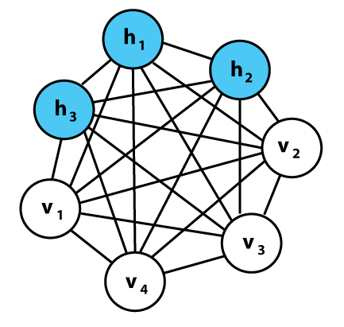
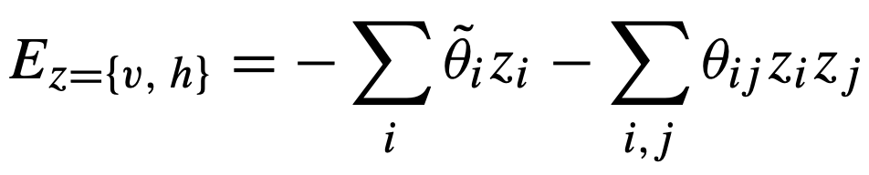
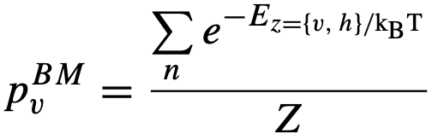
Classical Boltzmann machines
Powerful framework for modelling probability distributions.
Undirected graph structure- Store information in connection weights and biases
Stochastic generative neural network, with visible- and hidden nodes(layers)
Network structure linked to an energy function which facilitates probability distributions over possible node configurations:
Probability to observe certain configuration
Optimizing loss function

Slide 3
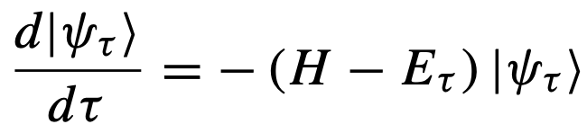
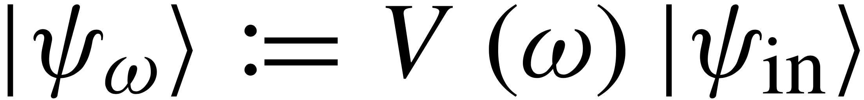
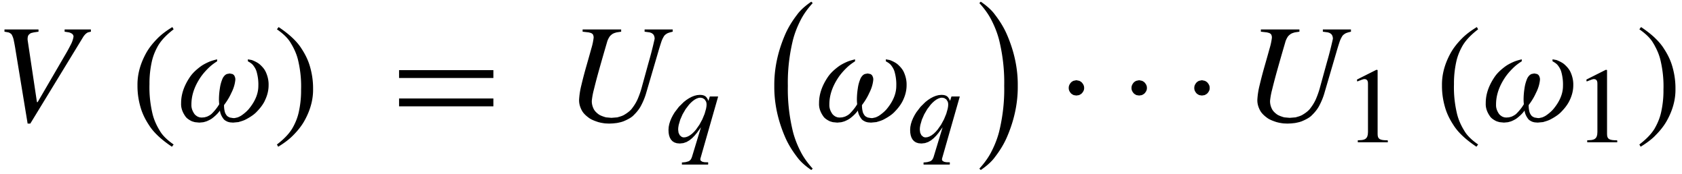
Variational Quantum Boltzmann machine
Imaginary time evolution used for classical ground state
Describe evolution (Wick-rotated S.E.):
Finite time →Gibbs states
Basic idea: Parameterized trial circuit:
.
McLachlan’s variational principle:
.
Basically, find the parameters that minimizes the equation

Slide 4
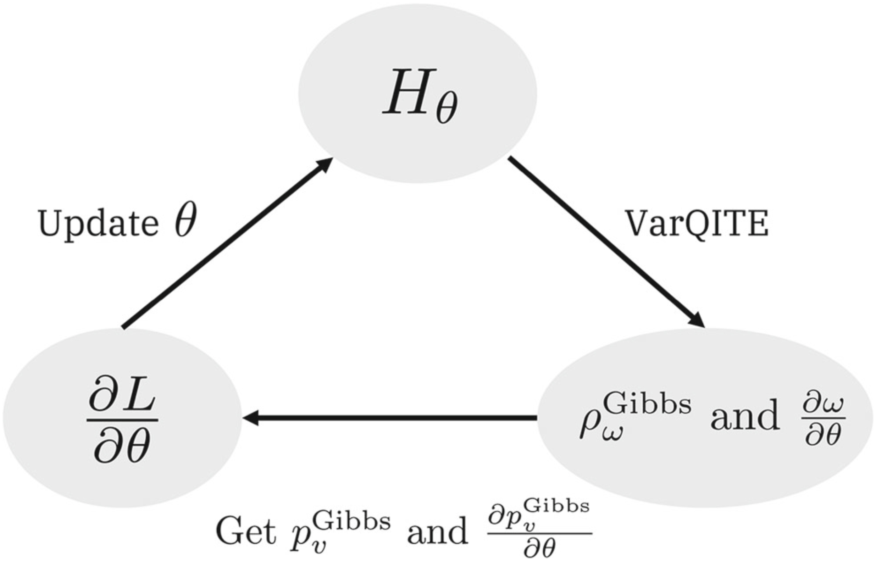
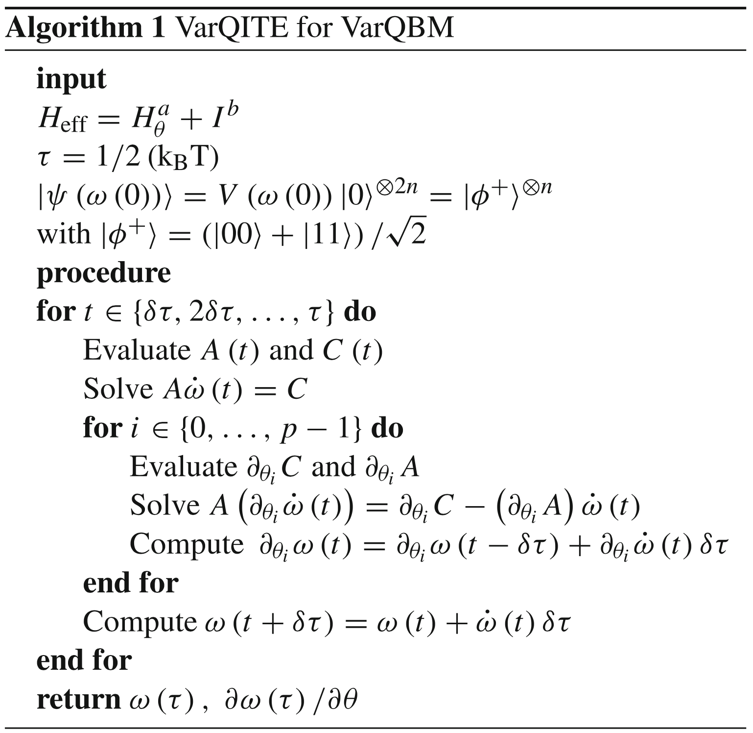
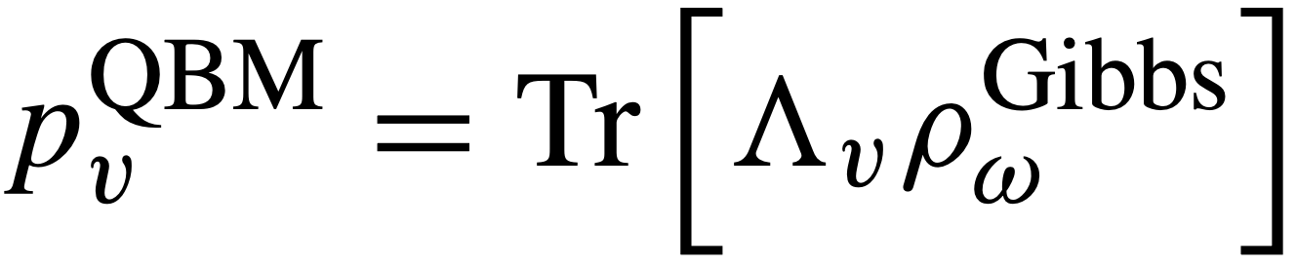
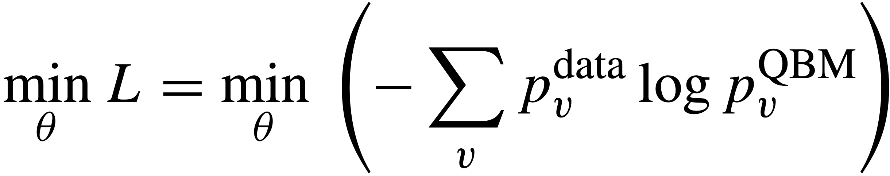
The algorithm
Finds BM distribution from:
.
Minimizes loss
.

Slide 5
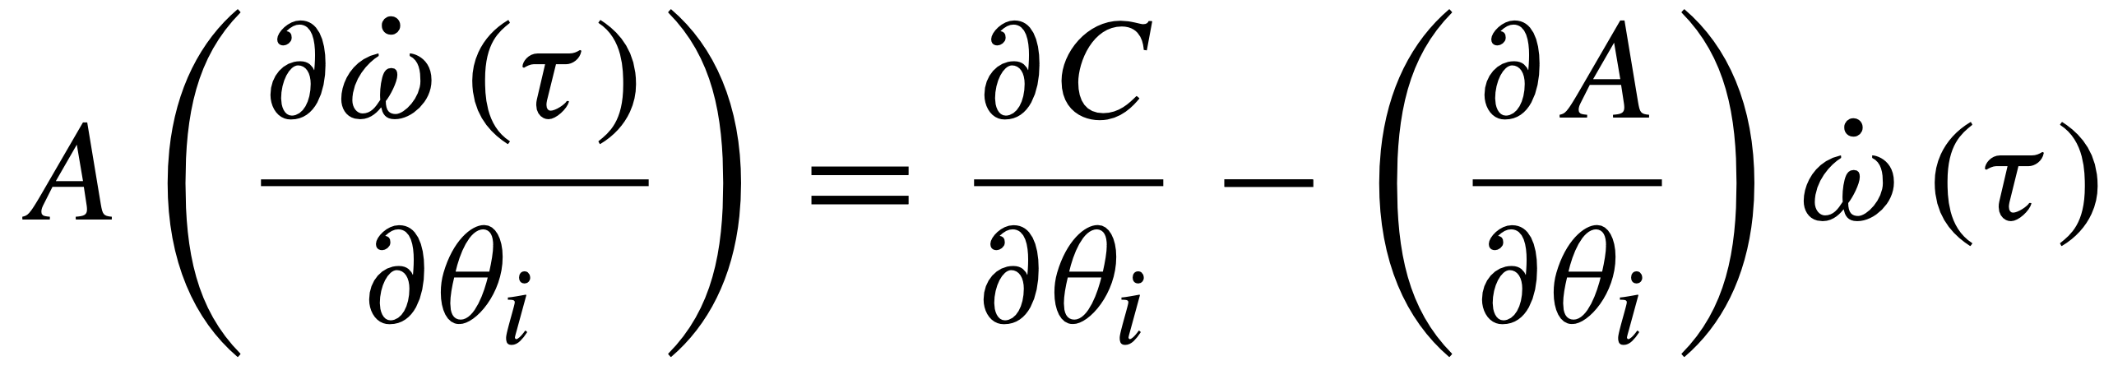

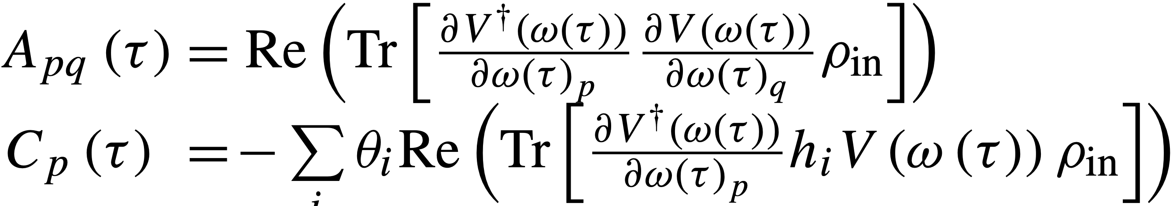
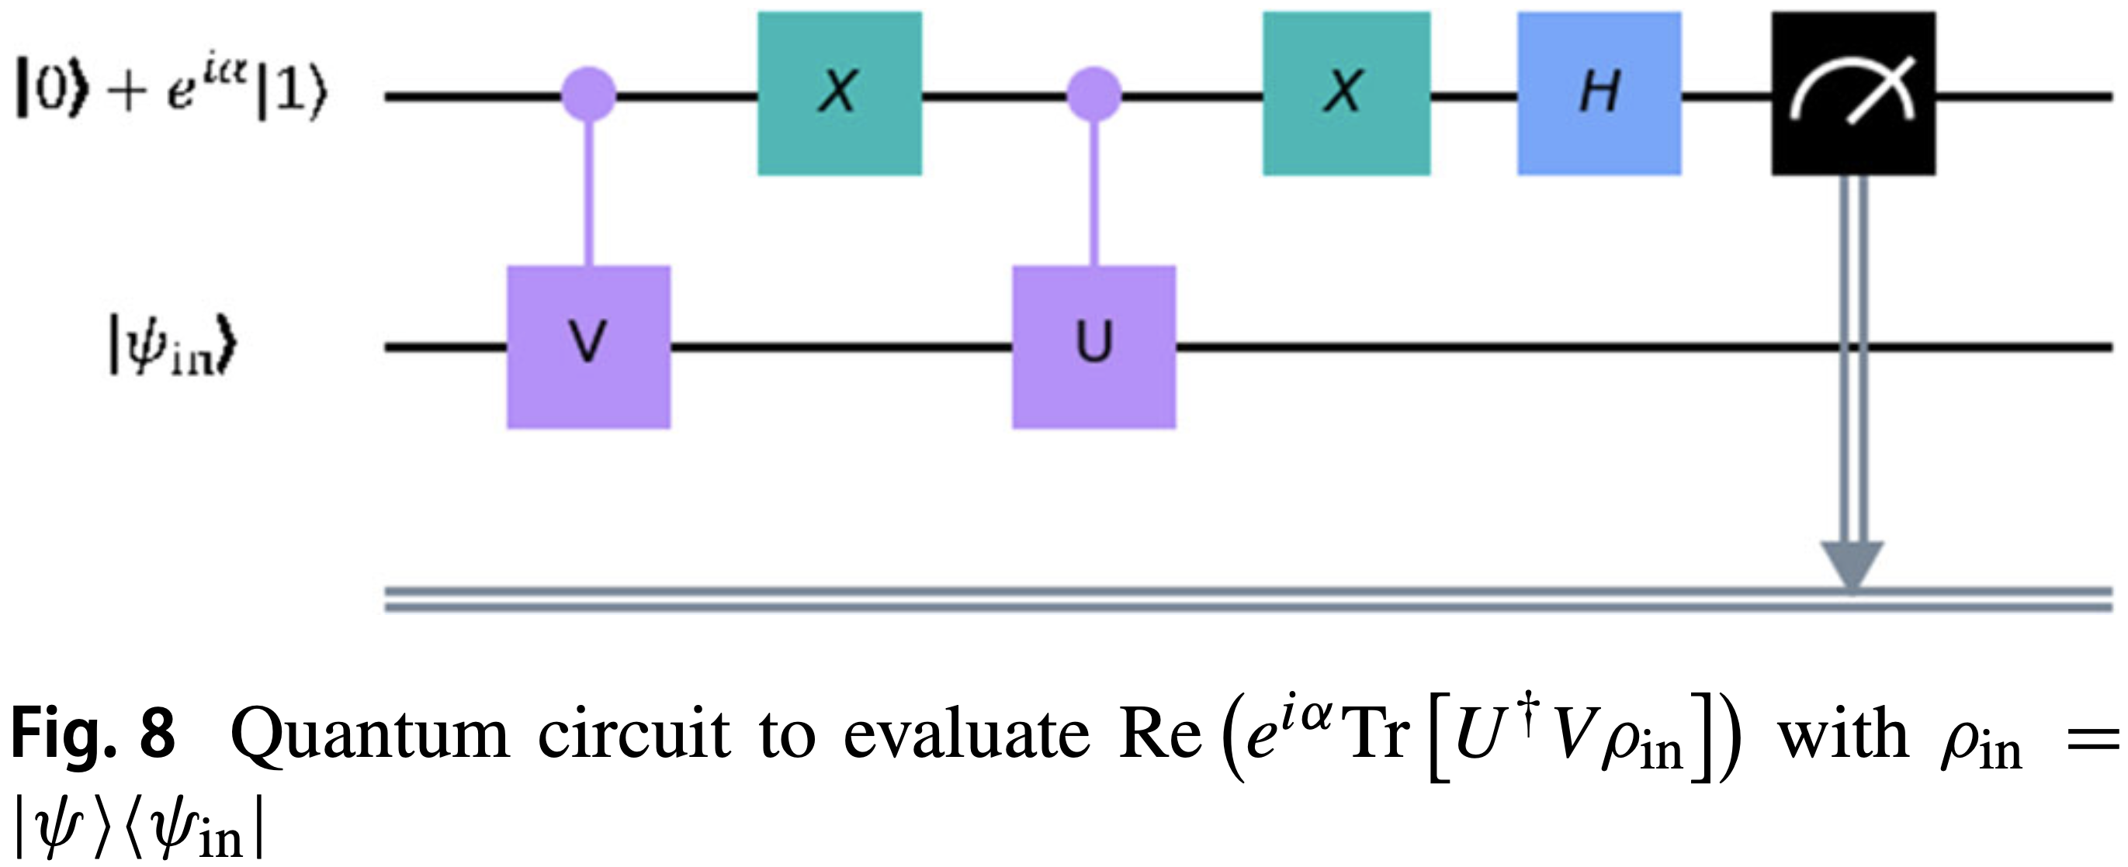
Main Challenge
Solving and
With
.
.
Solved using the generalized circuit:

Slide 6
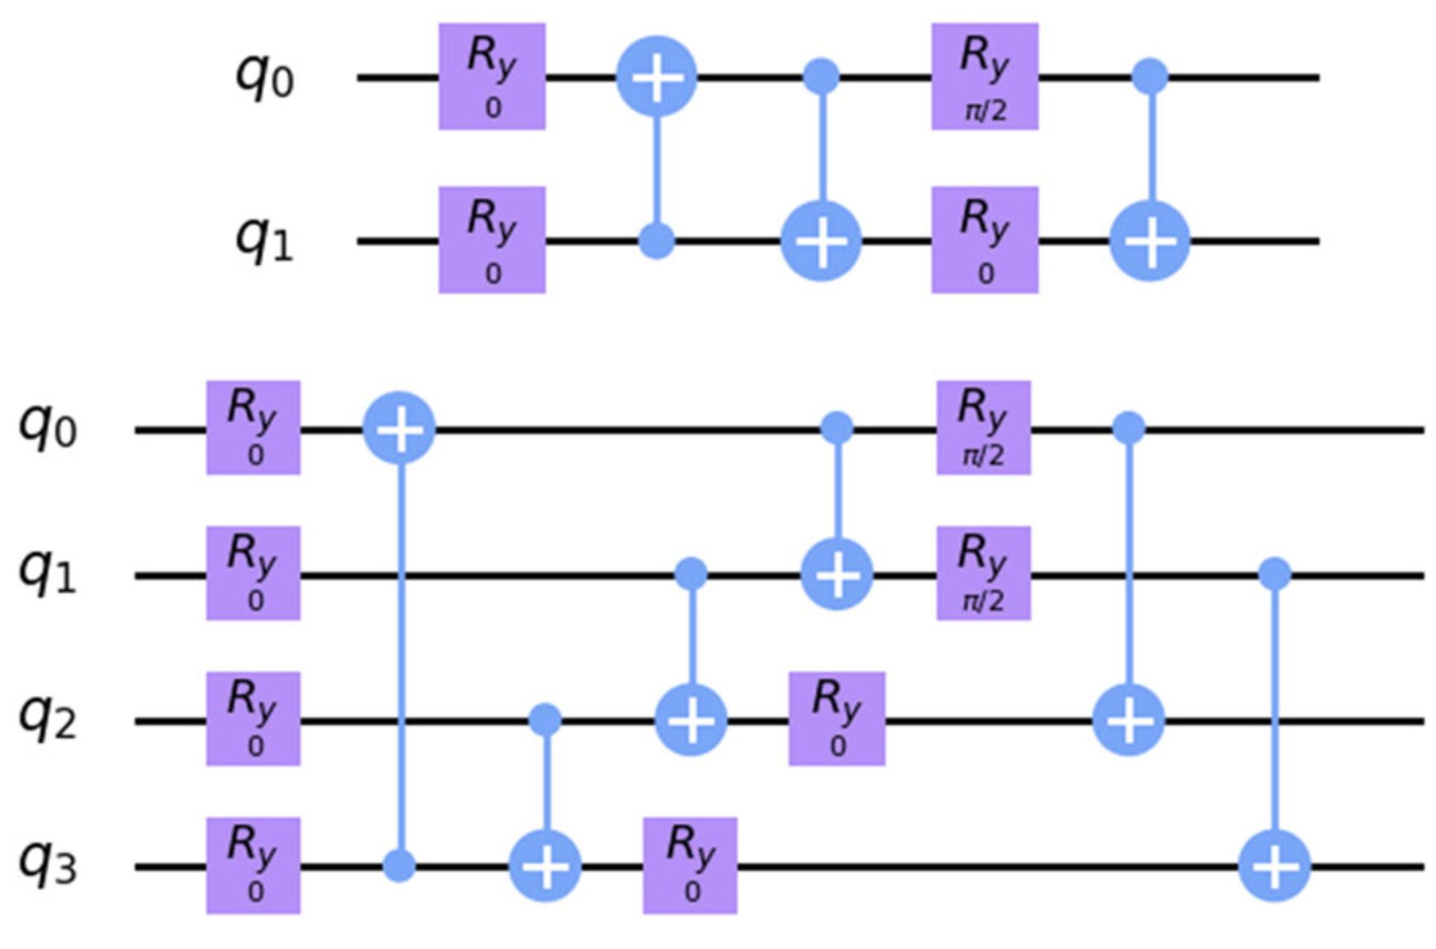
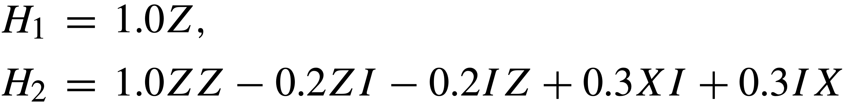
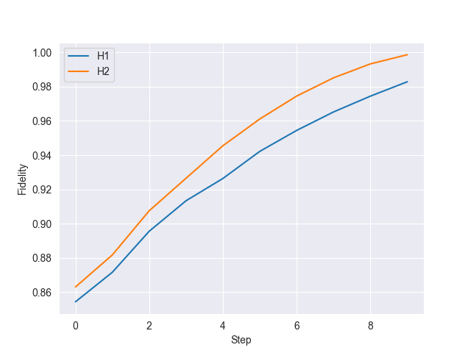
Benchmark: Generation of gibbs states
Hamiltonians: Trial circuits:
.
.
10 steps
Ridge: Low lambda but not singular
λ with the least loss
Fidelity compared to analytical solution:
H1: 0.98 and H2: 1.0

Slide 7
Results: Training the QBM
Reproduce Bell state
Hamiltonian: H= 𝛳₀ Z Z+𝛳₁ Z I +𝛳₂ I Z
Uniform distribution [-0.5,0.5]
AmsGrad optimizer, learning rate=0.1, m1=0.7, m2=0.99
Ansatz 2
(Without finetuning and optimal parameters)

Slide 8
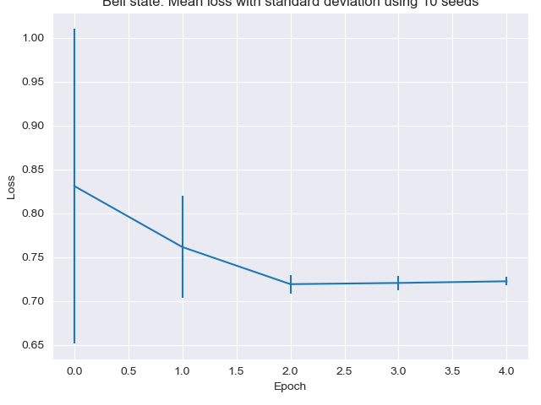
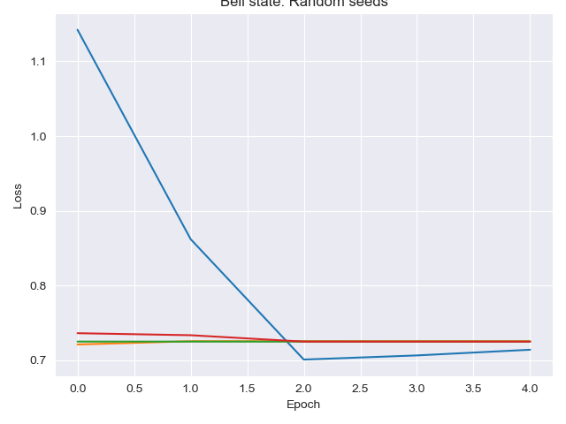
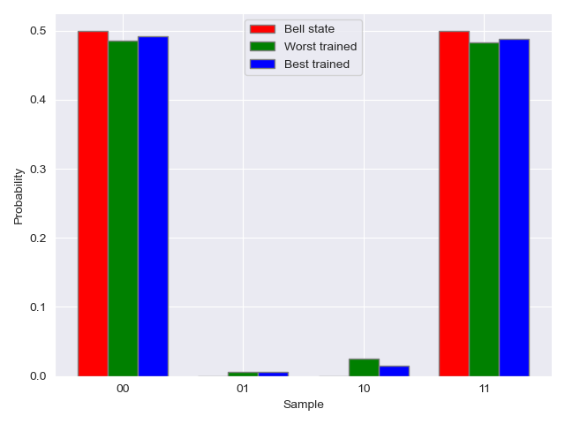
Results
1 seeds, target data [0.7, 0.3] and [0.5, 0, 0, 0.5]:

Slide 9
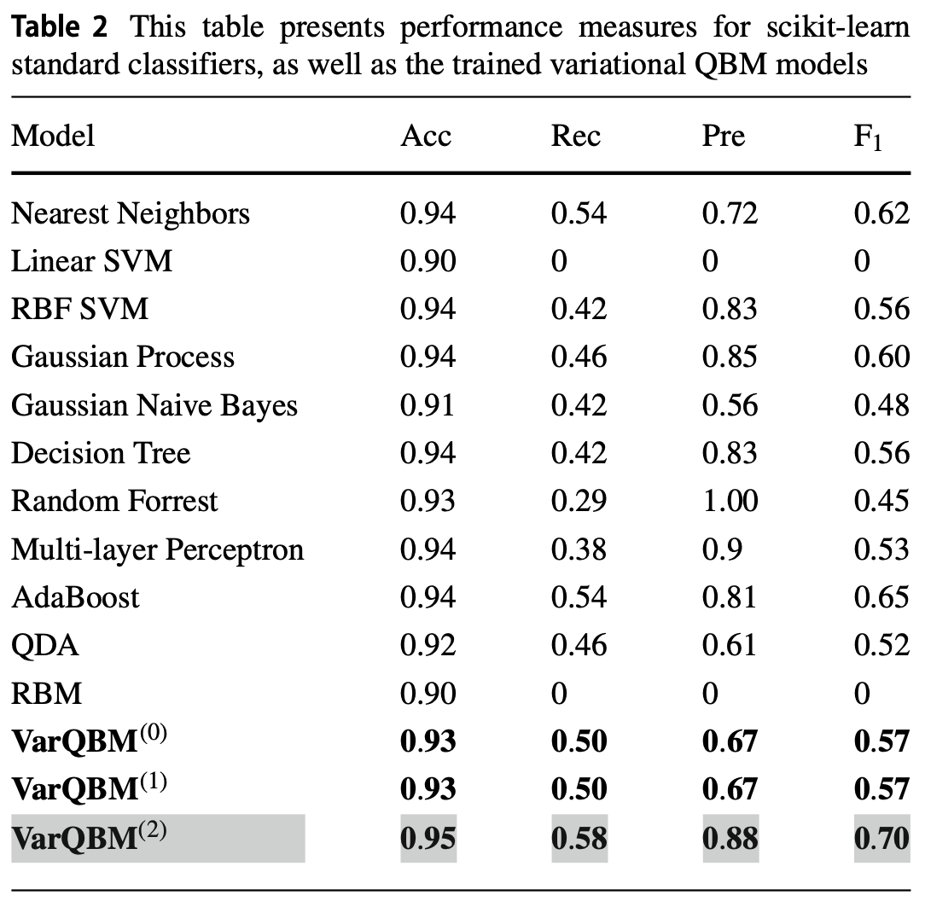
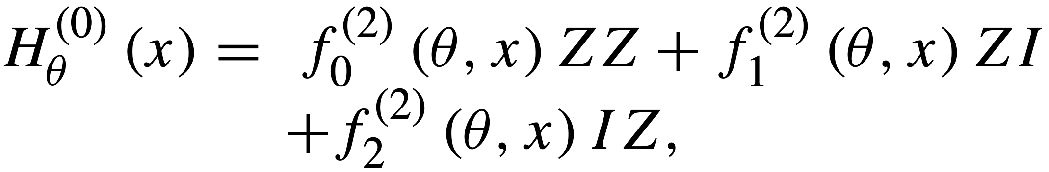
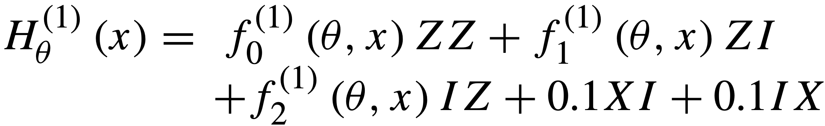
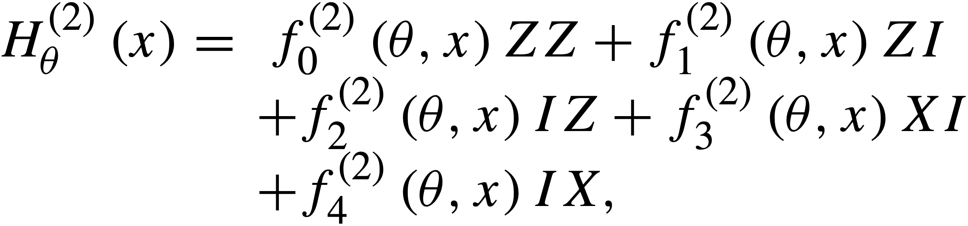
Further work
Focus a bit on the classical BM
Finetune both classical- and quantum BM
Reproduce more results from the article
Might try to overcome results from the article
achieved on the fraud dataset by testing some
more powerful Hamiltonians, these were used:

