Slide 1
Variational quantum boltzmann machines
Philip Niane

Slide 2
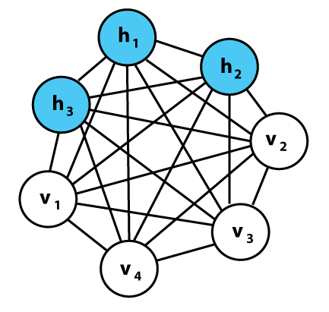
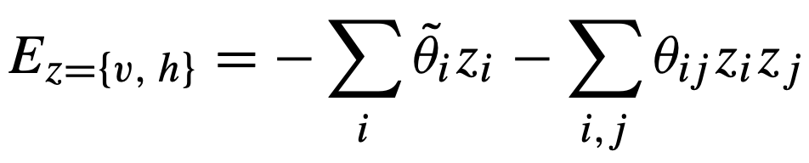
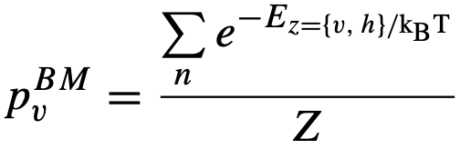
Classical Boltzmann machines
Powerful framework for modelling probability distributions.
Undirected graph structure- Store information in connection weights and biases
Stochastic generative neural network, with visible- and hidden nodes(layers)
Network structure linked to an energy function which facilitates probability distributions over possible node configurations:
Probability to observe certain configuration
Optimizing loss function

Slide 3
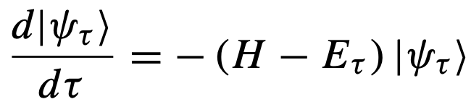
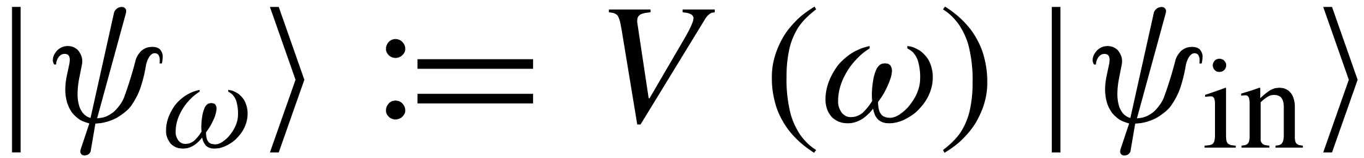
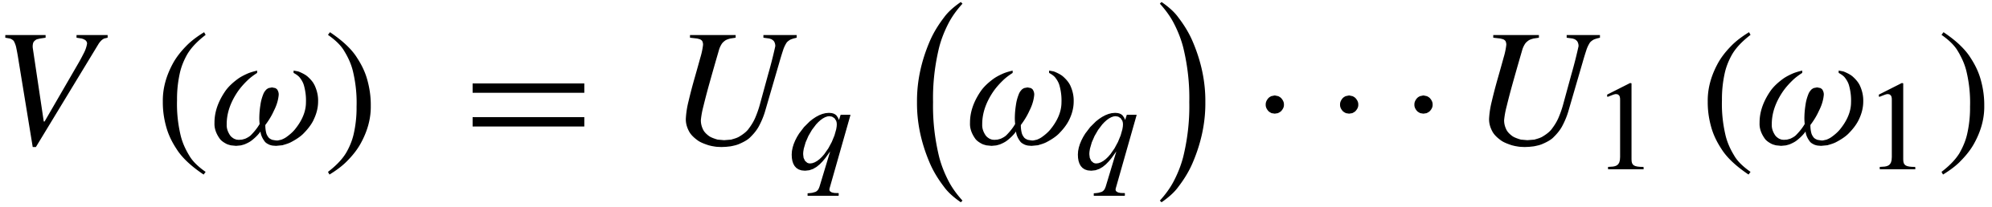
Variational Quantum Boltzmann machine
Imaginary time evolution used for classical ground state
Describe evolution (Wick-rotated S.E.):
Finite time →Gibbs states
Basic idea: Parameterized trial circuit:
.
McLachlan’s variational principle:
.
Basically, find the parameters that minimizes the equation

Slide 4
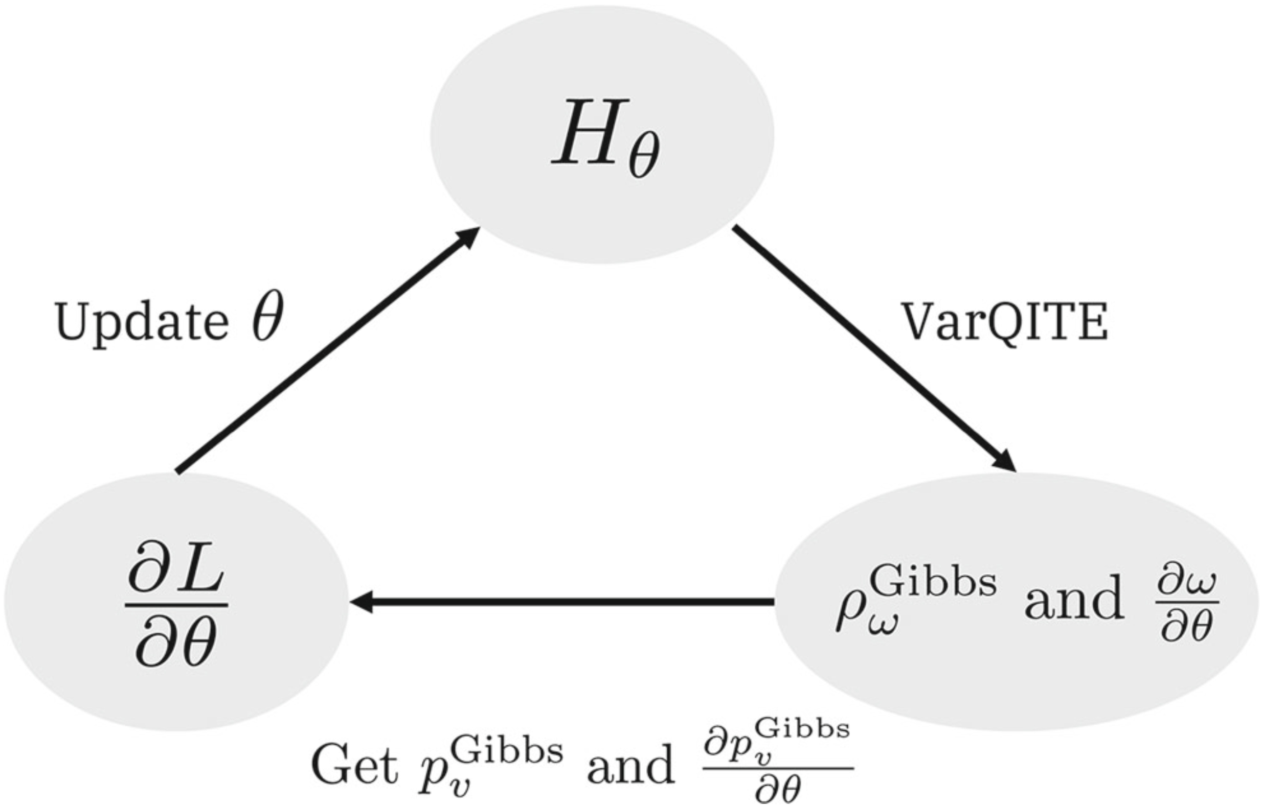
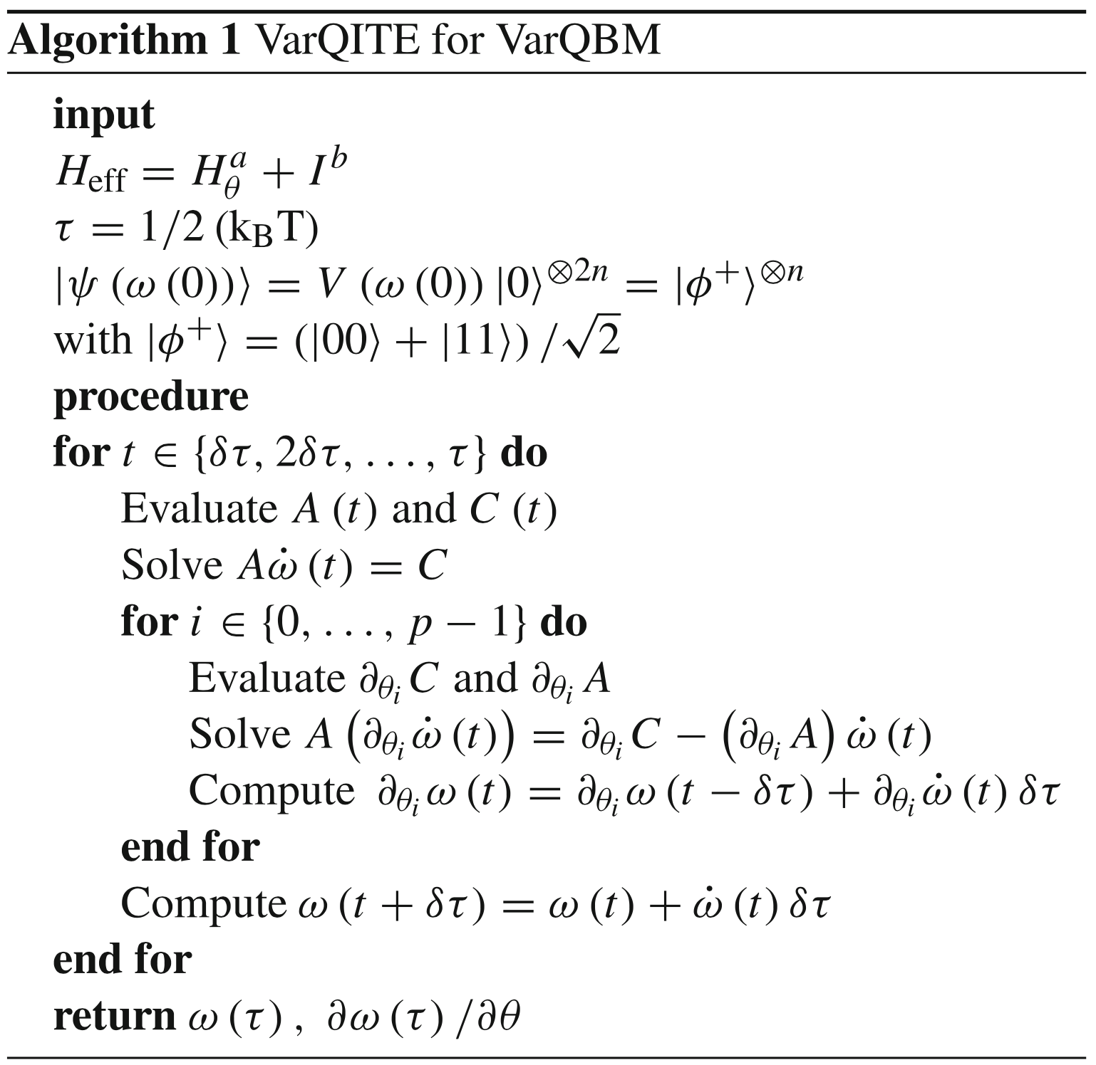
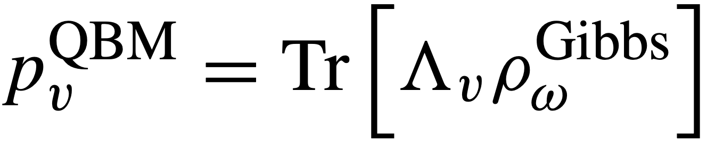
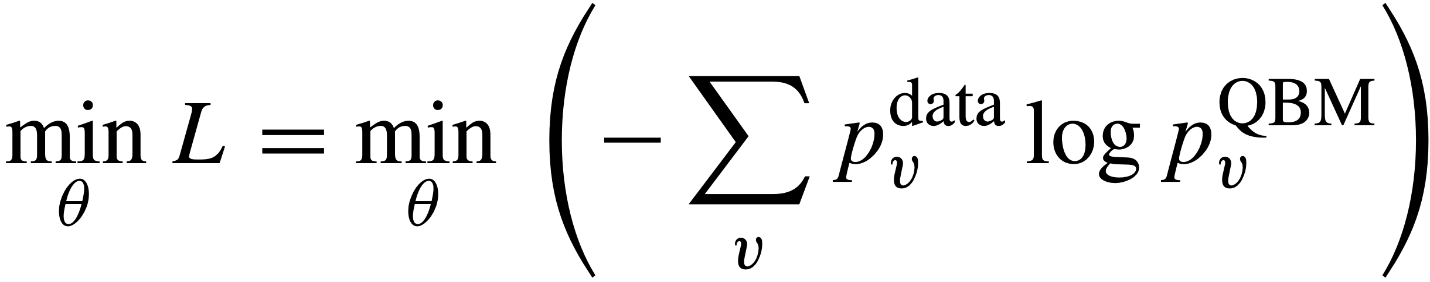
The algorithm
Finds BM distribution from:
.
Minimizes loss
.

Slide 5
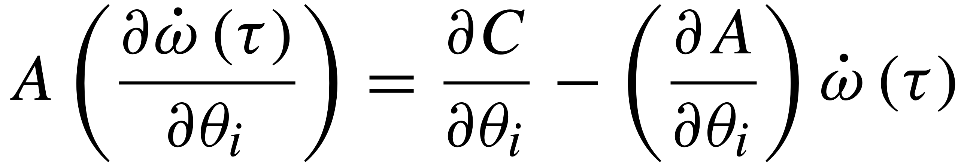

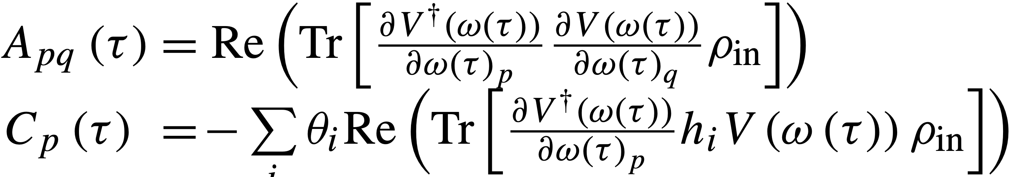
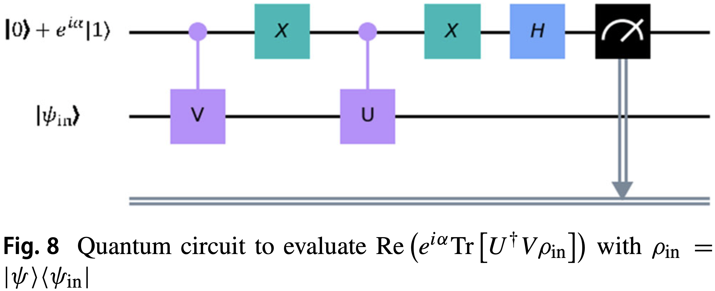
Main Challenge
Solving and
With
.
.
Solved using the generalized circuit:

Slide 6
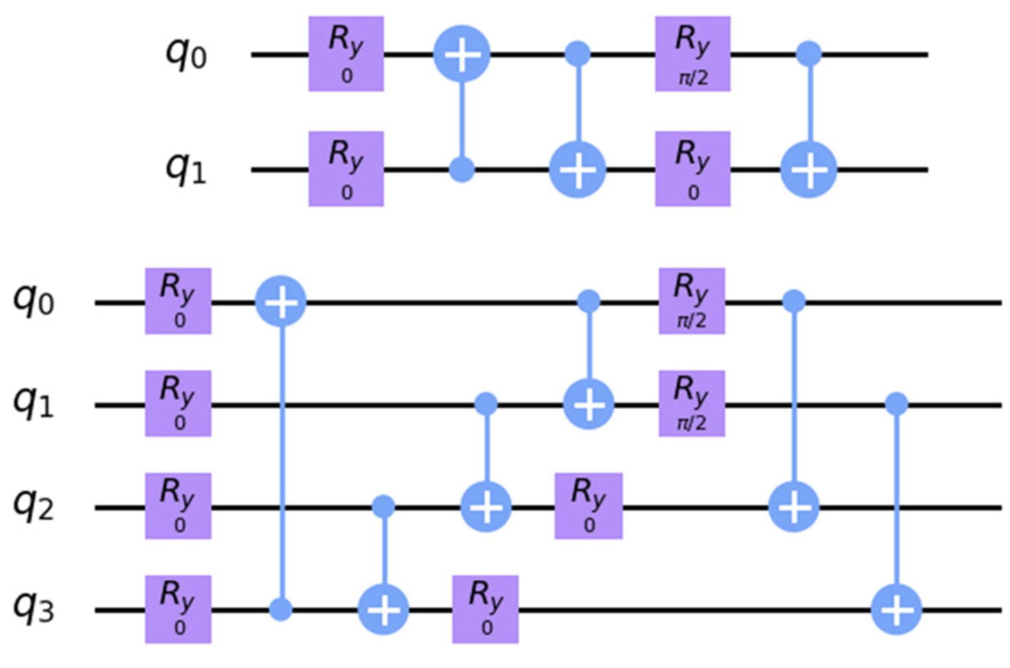
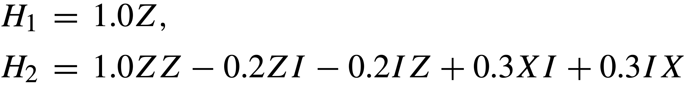
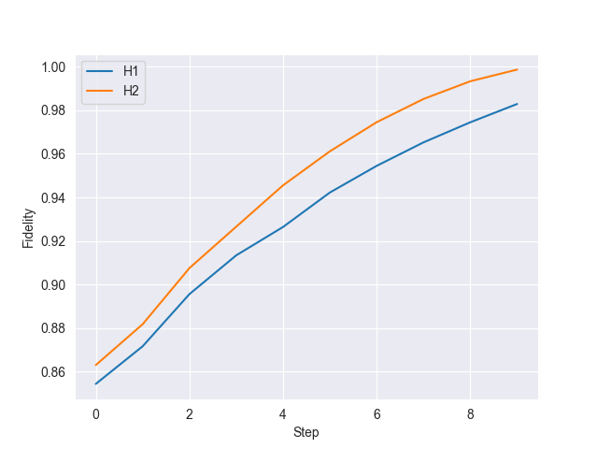
Benchmark: Generation of gibbs states
Hamiltonians: Trial circuits:
.
.
10 steps
Ridge: Low lambda but not singular
λ with the least loss
Fidelity compared to analytical solution:
H1: 0.98 and H2: 1.0

Slide 7
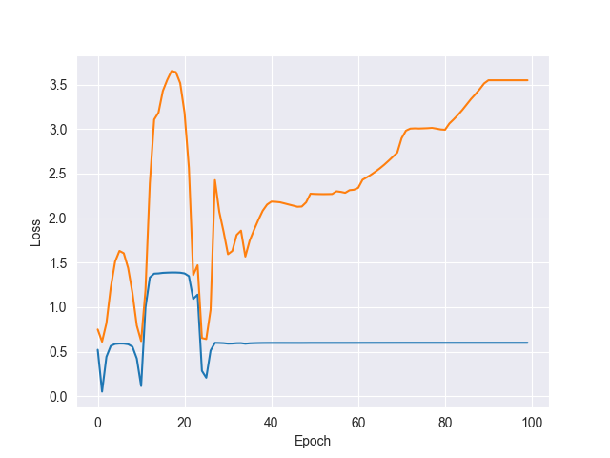
Results: Training the QBM
Reproduce [0.7, 0.3]
Hamiltonian: H= 𝛳₀ Z
Uniform distribution [-0.5,0.5]
AmsGrad optimizer,
𝛾=0.1, m1=0.7, m2=0.99
Ansatz 1
(Without finetuning and optimal parameters)
If 2 plots: Blue=L1 norm, Orange=Loss

Slide 8
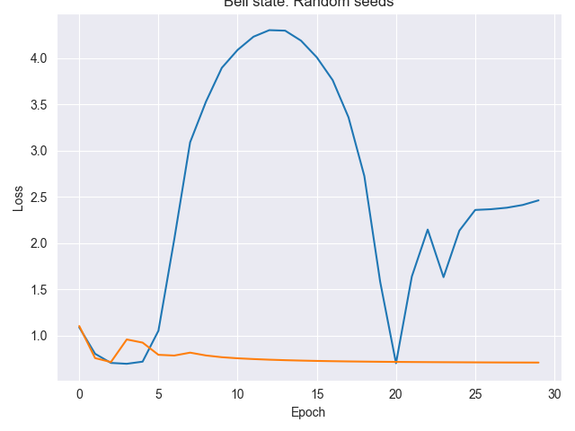
Results: Training the QBM
Hamiltonian: H= 𝛳₀ Z Z+𝛳₁ Z I +𝛳₂ I Z
Ansatz 2
Target: [0.5, 0, 0, 0.5]
𝛾=0.1, m1=0.8, m2=0.99
2 seeds, both loss

Slide 9
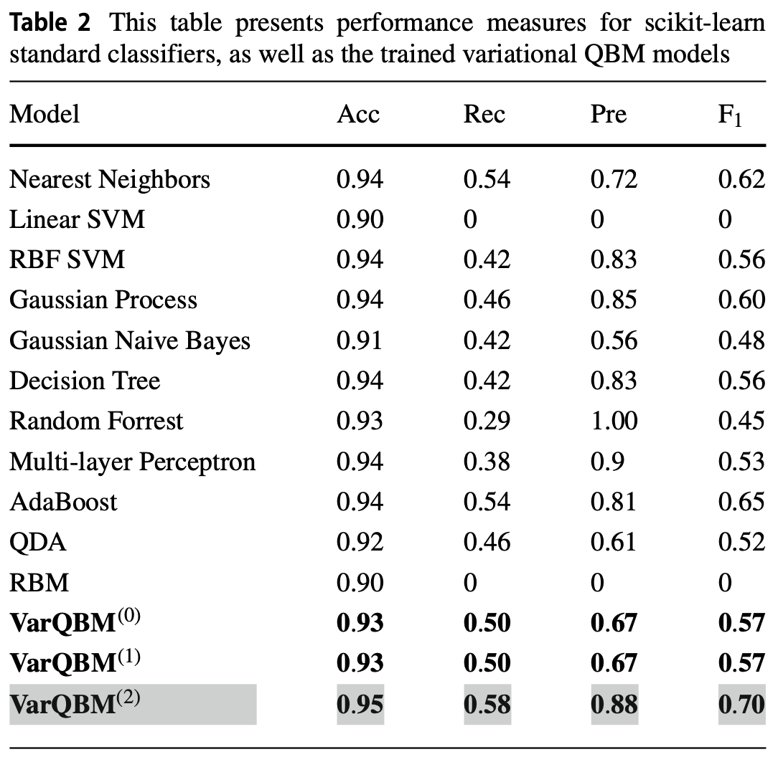
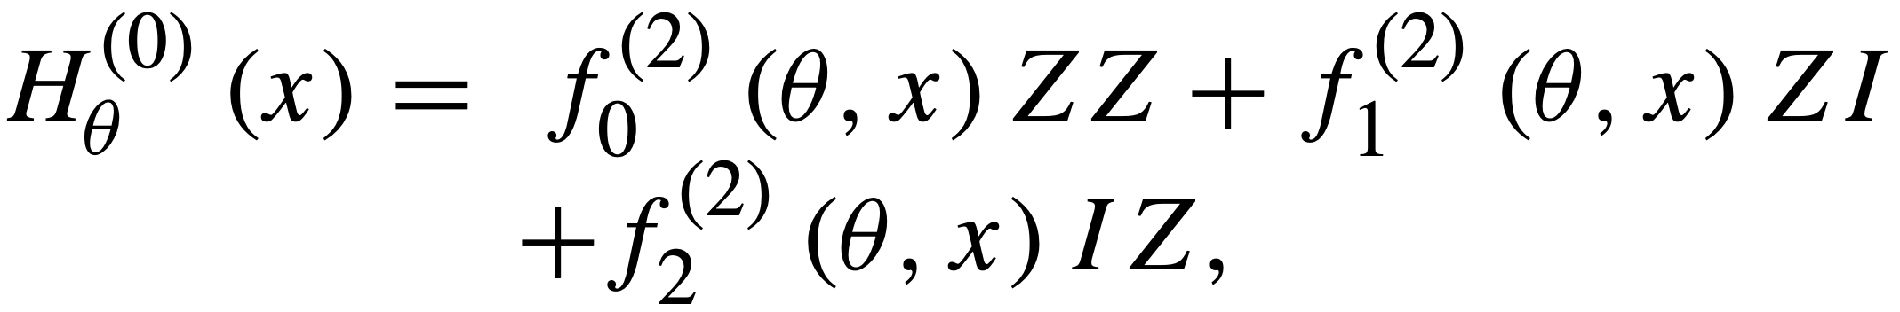
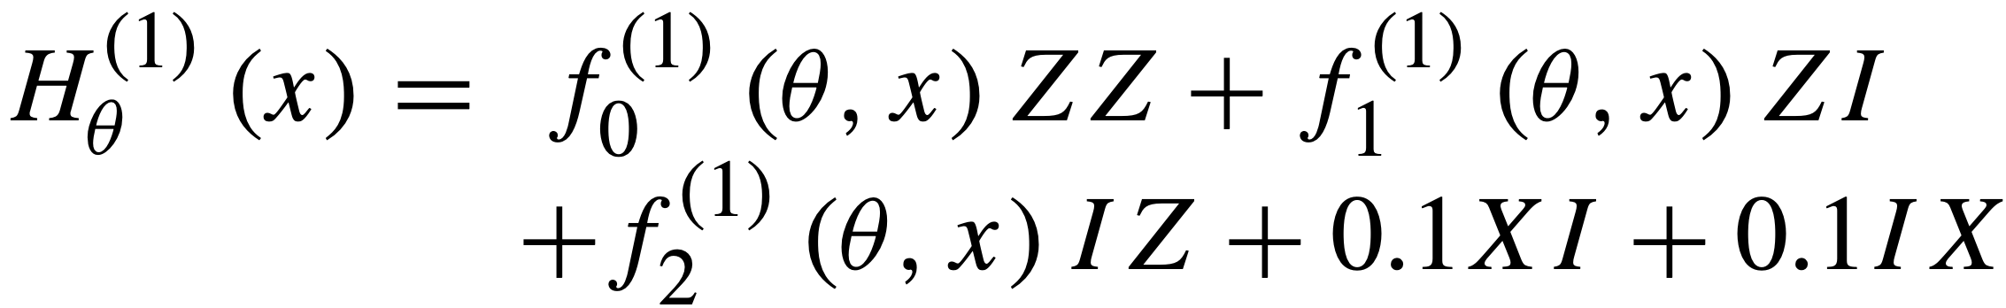
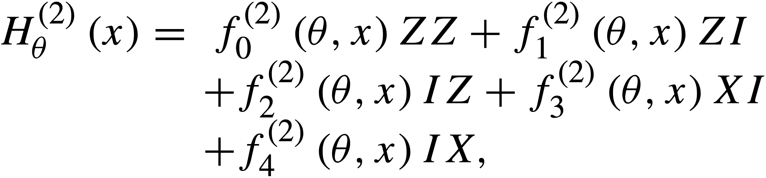
Further work
Focus a bit on the classical BM
Finetune both classical- and quantum BM
Reproduce more results from the article
Might try to overcome results from the article
achieved on the fraud dataset by testing some
more powerful Hamiltonians, these were used:

Slide 10
Last week
Finally made the QBM work!
Switched to statevector simulator without sampling, made the (code much faster)
Tested with some Hamiltonians
Started a bit on the transaction fraud dataset

Slide 11
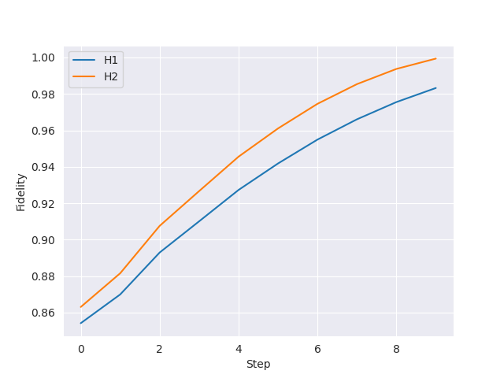
Results: State preparation
H₁=𝛳₀ Z
H₂=𝛳₀ ZZ+𝛳₁ IZ+𝛳₂ ZI
Fidelities 0.98 and 1.0 for H1 and H2
Think it is due to singular values
(3 of 4 elements along diagonal = 0)
‘However, since the algorithm is employed in
the context of machine learning, we do not
necessarily require perfect state preparation.‘

Slide 12
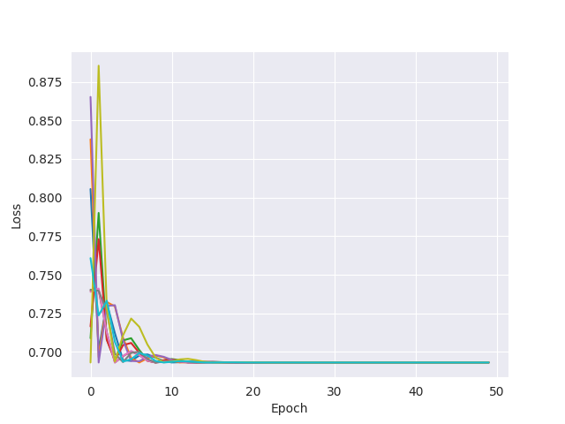
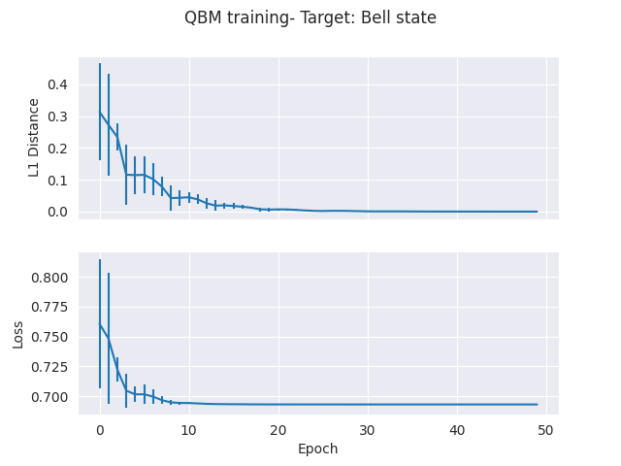
Results: H1- sampling probability
10 seeds, [-1, 1] uniform distribution
Target: [0.5, 0.5]

Slide 13
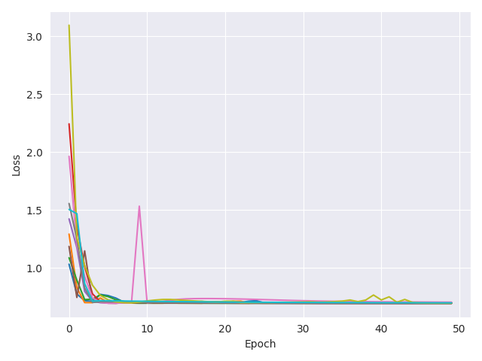
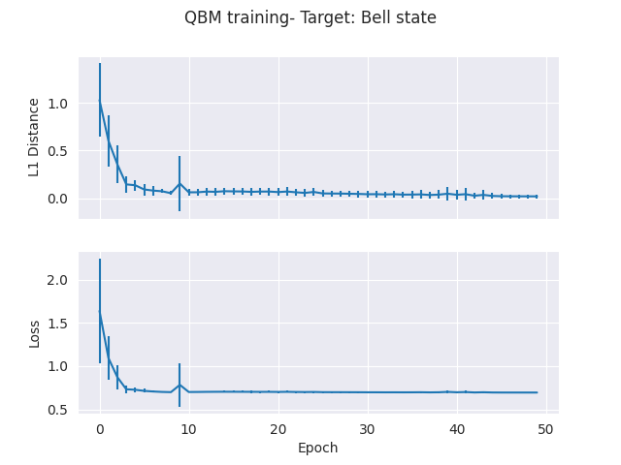
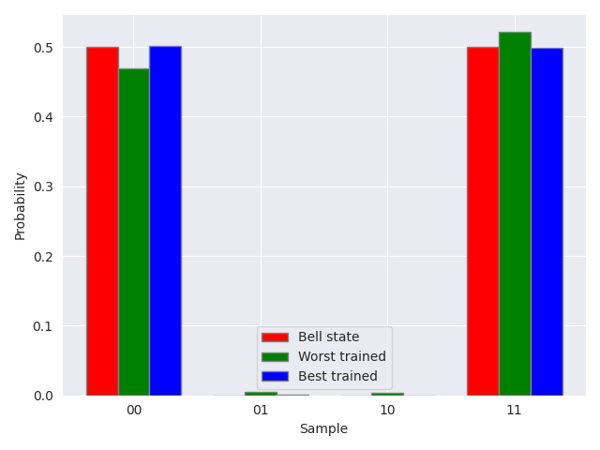
Results: H2- s.p.
10 seeds, [-1, 1] uniform distribution
Target: Bell state
Notes:
lr100.04H2_latest_10_seeds_both.png

Slide 14
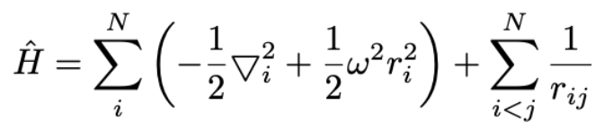
Plan next week
Run QBM with 3 and 4 qubit Hamiltonians(Did try to run it, but not enough RAM, must short it down)
Test discriminative learning: identification of fraudulent credit card transactions
Using the Hamiltonian:
Using second quantization and JW transformation to rewrite, compare with classical BM
Not sure what to do further on- Ideas:
Finding the Hamiltonian from experimental data: https://arxiv.org/pdf/2002.06169.pdf
Combinatorial optimization problems : Max cut problem
Combining QBM and GANs

