Slide 1
Variational quantum boltzmann machines
Philip Niane

Slide 2
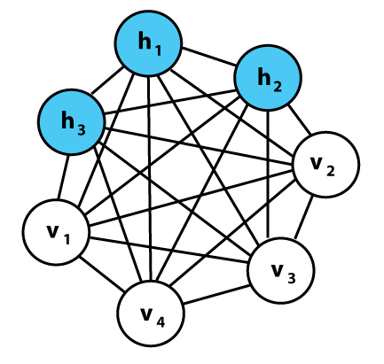
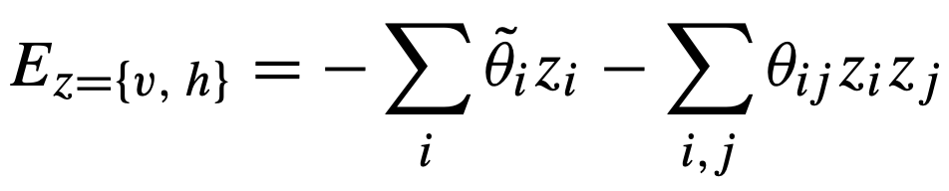
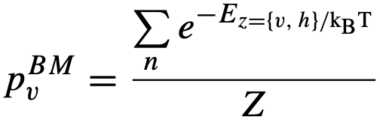
Classical Boltzmann machines
Powerful framework for modelling probability distributions.
Undirected graph structure- Store information in connection weights and biases
Stochastic generative neural network, with visible- and hidden nodes(layers)
Network structure linked to an energy function which facilitates probability distributions over possible node configurations:
Probability to observe certain configuration
Optimizing loss function

Slide 3
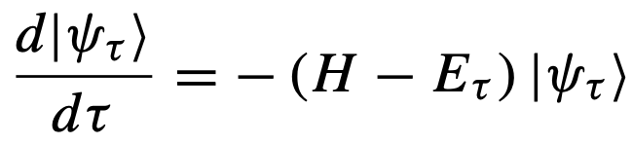
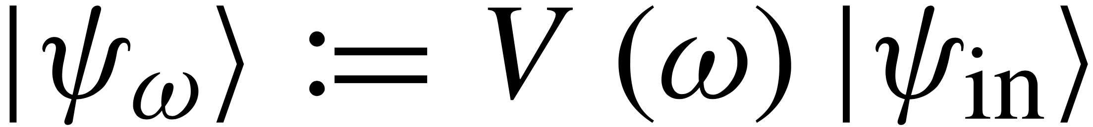
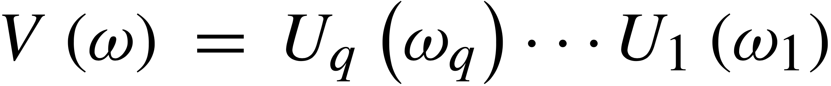
Variational Quantum Boltzmann machine
Imaginary time evolution used for classical ground state
Describe evolution (Wick-rotated S.E.):
Finite time →Gibbs states
Basic idea: Parameterized trial circuit:
.
McLachlan’s variational principle:
.
Basically, find the parameters that minimizes the equation

Slide 4
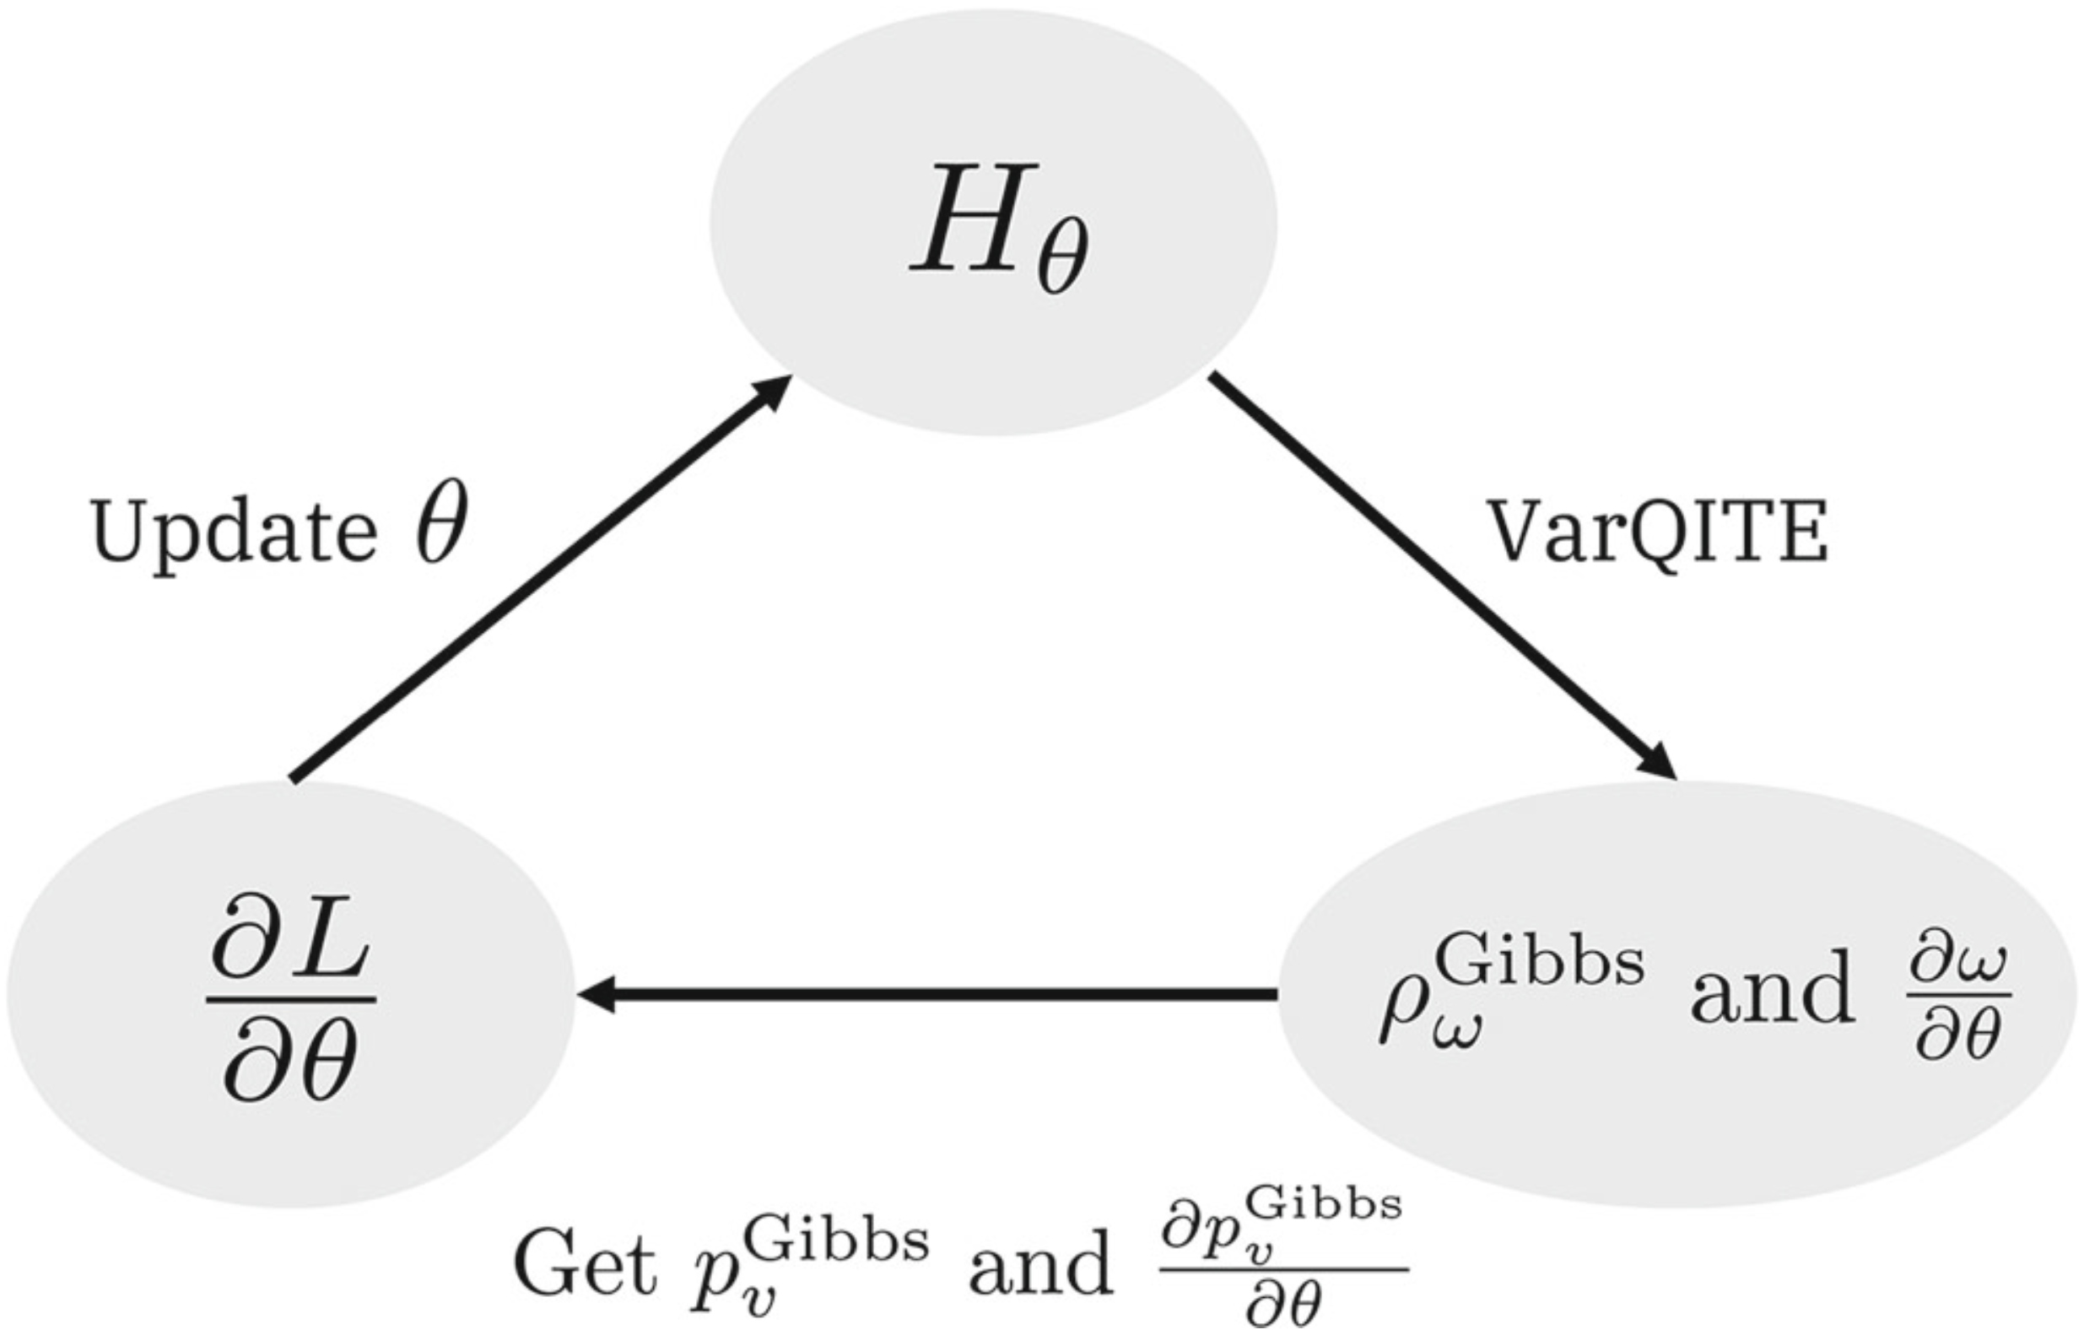
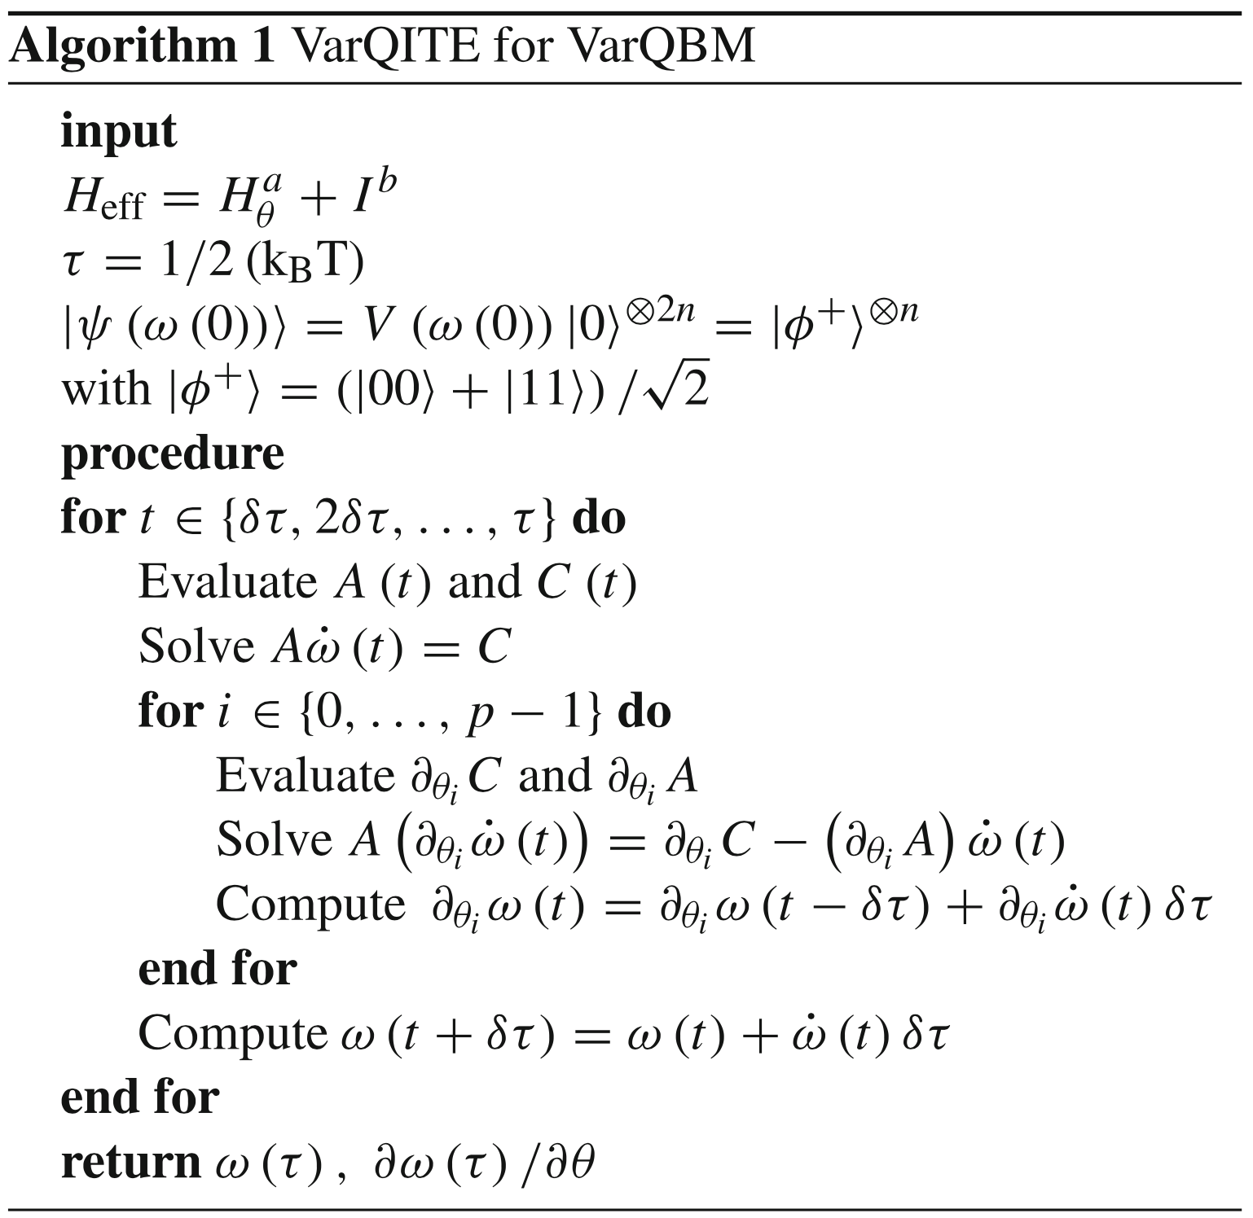
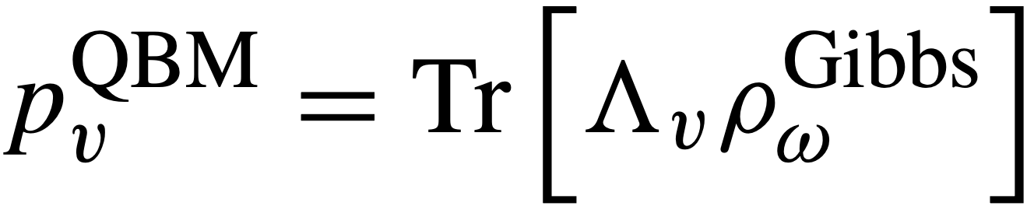
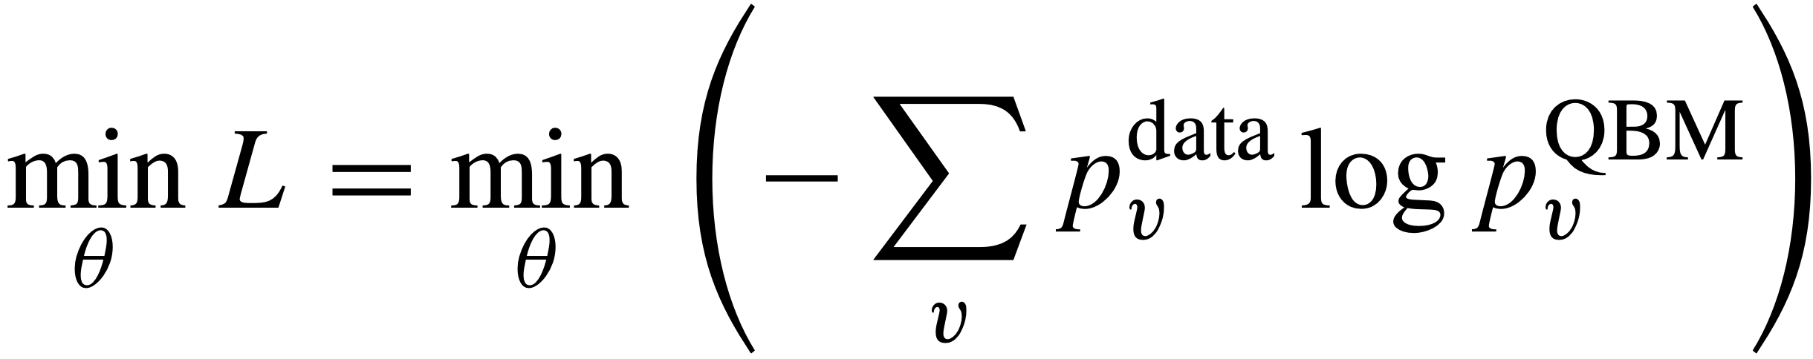
The algorithm
Finds BM distribution from:
.
Minimizes loss
.

Slide 5
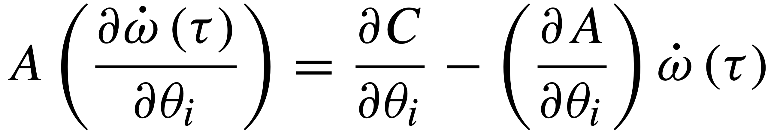

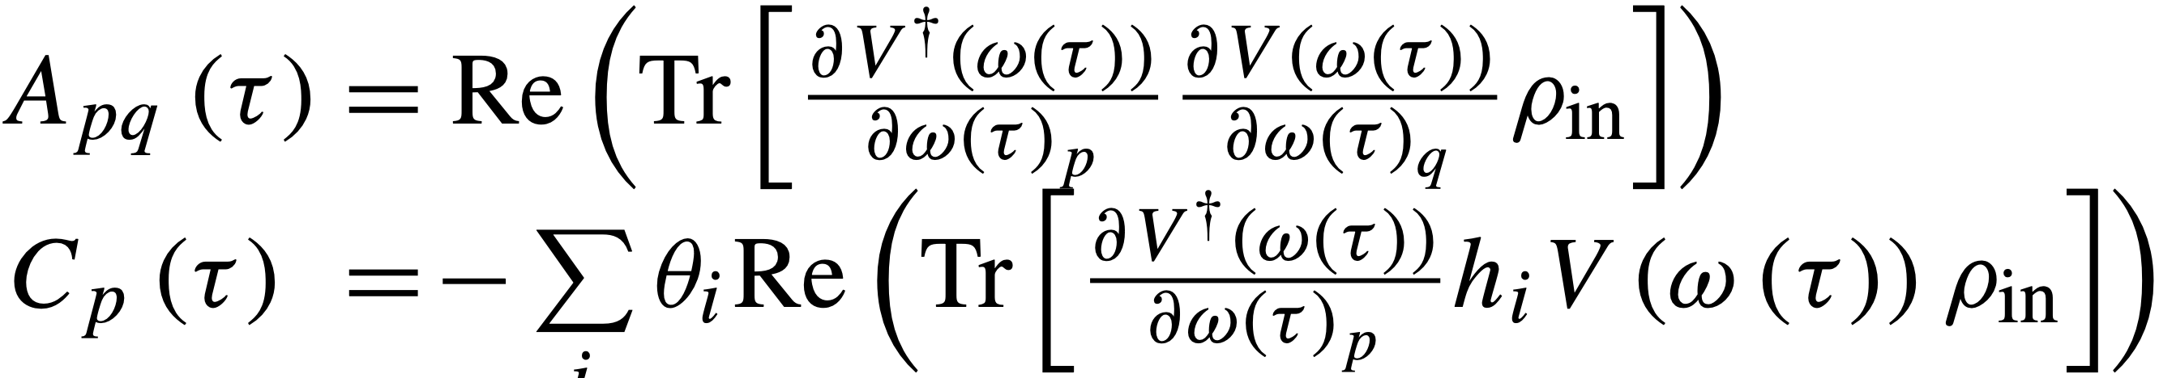
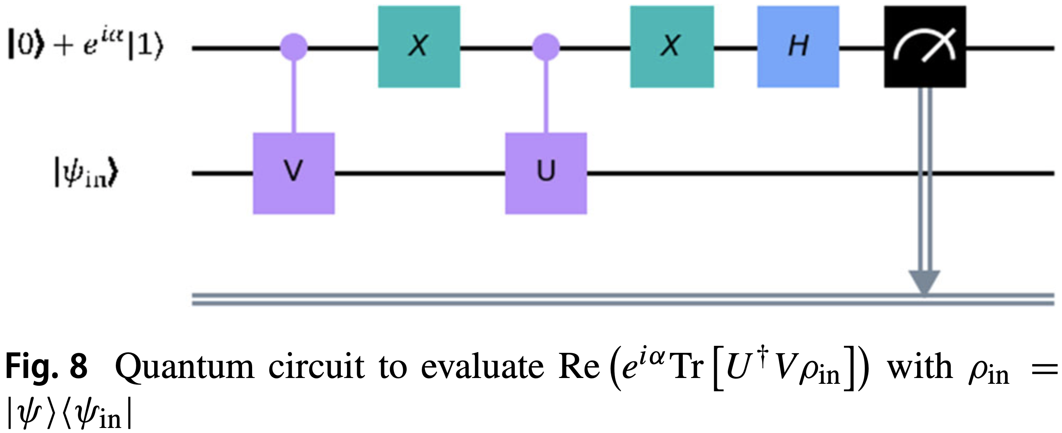
Main Challenge
Solving and
With
.
.
Solved using the generalized circuit:

Slide 6
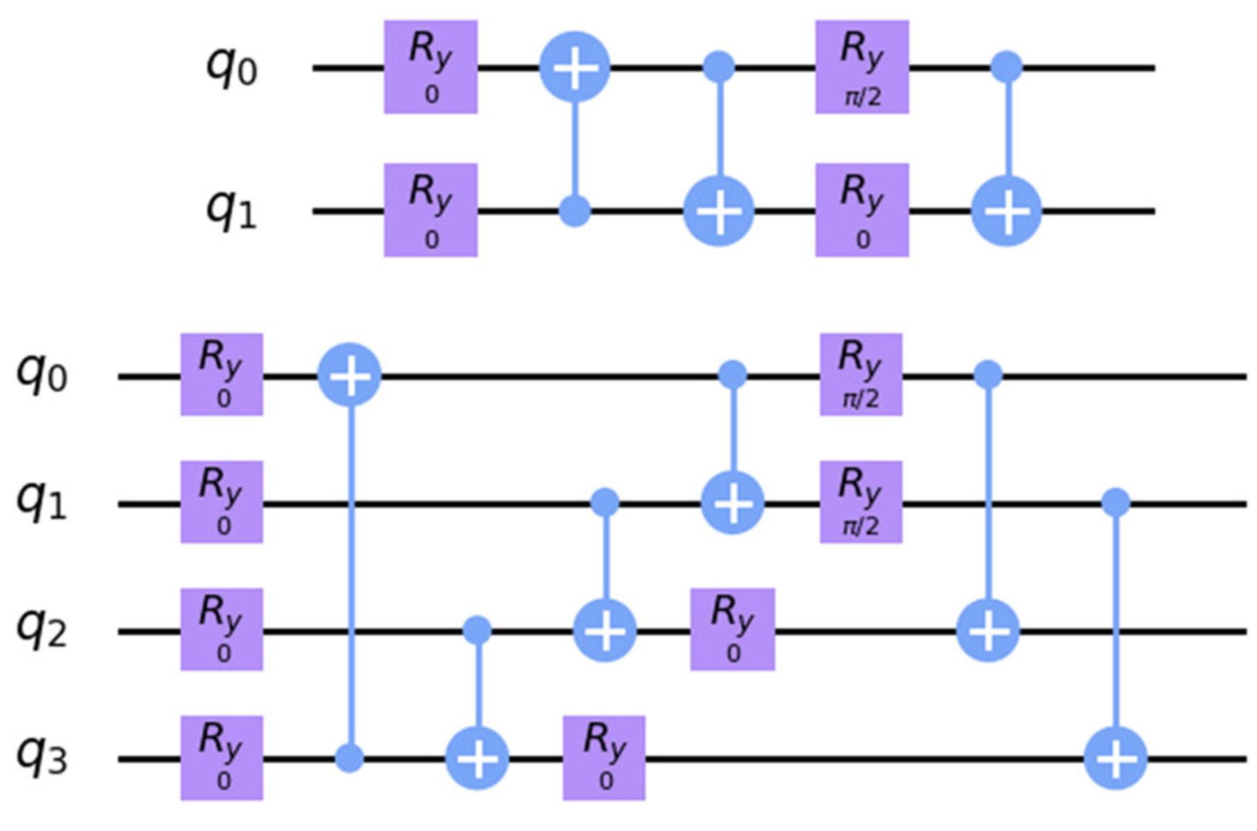
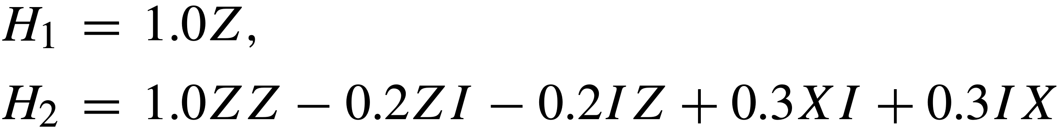
Benchmark: Generation of gibbs states
Hamiltonians: Trial circuits:
.
.
Two ways:
1. Following the article:
Fidelities with analytical solution: H1: 0.82 and H2: 0.96
2. Implementing C by ignoring the factor without a derivative
Fidelities with analytical solution: H1: 0.99 and H2: 0.98 (Not entirely sure why this work)

Slide 7
Results: Training the QBM
Reproduce Bell state
Hamiltonian: H= 𝛳₀ Z I+𝛳₁ I Z+𝛳₂ Z I +𝛳₃ I Z (See now that this equals 𝛳₃ Z I+𝛳₄ I Z )
Uniform distribution [-0.5,0.5]
Adam optimizer, learning rate=0.1
Ansatz 2
(Without finetuning and optimal parameters)

Slide 8
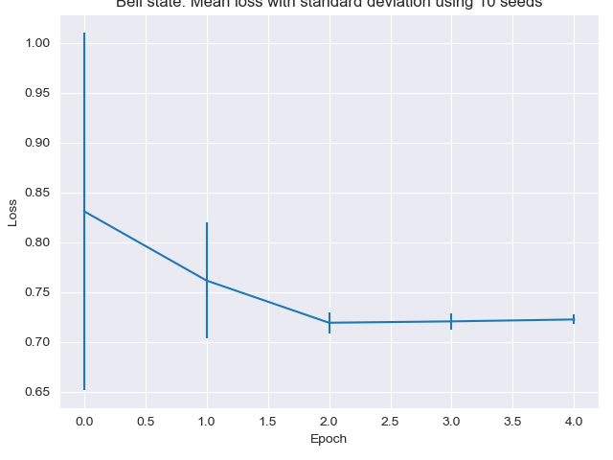
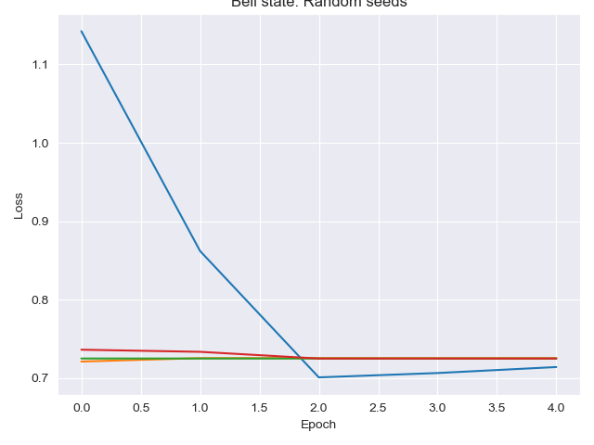
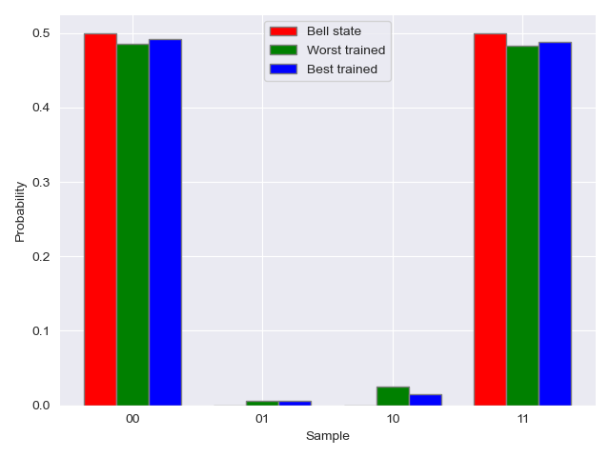
Results
4 seeds
Optimistic

Slide 9
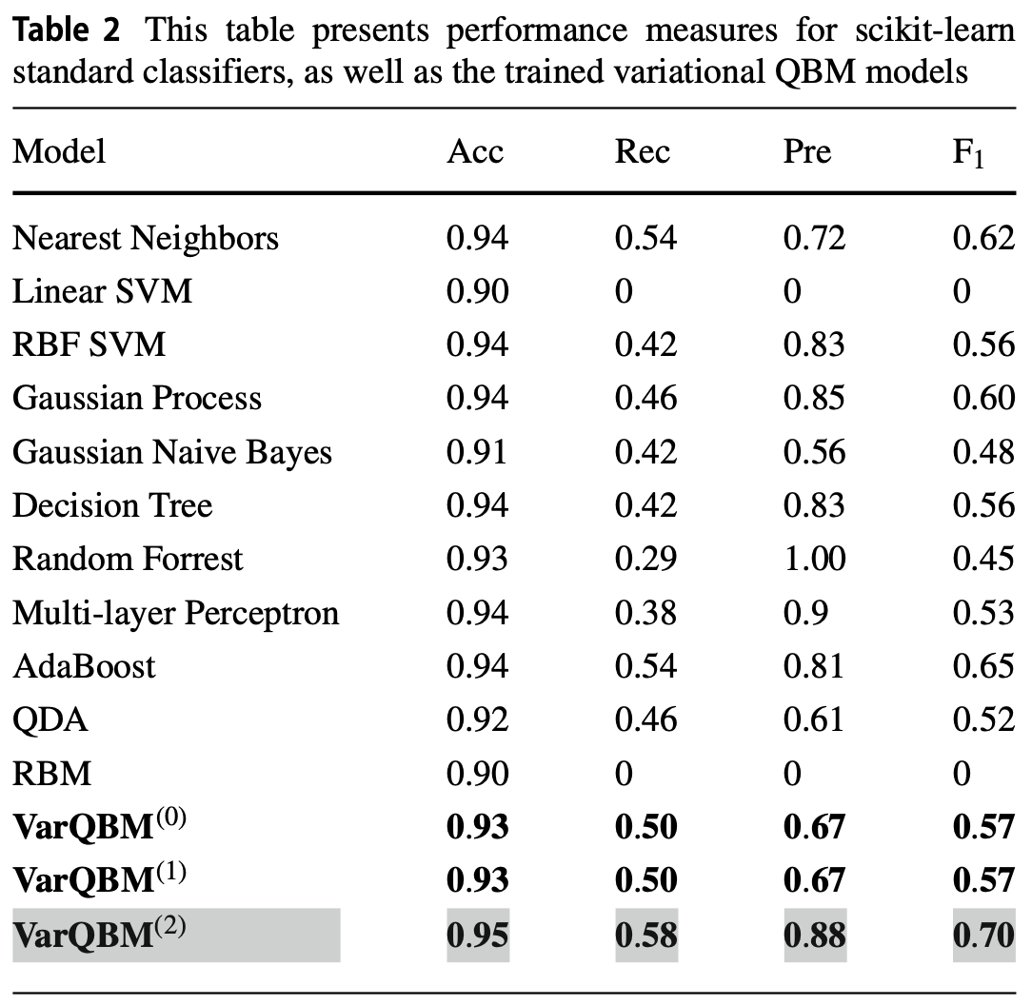
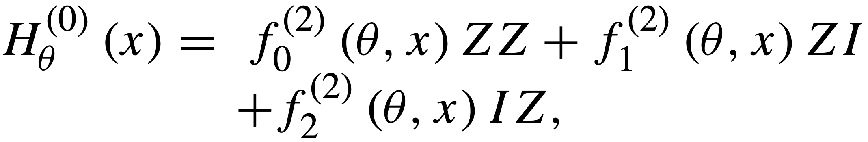
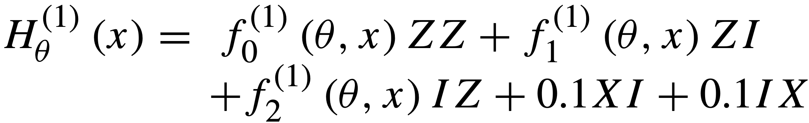
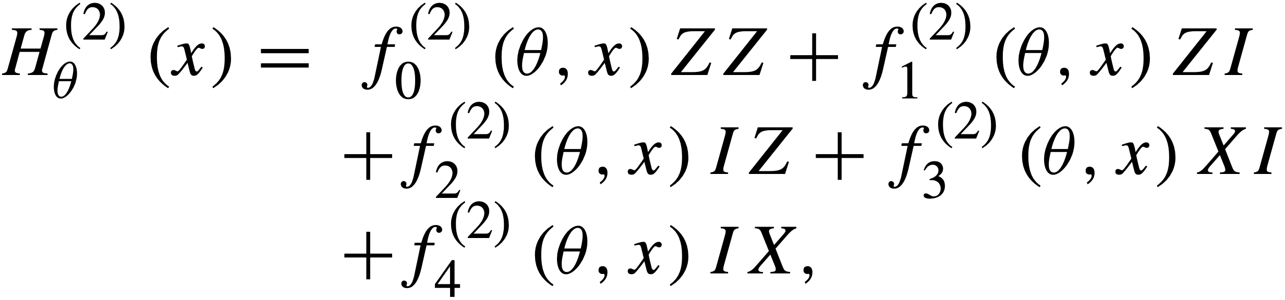
Further work
Reproduce all results from the article
Classical implementation
Quantum mechanical problems
Might try to overcome results from the article
achieved on the fraud dataset by testing some
more powerful Hamiltonians, these were used:

