Slide 1



NERC DataGrid Security
OMII-UK Commissioned Software Projects
Face to Face Meeting
Philip Kershaw
BADC

Slide 2
Overview
What does NDG Security do and who it's targeted at?
Current status
Plans for next three months
Integration with other tools and the software used by our target communities of users
Any things which we would benefit from using
Sustaining NDG Security after the end of the CSP funding

Slide 3
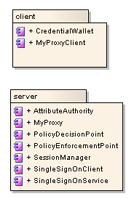
What does it do and what’s the target audience?
A suite of services to enable access to secured distributed resources
Developed in Python
Targeted at scientists, researchers and data providers in the environmental sciences research community.
  To date: Atmospheric Science, Oceanography, Earth Observation [, Health data and Marine Search and Rescue]
  But potentially applicable to other areas
What does it do for:
  Users
  Data Providers
  Developers

Slide 4
What does NDG Security do for users?
Access to previously unavailable data across organisational boundaries
Single Sign On:
  no need to remember multiple account IDs
  Support for OpenID account holders
Principle Investigators can make data to a small set of trusted collaborators
Access via:
  a browser
  Shell script (wget)
  Python based scripting suited to the scientific community (esp. atmospheric science)

Slide 5
What does NDG Security do for
Data Providers?
Provides middleware to layer over the top of existing site infrastructures without the need to replace or rewrite existing systems
Joined up access to datasets across partners organisations
Open access to data to a wider user community
Enables auditing of access
  e.g. provide stats to funding bodies
Protect finite resources by restricting access
Potential commercial value – sell datasets
Easy to install with Python Eggs.

Slide 6
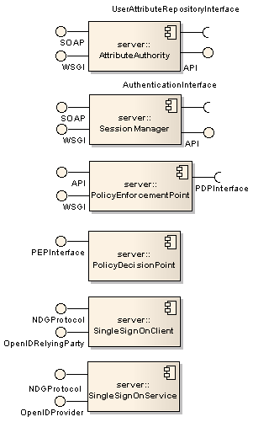
What does NDG Security do for developers?
An API to integrate with existing security infrastructures
Python with support for Java web service clients
Integrates with Perl
Web based and rich client based access
Easy install via Python Eggs
Standards based to facilitate interoperability: SOAP, WS-Security, SAML, OpenID, OGC (Open Geospatial Consortium)
Trac website incl. documentation and SubVersion
  http://proj.badc.rl.ac.uk/ndg/wiki/T12_Security
Python egg repository:
  http://ndg.nerc.ac.uk/dist/

Slide 7
Current Status
Deployed with NDG2 project partners:
  the British Oceanography Data Centre, National Oceanography Centre, Southampton and Plymouth Marine Laboratory updated through OMII-UK CSP funding
BADC integration
  retrofitted with the BADC Data Browser
Preparing a new release to include refactored version using Python WSGI (Web Services Gateway Interface) based architecture
  http://ndg.nerc.ac.uk/dist/
Federated Security for IPCC AR5 Archive:
  Trialled OpenID based Single Sign On with ESG (Earth System Grid)
  Agreed an interoperable security architecture with ESG partners which builds and extends on the existing NDG Security architecture
  Submitted a patch to extended OpenID support for Python AuthKit package

Slide 8
Plans for the Next Three Months
Completion of OMII-UK CSP including:
  WS-Security, MyProxy contributions to the Python/Grid/Open Source communities
NERC Data Grid MSI (Middle Sized Initiative)
  Develop gatekeepers to secure access to Python based implementations of OGC services: WMS and WCS – provide visualizations and interoperable access
  The EU INSPIRE Directive mandates the use of OGC services
IPCC Fifth Assessment Report Data Archive:
  distributed atmospheric science data held at institutions across the world with three major archives each hosting ~ 500Tb of data:
    BADC
    PCMDI (based Laurence Livermore National Laboratory, California), key participant of Earth System Grid
    DKRZ (German Climate Computing Centre), Hamburg
  Develop secure federated access using OpenID and SAML based interfaces to services

Slide 9
Integration and Our Target Communities
Atmospheric Science Community
  Python implementation means it’s suited to this community e.g. CDAT a python based analysis, manipulation and visualization tools
OGC (Open Geospatial consortium) Web Services challenges:
  existing 3rd party implementations are not secured:
    A need to apply security at a level with minimal impact on existing implementations: use of HTTP, HTTP Auth, cookies, SSL
  Standards such as WCS (Web Coverage Server) are widely interpreted and so hard to make interoperable
  GeoRM includes a WS-Security based SOAP interface but existing clients don’t support this
OPeNDAP
  Open access to a broader user base (esp. US)
  Python pyDAP implementation
  THREDDS: Java based middleware to publish, discover and access environmental data

Slide 10
What Would We Benefit from Using?
Shibboleth
  On original project plan but ran out of time
  We would (and have already) benefited from expertise in this area
  Require a Shibboleth SP interface
OMII-UK Security expertise or future projects
  … ?
OGC GeoRM
  Contacts with OGC Security technical committee
  See-Geo
XACML experience

Slide 11
Sustaining NDG Security into the Future
Interoperability for the IPCC 5th Assessment Report
Metafor
  To a develop a Common Information Model (CIM) for the representation of climate model data
  Will use the security model adopted for IPCC AR5 interoperability.
NDG will input into NERC’s long term strategy
OGC GeoRM
Other OMII-UK collaboration?

