Slide 1



Applying the Earth System Grid Security in a Heterogenous Environment of Data Access Services
Philip Kershaw
STFC Rutherford Appleton Laboratory

Slide 2




Coupled Model Intercomparison Project Phase 5
CMIP5 is a framework for co-ordinated climate change experiments
Will input into the IPCC 5th Assessment Report (AR5) scheduled for 2013
Software infrastructure under development:
20 modelling centres
50 numerical experiments
86 simulations (total ensemble members) within experiments
6500 years of simulation
Data to be available from “core-nodes” and “modelling-nodes” in a global federation.
Users need to find & download datasets, and discriminate between models, and between simulation characteristics.
mid-2009
2009
end of 2010
early to mid 2012
early 2013!
Simulations Starting
Model and Simulation Documentation needed
Data available
Scientific Analysis, Paper Submission and Review
Reports

Slide 3
ESG Access Control Requirements
Organisations responsible for model data need the ability to
register users and audit access,
keep the user community informed
protect finite computing resources
But, minimise the technical and administrative barriers to participation
Layer access control:
Over heterogeneous mix of individual organizations’ existing tools and services
whilst at the same time maintaining usability and ease of access.
2. and 3. are points of failure for grids / federated systems

Slide 4
Tackling Heterogeneity
The problem:
Different services
Technology stacks
Organisational structures
Limitations on rsources, bandwidth, storage processing power
Some solutions
Separation
Web services – SoA
but also application middleware
REST based principles for Access Control
Degree of separation of concerns proportional to potential interoperability and reusability

Slide 5
ESG Security Interfaces
Use common libraries or common specifications ... or both?!
Answer: common specifications, independent implementations
ESG development team: Java implementation
Parallel CEDA implementation in Python
Web Services and agreed standards to ensure interoperability:
Single sign on
OpenID 2.0 with SSL, MyProxy
Attribute Retrieval
SAML 2.0, OpenID AX (Attribute Exchange)
SAML Assertion in X.509 Extension
Authorisation
SAML 2.0
Testing across implementations ensures more robust adherence to the standards.

Slide 6
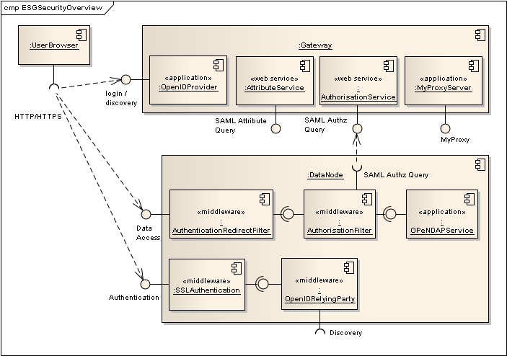
ESG Security Architecture

Slide 7

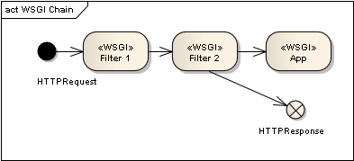
Functionality Slicing with WSGI
SoA – capability to slice up across web service interfaces
What about the applications themselves?
Application middleware
in Python => WSGI (Web Server Gateway Interface)
Akin to Java servlets
A web application can be separated into a chain of middleware components each taking a pass over the input request and then passing it on to the next middleware or short circuiting the chain to return a response
Slicing based on the functionality being provided

Slide 8
REST and Access Control Policy
“With URI-based (REST) web services, administrators can apply ACLs to the service itself and to every document that passes through the service, because each of them would have a URI.”
“It is much harder to secure an RPC-based system where the addressing model is proprietary and expressed in arbitrary parameters, rather than being group together in a single URI.”
http://www.xml.com/lpt/a/923 REST and the Real World, Paul Prescod, 20 Feb ’02
Different applications and toolkits each with their own security API
For HTTP, access control policy is determined by the characteristics of a request: the URI, the method GET, PUT etc.
Attributes which are independent of the specific of any given API toolkit.
This makes it independent of the application inner workings => separation from the application

Slide 9

Preserving Modularity
Challenges to modularity:
Requirements solidify, implementation beds down and can become brittle – lava flow
Developers can prefer application specific security APIs
Preserve with:
Vigorous unit testing
Perhaps more importantly integration testing
Do the components still fit together OK?!
Is it worth preserving?

Slide 10
COWS – CEDA OGC Services and ESG Security
COWS – CEDA OGC Web Services
Python implementation
COWS WMS secured with generic ESG security filters
Can accept SSL and OpenID based authentication
COWS Client
Open Layers based
Understands ESG Security enabled COWS WMS:
Invoke OpenID based sign in on HTTP 401 Unauthorized response.
403 Forbidden => user doesn’t have the required access rights
Demo

Slide 11
Future Plans
Tackle delegation
MashMyData Project: user delegates to portal data mash up application which can retrieved secured datasets from other services
Proxy certificates
OAuth
WPS implementation and access control policy
URI based where possible but
policies based on POST’ed request content also likely
XACML (eXtensible Access Control Markup Language)
Richer functionality for policy expression
Standardised policy
Python XACML 2.0 implementation recently completed

