Slide 1
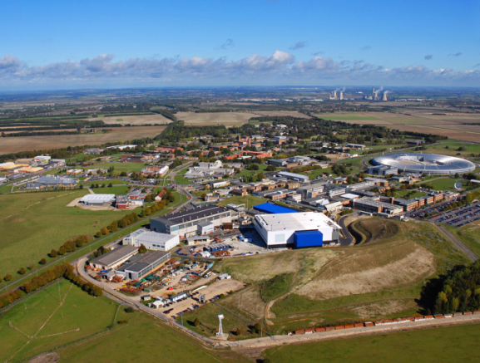


A Flexible Component based Access Control Architecture for OPeNDAP Services
Philip Kershaw
STFC Rutherford Appleton Laboratory
Notes:
CEDA (Centre for Environmental Data Archival) at STFC Rutherford Appleton Laboratory hosts two of the Natural Environment Research Council (NERC) Designated Data Centres

Slide 2
Background Themes
Focus on two areas alluded to in the abstract:
“Without ready means to restrict access to data for such services, data providers and data owners are constrained from making their data more widely available.”
“The range of different security technologies available can make interoperability between services and user client tools a challenge.”
Paradox: provision of access control can open access?!
Illustrated by the BADC and OPeNDAP
But in the wider context of changing attitudes: data.gov.uk
Vision of seamless access can seem remote:
Services too complicated, get in the way or simply broken
Notes:
"The changes signal a wider cultural change in Government based on an assumption that information should be in the public domain unless there is a good reason not to - not the other way around,“ – Communities Secretary John Denham.

Slide 3
Inception
Seeds planted with discussion started at this conference last year
OPeNDAP implementations have existing support to follow HTTP redirects*
A pre-existing Design Pattern:
Initiate request,
server side security challenge
Redirect to authentication endpoint
Redirect authenticated client back to original requested URI
NERC DataGrid Security and Python WSGI middleware
Security filters based on a flexible, pluggable architecture
* TDS: http://www.unidata.ucar.edu/projects/THREDDS/tech/reference/RestrictedAccess.html
PyDAP: http://pydap.org/client.html
Notes:
Soup of overlapping ideas and related activities

Slide 4
Alternative Approaches to Authentication
Why use redirects at all? Everything over HTTPS:
but then performance limitation for large datasets,
change from a well known HTTP address to HTTPS – user confusion?
HTTP Digest
Not secure enough
What about SOAP?
An invasive approach which would change the interfaces breaking existing client tools
Unsuited to large dataset transfers

Slide 5




Coupled Model Intercomparison Project Phase 5
CMIP5 is a framework for co-ordinated climate change experiments
Will input into the IPCC 5th Assessment Report (AR5) scheduled for 2013
Software infrastructure under development:
20 modelling centres
50 numerical experiments
86 simulations (total ensemble members) within experiments
6500 years of simulation
Data to be available from “core-nodes” and “modelling-nodes” in a global federation.
Users need to find & download datasets, and discriminate between models, and between simulation characteristics.
mid-2009
2009
end of 2010
early to mid 2012
early 2013!
Simulations Starting
Model and Simulation Documentation needed
Data available
Scientific Analysis, Paper Submission and Review
Reports

Slide 6

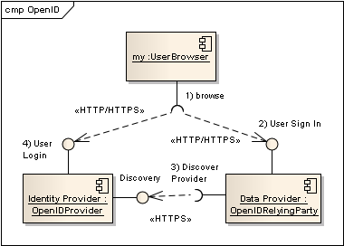

Earth System Grid Security: Single sign on
Users have an identity URI: both an identifying for them and the location of an OP (OpenID Provider), a service where they can be authenticated
An OpenID Relying Party trusts the authentication assertion of a given OP
ESG stipulates SSL to enable RPs and OPs to mutually authenticate and enable RPs to whitelist OPs and only trust ones known to the ESG Federation
OpenID less suited to non-browser based clients
MyProxy provides compatibility with any PKI based authentication including Grid based applications

Slide 7
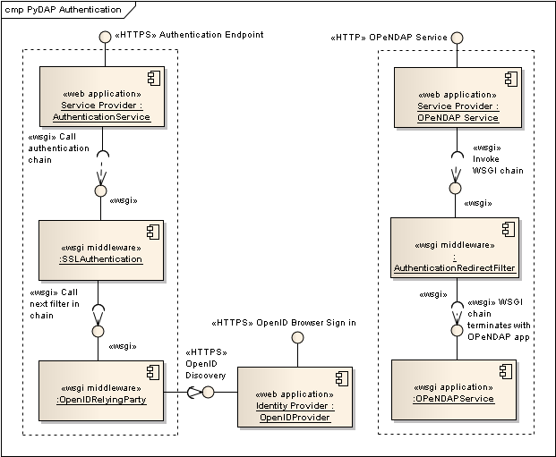
Filter Architecture
OPeNDAP service is protected by an Authentication filter
This redirects unauthenticated requests to an authentication service
This authenticates based on the client request
If client certificate provided, authenticate with this
Default to OpenID based sign in

Slide 8
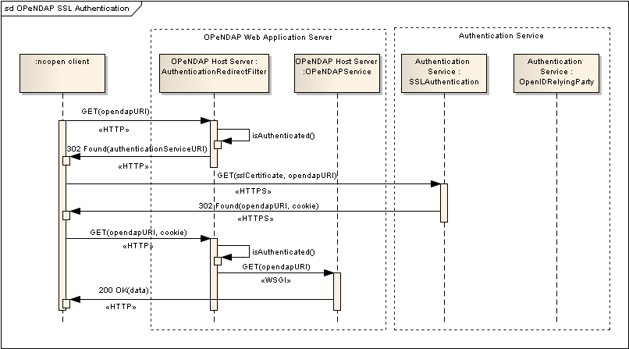
Authentication Example – ncopen client

Slide 9
Demo ...
Browser based access
Command line access with wget

