Slide 1
Practical Access Control Using NDG Security
  e-Science All Hands Meeting
  11 September 2007
  Philip Kershaw BADC
  Bryan Lawrence BADC
  Jon Blower ESSC

Slide 2
Overview
Introduction to NDG and NDG Security
Why secure data?
Requirements
Authentication
Authorisation
Credential Management
Single Sign On
Software Implementation
NDG Security for DEWS
Discussion
Plans for the future

Slide 3
Introduction
NERC Data Grid – a NERC funded e-Science project to improve the integration of data holdings in atmospheric and oceanographic science
  enable mix and match of data from multiple sources in “single sign on” context
A partnership between the BADC, the British Oceanographic Data Centre (BODC) and STFC e-Science Department
extended to National Oceanography Centre, Southampton (NOCS) and Plymouth Marine Laboratory (PML) for the second phase of work
NDG Security was also applied to DEWS (Delivering Environmental Web Services), a technology demonstrator project looking at two example application areas:
  delivery of marine forecasts into Search and Rescue applications
  take data from the health sector and feed it into a system which predicts hospital admissions

Slide 4
Why is Secured Access Required?
It may be owned by a 3rd party or they have IPR over it
For the protection of legal rights of 3rd parties
Constrains access to priority users
Data may be in some interim form which is not suitable for general use
Enables auditing
To summarise there are two driving requirements for access control:
  protect access to finite resources
  ensure that the use of resources is scientifically and/or legally appropriate

Slide 5
Requirements for NDG Security
Data holders could not and would not consider changing the way they stored data and fundamental metadata (including user information)
User information could not be shared between partners without explicit authorisation by the users on a case by case basis
Licensing constraints affect what common “authorisation roles” could be established, and that with more than two partners, common roles across all partners would be few
Real existing users couldn’t be asked to work directly with X.509 certificates
Any new access paradigm had to support what was already possible and did not necessarily have to be more secure than current practice
The technology had to be portable and easily deployed in groups that have little resource for “tinkering”.
Simple to devise and build

Slide 6
Authentication
MyProxy was selected as a tool in authentication for NDG:
  Principle 4) outlined earlier: Real existing users could not be asked to work directly with X.509 certificates
  Pre-existing systems at NDG Partners used username/pass-phrase based authentication.
MyProxy enables the use of individual user certificates by intermediate services acting on behalf of the user for the brokering of access to a secured resource
...but the user experience is still username/pass-phrase: it provides a level of abstraction for the user such that they never need to deal with the certificates directly.
“Lightweight” certificates are used issued by an NDG CA using Globus SimpleCA package.

Slide 7
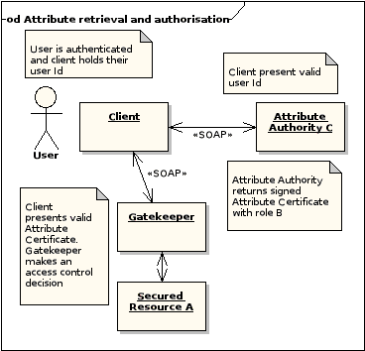
Authorisation
NDG-Security uses a role based access control mechanism
Roles are issued to users in Attribute Certificates issued by Attribute Authorities
Access control policy for a resource is based on the triple: for resource A, access control depends on role B known by Attribute Authority C
Access control is mediated by a Gatekeeper

Slide 8
Trust based on Role Mapping
Org C
Trust
Org D
C’s User with Role B
D’s User with Role E
C’s data secured with Role B
Mapping:
D user with a role E can access data at Org C secured with role B
:
Organisation C holds a map configuration file listing D as a trusted organisation and detailing which D based roles map to roles supported by C
<AAmap>…
<trusted name=“D”>
<role remote=“E” local=“B”>
…
</trusted> …

Slide 9
Characteristics of NDG Role Mapping
Bilateral trust agreed on a case by case basis
C can trust D but D need not trust C
New organisations can join keeping their existing roles and without the need to re-register users
New trust relationships can easily be made or existing ones broken
The level of trust may be set: C can set the mapping so that “gold” user role in D may only map to “bronze” in C
NDG permits only one level of mapping for reasons of auditability and to avoid the potential for an escalation of privileges through multiple mappings
Org C
Attribute
Certificate
Map roles
Org D
Attribute
Certificate
Map roles
Org N
Attribute
Certificate

Slide 10
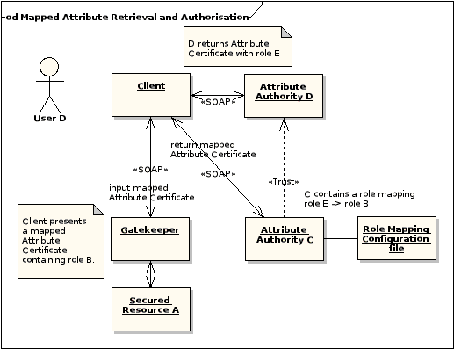
Role Mapping

Slide 11
Credential Management
A user session includes a Credential Wallet:
  Holds user id: proxy certificate
  …and user attributes: Attribute Certificates
  Emphasis on control for the user and respect for the confidentiality of their credentials and who they divulge them to in order to gain access
  A user might hold two different Attribute Certificates based on accounts they have with two different organisations one commercial one academic. They may wish to use different ones in different scenarios
Session Manager web service to manage user’s credentials (particularly in browser based scenario)
  Caches a users Credential Wallet
  When a user logs in, it calls MyProxy with their credentials, obtains a proxy certificate and adds this to a new wallet
  Acts on the user’s behalf to broker attribute certificates for access to a given resource

Slide 12
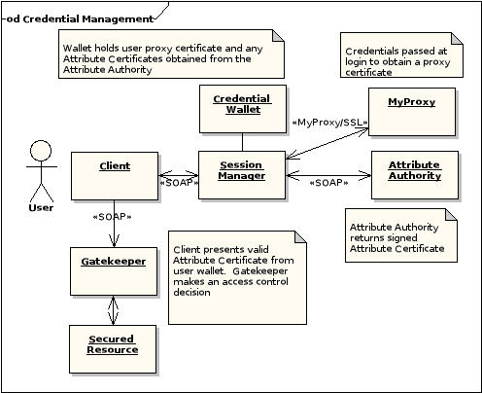
Credential Management

Slide 13
Single Sign On
There are a number of existing solutions including Shibboleth and OpenID
NDG envisages browser and non-browser based profiles
The browser based profile uses a Login Service:
  Login triggered in response to a request for a restricted resource
  The Portal presents a WAYF (Where Are You From?) page listing a number of trusted sites trusted from which the user could select to login.
  For NDG, it is the Attribute Authority which provides the list of trusted organisations for the page to display.
  The user selects their site for login and is redirected there
  They enter their credentials at the login page. Login calls the Session Manager to authenticate the user with MyProxy and create a new session wallet for the user
  They are redirected back to the URL to continue their request
  NDG Discovery Demo…

Slide 14
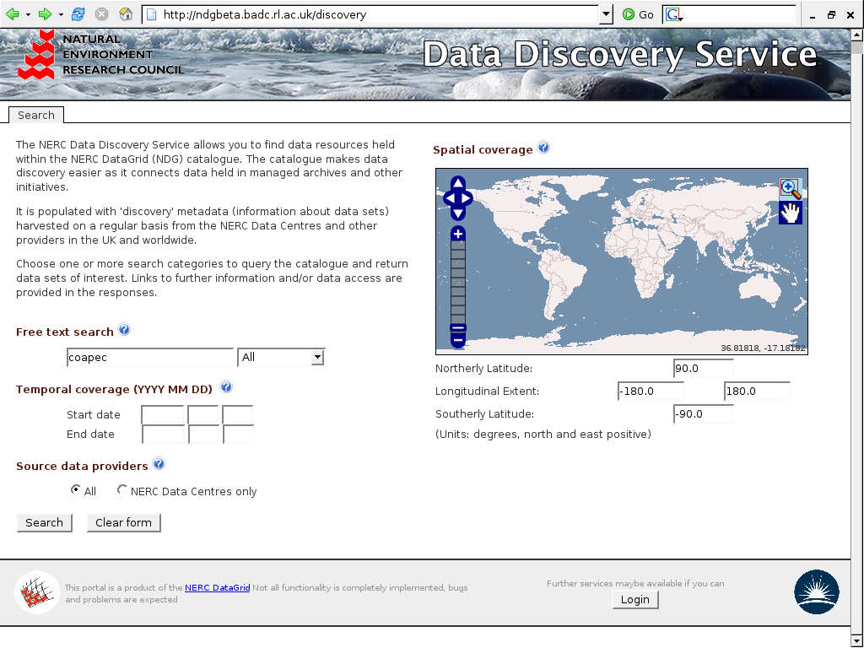

Slide 15
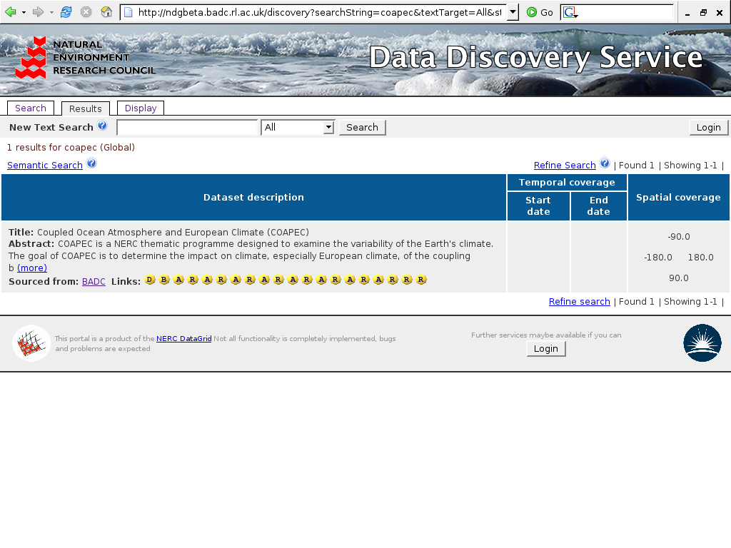

Slide 16
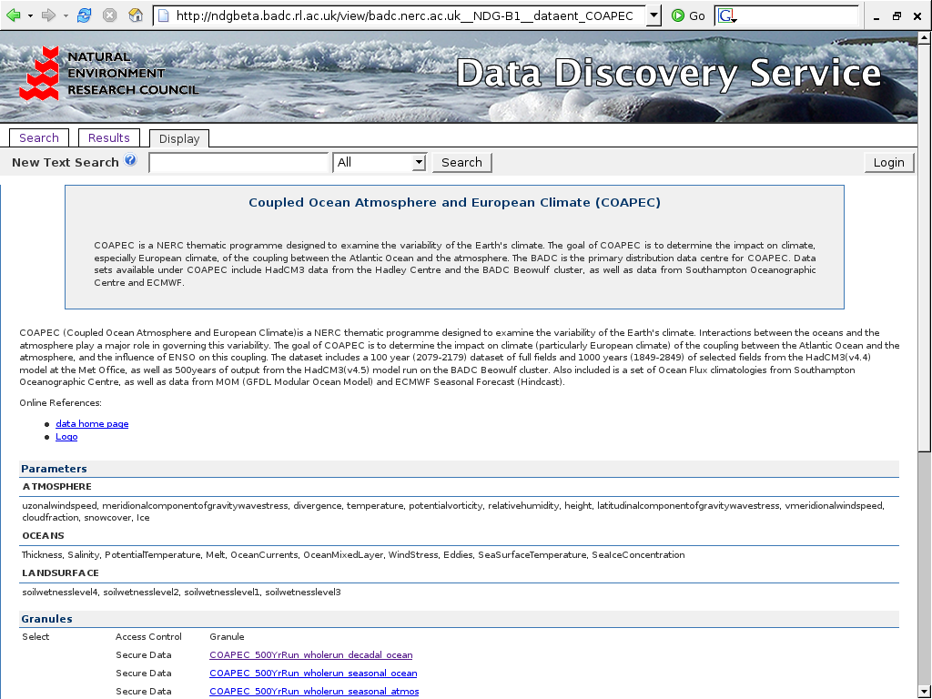

Slide 17
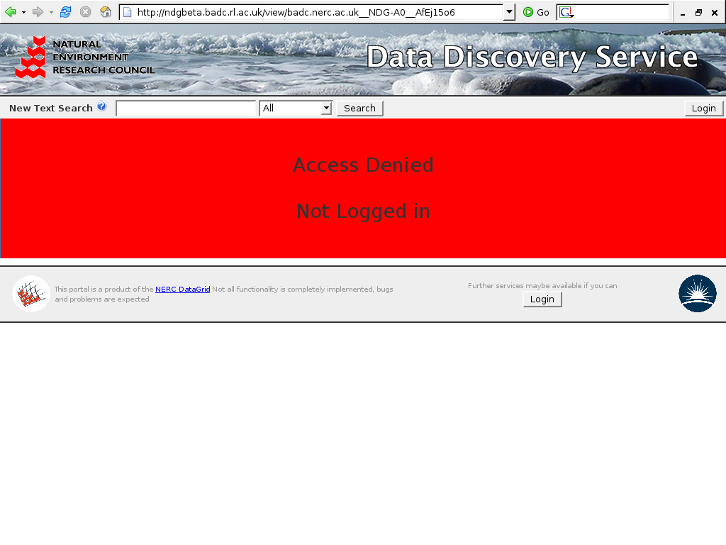

Slide 18
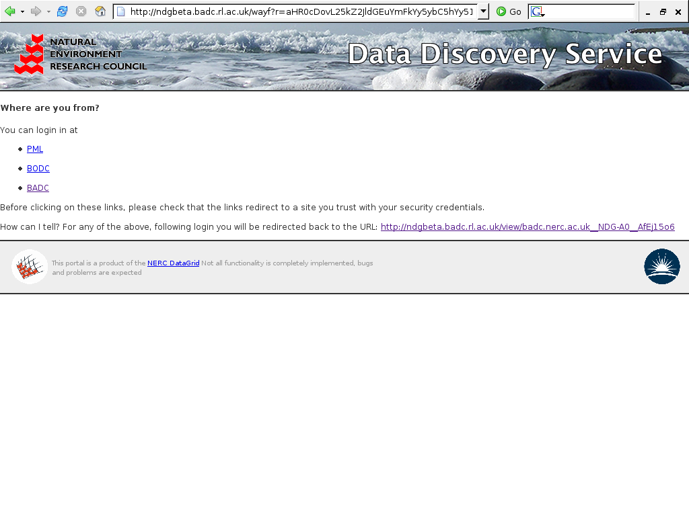

Slide 19
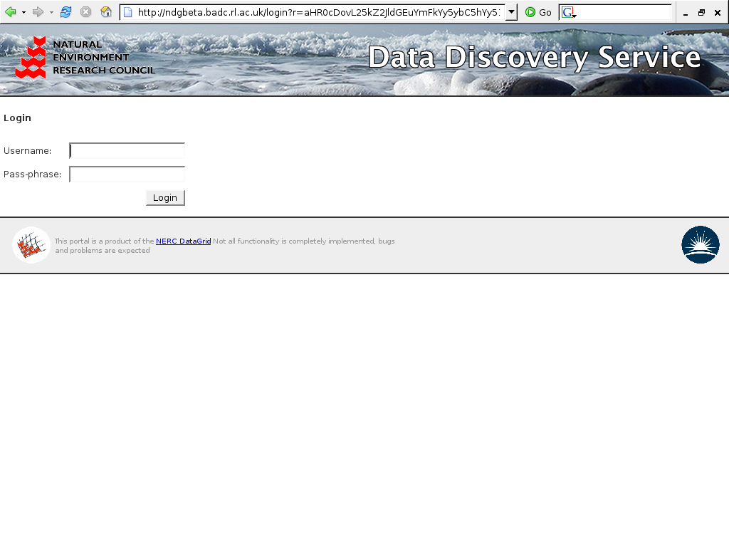

Slide 20
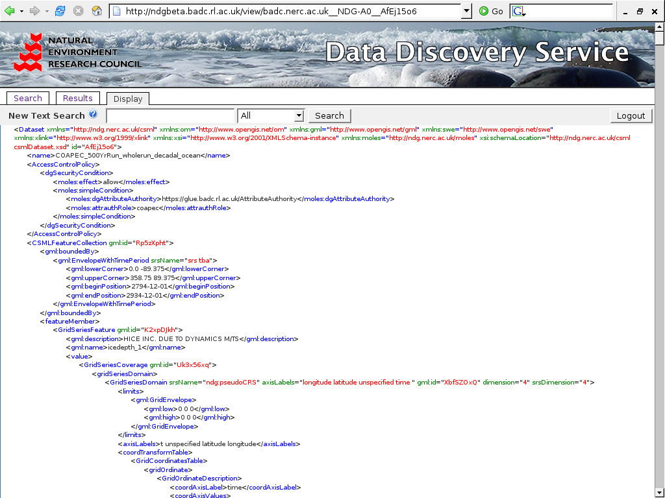

Slide 21
Software Implementation
NDG Security is written in Python
It consists of distinct client and server side components deployable as separate Python Eggs (akin to Java JARs)
The server side uses the Twisted framework for an application server
The Session Manager and Attribute Authority services are SOAP based with WS-Security for digital signature and transport level encryption to secure messages
SOAP services are implemented using the ZSI package.
WS-Security digital signature is a custom implementation adapted from pyGridWare
The Login Service has RESTful interface and is written using the Pylons application framework.

Slide 22
NDG Security for the DEWS Project
Deployment in DEWS provided a set of new requirements:
  Secured cross organisational transfer of datasets
  Secure an implementation of OGC (Open Geospatial Consortium) WCS (Web Coverage Server).
Challenges:
  Python based NDG Security services interoperating with Java (WebSphere and Axis) based ones with SOAP and WS-Security
    A major stumbling block!
  WCS uses REST style interface but must present a SOAP interface secured with WS-Security
    a Gatekeeper to the OGC services to manage access control and act as a SOAP proxy to the OGC interface
  WCS returned binary data over same channel as HTTP GET request
    Deliver the data over a separate secure channel to the Gatekeeper’s SOAP interface.

Slide 23
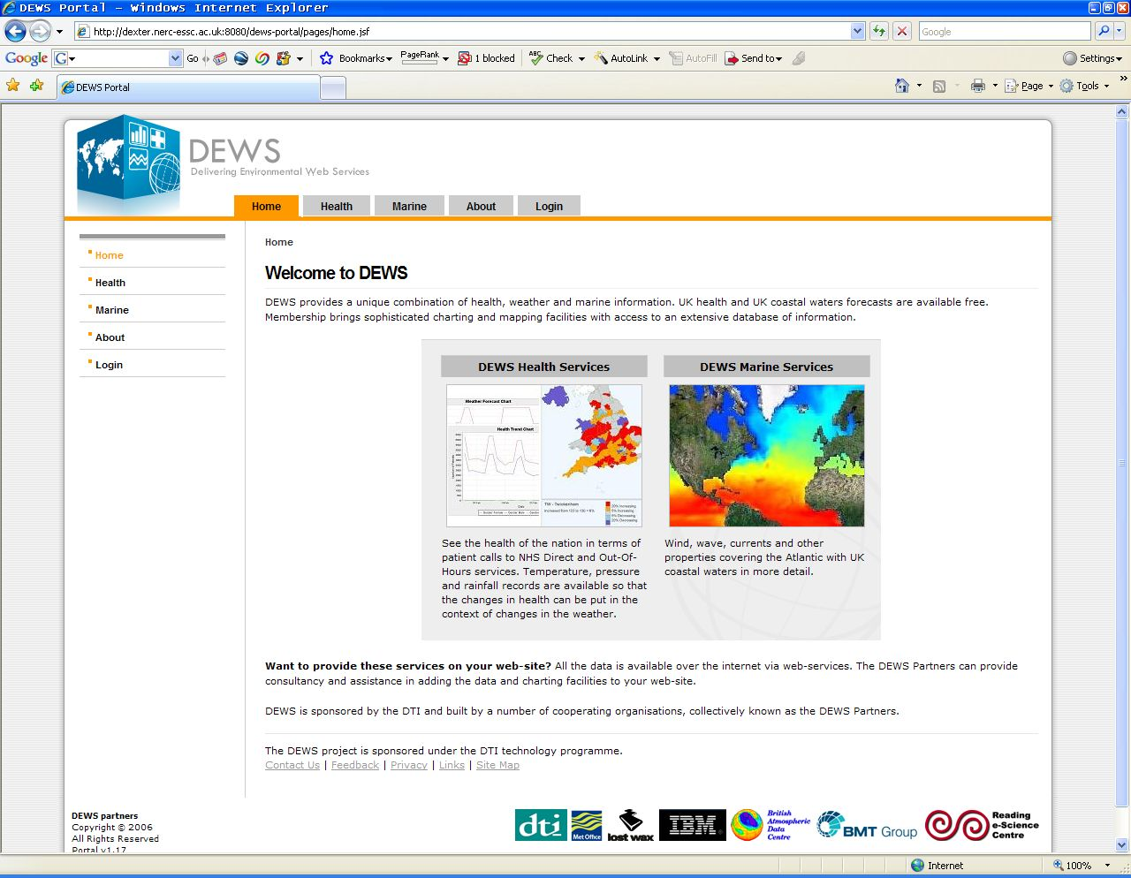

Slide 24
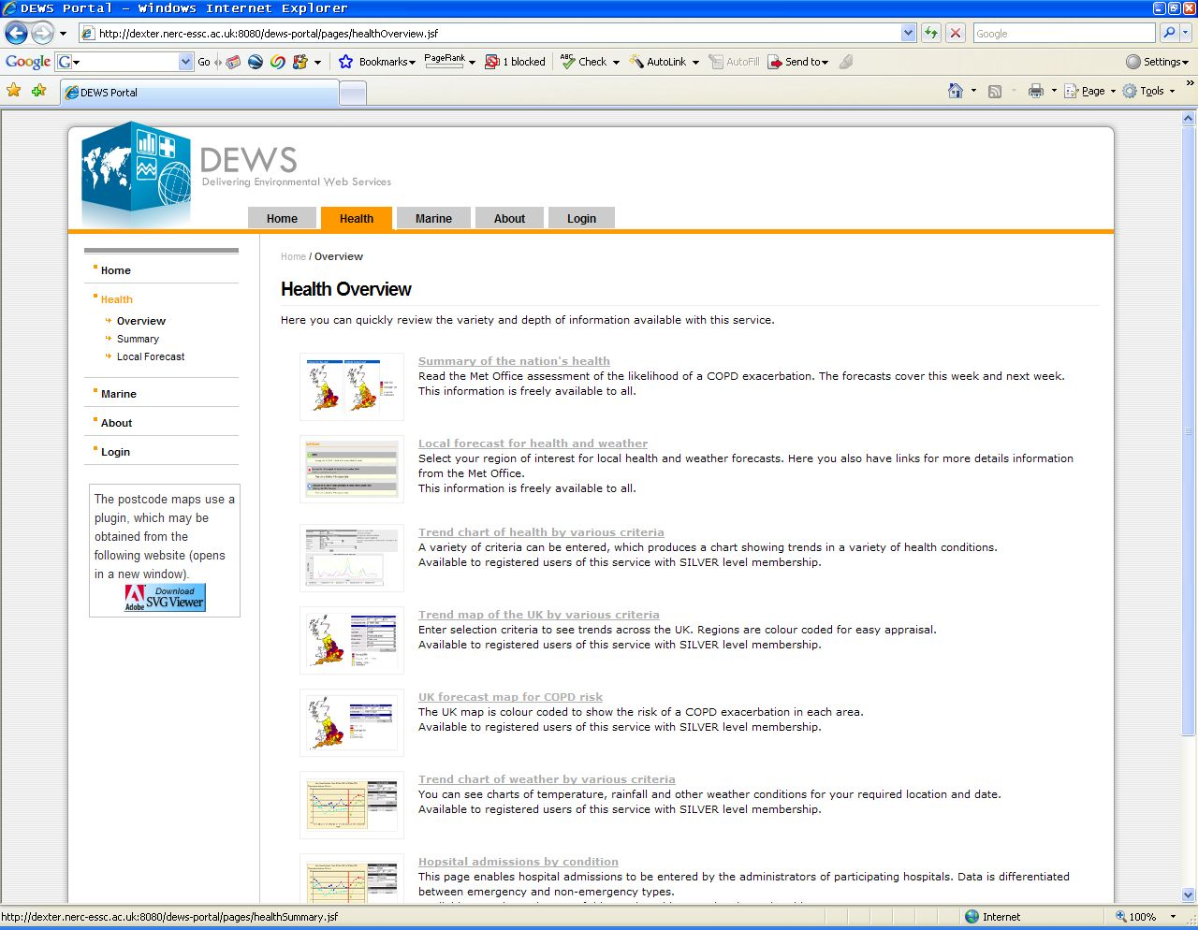

Slide 25
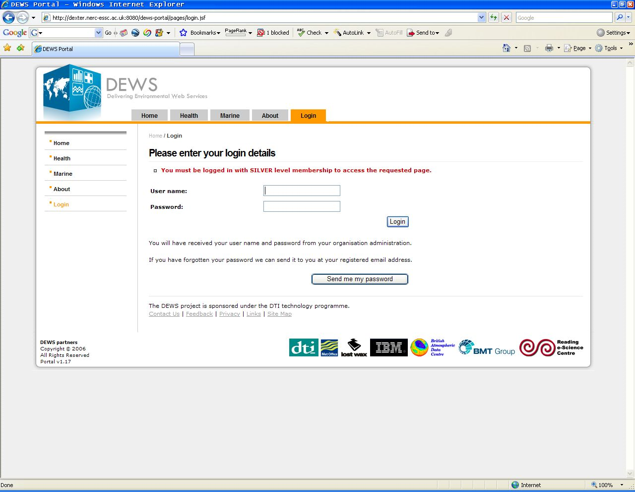

Slide 26
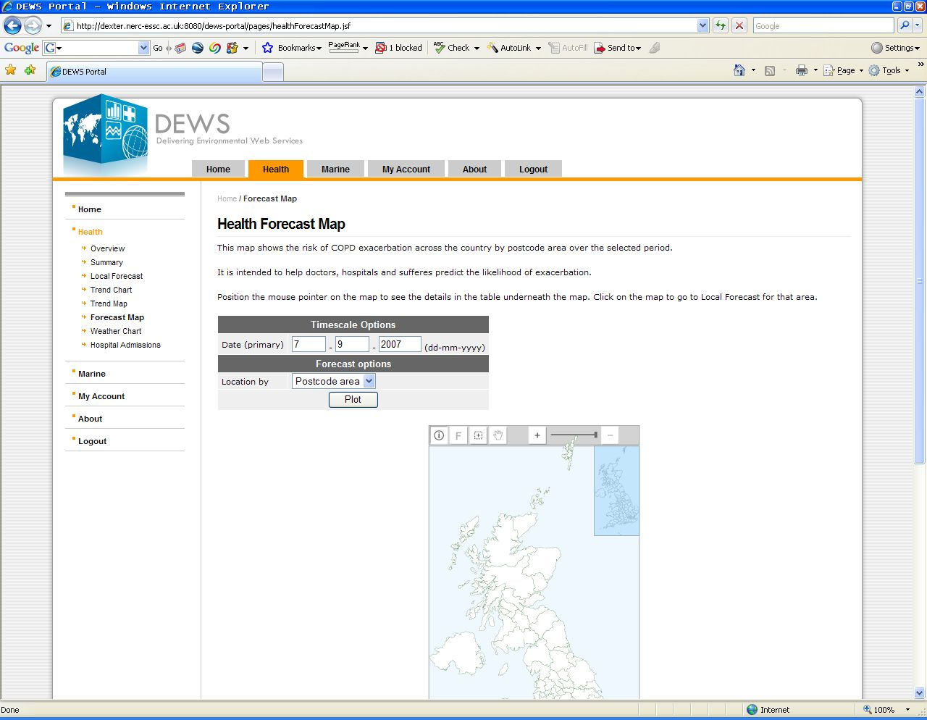

Slide 27
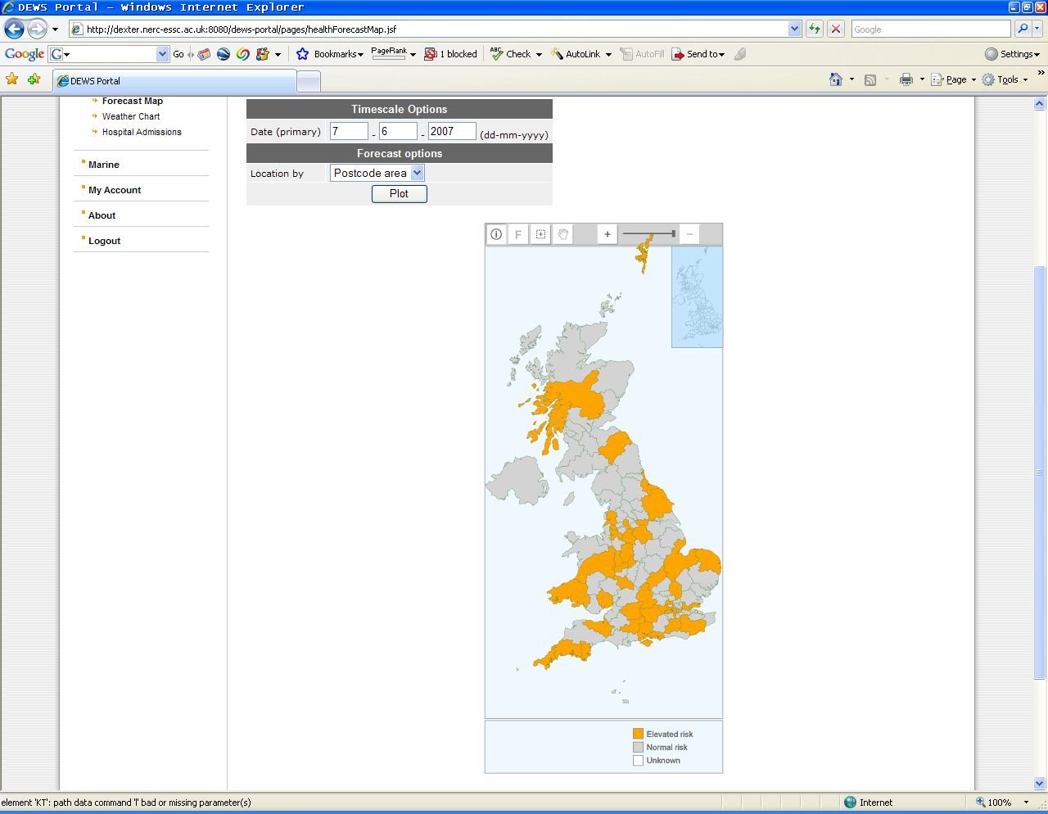

Slide 28
Discussion
Roles and alternative models for trust
  NDG Security choose role mapping as a way of expressing trust between organisations
  A single set of roles across a virtual organisation:
    But, large numbers of datasets with pre-existing roles
    Users already registered with a participating organisation must then re-register with the VO.
  Role delegation:
    Organisation A delegates authority to Organisation B to issue B users with A based roles
Mechanism for role mapping
  Client negotiates mapped Attribute Certificate
  Alternative: the service maps roles at the Gatekeeper
Further develop access control and attribute assignment policies
Multiple levels of role mapping
Use of proxy certificates and SOAP toolkits

Slide 29
Plans for the Future
The team has no desire to develop NDG security into the indefinite future, especially given the range of activity in the field of grid security but we need to deploy it now with as many applications as possible
The BADC has been awarded funding from OMII-UK to carry out follow on work
Package the software
  Enhance documentation for easy deployment
  Change to use WSGI (Python analogue to servlets) interfaces to enhance interoperability across Python frameworks
  Integrate SAML
Develop Java and PHP clients for services
We will integrate other security technologies
  Shibboleth
  OpenId
  Thredds and OpenDAP: in common use in the Met-Ocean community
  OMII-AuthZ
HTTPsec enables message level security using HTTP headers

