Slide 1
Introducing Mutator Layer in Rails
By Philip Lambok

Slide 2
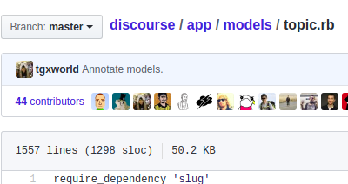
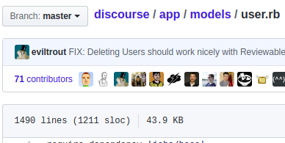
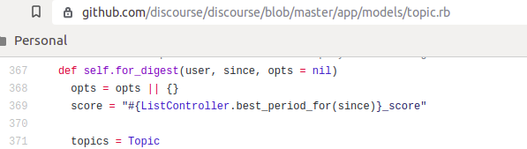
Skinny Controller – Fat Model

Slide 3
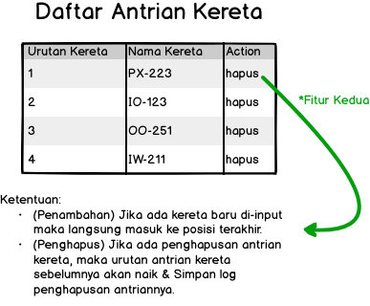
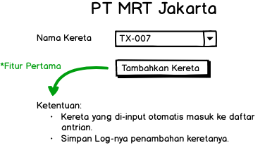
Studi Kasus

Slide 4
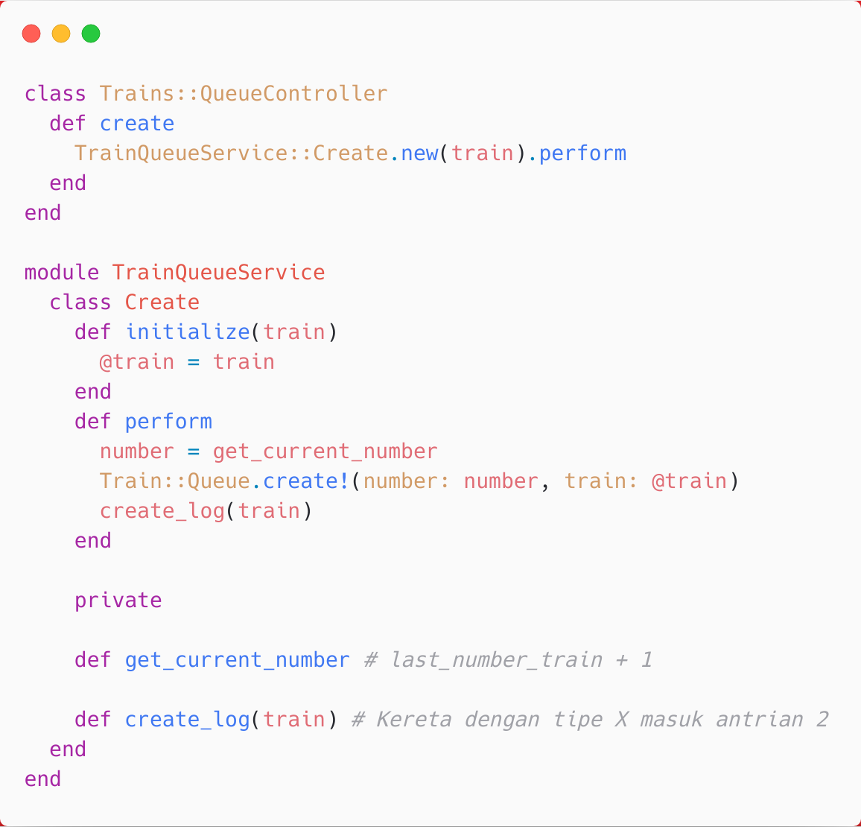
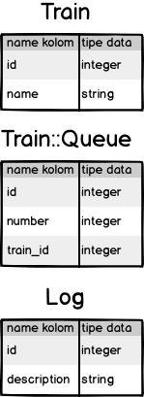

Slide 5
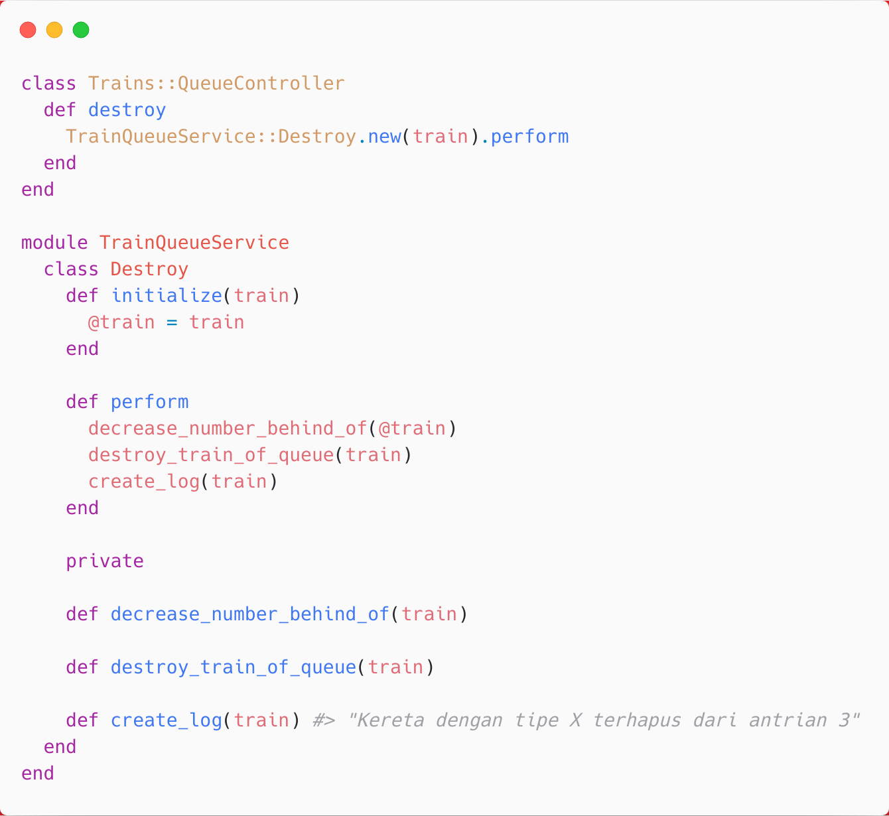

Slide 6
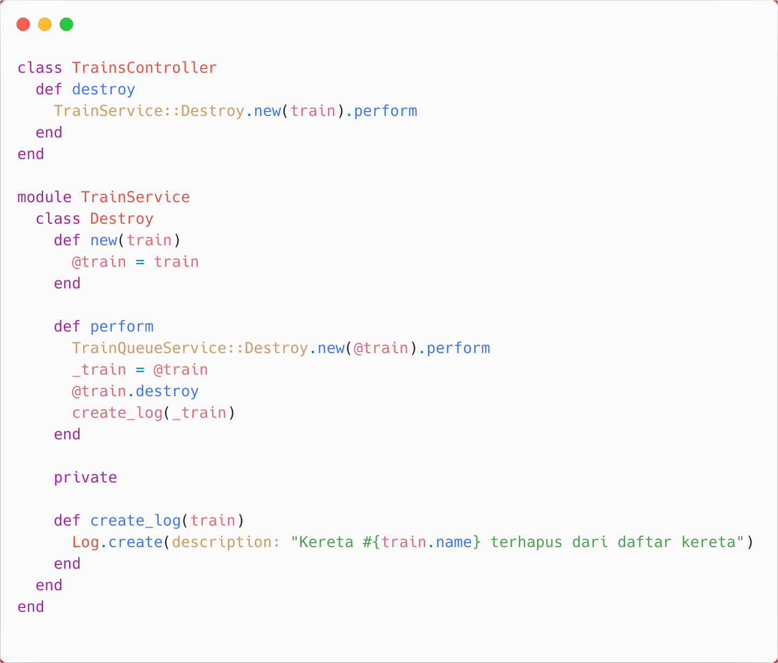
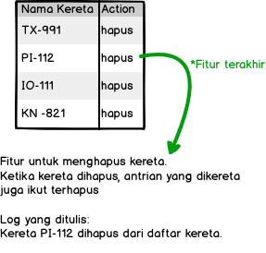


Slide 7
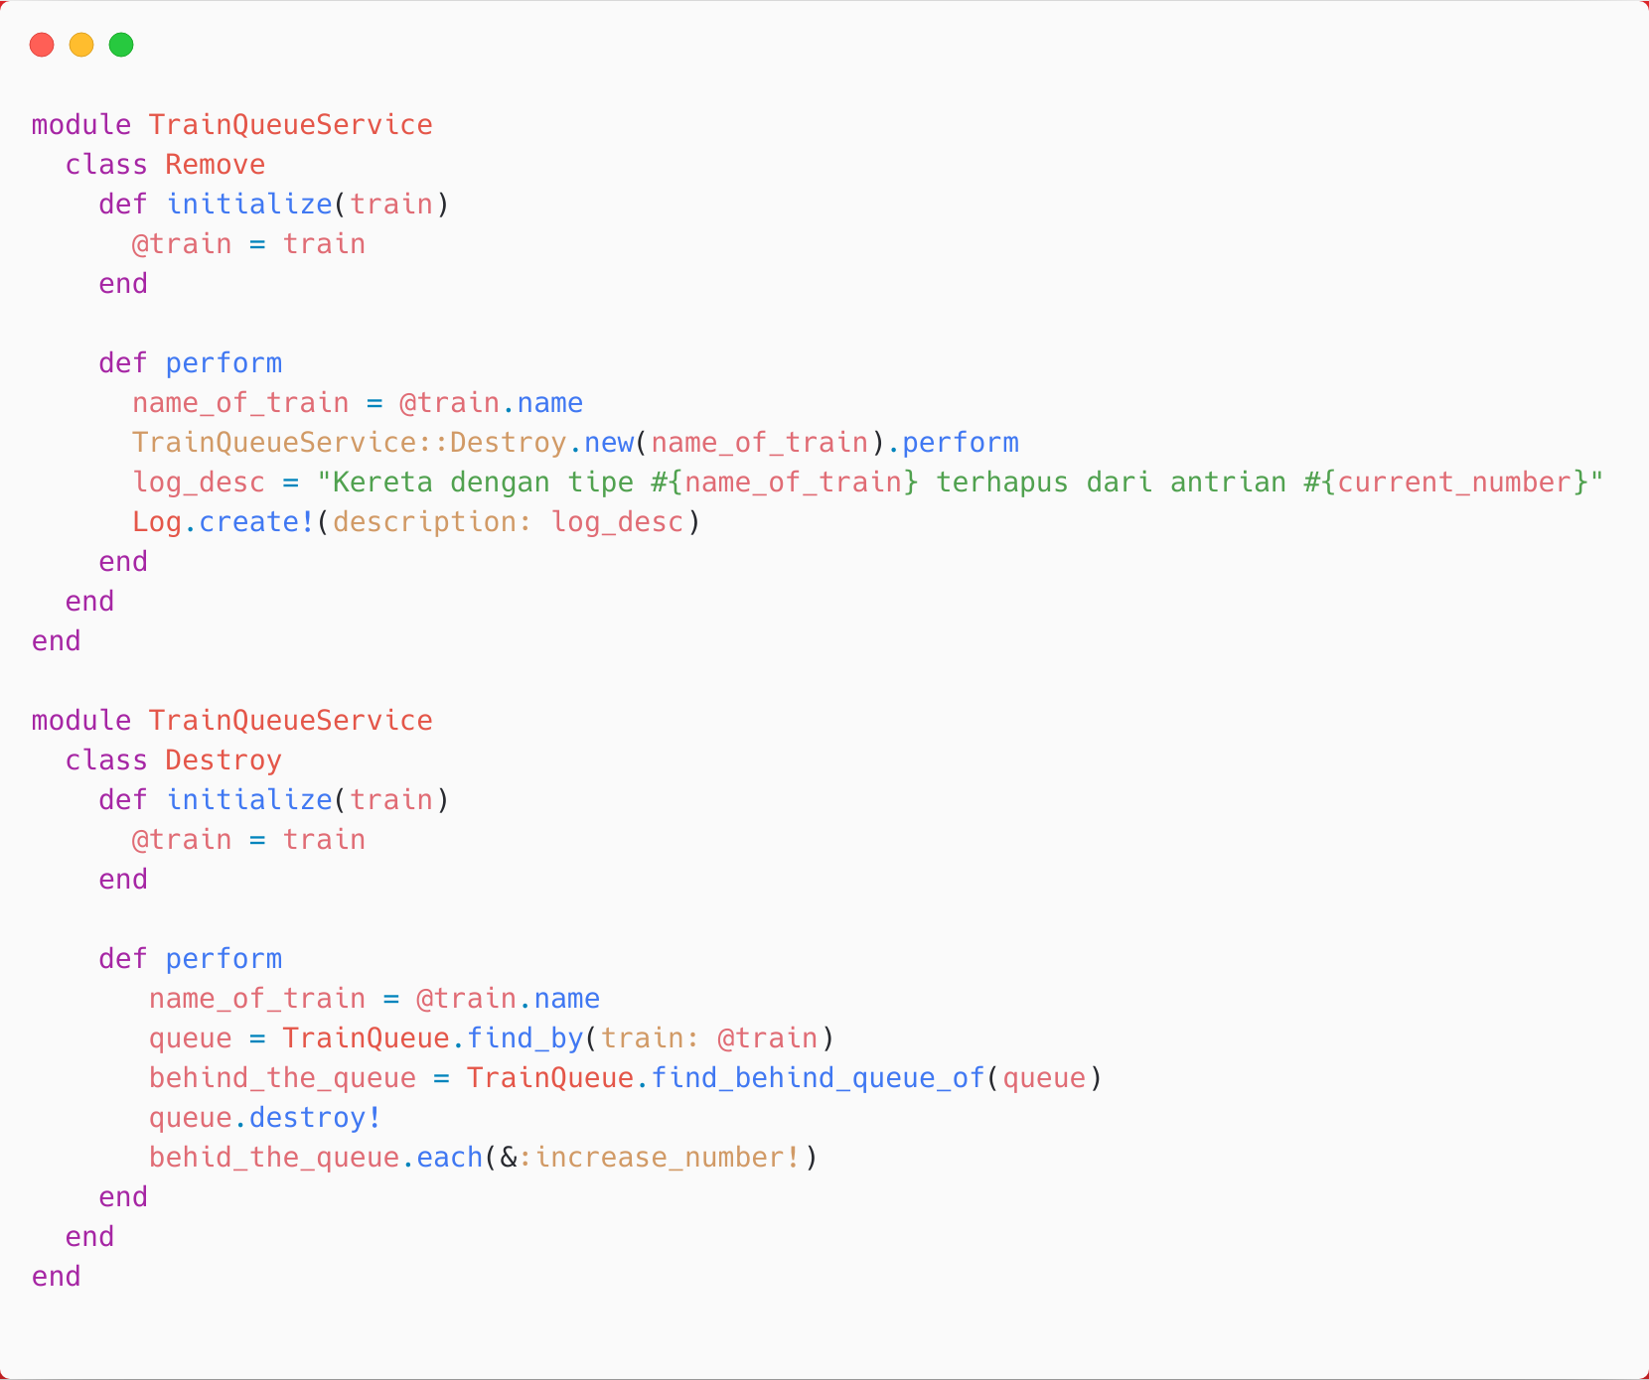


Slide 8
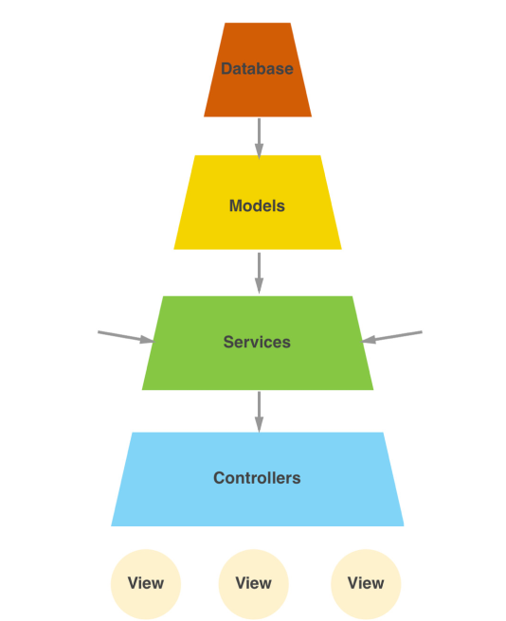
Skinny Controller
Skinny Model
Fat Service

Slide 9
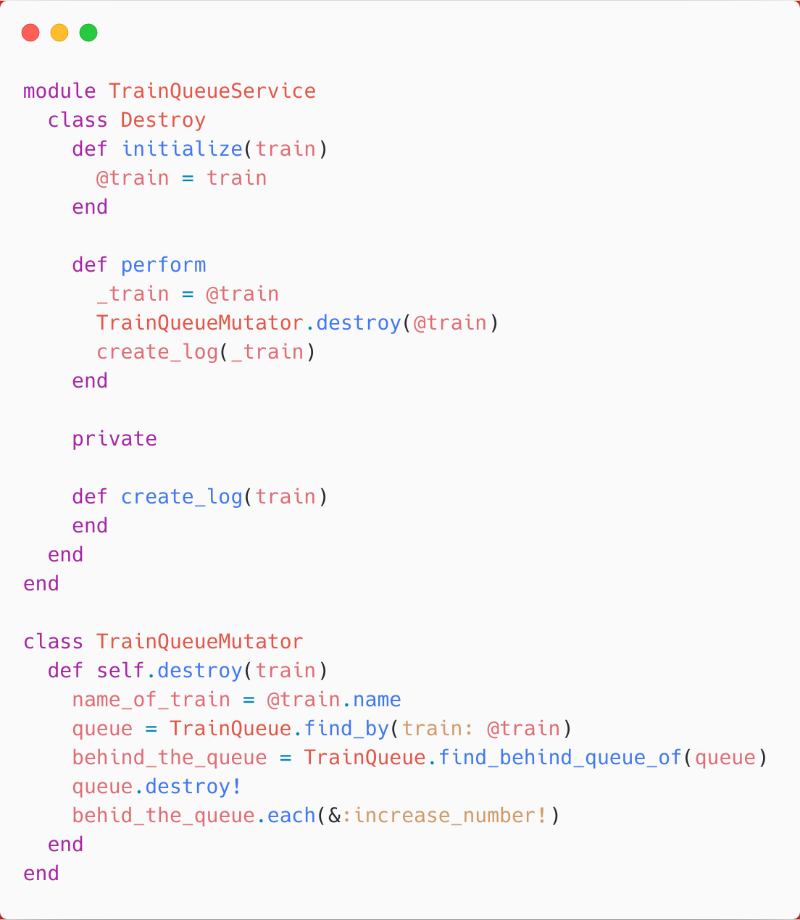


Slide 10
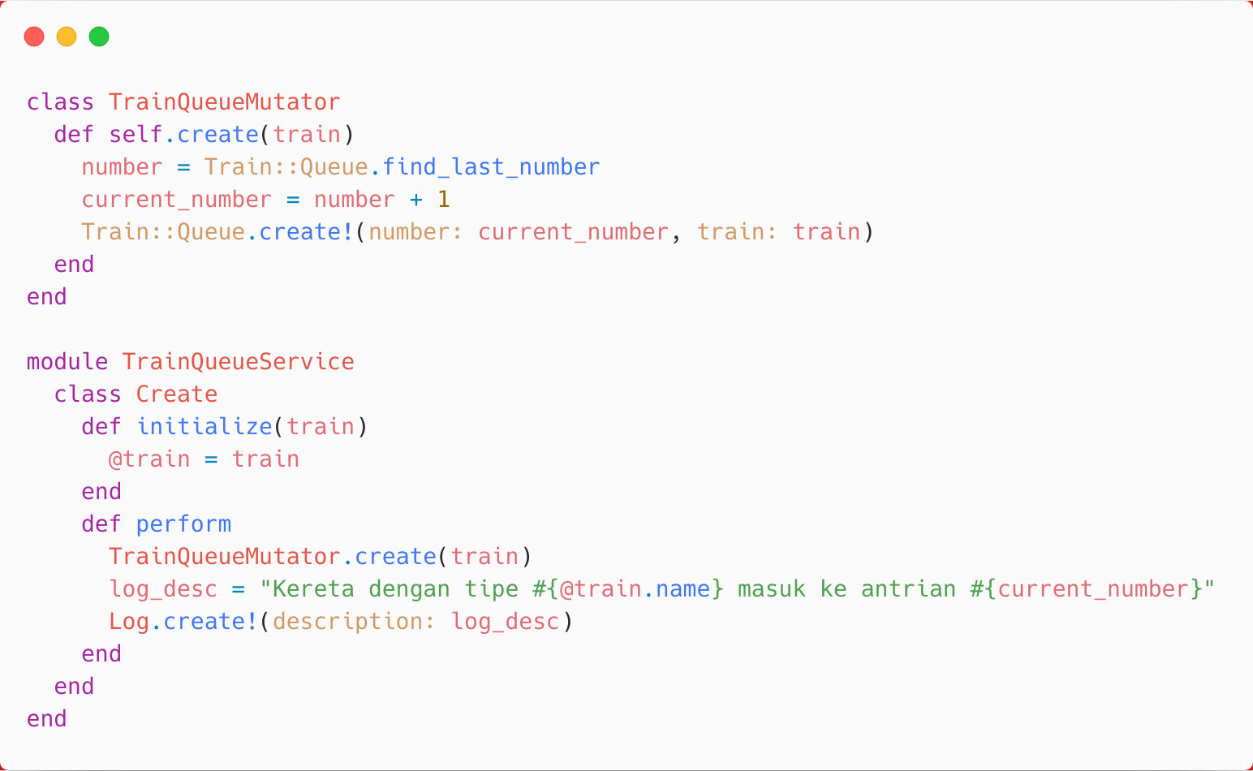

Slide 11
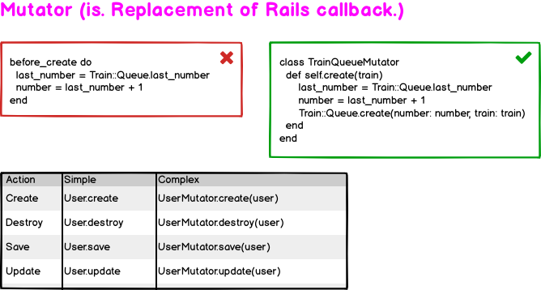

Slide 12
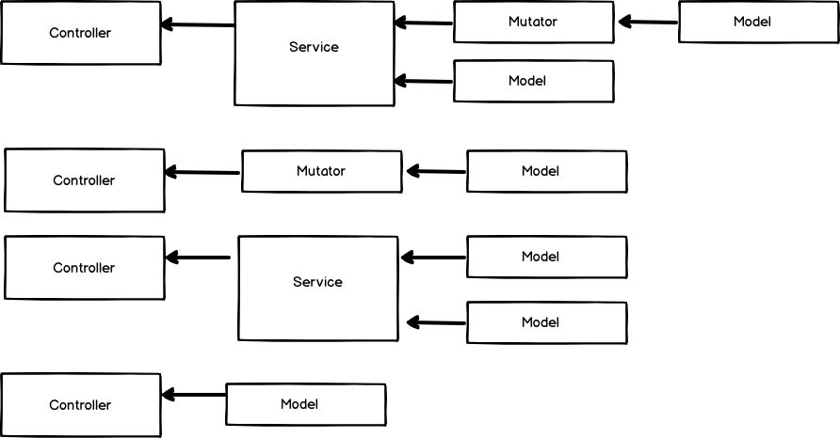

Slide 13
Rules
Service (High Level Application Logic)
→ Ketika logic memuat lebih dari satu model!
Mutator (Low Level Application Logic)
  Aplication Logic yang memuat satu model saja!
    before_create = UserMutator.create(user)
    before_destroy = UserMutator.destroy(user)
    before_save = UserMutator.save(user)
    ...

Slide 14
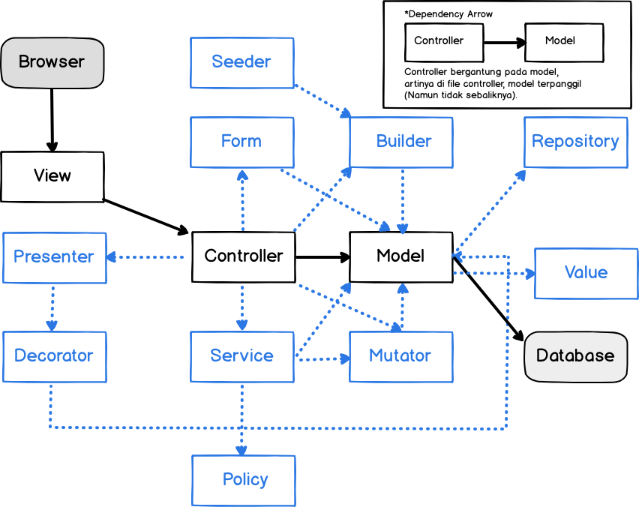
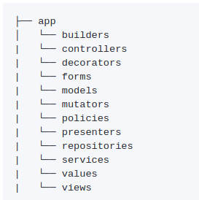

Slide 15

Thanks!

