Slide 1
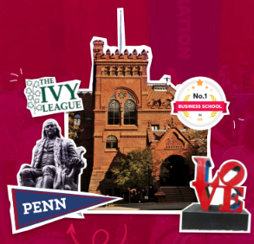
Starbucks : The Way Forward
High School Group
PennSEM Business Case
Competition
October 2024
Team Members:
Raunak Agarwal
Kota Furusho
Philip Leitner
Euan Wang
Video Link

Slide 2
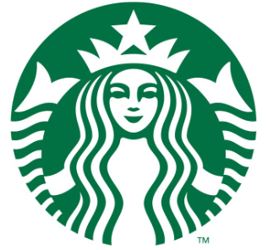
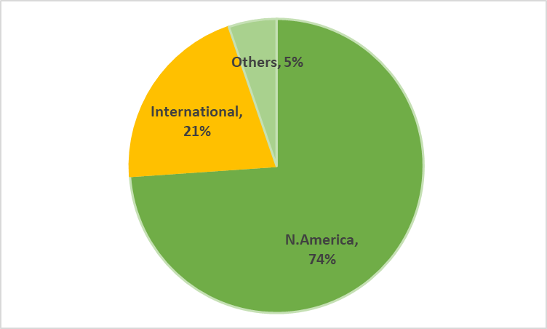
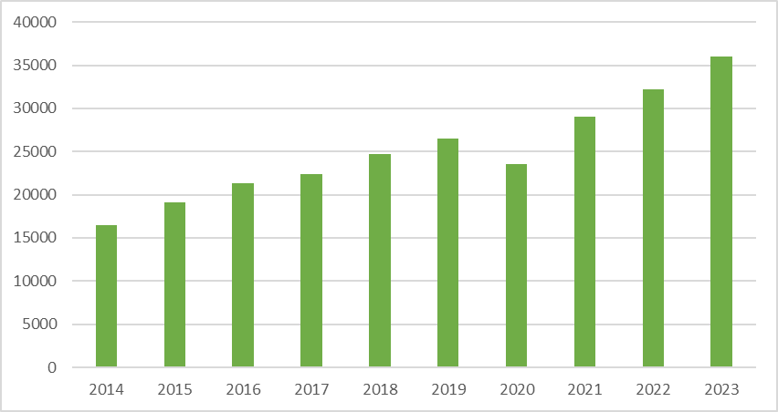
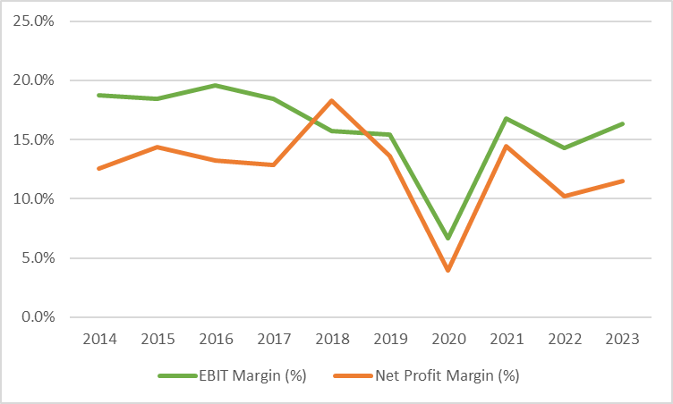
Starbucks – Brewing Success over the Years
Starbucks with sales of USD 36 bn is the largest specialty coffee chain in the world
It operates more than 38,000 (80% company operated) in 80 countries globally
74% of the sales are from N.America with China being the biggest market internationally (~12% of annual revenues)
Company has exhibited a CAGR of 9%+ in revenues over the last 10 years
Starbucks also enjoys stable healthy margins given its strong pricing power and brand value
Regional Revenue Split (%)
Revenue (USD mn)
Margin (%)
Source : Company reports, Bloomberg

Slide 3
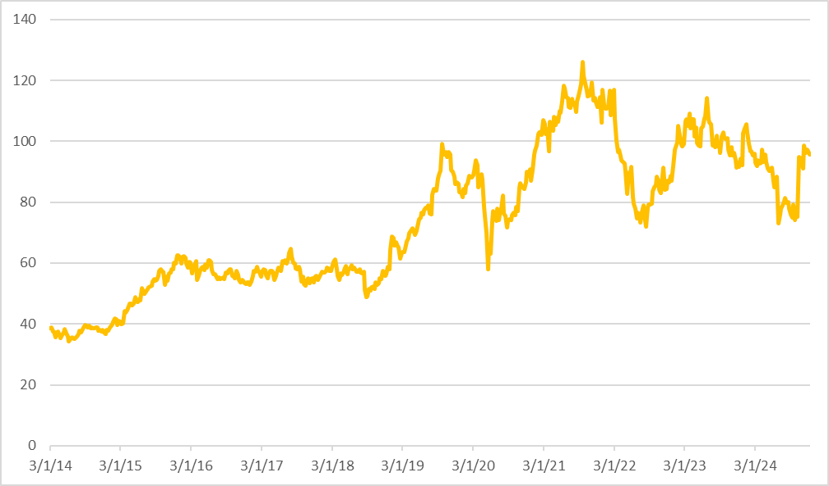
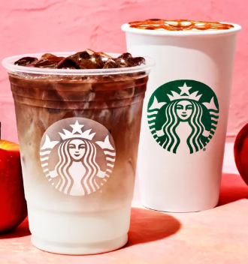
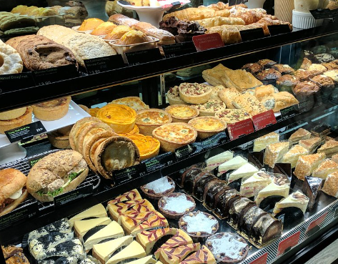
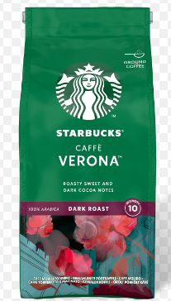
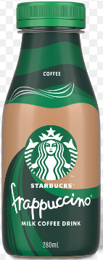
Starbucks – Brewing Success over the Years
Beverages account for 60% of revenues and food for ~18%. Rest is others (packaged coffee, ready-to-serve beverages etc)
Cold beverages now represents ~70% of the mix and ~60% of the beverages are customized
Starbucks has pioneered digital adoption with its mobile app. Mobile orders now account for 30%+ of US transactions
MOP (Mobile Order & Pay) drive-thru and delivery now make up ~75% of the business
Strong earnings growth along with consistent dividends and buybacks has made it the darling of investors
It currently has a market cap of USD 100 bn + (doubling its market cap in 10 years) and trades at 25x Price Earnings
Revenue Mix
Share Price Performance (Jan1, 2014 – Oct 10, 2024)
Beverages
Food
Others
Source : Company reports, Bloomberg

Slide 4
Starbucks – No Longer “Grande” : Why?
Quarter | Results | Key Reasons (Brief) | Guidance | Street Reaction
Q1 2024 | EPS $0.90 vs consensus at $0.94, driven by lower than expected revenue (however global comparable store sales still increased 5%) and higher COGS (Cost of goods sold) | US miss was attributed to boycott driven by post about Middle East and tough comps in China given rising competition and slowing consumer | Tempered F24 Global comps growth to 4%-6% from 5%-7%, although EPS guidance was maintained (reassuring investors) | Slight miss made investors cautious, however market reaction was muted as most dismissed this as a one-off
Q2 2024 | EPS $0.68 vs consensus at $0.80, driven by lower than expected revenue (global comparable store sales declined 4%) and higher operating expenses | US pullback attributed to slowdown of occasional users and consumer weakness. China slowdown was attributed to significant increase in price competition amongst slowing consumer | Major reset of F24 guidance with Global comps growth lowered to flat to down single digit and EPS guidance was lowered to flat to up single digit (spooking investors) | Major reset making investors realize that Q1 wasn’t a one-off but the company is facing some structural issues. Stock was down ~16% on the news
Q3 2024 | EPS $0.93 vs consensus at $0.93, driven by slightly lower than expected revenue in China. Global comparable store sales declined 4%. However, margins were in line with consensus | Continuous slowdown in occasional users and consumer weakness in US. China weakness was driven by significant increase in price competition, slowing consumer and deflation dynamics in China | F24 guidance was reiterated reassuring investors than things aren’t worsening further | The management reassurance on the F24 guidance was a sigh of relied for investors. Stock exhibited a minor relief rally post results
Three consecutive quarters of disappointing results, including declining same-store sales and earnings in its two most recent quarters. The recent revenue misses were the first in 15 years and led to sacking of its CEO, Mr. Narasimhan, within 17 months Lets explore the reasons for 3 consecutive quarters of disappointing results in detail in the next few slides

Slide 5
Key Reasons for Underperformance
Confused Brand Identity : Starbucks used to be a place where people could hang out together in a cool environment and have quality coffee. Change in business model in response to customer demand from a predominately sit-down coffee shop to a mostly drive-thru and mobile takeout chain has diluted the experience for its occasional customers, which have driven the decline in sales.
Consumer Pullback: The overall economic climate, marked by inflation and high interest rates, has led consumers to be more cautious about spending, leading to decline in sales. Struggling customers no longer want to shell out for high-priced coffee drinks, unless they see value in the coffee and the experience. Occasional customers (under 6 visits/quarter) pulled back the most
Higher Prices : Average check at Starbucks has grown by almost 50% in the last 5 years driven by rising inflation (Higher cocoa prices, rising wages driven by labour shortages etc). Even though ~30% of that has come from mix and premiumization, but still the hikes have come at a time when consumer is struggling and the in-store experience has been dwindling, further impacting sales
Long Wait Times: While Starbucks boasts strong mobile order and pay sales, a significant number of potential customers abandon their orders (mid-teens as per company estimates) due to long wait times and unavailability of product. This unmet demand was a missed opportunity for sales

Slide 6
Key Reasons for Underperformance
Perception Problem with Gen Z : One demographic where Starbucks has been struggling to reach recently is surprisingly Gen Z (specifically 18-24-year-olds), given their fiscal challenges, as well as some politically motivated boycotts around the Israeli-Palestinian conflict
Increased Competition: Starbucks is facing stiff competition from other coffee houses (eg Dunkin’ Donuts etc and local coffee chains) that offer similar or better quality coffee and amenities, making it harder for the company to maintain its growth trajectory, thus impacting margins. Competition has also been more innovative with their food/beverage offerings
Struggles in China: Starbucks' ambitious expansion plans in China have been hampered by competition from local players like Luckin Coffee, which has a larger number of locations. China’s economic slowdown as well as deflation dynamics has not only impacted comps growth but also unit growth has been negative, further impacting margins
Employee Discontent : The company has also been dealing with employee discontent and heavy unionization efforts. Baristas are also having a hard time creating signature custom beverages at a satisfactory pace

Slide 7
1-Year Turnaround Strategy
1. Put a new management in place : Starbucks Board has already taken the most important step towards brand revival by appointing Mr Brian Niccol as the new CEO. He comes from Chipotle where he took over as CEO in early 2018 during a challenging period marked by food safety scandals and declining customer trust. He implemented a series of strategic changes that revitalized the brand, enhanced operational efficiency and digital transformation. These initiatives led to doubling of sales under his tenure. He has shown expertise in both operations and marketing, both of which are very crucial for Starbucks. The new CEO should get his new management team in place at the earliest.
2. Improve in-store experience : Starbucks used to be a place where people gather and have quality handcrafted coffee. Company needs to accelerate innovation and implement tweaks to store-design by reallocating capital budgets from new stores to existing ones. Replace wooden chairs, classroom like seating to a much friendlier environment with sufficient cushioned seating thus creating a homogeneous in-store experience.
3. Accelerate deployment of Siren Craft System : Baristas need tools and time to craft great drinks every time. Rapid deployment of Siren Craft System (Process improvement system) along with investments in equipment could reduce wait times by 30-40 sec. Current target is deployment in ~10% of stores by FY24 and ~40% by FY26. This needs to be brought forward.

Slide 8
1-Year Turnaround Strategy
4. Ensuring that morning rush, dinks and food are delivered on time : ~10% efficiency improvement can lead to ~5% increase in sales. There is a mid-teens demand which is unmet given higher wait times. Process improvement driven by capex could help meet a part of this unmet demand leading to increased sales and happy customers.
5. Introduce few innovative menu options : Key here is to offer something innovative to the customer (seasonal beverages, bundled offerings, introductory pricing on new offerings etc) while simplifying its core menu at the same time. Reducing complexity in the menu will also reduce waiting time. Customers should feel the brand is changing thus attracting the younger cohorts as well as the occasional customers.
6. Scrap one year guidance but illustrate a clear vison ahead : Scrapping guidance will give the new CEO and his management team time to refocus the company and detail a clear vision to internal and external stakeholders. Market is likely to look through the noise given his track record and regard F25 as a transition year.

Slide 9
1-Year Turnaround Strategy
7. Slowdown investments in China : Competition in China is likely to remain elevated and rising geopolitical risks aren’t going to fade away irrespective of the election outcome. The company needs to scale back its ambitions in China in the short-term. It would make sense to refocus the energy and resources on its key market of North America over the next year or so.
8. Elevate the brand image and deliver value to the customers : The company needs to tell Starbucks story again reminding customers of the brand's coffee expertise, role in communities, unique experiences etc.. Key is to reinforce brand’s premium position, focus on being experiential not transactional, thus justifying brand’s value. New CEO has already created a role of a Global Chief Brand Officer to oversee product, digital customer insights, creative and store concepts etc.

Slide 10
Long-Term Growth Strategy
Alternatives for China : Same store sales growth has been sluggish and deflation trends have led to almost a 40% fall in in EBITDA/store from peak levels in Q1 2021. The company should consider either a full spin-off, licensing of the business (in-part or full) or a JV (Joint-venture) in China as slowing consumer, increasing competition and deflationary trends will continue to drive China profitability lower.
Unlocking Productivity and efficiencies : In the long-term focus should again shift to supply chain savings, in-store efficiencies and General & Administrative expenses optimization. Flattening the organizational structure and giving more power regionally / locally could help reduce costs as well as drive sales. Laser-eyed focus on these opportunities should help to reduce costs by 1% of sales over time. This can bring margins back in the 18%+ range which the company enjoyed historically.
Enhance rewards program: A refresh is also needed with regard to the incentives that go to loyal customers, so that they keep coming back on a frequent basis, the way they previously did. Enhanced data analytics can be used to provide customers with a much more personalized experience. Offer more generous gamification journeys which will enable customers to earn rewards quickly and could entice Gen Z customers to become more loyal.

Slide 11
Long-Term Growth Strategy
International expansion : Starbucks should continue to use its brand power to expand globally through various strategies ranging from organic growth to partnership to licensing etc. International expansion will require it to balance its global brand consistency with local responsiveness. This approach will allow the company to adapt its offerings, store designs, and marketing strategies to meet the unique preferences of each market while maintaining its core brand standards.
New menu options : Enhanced food offerings that could unlock growth across both breakfast and lunch. As per a recent survey by Deutsche Bank, 15-16% of the consumers indicated that a better lunch or breakfast offering would drive increased visits from them. Addition beverage offerings in line with changing trends (eg trends like boba and energy drinks) should be combined with effective marketing and innovative pricing to drive more customer visits.
Continue to spend on marketing to elevate brand perception : Starbucks‘ marketing efforts should be focused on presenting it as a positive status symbol which provides high quality experience worth paying for. Additionally, the company must highlight its commitment to sourcing exceptional coffee beans and its dedication to innovation via exclusive product offerings.

Slide 12
Conclusions
Starbucks is still a very popular brand with over $36 bn in sales and a loyal customer base globally
What Starbucks needs to do is strengthen its market position by streamlining operations and enhancing the customer experience. Simplifying mobile ordering, enriching in-store interactions, and focusing on a core menu, the brand can reduce frustration and elevate customer satisfaction.
Additionally, cultivating a strong brand identity and communicating it well should ensure that Starbucks remains a beloved destination for coffee lovers worldwide and enjoys long-term stable growth

Slide 13
References
https://www.moneycontrol.com/news/companies-2/starbucks-fall-from-grace-that-precipitated-ceo-narasimhans-untimely-exit-12795850.html#goog_rewarded
https://www.forbes.com/sites/gregpetro/2024/08/16/starbucks-has-lost-its-way-again-and-founder-howard-schultz-knows-why/
https://www.insighttrendsworld.com/post/insight-of-the-day-how-did-starbucks-fall-from-grace
https://theweek.com/business/starbucks-coffee-low-sales-fall-from-grace
https://edition.cnn.com/2024/07/30/investing/starbucks-coffee-sales?cid=ios_app
https://www.nrn.com/operations/how-starbucks-can-get-back-track-after-two-rough-quarters
https://www.fool.com/investing/2024/09/13/is-it-too-late-to-buy-starbucks-stock/
https://theweek.com/business/starbucks-coffee-low-sales-fall-from-grace
https://hbr.org/2024/06/how-starbucks-devalued-its-own-brand
https://intelligence.coffee/2024/05/starbucks-loses-market-in-us-and-china/
https://qz.com/starbucks-q2-earnings-2024-us-and-china-market-sales-fa-1851455292
https://www.thestreet.com/restaurants/starbucks-has-a-problem-thats-bigger-than-mcdonalds
https://www.justologist.com/how-starbucks-failed-in-australia/
https://edition.cnn.com/2024/08/14/business/starbucks-brian-niccol-chipotle/index.html
https://www.nbcnews.com/business/business-news/starbucks-ceo-just-year-sales-struggles-rcna166354
https://www.forbes.com/sites/shelleykohan/2024/08/13/starbucks-ceo-is-tossed-out-like-a-poorly-made-latte/
Company Website
Bloomberg

