Slide 1

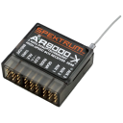
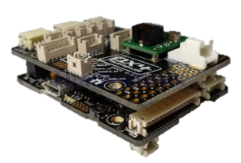
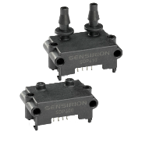
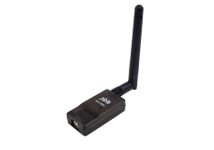
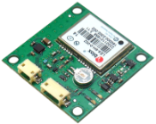
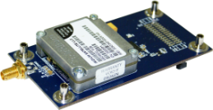
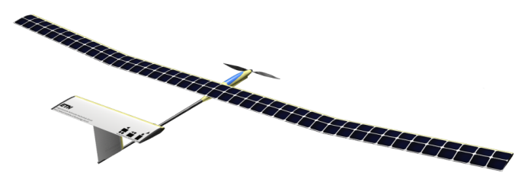
Sensors
Communication
Autopilot
IMU: ADIS16448
Pixhawk PX4 (ETH Zurich)
RC Control: Spektrum 2.4Ghz
Airspeed Sensing: Sensirion SDP600
Primary Telemetry: 3DR 433Mhz
GPS: U-Blox Lea-6H
Long-Range Telemetry: Iridium SATCOM

