Slide 1
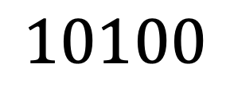





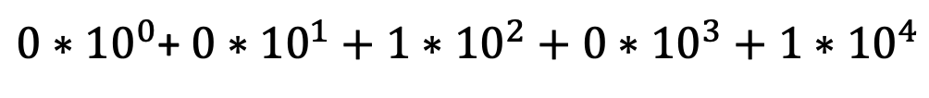

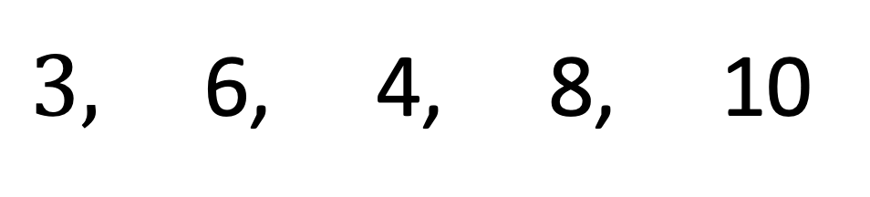



$5,$ 9, 4, 7, 10
$${10}^{−2.1}$$
$${10}^{−2.2}$$
$3,$ 6, 4, 8, 10
$0∗{10}^{0}$+ $0∗{10}^{1}+1∗{10}^{2}+0∗{10}^{3}+1∗{10}^{4}$
$5,$ 9, 4, 7, 10
$$=$$
$$10100$$
$3,$ 6, 4, 8, 10
$0∗{10}^{0}$+ $0∗{10}^{1}+1∗{10}^{2}+0∗{10}^{3}+1∗{10}^{4}$
$$=$$
$$10100$$

Slide 2
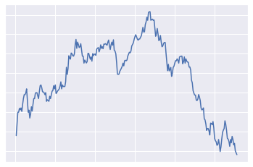
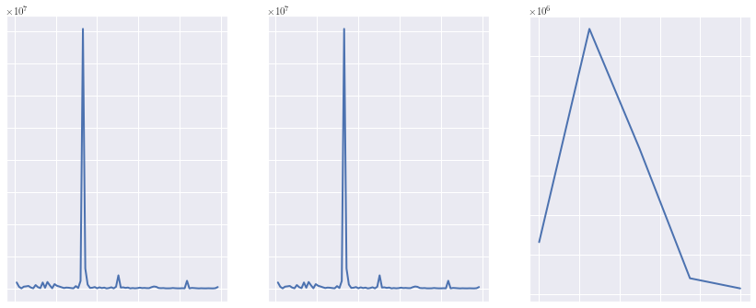
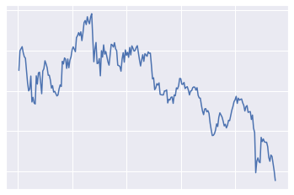
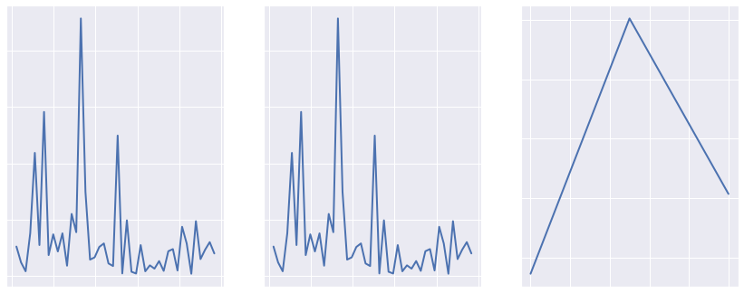
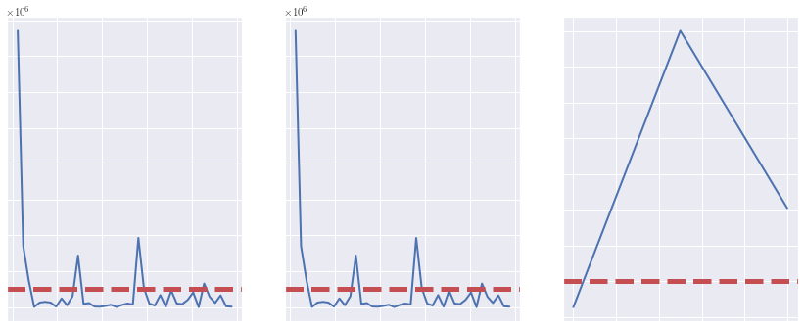
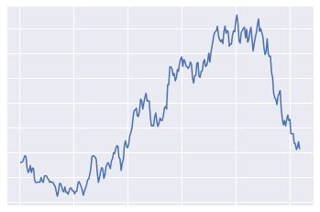
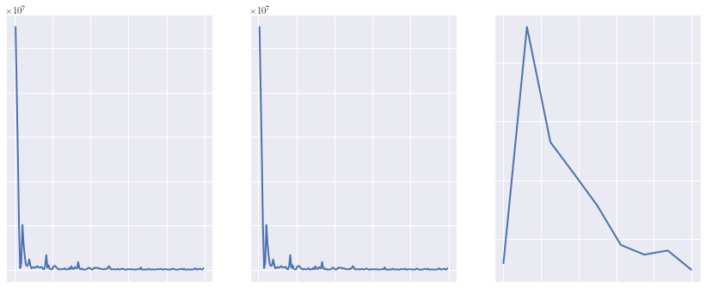
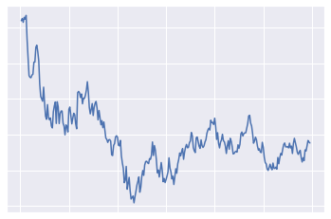
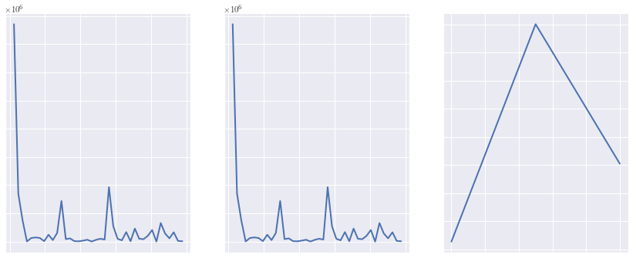








Raw
Time Series
Transform to Frequency Domain
Identify Top 5 Frequencies
Compute Top 5
Frequency Ranges
Standard FFT
FFT with
Hamming
FFT with
Welch
$$F(t)$$
$$F(t)$$
$$F(t)$$
$${10}^{−2.1}$$
$${10}^{−2.2}$$
$$F(t)$$
$$1$$
$$2$$
$$3$$

Slide 3
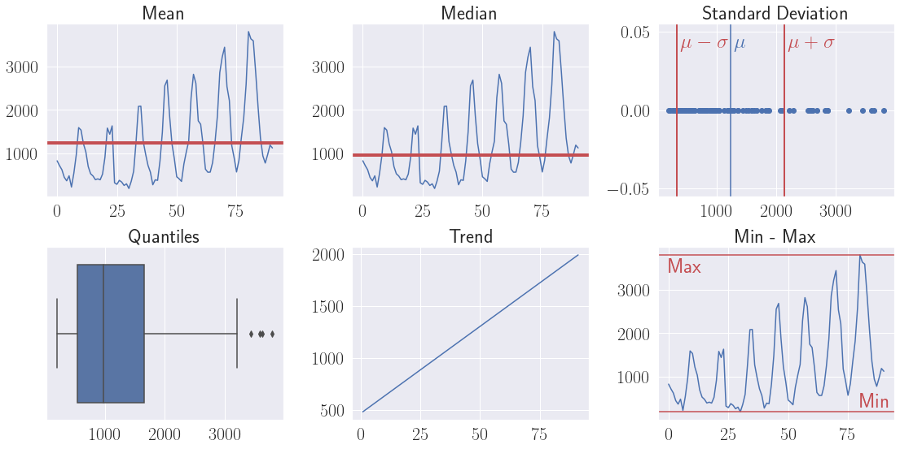


Raw
Time Series
Compute Summary Statistics for each Time Series
$$Stats$$
$$Stats$$
$$Stats$$

Slide 4













Template
Time Series
Identify top K
frequencies
Transform to Frequency Domain
Compute Match Score
$$Templ.$$
$5,$ 9, 4, 7, 10
$${TS}_{1} [3, 6,4,8,10]\underset{→}{\text{yields}}10100$$
$${TS}_{2} [⋯]\underset{→}{\text{yields}}⋯$$
FFTs
$$Pool {TS}_{1}$$
$3,$ 6, 4, 8, 10
$$⋮$$
$0∗{10}^{0}$+ $0∗{10}^{1}+1∗{10}^{2}+0∗{10}^{3}+1∗{10}^{4}$
$$=$$
$$10100$$
$${TS}_{n} [⋯]\underset{→}{\text{yields}}⋯$$
$${10}^{−2.1}$$
$${10}^{−2.2}$$
Highest Matches per Type
 | FFT | Hamming | Welch
Best Match | 11010 | 10100 | 11011
$$F(t)$$
Compute Summary Statistics
$$Stats$$
Match Slope Direction
$A_{trend}=\{S_{i}∈S_{n}∣1\left(−\frac{m_{S_{t}}}{∣m_{S_{t}}∣}=−\frac{m_{S_{i}}}{∣m_{S_{i}}∣}\right)$}
Miminize Statistical Metric
$$\arg{\min{f\left(S_{i}\right)≔|φ_{S_{t}}−φ_{S_{i}}|}}$$

