Slide 1


$${10}^{−2.1}$$
$${10}^{−2.2}$$

Slide 2
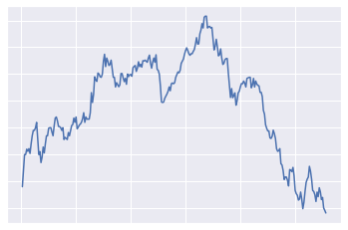
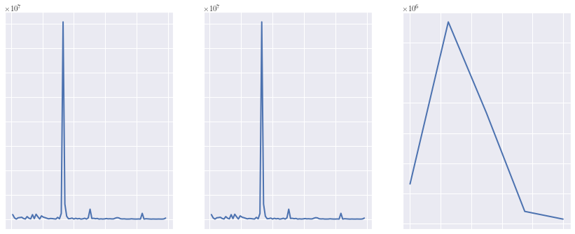
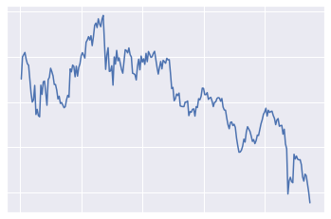
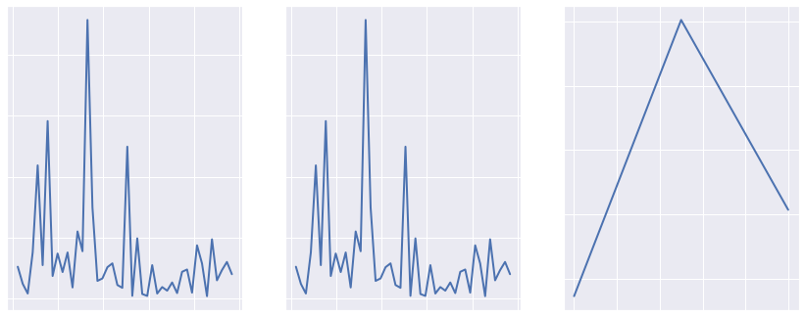
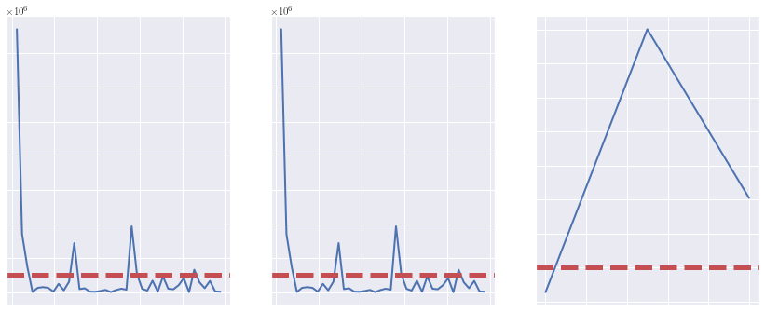
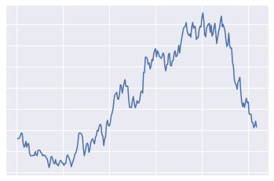
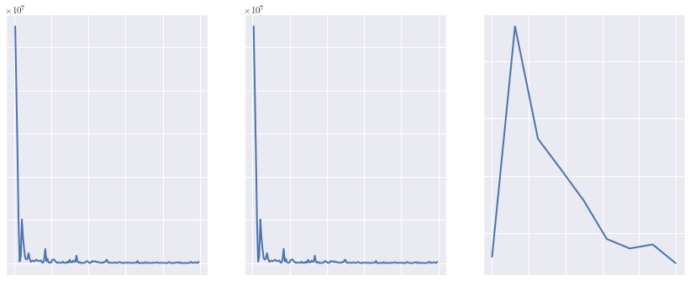
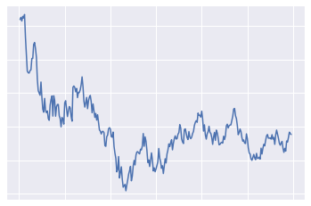
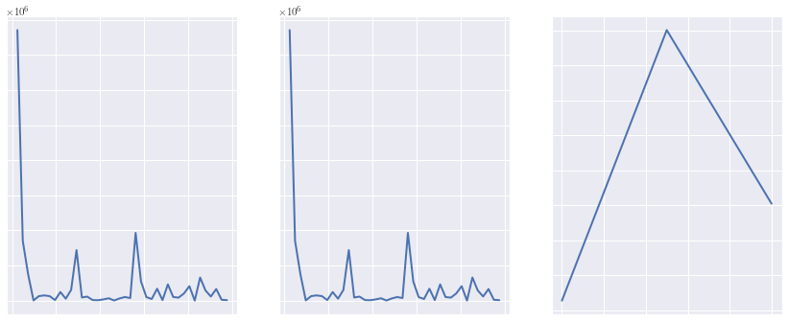





Raw
Time Series
Transform to Frequency Space
Identify Top 5 Frequencies
Compute Top 5
Frequency ranges
Standard FFT
FFT with
Hamming
FFT with
Welch
$$F(t)$$
$$F(t)$$
$$F(t)$$
$${10}^{−2.1}$$
$${10}^{−2.2}$$
$$F(t)$$

