Slide 1
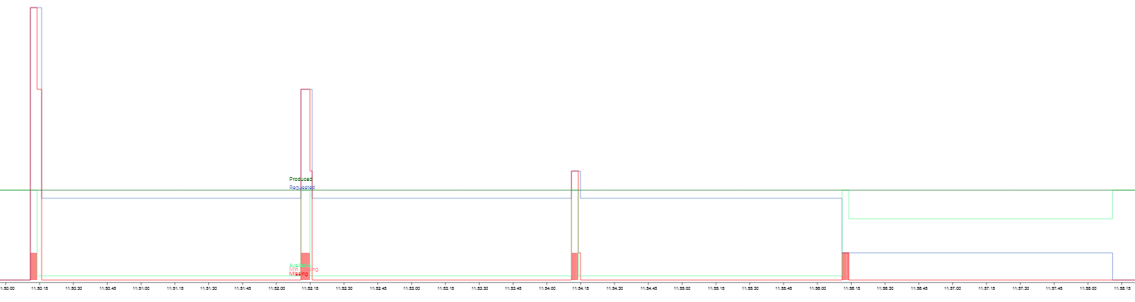
(history view)
produced
available
demand
demand
(A)
(B)
(C)
(D)
Period 1 : consumer 1,2,3
Period 2 : consumer 4,5,6
Period 3 : consumer 7,8,9
Period 4 : consumer 10
Demands staggered in 4 periods => 100% of demands met
(A), (B), (C), (D) : time taken to generate new contracts

Slide 2
Cheapest period for all consumers

Slide 3
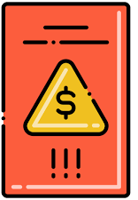










Social acceptability : scenario with awards (badge)
scenario_credits.png
-460 pts
+150 pts
Prosumer-3
(Free-rider)
Regulator twin
Coordination model
Coordination laws
Prosumer-2
(Altruist)
LSA
Spreading
LSA
Decay
Award/penalty attribution based on:
- energy contribution
- equity in energy distribution
- ability to limit consumption
Supply
Contract
LSA
LSA
Bonding
Prosumer-1
(Altruist)
Aggregation
+220 pts
Prosumer 2
Prosumer 3
“peer to peer” supply
Use of awards in transactions
award/penalty attribution

Slide 4
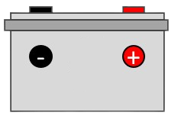



Private storage
storage_private.png
Prosumer Digital Twins
Prosumer 1: supplies 1 KW
2 KW
Coordination model
1 KW
battery charging
(energy surplus)
Supply
Coordination laws
Prosumer 2: receives 1 KW
Supply
Contract
1 KW
LSA
Spreading
Need
LSA
Decay
battery discharged
Bonding
LSA
Aggregation
Prosumer 3: self sufficient
1.5 KW
battery discharge
“internal” supply
Supply
“peer to peer” supply
External provider: supplies
“internal“ storage of energy surplus

Slide 5
Prosumer Digital Twins
storage_common.png
Common storage
Prosumer 1: supplies
2 KW
1 KW
Energy surplus
Supply
Coordination model
Storage: supplies 1.5 KW and receives 2 KW
Coordination laws
Supply
Contract
1 KW
Battery charging
LSA
0.5 KW
Spreading
Supply
battery discharge
LSA
Decay
LSA
Bonding
Prosumer 2: receives 1 KW
Aggregation
Need
LSA
Supply
Contract
0.5 KW
Prosumer 3: receives 1.5 KW
Need
Supply
External provider: supplies
“internal” supply
“peer to peer” supply
storage of energy surplus

