Slide 1
Software agents
Organisms
Host, agents, memory, sensors, actuators
Infrastructure
Infrastructural agents
Environment
Environment
(a) Biological Model
(b) Computational Model
models_bio_computing.png

Slide 2
High Level
Patterns
Flocking
Foraging
Quorum
Sensing
Chemotaxis
Morphogenesis
Composed
Patterns
Digital
Pheromone
Gradients
Gossip
Basic
Patterns
Repulsion
Evaporation
Aggregation
Spreading
bio_inspired_patterns.png

Slide 3

Destination nodes
Neighbour₂
(address₂)
Neighbour₃
(address₃)
LSA
Neighbour₁
(address₁)
Spreading to neighbour 2
LSA
Spreading to neighbour 3
LSA
Spreading to neighbour 1
Local node
LSA
Spreading to neighbour n
LSA
Reception from neighbour k
Neighbour_{n}
(address_{n})
Neighbour_{k}
(address_{k})
origin node
LSA synthetic properties:
Key | Value
SOURCE | address_{k}
SENDING | address₁, address₂, address₃, , address_{n}
spreading_of_lsa.png

Slide 4
distance travelled by the LSA = 2
Source = N0, PATH = Nk,N1
Nk
LSA
LSA
Neighbour 2
(address²)
N0
N1
(Current node)
Ni
update of distance(N1, N0):
distance(N1, N0) <- min(2, distance(N1, N0))
distance_update.png

Slide 5
Lsa2
Name | Value
AAA | Obj1_1
CCC | Obj1_2
DDD | Obj1_3
Lsa2₁ : matching
labels of properties
targeted by Lsa1
AAA
BBB
Name | Value
FFF | Obj2_1
CCC | Obj2_2
Lsa2₂ : not matching
Lsa1
Lsa2₃ : not matching
Name | Value
ZZZ | Obj3_1
CCC | Obj3_2
EEE | Obj3_3
Lsa2₄ : matching
Name | Value
TTT | Obj4_1
BBB | Obj4_2
Lsa1 will target Lsa2₁ and Lsa2₄
bonding.png

Slide 6
Example of an ‘AGGREGATION’ synthetic property containing 4 elements:
operator used in the aggregation method | arguments sent to the aggregate method
STD_OP_NEWEST (standard aggregator defined in the middleware library) | All LSAs properties named ” LAST_UPDATE” Class : Date
SUM (customized operator defined in NodeTotal class) | All LSAs properties named “NODE_TOTAL” Class: NodeTotal
AVG_SAMPLING_NB (customized operator defined in in class AbstractLearningModel) | All LSAs properties named “MODEL_1” Class: AbstractLearningModel
DIST_POWER_PROFILE (customized operator defined in in class AbstractLearningModel) | All LSAs properties named “MODEL_2” Class: AbstractLearningModel
property name | LAST_UPDATE
type | Standard
operator | STD_OP_NEWEST
activate Gossip? | True
LAST_UPDATE
property name | NODE_TOTAL
type | Customized
operator | SUM
activate gossip? | True
NODE_TOTAL
MODEL_1
property name | MODEL_1
type | Customized
operator | AVG_SAMPLING_NB
activate gossip? | True
MODEL_2
Property name | MODEL_2
type | Customized
operator | DIST_POWER_PROFILE
activate gossip? | True
aggregation_synth_property.png

Slide 7

Retrieval of objects to aggregate from: LSA₁, LSA₂, …, LSA_{n}
LSA₁
LSA₂
LSA_{n}
Aggregation specification:
Property | value
<propName>
Property | value
<propName>
Property | value
<propName>
…
property | <propName>
type | Customized
operator | <operator>
obj₁
obj₂
obj_{n}
Aggregator inputs
agent authentication
<operator>
obj₁: aggregatable
obj₂: aggregatable
obj_{n}: aggregatable
(2) Execution of obj₁.aggregate (authentication, operator, obj₁, obj₂, …, obj_{n})
obj_{aggr}: aggregatable
LSA₁
Property | Value | AggregatedValue
<propName>
(3) Update of “aggregatedValue” in LSA₁
obj₁
obj_{aggr}
middleware_aggregation.png

Slide 8
Retrieval of objects to aggregate from: LSA₁, …, LSA_{n}
LSA₁
LSA_{n}
Aggregation specification:
Property | value
<propName>
Property | value
<propName>
[for i in range 1 to n]
property | <propName>
type | Customized
operator | <operator>
obj₁
obj_{n}
Aggregator inputs
agent authentication
<operator>
obj₁: aggregatable
obj_{n}: aggregatable
(2) Execution of obj₁.aggregate (authentication, operator, obj₁, , obj_{n})
obj_{aggr}: aggregatable
LSA₁
Property | Value | AggregatedValue
<propName>
(3) Update of “aggregatedValue” in LSA₁
obj₁
obj_{aggr}
middleware_aggregation.png

Slide 9

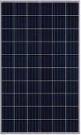











Primary school
After-school building
Gymnastics room
Clemap
SE05000163
Solar
Import script
Test simulator
Electric panel
TSP.02
Electric panel
TSC.01
Electric panel
TSG.03
Clemap
SE05000159
Clemap
SE05000238
Clemap
SE05000283
Read access
Read access
Updates
RESTFUL Web service
Digital twin (agents)
Digital twin
Digital twin
Digital twin
Clemap
SE05000282
Clemap
SE05000281
Database
Electric panel
TE-BEC-1
LSA
LSA
LSA
Exoscale cloud
Coordination laws
Clemap
SE05000318
Tuples space
Underground
coordination platform
3-phases current:
single-phase current:
sending of sensor data:
SIG
archi_meyrin.png

Slide 10
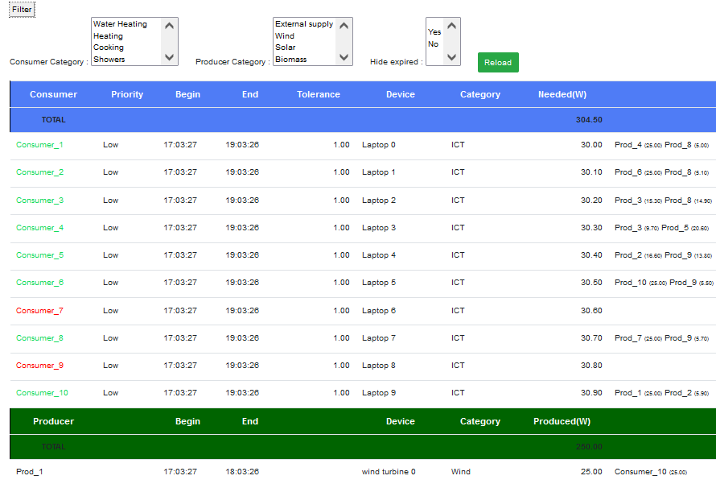







Test simulator
Web Application
web page
Request
Request
HTTP/JSON
Neighbor node 1
Response
Response
Coordination platform service
Controller
Web service
RESTFUL
Neighbor node 2
Digital twin (agents)
Database
Digital twin
Digital twin
Digital twin
Reading /
writing
« Derivative SAPERE »
kernel
LSA
LSA
LSA
…
Coordination laws
Neighbor node N
Tuples space
Coordination model
architecture.png

Slide 11
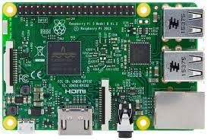

Web Application
web page
Test simulator
Client applications
Request
Request
Neighbor node 1
HTTP/JSON
Coordination platform service
Response
Response
Coordination platform service
TCP/IP
RESTFUL server
Neighbor node 2
Coordination platform service
Digital twin (agents)
Digital twin
Digital twin
Digital twin
Reading /
writing
…
« Derivative SAPERE »
kernel
LSA
LSA
LSA
Neighbor node n
Coordination laws
Coordination platform service
Tuples space
architecture_with_raspberry_pi.png

Slide 12

Physical twin
Physical twin
Physical twin
Digital Twin
Digital Twin
Digital Twin
Acting / Sensing / Learning
Acting / Sensing / Learning
Acting / Sensing / Learning
Data (LSA)
Data (LSA)
Data (LSA)
Network
communication
Network
communication
Coordination laws
Spreading
Bonding
Decay
Aggregation
Coordination medium
coordination_model.png

Slide 13
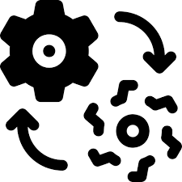


Network
communication
Digital Twin
Coordination medium
Physical twin
Data (LSA)
Acting - Sensing - Learning
Coordination laws
Digital Twin
Spreading
Physical twin
Data (LSA)
Acting - Sensing - Learning
Decay
Bonding
Digital Twin
Physical twin
Data (LSA)
Aggregation
Acting - Sensing - Learning
Network
communication
coordination_model2.png

Slide 14
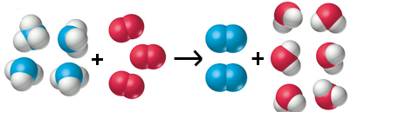
Adaptation for energy agents
Energy digital twins
Supervision digital twins
Consumer
Producers
Consumer digital twin 1
Consumer digital twin 2
…
Consumer digital twin N
Producer
digital twin 1
Producer
digital twin 2
…
Producer
digital twin
N
Regulator digital twin
Learning digital twin
…
LSA
…
LSA
LSA
LSA
LSA
LSA
LSA
LSA
LSA TUPLE SPACE
Operations on LSA
Coordination laws
Bonding
Spreading
Decay
Aggregation

Slide 15

Adaptation pour les agents énergétiques
Jumeaux numériques d’énergie
Jumeaux numériques superviseurs
Consommateur
Producteur
Jumeau numérique consommateur 1
Jumeau numérique consommateur 2
…
Jumeau numérique consommateur N
Jumeau numérique producteur 1
Jumeau numérique producteur 2
…
Jumeau numérique producteur N
Jumeau numérique Régulateur
Jumeau numérique d’apprentissage
…
…
LSA
LSA
LSA
LSA
LSA
LSA
LSA
LSA
ESPACE DE TUPLES
Operations sur les LSA
Lois de coordination
Bonding
Spreading
Decay
Aggregation

Slide 16





Consumer device
Producer device
digital_twins_all2.png
Consumer digital twin
Producer digital twin
Submitted data
Retrieved data
Submitted data
Retrieved data
Request in energy
Up-to-date contract
Event
Energy offer
Producer confirmation
Event
Properties
Properties
Consumer LSA
Producer LSA
Spreading
Bonding
Coordination media
Coordination laws
Decay
Aggregation
Learning LSA
Regulator LSA
Prediction
Interruption
Submitted data
Retrieved data
Submitted data
Retrieved data
Learning digital twin
Regulator digital twin
Node server

Slide 17
Consumer device
Producer device
Consumer digital twin
Producer digital twin
Submitted data
Retrieved data
Submitted data
Retrieved data
Request in energy
Up-to-date contract
Energy offer
Producer confirmation
Energy offer
Producer confirmation
Request in energy
Up-to-date contract
Request in energy
Up-to-date contract
Energy offer
Producer confirmation
Properties
Properties
Energy offer
Producer confirmation
Request in energy
Up-to-date contract
Consumer LSA
Producer LSA
Spreading
Bonding
Decay
Aggregation
Coordination laws
Coordination media
digital_twins_prosumers.png

Slide 18






Digital twin
(Authenticated agent)
Request for access to the sensitive object
?
wrapper object (manages the access)
KO
Authentication
verification
Access denied
OK
Request for access to the sensitive object
?
Sensitive object
Complete
data
No access
Calculation of visibility
on information
Access denied
Partial or total access
Restricted data
protection.png

Slide 19
Jumeau numérique
Demande d’accès aux données
Objet protégé
KO
Contrôle
d’authentification
Accès refusé
OK
Demande d’accès aux données
Objet encapsulé
Données complètes
Aucun accès
Calcul de la visibilité
aux données
Accès refusé
Accès partiel ou total
Données restreintes

Slide 20
Consumer 1
Consumer 2
Consumer 3
visibility_on_contract.png
Contract
stakeholders
full visibility
No
access
No
access
Supply contract
Producer 2
60 Watts
Consumer 1
40 Watts
Producer 3
Field | Value | Who has the visibility?
Consumer | Consumer 1 | All stakeholders (Consumer 1 + Producer 2 + Producer 3)
Supply[0] | Producer 2 : 60W | Consumer 1 + Producer 2
Supply[1] | Producer 3 : 40W | Consumer 1 + Producer 3
No
access
Field | Value
Consumer | Consumer 1
Supply[0] | Producer 2 : 60W
Field | Value
Consumer | Consumer 1
Supply[0] | Producer 3 : 40W
restricted visibility
restricted visibility
Producer 1
Producer 2
Producer 3

Slide 21
Key | Domain | Synopsis | Used by eco-laws
SOURCE | Word | Address of LSA source node. | All eco-laws
LOCATION | Word | Destination node addresses where a new LSA is injected in tuple space. | All eco-laws
DECAY | Integer | Time period in seconds before an LSA expires and be deleted by the DECAY law. Indicates the pertinence level of LSA data. | Decay
QUERY | Word | Identifies a particular request to be processed. Enables the Bonding law to apply a finer filter to determine the LSAs of interest to an agent. | Bonding
OUTPUT | List of words | Identifies property names generated by the LSA owner agent | Bonding
BOND | Word | Agent name of the last targeted LSA by the bonding law | Bonding
TYPE | Word | Identifies the main types of LSA. (Service, Query, Reward, System). We only use service LSAs | Bonding
DIFFUSE | Boolean | Indicator used to confirm whether to continue broadcasting an LSA to neighbouring nodes. | Spreading
DESTINATION | Word | Destination node addresses at the last sending. This information is updated before the LSA is sent | Spreading
SENDINGS | List of words | List of node addresses where a same LSA has been sent. This information is updated before the LSA is sent : if sending fails, the address will be present in SEDINGS but not in PATH. | Spreading
PATH | List of words | List of the node addresses that have been reached by the LSA (do not include the source address) This information is updated at reception. | * Reception thread
AGGREGATION | Mapping table of word, aggregation property | Contains the aggregation to be applied for each LSA property identified by its name. This structure allows several aggregations to be applied independently to different LSA properties. | Aggregation
LAST_AGGREGATION | Date | Last time of aggregation | Aggregation
LSA_SyntheticProperties.png

Slide 22
Digital Twin submitting | Label | Class | Digital Twin Retrieving |  |  | Synopsis
Prosumer | EVENT | EnergyEvent | Learning |  |  | Event occurred (start, deactivation, stop)
 | DISABLED | RegulationWarning | Prosumer | Regulator |  | Regulation order (interruption, deactivation, forced modification)
 | CONTRACT_CONFIRM | ProtectedConfirmationTable | Prosumer |  |  | Confirmations issued by a contract stakeholder (producer or consumer) to confirm or cancel
Prosumer (as consumer) | REQ | EnergyRequest | Prosumer (as producer) |  |  | Energy supply demand
Consumer | SATISFIED | Word |  |  |  | Confirmation of satisfaction
Consumer | CONTRACT1 | ProtectedContract |  |  |  | Updated version of the main contract
Consumer | CONTRACT2 | ProtectedContract |  |  |  | Updated version of the temporary contract
Prosumer (as producer) | PROD | EnergySupply | Prosumer (as consumer) |  |  | Producer global supply
Producer | OFFER | SingleOffer |  |  |  | Supply of energy sent to a consumer to meet its demand.
 | DONATION | EnergyWithdrawal | Prosumer (as producer) |  |  | Surplus of energy sent to the “storage” prosumer.
Learning | PRED | PredictionForm | Regulator |  |  | Prediction of the node state obtained at a certain horizon (product, demand, consumption, missing, availability)
 | PRED_CLUSTER | PredictionForm |  |  |  | Prediction of the cluster aggregated state obtained at a certain horizon (product, demand, consumption, missing, availability)
Regulator | AWARDS | AwardsTable | Prosumer |  |  | Contains all the rewards/penalties granted to prosumers by the regulator.
Regulator | RESCHEDULE | RescheduleTable |  |  |  | Activity rescheduling table (key: twin, value: rescheduling
 | WARNING | RegulationWarning | Prosumer |  | Learning | Regulation order sent to a twin (interruption, deactivation, forced modification)
LSA_Properties.png

Slide 23
Learning digital twin
Regulator digital twin
LSA
(step 1)
LSA
(step 2)
Prediction
Coordination laws
Event
Bonding
Spreading
Decay
Replanning
(step 3)
LSA
LSA
(step 4)
(step 4)
Tuple space
Consumer digital twin
Producer digital twin
peak_shaving.png

Slide 24



Learning twin
Regulator twin
Data
(1)
Data
(2)
Prediction
prosumer stop
Coordination model
Replanning
(3)
Data
(step 4)
(step 4)
Prosumer
twin

Slide 25

Consumer device
Producer device
Consumer twin
Producer twin
Request in energy
Energy offer
Energy offer
Request in energy
Data
Data
Coordination model
digital_twins_prosumers.png

Slide 26
Contract 1
1000 W
Producer 1
Consumer 1
800 W
200 W
Producer 2
(300
+ 800)
Initial contract
(1000 W)
Contract 1
1300 W
Producer 1
Consumer 1
1100 W
200 W
Producer 2
Contract 2
300 W
Consumer 1
300 W
Producer 1
Merged contract
(1300 W)
New temporary contract
(300 W)
Step 1: Generate a new temporary contract
Step 2: Merge contracts
Adaptation to meet a growing demand for electricity ( + 300 Watts)
growing_demand.png

Slide 27
Adaptation pour répondre à une hausse de demande ( + 300 Watts)
Contrat 1
1000 W
Producteur 1
Consommateur 1
800 W
200 W
Producteur 2
Contrat 1
1300 W
Producteur 1
Initial contract
Consommateur 1
1100 W
200 W
Producteur 2
Contrat 2
300 W
Consommateur 1
300 W
Producteur 1
Merged contract
Etape 2: fusion des contrats
New temporary contract
Etape 1: Création d’un contrat temporaire

Slide 28
Consumer 1
Producer 1
Producer 2
Producer 3
(1 ) Checking for energy deficiencies
REQUEST :100W
(2) Processing of received requests
(2) Processing of received requests
(2) Processing of received requests
OFFER : 13W
OFFER : 60W
OFFER : 90 W
(2) Processing of received offers
Issuance of a new contract from the offers of Prod2 and Prod3
CONTRACT :pending
(consom.1:OK, Prod2:?, prod3:?)
Prod2=60W,Prod3=40W
contract ignored
(Prod1 not concerned)
(4) contract processing
(4) contract processing
Contract accepted by prod2
Contract accepted by prod3
PROD_CONFIRM
{Prod2:OK}
PROD_CONFIRM
{Prod3:OK}
(5) Processing of received confirmations
Partial contract validation (Prod2:OK)
CONTRACT pending
(consom.1 :OK, Prod2:OK, prod3:?)
Prod2=60W,Prod3=40W
PROD_CONFIRM
{Prod3 :OK}
(5) Processing of received confirmations
Total contract validation(Prod2 OK,Prod3:OK)
CONTRACT : validated
Prod2:60W,Prod3:40W
Consumer satisfied
SATISFIED : 1
Contract ignored
(Prod1 not concerned)
(4) contract processing
(4) contract processing
supply onsumer1 (60 watts)
supply onsumer1 (40 watts)
: Transmission of information to other agents via the "Bonding" eco-law

Slide 29
Consumer 1
Producer 1
(13W)
Producer 2
(60W)
(1 ) Checking for energy deficiencies
[Step 1]
REQUEST :50W
(2) Processing of received requests
(2) Processing of received requests
[Step 2]
OFFER : 13W
OFFER : 50W
(3) Processing of received offers
Issuance of a new contract from the offers of Prod2
CONTRACT :pending
(consumer1:OK, Prod2:?)
Prod2=50W
[Step 3]
contract ignored
(Prod1 not concerned)
(4) contract processing
Contract accepted by Prod2
[Step 4]
PROD_CONFIRM
{Prod2:OK}
(5) Processing of received confirmations
contract validation
CONTRACT validated
(consumer1 :OK, Prod2:OK,)
Prod2=50W
Consumer satisfied
SATISFIED : 1
[Step 5]
Contract ignored
(Prod1 not concerned)
(4) contract processing
Supply consumer1 (50 Watts)
: Transmission of information to other agents via the "Bonding" eco-law

Slide 30
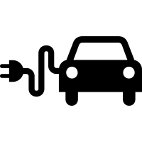






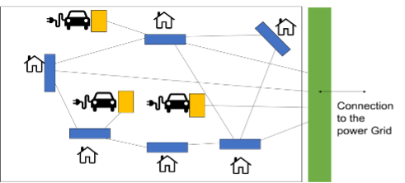
GED
GED (Grid Edge Device)
GED
GED
Coordination platform
Connection
to the
Power Grid
GED
Interactions between GEDs for :
– Exchanging electricity
– Peak shaving
– Gossip Learning
(algorithms)
Flow of information
GED
Flow of electricity

Slide 31
Node 1
Node 2
Node 3
Node 6
Coordination platform
Connection
to the
Power Grid
Node 4
Interactions between GEDs for :
– Exchanging electricity
– Peak shaving
– Gossip Learning
(algorithms)
Flow of information
Node 5
Flow of electricity
connection_graph.png

Slide 32

Primary school
4 consumers
After-school building
2 consumers
1 producer
Gymnastics room
1 consumer
Underground
5 consumers
1 producer
N1
N2
N3
N4
Electric panel
TSP.02
Electric panel
TSC.01
Electric panel
TSG.03
Electric panel
TE-BEC-1

Slide 33

Connection
to the
Power Grid

Slide 34

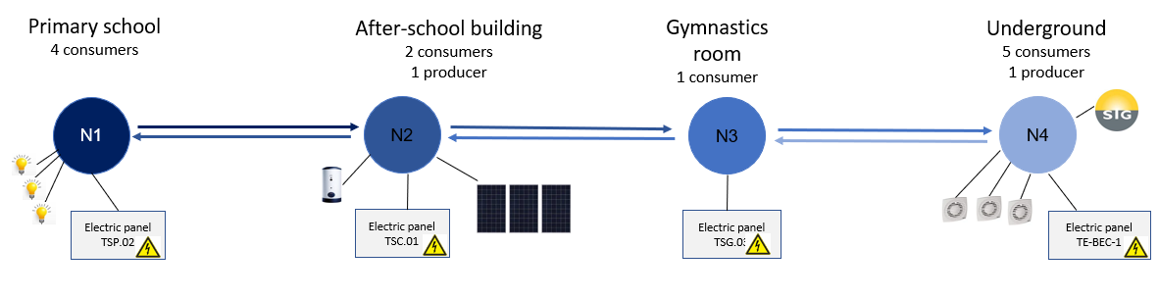
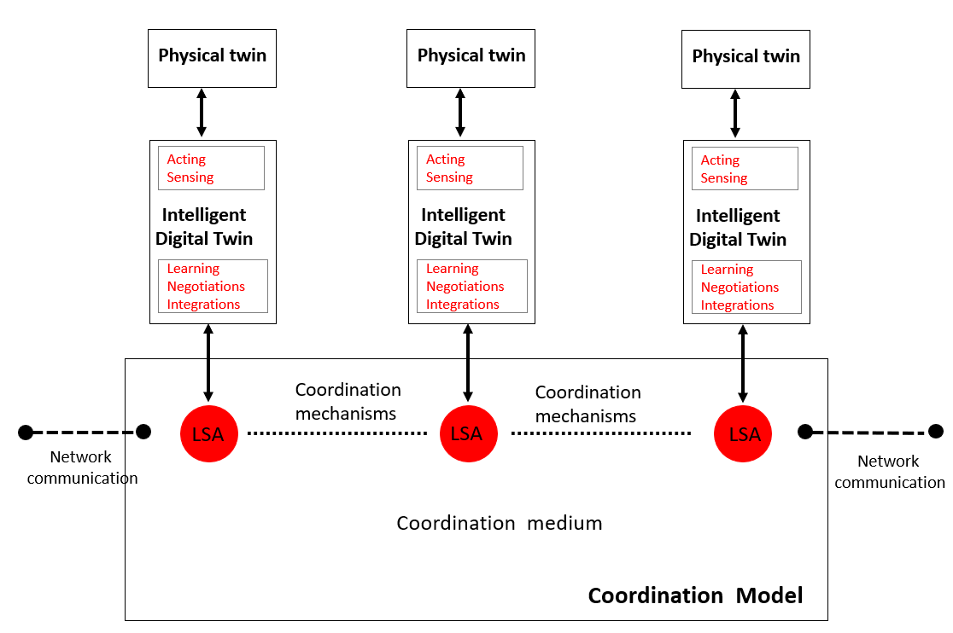
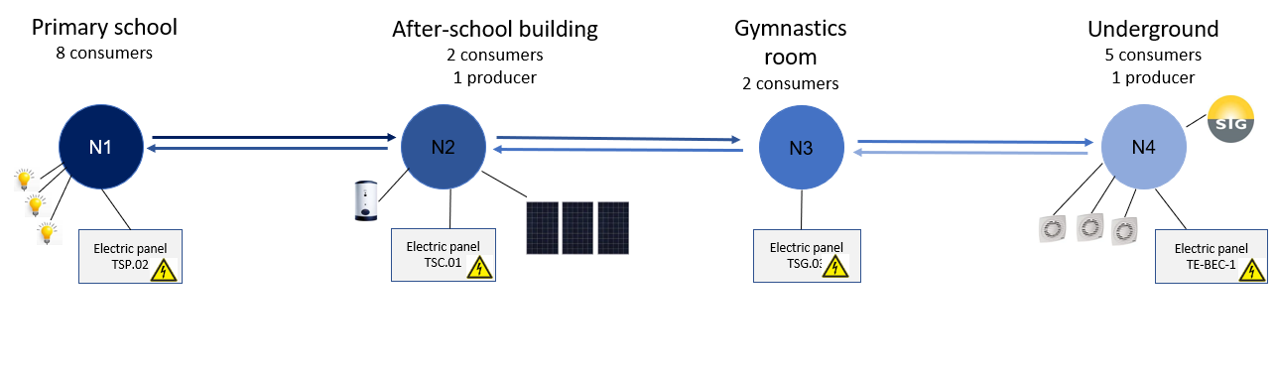
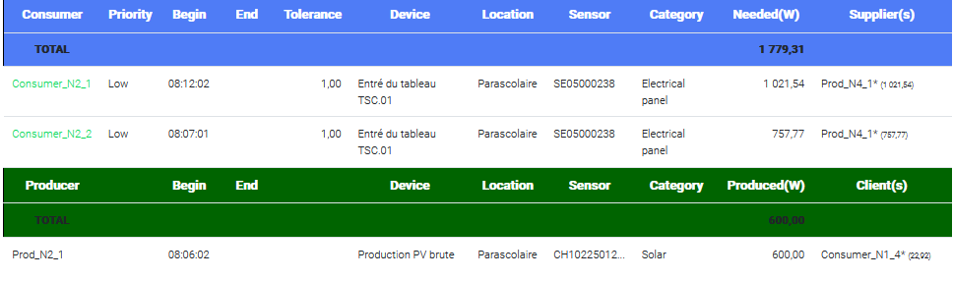
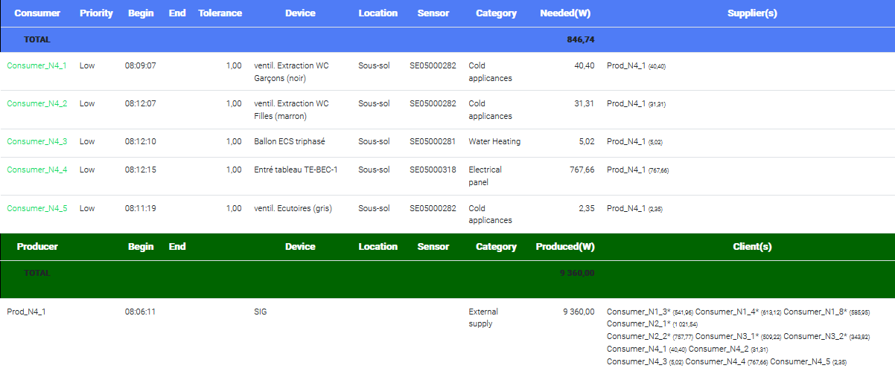
chained_graph_4nodes.png

Slide 35
Solar panels
N1
Solar
N3
Primary school
N2
Electric panel
TSP.02
Electric panel
TSC.01
Gymnastics room
Electric panel
TSG.03
After-school building
SIG
Electric panel
TE-BEC-1
N4
Underground
3-phases current:
single-phase current:

Slide 36


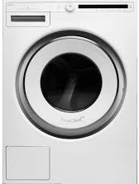

Simplified micro-grid with district-level, house-level and appliance-level goals.
holonic_architecture.png
Evaluation
Prosumer goal
Evaluation
Prosumer goal
Evaluation
Prosumer goal
Evaluation
Prosumer goal
Evaluation
Prosumer goal
Evaluation
Evaluation
Evaluation
Evaluation
Prosumer goal
Prosumer goal
Prosumer goal
Prosumer goal

Slide 37
After-school building
2 consumers
1 producer
Gymnastics room
2 consumers
Electric panel
TSC.01
Electric panel
TSG.03
N2
N3
N1
N4
Electric panel
TSP.02
Electric panel
TE-BEC-1
Primary school
8 consumers
Underground
5 consumers
1 producer

Slide 38

context memorization
Long term : c (cell state) | Short term: h (hidden state)
Output at t
c^{t-1}: cell state at t-1
c^{t}: cell state at t
c^{t}
X
+
F^{t}
Information to discard from a previous state.
New information to store in the current state.
X
Information to write to the cell-state.
Information to write int the output.
I^{t}
G^{t}
c^{t}
tanh
Previous cell
forget gate
F^{t}
input gate
I^{t}
candidate gate
G^{t}
output gate
O^{t}
O^{t}
Next cell
X
W_{o}
h^{t}
σ
σ
tanh
σ
Weight matrix:
U_{f}
W_{f}
U_{i}
W_{i}
U_{c}
W_{c}
U_{O}
W_{O}
h^{t-1}
x^{t}
h^{t-1}
x^{t}
h^{t-1}
x^{t}
h^{t-1}
x^{t}
h^{t-1}
h^{t}
Hidden state at t-1
x^{t}: input at t
Hidden state at t
lstm_cell.png

Slide 39
