Slide 1











Genève
Advisory Board
Valais
research & development
research & development
UNIGE
deployments

Slide 2
Software agents
Organisms
Host, agents, memory, sensors, actuators
Infrastructure
Infrastructural agents
Environment
Environment
(a) Biological Model
(b) Computational Model

Slide 3

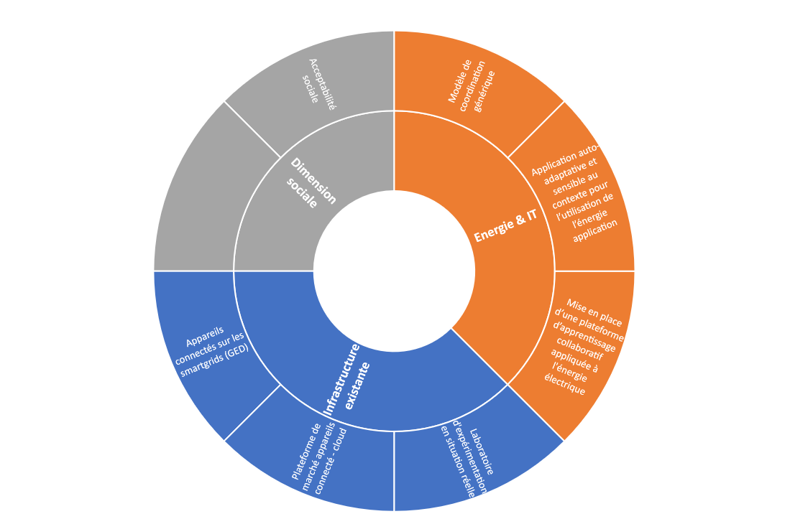

Slide 4
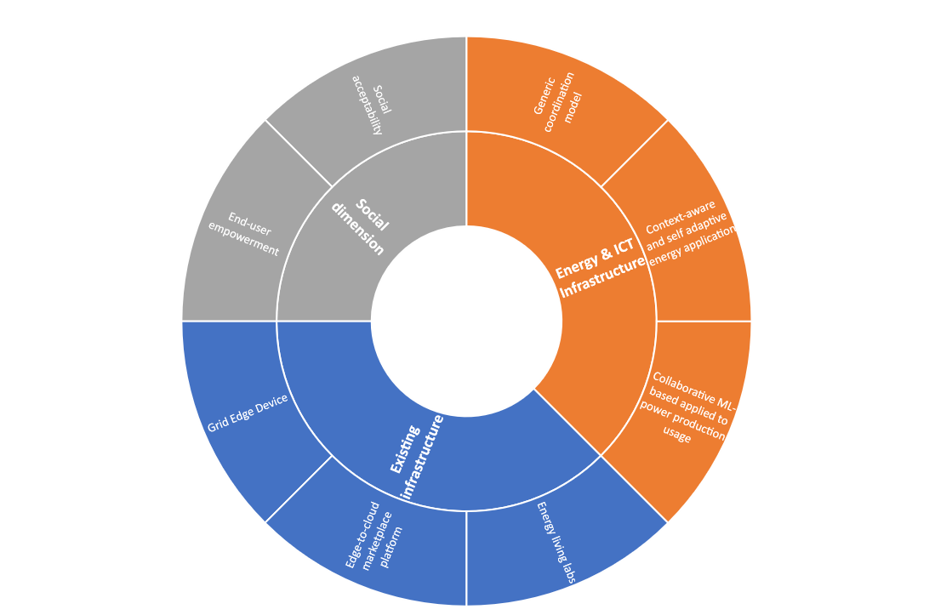
Main axes of enhancement

Slide 5
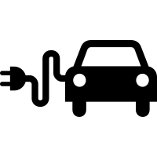

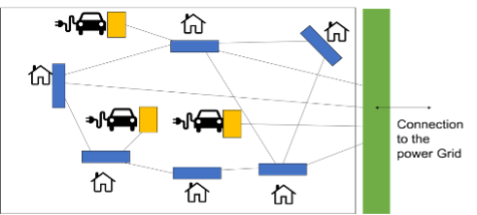
Connection
to the
Power Grid

Slide 6

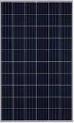







Primary school
After-school building
Gymnastics room
Clemap
SE05000163
Solar
Import script
Test simulator
Electric panel
TSP.02
Electric panel
TSC.01
Electric panel
TSG.03
Clemap
SE05000159
Clemap
SE05000238
Clemap
SE05000283
Read access
Read access
Updates
RESTFUL Web service
Digital twin (agents)
Digital twin
Digital twin
Digital twin
Clemap
SE05000282
Clemap
SE05000281
Database
Electric panel
TE-BEC-1
LSA
LSA
LSA
Exoscale cloud
Coordination laws
Clemap
SE05000318
Tuples space
Underground
coordination platform
3-phases current:
single-phase current:
sending of sensor data:
SIG

Slide 7
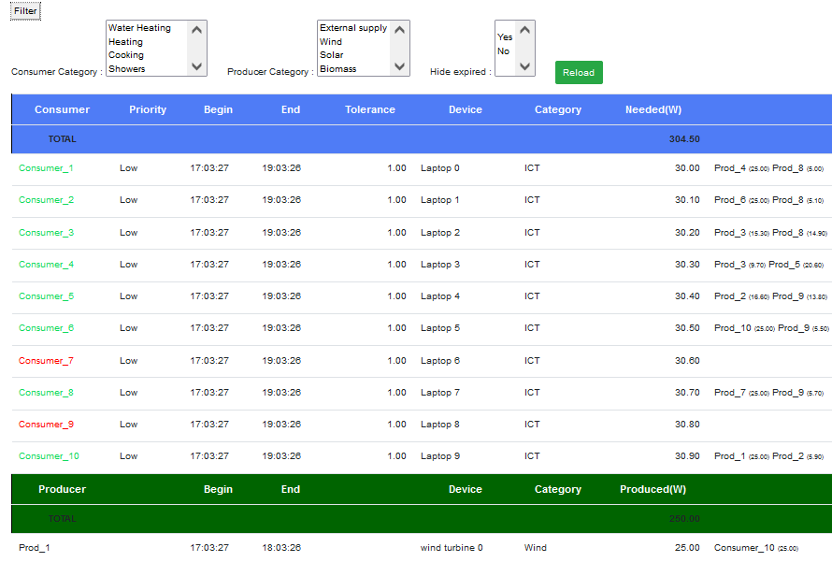








Test simulator
Web Application
web page
Request
Request
HTTP/JSON
Neighbor node 1
Response
Response
Controller
Web service
RESTFUL
Node
(Micro-service)
Neighbor node 2
Digital twin (agents)
Database
Digital twin
Digital twin
Digital twin
Reading /
writing
« Derivative SAPERE »
kernel
LSA
LSA
LSA
…
Coordination laws
Neighbor node N
Tuples space
Coordination model

Slide 8
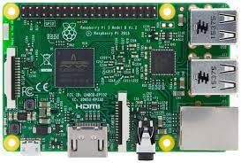


Test simulator
Web Application
web page
Request
Response
Request
Response
HTTP/JSON
Neighbor node 1
Coordination platform service
RESTFUL server
Neighbor node 2
Digital twin (agents)
TCP/IP
Digital twin
Digital twin
Digital twin
Reading /
writing
« Derivative SAPERE »
kernel
LSA
LSA
LSA
…
Coordination laws
Neighbor node N
Tuples space

Slide 9
Physical twin
Physical twin
Physical twin
Acting
Sensing
Acting
Sensing
Acting
Sensing
Intelligent
Digital Twin
Intelligent
Digital Twin
Intelligent
Digital Twin
Learning
Negotiations
Integrations
Learning
Negotiations
Integrations
Learning
Negotiations
Integrations
Coordination mechanisms
Coordination mechanisms
LSA
LSA
LSA
Network
communication
Network
communication
Coordination medium
Coordination Model

Slide 10
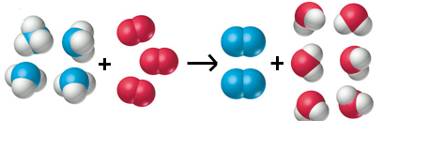

Adaptation for energy agents
Energy digital twins
Supervision digital twins
Consumer
Producers
Consumer digital twin 1
Consumer digital twin 2
…
Consumer digital twin N
Producer
digital twin 1
Producer
digital twin 2
…
Producer
digital twin
N
Regulator digital twin
Learning digital twin
…
LSA
…
LSA
LSA
LSA
LSA
LSA
LSA
LSA
LSA TUPLE SPACE
Operations on LSA
Coordination laws
Bonding
Spreading
Decay
Aggregation

Slide 11
Adaptation pour les agents énergétiques
Jumeaux numériques d’énergie
Jumeaux numériques superviseurs
Consommateur
Producteur
Jumeau numérique consommateur 1
Jumeau numérique consommateur 2
…
Jumeau numérique consommateur N
Jumeau numérique producteur 1
Jumeau numérique producteur 2
…
Jumeau numérique producteur N
Jumeau numérique Régulateur
Jumeau numérique d’apprentissage
…
…
LSA
LSA
LSA
LSA
LSA
LSA
LSA
LSA
ESPACE DE TUPLES
Operations sur les LSA
Lois de coordination
Bonding
Spreading
Decay
Aggregation

Slide 12





Consumer device
Producer device
Consumer digital twin
Producer digital twin
Submitted data
Retrieved data
Submitted data
Retrieved data
Request in energy
Up-to-date contract
Event
Energy offer
Producer confirmation
Event
Properties
Properties
Consumer LSA
Producer LSA
Spreading
Bonding
Coordination media
Coordination laws
Decay
Aggregation
Learning LSA
Regulator LSA
Prediction
Interruption
Submitted data
Retrieved data
Submitted data
Retrieved data
Learning digital twin
Regulator digital twin
Node server

Slide 13
Consumer device
Producer device
Consumer digital twin
Producer digital twin
Submitted data
Retrieved data
Submitted data
Retrieved data
Request in energy
Up-to-date contract
Energy offer
Producer confirmation
Energy offer
Producer confirmation
Request in energy
Up-to-date contract
Request in energy
Up-to-date contract
Energy offer
Producer confirmation
Properties
Properties
Energy offer
Producer confirmation
Request in energy
Up-to-date contract
Consumer LSA
Producer LSA
Spreading
Bonding
Decay
Aggregation
Coordination laws
Coordination media

Slide 14

Digital twin
Request for access to data
Protected object
KO
Authentication
verification
Access denied
OK
Request for access to data
Encapsulated object
Complete
data
No access
Calculation of visibility
on information
Access denied
Partial or total access
Restricted data

Slide 15
Jumeau numérique
Demande d’accès aux données
Objet protégé
KO
Contrôle
d’authentification
Accès refusé
OK
Demande d’accès aux données
Objet encapsulé
Données complètes
Aucun accès
Calcul de la visibilité
aux données
Accès refusé
Accès partiel ou total
Données restreintes

Slide 16
Agent submitting | Retriever | Label | Class | Synopsis
Consumer | Producer | REQ | EnergyRequest | Energy supply demand
Consumer | Producer | SATISFIED | String (‘1’) | Confirmation de satisfaction
Consumer | Producer | CONTRACT1 | ProtectedContract | Updated version of the main contract
Consumer | Producer | CONTRACT2 | ProtectedContract | Updated version of the temporary contract
Consumer, Producer | Producer, Learning agent, Regulator agent | DISABLED | RegulationWarning | Regulation order (interruption, deactivation, forced modification)
Producer | Consumer | PROD | EnergySupply | Alert causing agent deactivation
Producer | Consommateur | OFFER | SingleOffer | Supply of energy sent to a consumer to meet its demand.
Producer | Consumer | PROD_CONFIRM | ProtectedConrmationTable | Confirmations issued by the producer.
Consumer, Producer | Regulator agent | EVENT | Event | Event occurred (start, deactivation, stop)
Learning agent | Regulator agent | PRED | PredictionForm | Prediction of the state obtained at a certain horizon (product, demand, consumption, lack, availability)
Regulator agent | Consumer, Producer | WARNING | ProtectedContract | Regulation order sent to an agent (interruption, deactivation, forced modification)
Regulator agent | Consumer, Producer | RESCHEDULE | RescheduleTable | Activity rescheduling table (key: agent, value: rescheduling

Slide 17
Consumer 1
Consumer 2
Consumer 3
Consumer 1 visibility: full
Field | Value
Consumer | Consumer 1
Supplies in Watts | Producer 2 : 60W Producer 3 : 40W
Access denied
Access denied
Contract between Consumer 1 and Producers 2,3
(Consumer 1 receives 60 Watts from Producer 2 and 40 Watts from Producer 3)
Field | Value | Who has the visibility?
Consumer | Consumer 1 | All stakeholders
Supplies in Watts | Producer 2 : 60W Producer 3 : 40W | Consumer 1 + Producer 2 Consumer 1 + Producer 3
Producer 2 visibility: restricted
Producer 3 visibility: restricted
Field | Value
Consumer | Consumer 1
Supplies in Watts | Producer 2 : 60W
Field | Value
Consumer | Consumer 1
Supplies in Watts | Producer 3 : 40W
Access denied
Producer 1
Producer 2
Producer 3

Slide 18
consommateur
#Cons1
consommateur
#Cons2
consommateur
#Cons3
Champ | Valeur
Agent approvisionné | #Cons1
Approvisionnement (Watts) | #Pr2: 60W #Pr3 : 40W
Accès refusé
Accès refusé
#Cons 1 : visibilité totale
Contrat entre #Cons1, #Pr2 et #Pr3
Champ | Valeur | Qui a la visibilité?
Agent approvisionné | #Cons1 | Toutes les parties prenantes du contrat
Approvisionnement (en Watts) | #Pr2 : 60W #Pr3 : 40W | #Cons1 + #Prod2 #Cons2 + #Prod3
#Cons : + 100 Watts
#Pr2 : - 60 Watts
#Pr3 : - 40 Watts
#Pr2 : visibilité restreinte
#Pr3 : visibilité restreinte
Champ | Valeur
Agent approvisionné | #Cons1
Approvisionnement (Watts) | #Pr2 : 60W
Champ | Valeur
Agent approvisionné | #Cons1
Approvisionnement (Watts) | #Pr3 : 40W
Access refusé
Producteur
#Pr1
Producteur
#Pr2
Producteur
#Pr3

Slide 19
Learning digital twin
Regulator digital twin
LSA
(step 1)
LSA
(step 2)
Prediction
Coordination laws
Event
Bonding
Spreading
Decay
Replanning
(step 3)
LSA
LSA
(step 4)
(step 4)
Tuple space
Consumer digital twin
Producer digital twin

Slide 20
Adaptation to meet a growing demand for electricity ( + 300 Watts)
Contract 1
1000 W
Producer 1
Consumer 1
800 W
200 W
Producer 2
Contract 1
1300 W
Producer 1
Initial contract
Consumer 1
1100 W
200 W
Producer 2
Contract 2
300 W
Consumer 1
300 W
Producer 1
Merged contract
Step 2: Merge contracts
New temporary contract
Step 1: Generate a new temporary contract

Slide 21
Adaptation pour répondre à une hausse de demande ( + 300 Watts)
Contrat 1
1000 W
Producteur 1
Consommateur 1
800 W
200 W
Producteur 2
Contrat 1
1300 W
Producteur 1
Initial contract
Consommateur 1
1100 W
200 W
Producteur 2
Contrat 2
300 W
Consommateur 1
300 W
Producteur 1
Merged contract
Etape 2: fusion des contrats
New temporary contract
Etape 1: Création d’un contrat temporaire

Slide 22
Consumer 1
Producer 1
Producer 2
Producer 3
(1 ) Checking for energy deficiencies
REQUEST :100W
(2) Processing of received requests
(2) Processing of received requests
(2) Processing of received requests
OFFER : 13W
OFFER : 60W
OFFER : 90 W
(2) Processing of received offers
Issuance of a new contract from the offers of Prod2 and Prod3
CONTRACT :pending
(consom.1:OK, Prod2:?, prod3:?)
Prod2=60W,Prod3=40W
contract ignored
(Prod1 not concerned)
(4) contract processing
(4) contract processing
Contract accepted by prod2
Contract accepted by prod3
PROD_CONFIRM
{Prod2:OK}
PROD_CONFIRM
{Prod3:OK}
(5) Processing of received confirmations
Partial contract validation (Prod2:OK)
CONTRACT pending
(consom.1 :OK, Prod2:OK, prod3:?)
Prod2=60W,Prod3=40W
PROD_CONFIRM
{Prod3 :OK}
(5) Processing of received confirmations
Total contract validation(Prod2 OK,Prod3:OK)
CONTRACT : validated
Prod2:60W,Prod3:40W
Consumer satisfied
SATISFIED : 1
Contract ignored
(Prod1 not concerned)
(4) contract processing
(4) contract processing
supply onsumer1 (60 watts)
supply onsumer1 (40 watts)
: Transmission of information to other agents via the "Bonding" eco-law

Slide 23
Consumer 1
Producer 1
(13W)
Producer 2
(60W)
(1 ) Checking for energy deficiencies
[Step 1]
REQUEST :50W
(2) Processing of received requests
(2) Processing of received requests
[Step 2]
OFFER : 13W
OFFER : 60W
(3) Processing of received offers
Issuance of a new contract from the offers of Prod2
CONTRACT :pending
(consumer1:OK, Prod2:?)
Prod2=50W
[Step 3]
contract ignored
(Prod1 not concerned)
(4) contract processing
Contract accepted by Prod2
[Step 4]
PROD_CONFIRM
{Prod2:OK}
(5) Processing of received confirmations
contract validation
CONTRACT validated
(consumer1 :OK, Prod2:OK,)
Prod2=50W
Consumer satisfied
SATISFIED : 1
[Step 5]
Contract ignored
(Prod1 not concerned)
(4) contract processing
Supply consumer1 (50 Watts)
: Transmission of information to other agents via the "Bonding" eco-law

Slide 24

“propagation” eco-law
Neighbor nodes of current Node
NB 1
NB 2
…
NB n
Aggregtion
Aggregtion
Aggregtion
Current
Node
Aggregtion
<<-- Received model data
Sent model data -->>
“aggregation” eco-law
Model data of current node
Model data of NB 1
update
Model data of NB 2
Aggregated model data
Model data of current node
…
Model data of NB n

Slide 25




node i
…
node 2
W²
W^{i}
…
node n
W^{n}
W¹
node 1
Central server
Average aggregation:
Σ(n_{k}/ n_{total} )*W^{k}
⁽n_{total} = Σ n_{k}⁾

Slide 26

Aggregation
Neighbour 2
…
Spreading of W²
W²
Spreading of W⁰
Aggregation
Aggregation
Spreading of W⁰
Neighbour 1
Neighbour i
W^{i}
W⁰
W¹
Spreading of W^{i}
Spreading of W¹
W⁰
W⁰
Aggregation
…
Current node
(node 0)
W⁰
Spreading of W⁰
Spreading of W^{n}
W^{n}
Aggregation
Neighbour n
Aggregation in current node (node 0)
Model weights of the current node
W⁰
neighbour 1
W¹
Aggregation operator:
neighbour 2
W²
n^{total} <- Σ n^{i}
W⁰ <- Σ_{i=0…n}(n^{i} /n^{total}).W^{i}
Model weights of neighbour nodes
(1,2,…,n)
…
…
neighbour i
W^{i}
…
…
neighbour n
W^{n}

Slide 27
1
Node 1
2
Node 2
3
Node 3
4
Node 4
5
Node 5
τ1 local updates
τ2 inter-node communications
W₃
3
Node 3
Step 1 | ( W₂ + W₃ + W₄ ) / 3
Step 2 | ( W₁ + 2 W₂ + 3 W₃ + 2 W₄ + W₅ ) / 9
Step 3 | ( 4 W₁ + 6 W₂ + 7 W₃ + 6 W₄ + 4 W₅ ) / 27
Step 4 | (14 W₁ +17 W₂ + 19 W₃ + 17 W₄ + 14 W₅ ) / 81
W₂
2
4
W₄
W₅
1
5
W₅

Slide 28
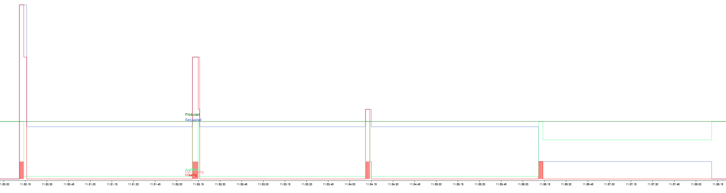
(history view)
produced
available
demand
demand
(A)
(B)
(C)
(D)
Period 1 : consumer 1,2,3
Period 2 : consumer 4,5,6
Period 3 : consumer 7,8,9
Period 4 : consumer 10
Demands staggered in 4 periods => 100% of demands met
(A), (B), (C), (D) : time taken to generate new contracts

Slide 29

Primary school
4 consumers
After-school building
2 consumers
1 producer
Gymnastics room
1 consumer
Underground
5 consumers
1 producer
N1
N2
N3
N4
Electric panel
TSP.02
Electric panel
TSC.01
Electric panel
TSG.03
Electric panel
TE-BEC-1

Slide 30


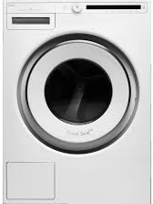

Simplified micro-grid with district-level, house-level and appliance-level goals.
Evaluation
Prosumer goal
Evaluation
Prosumer goal
Evaluation
Prosumer goal
Evaluation
Prosumer goal
Evaluation
Prosumer goal
Evaluation
Prosumer goal
Evaluation
Prosumer goal
Evaluation
Prosumer goal
Evaluation
Prosumer goal

Slide 31
After-school building
2 consumers
1 producer
Gymnastics room
2 consumers
Electric panel
TSC.01
Electric panel
TSG.03
N2
N3
N1
N4
Electric panel
TSP.02
Electric panel
TE-BEC-1
Primary school
8 consumers
Underground
5 consumers
1 producer

