Slide 1

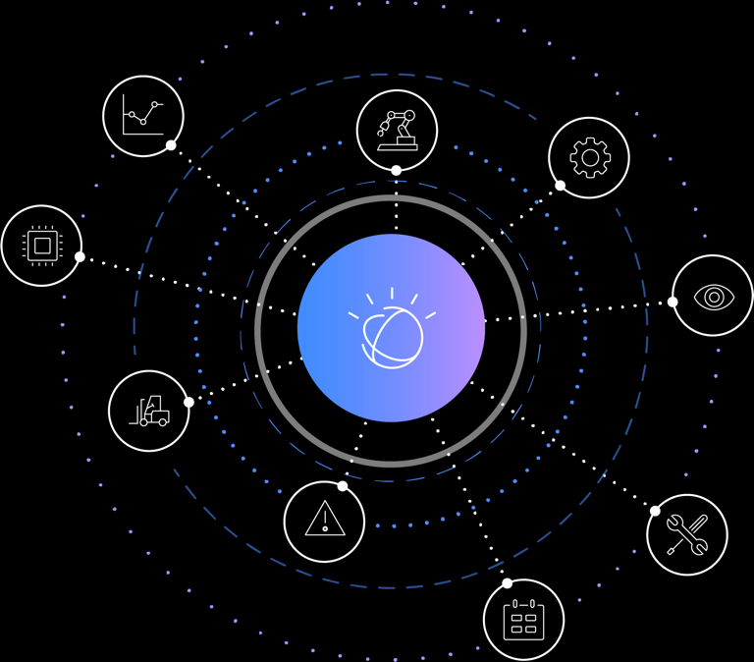
Introduction
Agenda

Slide 2

Agenda
Workshop Objectives
Get started using Watson IoT Platform on IBM Cloud
Agenda
Watson IoT Platform Overview
Lab 1: Getting Started, Connectivity
Node-RED Overview
Lab 2: IoT Data operational dashboarding and visualization
IoT and Analytics with Watson Studio
Lab 4: Analysis of historical data with a Jupyter notebook
Cognitive IoT and AI
Lab 5: ChatBot

Slide 3
Introductions
Instructor:
Philippe Gregoire
IBM Ecosystem Advocacy Group
Technical Enablement Europe
philippe.gregoire@fr.ibm.com
Participants roundtable
Experience with IBM Cloud (BlueMix)
Which services, languages?
With another Cloud?
Experience with IoT?
Hardware/Firmware
What platform?
Experience with Data and Analytics
Which environment?

Slide 4
Logistics
Lunch break 13:00-14:00

