Slide 1
Section 1
Watson IoT Platform
Overview

Slide 2

Agenda
Workshop Objectives
Give an overview of Watson IoT on IBM Cloud
Agenda
Watson IoT Platform Overview
Lab 1: Getting Started, Connectivity
Node-RED Overview
Lab 2: Data visualization
Watson IoT API overview
MQTT, Device Management, Security
IoT and Analytics
Lab 4: Analysing historical data with a notebook
Cognitive IoT and AI
Lab 5 & 6: ChatBot and Vision

Slide 3
IoT Introduction

Slide 4






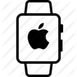







IoT: Driving digital disruption into the Physical World
Accelerating Advancements in Technology… Are transforming every part of business…
Improving Operations and Lowering Costs
Predictive maintenance
Analyze and reduce risk
Factory automation
Advanced Analytics
Product Lifecycle Mgmt
Cloud Computing
Pervasive Connectivity
Embedded Sensors
Creating New Products and Business Models
Smarter, safer cars
Health and fitness
Home and building automation
Driving Engagement and Customer Experience
Smarter, more profitable retail
Engaged events and venues
Apps that link the digital and physical world around a brand

Slide 5













What is an IoT Platform?
Devices
Platform
Applications
01
0110
0010
001001
Other
Data Sources
Sensors & Networks
Weather
Map
Other IoT platforms

Slide 6





The IoT value chain
Opportunity for partnerships right across the IoT value chain to provide end-end IoT solutions
IBM IoT Industry solutions
IBM GBS services
Industry sales & distribution expertise
Connectivity & Security technology
Connectivity & Security technology
Connectivity, Security and edge analytics
Relationships & reach
IBM Cloud platform
Watson IoT Platform
IBM
Silicon
IoT Devices
Gateways
Networks
Cloud
Solution
& Applications
Oil & Gas
Energy & Utilities
Smarter Cities
Consumer Electronics
Connected Vehicle
Transport & Rail
Life Science & Healthcare
Industrial Manufacturing
Your silicon, embedded OSes &
Recipes
Your IoT devices & recipes for connecting them
Your gateway and recipes for connecting them
Your network
Additional value add cloud services
Customer solutions built on IBM IoT technology
Partners
End-end IoT solution

Slide 7
IBM Watson IoT Platform

Slide 8
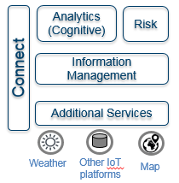
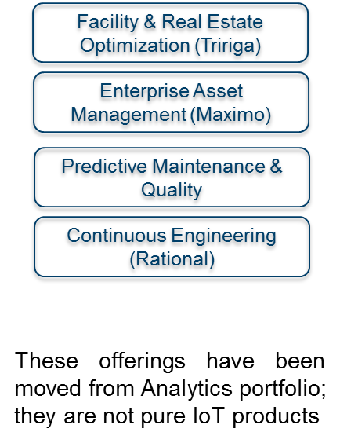
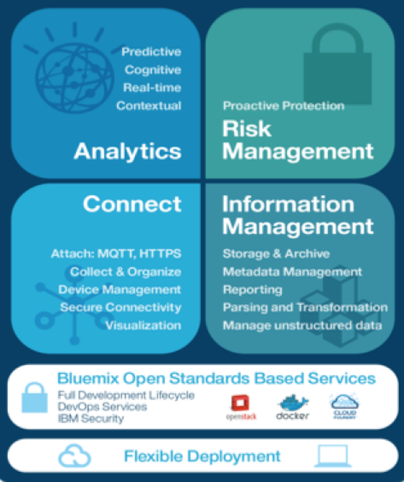
IBM IoT portfolio structure
On-Prem IoT Applications
and Infrastructure
Watson IoT Platform
Cloud
IoT Industry Solutions
Integrated Offerings
IBM IoT for Automotive
IBM IoT for Insurance
IBM IoT for Electronics IBM IoT Connected Solutions
Blueprint Offerings
IBM IoT for Retail
IBM IoT for Industrial Products
IBM IoT for Telecom
IBM IoT for Manufacturing

Slide 9





IBM Watson IoT Platform
Connect
Information Management
Analytics
Risk Management
Secure Connectivity
Attach: MQTT, HTTPS
Collect & Organize
Device Management
Visualization
Store & Archive
Metadata Management
Reporting, Parsing and Transformation
Manage unstructured data
Predictive
Cognitive
Real-Time
Edge
Proactive Protection
Anomaly Detection
Blockchain
Firmware Updates
IBM Cloud Open Standards Based Services
Full Development Lifecycle DevOps Services IBM Security
IBM Watson IoT Platform

Slide 10
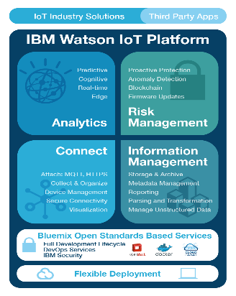
IBM Watson IoT Platform - Connect Connect what matters
The Hub for IoT Devices
Connect and manage your IoT Devices, Gateways and Networks from a broad and growing ecosystem
Open standards based communications (MQTT, HTTPS)
Secure communication and management
Globally scalable, starting with a single device

Slide 11
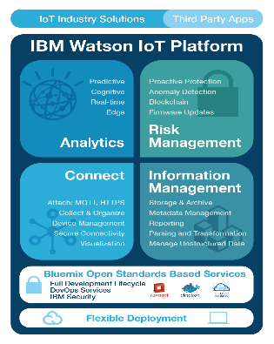
IBM Watson IoT Platform
Information Management and Analytics
Deal with data from millions of devices continuously in the cloud
Combine contextual data with analytics and IoT data to deliver better outcomes
Handle Data Storage requirements
Historical streaming to No-SQL database
Long-term cold storage with Cloud Object Storage
Use for historical Data Analytics
Apply Machine Learning
Integrate critical data from other information platforms such as Weather and social sentiment and other IoT platforms
Leverage advanced capabilities for data storage, caching and transformation
Improve visibility of IoT systems through rapid dashboarding

Slide 12
IBM Watson IoT Platform - Risk Management
Leading Security Capabilities
Enforce the appropriate level of security and privacy to your IoT solution from the device through the network to the cloud and beyond
End to end core security features for devices, data and connections
Gain system wide confidence via Security Analytics
Provide support for secure decentralized systems such as Blockchain

Slide 13













Watson IoT Platform ‘Connect’
Device connectivity and management
Your device or gateway
We start with your device, be it a sensor, a gateway or something else.
To find out how to get it connected, search our recipes.
MQTT
IBM Watson IoT Platform Connect
This is the hub of all things IBM IoT. This is where you can setup and manage your connected devices so that your apps can access their and historical data.
Your device data is sent securely up to the cloud using the open, lightweight MQTT messaging protocol.
REST & Real-time APls
Use secure APIs to connect your apps with the data coming from your devices.
Your application and analytics
Create applications within IBM Bluemix. another cloud, or your own servers to interpret the data you now have access to!

Slide 14




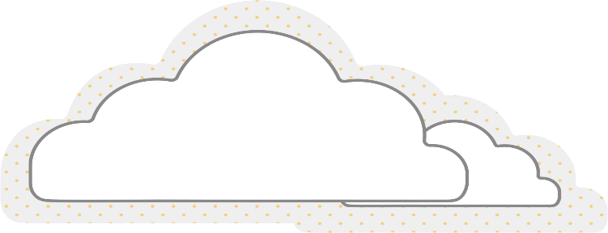












Watson IoT Platform Components
Watson
IoT Platform
Connect
3a
Real time data consumed by
RTI analytics or customer
applications
Interact with devices
via Connect
4
Cached or historical data
consumed by customer
applications
1a
Real-time data
MQTT or HTTP
IBM Watson IoT Platform Connect
3b
Latest values made available in fast cache
1b
Interact with devices
via 3rd party platforms
2
Data is parsed,
Filtered, transformed as required
3c
Historical values stored in datastore of choice
1c
Ingest data from 3rd party source
5
Data stored externally
for archive or off-platform
analytics

Slide 15

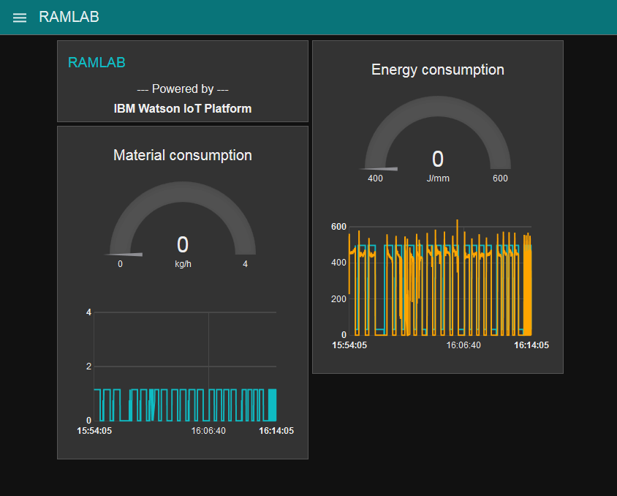


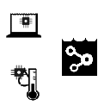
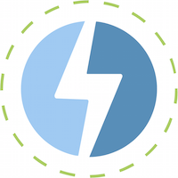
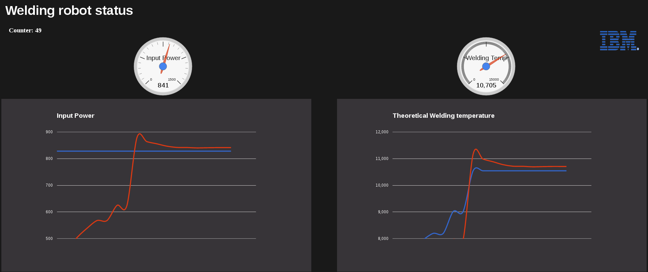

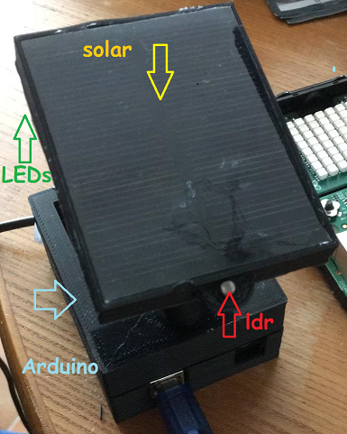
Example: Architecture to leverage IBM Cloud Analytics
Lab 4
Lab 2
Operator
Dashboard
Cloudant
Datastore
Watson Studio
IBM Machine Learning
Other sources
Raw events
Lab 1
Raw events
Aggregated values
Raw events
Watson IOT
Platform
Streaming
Analytics
Analytics
Dashboard
Feedback loop
(predicted errors, control)

Slide 16
IBM Watson IoT Connected Services
A dedicated Watson IoT Platform environment on Cloud
Create innovative “connected products” that drive increased revenue,
reduce operational costs and improve customer engagement
Create innovative products and services
Optimize operations and resources
Deliver intelligent end-user services
Capture real time insights on product usage and identify opportunities to create new products and services
Make use of operational device data to optimize existing systems while creating new enhanced processes to drive cost out of manufacturing, maintenance, service, and support
Establish direct connection with end users and collect feedback to continually improve the customer experience. Identify opportunities to grow customer base and drive new revenue streams
Notes:
Formerly “IoT for Connected Products” – rename in progress

Slide 17
Lab 1
Lab instructions and material at
https://ibm.box.com/v/WatsonIoTWS2019
Lab1_SmartLampConnect.pdf
Connecting the IoT device to Watson IoT Platform
Wifi router: TP-LINK_2B5398
5martCity
Raspberry Pi Node-RED:
http://192.168.0.20X:1880

