Slide 1
Section 4
Watson IoT Analytics
With Watson Studio

Slide 2

Agenda
Workshop Objectives
Give an overview of Watson IoT on IBM Cloud
Agenda
Watson IoT Platform Overview
Lab 1: Getting Started, Connectivity
Node-RED Overview
Lab 2: Data visualization
Watson IoT API and Security overview
MQTT, Device Management, Security
IoT and Analytics with Watson Studio
Lab 4: Analysis of historical data with a Jupyter notebook
Cognitive IoT and AI
Lab 5 & 6: ChatBot and Vision

Slide 3


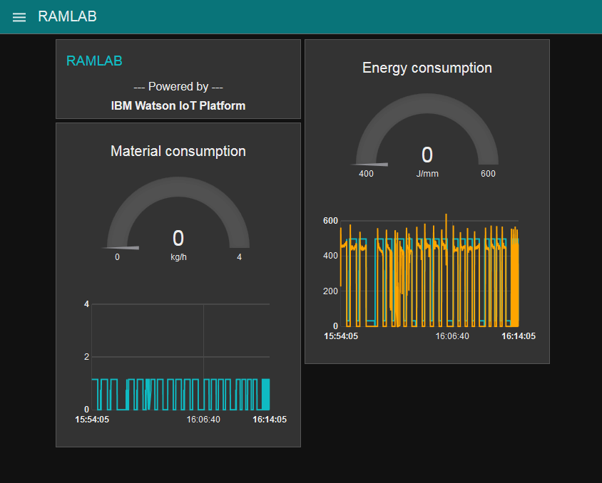
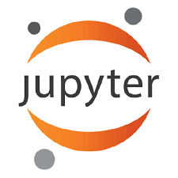



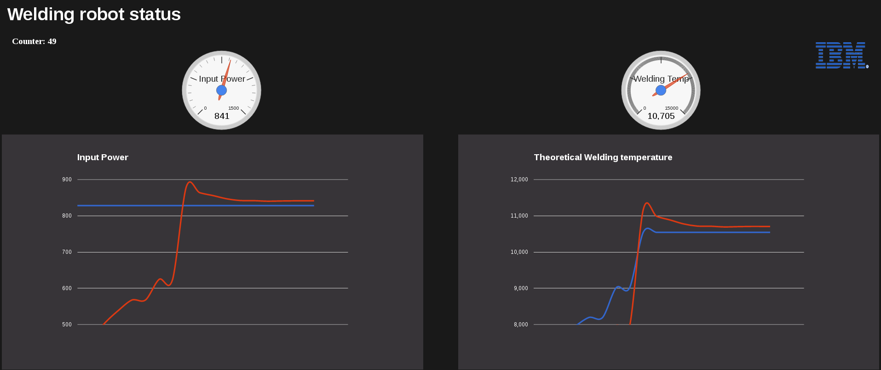
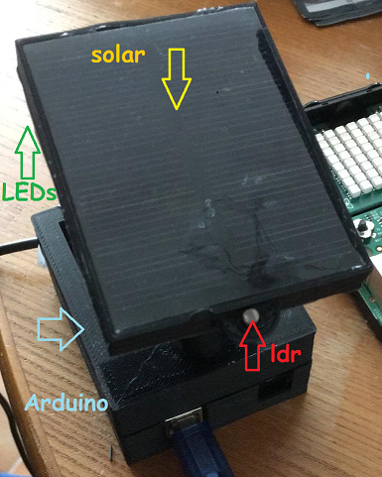


Example: Architecture to leverage IBM Cloud Analytics
Lab 4b
Lab 2
Operator
Dashboard
Watson Studio
Notebook
Analysis
Lab 1
Raw events
Raw events
Watson IOT
Platform
Cloudant
Datastore
Lab 4a
Feedback loop
(predicted errors, control)
Object
STORAGE
Streaming
Analytics

Slide 4
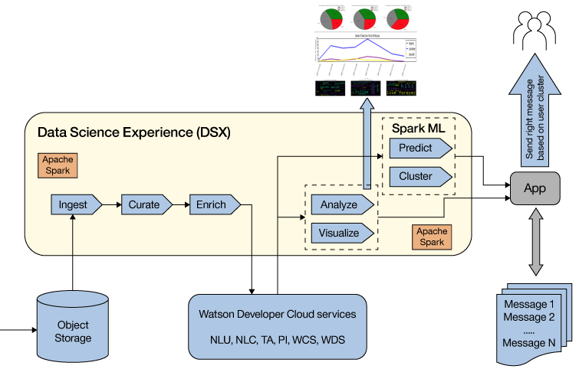






Watson IoT to Studio analytics flow
Watson Studio
Data Exploration
Feature Engineering
Production
Monitor
Machine Learning
Evaluate

