Slide 1



The Perceptron: The Biological Inspiration
Artificial Neuron
Weighted Inputs
Activation Threshold
Mathematical model mimicking biological nerve cells to process binary inputs.
Each incoming signal is multiplied by a weight determining its relative importance.
Summed inputs pass through an activation function to trigger output firing.

Slide 2
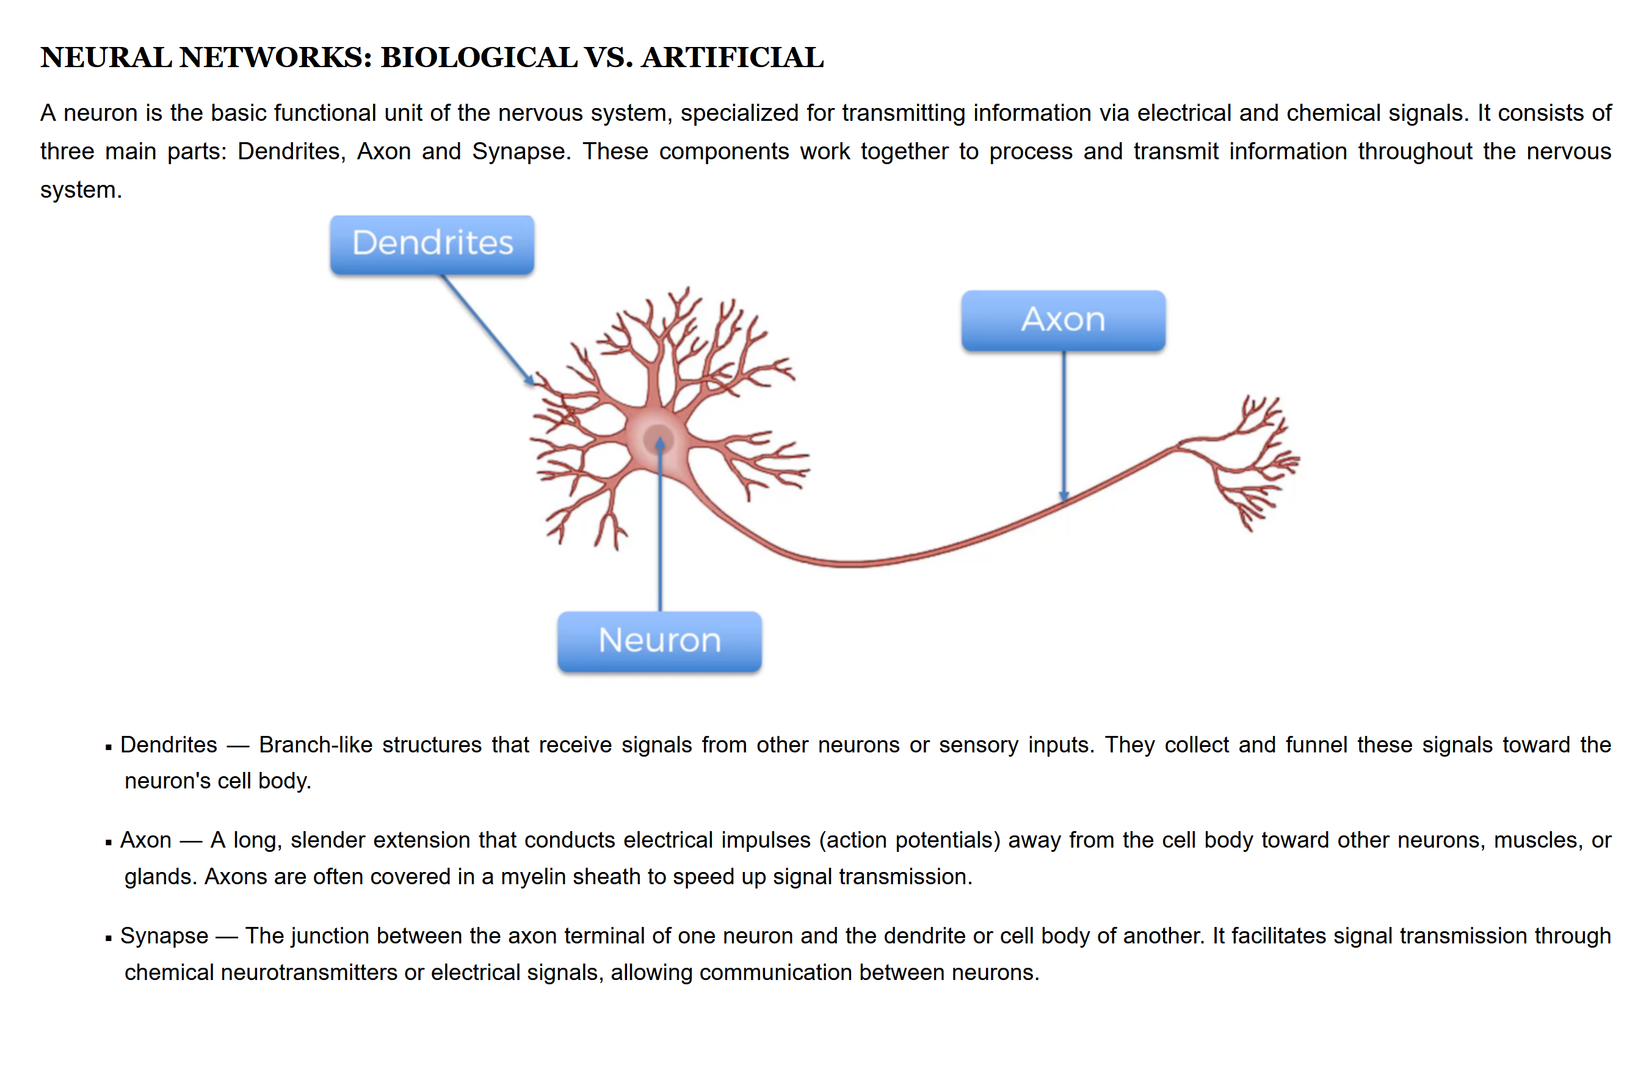

Slide 3
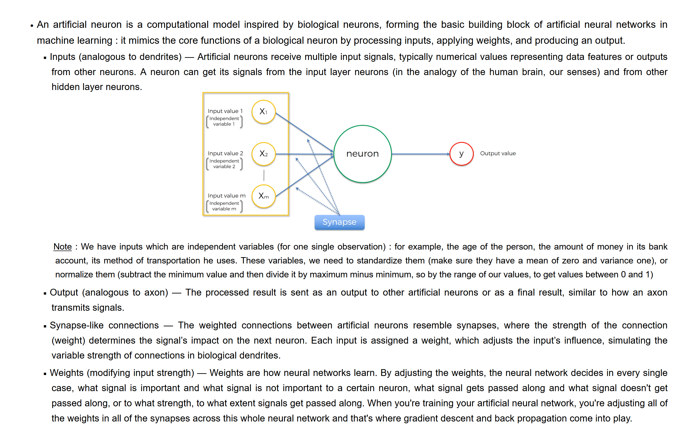

Slide 4
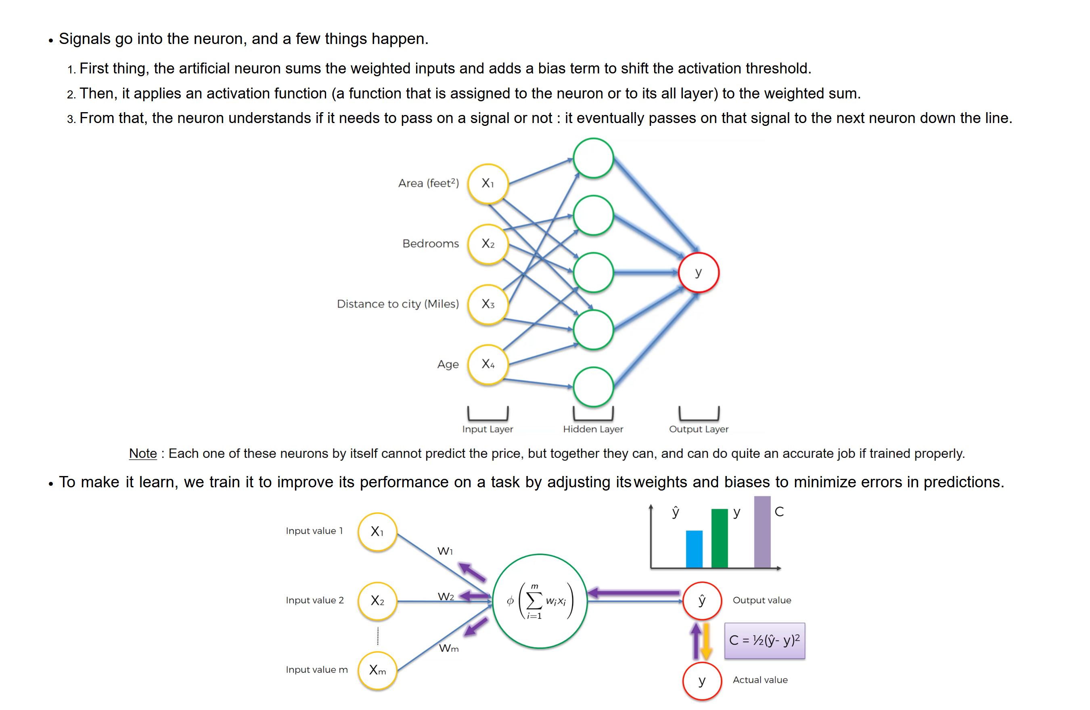

Slide 5
How the Perceptron Computes Decisions
Linear Separation
Learning Rule
Draws a decision boundary to classify data points into distinct groups.
Automatically adjusts weights based on classification errors during training.
•
Limitation: Cannot solve non-linear problems like XOR.
•
Feedback: Iterative correction refines accuracy over time.
•
Evolution: Led directly to modern deep neural networks.
•
Foundation: Core building block of machine perception.

Slide 6



Perceptron Mathematical Formulation
Weighted Sum Calculation
Linear combination of inputs and weights plus bias
Activation Function (Heaviside Step)
Maps net input to binary output

