Slide 1
Continuous Slides for Bachelor Thesis
Philipp Gehrig

Slide 2
05-05-2025: Structure for Thesis
Created Overview on GitHub: https://github.com/philippgehrig/T3300-Thesis/issues/12
Feedback?

Slide 3
05-05-2025: Progress for communication
What is send via PCIe
Message hardcoded in program (counter, helloworld etc.)
Maybe: GPIO (not sure since I don’t see any advantage)
CAN Messages
FlexRay Messages (potentially implement QoS and deterministic communication)
Highspeed Video Link

Slide 4
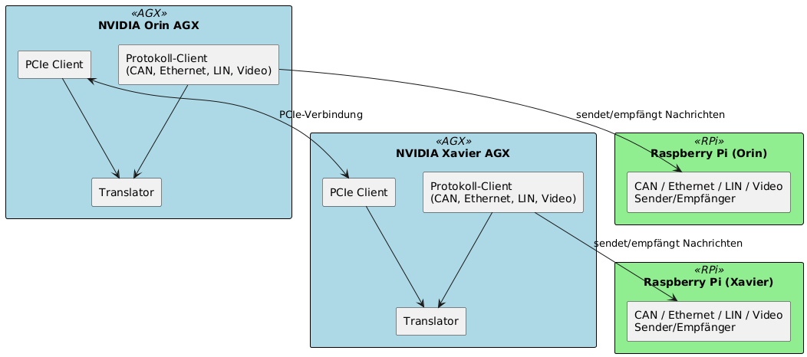
05-05-2025: Software Architecture
Little bit clunky to look at (just to show for now)

