Slide 1
Pattern Classification Using Stacked Autoencoders
Grafendorfer Philipp Maier Tamara
Kastner Christina Rothschadl Alexander
Lassnig Karin

Slide 2
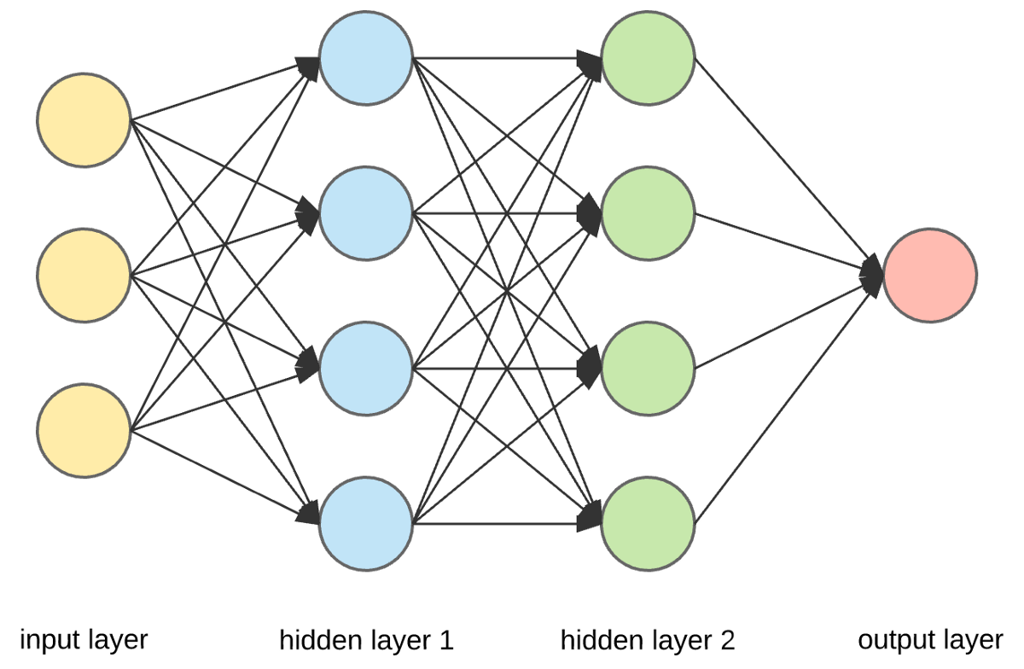
Neural Networks
Inspired by biological neural networks
Components
Neurons
Activation function
Connections and weights
Propagation function
Learning rule

Slide 3
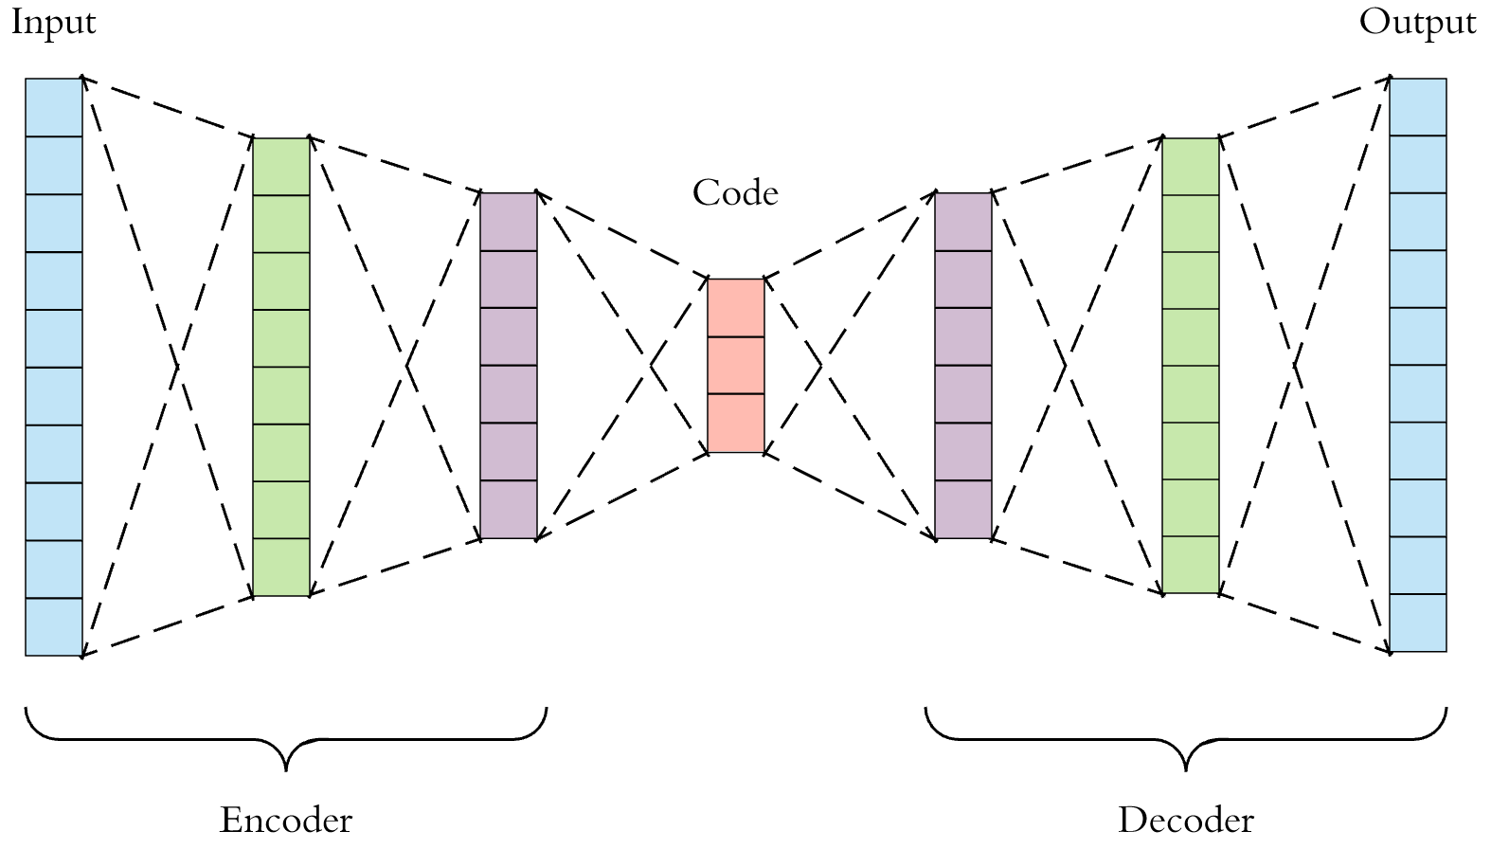
Stacked Autoencoders

Slide 4
Stacked Autoencoders
Dimensionality reduction (or compression) algorithm
Main components:
Encoder
Code
Decoder
Hyperparameters:
Code size
Number of layers
Number of nodes per layer
Loss function

Slide 5
Our Plan for the Project
Software: R (Packages ‘neuralnet‘, ‘SAENET‘, ‘autoencoder‘)
Finetuning with back propagation
Questions:
How many layers?
Activation function: logit or relu function?
Perhaps we will also deal with
Variational Autoencoders
Generative Adversarial Networks (GANs)

Slide 6
thank you for your attention

