Slide 1
An Introduction to ggplot2
Roy Roberts and Chris Bird

Slide 2


Included Data Sets
storms (dplyr)
Storm tracks data
stm <-tibble(storms)%>%
storms_ymdh()
diamonds (ggplot2)
Prices of over 50,000 round cut diamonds
dmd <-tibble(diamonds)
istockphoto.com

Slide 3
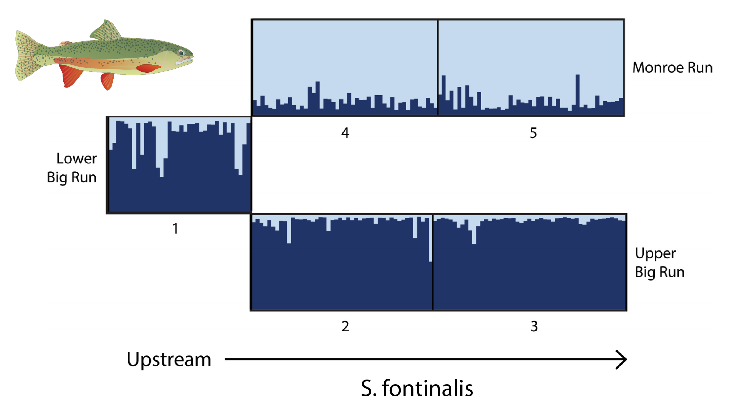
Scientific Visualizations Should be Clear
What is being plotted?
What are the axes?
What do the colors, shapes, & sizes represent?
What is the message you want to convey?
What’s wrong with this figure?

Slide 4
Philosophy of ggplot2
The grammar of graphics (Wilkinson 2006)
Describe a graph using text
Data – data frame to plot
Aesthetic Mapping (aes)
which parts of data frame are associated with which parts of plot
X-axis, Y-axis, colors of points, etc
Geometry (geom)
Lines, points, etc
Coordinates
cartesian, polar
Faceting
Panels
Statistics
Fit line, smoothing, etc
Theme
Adjust look and feel of the graphics

Slide 5
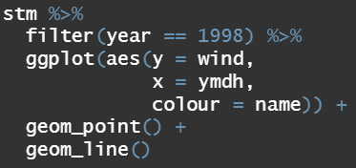
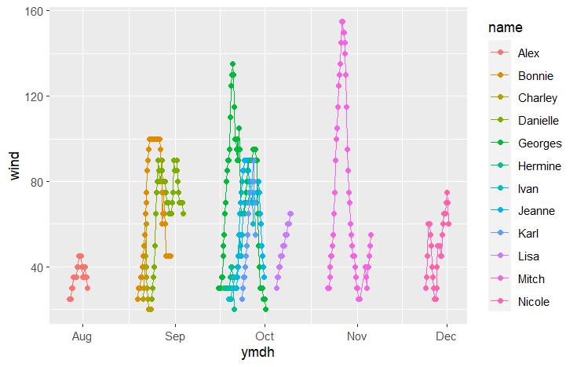
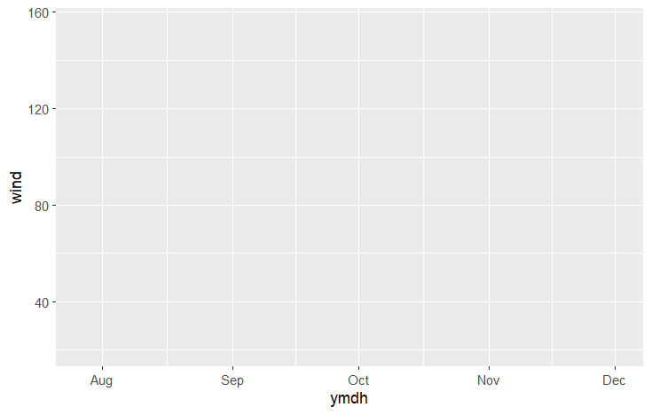
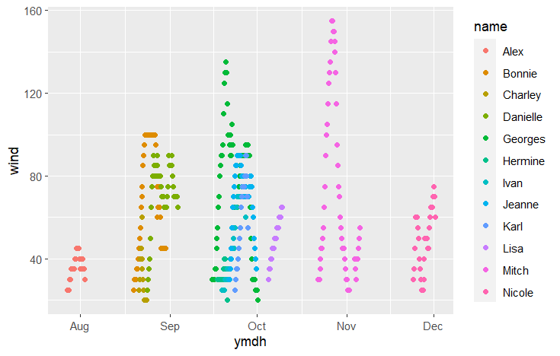
Building a ggplot
Plot the wind speed for every storm in the year 1998
Add data
data = stm
Add aesthetics (aes)
x = ymdh
y = wind
colour = name
Add data point geometry
geom_point()
Add line geometry
geom_line()

Slide 6
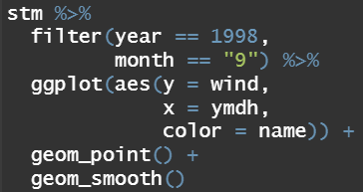
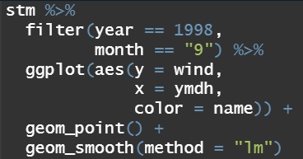
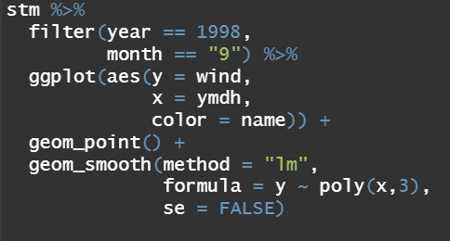
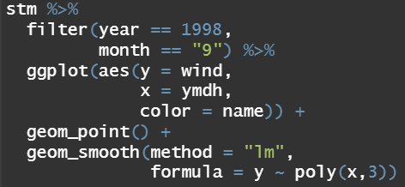
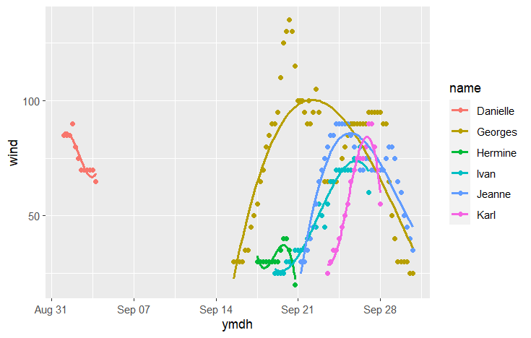
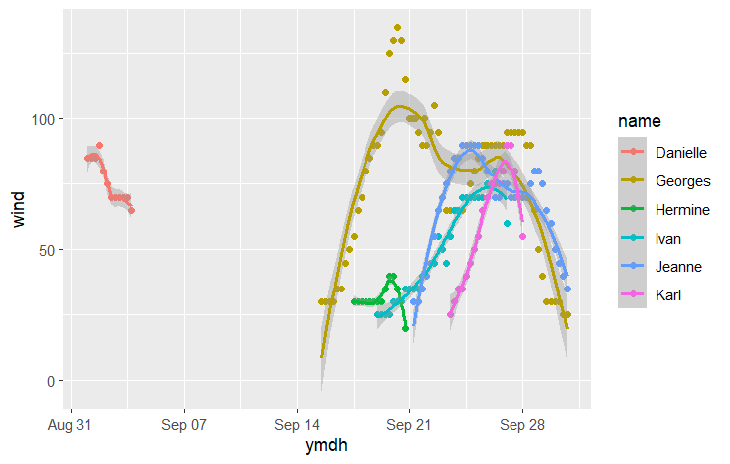
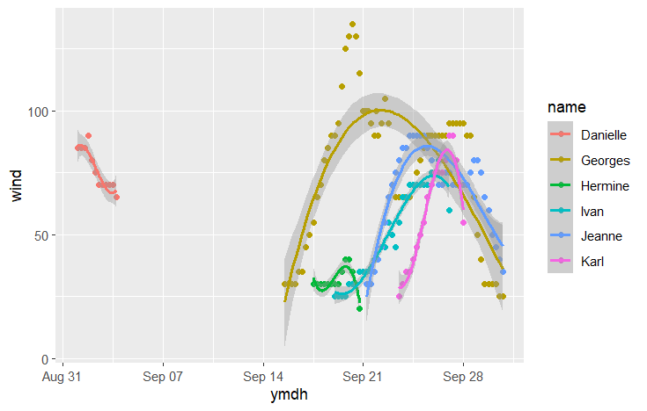
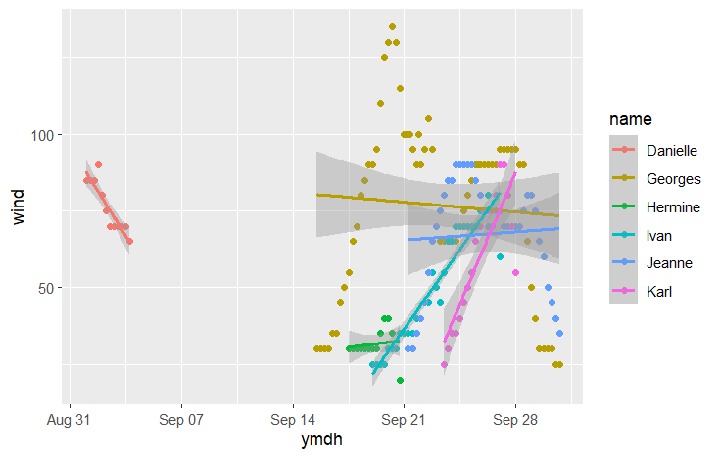
Scatter Plot with Trend Lines
Visualize relationship between two continuous variables
Fit lines can be added
geom_smooth()
Uses loess smoother by default
geom_smooth(method=“lm”)
Linear model fit line
geom_smooth(method=“lm”,
formula = y ~ poly(x,3))
3rd order polymonial model fit line
geom_smooth(se=FALSE)
Remove error “ribbon”

Slide 7
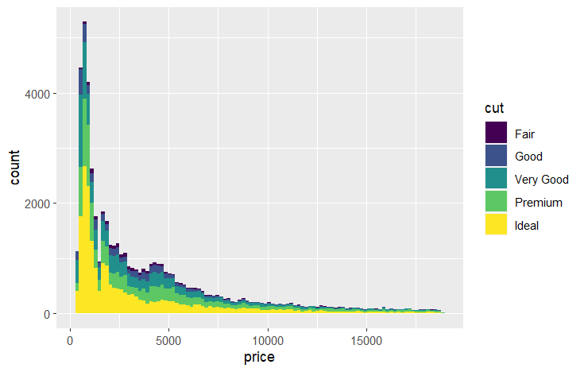
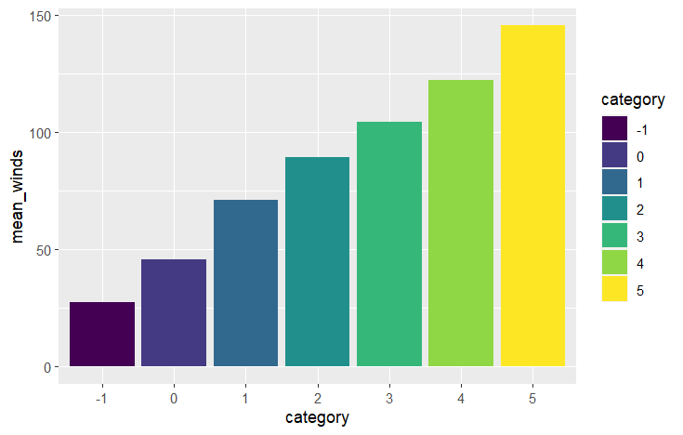
Histogram VS Bar Plot

Slide 8
Remake this plot using geom_histogram()

Slide 9
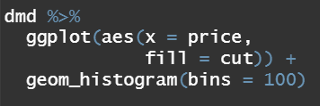
Histograms
Add data
data = dmd
Add aesthetics
aes(x = price,
fill = cut)
Add data point geometry
geom_histogram(bins = 100)

Slide 10
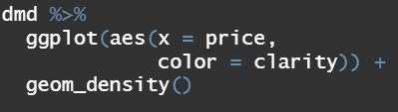
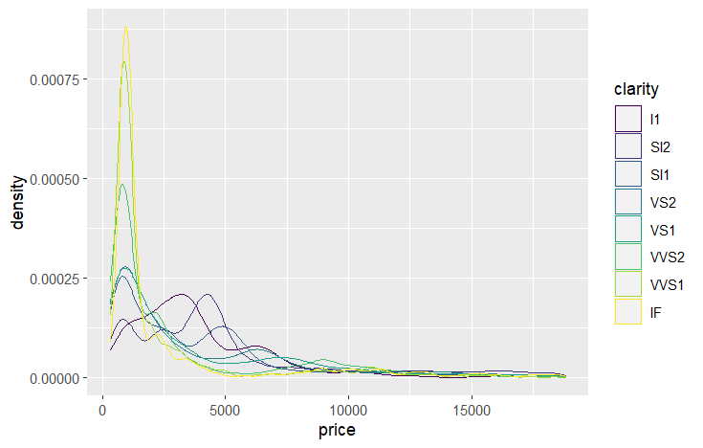
Density Plot
Add data
data = dmd
Add aesthetics
aes(x = price,
colour = cut)
Color changes the color of the line
Fill colors the area below the line
Add data point geometry
geom_density()

Slide 11
Remake this plot using geom_col()

Slide 12
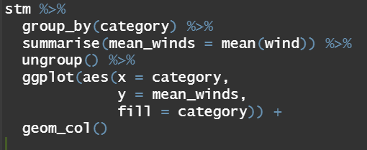
Bar Plot
Summarise storms, grouping by category, to calculating the mean wind speed
Add aesthetics
aes(x = category,
y = mean_winds,
fill = category)
Add data point geometry
geom_col()

Slide 13
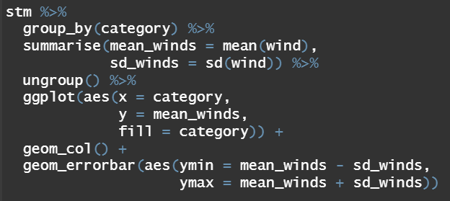
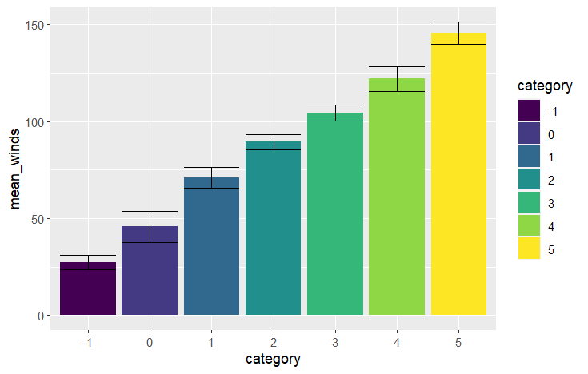
Error Bars
Error bars are typically plotted based upon values that you calculate
Standard deviation can be calculated by adding it to summarise()
Adding error bars
geom_errorbar(aes(ymax, ymin))

Slide 14
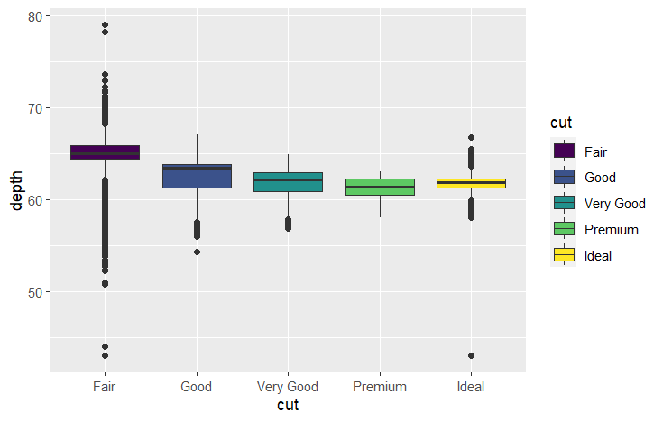
Remake this plot using geom_boxplot()

Slide 15
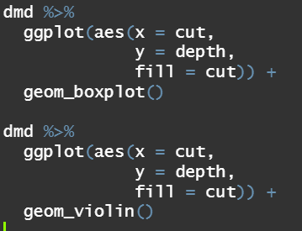
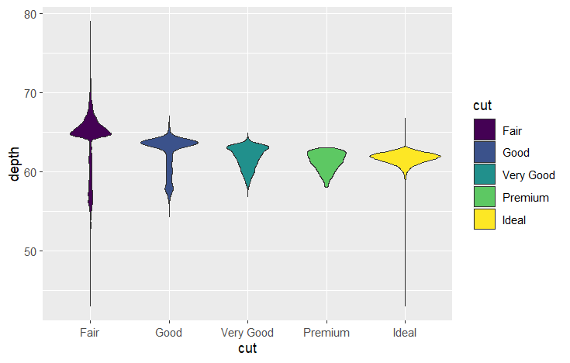
Box and Violin Plots
Add data
data = dmd
Add aesthetics
aes(x = cut,
y = depth,
fill = cut) Add data point geometry
geom_boxplot()
Geom_violinplot()
or

Slide 16
ggplot2 Assignment 1
Using the provided PSMC or your own data, make an informative plot
If using psmc use the following commands to create the tibble:
source(“workshop_functions.R”)
psmc <- psmc.result(“SfadenovoSSL100kall.psmc”)

Slide 17
Faceting
Faceting visually splits your data
Creates a matrix of panels based on specified variables
facet_grid(column2~column1)
facet_wrap(column2~column1)
Faceting options
scale = “free_x” or “free_y”, or “free”
rows = Num.
columns = Num.

Slide 18
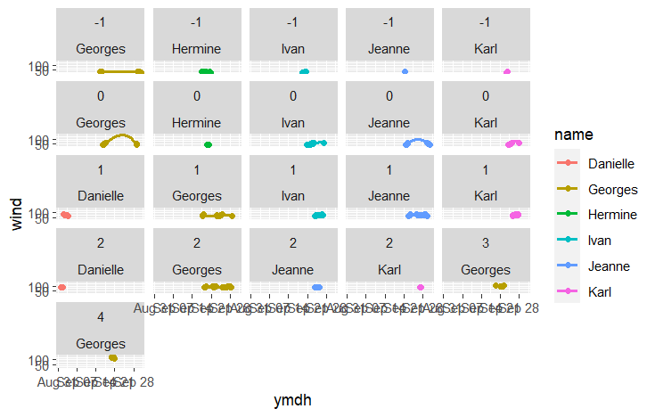
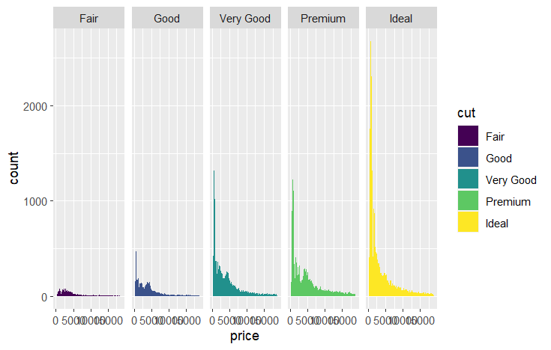
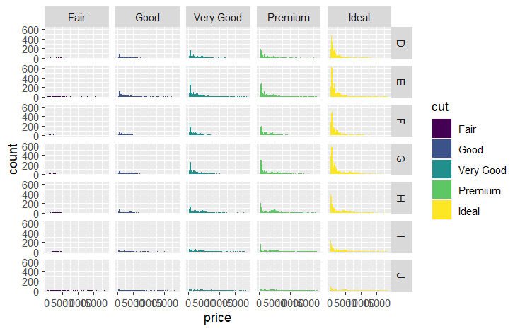
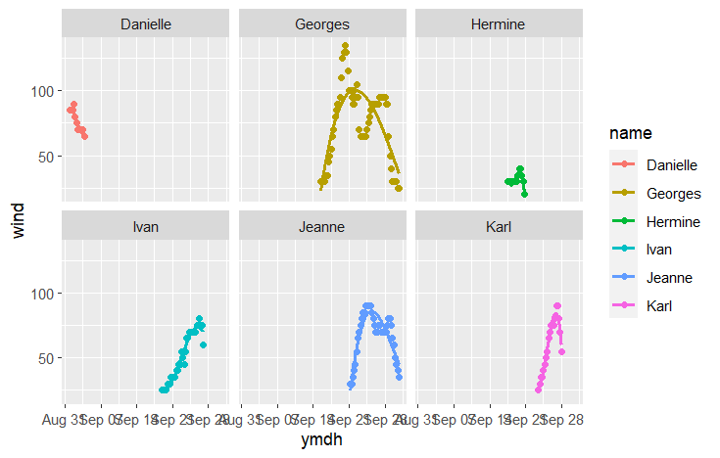

Slide 19
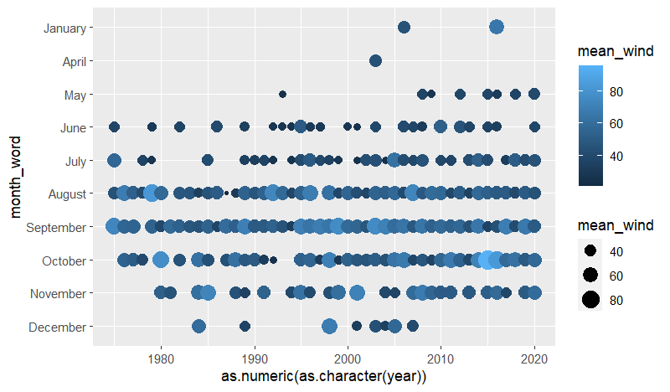
Plot Modification
Modify the x and y axes, & determine how colors, sizes, shapes behave
fill
Color fill an object
colour
Color of border of object, point, line
size
Size of point
shape/linetype
Shape of point/line
alpha
Level of transparency of point or bar
Discrete variables get discrete colors, continuous variables get continuous color

Slide 20
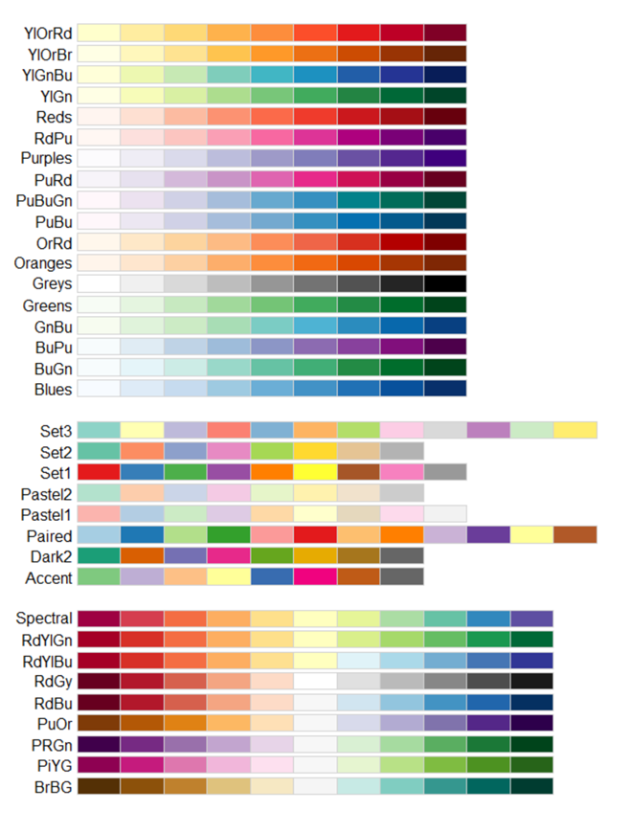
Custom Colour and Fill
library(RColorBrewer)
display.brewer.all()
scale_colour_brewer()
scale_brewer_manual()
Hexcodes
https://htmlcolorcodes.com/
https://vis4.net/palettes
scale_colour_manual()
scale_fill_manual()

Slide 21
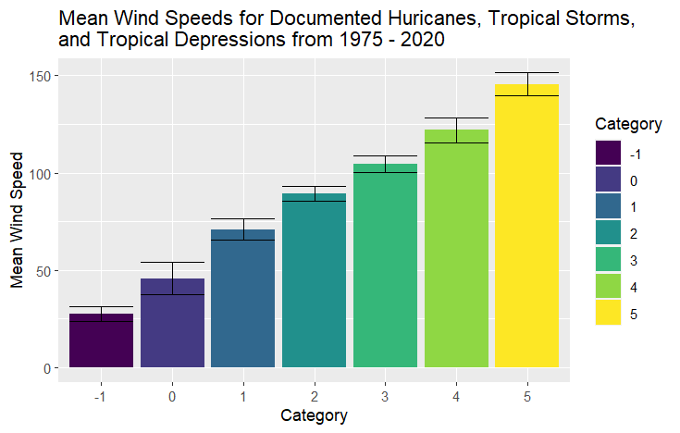
Labels
You can change axis and title labels
xlab(“x_axis_label”)
ylab(“y_axis_label”)
labs(colour = “legend_label”,
fill = “legend_label”,
title = “plot_title”)

Slide 22
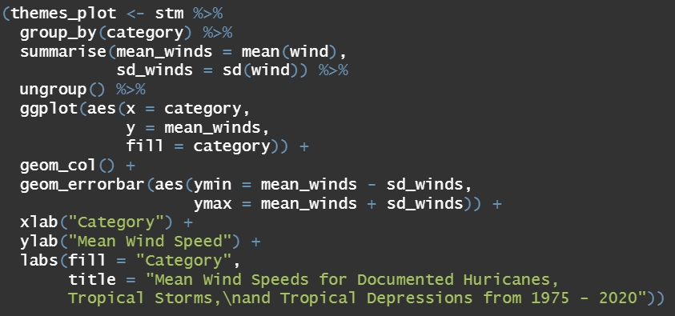
Labels

Slide 23
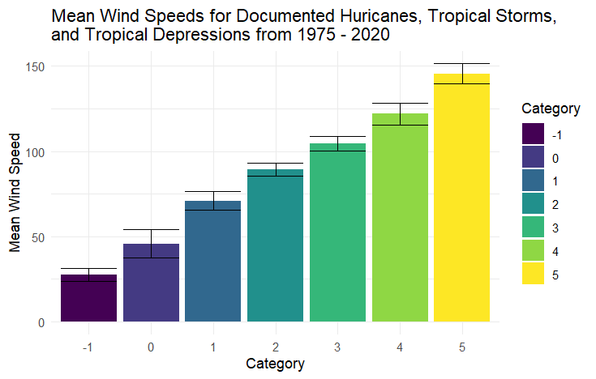


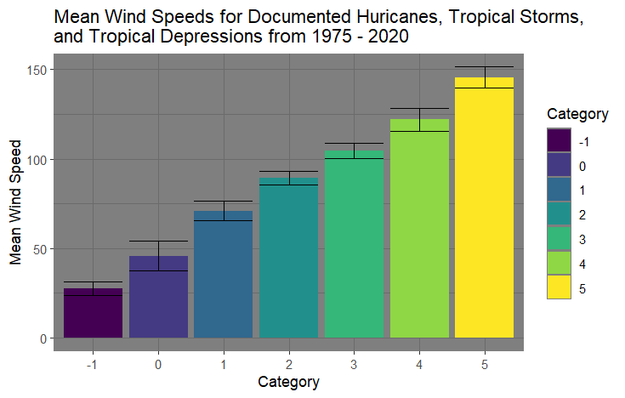
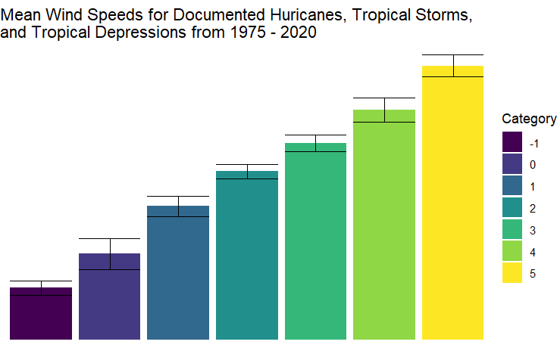
Themes
Change the look of the plot area by adding a theme
theme_bw()
theme_classic()
theme_dark()
theme_minimal()
theme_void()

Slide 24
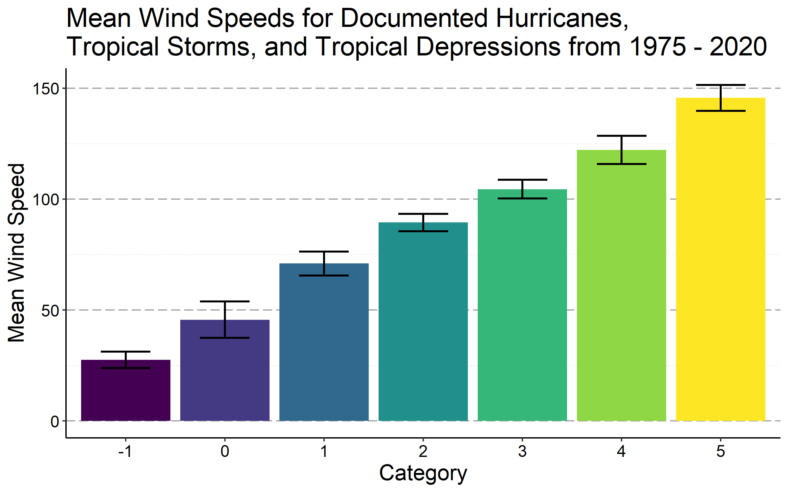
Changing Font and Other Miscellaneous Details
theme()
There are more then 90 different options on changing elements of your plot

Slide 25
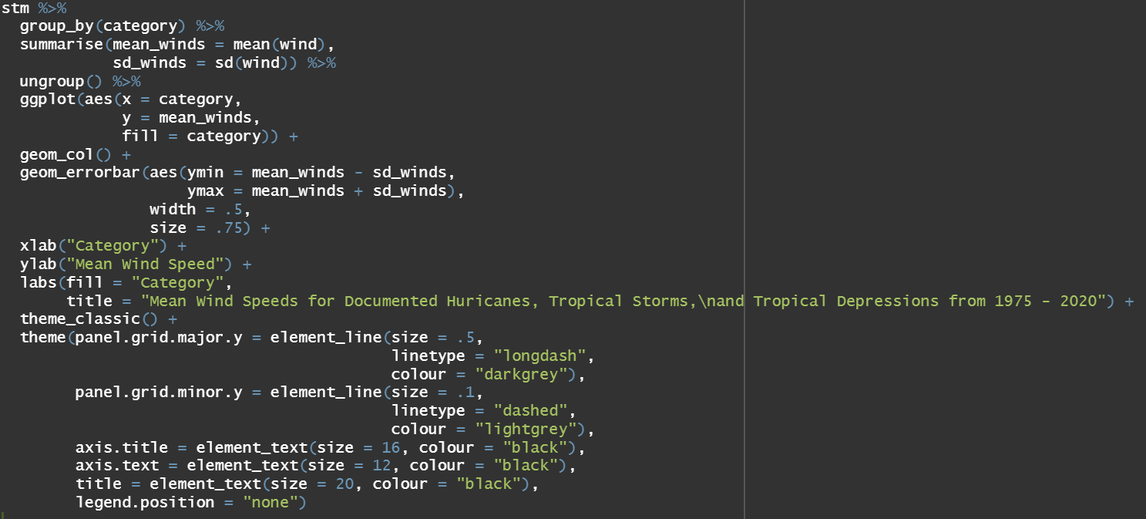

Slide 26
ggplot2 Assignment 2
Improve or enhance the previous plot you made from ggplot2 assignment 1

