Slide 1
An Introduction to ggplots2
Roy Roberts and Chris Bird

Slide 2


Included Data Sets
storms (dplyr)
Storm tracks data
stm <-tibble(storms)%>%
storms_ymdh()
diamonds (ggplot2)
Prices of over 50,000 round cut diamonds
dmd <-tibble(diamonds)
istockphoto.com

Slide 3
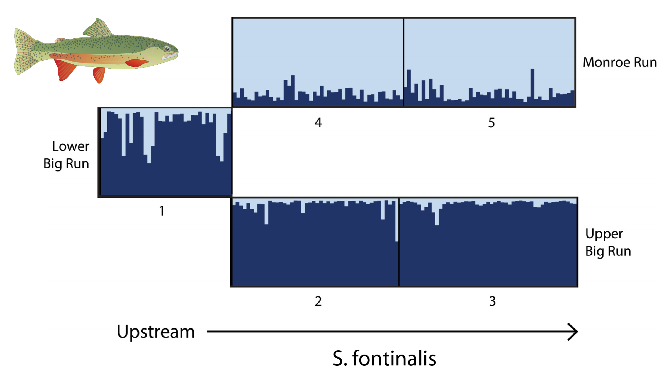
Scientific Visualizations Should be Clear
What is being plotted?
What are the axes?
What do the colors, shapes, & sizes represent?
What is the message you want to convey?
What’s wrong with this figure?

Slide 4
Philosophy of ggplot2
The grammar of graphics (Wilkinson 2006)
Describe a graph using text
Data – data frame to plot
Aesthetic Mapping (aes)
which parts of data frame are associated with which parts of plot
X-axis, Y-axis, colors of points, etc
Geometry (geom)
Lines, points, etc
Coordinates
cartesian, polar
Faceting
Panels
Statistics
Fit line, smoothing, etc
Theme
Adjust look and feel of the graphics

Slide 5
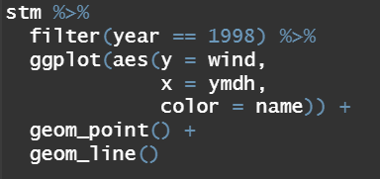
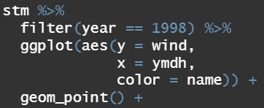
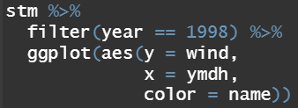
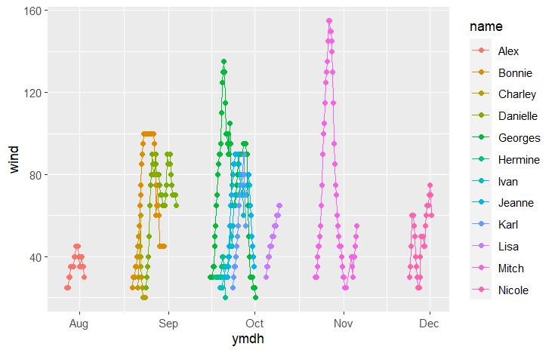
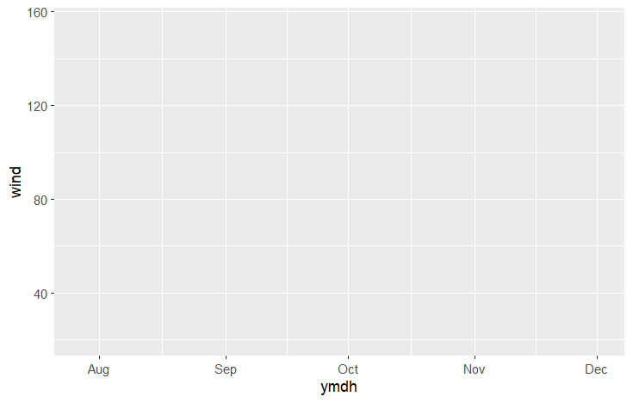
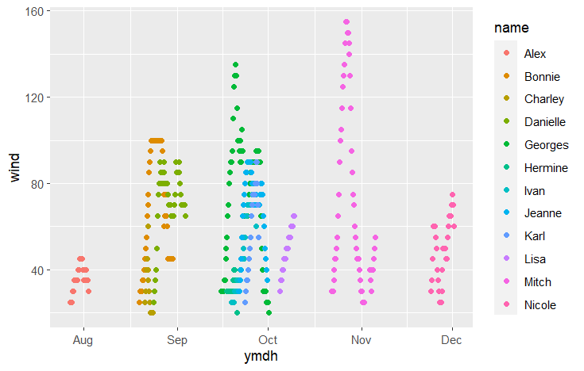
Building a ggplot
Plot the wind speed for every storm in the year 1998
Add data
data = stm
Add aesthetics (aes)
x = ymdh
y = wind
colour = year
Add data point geometry
geom_point()
Add line geometry
geom_line()

Slide 6
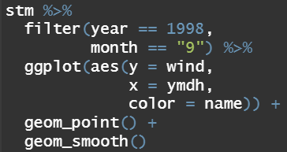
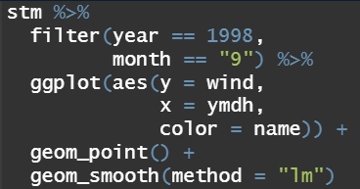
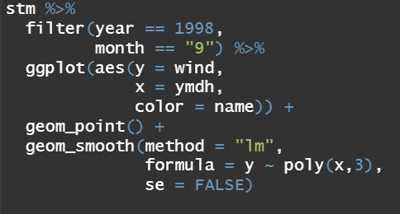
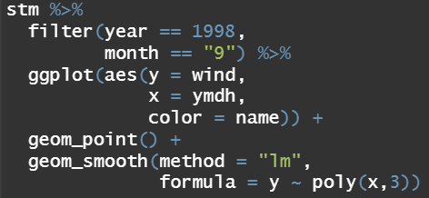
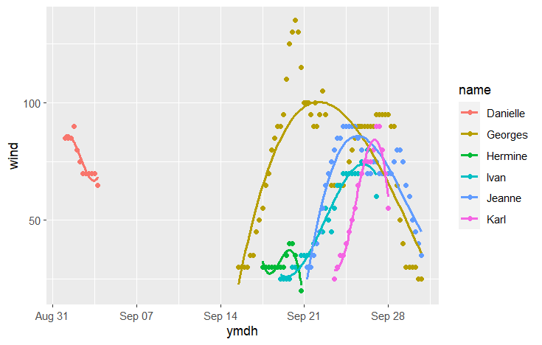
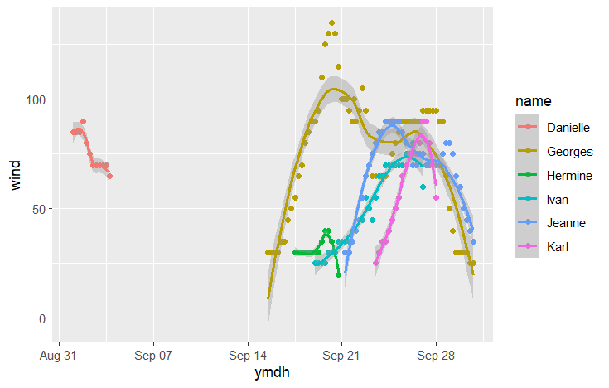
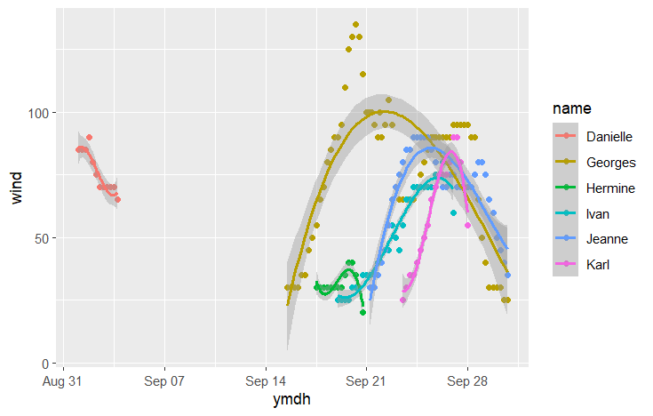
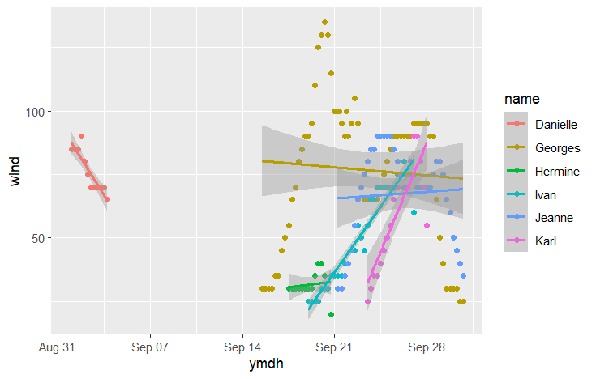
Scatter Plot with Trend Lines
Visualize relationship between two continuous variables
Fit lines can be added
geom_smooth()
Uses loess smoother by default
geom_smooth(method=“lm”)
Linear model fit line
geom_smooth(method=“lm”,
formula = y ~ poly(x,3))
3rd order polymonial model fit line
geom_smooth(se=FALSE)
Remove error “ribbon”

Slide 7
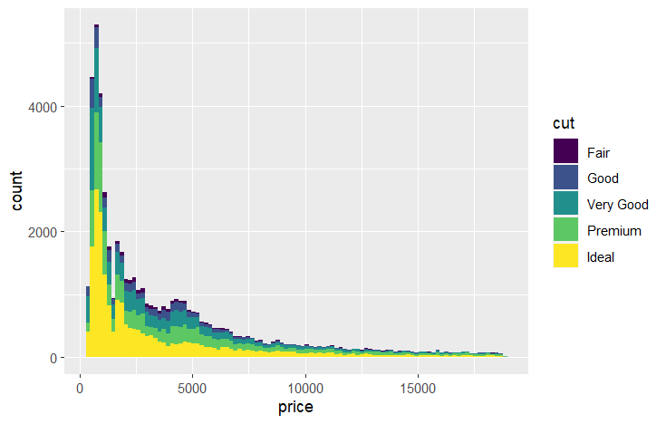
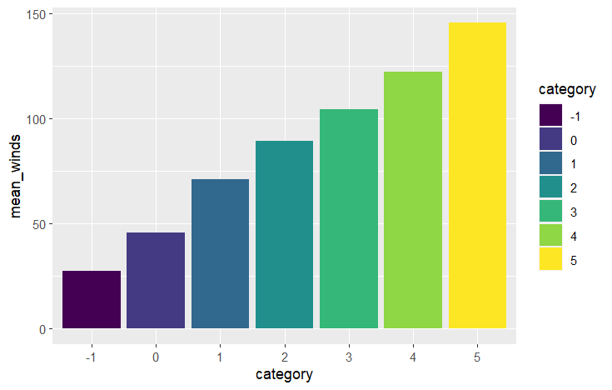
Histogram VS Bar Plot

Slide 8
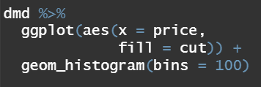
Histograms
Add data
data = dmd
Add aesthetics
aes(x = price,
fill = cut)
Add data point geometry
geom_histogram(bins = ?)

Slide 9
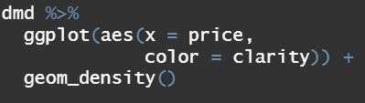
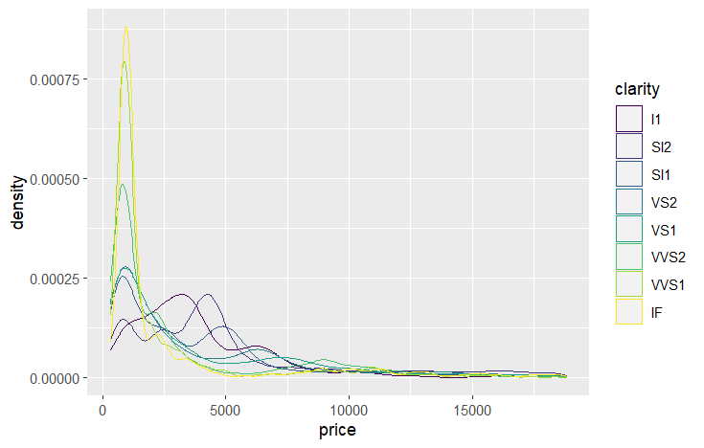
Density Plot
Add data
data = dmd
Add aesthetics
aes(x = price,
colour = cut)
Color changes the color of the line
Fill colors the area below the line
Add data point geometry
geom_density()

Slide 10
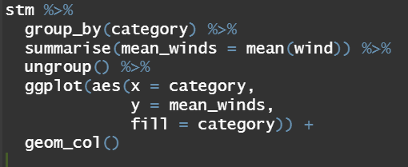
Bar Plot
Summarise storms, grouping by category, to calculating the mean wind speed
Add aesthetics
aes(x = category,
y = mean_winds,
fill = category)
Add data point geometry
geom_col()

Slide 11
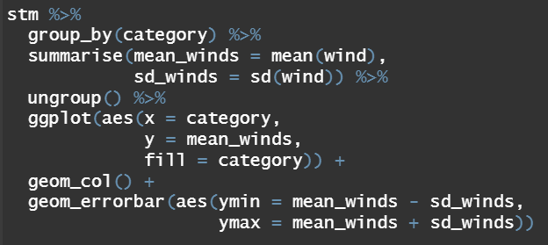
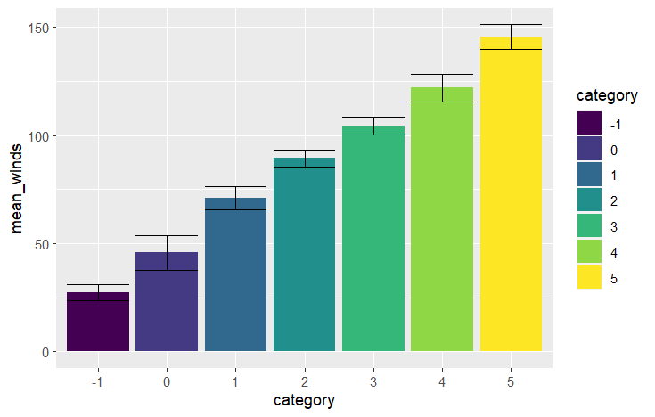
Error Bars
Error bars are typically plotted based upon values that you calculate
Standard deviation can be calculated by adding it to summarise()
Adding error bars
geom_errorbar(aes(ymax, ymin))

Slide 12
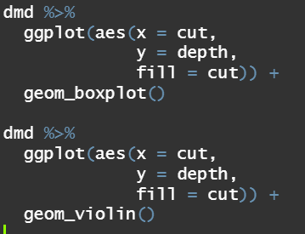
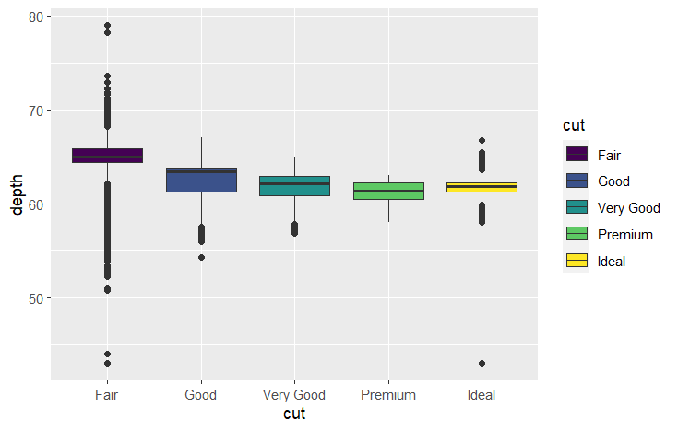
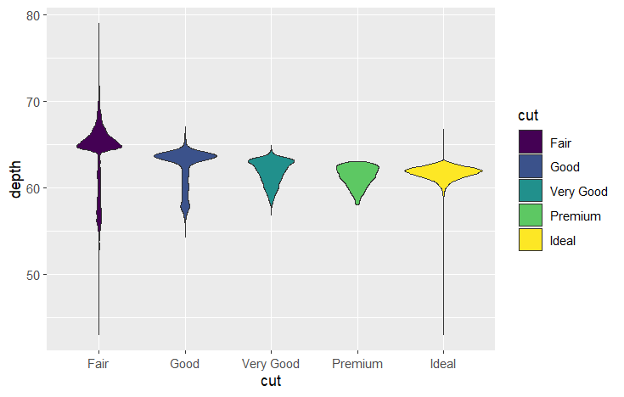
Box and Violin Plots
Add data
data = dmd
Add aesthetics
aes(x = cut,
y = depth,
fill = cut) Add data point geometry
geom_boxplot()
Geom_violinplot()
or

Slide 13
ggplot2 Assignment 1

Slide 14
Box and Violin Plots
Add data
data = dmd
Add aesthetics
aes(x = cut,
y = depth,
fill = cut) Add data point geometry
geom_boxplot()
Geom_violinplot()
or

