Slide 1
An Introduction to R and R Studio
Roy Roberts and Dr. Chris Bird

Slide 2
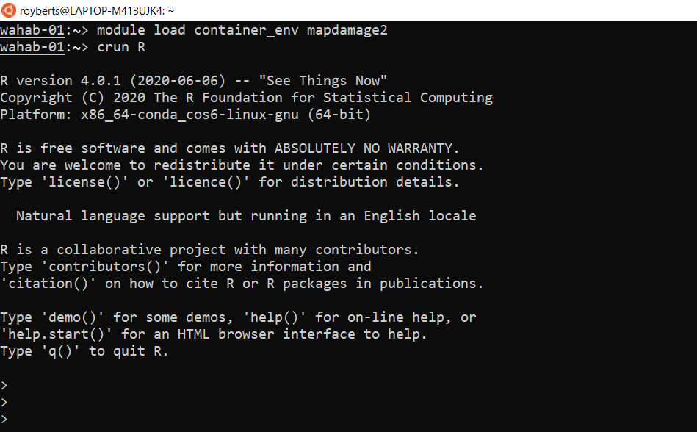
What is R?

Slide 3
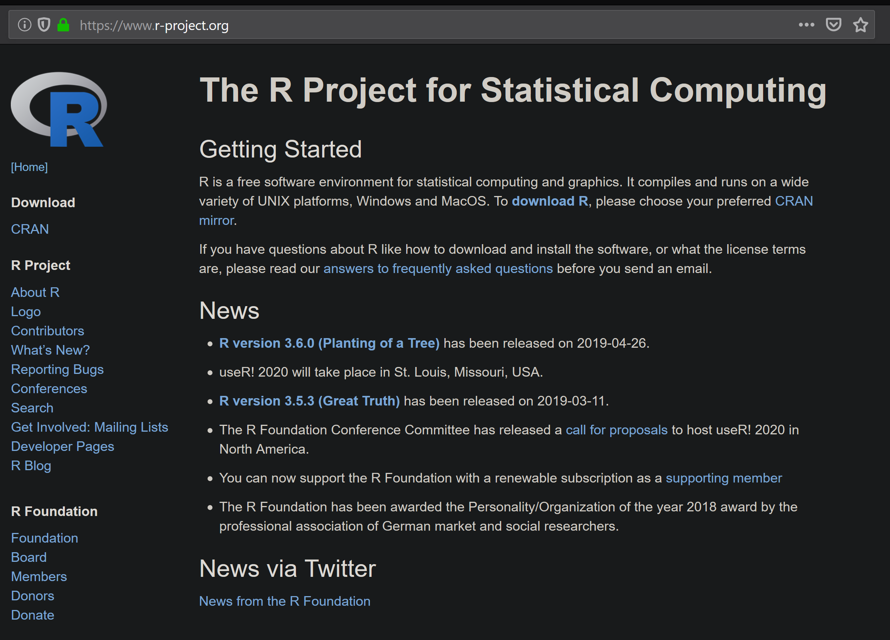
Why use R ?
Free
Open source
Popular among biologists
Almost any analysis is available for free
Easy to use
Flexible
Command line interface
Linux, Win, Mac

Slide 4
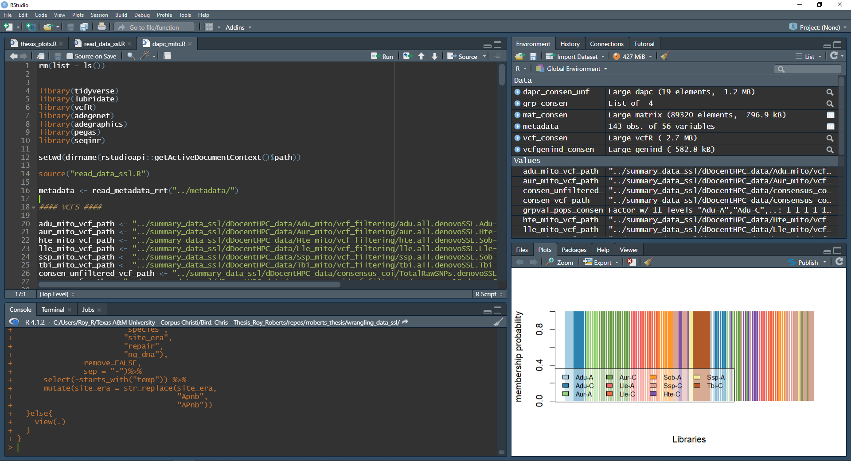
R Studio

Slide 5
R Studio

Slide 6
R Studio

Slide 7
R Studio

Slide 8
R Studio

Slide 9
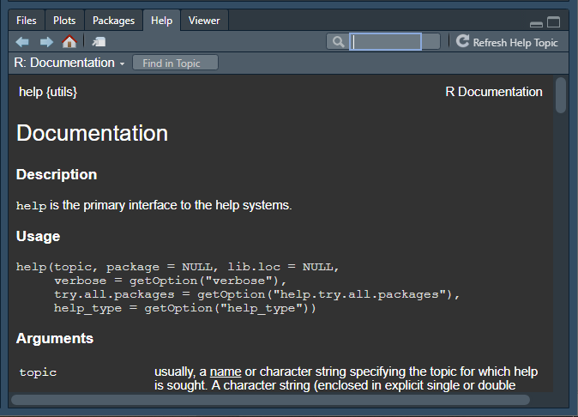
R Studio

Slide 10
Yellow and Green
= Code that you don’t change
= Code that you customize

Slide 11
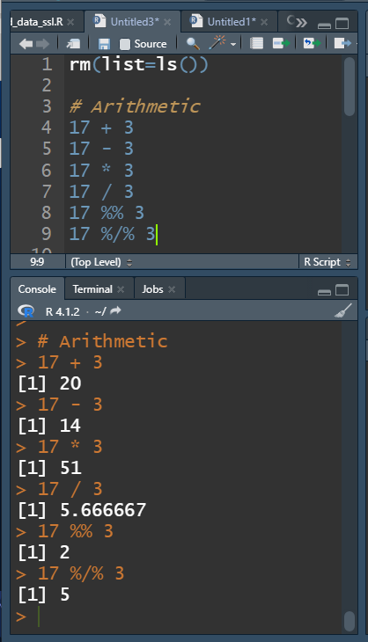
Arithmetic
+ Addition
- Subtraction
* Multiplication
/ Division
^ Exponentiation
%% Modulo (remainder from division)
%/% Integer Division

Slide 12
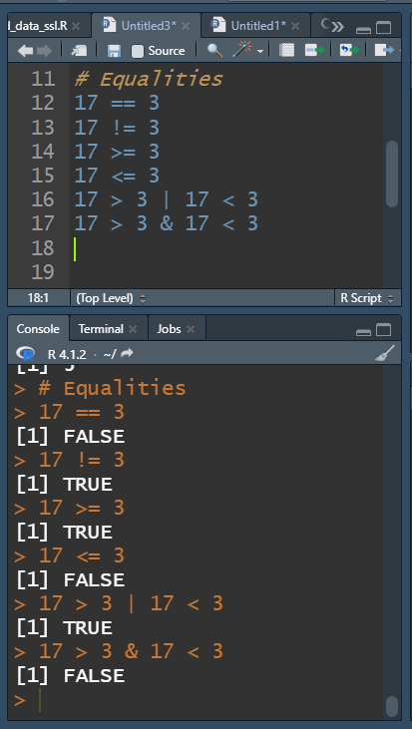
Logical Equalities
== Equal to
!= Not equal to
> Greater than
< Less than
>= Greater than or equal
<= Less than or equal
& And
| Or
! Not

Slide 13
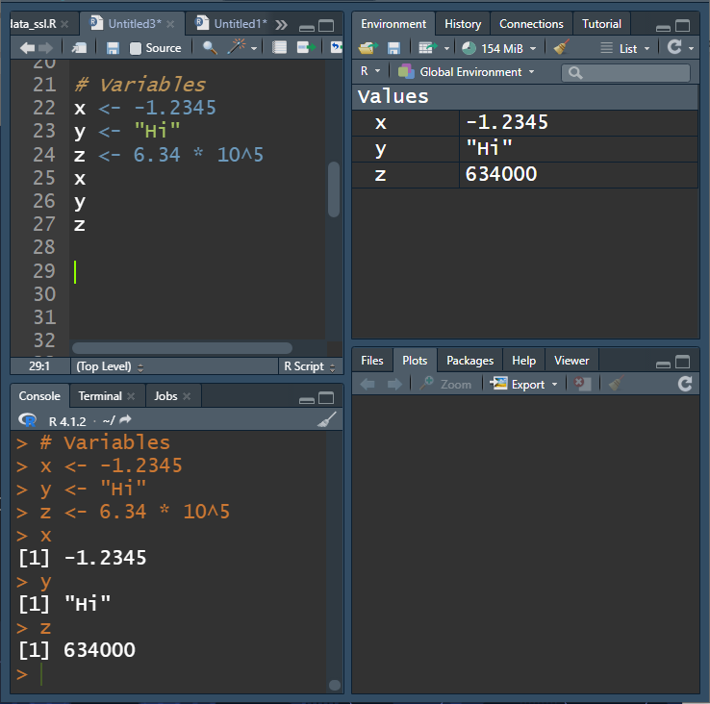
Variables
Variables hold data
Any alpha-numeric-logical-NA
Values are numbers or strings
Values can be assigned to variables using <-
Clear all variables: rm(list=ls())

Slide 14
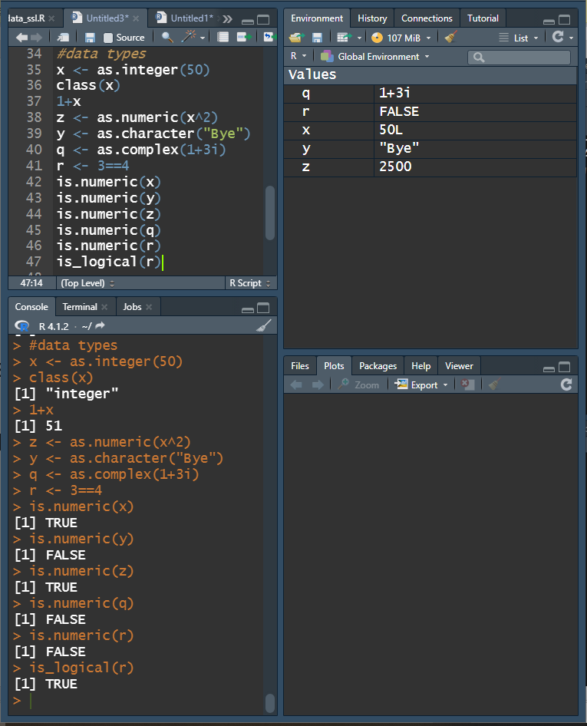
Data Types
integer Whole Numbers
numeric Real Numbers
complex Complex Numbers
logical TRUE or FALSE
character String
Specify data type using as.type(variable)
Query data type use is.type(variable)

Slide 15
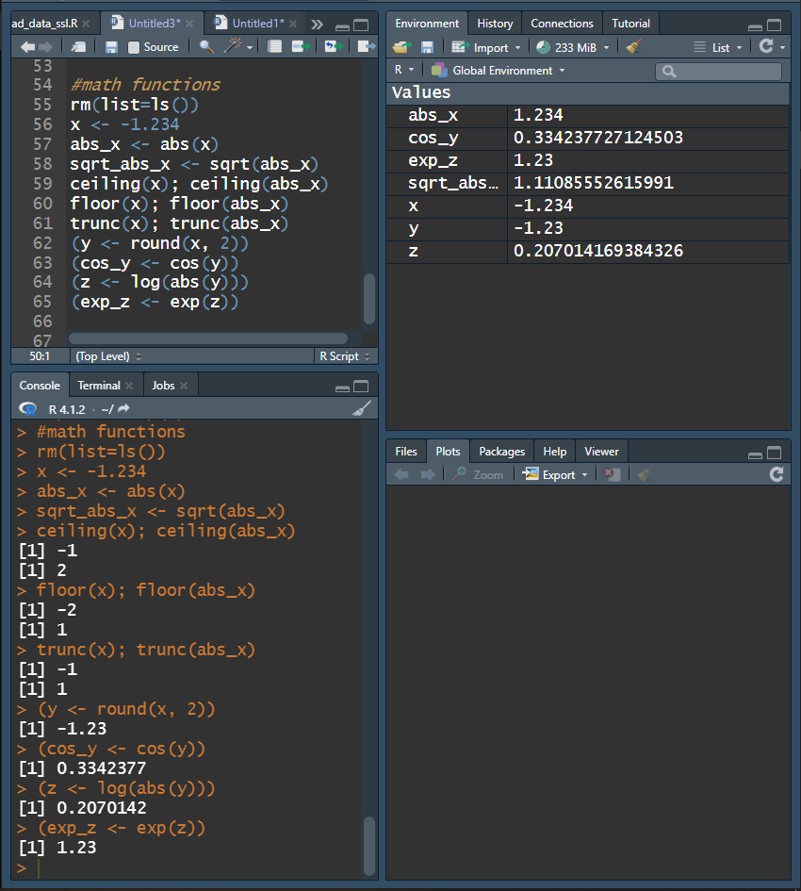
Mathematical Functions
abs(x) absolute value
sqrt(x) square root
ceiling(x) round up
floor(x) round down
trunc(x) remove decimals
round(x, digits = n) round x to n digits
cos(x), sin(x), tan(x), etc. trig
log(x) natural log
exp(x) e^{x}
log10(x) base 10 log

Slide 16
An Overview of Data Structures in R
Element a single value or string
Vector several elements of same data type
Matrix 2-dimensional table of elements of same data type
Array 3-dimensional table of elements of same data type
Tibble 2-dimensional table of elements of different data types
Data frame 2-dimensional table of elements of different data types
List several elements or data structures of any type

Slide 17
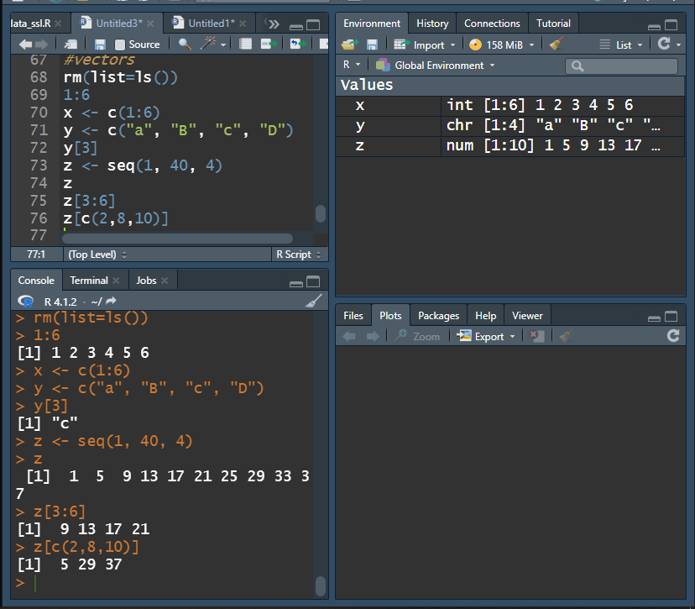
Vectors
A vector is a collection of elements
1, 2, 3, 4, 5, 6
Vectors can be specified using c(), or seq() or rep()
Particular values in the vector can be specified by their index [index_num]

Slide 18
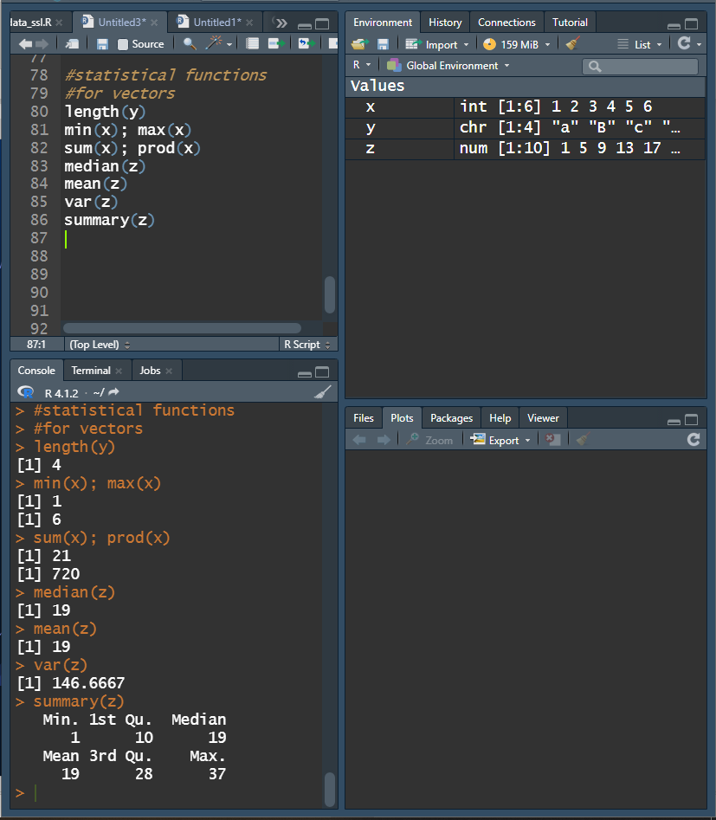
Statistical Functions
length(x) # elements
min(x) minimum
max(x) maximum
sum(x) sum, +
prod(x) product, *
median(x) central value
mean(x) average
sd(x) standard deviation
summary(x)

Slide 19
Base R Mind Expander
https://forms.gle/nE2CnAJj6rz8QVYo9

