Slide 1
An Introduction to Tidyverse
Roy Roberts

Slide 2
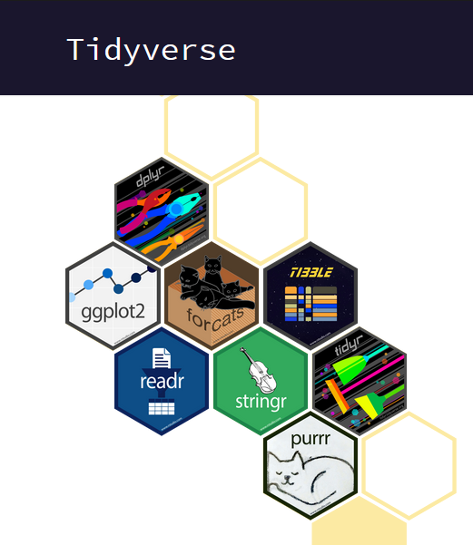
The Tidyverse
“The tidyverse is an opinionated collection of R packages designed for data science. All packages share an underlying design philosophy, grammar, and data structures.”

Slide 3
The Tidyverse
What is tidy data?
Every column is a variable
Every row is an observation
Every cell is a single value

Slide 4
Packages in Tidyverse
Core Tidyverse contains:
tibble
ggplot2
dplyr
tidyr
readr
purrr
stringr
forcats

Slide 5
How to Install and Load Tidyverse
Installing and loading Tidyverse
install.packages(“tidyverse”)
library(tidyverse)

Slide 6
Miscellaneous Information Before Starting Tidyverse
%>%
view()
function(.)
source(“path/to/file”)
tibble$colunm_name

Slide 7
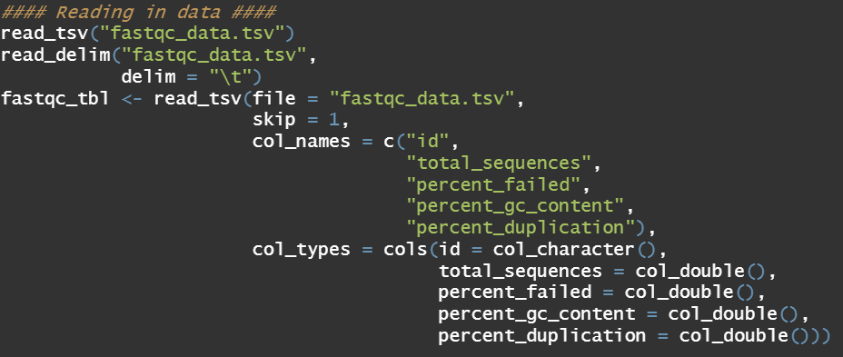
Reading in Data With readr
Package ‘readr’
read_tsv()
read_csv()
read_delim()
read_table()
Package ‘readxl’
read_excel()

Slide 8
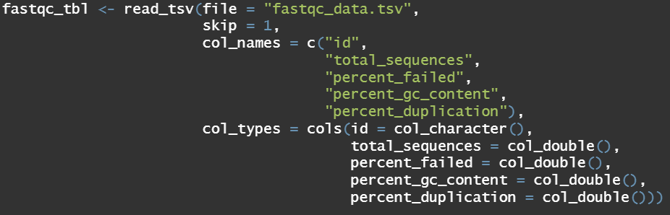
Reading in Data With readr
Helpful options:
read_FILETYPE(
file = “path_to_file”,
skip = Integer,
col_names = c(“vector”, “of”, “colnames”),
col_types = cols(colname = col_type())
)

Slide 9
Tidyverse Activity 1
Read in altered “Davis” from car dataset located in the current working directory.
Save as a variable.
Try and use some of the other options when saving as a variable.
Pipe in drop_na() and compare with and without the new command.
Save the above tibble as a variable to use for later activities.

Slide 10
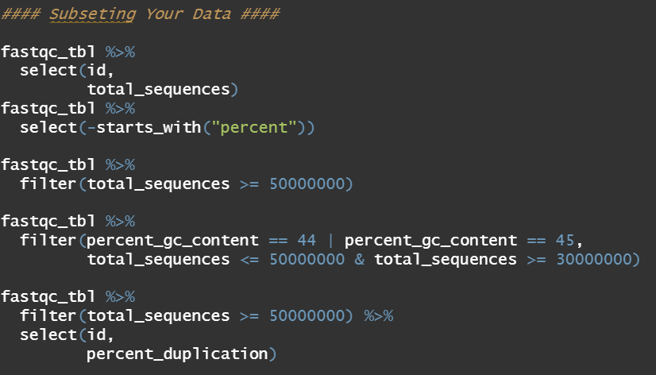
Subsetting Data in R
select()
Subsets columns of a tibble
filter()
Subsets rows of a tibble

Slide 11
Transforming Data in R
mutate()
Create, modify, and delete columns
data %>% mutate(New_Column = Column_1 * Number)
data %>% mutate(Column_1 = Column_1 * Number)
case_when()
A general vectorized conditional (if) statement that can be used with mutate
data %>% mutate(New_Column = case_when(Column1 == Value ~ Value,
Column1 == Value ~ Value))

Slide 12
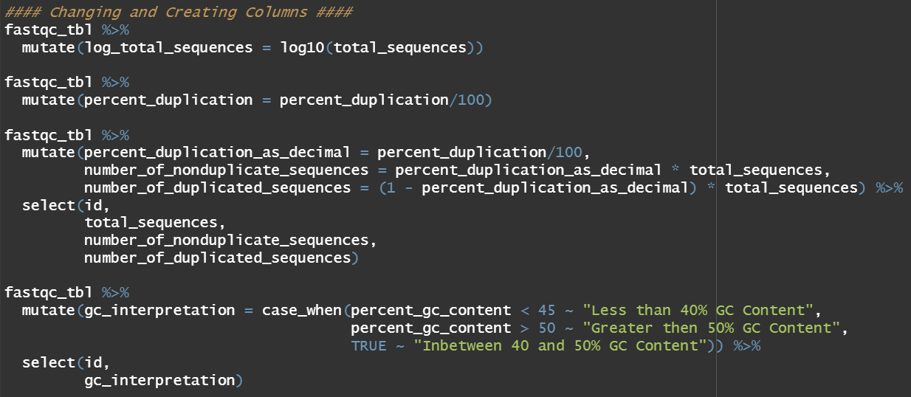

Slide 13
Tidyverse Activity 2
Using the previously read in davis tibble, remove both heights from the data set using select.
Filter your data by Male or Female and also by 1 or 2 different hair colors.
Create 2 new columns
The mean of weight 1 and 2
The difference of weight 1 and 2
Create a new column that’s value is either negative if the difference of weight 1 and 2 is negative, positive if positive, and no change if 0

Slide 14
Transforming Data in R
relocate()
Change column order
unite()
Unite multiple columns into one by pasting strings together
separate()
Separate a character column into multiple columns with a regular expression or numeric locations

Slide 15
Transforming Data in R
unite()
data %>% unite(“New_Column”,
columns_to_select,
sep = “delimiter”,
remove = FALSE)
separate()
data %>% separate(Column_1,
into = c(“New_Col1”, “New_Col2”, “New_Col3”),
sep = “delimiter”,
remove = FALSE)

Slide 16
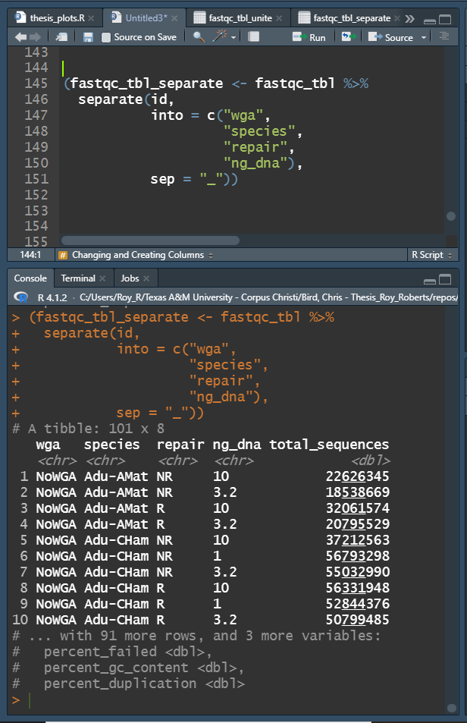
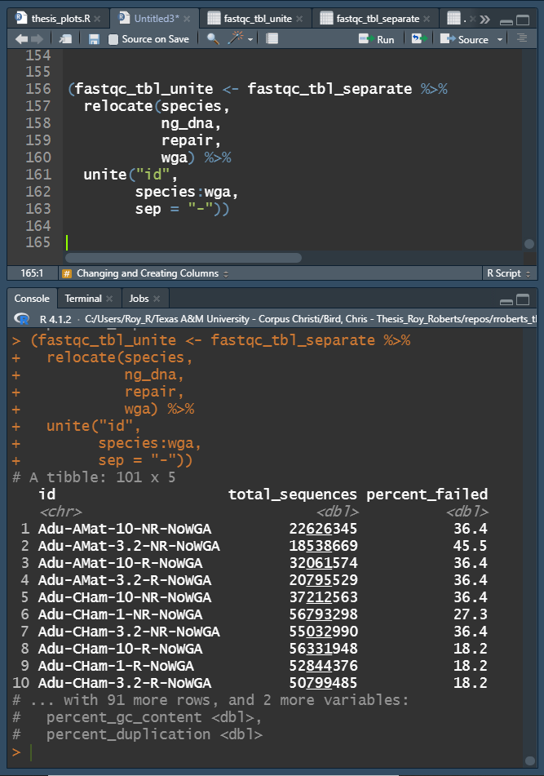

Slide 17
Tidyverse Activity 3
Separate name into surname and given_name
Combine haircolor and sex into haircolor_sex
Move the columns around for fun!

Slide 18
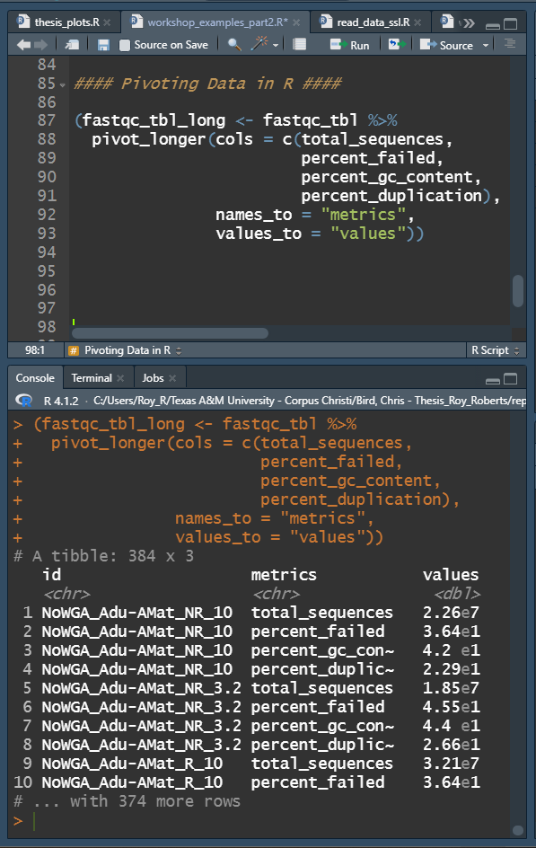
Pivoting Data in R
pivot_longer()
Pivots wide data to long data
Wide data sets do not contain
repeating values in the ID
Long data sets do contain repeating
values in the ID
pivot_longer(cols = ColumnX:ColumnY,
names_to = “Column_Name1”
values_to = “Column_Name2”)

Slide 19
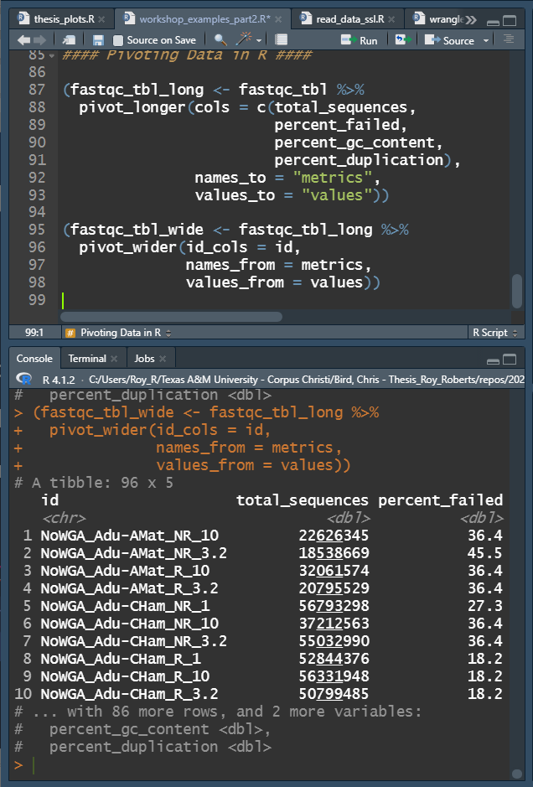
Pivoting Data in R
pivot_wider()
Pivots long data to wide data
Wide data sets do not contain
repeating values in the ID
Long data sets do contain repeating
values in the ID
pivot_longer(id_cols = ColumnX,
names_from = Column_Name1
values_from = Column_Name2)

Slide 20
Tidyverse Activity 4
Pivot longer all davis numeric davis values longer and save the new tibble as a variable.
Pivot wider the previous tibble back to its original state.

Slide 21
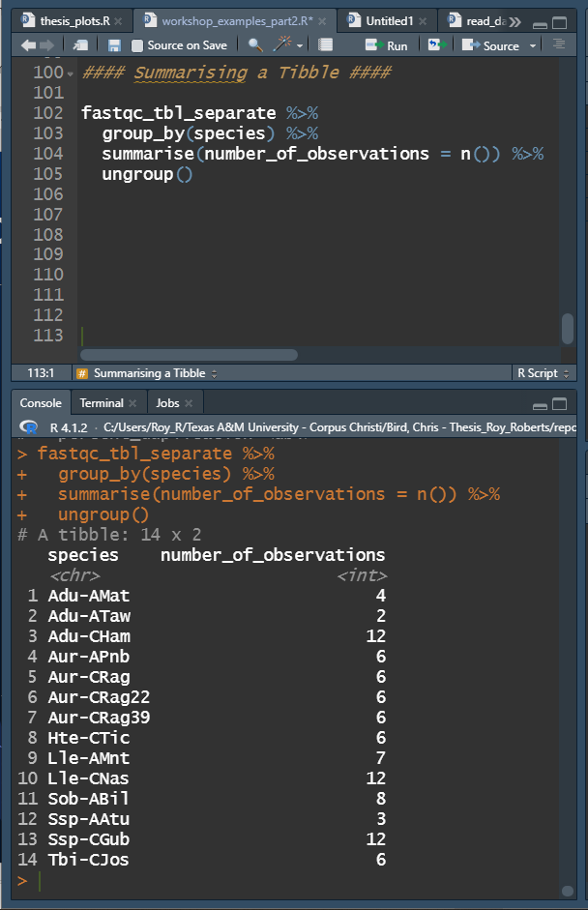
Summarising a Tibble in R
summarise()
To use summarise() a tibble must be grouped by one or more variables using group_by()
group_by(ColumnX, ColumnY)
summarise(NewColumn1 = function(Column),
NewColumn2 = function(Column),
…)
Keeping a tibble grouped can cause problems with other functions so ungroup() should be used after grouping is no longer needed

Slide 22
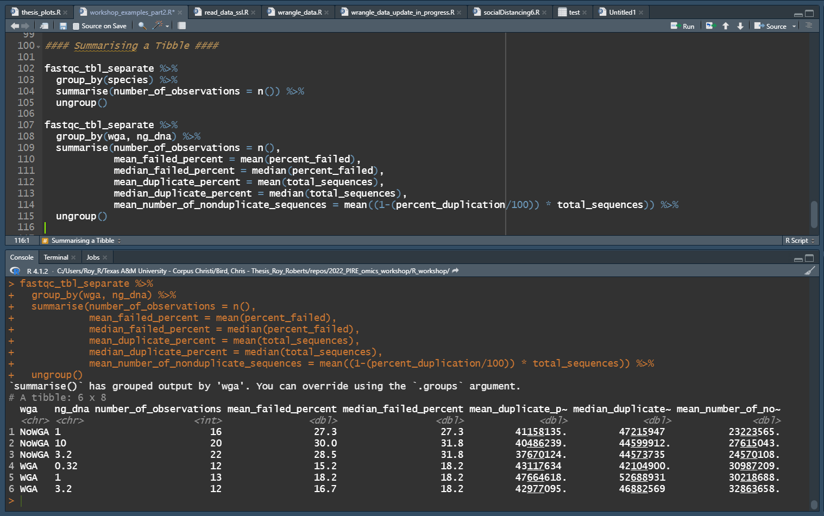

Slide 23
Tidyverse Activity 5
Create mean_weight and summarise mean_weight by grouping by haircolor and sex, calculating the following:
Count, n()
Mean, mean()
Standard Deviation, sd()
Median, median()
Interquartile Range, IQR()

