Slide 1
An Introduction to R and R Studio
Roy Roberts

Slide 2

The Tidyverse
“The tidyverse is an opinionated collection of R packages designed for data science. All packages share an underlying design philosophy, grammar, and data structures.”

Slide 3
The Tidyverse
What is tidy data?
Every column is a variable
Every row is an observation
Every cell is a single value

Slide 4
Packages in Tidyverse
Core Tidyverse contains:
tibble
ggplots2
dplyr
tidyr
readr
purrr
stringr
forcats

Slide 5
How to Install and Load Tidyverse
Installing and loading Tidyverse
install.packages(“tidyverse”)
library(tidyverse)

Slide 6
Things to know before starting Tidyverse
%>%

Slide 7
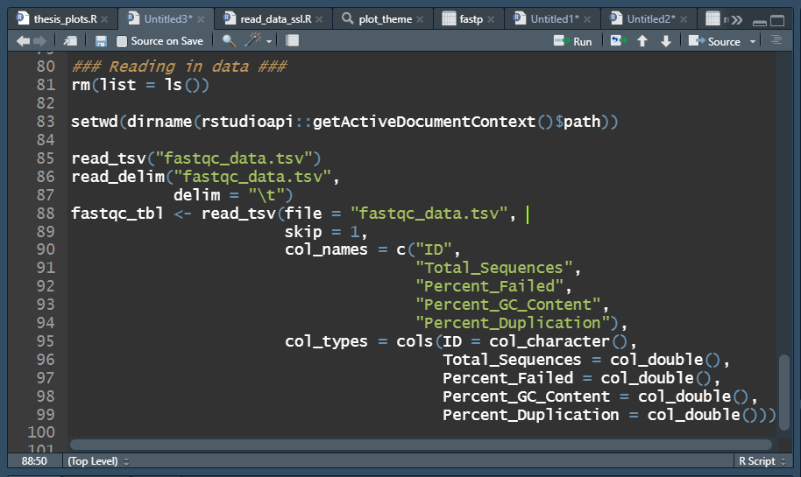
Reading in Data With readr
Package ‘readr’
read_tsv()
read_csv()
read_delim()
read_table()
Package ‘readxl’
read_excel()

Slide 8
Reading in Data With readr
Helpful options:
read_FILETYPE(
file = “path_to_file”,
skip = Integer,
col_names = c(“vector”, “of”, “colnames”),
col_types = cols(colname = col_type())
)

Slide 9
Tidyverse Assignment 1
Read in altered “Davis” from car dataset from the 2022_PIRE_omics_workshop
Save as a variable
Try and use some of the other options when saving as a variable

Slide 10
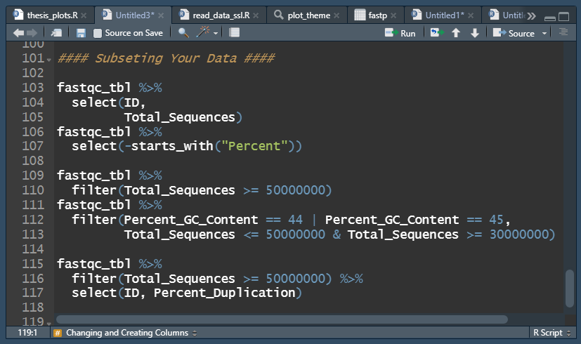
Subsetting Data in R
select()
Subsets columns of a tibble
filter()
Subsets rows of a tibble

Slide 11
Transforming Data in R
mutate()
Create, modify, and delete columns
data %>% mutate(New_Column = Column_1 * Number)
data %>% mutate(Column_1 = Column_1 * Number)
case_when()
A general vectorized conditional (if) statement that can be used with mutate
data %>% mutate(New_Column = case_when(Column1 == Value ~ Value,
Column1 == Value ~ Value))

Slide 12
Tidyverse Assignment 2

Slide 13
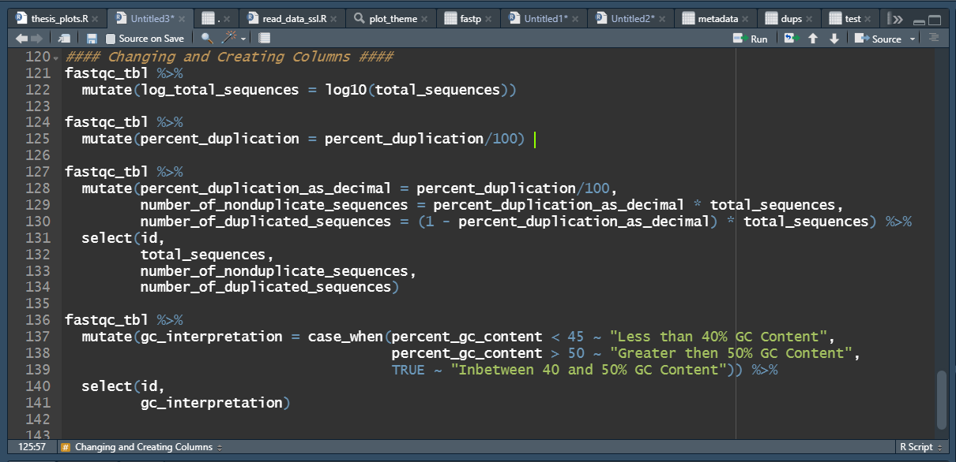

Slide 14
Transforming Data in R
relocate()
Change column order
unite()
Unite multiple columns into one by pasting strings together
mutate()
Separate a character column into multiple columns with a regular expression or numeric locations

Slide 15
Transforming Data in R
unite()
data %>% unite(“New_Column”,
columns_to_select,
sep = “delimiter”,
keep = FALSE)
separate()
data %>% separate(Column_1,
into = c(“New_Col1”, “New_Col2”, “New_Col3”),
sep = “delimiter”,
keep = FALSE)

Slide 16
