Slide 1
HoloViews: Let your Data Reveal Itself
Philipp Rudiger, Jean-Luc Stevens and James A. Bednar
© 2016 Continuum Analytics

Slide 2
“Stop plotting your data - annotate your data and let it visualize itself.”
© 2016 Continuum Analytics

Slide 3
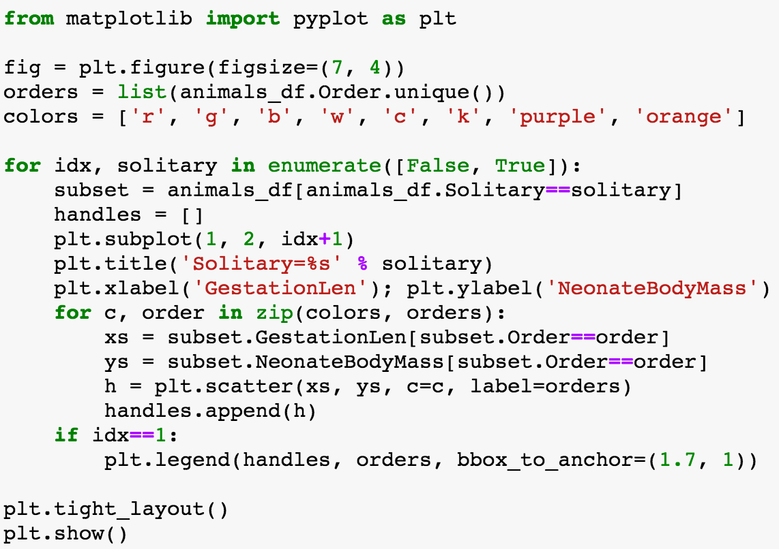
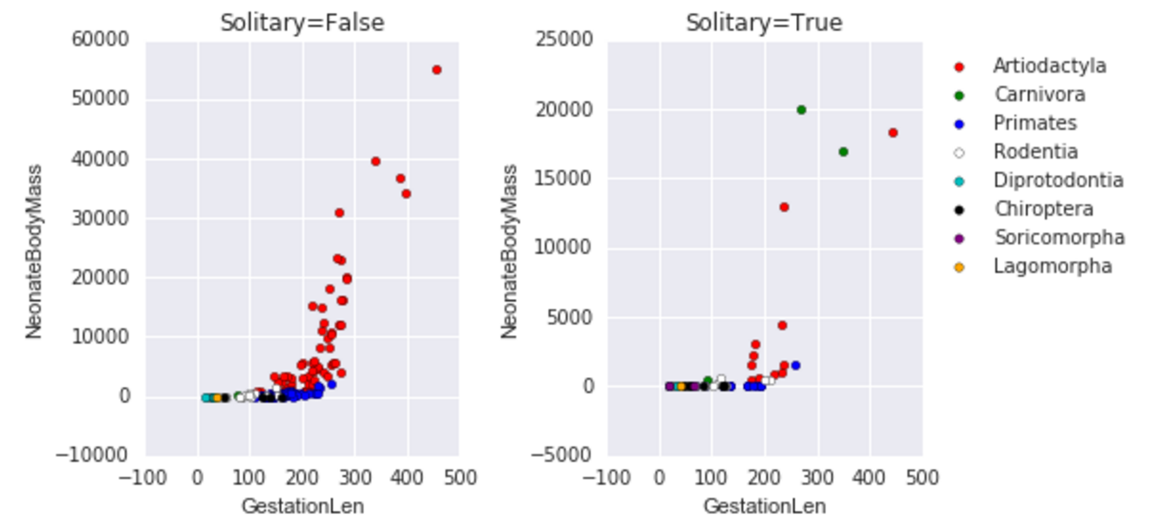
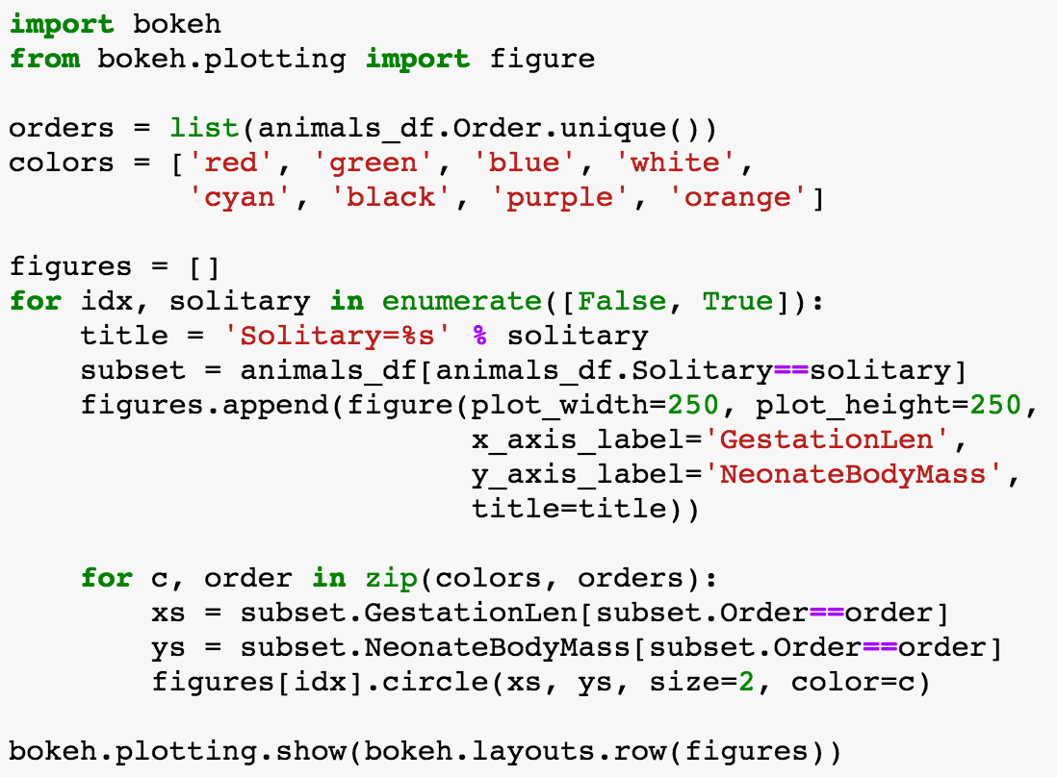
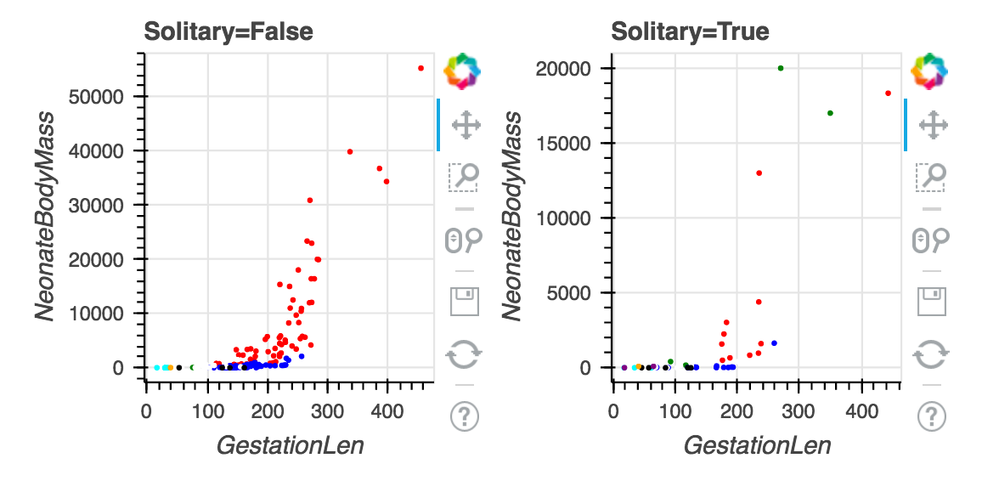
Matplotlib
Bokeh
© 2016 Continuum Analytics

Slide 4
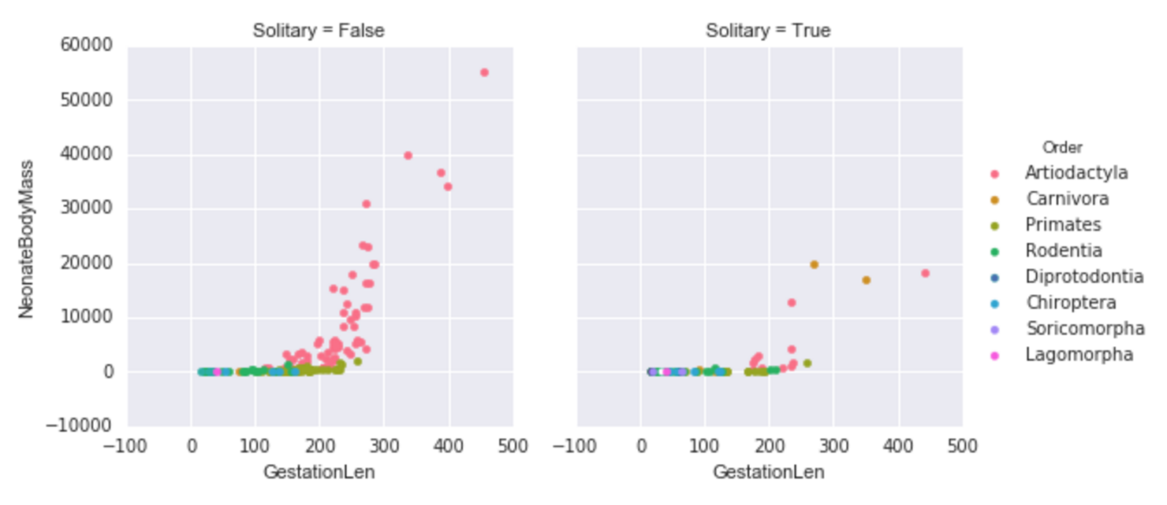
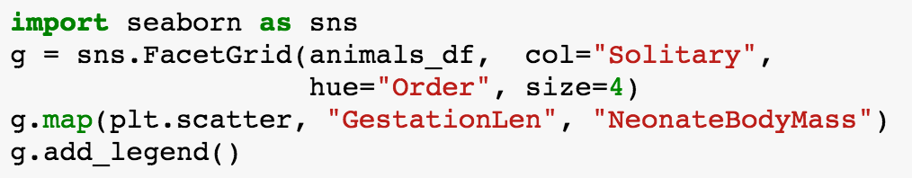
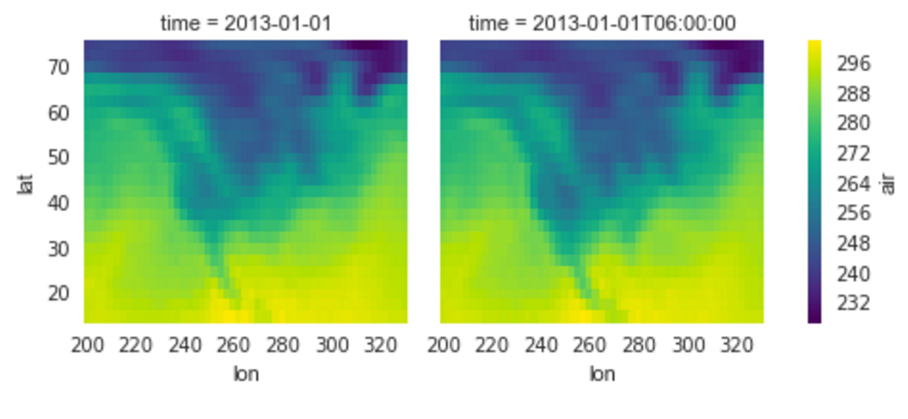
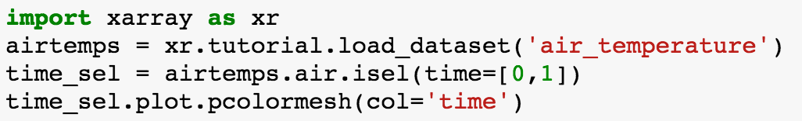
Seaborn
XArray
© 2016 Continuum Analytics

Slide 5
Analysis Methods
.groupby: Faceting
.to: Convert to any Element
.sort: Sort by value
.select: Selecting a subset by value
.aggregate: Aggregation with a ufunc

Slide 6
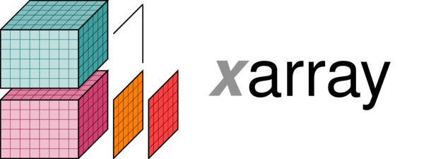
Data Interfaces
Column based:
NumPy: Supports numeric data
Pandas: Supports any kind of data
Grid based:
NumPy
xarray
iris

Slide 7
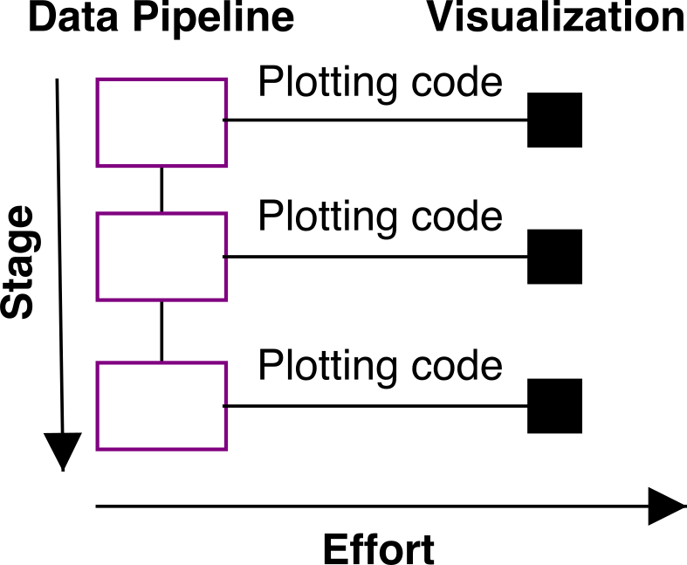
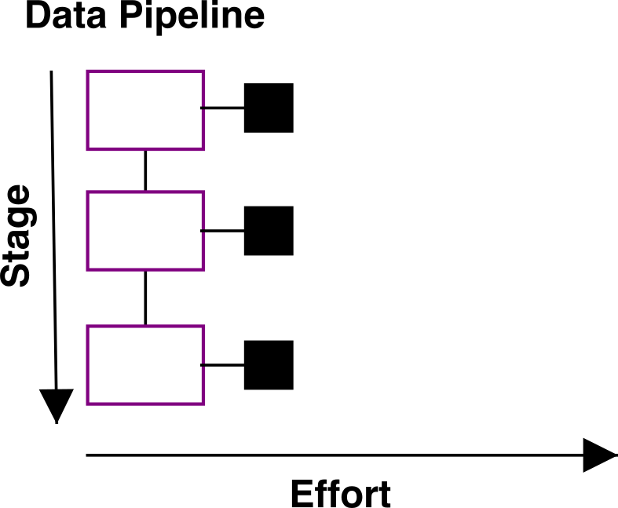
Workflow Differences
Without HoloViews
With HoloViews
© 2016 Continuum Analytics

Slide 8
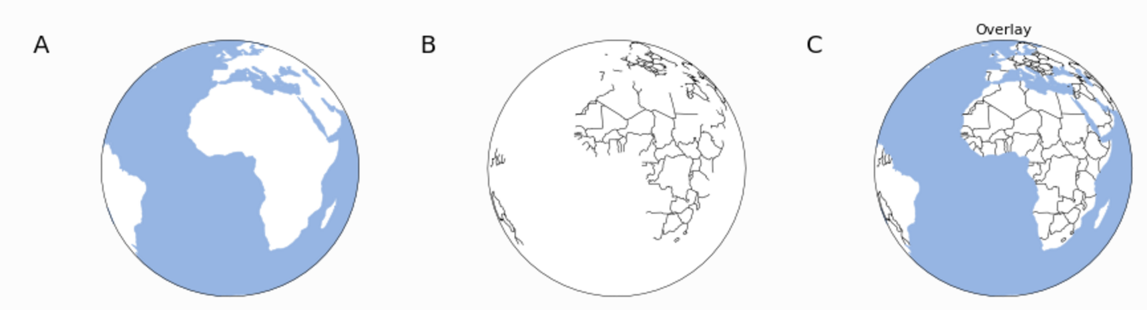
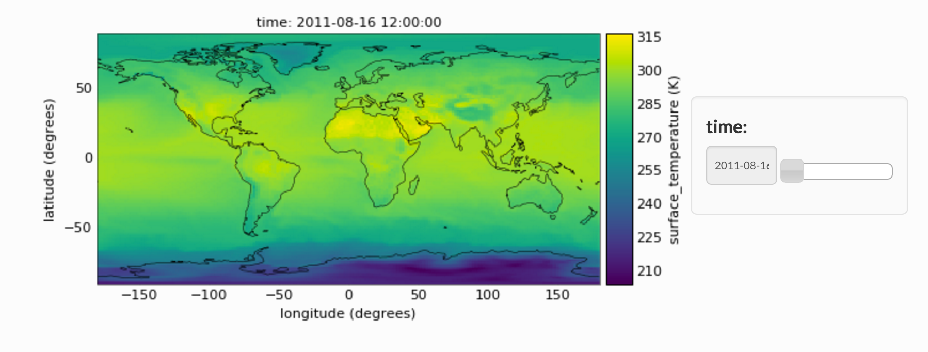
GeoViews
(geo.holoviews.org)
© 2016 Continuum Analytics

Slide 9
More information
© 2016 Continuum Analytics

Slide 10
Open to questions!
Visit holoviews.org and geo.holoviews.org
Join us on gitter.im/ioam/holoviews
We will also be available at the Continuum Happy Hour and please drop by! (6-9 pm RSVP @ bit.ly/anacondahh)
© 2016 Continuum Analytics

Slide 11
© 2016 Continuum Analytics- Confidential & Proprietary

Slide 12
© 2016 Continuum Analytics- Confidential & Proprietary

Slide 13
© 2016 Continuum Analytics- Confidential & Proprietary

Slide 14
© 2016 Continuum Analytics- Confidential & Proprietary

Slide 15
© 2016 Continuum Analytics- Confidential & Proprietary

Slide 16
© 2016 Continuum Analytics- Confidential & Proprietary

Slide 17

© 2016 Continuum Analytics- Confidential & Proprietary

Slide 18
© 2016 Continuum Analytics- Confidential & Proprietary

Slide 19
© 2016 Continuum Analytics- Confidential & Proprietary

Slide 20
© 2016 Continuum Analytics- Confidential & Proprietary

Slide 21
© 2016 Continuum Analytics- Confidential & Proprietary

Slide 22
© 2016 Continuum Analytics- Confidential & Proprietary

