Slide 1
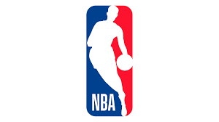
THE FANDOMS OF THE NBA
Social Media Research Project by Philipp Kläger
SNR: 2062105

Slide 2
I. Motivation
Initial Questions
Why do people love sports so much?
How are NBA teams perceived differently
Research Gap: surprisingly little research on fan behavior and its respective emotions.
Purpose of this Study:
add to the already existing scenery of empirical studies with an exploratory analysis of sentiments and emotions towards different NBA teams
synthesize the current status of research regarding the sentiments and emotions towards sports teams, as well as provide an industry background regarding the characteristics and possible differences between current NBA teams and its supporters

Slide 3
II. Data
Source: Twitter Search API
Seeds: NBA Team Names as hashtags
Time Frame: March 13th – March 20th 2021
Variable | Unique (#) | Missing (%) | Mean | SD | Min | Median | Max
Character Length | 287 | 0 | 107.7 | 88.3 | 4.0 | 77.0 | 294.0
Favorite Count | 169 | 0 | 8.2 | 109.6 | 0.0 | 0.0 | 5826.0
Retweet Count | 63 | 0 | 0.7 | 8.7 | 0.0 | 0.0 | 409.0
N: 9714 observations

Slide 4
III. Methodology
Sentiment Analysis
NRC Word-Emotion Association Lexicon
Sentiments: Anger + Anticipation + Disgust + Fear + Joy + Sadness + Surprise + Trust
Emotions: Negative + Positive
Linear Regressions
30 regressions of the type:
team_id ~ sentiments + emotions

Slide 5
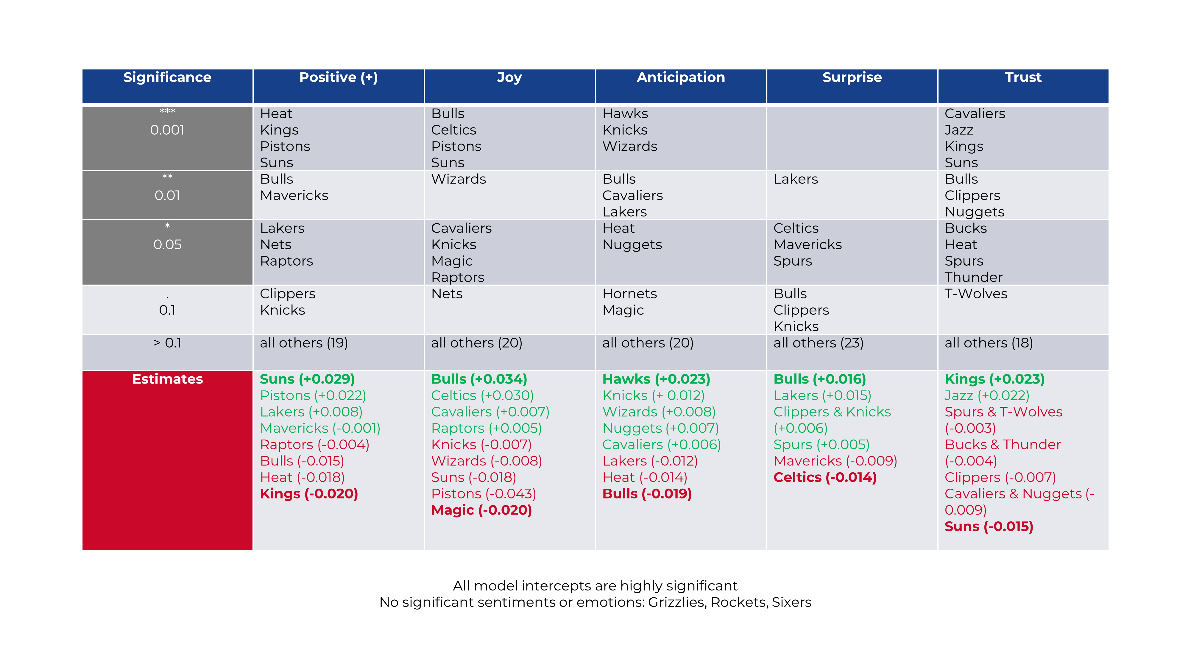
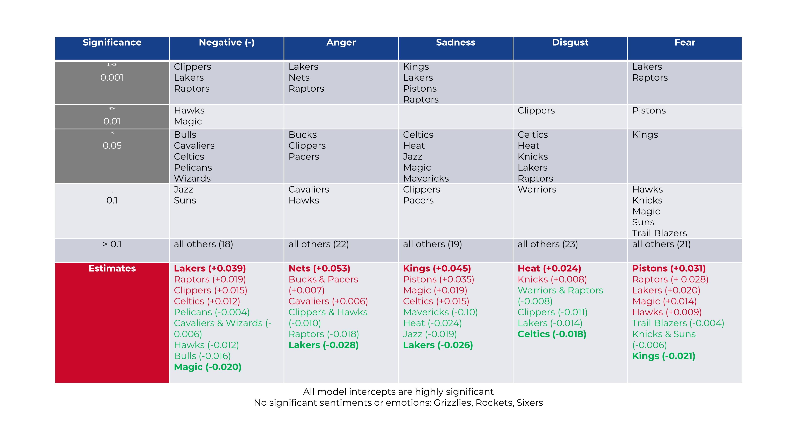
IV. Results

Slide 6
V. Conclusions
Literature Review
NBA fandom is often dependent on a supporter’s location
Recent success can be the source of both allegiance and resentment towards NBA teams
Analysis
Sentiments and emotions towards different NBA teams are not only different, but also ambivalent in its direction. There are no teams that are "purely" perceived in a negative or positive manner.
Small market teams do more on social media: in a increasingly globalizing world, where the Covid-19 pandemic has accelerated the diminishing importance of locations in the real-world in favor of digital experiences, social media strategies like this could enable small market teams to even up the playing field with the traditionally successful teams that reside in the metropolis cities of Northern America.

