Slide 1
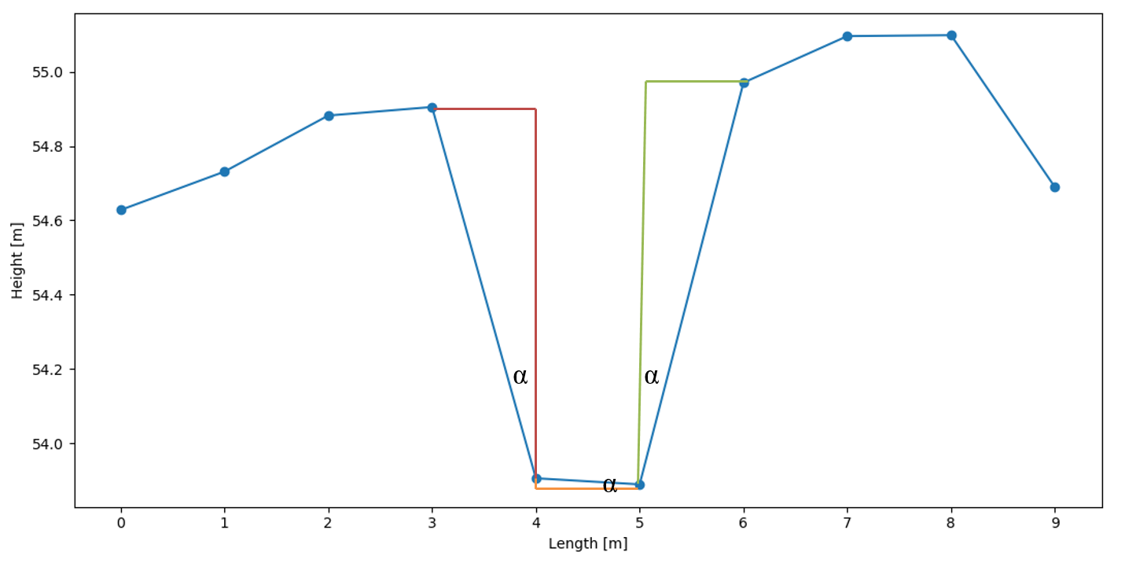
Analysis direction
left
right
Highest point right
Highest point left
Lowest point

