Slide 2
Python in the world of mail order and retail
EuroPython 2015, Dr. Philipp Mack

Slide 3
Agenda
Use cases in the ‘real’ world for a replenishment solution
Simplified and purified use case – the essence
What you need – the ingredients
Putting it all together – the cook book
What do you get at the end – the meal
or a simple replenishment application

Slide 4
Material
Where can you find everything ?
https://github.com/philippmack/europython2015-pmack.git
Includes this presentation, notebooks, examples and
the framework

Slide 5
Real world use cases
Mail order
Estimate what will be ordered by customers the next days and preorder the right amount to minimize delivery time for the customers
O(100000) items
Seasonality / delivery time of goods
Slow selling goods and returns

Slide 6
Real world use cases
Retail
Predict the correct order amount of goods to minimize out-of-stock situations as well as the surplus
O(100) items and O(100) locations
Seasonality / events / weather / expiry date
Fast moving goods

Slide 7
Simplified use case
What is the purified essence of these examples ?
Know the demand and stocks for certain periods or
points in time depending on the delivery time and the frequency of orders
Order the right amount of items considering given conditions like expiry range, availability, excess …

Slide 8
Simplified use case
Predict the correct order amount of goods to minimize out-of-stock situations as well as the surplus
Simulated data – timeseries of poisson distributed sales
Order every day in the evening
Throw everything away in the evening
Delivery the next morning

Slide 9
Framework
What are the prerequisites for a basic/simple solution?
No input/output interface
Data is stored in csv-files – no database
Prediction/simulation/replenishment module
Testing – code and configuration
Plotting/reporting/monitoring
Logging
Documentation
Deployment

Slide 10
Ingredients
Predictions
We need to know the tomorrow‘s demand
Model examples :
Take yesterday‘s sales
Take last week sales of same weekday
Rolling mean
Moving average
Gradient boost …

Slide 11
Ingredients
Order calculation
stock in the evening : 0 ,
demand interval : 1 day , forecast horizon : 1 day
order = demand of tomorrow – stock in the evening
stock
demand
order
incoming
today
tomorrow

Slide 12
The cook book
Simulation
Predict demand for each day on test sample
Take yesterday‘s demand
Rolling mean of the last five days
Calculate order for these demands with a given strategy
Order the expectation value of your prediction
Take quantile x from a assumed probabilty density

Slide 13
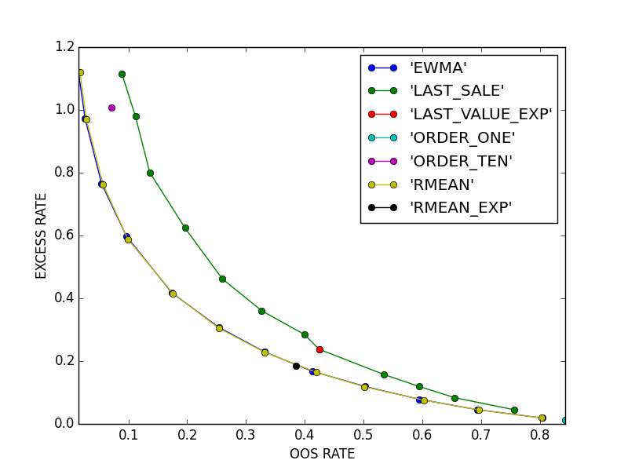
The cook book
Evaluation of working points for a replenishment solution
Excess rate :
surplus amount/
sold amount
OOS rate :
‚item‘ days out of stock/
all items times days

Slide 14
The cook book
Paralellisation :
https://docs.python.org/2/library/multiprocessing.html
from multiprocessing import Pool
p = Pool(4)
result = p.map(f,list_of_values)
For multiple hosts :
Redis : https://redis-py.readthedocs.org/en/latest/

Slide 15
The cook book
Testing :
Code :
http://pytest.org/latest/
https://pypi.python.org/pypi/pytest-cov
Config : yaml / json
https://pypi.python.org/pypi/voluptuous

Slide 16
The cook book
Replenishment
Chose a strategy and the working point
derived from your simulation and
calculate an order for the next day
for each given product

Slide 17
The cook book
What is missing ?
Logging :
https://docs.python.org/2/library/logging.html
Reporting/Monitoring/Plotting :
http://matplotlib.org/
http://stanford.edu/~mwaskom/software/seaborn/
http://bokeh.pydata.org/en/latest/

Slide 18
The cook book
What is missing ?
Documentation :
http://sphinx-doc.org/
Deployment :
http://docs.ansible.com/developing_api.html
http://www.ansible.com/application-deployment

Slide 19
The meal
Putting it all together
Logging
Prediction
Replenishment rules
Tests
Replenishment
Simulation
Documentation

Slide 20
What‘s the lesson ?
This simple replenishent framework provides a
basic solution for an order forecast system and includes
all the necessary requirements on a simple level.
Thank you for your attention and visit us at our
blue yonder booth

