Slide 1
EMPIR CALL 2020
Metrology infrastructure for high-pressure gas and liquified hydrogen flows
CFD Workshop
Part 3: Tutorial case of a critical nozzle
"FROM Adjusting the mesh TO visualiZing the flow field"
Sebastian Weiss
Working Groups 8.41 “Modelling and Simulation” and 1.45 “Hydrogen Quantity Metering”
Physikalisch-Technische Bundesanstalt (PTB), Berlin, Germany
CFD Workshop – Part 3 15 June 2023 Borås, SWE

Slide 2
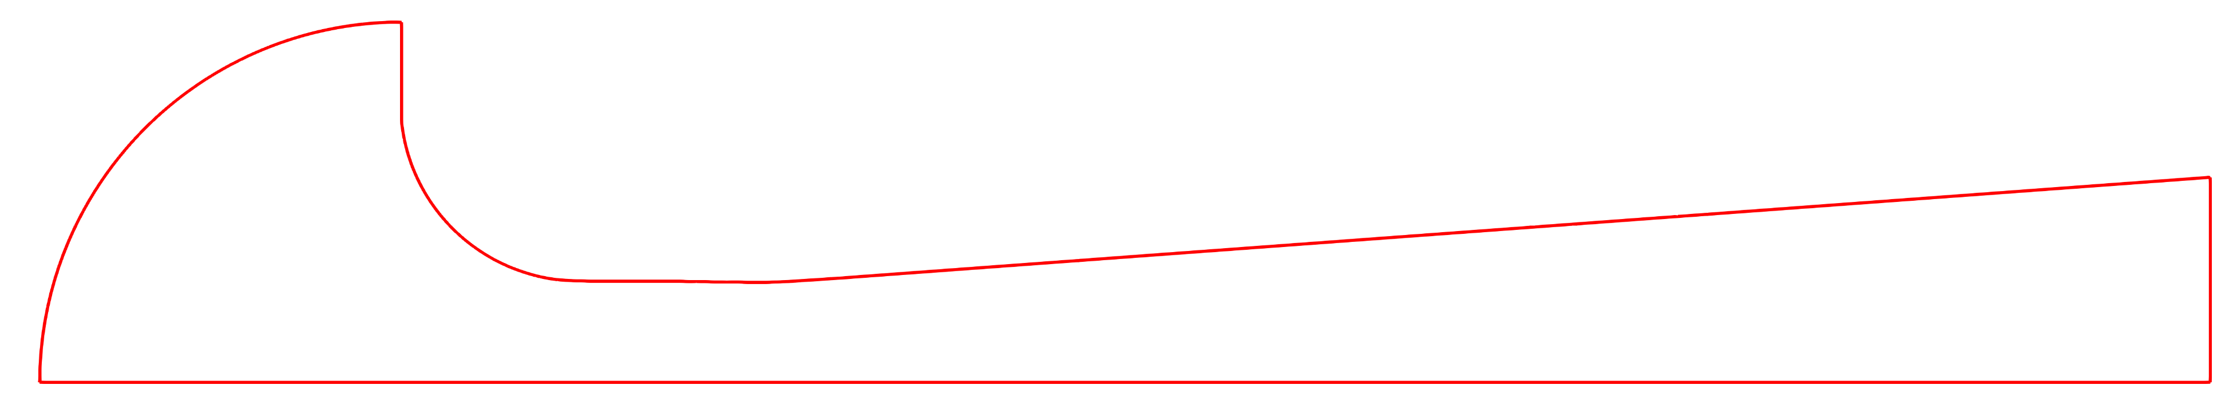









Tutorial case description
High-pressure hydrogen flow through a cylindrical non-ideal critical nozzle
Inlet:
Wall:
A – A
$$p_{0}=200 bar$$
Outlet:
$$T_{0}=300 K$$
Measured nozzle contour from project
$$α=5°$$
$$p_{s}=100 bar$$
A
$$α$$
$$y$$
$$z$$
$$d/2$$
A
$$d=1 mm$$
Simulation is conducted with OpenFOAM version:
ESI OpenCFD Release OpenFOAM® v2012 (20 12)

Slide 3



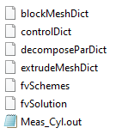
Agenda (Part 1)
OpenFOAM folder structure
/
turbulent thermal diffusivity
turbulence kinetic energy
turbulent viscosity
turbulence specific dissipation rate
pressure
temperature
velocity
Pre-processing
Geometry creation
Mesh creation
Numerical setup
Boundary conditions
Turbulence model
Real gas model
Numerical settings
/
thermophysical properties
turbulence properties
/
mesh settings
simulation settings
decomposition settings
mesh extrusion settings
numerical schemes
numerical solvers
nozzle contour file

Slide 4
Agenda (Part 1)
OpenFOAM folder structure
/
turbulent thermal diffusivity
turbulence kinetic energy
turbulent viscosity
turbulence specific dissipation rate
pressure
temperature
velocity
Pre-processing
Geometry creation
Mesh creation
Numerical setup
Boundary conditions
Turbulence model
Real gas model
Numerical settings
/
thermophysical properties
turbulence properties
/
mesh settings
simulation settings
decomposition settings
mesh extrusion settings
numerical schemes
numerical solvers
nozzle contour file

Slide 5






1. Geometry creation
Nozzle contour file
Meas_Cyl.out
$$BSy$$
$$BSd$$
$$BSz$$
$$d/2$$
$$=0.5$$
Nozzle contour file is created using Python script
Specific file format required for later use in meshing tool
BSz: vector of axial nozzle coordinates
BSy: vector of radial nozzle coordinates
BSd: index of throat diameter position
Note: throat diameter is always normalized to 1 in this file
Functions are available for:
Toroidal nozzles (Tor_ideal)
Cylindrical nozzles (Cyl_ideal)
Measured nozzles (Meas_CFVN)
Creation of geometry file (create_geometry_file)
Let’s have a look at how to create the geometry file Meas_Cyl.out for our tutorial case
Nozzle contour file format
(for use in blockMesh)
$$BSz \left( z_{0} z_{1} …z_{nz−1} \right);$$ $$BSy \left( y_{0} y_{1} …y_{nz−1} \right);$$
$BSd {index}_{d};$

Slide 6
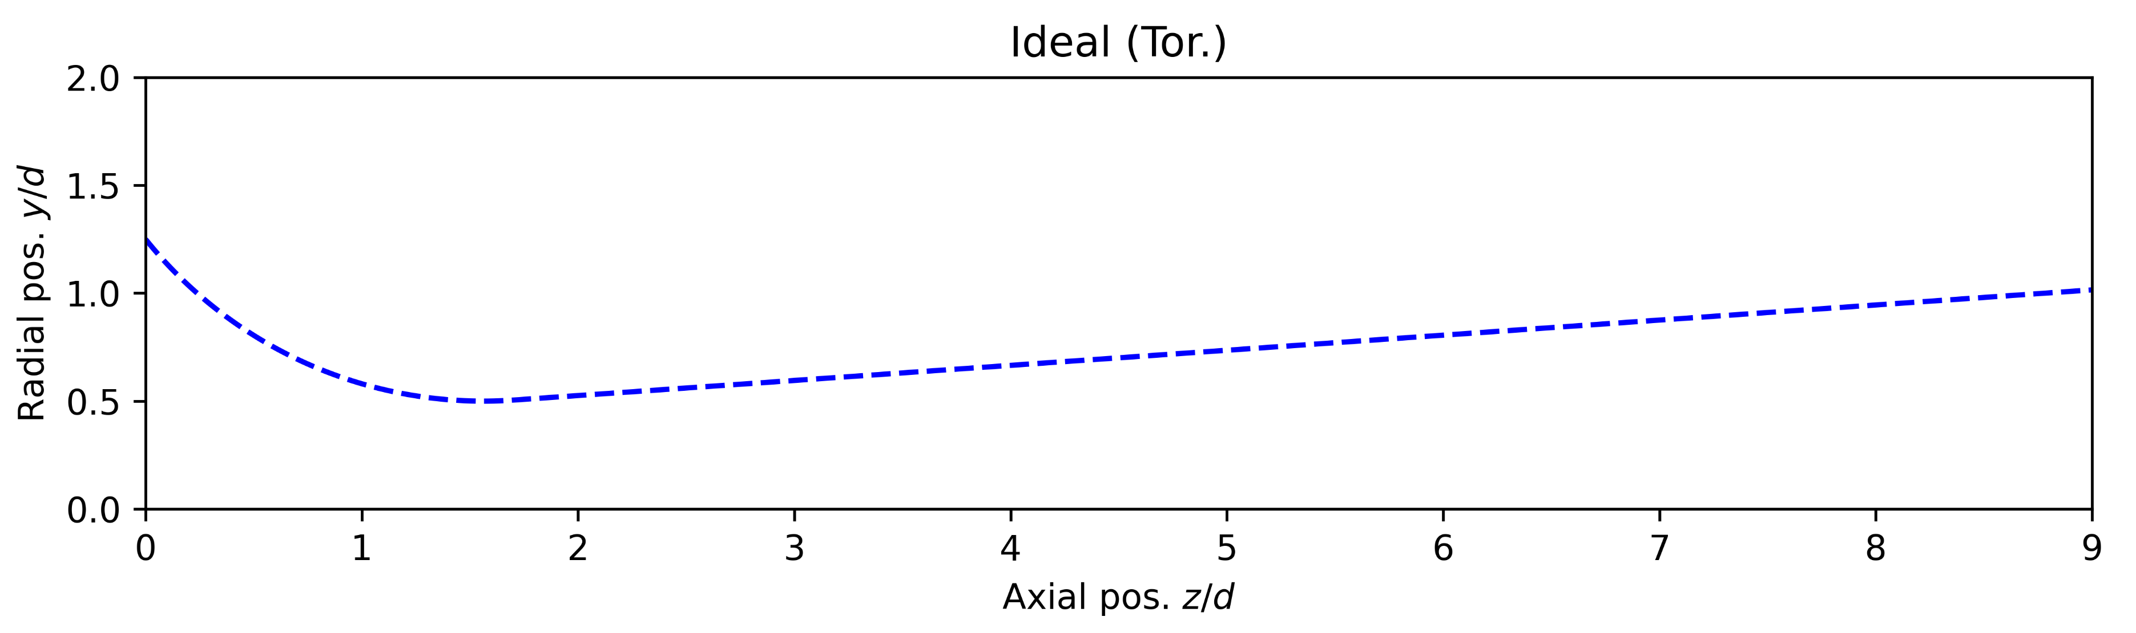
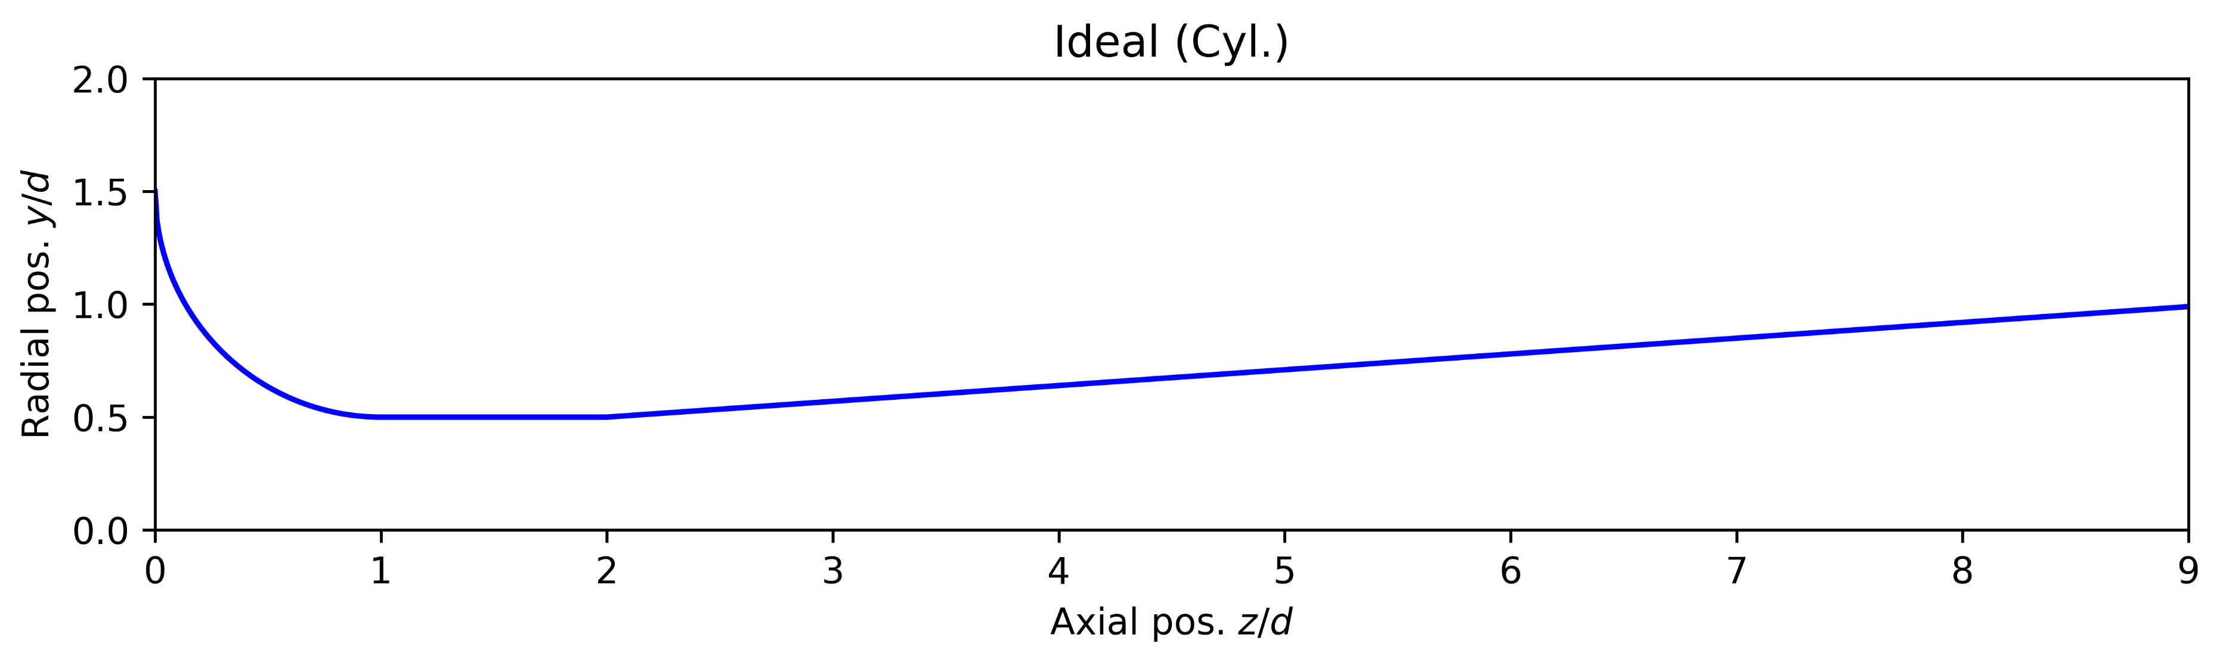
1. Geometry creation
Recap of the geometry functions
Ideal toroidal nozzle:
Function: Tor_ideal(l, al, nz)
Parameters:
l nozzle length (in d)
al diffusor angle (in °)
nz number of points
zd, yd, dpos = Tor_ideal(9.0, 4.0, 1000)
nz
al
l
Ideal cylindrical nozzle:
Function: Cyl_ideal(l, al, nz)
Parameters:
l nozzle length (in d)
al diffusor angle (in °)
nz number of points
zd, yd, dpos = Cyl_ideal(9.0, 4.0, 1000)

Slide 7
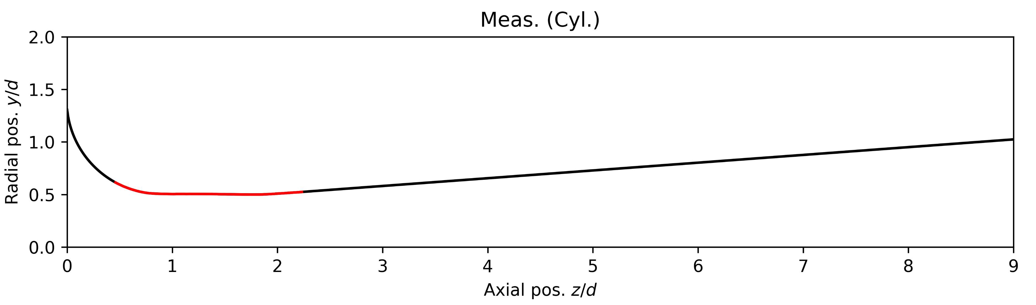
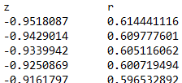
1. Geometry creation
Recap of the geometry functions
Measured nozzle:
Function: Meas_CFVN(meas_data, NType, l, n_in, n_out)
zd, yd, dpos, zdRaw, ydRaw = Meas_CFVN(‘Cyl_D1_meas.txt’, 0, 9.0, 40, 25)
meas_data
n_in
n_out
l
Parameters:
meas_data file containing measured contour data
(list of z and y positions, tab-separated)
NType nozzle type (0 if cylindrical, 1 if toroidal)
l nozzle length (in d)
n_in point index for inlet circle (in meas_data)
n_out point index for outlet slope
(counted from last index in meas_data)
meas_data
NType
From CMM measurement:
Cyl.
0
Cyl_D1_meas.txt
1
Tor.

Slide 8
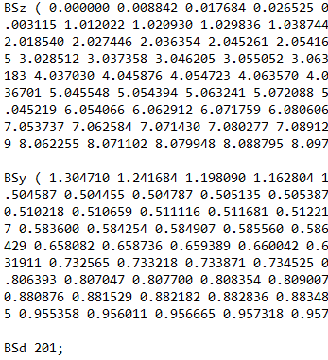
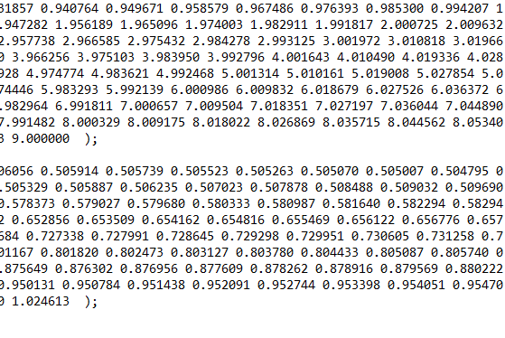
1. Geometry creation
Recap of the geometry functions
Creation of geometry file:
Function: create_geometry_file(name, BSz, Bsy, BSd)
Parameters:
name name of output file (here: Meas_Cyl.out)
BSz vector of axial nozzle coordinates (already created)
BSy vector of radial nozzle coordinates (already created)
BSd index of throat diameter position (already created)
Output file (Meas_Cyl.out)
…
…
Geometry is created 

Slide 9
Agenda (Part 1)
OpenFOAM folder structure
/
turbulent thermal diffusivity
turbulence kinetic energy
turbulent viscosity
turbulence specific dissipation rate
pressure
temperature
velocity
Pre-processing
Geometry creation
Mesh creation
Numerical setup
Boundary conditions
Turbulence model
Real gas model
Numerical settings
/
thermophysical properties
turbulence properties
/
mesh settings
simulation settings
decomposition settings
mesh extrusion settings
numerical schemes
numerical solvers
nozzle contour file

Slide 10
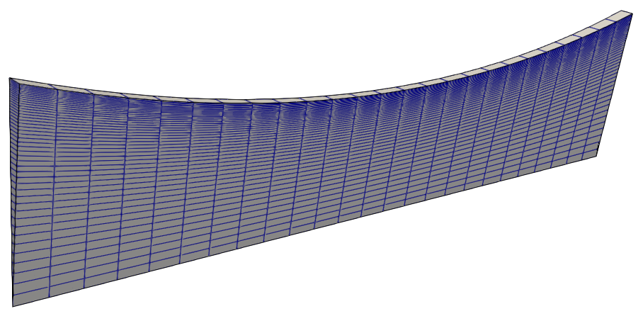
2. Mesh creation
Mesh is created using blockMesh utility in OpenFOAM
blockMesh generates hexaedral meshes from geometry using block structure
Mesh information is written in blockMeshDict file
We will create the mesh for the measured cylindrical nozzle geometry with a blockMesh-based nozzle meshing tool
But first, let’s have a look at a simple example to understand the blockMesh structure
Simple example

Slide 11
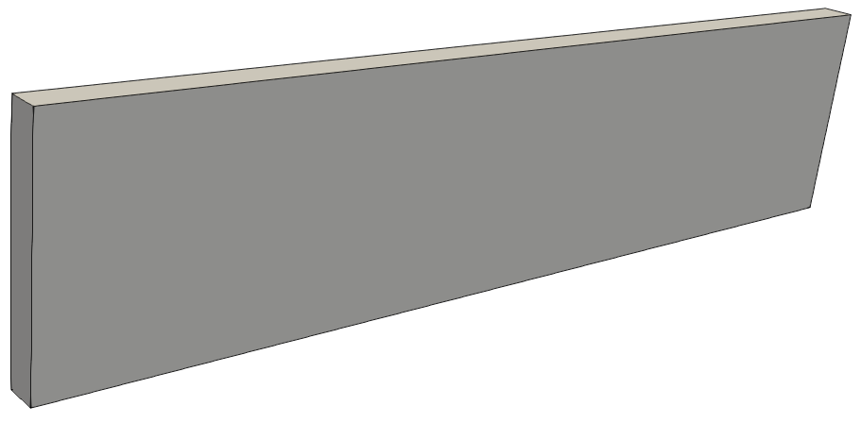
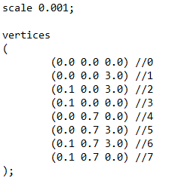
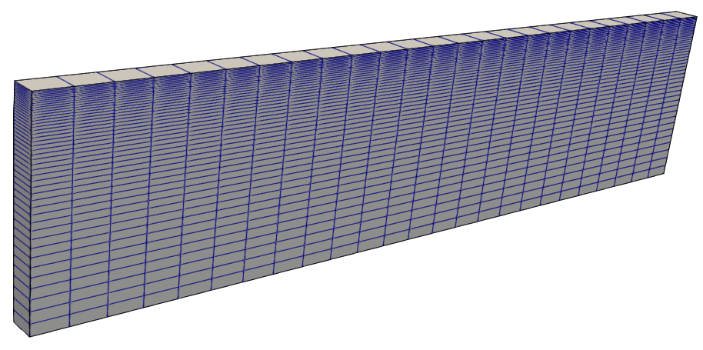

2. Mesh creation
Simple example (blockMeshDict file)
scale: Scaling factor (0.001 scales to mm)
6
0.1 mm
5
7
4
2
vertices: List of vertex coordinates
0.7 mm
1
x
y
3 mm
3
z
0
6
5
7
blocks: Ordered list of vertex labels and mesh size
4
2
1
Vertex numbers
Number of cells in each direction
Cell expansion ratios
3
0

Slide 12

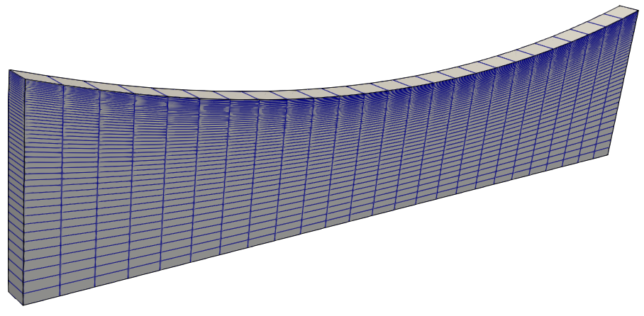
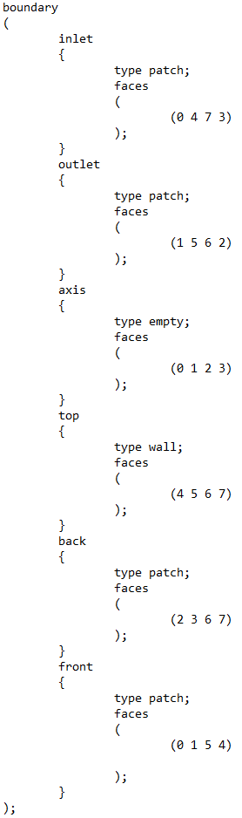
2. Mesh creation
edges: Used to define arc or spline edges
boundary: List of boundary faces and type
back
top
6
5
7
outlet
4
2
1
inlet
front
3
axis
0

Slide 13
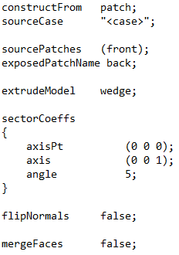
2. Mesh creation
extrudeMeshDict: Used to create a 5° wedge sector mesh
back
top
6
5
7
outlet
4
2
1
inlet
front
3
axis
0
Now we create the mesh for our tutorial case using more advanced nozzle meshing tool

Slide 14
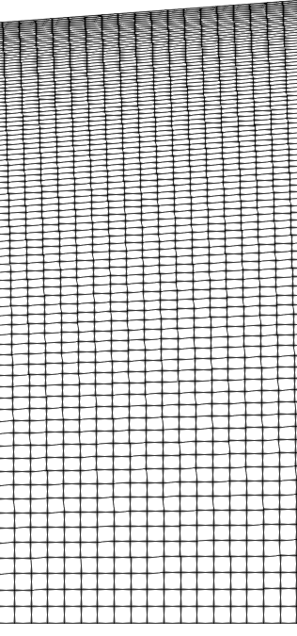
2. Mesh creation
2D meshing tool to create an arbitrary nozzle contour
li
Nozzle contour
Meas_Cyl.out
t1
gy = t2/t1
y
cy
z
d/2
t2
cz
User input mask (in blockMeshDict)
Input variables
Geometry
sc scaling factor (sc = 0.001 → d = 1 mm)
li inlet length (in d)
Nozzle contour file
Mesh
cy number of cells in the y-direction
cz number of cells in the z-direction
gy grading in the y-direction
// * * * * * * * * * * * MESH GENERATION TOOL OF 2D NOZZLE * * * * * * * * * //
// //
// * * * * * * * * * * * * * * * INPUT PARAMETERS * * * * * * * * * * * * * //
// //
// - - - - - - - - - - - - - - - - - Geometry - - - - - - - - - - - - - - - //
// //
sc 0.001; // Scaling factor (sc = 0.001 ==> d = 1 mm) //
li 0.5; // Inlet length (in d) //
// list of z and y coordinates of nozzle contour //
#include "Meas_Cyl.out"; //
// //
// - - - - - - - - - - - - - - - - - - Mesh - - - - - - - - - - - - - - - - //
// //
cy 90; // Number of cells in y of nozzle //
cz 600; // Number of cells in z of nozzle //
gy 10; // Grading in y towards nozzle wall //
// //
// * * * * * * * * * * * * * * * * * * * * * * * * * * * * * * * * * * * * * //

Slide 15
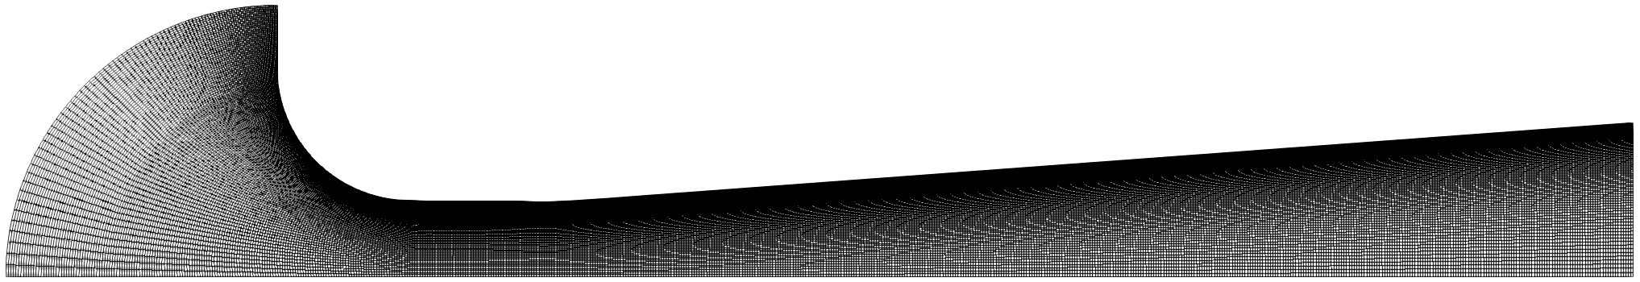
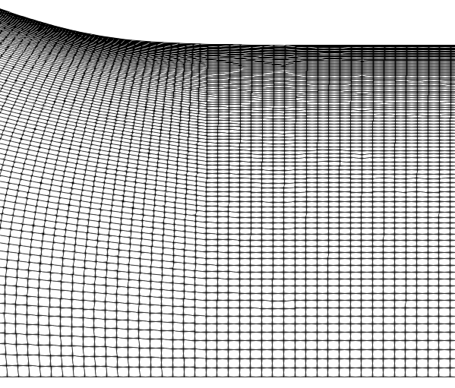
2. Mesh creation
2D meshing tool to create an arbitrary nozzle contour
Use the following command to create the mesh
blockMesh && extrudeMesh &
y
z
The following folders have been created and contain mesh information
/
/
Command checkMesh can be used to check the mesh metrics (skewness, orthogonality, aspect ratio, etc.)
Let‘s see the mesh in ParaView
Mesh is created 

Slide 16
Agenda (Part 1)
OpenFOAM folder structure
/
turbulent thermal diffusivity
turbulence kinetic energy
turbulent viscosity
turbulence specific dissipation rate
pressure
temperature
velocity
Pre-processing
Geometry creation
Mesh creation
Numerical setup
Boundary conditions
Turbulence model
Real gas model
Numerical settings
/
thermophysical properties
turbulence properties
/
mesh settings
simulation settings
decomposition settings
mesh extrusion settings
numerical schemes
numerical solvers
nozzle contour file

Slide 17





3.a) Boundary conditions
inlet
$$p_{0}=200 bar$$
$$T_{0}=300 K$$
top
front
back
$$d/2$$
$$d=1 mm$$
axis
outlet
$$p_{s}=100 bar$$
First, let‘s estimate the throat Reynolds number

Slide 18
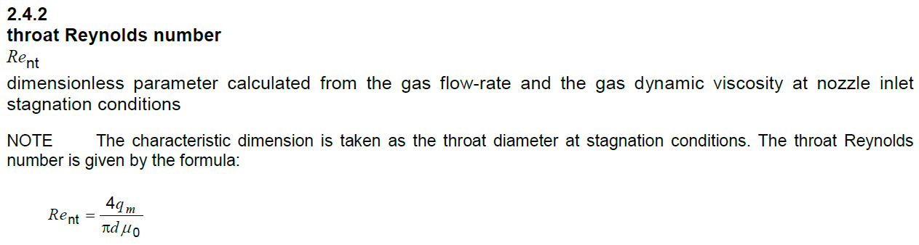
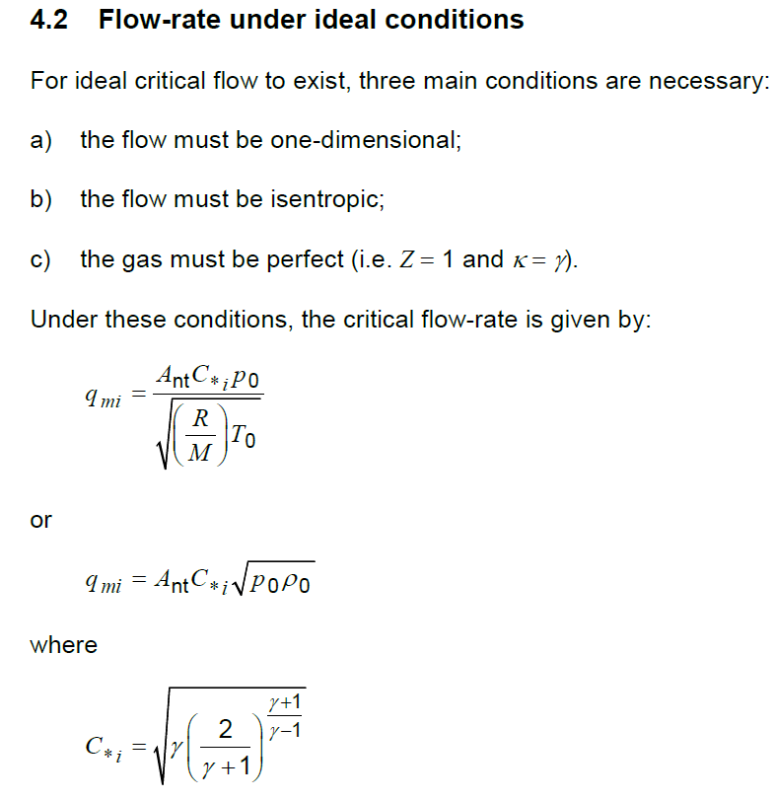

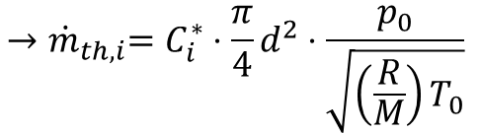
3.a) Boundary conditions
Estimation of throat Reynolds number
Use definitions from ISO 9300
For reasons of simplicity, assume ideal gas and isentropic, 1D flow
Throat Reynolds number
Ideal mass flow rate
$$→Re_{nt,th,i}=\frac{4{\dot{m}}_{th,i} }{πdμ_{0}}$$
$${→\dot{m}}_{th,i}=C_{i}^{∗}⋅\frac{π}{4}d^{2}⋅\frac{p_{0}}{\sqrt{\left(\frac{R}{M}\right)T_{0}}}$$
We often take this expression for granted
But how can we actually derive this formulation?

Slide 19




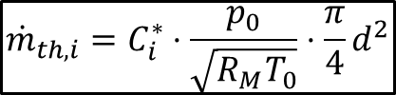









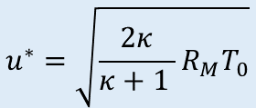


3.a) Boundary conditions
Critical area
$$A^{∗}=\frac{π}{4}d^{2}$$

$$p_{0}, T_{0}$$
$$ρ^{∗}, u^{∗}, A^{∗}$$
critical*
Critical velocity
Isenthalpic process
(constant total enthalpy)
Critical Mach number
$$h_{0}=h^{∗}+\frac{1}{2}{u^{∗}}^{2}$$
Ideal gas
Mass flow rate
$$M^{∗}=\frac{u^{∗}}{a^{∗}}=1$$
$$κ=\frac{c_{p}}{c_{v}}$$
( in ISO 9300)
$${\dot{m}}_{th,i}=C_{i}^{∗}⋅\frac{p_{0}}{\sqrt{R_{M}T_{0}}}⋅\frac{π}{4}d^{2}$$
$$γ$$
$$u^{∗}=a^{∗}=\sqrt{κR_{M}T^{∗}}$$
$${c_{p}T}_{0}={c_{p}T}^{∗}+\frac{1}{2}κR_{M}T^{∗}$$
$$R_{M}=c_{p}−c_{v}$$
Rearranging
How can we derive this equation?
Critical temperature is still unknown
$$T_{0}=T^{∗}\left(1+\frac{1}{2}⋅\frac{κR_{M}}{c_{p}}\right)$$
$$1+\frac{1}{2}⋅\frac{κR_{M}}{c_{p}}$$
Start with simple definition:
$$=1+\frac{1}{2}⋅\frac{c_{p}\left(c_{p}−c_{v}\right)}{c_{v}⋅c_{p}}$$
$${\dot{m}}_{th,i}=ρ^{∗}u^{∗}A^{∗}$$
$$u^{∗}=\sqrt{\frac{2κ}{κ+1 }R_{M}T_{0}}$$
$$T^{∗}=T_{0}\left(\frac{2}{κ+1}\right)$$
Assume:
Ideal gas
Reversible process
Adiabatic process
1D flow
$$=1+\frac{κ−1}{2}=\frac{κ+1}{2}$$

Slide 20


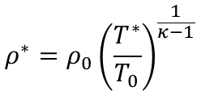

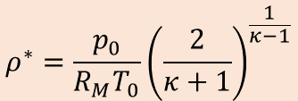



3.a) Boundary conditions
Critical area
$$A^{∗}=\frac{π}{4}d^{2}$$

$$p_{0}, T_{0}$$
$$ρ^{∗}, u^{∗}, A^{∗}$$
$$u^{∗}=\sqrt{\frac{2κ}{κ+1 }R_{M}T_{0}}$$

critical*
Critical velocity
Mass flow rate
$$ρ^{∗}={\frac{p_{0}}{R_{M}T_{0}}\left(\frac{2}{κ+1}\right)}^{\frac{1}{κ−1}}$$
Critical density
$${\dot{m}}_{th,i}=C_{i}^{∗}⋅\frac{p_{0}}{\sqrt{R_{M}T_{0}}}⋅\frac{π}{4}d^{2}$$
Isentropic process
(constant entropy)
How can we derive this equation?
$$\frac{p_{0}}{ρ_{0}^{κ}}=\frac{p^{∗}}{{ρ^{∗}}^{κ}}$$
Ideal gas law
With critical temperature
Start with simple definition:
$$\frac{R_{M}T_{0}}{ρ_{0}^{κ−1}}=\frac{R_{M}T^{∗}}{{ρ^{∗}}^{κ−1}}$$
$$p=ρR_{M}T$$
$${\dot{m}}_{th,i}=ρ^{∗}u^{∗}A^{∗}$$
$$T^{∗}=T_{0}\left(\frac{2}{κ+1}\right)$$
Assume:
Ideal gas
Reversible process
Adiabatic process
1D flow
$${\left(\frac{ρ^{∗}}{ρ_{0}}\right)}^{κ−1}=\left(\frac{T^{∗}}{T_{0}}\right)$$
$$ρ^{∗}=ρ_{0}{\left(\frac{T^{∗}}{T_{0}}\right)}^{\frac{1}{κ−1}}$$

Slide 21

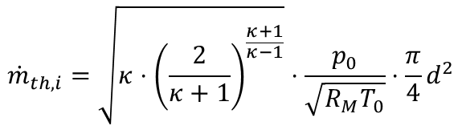
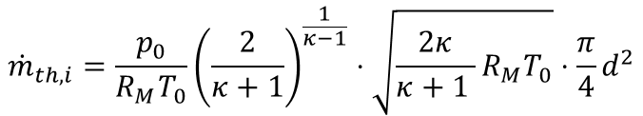
3.a) Boundary conditions
Critical area
$$A^{∗}=\frac{π}{4}d^{2}$$

$$p_{0}, T_{0}$$
$$ρ^{∗}, u^{∗}, A^{∗}$$
$$u^{∗}=\sqrt{\frac{2κ}{κ+1 }R_{M}T_{0}}$$

critical*
Critical velocity
Mass flow rate
$$ρ^{∗}={\frac{p_{0}}{R_{M}T_{0}}\left(\frac{2}{κ+1}\right)}^{\frac{1}{κ−1}}$$

Critical density
$${\dot{m}}_{th,i}=C_{i}^{∗}⋅\frac{p_{0}}{\sqrt{R_{M}T_{0}}}⋅\frac{π}{4}d^{2}$$
$${{\dot{m}}_{th,i}=\frac{p_{0}}{R_{M}T_{0}}\left(\frac{2}{κ+1}\right)}^{\frac{1}{κ−1}}⋅\sqrt{\frac{2κ}{κ+1 }R_{M}T_{0}}⋅\frac{π}{4}d^{2}$$
How can we derive this equation?
Start with simple definition:
Rearranging
$${\dot{m}}_{th,i}=ρ^{∗}u^{∗}A^{∗}$$
$${\dot{m}}_{th,i}=\sqrt{κ⋅{\left(\frac{2}{κ+1}\right)}^{\frac{κ+1}{κ−1}}}⋅\frac{p_{0}}{\sqrt{R_{M}T_{0}}}⋅\frac{π}{4}d^{2}$$
Assume:
Ideal gas
Reversible process
Adiabatic process
1D flow
ISO 9300
$$C_{i}^{∗}$$

Slide 22

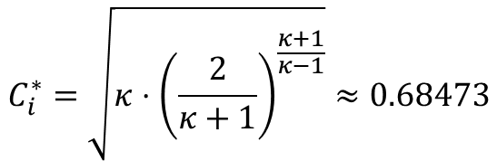



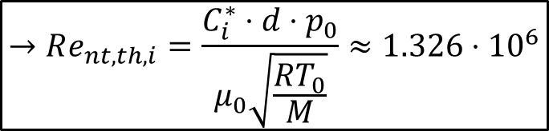
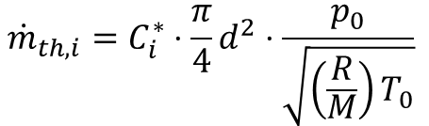

3.a) Boundary conditions
Estimation of throat Reynolds number
Throat Reynolds number
Ideal mass flow rate
Ideal critical flow factor
$$(κ=1.4)$$
$$C_{i}^{∗}=\sqrt{κ⋅{\left(\frac{2}{κ+1}\right)}^{\frac{κ+1}{κ−1}}}≈0.68473$$
$$Re_{nt,th,i}=\frac{4{\dot{m}}_{th,i} }{πdμ_{0}}$$
$${\dot{m}}_{th,i}=C_{i}^{∗}⋅\frac{π}{4}d^{2}⋅\frac{p_{0}}{\sqrt{\left(\frac{R}{M}\right)T_{0}}}$$
Dynamic viscosity (REFPROP):
$$μ_{0}\left(p_{0},T_{0}\right)=9.2823⋅{10}^{−6} Pa⋅s$$
$$→Re_{nt,th,i}=\frac{C_{i}^{∗}⋅d⋅p_{0}}{μ_{0}\sqrt{\frac{RT_{0}}{M}}}≈1.326⋅{10}^{6}$$
Universal gas constant:
$$R=8.3144626\frac{J}{molK}$$
Molar mass:
Let‘s set the boundary conditions in OpenFOAM
$$M=0.002016\frac{kg}{mol}$$

Slide 23
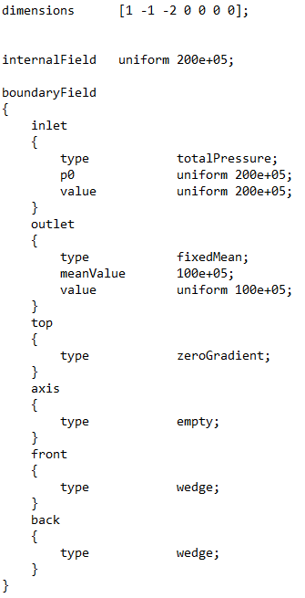
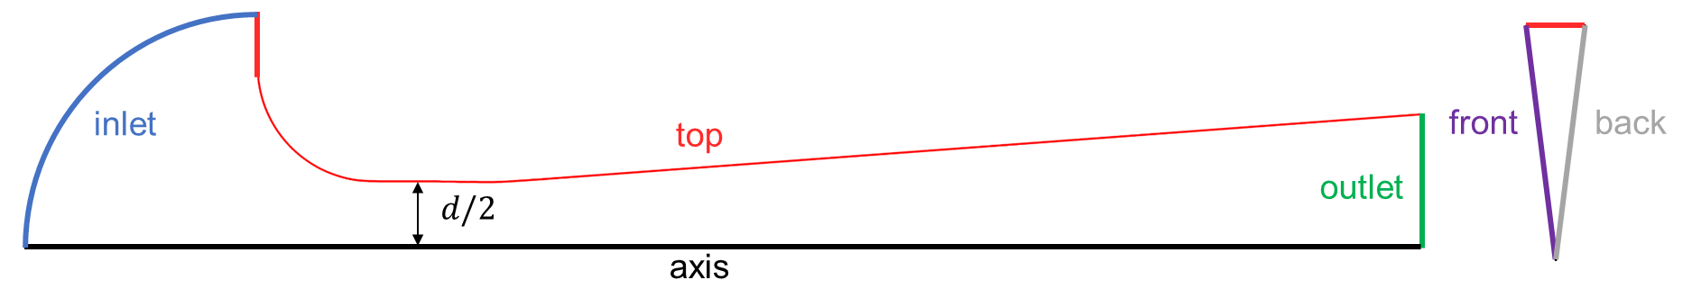
3.a) Boundary conditions
Mass [kg]
Time [s]
Quantity [mol]
Luminous intensity [cd]
Pressure p
= Pascal [kgm⁻¹s⁻²]
Length [m]
Temperature [K]
Current [A]
= Initial distribution inside of the nozzle (200 bar)
= Actual boundary conditions for each patch face

Slide 24
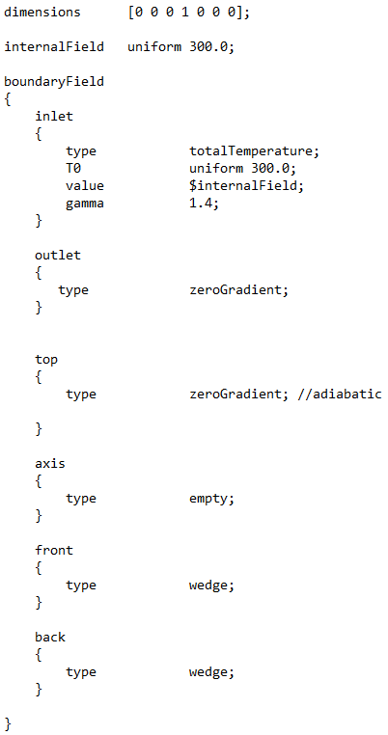
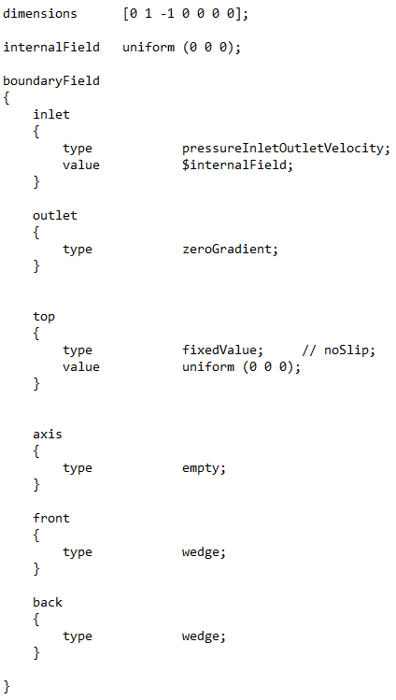
3.a) Boundary conditions
Pressure p
Temperature T
Velocity U
Inlet:
Total pressure
Total temperature
Outlet:
Static pressure
Wall:
No-slip
Adiabatic
Axis:
Rotation axis
Front and Back:
Symmetry

Slide 25
Agenda (Part 1)
OpenFOAM folder structure
/
turbulent thermal diffusivity
turbulence kinetic energy
turbulent viscosity
turbulence specific dissipation rate
pressure
temperature
velocity
Pre-processing
Geometry creation
Mesh creation
Numerical setup
Boundary conditions
Turbulence model
Real gas model
Numerical settings
/
thermophysical properties
turbulence properties
/
mesh settings
simulation settings
decomposition settings
mesh extrusion settings
numerical schemes
numerical solvers
nozzle contour file

Slide 26
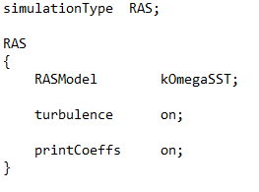

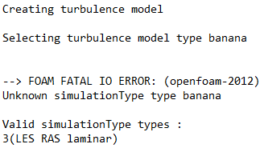
3.b) Turbulence model
The turbulence model is selected in the turbulenceProperties file
banana;
Banana?
‚Banana trick‘ output
The ‚banana trick‘ provokes an error message to show all valid types
We select the RAS type

Slide 27
3.b) Turbulence model
The turbulence model is selected in the turbulenceProperties file
Reynolds-averaged simulation (RAS)
k-ω Shear Stress Transport (SST) model
Two-equation model for turbulent kinetic energy k and turbulent specific dissipation rate ω
Eddy viscosity model based on Boussinesq‘s hypothesis
Combines strenghts of k-ω model (inner region of boundary layer) and k-ε model (free stream)
We solve for four additional quantities:
Turbulent kinetic energy k
Turbulent specific dissipation rate ω
Turbulent viscosity ν_{t}
Turbulent thermal diffusivity α_{t}
Solved in additional transport equations
Modeled and included in momentum equation
Modeled and included in energy equation

Slide 28
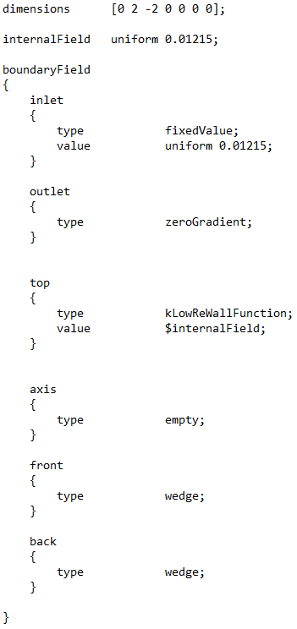




3.b) Turbulence model
Turb. kin. energy k
How can we calculate the inlet value?
For isentropic turbulence, k_{in} can be estimated by:
Estimated turbulence intensity:
Free stream velocity (based on preliminary calculations):
$$k_{in}=\frac{3}{2}{\left(Tu⋅U_{∞}\right)}^{2}$$
$$≈0.01215 \frac{m^{2}}{s^{2}}$$
$$Tu=0.5 \%$$
$$U_{∞}≈18 \frac{m}{s}$$
Chosen wall function for k
Provides a wall constraint depending on the y⁺ value

Slide 29
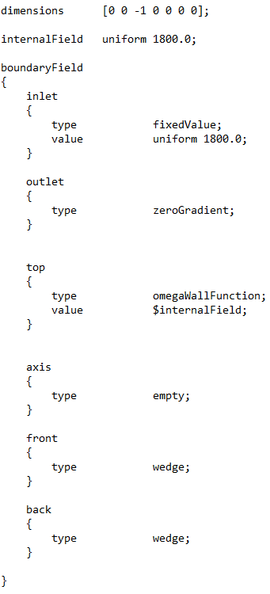





3.b) Turbulence model
Turb. kin. energy k
Turb. diss. rate omega
How can we calculate the inlet value?
ω_{in} is calculated as:
Turbulence length scale (fully developed pipe flow):
Inlet diameter:
Model parameter:
$$ω_{in}=\frac{\sqrt{k_{in}}}{C_{μ}^{0.25}⋅l}$$
$$≈1800 \frac{1}{s}$$
$$l=0.038⋅d_{in}$$
$$d_{in}=3⋅d$$
$$C_{μ}=0.09$$
Chosen wall function for ω
Provides a wall constraint depending on the y⁺ value

Slide 30
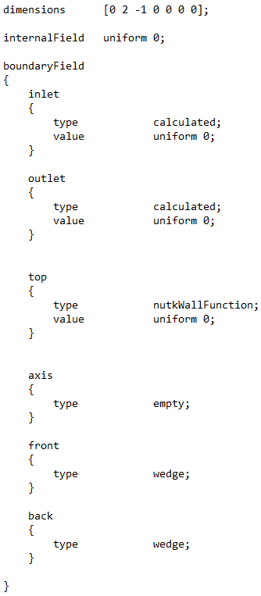
3.b) Turbulence model
Turb. kin. energy k
Turb. diss. rate omega
Turb. viscosity nut
Chosen wall function for ν_{t}
Provides a wall constraint depending on the y⁺ value

Slide 31
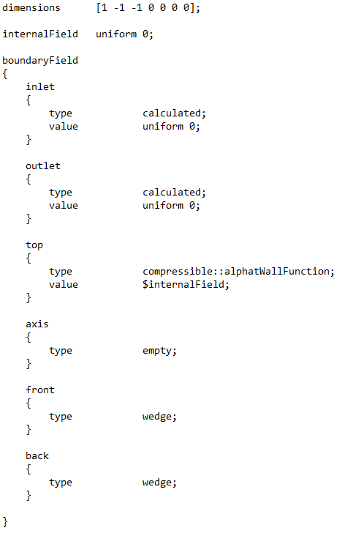
3.b) Turbulence model
Turb. kin. energy k
Turb. diss. rate omega
Turb. therm. diff. alphat
Chosen wall function for α_{t}
Provides a wall constraint depending on the y⁺ value

Slide 32
3.b) Turbulence model
Turb. kin. energy k
Turb. diss. rate omega
Turb. viscosity nut
Turb. therm. diff. alphat

Slide 33
Agenda (Part 1)
OpenFOAM folder structure
/
turbulent thermal diffusivity
turbulence kinetic energy
turbulent viscosity
turbulence specific dissipation rate
pressure
temperature
velocity
Pre-processing
Geometry creation
Mesh creation
Numerical setup
Boundary conditions
Turbulence model
Real gas model
Numerical settings
/
thermophysical properties
turbulence properties
/
mesh settings
simulation settings
decomposition settings
mesh extrusion settings
numerical schemes
numerical solvers
nozzle contour file

Slide 34
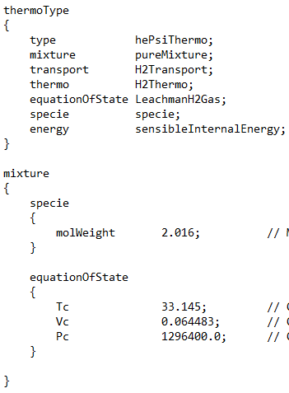
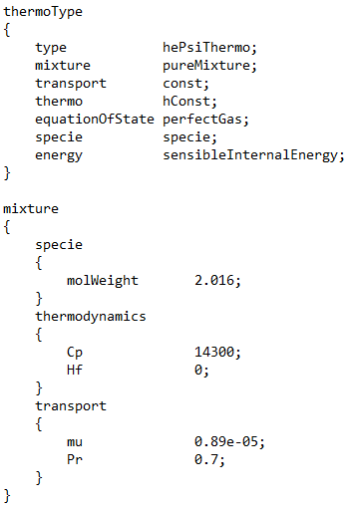
3.c) Real gas model
The real gas model for hydrogen is selected in the thermophysicalProperties file
Real gas settings
Ideal gas settings
r
Developed
real gas model
GitLab link
Molar mass [g/mol]
Critical temperature [K]
Critical volume [m³/kmol]
Critical pressure [Pa]
can be used for low pressure cases

Slide 35
Agenda (Part 1)
OpenFOAM folder structure
/
turbulent thermal diffusivity
turbulence kinetic energy
turbulent viscosity
turbulence specific dissipation rate
pressure
temperature
velocity
Pre-processing
Geometry creation
Mesh creation
Numerical setup
Boundary conditions
Turbulence model
Real gas model
Numerical settings
/
thermophysical properties
turbulence properties
/
mesh settings
simulation settings
decomposition settings
mesh extrusion settings
numerical schemes
numerical solvers
nozzle contour file

Slide 36
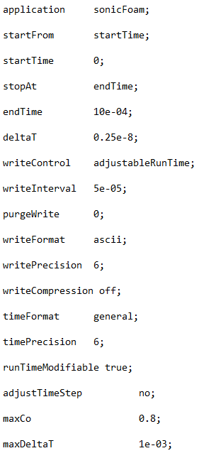

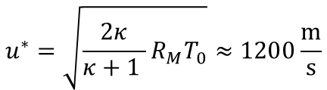



3.d) Numerical settings
In the controlDict file, the main case controls are set (e. g. time and write settings, functions objects, etc.)
Compressible flow solver
Start and end time
Time step of the simulation
How can we estimate an appropriate magnitude for the time step Δt?
Start with CFL condition in the axial direction at the nozzle throat:
$$CFL=u^{∗}⋅\frac{Δt}{Δz}≤1$$
Velocity at nozzle throat
$$u^{∗}=\sqrt{\frac{2κ}{κ+1 }R_{M}T_{0}}≈1200\frac{m}{s}$$
$$→Δt≤\frac{Δz}{u^{∗}}$$
$$≈1.25⋅{10}^{−8} s$$
Cell size in the axial direction
This value can be used as a starting point
Chosen time step (0.25·10⁻⁸ s) is smaller due to stability reasons
$$Δz=\frac{l_{z}}{cz}=\frac{9 mm}{600}=1.5⋅{10}^{−5} m$$

Slide 37
3.d) Numerical settings
In the controlDict file, the main case controls are set (e. g. time and write settings, functions objects, etc.)
Compressible flow solver
Start and end time
Time step of the simulation
Adjusts time step to coincide with writeInterval (for automatic time stepping)
Controls number of stored time directories (set to 0 to disable this)
Specifies data file format and precision, and whether they are compressed or not
Format and precision of the naming of the time directories
Allows user to modify parameters during simulation
Control to adjust time step during simulation (here: not active)

Slide 38
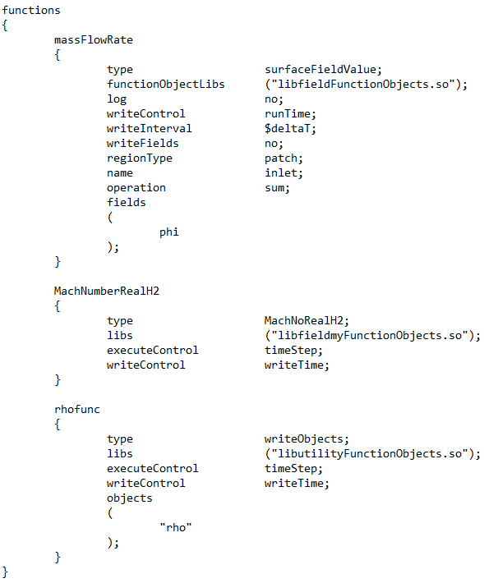


3.d) Numerical settings
Functions objects are specified under functions (included in controlDict file)
Storage location
Calculates mass flow rate at the inlet patch in every time step (deltaT) and stores it in a text file
/
/
/
Note: this is a user-defined function and library (suiting our developed real gas model)
Calculates Mach number distribution at defined time intervals (writeInterval) and stores it in the time directories
…
Calculates density distribution at defined time intervals (writeInterval) and stores it in the time directories
/

Slide 39
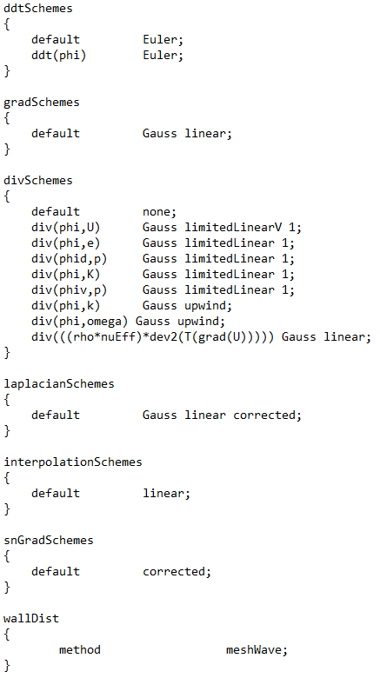




3.d) Numerical settings
In the fvSchemes file, the numerical schemes are set
Keywords:
General:
phi: Flux across cell faces
Gauss: Gaussian integration
Time scheme:
Euler: First order, implicit, bounded
Discretization schemes:
linear: Second order, unbounded
limitedLinear: First / second order, unbounded
upwind: First order, bounded
Correction scheme:
corrected: Second order, non-orthogonality
Time schemes
$$\frac{∂}{∂t}\left(φ\right)$$
Gradient schemes
$$∇\left(φ\right)$$
Divergence schemes
$$∇⋅\left(Q\right)$$
Laplacian schemes
$$∇^{2}\left(φ\right)$$
Remember:
Interpolation schemes
First order: bounded / stable but diffusive
Second order: accurate but might oscillate
Compromise between accuracy and stability
Surface-normal gradient schemes
Wall distance calculation method

Slide 40
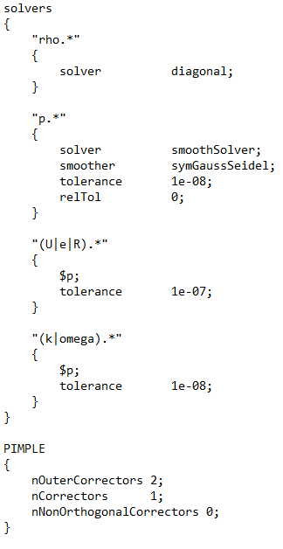
3.d) Numerical settings
In the fvSolution file, solvers, tolerances, and algorithms are set
PIMPLE algorithm (simplified)
Momentum
predictor
Diagonal solver for explicit systems
Symmetric Gauss-Seidel solver
Pressure equation
PIMPLE algorithm
Pressure-velocity coupling algorithm fulfilling momentum and continuity equation in each time step
nNonOrthogonal
Correctors
Velocity corrector
nCorrectors
nOuterCorrectors
nOuterCorrectors: number of momentum predictor (outer) loops
nCorrectors: number of velocity corrector (inner) loops
nNonOrthogonalCorrectors: number of pressure (inner) loops

Slide 41



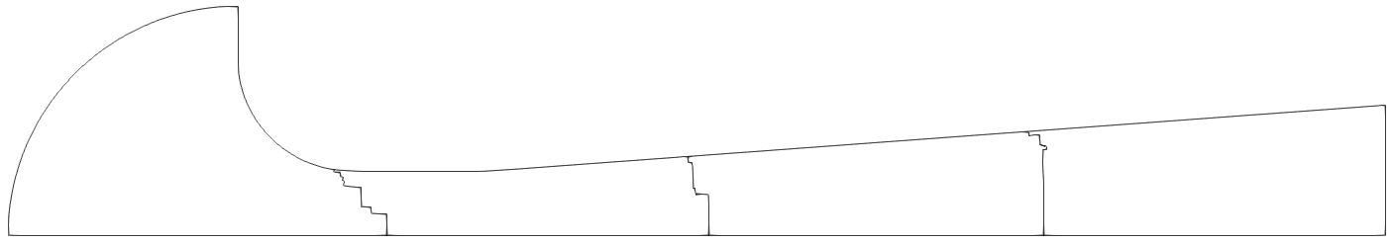
3.d) Numerical settings
Run simulation
Option 1
Option 2
Serial run:
Start simulation and write a log file
sonicFoam > log &
Parallel run:
Decompose flow domain into subdomains
decomposePar &
Start parallel simulation and write log file
mpirun -np 4 sonicFoam -parallel > log &
Reconstruct flow domain (after simulation)
reconstructPar &
Simulation running
decomposeParDict
Let‘s have a coffee break until the simulation is completed
0
3
1
2

Slide 42
Five-minute break

Slide 43


Agenda (Part 2)
OpenFOAM folder structure
Post-processing
/
Mach number
density
Log file
Convergence
Residuals
Mass flow rate
Discharge coefficient
Flow field
Surface plots
Line plots
/
internal energy
turbulent kinetic energy
turbulent specific dissipation rate
pressure
radial velocity
axial velocity
/
/
/
inlet mass flow rate

Slide 44
Agenda (Part 2)
OpenFOAM folder structure
Post-processing
/
Mach number
density
Log file
Convergence
Residuals
Mass flow rate
Discharge coefficient
Flow field
Surface plots
Line plots
/
internal energy
turbulent kinetic energy
turbulent specific dissipation rate
pressure
radial velocity
axial velocity
/
/
/
inlet mass flow rate

Slide 45


4. Log file
Let‘s have a look at the log file:
Command: vim log
Time step
Courant number
1st PIMPLE outer loop
2nd PIMPLE outer loop
Run time
$$≈17 h$$
Writing function objects
Run completed

Slide 46
Agenda (Part 2)
OpenFOAM folder structure
Post-processing
/
Mach number
density
Log file
Convergence
Residuals
Mass flow rate
Discharge coefficient
Flow field
Surface plots
Line plots
/
internal energy
turbulent kinetic energy
turbulent specific dissipation rate
pressure
radial velocity
axial velocity
/
/
/
inlet mass flow rate

Slide 47

5.a) Residuals
Let‘s check the convergence of the simulation
First, we extract the residual data from the log file:
Command: foamLog log &
This generates a /logs folder
Let’s plot the residuals from the output data
Residuals quicky drop and slightly oscillate around a constant value

Slide 48
Agenda (Part 2)
OpenFOAM folder structure
Post-processing
/
Mach number
density
Log file
Convergence
Residuals
Mass flow rate
Discharge coefficient
Flow field
Surface plots
Line plots
/
internal energy
turbulent kinetic energy
turbulent specific dissipation rate
pressure
radial velocity
axial velocity
/
/
/
inlet mass flow rate

Slide 49



5.b) Mass flow rate
Let‘s see how the mass flow rate is establishing
We monitored the mass flow rate at the inlet
< 0.015 %
Mean value
$${\dot{m}}_{CFD}≈0.00938793\frac{kg}{s}$$
Mass flow rate only varies within 0.015 % margin

Slide 50
Agenda (Part 2)
OpenFOAM folder structure
Post-processing
/
Mach number
density
Log file
Convergence
Residuals
Mass flow rate
Discharge coefficient
Flow field
Surface plots
Line plots
/
internal energy
turbulent kinetic energy
turbulent specific dissipation rate
pressure
radial velocity
axial velocity
/
/
/
inlet mass flow rate

Slide 51

















6. Discharge coefficient
Let‘s calculate the discharge coefficient
Area of CFD domain
$$C_{D}=\frac{{\dot{m}}_{CFD}}{{\dot{m}}_{th}}$$
$${\dot{m}}_{th}=C^{∗}A^{∗}\frac{p_{0}}{\sqrt{R_{M}T_{0}}}$$
$$b$$
$$=\frac{d}{2}\sin\left(\frac{α}{2}\right)$$
$$\frac{d}{2}$$
Ideal gas
Real gas
$$\frac{d}{2}$$
$$\frac{d}{2}$$
$$h$$
$$=\frac{d}{2}\cos\left(\frac{α}{2}\right)$$
$$C_{i}^{∗}=\sqrt{κ⋅{\left(\frac{2}{κ+1}\right)}^{\frac{κ+1}{κ−1}}}$$
(From REFPROP)
$$\frac{α}{2}$$
$$α$$
$$C_{r}^{∗}=0.67155$$
$$A_{CFD,wedge}^{∗}$$
$${→C}_{D,i}≈0.9721$$
$${→C}_{D,r}≈0.9912$$
$$=\sin\left(\frac{α}{2}\right)\cos\left(\frac{α}{2}\right)\frac{d^{2}}{4}$$
$$A_{CFD,wedge}^{∗}=b⋅h$$
Relation
$${→A}_{CFD}^{∗}=\frac{360}{α}A_{CFD,wedge}^{∗}$$
$$C_{D,r}=\frac{C_{i}^{∗}}{C_{r}^{∗}}C_{D,i}$$

Slide 52
Agenda (Part 2)
OpenFOAM folder structure
Post-processing
/
Mach number
density
Log file
Convergence
Residuals
Mass flow rate
Discharge coefficient
Flow field
Surface plots
Line plots
/
internal energy
turbulent kinetic energy
turbulent specific dissipation rate
pressure
radial velocity
axial velocity
/
/
/
inlet mass flow rate

Slide 53






7.a) Surface plots
Mach number function for real gas hydrogen
We introduced a specific function for the Mach number for our real gas model for hydrogen
For a real gas, the isentropic exponent is defined as follows:
$$κ_{real}=\frac{c_{p}}{c_{v}}{\left(\frac{∂p}{∂ρ}\right)}_{T}\frac{ρ}{p}$$
Our Mach number function directly uses the speed of sound correlation a_{real}:
Why is this necessary?
In OpenFOAM (OF), the Mach number function is defined as follows:
$$M_{real}=\frac{\left|u\right|}{a_{real}}$$
$$M_{OF}=\frac{\left|u\right|}{\sqrt{κ_{ideal}\frac{p}{ρ}}}$$
$$κ_{ideal}=\frac{c_{p}}{c_{v}}$$
Here, the ideal isentropic exponent is used
Let‘s see how to create surface plots like this

Slide 54







7.a) Surface plots
ParaView to visualize the flow field
3. Calculator
Variable
1. Surface
Time step
1. Surface plots
2. Contour plots
2. Contour
3. Calculated variables
Compressibility factor Z

Slide 55









7.a) Surface plots
Numerical Schlieren
Gradient of Unstructured DataSet filter
Set density gradient
Apply X Ray colormap
Experimental Schlieren
(for qualitative comparison)
$$=p_{0}/p_{s}$$
Adjust Min. and Max. values
Source: S. Matsuo et al., "Effects of Supersonic Nozzle Geometry on Characteristics of Shock Wave Structure“, Open Journal of Fluid Dynamics, Vol. 2 No. 4A, 2012.

Slide 56
Agenda (Part 2)
OpenFOAM folder structure
Post-processing
/
Mach number
density
Log file
Convergence
Residuals
Mass flow rate
Discharge coefficient
Flow field
Surface plots
Line plots
/
internal energy
turbulent kinetic energy
turbulent specific dissipation rate
pressure
radial velocity
axial velocity
/
/
/
inlet mass flow rate

Slide 57






7.b) Line plots
Plot velocity over nozzle throat height
Plot Over Line filter
Select the velocity
Save line data as text file
Define the line location

Slide 58
Thank you!

Slide 60
Sebastian Weiss
Working Group 8.41 “Modelling and Simulation” and Working Group 1.45 “Hydrogen Quantity Metering” Physikalisch-Technische Bundesanstalt (PTB) Berlin, Germany
sebastian.weiss@ptb.de

