Slide 1


Slide 2
WINDWECHSEL
WINDWECHSEL
WINDWECHSEL (unsicher)
ZEIT

Slide 3
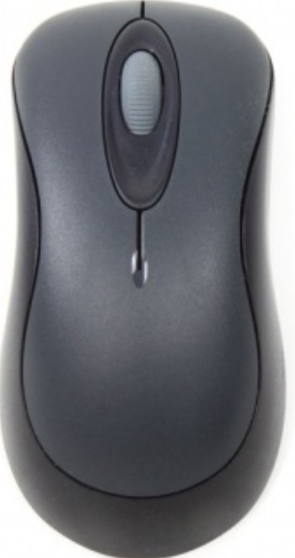

Slide 4
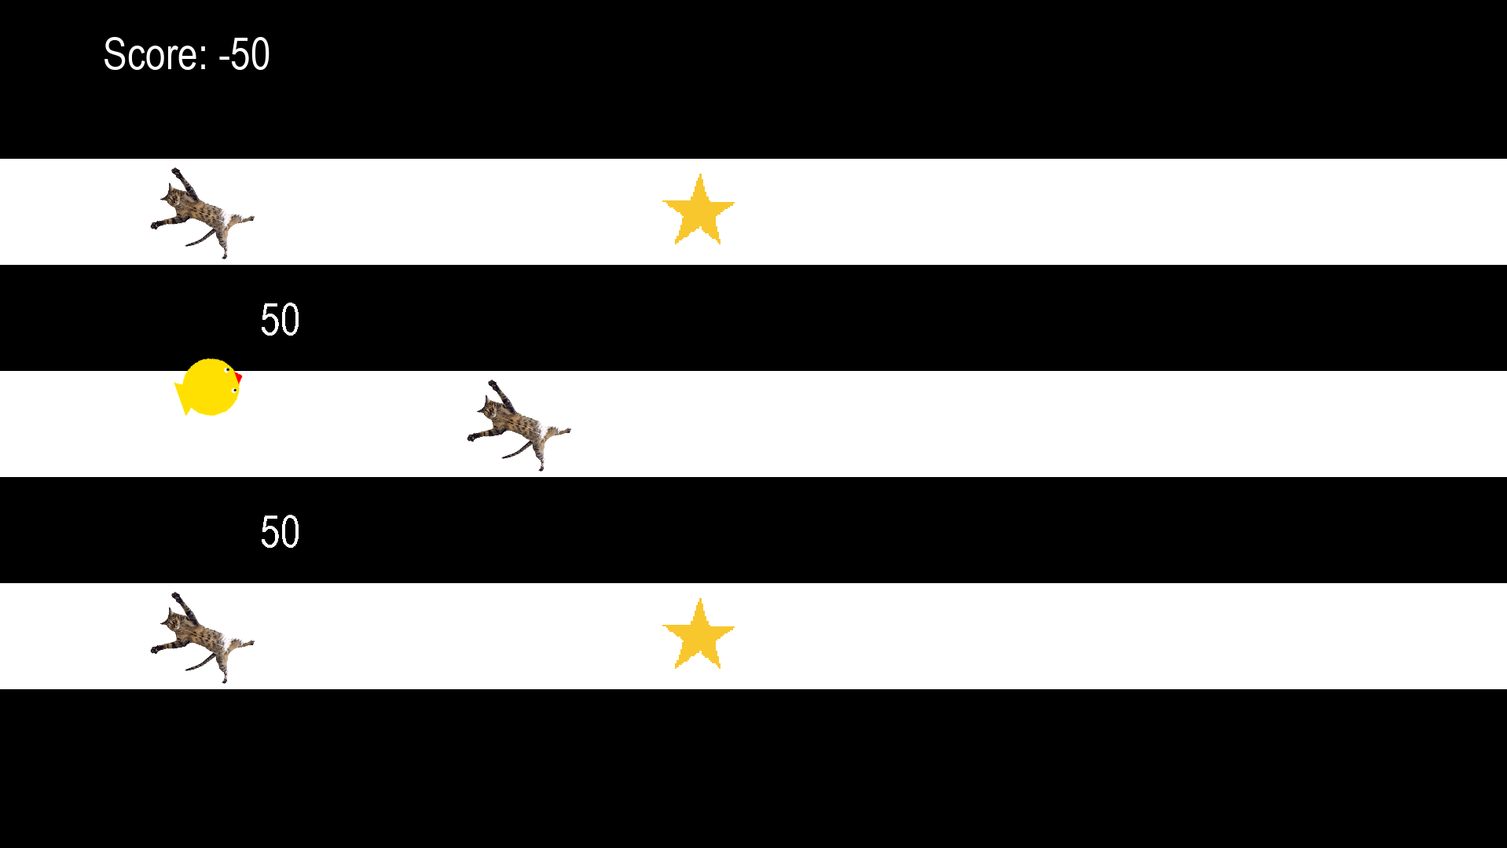

Slide 6


