Slide 1
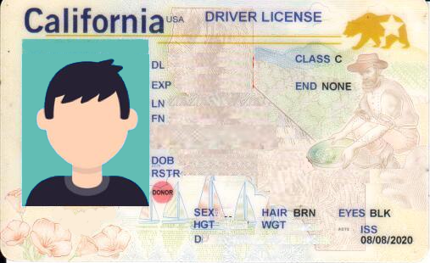
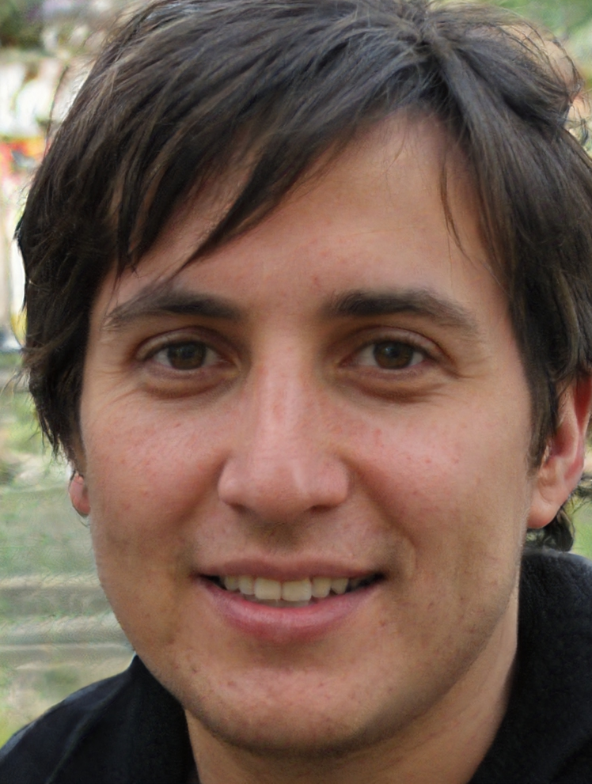
D12345678
01/01/2025
Harrington
Scott
1234 Circle Avenue, Apt 123
San Mateo, CA 94401
12/26/2011

Slide 2
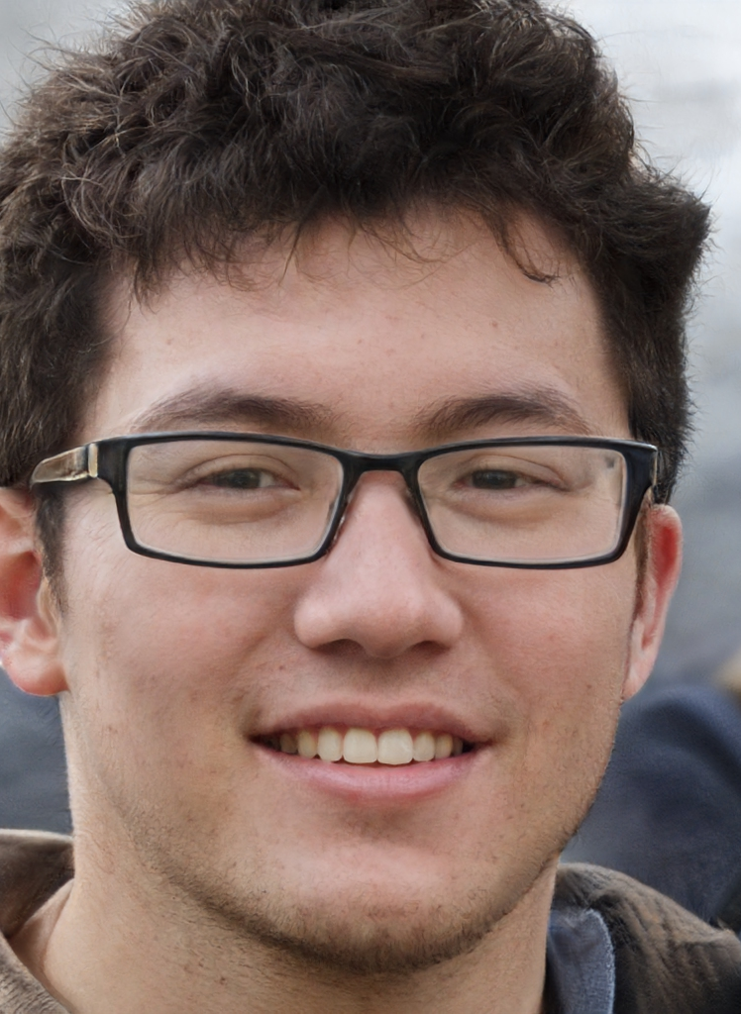
D12345678
01/01/2025
Lee
Kevin
1234 Circle Avenue, Apt 123
San Mateo, CA 94401
02/22/1935

Slide 3

D12345678
01/01/2025
Bennett
Amy
1234 Circle Avenue, Apt 123
San Mateo, CA 94401
02/22/1963

Slide 4
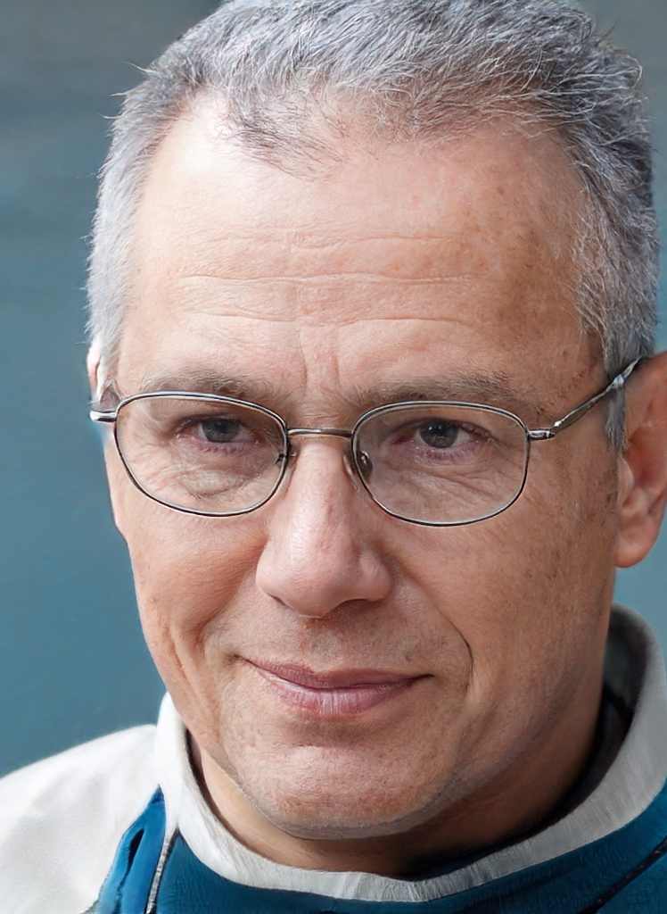
D12345678
01/01/2025
Lewis
Jason
1234 Circle Avenue, Apt 123
San Mateo, CA 94401
11/09/1950

Slide 5
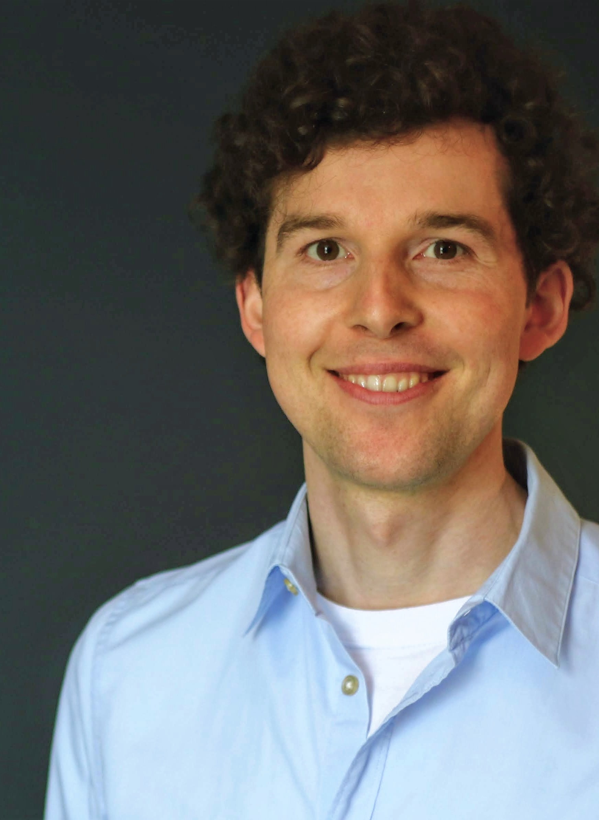
D12345678
01/01/2025
Schmalen
Philipp
1234 Circle Avenue, Apt 123
San Mateo, CA 94401
09/02/1990

