Slide 1
Forcing Deep Neural Networks to explore the Loss Landscape
Bachelor thesis talk
Philipp von Bachmmann
Sommersemester 2020

Slide 2
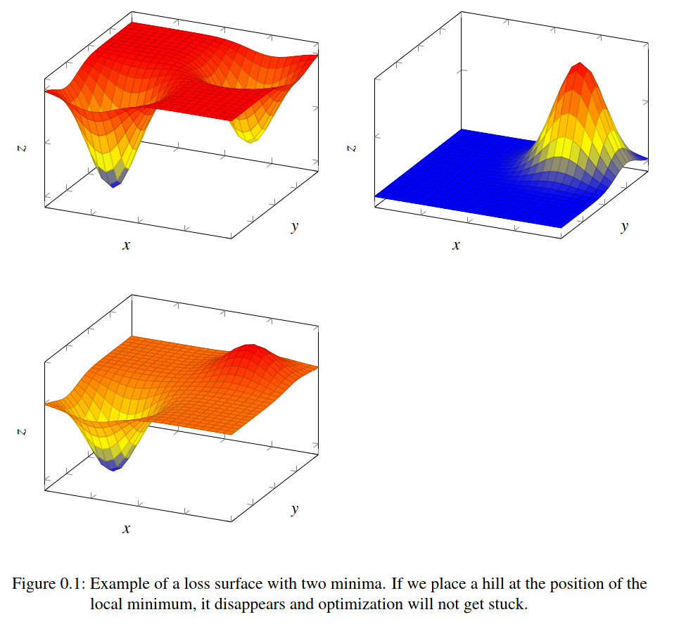
Introduction
From mathematical viewpoint, the recent success of neural networks is quite surprising
Non-convex loss landscape with many local minima creates a challenge for optimization
Current research suggests that low loss areas exist everywhere (Choromanska et al, 2015)
Techniques for exploration have been successful
Notes:
Create huge success, see self-driving cars
Neural networks create new challenges for optimization
But solved by trivial algorithms like SGD
Seems to be because all minima low loss and exist everywhere
See SGD Warm restart learning rate set back up, forcing exploration and leading to better performance
My work: Forcing exploration to see if better minima exist

Slide 3
Structure
Basics
Methods
Results
Discussion
Further work

Slide 4
Basics

Slide 5
Optimization
adjust a set of parameters to achieve better performance on some performance metric L
Formally: Risk
Problem: only access to the training set which is distributed according to
Solution: Empirical Risk minimization
Notes:
Arithmetic mean serves as unbiased estimator of expectation

Slide 6
Minibatch Algorithms
Computing empirical risk from whole training data is expensive
A subset of the data will give a good approximation, as the data is drawn from the same distribution
These subsets are called minibatches
Smaller minibatches can add a Regularization effect (Keskar et al., 2016)
Notes:
Why can we decompose them

Slide 7
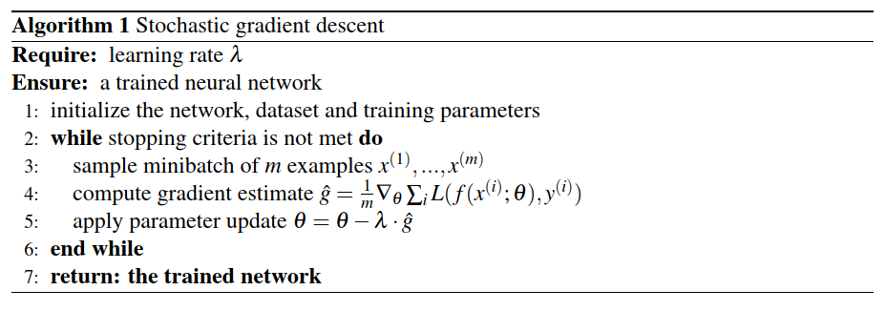
Stochastic gradient descent
Most basic optimization algorithm
Only takes the current gradient into account
Learning rate as hyperparameter

Slide 8
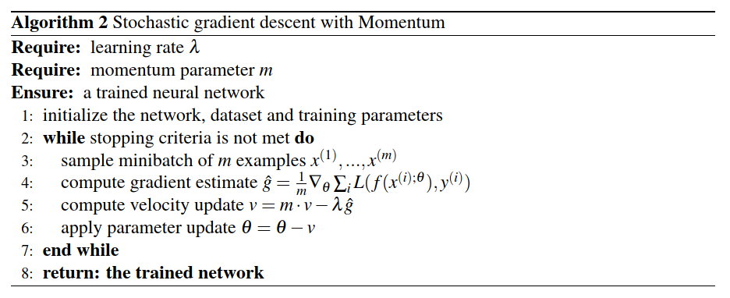
SGD with Momentum
Used to speed up training
Velocity to update the parameters:

Slide 9
Loss Landscape
Non-convex loss landscape with many local minima
Extrema with higher cost are exponentially likely to be saddle points (Choromanska et al, 2015)
Local minima are arranged in enclosed areas with same cost within each area (Draxler et al., 2018; He et al., 2020)
Each area is surrounded by walls of high loss
Notes:
- Loss surface is partitioned In

Slide 10
Cosine Decay with Warm Restart
Loshchilov & Hutter, 2016
Combination of learning rate schedulers and warm restarts
Learning rate schedulers decay learning rate over time
Warm restart: set the learning rate back to the initial every fixed number of epochs
Explore the landscape in phases of high learning rate and exploit in phases of low
Notes:
- Learning rate schedulers: lr is decayed over time

Slide 11
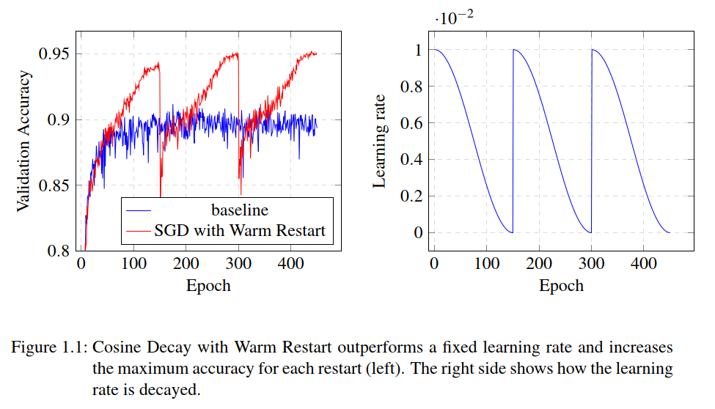
Cosine Decay with Warm Restart
Notes:
Maximum performance boosts with each cycle

Slide 12
Ensemble methods
Combines multiple models for a better prediction
Models need to have a high performance and a low correlation
Get multiple models with snapshots for free (Huang et al., 2017)
Technique for classification: Model averaging
For each class , we sum the probabilities of all models and then take

Slide 13
Methods
Notes:
First give a quick motivation for approach
Then describe in mathematical detail
Describe datasets and networks used for results

Slide 14
Motivation
Landscape consists of cells with minima of same loss surrounded by areas of high loss
Therefore SGD is unlikely to move out
Is it possible to find better minima by forcing exploration?
Example: Cosine Decay with Warm Restart
Other benefits for Ensemble Methods: lower correlation by more distant networks
Goal: Distance from current parameter values
Notes:
- Idea motivated by SGD Warm Restart, because high learning rate forced exploration and lead to boost
Lower Corellation is needed for Ensemble Methods

Slide 15
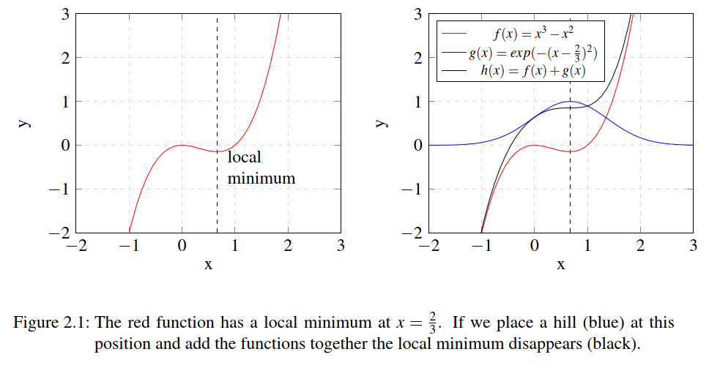
Notes:
Example for 2-dimensional case
Red function has local minimum at x=2/3, which is set as checkpoint
Place hill at this location in form of blue function
Local minimum disappears, algorithm not getting stuck anymore

Slide 16
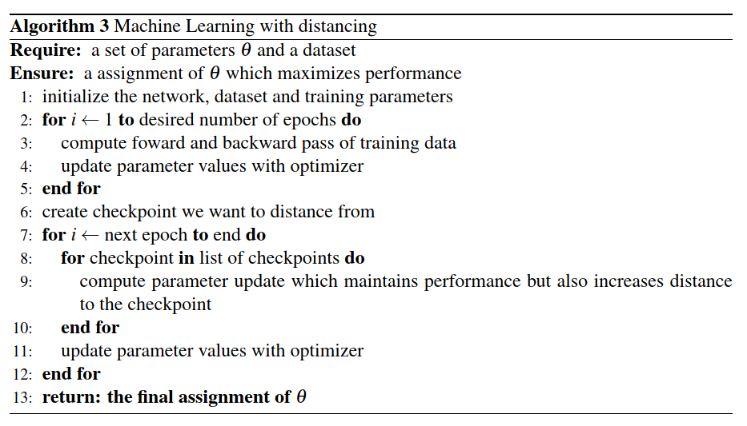
Notes:
Overview of pseudo-code
Line 2 to 5: normal training
Values to distance are stored as checkpoint
Line 7 to 11: difference is how gradients are computed

Slide 17
Distance function
Common choice is norm, defined as:
To compare two vectors and :
Notes:
Can get rid of root, doesn’t change direction of gradient
If x gets larger in size, distance will increase (for same distribution of x)

Slide 18
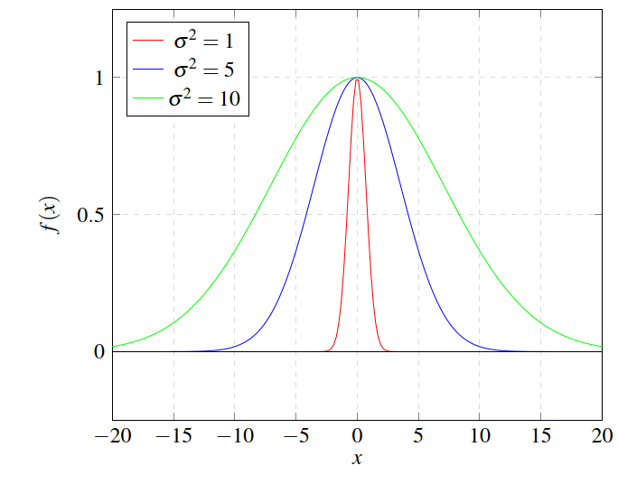
Distance function
Measure distance penalty with RBF Kernel from Support Vector Machines
distance
Notes:
Values are now bound between 0 and 1, see graph, also if move away no influence any more
Hyperparameter sigma to control for width (also known as standard derivation)
Graphs shows influence of sigma
The larger sigma, the wider function

Slide 19
Loss function
Combine the normal Loss function with the Distance penalty
Add parameter strength to control for influence
Multiple Checkpoints
Notes:
Distance is now a penalty
Normal loss function with empirical risk, used to keep performance high
Hyperparameter strength controls influence

Slide 20
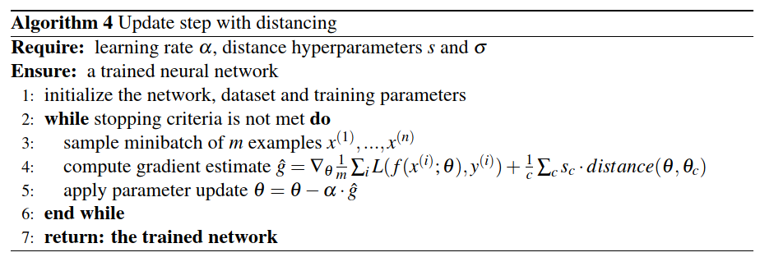
Notes:
Overview over update step
First compute gradient
Apply same as SGD

Slide 21
Effect on Gradient
Only factor will affect direction of gradient, other will only scale size
  and will be positive, so will get smaller when updated, therefore the distance increases
Notes:
Take negative gradient for update
Same case other way around
If both parameters the same, no update, but also gradient from normal loss function

Slide 22
Dataset and Networks
CIFAR-10
  60000 32x32 color images with 10 different classes
  Current top accuracy: 97.3%
ResNet (He et al., 2016)
  Learning residuals is easier than learning the full transformation
  Skip Connections:
MobileNetV2 (Sandler et al, 2018)
  Depthwise Separable Convolution
  Inverted Residuals
Notes:
Depthwise separable Convolution: Split Convolution in Depthwise and Pointwise Convolution, cheaper to compute
Inverted Residuals: Intermediate Representation low-dimensional

Slide 23
Results

Slide 24
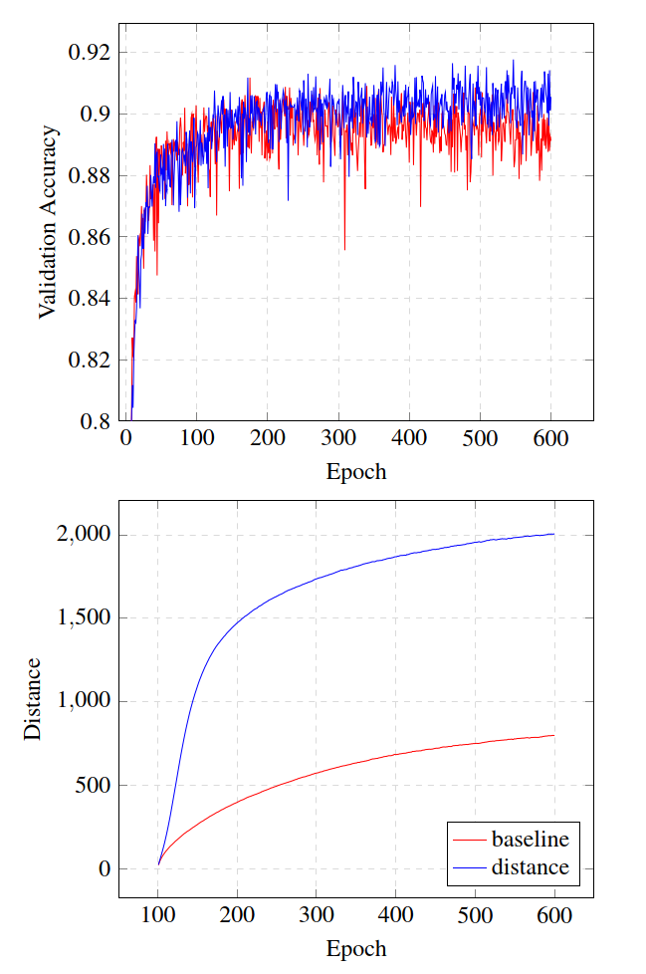
Baseline
Checkpoint after 100 epochs
Successful increased distance in comparison to normal network
Validation accuracy receives a small improvement to around 90% for MobileNetV2 and 89% for ResNet
Notes:
Shape of RBF Kernel is followed with large increase at beginning and then convergence
Note that normal validation accuracy without distance function is shown in all plots
If not stated different, only MobileNetV2 is shown, because results are the same

Slide 25
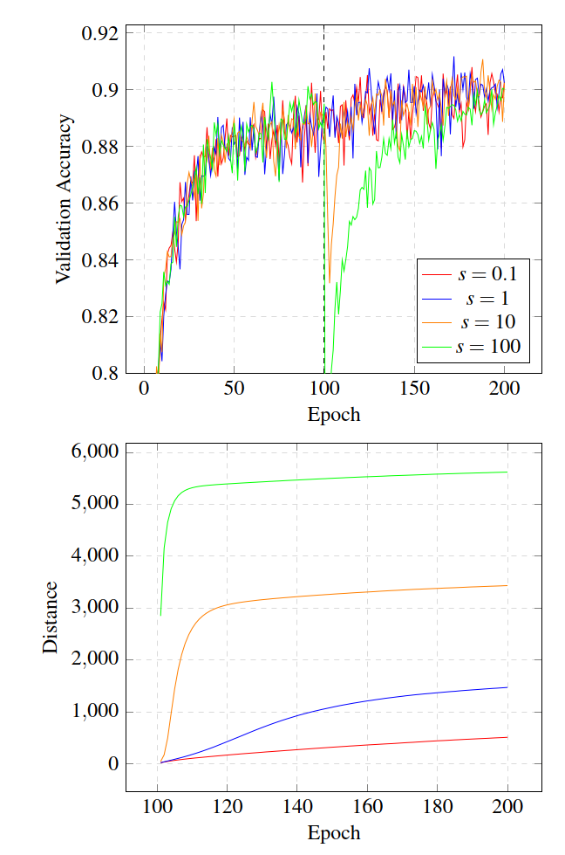
Strength
Higher strength values increase distance further
Strength increases distance fast but converges fast due to large gradient at the beginning which quickly vanishes
Initial drop in validation accuracy for high strength values
Notes:
Again form of Kernel is followed
Accuracy recovers to baseline
Maybe add plot of Kernel

Slide 26
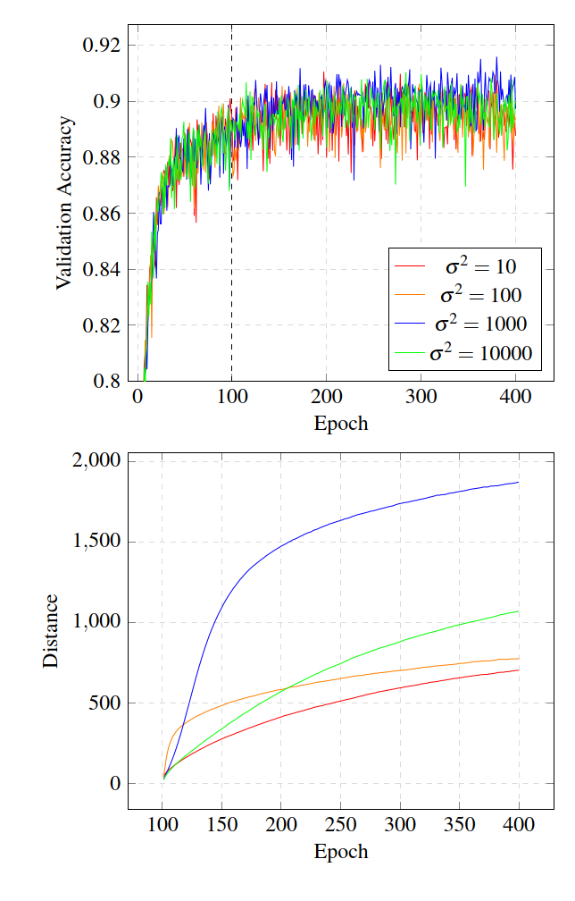
Width
Higher width values increase the distance further
Happens more slowly compared to strength parameter due to smaller gradient
The larger the width slower the distance increases
Notes:
Add pot of Kernel
Gradient smaller but more constant
Green curve slower increase but will eventually outperform blue one

Slide 27
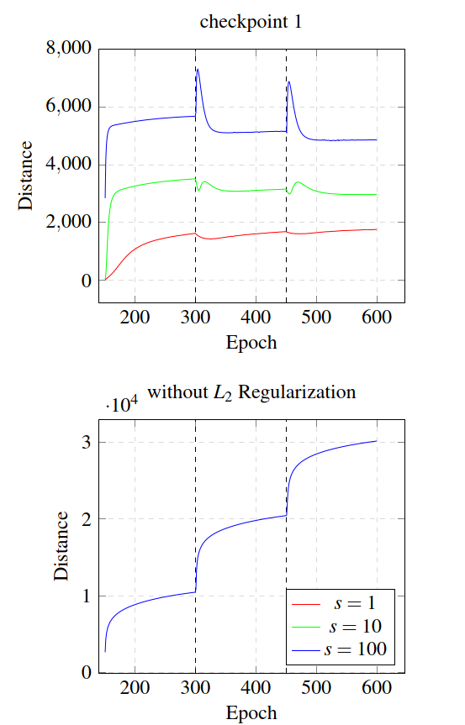
Multiple Checkpoints
Add new checkpoint every 150 epochs
New checkpoint decreases distance to old ones
Probably due to Regularization
Notes:
Add plot l2

Slide 28
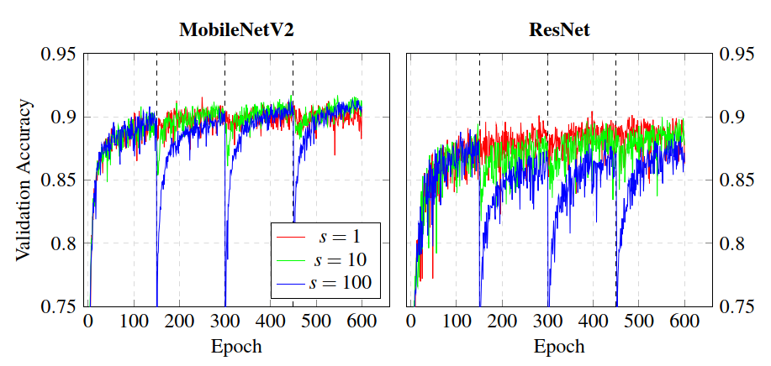
Multiple Checkpoints
Validation accuracy initial drop for higher strength values
Accuracy recovers and even tops for MobileNetV2
Similar to Cosine Decay with Warm restart, probably due to same effect
Notes:
Plot effect of SGD Warm restart next to it
Effect of both: Larger gradient/Learning rate at each restart

Slide 29
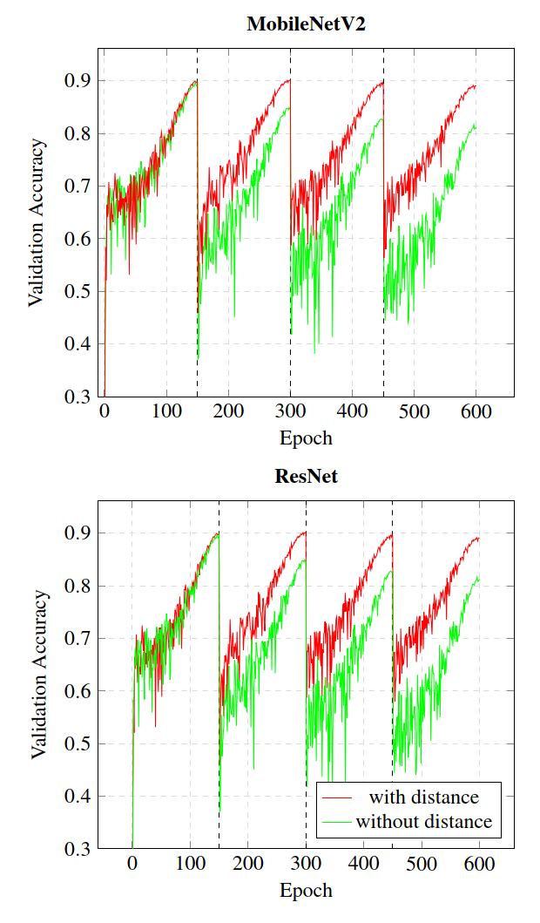
Suboptimal learning rate
Cosine Decay with Warm Restart worsen for every restart when suboptimal maximum learning rate is used
Distance function stabilizes the training
However only observed for one particular learning rate
Reason unclear

Slide 30
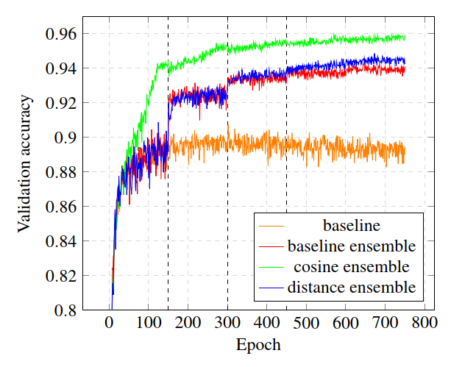
Ensemble methods
Recap idea: Higher Distance leads to lower correlation between snapshots
Take Snapshot before every new checkpoint
Leads to an increasement of 4% against single network
However still worse than Cosine Decay with Warm Restart
Notes:
Schedulers better overall performance, but less benefits of ensembles
Warm restart only 1% increase

Slide 31
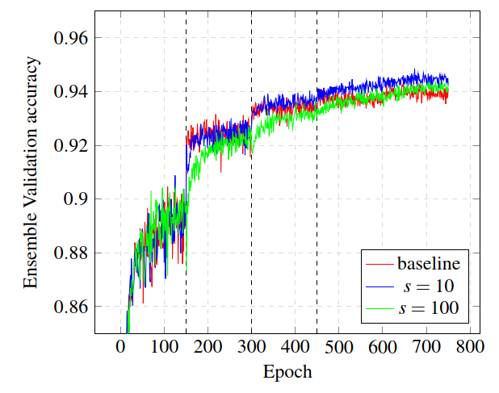

Ensemble methods
Increase strength hyperparameter to get more distant networks
Higher distance does not result in better performance
Correlation stays the same
Notes:
- Higher distance doesn’t result in lower corellation

Slide 32
Discussion and Outlook

Slide 33
Loss Landscape
Successful distancing from checkpoints
Does not translate to validation accuracy
Seems to confirm the view that areas of low loss exist everywhere and are of similar cost

Slide 34
Multiple Checkpoints and Schedulers
Multiple checkpoints give small benefit, probably due to same effects as in Cosine Decay with Warm restart
For a stable gradient direction, the distance function amplifies the gradient and increases update steps, similar to a high learning rate
No explanation for wrong initial learning rate
Notes:
Only amplifies if constant gradient direction
Simple explanation wrong lr: walks into area of bad loss, distance function helps to recover
However contradicts before

Slide 35
Ensemble Methods
Lower correlation leads to more benefits for ensemble
But cannot recover a low individual performance
Higher individual performance implies higher correlation
Distance on the loss landscape seems not to imply different predictions
Notes:
- Lower correlation better ensemble benefit but maybe worse ensemble performance because of worse individual performance

Slide 36
Conclusion and Further work
Exploration of Loss Landscape is possible, but in most cases no improvement in performance
Multiple checkpoints lead to improvement
Why do Warm Restarts increase performance?
Stabilization in case of suboptimal learning rate for schedulers
No lower correlation for more distant networks in snapshot ensembles
Connection between loss landscape and behavior
Notes:
Parameter initialization: does not matter at all, or can we regard other constrains?
Why do all ensemble networks on different locations on the loss landscape behave the same? Because training set or similar activation?

Slide 37
References
A. Choromanska, M. Henaff, M. Mathieu, G. B. Arous, and Y. LeCun. The loss surfaces of multilayer networks. In Artiﬁcial intelligence and statistics , pages 192–204, 2015.
F. Draxler, K. Veschgini, M. Salmhofer, and F. A. Hamprecht. Essentially no barriers in neural network energy landscape. arXiv preprint arXiv:1803.00885 , 2018.
F. He, B. Wang, and D. Tao. Piecewise linear activations substantially shape the loss surfaces of neural networks. arXiv preprint arXiv:2003.12236 , 2020.
K. He, X. Zhang, S. Ren, and J. Sun. Deep residual learning for image recognition. In Proceedings of the IEEE conference on computer vision and pattern recognition , pages 770–778, 2016.
G. Huang, Y. Li, G. Pleiss, Z. Liu, J. E. Hopcroft, and K. Q. Weinberger. Snapshot ensembles: Train 1, get m for free. arXiv preprint arXiv:1704.00109 , 2017.
N. S. Keskar, D. Mudigere, J. Nocedal, M. Smelyanskiy, and P. T. P. Tang. On large-batch training for deep learning: Generalization gap and sharp minima. arXiv preprint arXiv:1609.04836 , 2016.
I. Loshchilov and F. Hutter. Sgdr: Stochastic gradient descent with warm restarts. arXiv preprint arXiv:1608.03983 , 2016.
M. Sandler, A. Howard, M. Zhu, A. Zhmoginov, and L.-C. Chen. Mobilenetv2: Inverted residuals and linear bottlenecks. In Proceedings of the IEEE conference on computer vision and pattern recognition , pages 4510–4520, 2018.

Slide 38
Stochastic gradient descent
Only takes the current gradient into account
Learning rate as hyperparameter
Momentum: Velocity to update the parameters

Slide 39
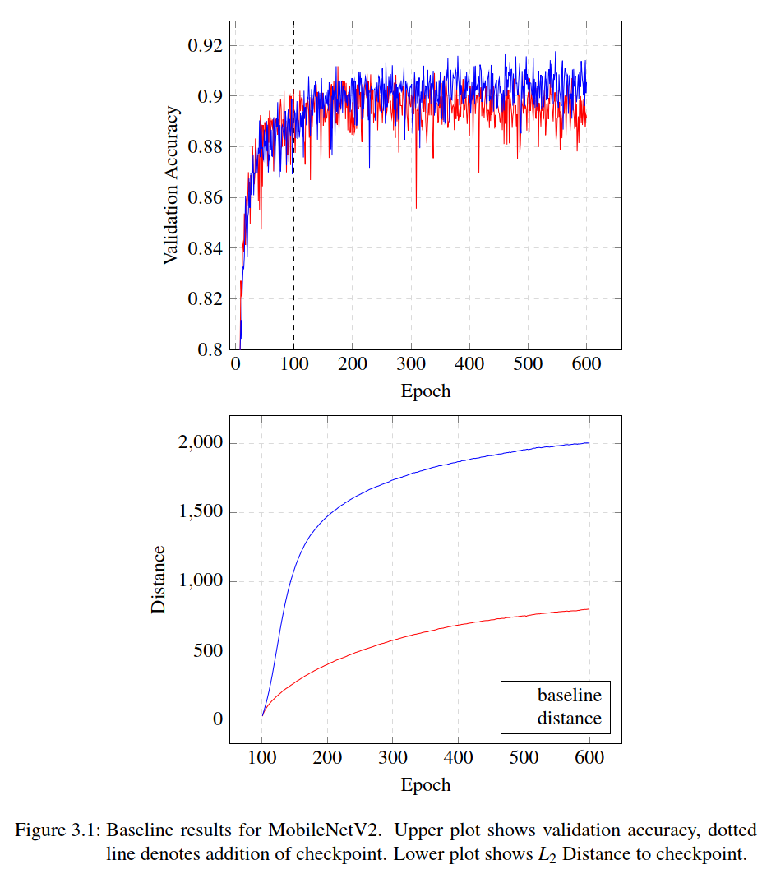
Baseline
Checkpoint after 100 epochs
Successful increased distance in comparison to normal network
Validation accuracy receives a small improvement to around 90% for MobileNetV2 and 89% for ResNet
Notes:
Shape of RBF Kernel is followed with large increase at beginning and then convergence
Note that normal validation accuracy without distance function is shown in all plots
If not stated different, only MobileNetV2 is shown, because results are the same

Slide 40
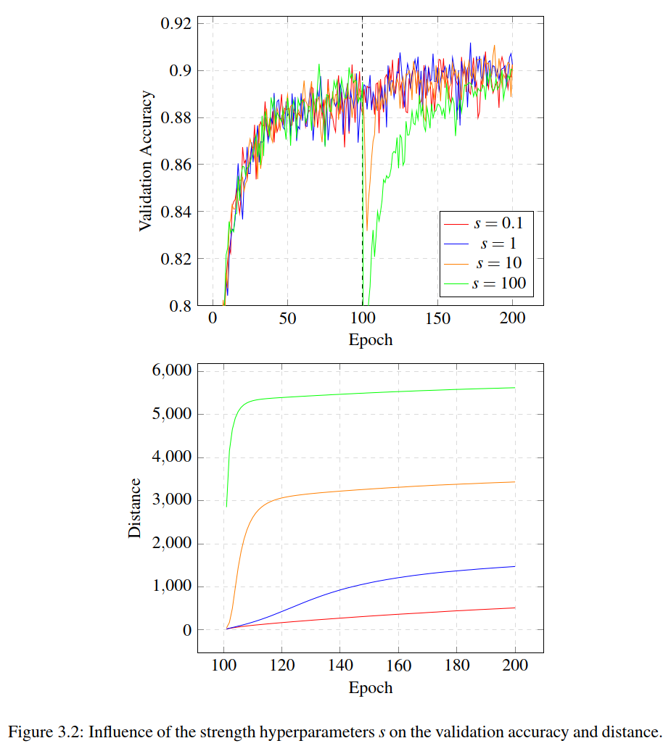
Strength
Higher strength values increase distance further
Strength increases distance fast but converges fast due to large gradient at the beginning which quickly vanishes
Initial drop in validation accuracy for high strength values
Notes:
Again form of Kernel is followed
Accuracy recovers to baseline
Maybe add plot of Kernel

Slide 41
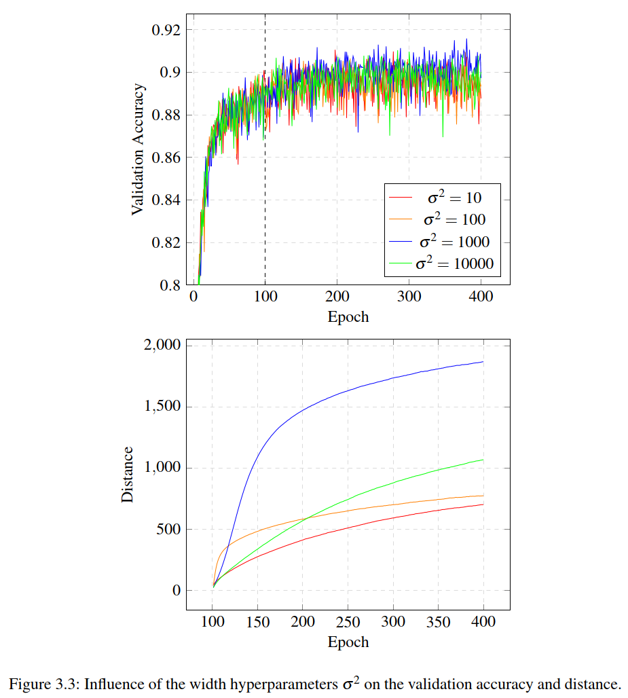
Width
Higher width values increase the distance further
Happens more slowly compared to strength parameter due to smaller gradient
The larger the width slower the distance increases
Notes:
Add pot of Kernel
Gradient smaller but more constant
Green curve slower increase but will eventually outperform blue one

Slide 42
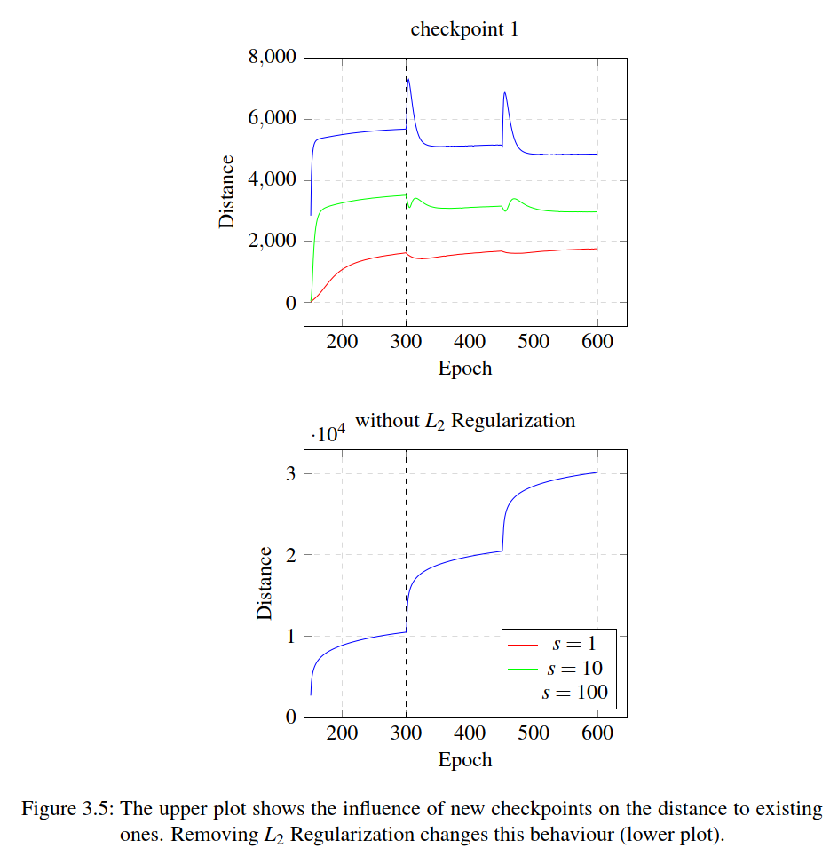
Multiple Checkpoints
Add new checkpoint every 150 epochs
New checkpoint decreases distance to old ones
Probably due to Regularization
Notes:
Add plot l2

Slide 43
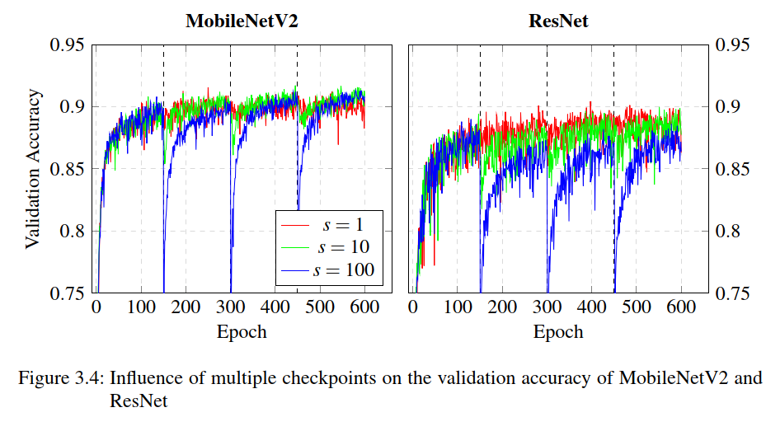
Multiple Checkpoints
Validation accuracy initial drop for higher strength values
Accuracy recovers and even tops for MobileNetV2
Similar to Cosine Decay with Warm restart, probably due to same effect
Notes:
Plot effect of SGD Warm restart next to it
Effect of both: Larger gradient/Learning rate at each restart

Slide 44
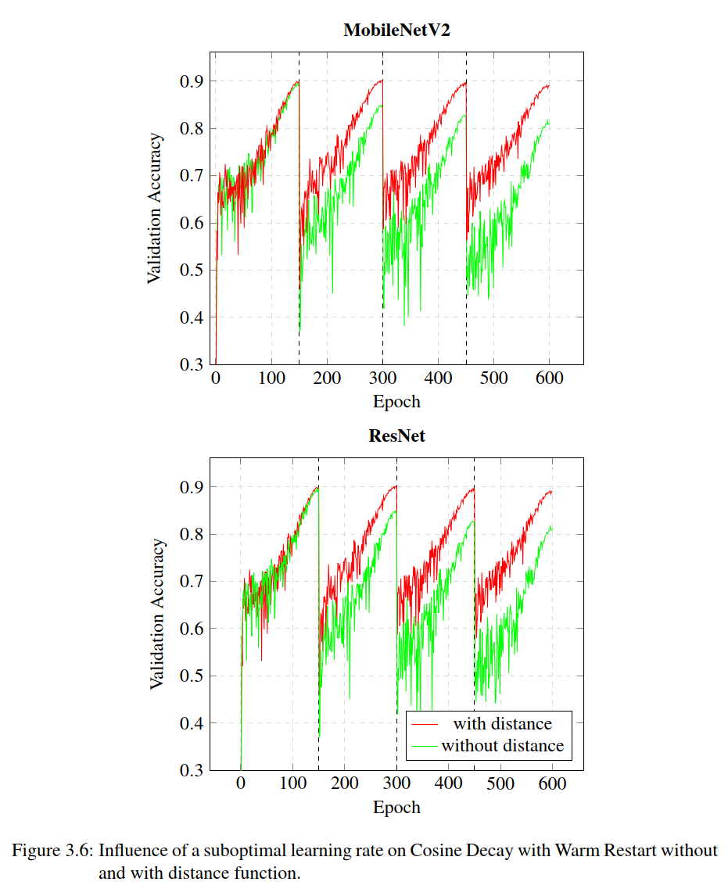
Suboptimal learning rate
Cosine Decay with Warm Restart worsen for every restart when suboptimal maximum learning rate is used
Distance function stabilizes the training
However only observed for one particular learning rate
Reason unclear

Slide 45
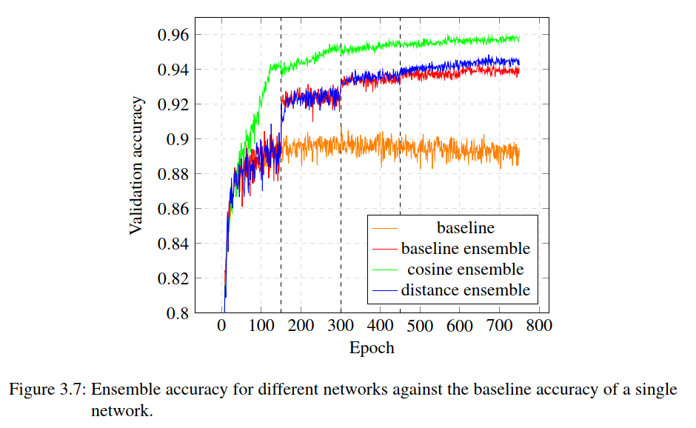
Ensemble methods
Recap idea: Higher Distance leads to lower correlation between snapshots
Take Snapshot before every new checkpoint
Leads to an increasement of 4% against single network
However still worse than Cosine Decay with Warm Restart
Notes:
Schedulers better overall performance, but less benefits of ensembles
Warm restart only 1% increase

Slide 46
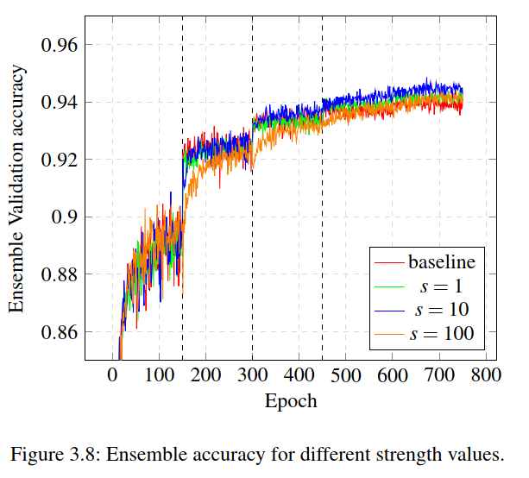
Ensemble methods
Increase strength hyperparameter to get more distant networks
Higher distance does not result in better performance
Correlation stays the same
Notes:
- Higher distance doesn’t result in lower corellation

Slide 47
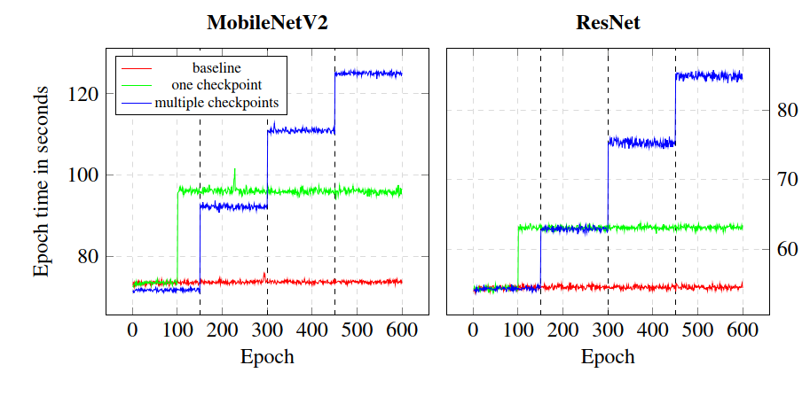
Computational Cost
Scales linear with the number of checkpoints
Nevertheless large increase of epoch time

Slide 48
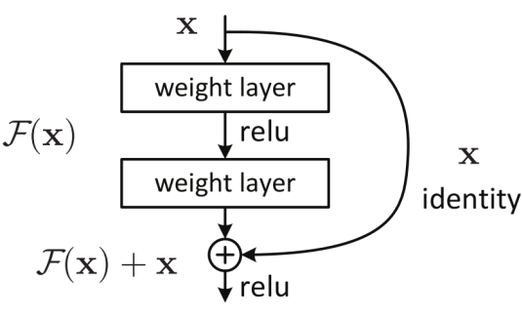
ResNet
Idea: Learning the residuals is easier than the full transformation
Realized by skip connections:

Slide 49
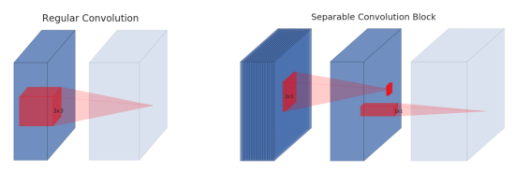
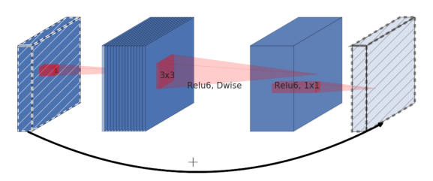
MobileNetV2
Lightweight network for mobile applications
Depthwise separable convolution: Split convolution in depthwise and pointwise convolution
Inverted Residuals: keep intermediate representation low-dimensional

Slide 50
Learning rate decay and schedulers
A high learning rate leads to fast performance increasement
A low learning rate can exploit the landscape better and therefore leads to better performance
Learning rate schedulers decay the learning rate with more epochs
Cosine decay
Step decay
Notes:
Emax =max lr
Emin = min lr
Tcur = current epoch
T0 = max number of epochs
[TODO]: add picture of cosine decay

