Slide 1
Time
General Introduction: 2 min
Introduction: 8 mins
Methods: 8 mins
Results: 8 mins
Discussion and Outlook: 4 mins
Total: 30 mins

Slide 2
Forcing Deep Neural Networks to explore the Loss Landscape
As part of Bachelor thesis
Philipp von Bachmmann
Sommersemester 2020

Slide 3
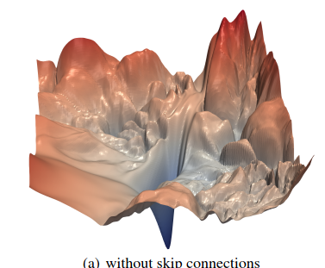
Introduction
From mathematical viewpoint, the recent success of neural networks is quite surprising
Non-convex loss landscape with many local minima creates a challenge for optimization
Current research suggests that low loss areas exist everywhere
Techniques for exploration have been successful
Notes:
Create huge success, see self-driving cars
Neural networks create new challenges for optimization
But solved by trivial algorithms like SGD
Seems to be because all minima low loss and exist everywhere
See SGD Warm restart learning rate set back up, forcing exploration and leading to better performance
My work: Forcing exploration to see if better minima exist

Slide 4
Structure
Basics
Methods
Results
Discussion
Further work

Slide 5
Basics
  Optimization
  Minibatches
  Algorithms

Slide 6
Optimization
adjust a set of parameters to achieve better performance on some performance metric L
Formally: Risk
Problem: only access to the training set which is distributed according to
Solution: Empirical Risk minimization
Notes:
Arithmetic mean serves as unbiased estimator of expectation

Slide 7
Minibatch Algorithms
Computing empirical risk from whole training data is expensive
A subset of the data will give a good approximation, as the data is drawn from the same distribution
These subsets are called minibatches
Example: Maximum likelyhood
In log space, the product decomposes into a sum:
Smaller minibatches can add a Regularization effect
Notes:
Why can we decompose them

Slide 8
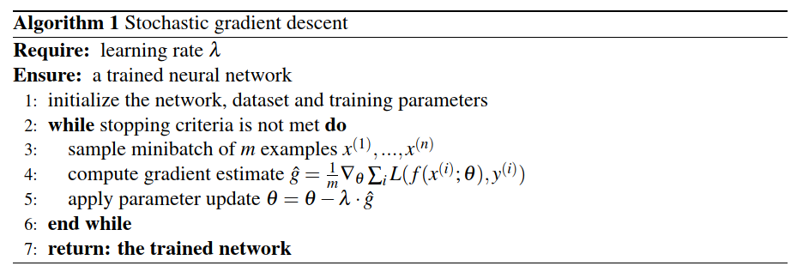
Stochastic gradient descent
Most basic optimization algorithm
Only takes the current gradient into account
Learning rate as hyperparameter

Slide 9
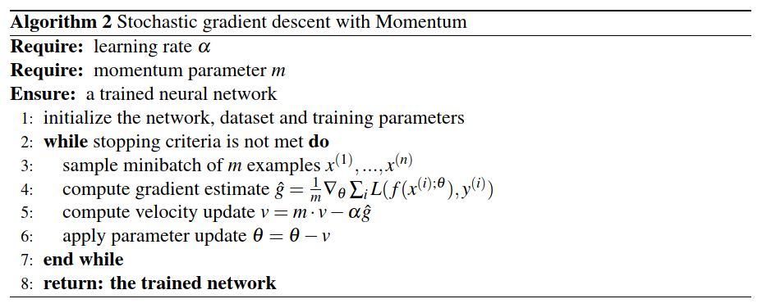
SGD with Momentum
Used to speed up training
Velocity to update the parameters:
controls the velocity, leads to a speed up of factor 10

Slide 10
Related work
  Loss Landscape
  Cosine Decay with warm restart
  Ensemble methods

Slide 11
Loss Landscape
Non-convex loss landscape with many local minima
Extrema with higher cost are exponentially likely to be saddle points
Local minima are arranged in cells with same cost in each cell
Cells are surrounded by areas of high loss
Notes:
- Loss surface is partitioned In

Slide 12
Cosine Decay with Warm Restart
Combination of learning rate schedulers and warm restarts
Learning rate schedulers decay learning rate over time
Warm restart: set the learning rate back to the initial every fixed number of epochs
explore the landscape in phases of high learning rate and exploit in phases of low
Notes:
- Learning rate schedulers: lr is decayed over time

Slide 13
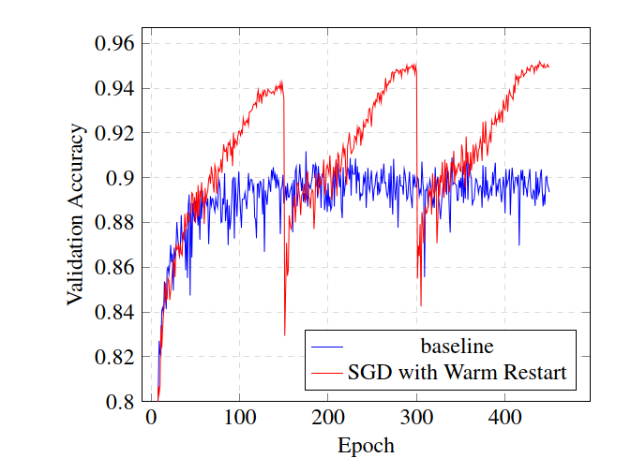
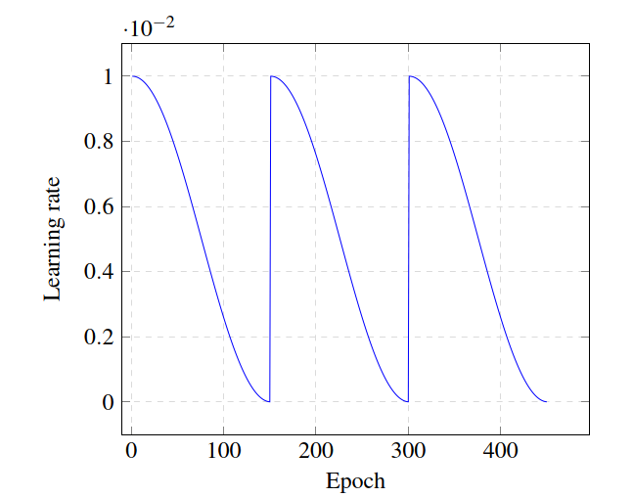
Cosine Decay with Warm Restart
Notes:
Maximum performance boosts with each cycle

Slide 14
Ensemble methods
Combines multiple models for a better prediction
Models need to have a high performance and a low correlation
Get multiple models with snapshots for free
Technique for classification: Model averaging
For each class , we sum the probabilities of all models and then take

Slide 15
Methods
  Motivation
  Mathematical Approach
  Datasets and Networks
Notes:
First give a quick motivation for approach
Then describe in mathematical detail
Describe datasets and networks used for results

Slide 16
Motivation
Landscape consists of cells with minima of same loss surrounded by areas of high loss
Therefore SGD is unlikely to move out
Is it possible to find better minima by forcing exploration?
Example: Cosine Decay with Warm Restart
Other benefits for Ensemble Methods: lower correlation by more distant networks
Goal: Distance from current parameter values
Notes:
- Idea motivated by SGD Warm Restart, because high learning rate forced exploration and lead to boost
Lower Corellation is needed for Ensemble Methods

Slide 17
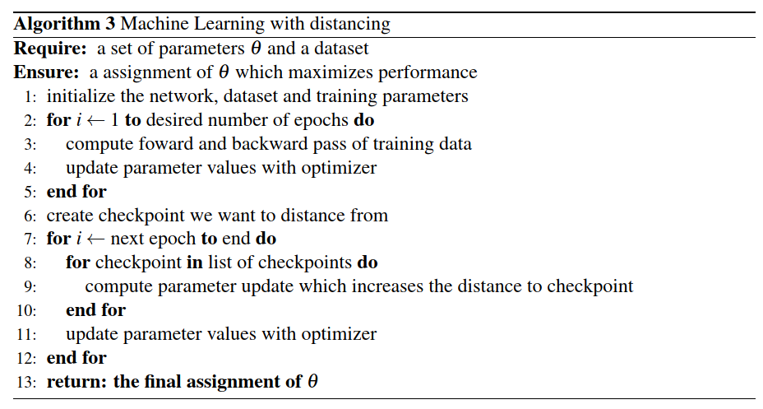
Notes:
Overview of pseudo-code
Line 2 to 5: normal training
Values to distance are stored as checkpoint
Line 7 to 11: difference is how gradients are computed

Slide 18
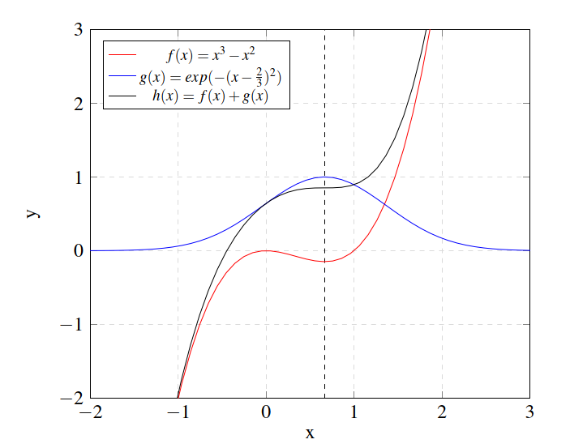
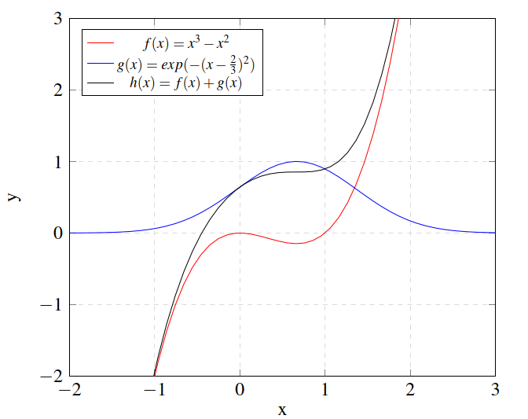
Notes:
Example for 2-dimensional case
Red function has local minimum at x=2/3, which is set as checkpoint
Place hill at this location in form of blue function
Local minimum disappears, algorithm not getting stuck anymore

Slide 19
Mathematical approach
  Distance function
  Loss function
  Effect on gradient

Slide 20
Distance function
Common choice is norm, defined as:
To compare two vectors and :
Problem: dependent on size of
Notes:
Can get rid of root, doesn’t change direction of gradient
If x gets larger in size, distance will increase (for same distribution of x)

Slide 21
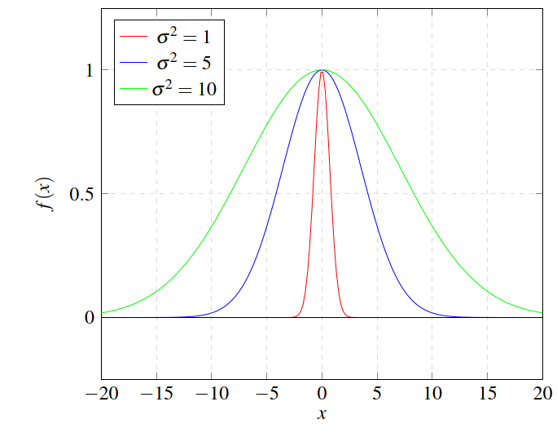
Distance function
Solution: RBF Kernel from Support Vector Machines
distance
Notes:
Values are now bound between 0 and 1, see graph, also if move away no influence any more
Hyperparameter sigma to control for width
Graphs shows influence of sigma
The larger sigma, the wider function

Slide 22
Loss function
Combine the normal Loss function with the Distance penalty
Add parameter strength to control for influence
Multiple Checkpoints
Notes:
Distance is now a penalty
Normal loss function with empirical risk, used to keep performance high
Hyperparameter strength controls influence

Slide 23
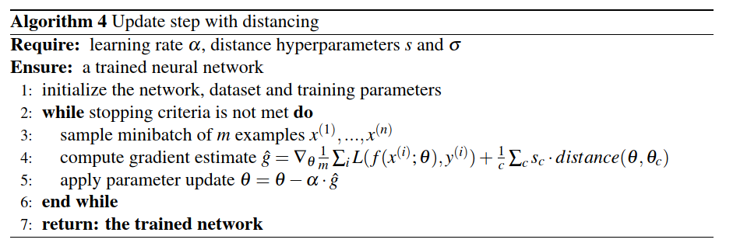
Notes:
Overview over update step
First compute gradient
Apply same as SGD

Slide 24
Effect on Gradient
Only factor will affect direction of gradient, other will only scale size
  and therefore will be positive so will get smaller when updated, therefore the distance increases
Notes:
Take negative gradient for update
Same case other way around
If both parameters the same, no update, but also gradient from normal loss function

Slide 25
Dataset and Networks
CIFAR-10
  60000 32x32 color images with 10 different classes
  Current top accuracy: 97.3%
ResNet
  Learning residuals is easier than learning the full transformation
  Skip Connections:
MobileNetV2
  Depthwise separable Convolution
  Inverted Residuals
Notes:
Depthwise separable Convolution: Split Convolution in Depthwise and Pointwise Convolution, cheaper to compute
Inverted Residuals: Intermediate Representation low-dimensional

Slide 26
Results
  Baseline
  Hyperparameters
  Multiple checkpoints
  Learning rate schedulers
  Ensemble Methods

Slide 27
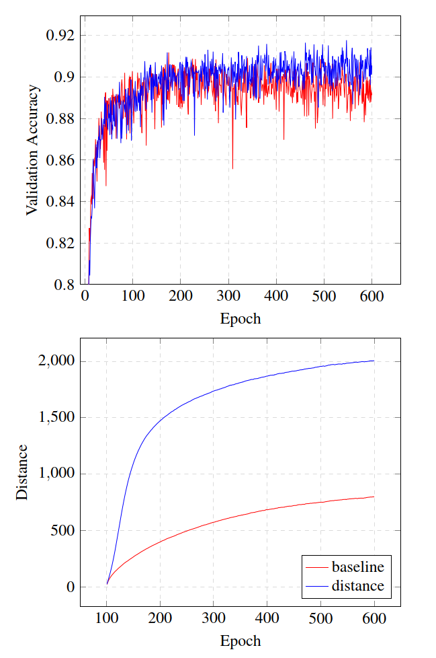
Baseline
Checkpoint after 100 epochs
Successful increased distance in comparison to normal network
Validation accuracy stays the same at around 90% for MobileNetV2 and 89% for ResNet
Notes:
Shape of RBF Kernel is followed with large increase at beginning and then convergence
Note that normal validation accuracy without distance function is shown in all plots
If not stated different, only MobileNetV2 is shown, because results are the same

Slide 28
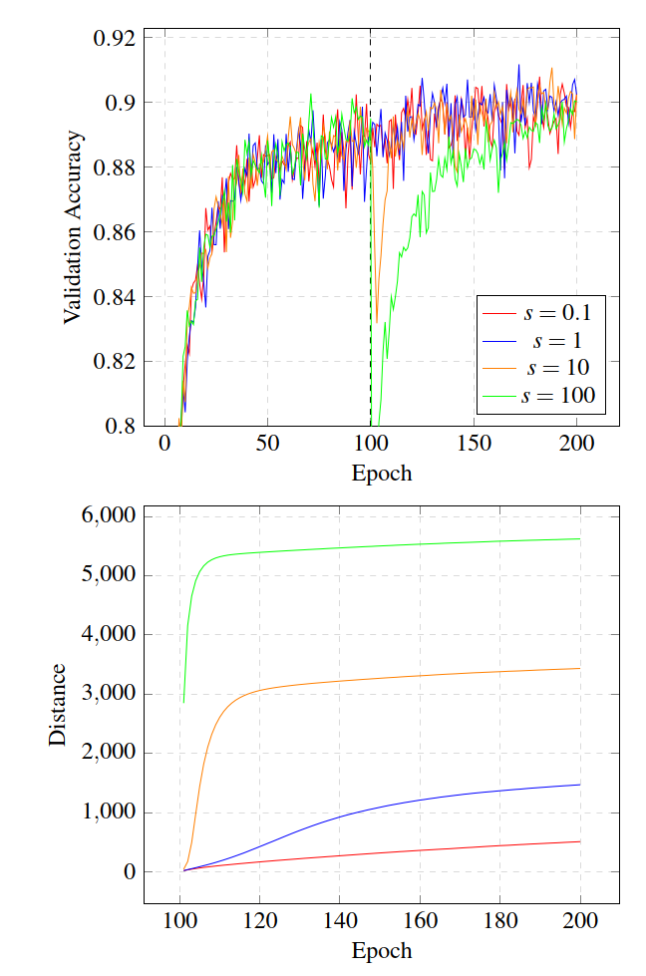
Strength
Higher strength values increase distance further
Strength increases distance fast but converges fast due to large gradient at the beginning which quickly vanishes
Initial drop in validation accuracy for high strength values
Notes:
Again form of Kernel is followed
Accuracy recovers to baseline
Maybe add plot of Kernel

Slide 29
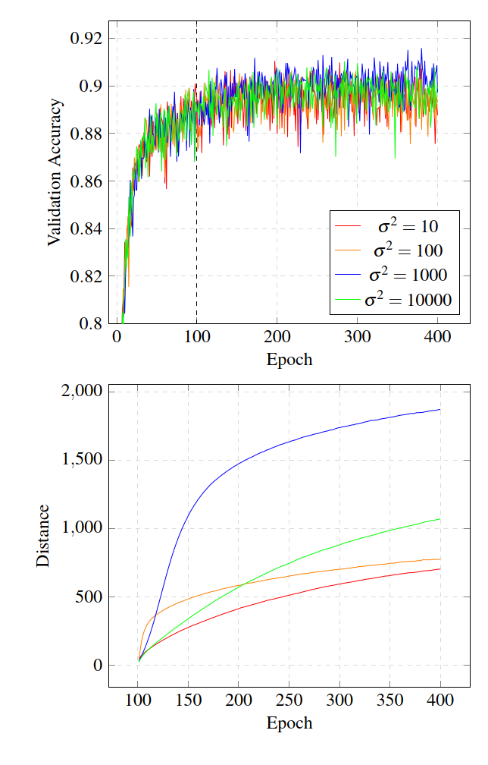
Width
Higher width values increase the distance further
Happens more slowly compared to strength parameter due to smaller gradient
The larger the width slower the distance increases
Notes:
Add pot of Kernel
Gradient smaller but more constant
Green curve slower increase but will eventually outperform blue one

Slide 30
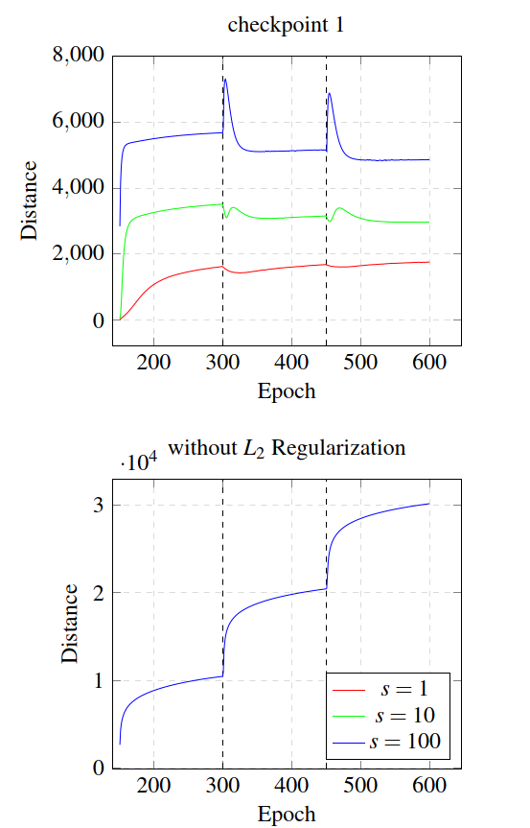
Multiple Checkpoints
Add new checkpoint every 150 epochs
New checkpoint decreases distance to old ones
Probably due to Regularization
Notes:
Add plot l2

Slide 31
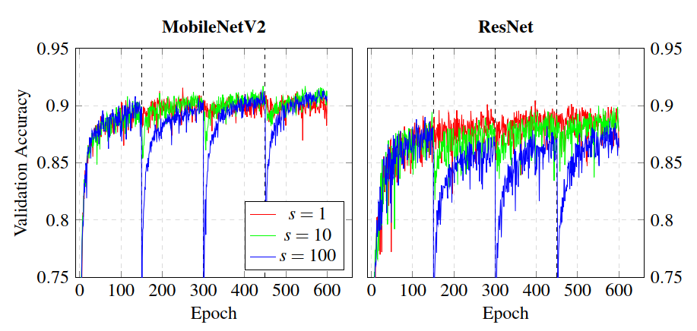
Multiple Checkpoints
Validation accuracy initial drop for higher strength values
Accuracy recovers and even tops for MobileNetV2
Similar to Cosine Decay with Warm restart, probably due to same effect
Notes:
Plot effect of SGD Warm restart next to it
Effect of both: Larger gradient/Learning rate at each restart

Slide 32
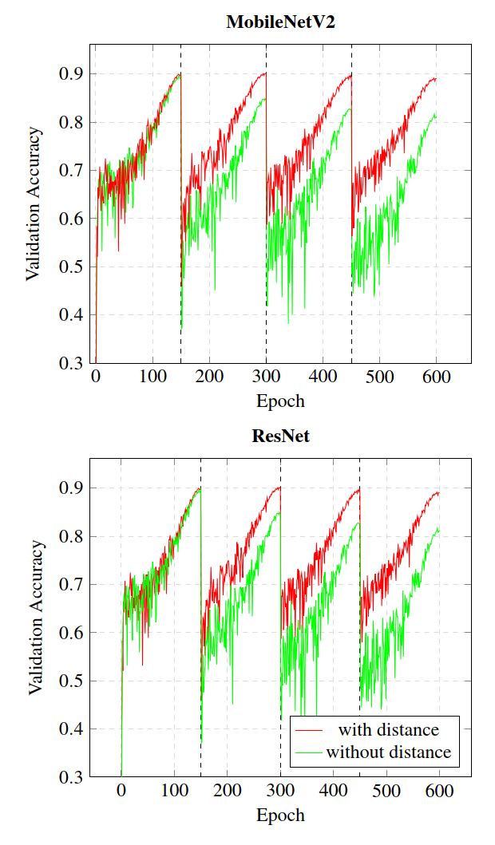
Suboptimal learning rate
Cosine Decay with Warm Restart worsen for every restart when suboptimal maximum learning rate is used
Distance function stabilizes the training
However only observed for one particular learning rate
Reason unclear

Slide 33
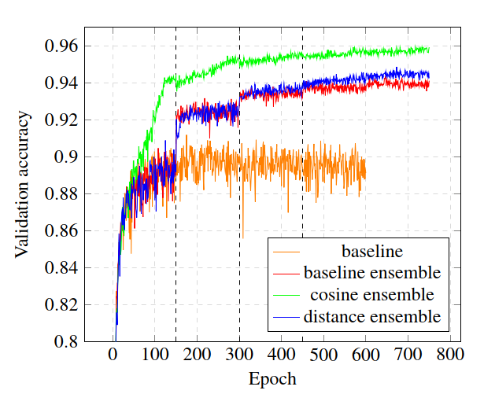
Ensemble methods
Recap idea: Higher Distance leads to lower correlation between snapshots
Take Snapshot before every new checkpoint
Leads to an increasement of 4% against single network
However still worse than Cosine Decay with Warm Restart
Notes:
Schedulers better overall performance, but less benefits of ensembles
Warm restart only 1% increase

Slide 34
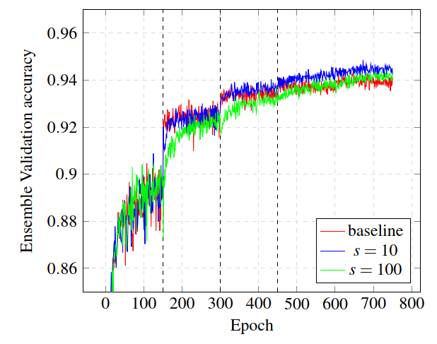

Ensemble methods
Increase strength hyperparameter to get more distant networks
Higher distance does not result performance
Correlation stays the same
Notes:
- Higher distance doesn’t result in lower corellation

Slide 35
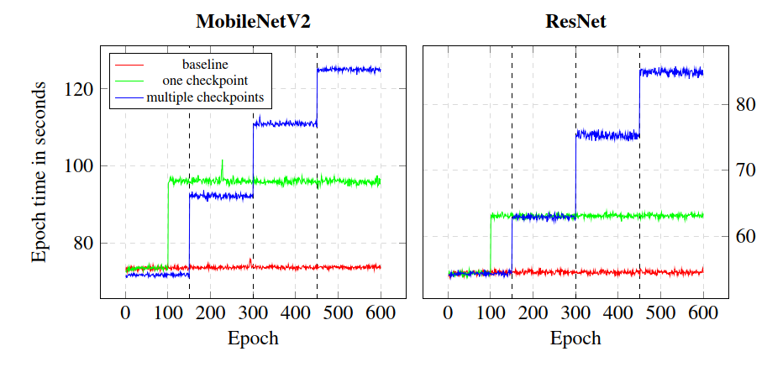
Computational Cost
Scales linear with the number of checkpoints
Nevertheless large increase of epoch time

Slide 36
Discussion and Outlook

Slide 37
Loss Landscape
Successful distancing from checkpoints
Does not translate to validation accuracy
Seems to confirm the view that areas of low loss exist everywhere and are of similar cost

Slide 38
Multiple Checkpoints and Schedulers
Multiple checkpoints give small benefit, probably due to same effects as in Cosine Decay with Warm restart
For a stable gradient direction, the distance function amplifies the gradient and increases update steps, similar to a high learning rate
No explanation for wrong initial learning rate
Notes:
Only amplifies if constant gradient direction
Simple explanation wrong lr: walks into area of bad loss, distance function helps to recover
However contradicts before

Slide 39
Ensemble Methods
Trade off between correlation and performance
Higher individual performance implies higher correlation
Distance on the loss landscape seems not to imply different predictions
Notes:
- Lower correlation better ensemble benefit but maybe worse ensemble performance because of worse individual performance

Slide 40
Conclusion and Further work
Exploration of Loss Landscape is possible, but might not be useful
Implications for Parameter Initialization
Why do Warm Restarts increase performance?
Connection of Loss Landscape and behavior
Notes:
Parameter initialization: does not matter at all, or can we regard other constrains?
Why do all ensemble networks on different locations on the loss landscape behave the same? Because training set or similar activation?

Slide 41
References

Slide 42
Discussion
Successful distancing from checkpoints
Does not translate to validation accuracy
Implication: Areas of low loss exist everywhere and are of same cost
Multiple checkpoints give small benefit, probably due to same effects as in Warm restart
No explanation for difference of suboptimal learning rate
Ensembles show that different locations still same prediction

Slide 43
Local Minima
Loss landscape is non-convex
Local minima can have higher cost than the global one
Example: Weight space symmetry
Chromanska et al. showed that extrema with higher cost are exponentially likely to be saddle points
Most local minima are of low cost

Slide 44
Saddle points
Both positive and negative Eigenvalues
Get more common for higher dimensions
No problems for first order algorithms, unlikely to get stuck
Second order algorithms are attracted to it

Slide 45
Poor correspondence between local and global structure
Local structure often does not resemble the global structure
Effects: Gradients point away from areas of low loss or construct a suboptimal path
For classification: No global optimum because of Softmax

Slide 46
Minibatch Algorithms
Minibatches have to be sampled randomly
If all data is only used once, the estimate is unbiased
Smaller batch sizes can add a regularization effect by adding noise to the gradient

Slide 47
Network Hyperparameters
Optimization Algorithm: SGD with Momentum,
Learning rate: 1e-2
Batch size: 128
Regularization: , factor 1e-3
Is it really important?

Slide 48
Computational Analysis
No interaction between standard Loss function and Distance function
For a given network size, the Distance function creates a constant additional cost
Distance is computed for every batch once, therefore a total of times through the loop
If the initial cost is in , it adds up to
Nevertheless cost is still raised by a constant amount
Maybe also not important here, only results

Slide 49
Dataset and Networks
  CIFAR-10
  ResNet
  MobileNetV2

Slide 50
CIFAR-10
Dataset for image classification
60000 32x32 color images with 10 different classes
Current top accuracy: 97.3%
Data transformation: Random crop, horizontal flip, normalization

Slide 51
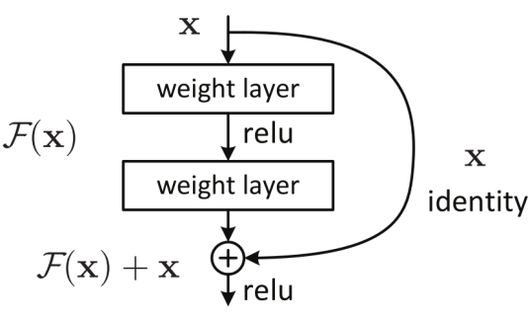
ResNet
Idea: Learning the residuals is easier than the full transformation
Realized by skip connections:

Slide 52
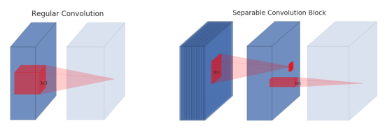
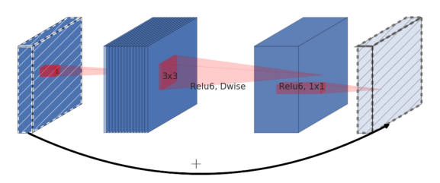
MobileNetV2
Lightweight network for mobile applications
Depthwise separable convolution: Split convolution in depthwise and pointwise convolution
Inverted Residuals: keep intermediate representation low-dimensional

Slide 53
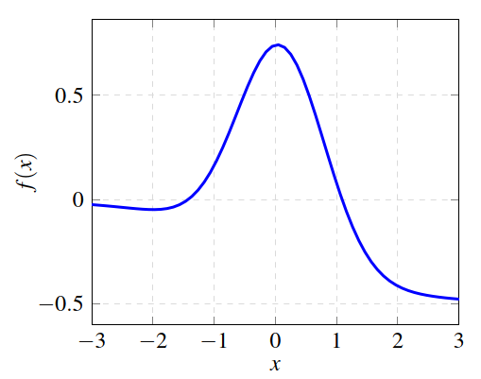
Example

Slide 54
Learning rate decay and schedulers
A high learning rate leads to fast performance increasement
A low learning rate can exploit the landscape better and therefore leads to better performance
Learning rate schedulers decay the learning rate with more epochs
Cosine decay
Step decay
Notes:
Emax =max lr
Emin = min lr
Tcur = current epoch
T0 = max number of epochs
[TODO]: add picture of cosine decay

Slide 55
Challenges
Local minima
  Non-convex loss landscape with many local minima
  Example: weight space symmetry
Saddle points
  More common for higher dimensional spaces than local minima
  Problem depends on choice of optimization algorithm
Poor correspondence between local and global structure
  Gradients point away of good areas or form suboptimal path
Notes:
- Weight space symmetry: Swap two units and their incoming and outgoing weights in one layer

Slide 56
Loss landscape
Exist infinitely many local minima with higher cost than global one
Extrema with higher cost are exponentially likely to be saddle points
Arranged in cells with same cost in each cell
Cells are connected by paths of low cost
However, the direct path is usually of high cost

