Slide 1
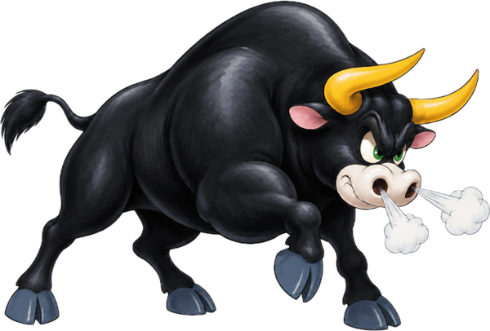
DEAL DESK
Ask a senior about a live deal.
Nobody knows it was you.
Live demo inside
Talk to Users hackathon · San Francisco · Oct 10, 2026

Slide 2
THE PROBLEM
Most acquisitions miss the goals the buyer set for them
70–75%
The people closest to the work
Analysts and associates build the models and read the documents, and they are the least likely to ask when something looks wrong.
of acquisitions fail to deliver their stated goals, across roughly 40,000 deals over 40 years¹
¹ Baruch Lev and Feng Gu, analysis of ~40,000 acquisitions, reported in Fortune, Nov 2024.

Slide 3
WHY PEOPLE STAY QUIET
Young staff are almost 3x as likely to feel awkward asking for help
26%
of leaders make their teams feel safe to speak up²
#1
Feeling safe to speak up was the top trait of Google's best teams, out of 180 studied³
¹ UK workplace survey, 2012 (BHP). ² McKinsey Global Survey, 2021. ³ Google Project Aristotle, 2012–2014.

Slide 4
WHAT BANKERS DO INSTEAD
Bankers already go around official channels, and regulators charge for it
$2.5B+
1
30+ firms fined
including JPMorgan, Goldman Sachs and Citi
2
Private chats are where the real questions go
because they feel safe
in SEC and CFTC fines since Dec 2021 for work talk on WhatsApp and texts that firms never recorded¹
3
Deal Desk keeps the safety
and adds a sealed record for compliance
¹ InvestmentNews and Bloomberg reporting on SEC/CFTC recordkeeping settlements, Dec 2021 – Aug 2023.

Slide 5
HOW IT WORKS
A junior asks, two matched seniors answer, and neither learns who the other is
1
2
3
4
Attach a deal
Pick it from the firm's deal database, with its files
Names become codenames
“Northwind” becomes “Project Falcon (Buyer)” before anyone reads it
Routed to 2 seniors
Matched by deal type and sector
Answer comes back
Bottom line, their words, why, and what to watch
→
→
→
Everyone sees only an anonymous handle and a level. Compliance keeps a sealed copy it can open if regulators ask.

Slide 6
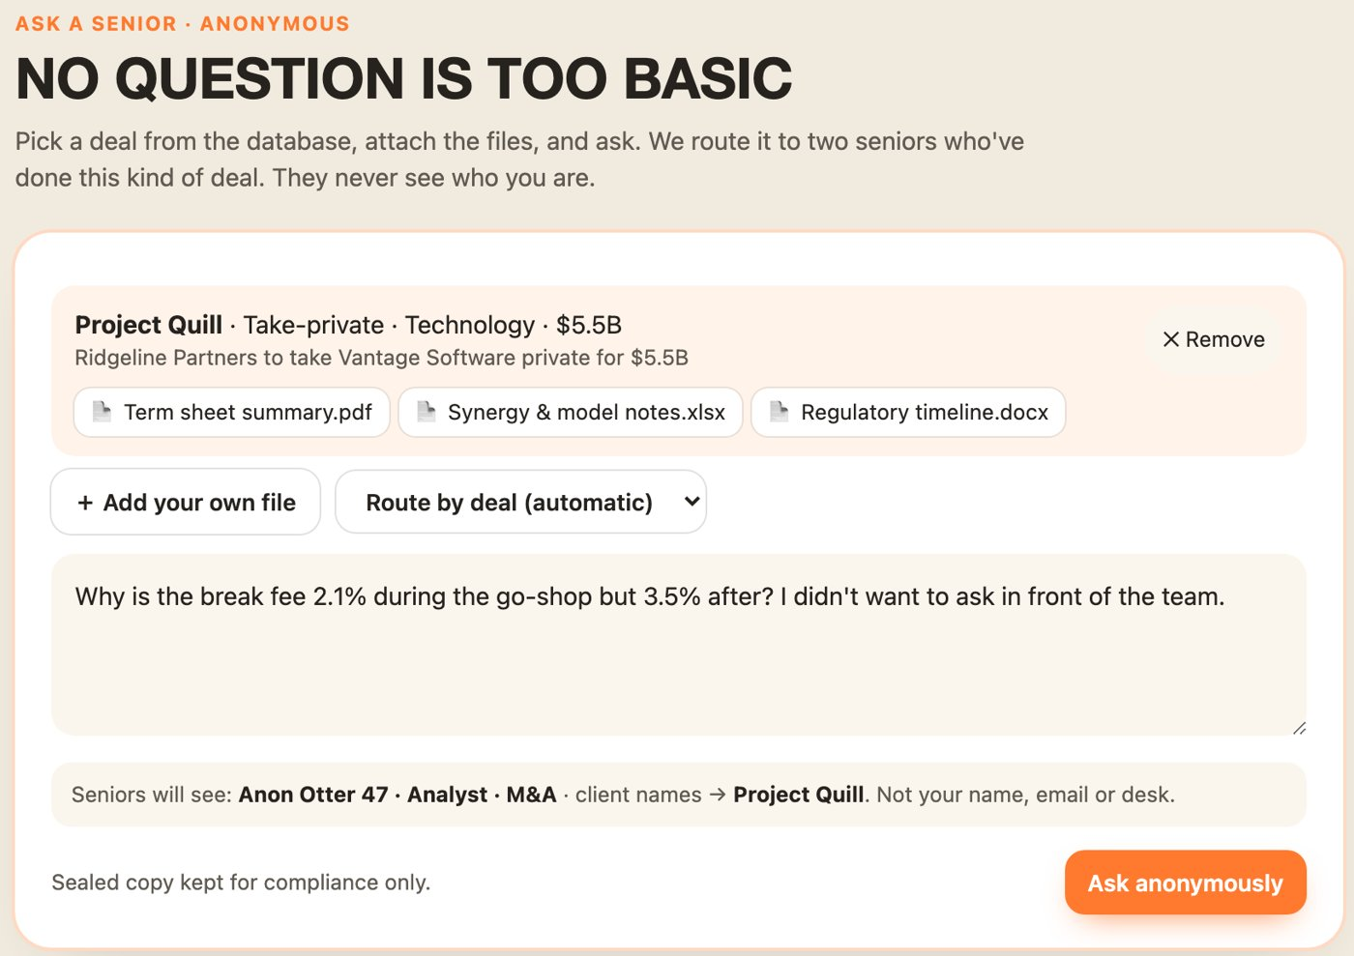
THE PRODUCT
A junior attaches the deal and asks in plain words
Deal database
10 deals: mergers, LBOs, spin-offs, hostile bids, earnings events
Files come along
Term sheet, model notes, timeline, or the junior's own file
The junior sees what seniors will see
An anonymous handle and level, never a name

Slide 7
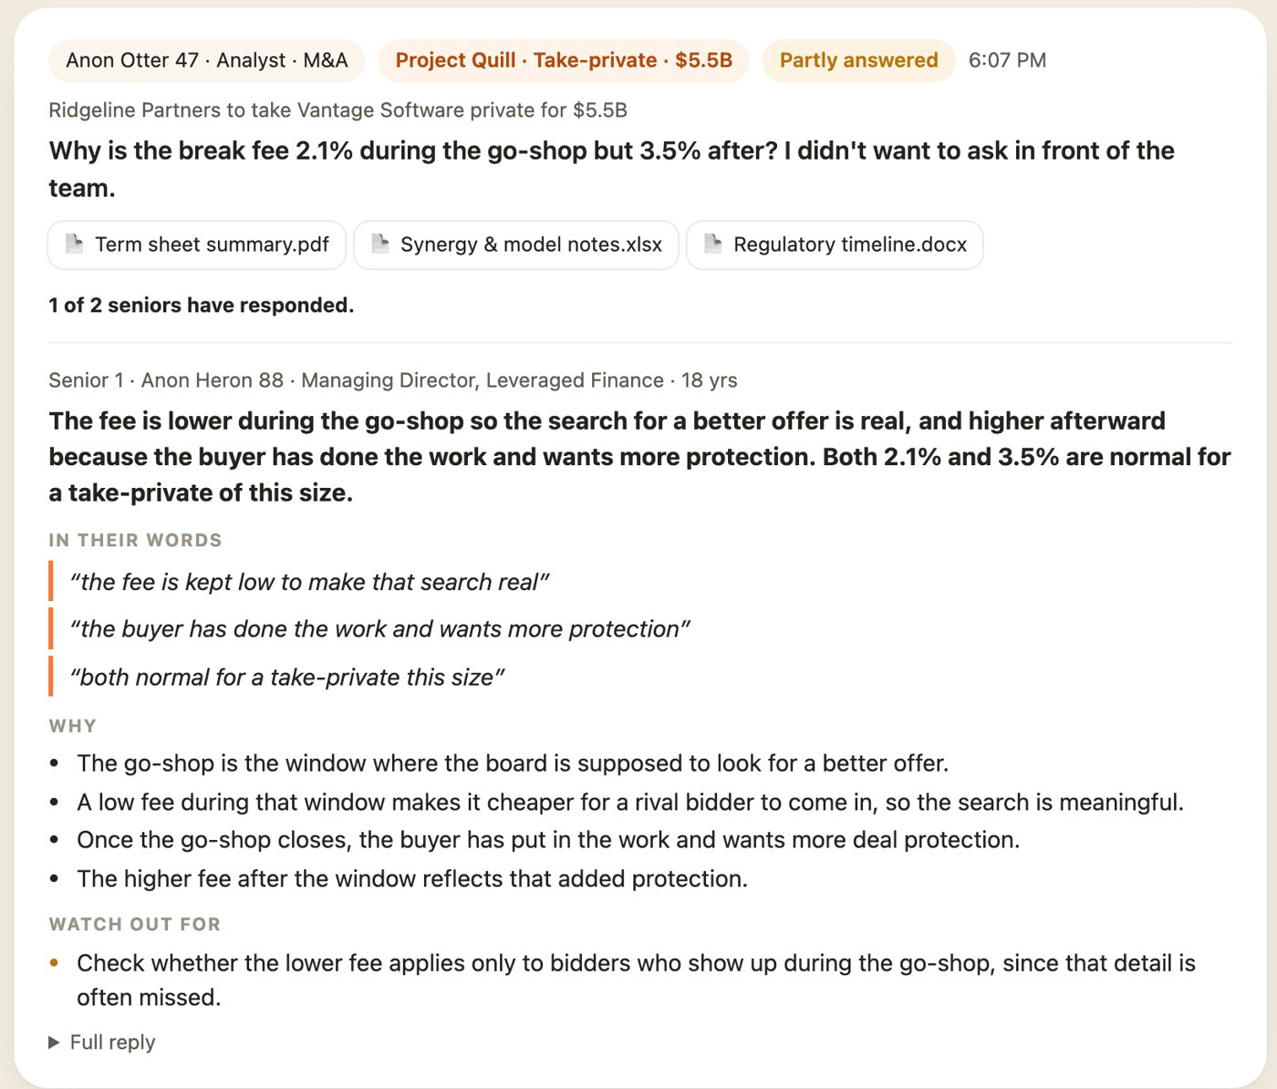
THE ANSWER
Seniors reply in their own words, and the junior gets a short, structured answer
Formatted like a Sense AI result
Bottom line, quotes, why, watch-outs
Seniors write normally
Claude turns a quick reply into a clear answer
Two views per question
A summary shows where the seniors agree

Slide 8
DEMAND
Professionals already use anonymous channels and lose time waiting for answers
7M+
53%
49%
verified professionals use Blind, an anonymous work app most popular in tech, finance and consulting¹
of 28,747 professionals say waiting on answers interrupts their work²
often answer questions they have already answered before²
¹ Blind company blog; Fortune, Apr 2022. ² Stack Overflow Developer Survey 2024, professional developers.

Slide 9
WHAT TESTERS TOLD US
Finance testers worry about names leaking and about IT approval
“It was mentioning names, and it's not supposed to mention names in that summary.”
Tester, on an AI summary at work
“to use a new application or artificial intelligence, they have to go through IT. And IT has to approve it”
Same tester, on adopting new tools
What we built in response: client names become codenames before any senior reads a question, and Deal Desk runs inside the bank with a sealed record for compliance.
Sense AI phone interview with a finance tester, Oct 10, 2026.

Slide 10
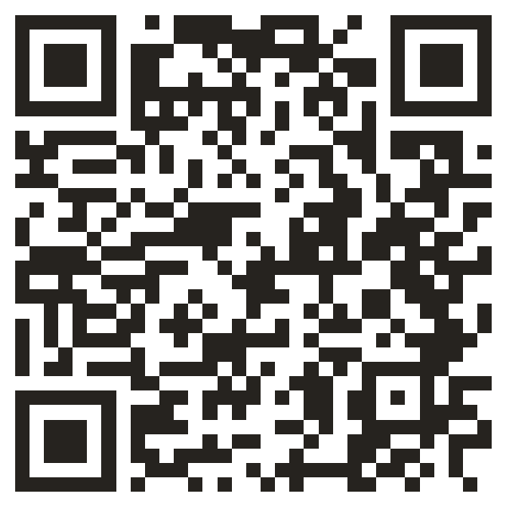
TRY IT NOW
Log in as a junior in one tab and a senior in another. Ask, answer, and watch the result come back.
deal-desk-production-7983.up.railway.app
Scan to open Deal Desk

