Slide 1
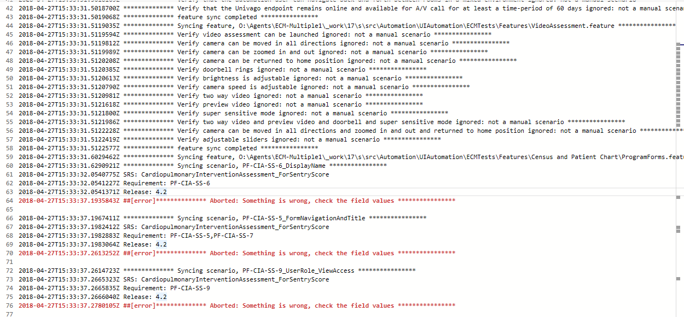
Gherkin2Mtm
A tool to export Gherkin (in a TFS repo) to MTM

Slide 2
Overview
It exports the transformed test case out of a validated Gherkin to the MTM

Slide 3

Requirements
Support single language
Facilitate test case reviews
Manage test plan
Sunset HP Quality Center (bye bye QC)

Slide 4

Technicalities
Is a console application
Accepts credentials in different forms to access the TFS API,
un-pwd pair
PAT(Personal Access token)
NTLM authentication
Connects to a project where the test cases are to be stored
Gherkin library is used to parse feature files
Provides 3 ways to input feature files
a single feature file
multiple feature files
a folder

Slide 5
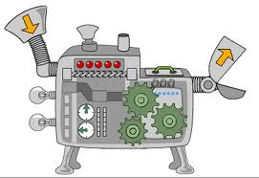
High-level flow
Input
Gherkin
Path to a resource
Process
Parses feature files
Field validation
Publish
Publish changes
Accepts only manual scenarios
Hash check
Link scenario to a test case

Slide 6

Input Semantics
FieldMapper.xml the place where the mapping between test case fields and scenario tags is defined. A typical definition is like below
<TestCaseField>
<Name>SRS</Name> --------- Is the name of the test case field which gets the value of the SRS tag
<Tag>SRS</Tag> --------- Is the name of the tag decorated on a scenario whose value will be copied to the corresponding field
<Required>true</Required> --------- Specifies that the use of this tag on a scenario is mandatory
<AllowMultiple>false</AllowMultiple> --------- Specifies that if this field allows multiple values, in which case, there would be multiple such tags on a scenario which will be a concatenated value for the corresponding test case field.
<Prefix>eCareManager\</Prefix> --------- If there is a need to prepend any field value with a text across a project, that can be mentioned here.
</TestCaseField>
The corresponding tag should be in the form @Tag:Value
Any tags other than those supplied thru this, excluding @Manual and @MTMID, will be added to the Tags field of the test case
Every project should have one defined
Every scenario should be syntactically correct (This should be ensured by the author by building the project before checking in changes)

Slide 7
Input Semantics
Every scenario must have the following list of tags
@RELEASE:XX
@REQUIREMENT:XX
@SRS:XX
@TESTCASE:XX
@MANUAL
@RELEASE, @SRS should have a valid, existing values available for a test case and for a given product
Every scenario should be syntactically correct (This should be ensured by the author by building the project before checking in changes)

Slide 8
Process Flow
Start
Parse the feature file
No
Log error
Is Valid?
Yes
End
No
1-n scenarios?
Yes
Get next scenario
No
Is manual?
Log info
Yes
Yes
Missing tags?
Log error
No
No
No
Yes
No
Is new?
Valid fields?
Needs Change?
Log info
(Scenario uptodate)
Yes
Yes
Create test case
Update test case
No
Valid fields?
Yes
Publish changes

Slide 9
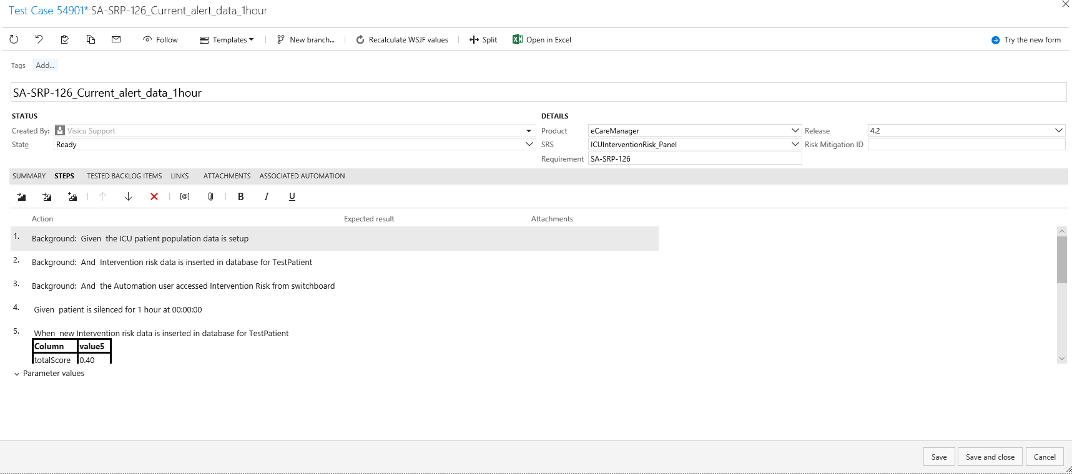

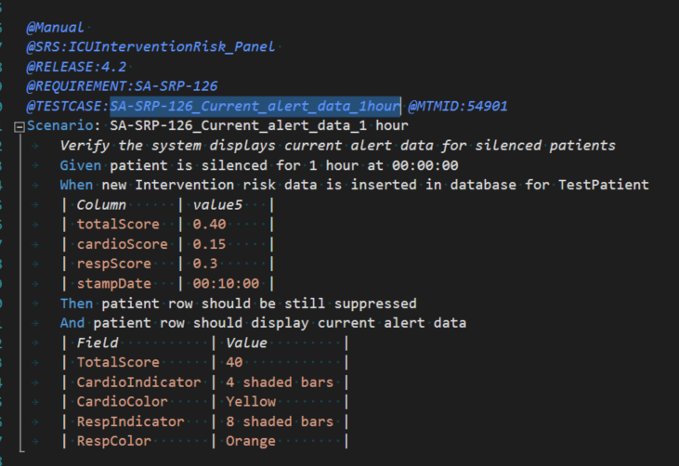
Publish
Creates a test case
Links the scenario
Updates the test case
Test case sample

Slide 10
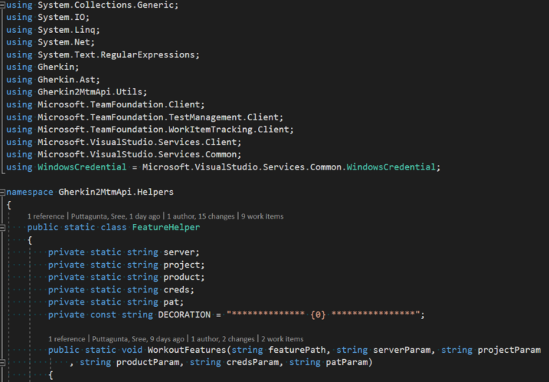
Source code
Source code path
http://devtfs2012:8080/tfs/Philips%20VISICU/VisicuCommon/_versionControl?path=%24%2FVisicuCommon%2FAutomation
Any change to the source triggers the build – Checkin hook on features for a project uses the latest build

Slide 11
Triggers
Though, every one can use it from their machine, it is highly discouraged
It should be triggered automatically on committing changes to a feature file of a project

Slide 12

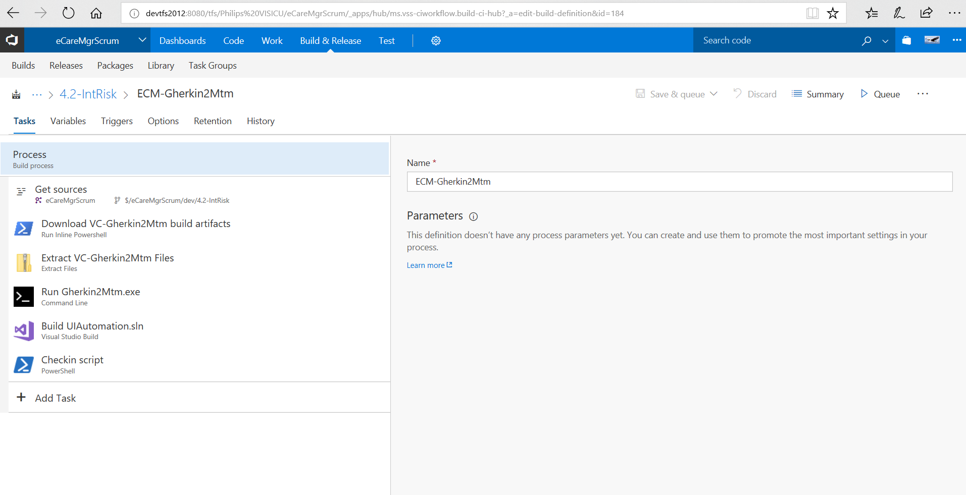
Build definition

Slide 13
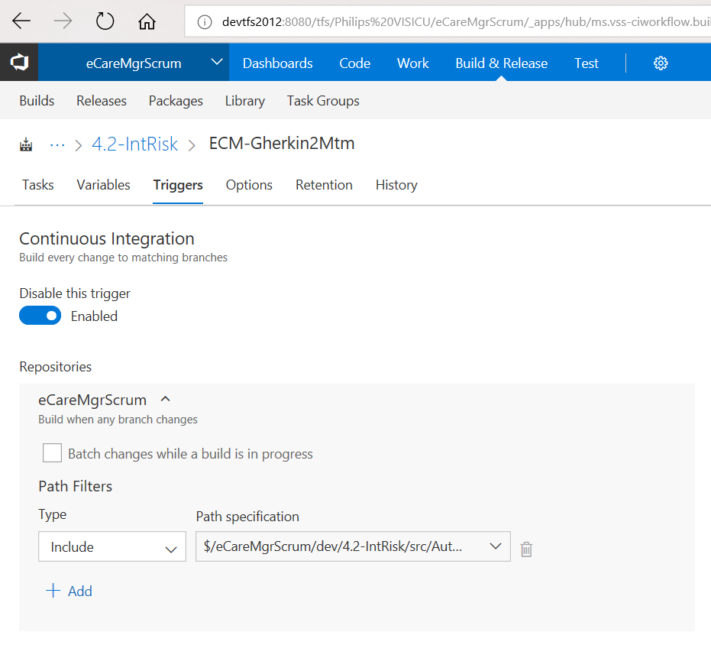

Trigger

Slide 14
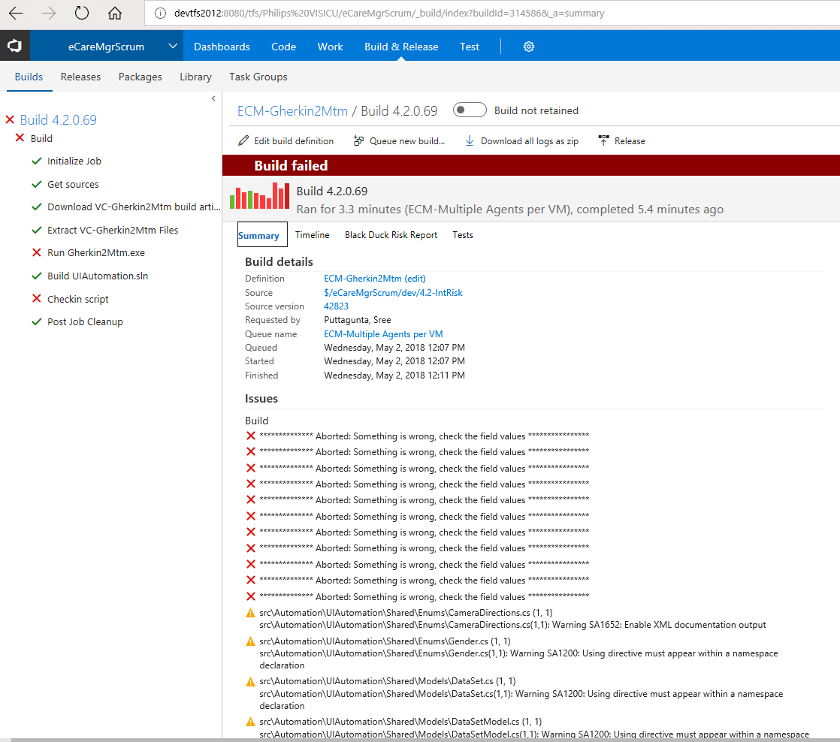

Build log

Slide 15
Thank y’all

