Slide 1
Linux Kernel Development model
i.e. well-versioned chaos
Brandon Philips
SuSE Labs / Novell
brandon@ifup.org

Slide 2
34,550 files
11,600,000 lines
Kernel release 2.6.34
May 16 2010

Slide 3
2,450 developers
340 companies
Kernel releases 2.6.31 – 2.6.34
March 2009 – February 2010

Slide 4
10,600 lines added
5,600 lines removed
4,931 lines modified
2.6.20 to 2.6.24-rc8
Kernel releases 2.6.31 – 2.6.34
June 2009 – May 2010

Slide 5
10,600 lines added
5,600 lines removed
4,931 lines modified
for the last year
2.6.20 to 2.6.24-rc8
Kernel releases 2.6.31 – 2.6.34
June 2009 – May 2010

Slide 6
5.54 changes per hour
Kernel releases 2.6.31 – 2.6.34
June 2009 – May 2010
2.6.20 to 2.6.24-rc8
Notes:
Last year this was 3.69, crazy...

Slide 7
commit 4bdae98f1a456ea1fea5ea02f9249d23bceab75b
Author: Shaohua Li <shaohua.li@intel.com>
Date: Thu Apr 8 11:16:15 2010 +0800
ACPI: fix acpi_hest_firmware_first_pci() caused oops
acpi_hest_firmware_first_pci() could be called when acpi
is disabled and cause system oops.
Signed-off-by: Shaohua Li <shaohua.li@intel.com>
Signed-off-by: Len Brown <len.brown@intel.com>
diff --git a/drivers/acpi/hest.c b/drivers/acpi/hest.c
index 4bb18c9..1c527a1 100644
--- a/drivers/acpi/hest.c
+++ b/drivers/acpi/hest.c
@@ -123,6 +123,10 @@ int acpi_hest_firmware_first_pci(struct pci_dev *pci)
struct acpi_table_header *hest = NULL;
+
+ if (acpi_disabled)
+ return 0;
+
status = acpi_get_table(ACPI_SIG_HEST, 1, &hest);

Slide 8
Developer's Certificate of Origin
(a) I created this change; or
(b) Based this on a previous work with a
compatible license; or
(c) Provided to me by (a), (b), or (c) and not
modified
(d) This contribution is public.

Slide 9

Notes:
2800 developers last year

Slide 10
Notes:
590 different driver/file/subsystem maintainers

Slide 11
Notes:
Around 120 subsystem maintainers

Slide 12
Notes:
125 trees in -next

Slide 14

New release every
2¾ months
Kernel releases 2.6.20 - 2.6.34
Notes:
86 days to be exact.

Slide 15
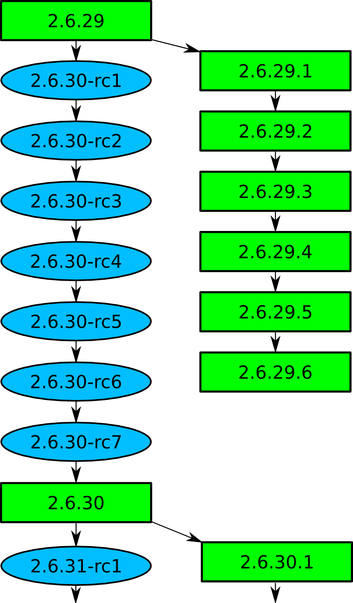

Slide 17

Top developers by quantity
Paul Mundt 586
Bartlomiej Zolnierkiewicz 504
Johannes Berg 475
Peter Zijlstra 474
Takashi Iwai 424
Mark Brown 417
Ingo Molnar 405
Roel Kluin 379
Joe Perches 359
Greg Kroah-Hartman 357
Kernel releases 2.6.31 - 2.6.33

Slide 18
Top Signed-off-by:
David S. Miller 4278
John W. Linville 2985
Greg Kroah-Hartman 2701
Ingo Molnar 2638
Andrew Morton 2566
Mauro Carvalho Chehab 1863
James Bottomley 1098
Dave Airlie 661
Len Brown 577
Paul Mundt 558
Kernel releases 2.6.31 - 2.6.33

Slide 19

Who is funding this work?
1. 16.5%
2. Red Hat 11.4%
3. Intel 7.8%
4. 5.9%
5. Novell 5.3%
6. IBM 5.1%
7. Consultants 2.2%
8. Oracle 1.9%
9. Renesas Technology 1.9%
10. Fujitsu 1.8%
Kernel releases 2.6.30 - 2.6.33

Slide 20
Who is funding this work?
1. “Amateurs” 16.5%
2. Red Hat 11.4%
3. Intel 7.8%
4. Unknown individuals 5.9%
5. Novell 5.3%
6. IBM 5.1%
7. Consultants 2.2%
8. Oracle 1.9%
9. Renesas Technology 1.9%
10. Fujitsu 1.8%
Kernel releases 2.6.30 - 2.6.33

Slide 21
Getting involved
2.6.20 to 2.6.24-rc8
10,900 lines added
5,500 lines removed
2,200 lines modified
per day 2008 - 2009

Slide 22
Getting involved
Documentation/HOWTO
Documentation/development-process
2.6.20 to 2.6.24-rc8

Slide 23

Getting involved
Kernel Newbies
2.6.20 to 2.6.24-rc8

Slide 24
Getting involved
Linux Driver Project
drivers/staging/*/TODO
2.6.20 to 2.6.24-rc8

Slide 25


