Slide 1
Embedded Linux development: a glance from inside
Mike Rapoport
CompuLab Ltd.

Slide 2
Outline
Embedded development overview
BSPs cons and cons
To merge or not to merge
What's next?

Slide 3
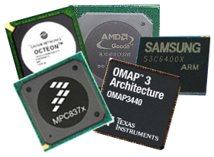
Embedded development
Define a product
Choose the CPU (SoC)
  Start HW design
Get the CPU evaluation board
  evaluation board support package (BSP)
Notes:
* define a product :
We want to create a device, that will run one and only one application. The application defines hardware interfaces we need, and the hardware interfaces in turn impose the most applicable SoC family.
* start HW design
We have really good case when SW development starts at the same time or slightly after the HW design. It could be that some work on “the application” development is started at the same time or little bit after the HW design, and the kernel and basic HAL are developed on the prototype HW. Worse, the entire SW development starts after HW is ready
* eval board:
If we have the eval board we can start working on our own SW, and it's not always the case. Saving 1-2 k$ seems sometimes good idea to the bosses. BUT eval-board has BSP...

Slide 4
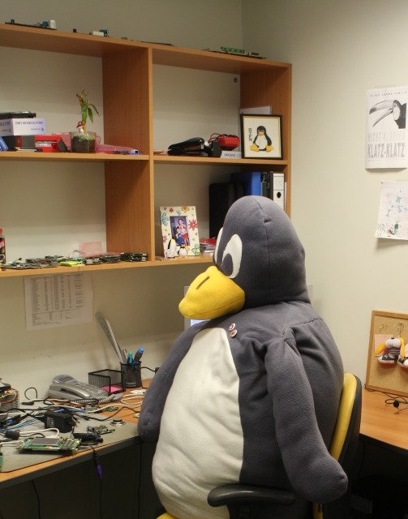
Embedded development
Hardware bringup: patch everythihng, just make it work!
  Tweak the BSP to make the prototype breath
Prototype works, let's do The Application.
Adjust kernel further to suit The Application needs

Slide 5
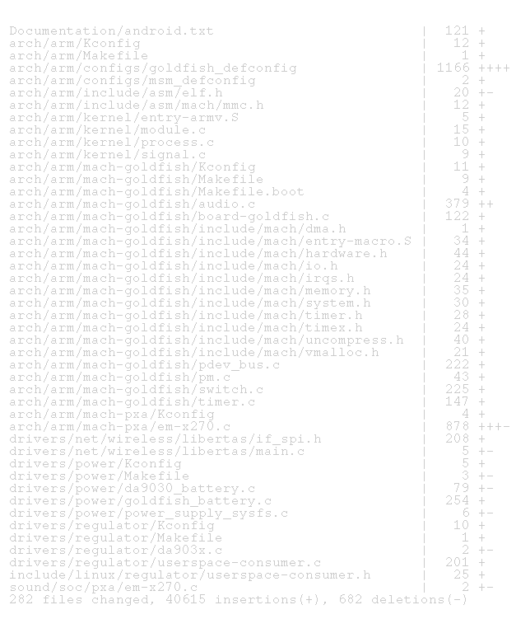
We do not really care that kernel should be corrected, updated and mainlined. We want to ship a product that runs
The Application

Slide 6

Embedded Development:
Management POV
We develop a product and we want to ship it as soon as possible
No-one will ever see our source code
We only run The Application. No changes will be required
We have the BSP – let’s use it
Notes:
We have a kernel that works with the eval-board, differences between
our board and the eval-board are minimal, just enforce them into the
BSP kernel and we can live with it
No one will see because nobody will even suspect that our set-top box,
motor controller, whatever else is running Linux. Even if somebody
does, we can send an archive with the sources that fall under GPL
upon requirement. The sources are ugly, so what?
Embedded device is intended to run one and only one application;
updatability as well as need to incorporate new features are not an issue.

Slide 7
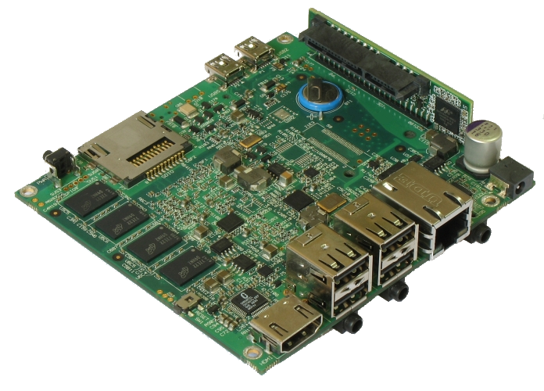
Board Support Package
Board Support Package (BSP) is implementation specific support code for a given board that conforms to a given operating system (http://en.wikipedia.org/wiki/Board_support_package)
Common practice in VxWorks and later in Windows CE and Linux
BSP does not assume contributing to the origin

Slide 8
BSP (continued)
Chip vendors provide BSP based on not-very-recent kernel with lot of patches.
  Freescale iMX.27 – 2.6.22, iMX.31 -2.6.24, iMX.515 – Windows CE
  Marvell PXA – 2.6.28
  TI OMAP3 - 2.6.29-rc3
Parts of the BSP are really intrusive and ugly hacks
BSPs have features that will never make it to the mainline

Slide 9
BSP (continued)
BSPs are self-contained (toolchains, kernel, userspace)
Manager sees BSP working on the eval-board and says: "It works here, there's no reason why we can't have it exactly the same way"
Only recently chip vendors started to mainline chip support.

Slide 10

Reasons for not mainlining
Is it worth the effort?
BSP uses 2.6.x and the mainline is already 2.6.y. We have no time for rebasing.
We need the features unique to the BSP kernel.
Need to mainline some parts before continuing to work on others
We are fine with what we have
We have no time for
submit - review – fix headache
Notes:
* need to mainline:
If the patches are not accepted their rework may in turn require major rework of other parts of the system: e.g. Android wakelocks
It's not obvious that mainlining can improve product success and reduce the development cost
We do not not need shine and glory of the recent kernels
If we want to mainline we have to keep “working” tree and “mainlining” tree.

Slide 11

Reasons for not mainlining
We have a hack that enables some feature on our device. Making it generic enough can be really hard.
We never even thought about mainlining
Will anybody listen to me?
We are different…
Notes:
* we have a hack..:
DA9030 USB
CardBus support on CM-X270 reguires
if (machine_is_armcore() && cpu_is_pxa270())
gpio_set_value(x, y);
all over it8152.c (bridge driver)
dm9000 with PXA DMA
You send a e-mail to the mailing list and there’s nothing back comes to you. Resend? Or not?
To mainline you have to be open-source enthusiast
We speak different languages, e.g. synaptics_i2c and Dmitry Torokhov

Slide 12
Are we different?
“We are not so special!”
(dwmw2, Embedded Linux Conference 2009)
  Develop software for not-yet-existing hardware
  No BIOS/EFI/PCI/PCI Express – most of the devices are 'platform_device'
  No standard boot
  Small user base, most users are not rocket scientists
  Tight schedules for entire product
Notes:
I completely agree with David, that top-level embedded device requirements overlap largely with desktop, server and others?
It's completely true that fastboot, IOMMU, power management are for everybody. But when it comes to support of that particular piece of hardware, things start to diverge.
No BIOS – machines are different, there's no standard way for device enumeration and registration. Moreover, each driver may require some specific bits on that particular platform.
Small user base – medical equipment, or school bus computer are not operated even by sysadms.
Our development is not OS-centric. Our goal is to make the device work. If The Application can run on the bare HW, we’d not use OS at all.

Slide 13
Future
“ARM … with its insane number of platforms”
(Linus Torvalds, http://lkml.org/lkml/2009/9/9/357)
Chip vendors go mainline
  TI, Marvell, Samsung, Freescale?
    Still 'diff --stat mainline bsp-kernel' is huge
Mainlining awareness climbs up the management stairs
2419 registered ARM machines, even more exist, only 137 are in the mainline. Will that change?
Notes:
ARM … with its insane number
of platforms (Linus Torvalds, http://lkml.org/lkml/2009/9/9/357)

