Slide 1

Merging KGDB KDB and
Kernel Mode Setting
Jason Wessel – Wind River
Jesse Barnes - Intel
Notes:
The title of your presentation should be short and direct.
The subtitle of your presentation should consist of the presenter’s name and title.

Slide 2
The Glossary
KGDB – Kernel GDB remote interface
  KGDB core merged to mainline kernel in 2.6.26
  Generic gdb serial interface for single or multi processor systems, where gdb provides a source view of the system
  Works only with a uart based console driver
KDB – Kernel debugger
  Never merged to mainline kernel and not likely to merge as is
  Supports only i386 and x86_64
  Provides a simple debugger via the system console or a serial port, with no high level source
KMS – Kernel Mode Settting
  Merged to mainline kernel in 2.6.29
  Core graphics driver in the kernel provides seamless switch from console to graphics modes (vs reinitializing the HW each time)

Slide 3
The Goal – Let the MERGE BEGIN!
A simple, reliable multi-architecture debug shell
Works with graphics or serial
Ability to use kgdb or kdb
Join the KDB and KGDB communities together
Provide an API for future command expansion
  Trace dumping
  Disassembly
  Subsystem inspection commands (vfs, network, etc)

Slide 4
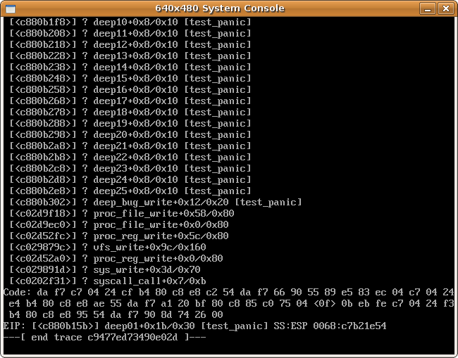
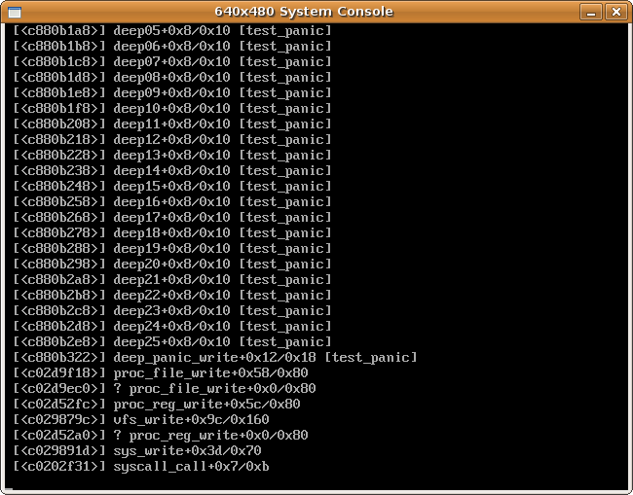
An example problem
Awe MAN! If only I had a few more lines in the trace...

Slide 5
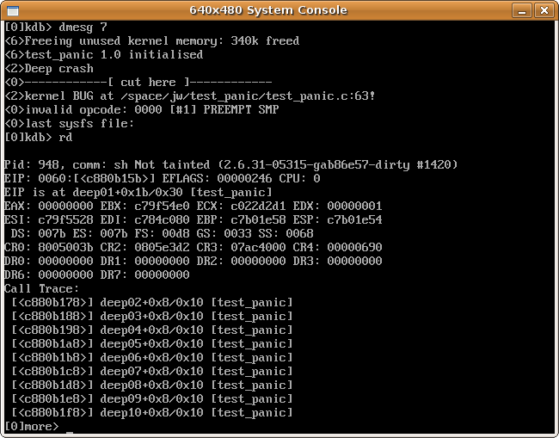
The debug shell

Slide 6
Basic KGDB design
Debug
Core
GDB
Stub
KGDB has 4 main pieces
Debug Core – Generic debug API
  Handles exceptions
  Syncs/saves/restores CPUs
  API for SW/HW breakpoints
Arch specific KGDB
  Interface to read/write registers
  Arch specific exceptions and watch dogs
  Single stepping interface
GDB Stub
  Speaks the gdb serial protocol
Polled I/O Driver (kgdboc / kgdboe / kgdbou / kgdb_8250)
  Uses the console UART driver to multiplex a single serial line
  Another host's gdb connects to this port
Polled
I/O Driver
Arch
Specific
KGDB

Slide 7
Basic KDB design
KDB has lots of parts
129 files changed, 57952 insertions(+), 10 deletions(-)
Splat!
Thunk!
Assembly
set_jmp() long_jmp()
Low Level Arch Specific exceptions
BOOM!
Back tracer
kdb_main
Single Step
kdb_io
disassembler
Polled Keyboard driver
Other modules kdump etc...
Crash!
Polled serial driver

Slide 8
Merging KDB & KGDB
The polled keyboard driver hooks into kgdboc
The kdb_main, kdb_io and cmd handlers hook straight to the debug core
gdb can use “monitor ...cmd...” to issue kdb cmds
KDB got all the architecture specific pieces removed
  KDB core = 27 files changed, 6521 insertions(+), 10 deletions(-)
  KGDB changes = 9 files changed, 154 insertions(+), 31 deletions(-)
Debug
Core
GDB Stub
kdb_main and kdb_io
Polled
I/O Driver
KGDBOC
Arch
Specific
KGDB
KDB Polled Keyboard driver

Slide 9
KMS (kernel mode setting) basics
Mode setting refers to changing the graphics console display characteristics, such as the display type/size, screen blanking and graphics hw management
Mode setting in userspace causes issues:
  suspend/resume
  interaction with kernel drivers
  Ability to change from X to console on crash (BOSD)
KMS paves the way for flicker free console switching
Adding in console debugger support becomes desirable to analyse a crash or inspect the system
The hard part lies in making KMS work without locks
  Take an exception
  Transition to console atomically
  Run kdb
  Restore graphics
  Resume system

Slide 10
kgdb + kdb + kms
KMS bolts into the debugger via kgdboc entry/exit call backs
Configuration of using KMS is dynamic through kgdboc
Debug
Core
GDB Stub
kdb
kgdboc
Arch
Specific
KGDB
KMS
Hooks

Slide 11
Demonstration time
KGDB, KDB and KMS in < 60 seconds
  http://www.youtube.com/watch?v=PDds73yDCNo

Slide 12
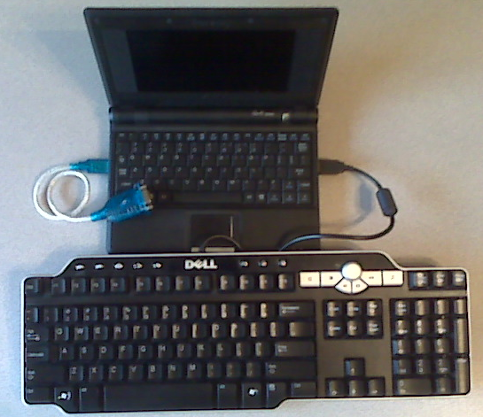
But wait there's MORE!
How about kgdb + kdb + kms + usb serial

Slide 13
Moving beyond the prototype
The first priority is to finish cleaning kdb core and post to LKML
  kernel/kgdb.c → kernel/debug/debug_core.c and gdbstub.c
  kernel/debug/kdb/*
  Rename arch/*/kernel/kgdb.c → arch/*/kernel/debug_arch.c
For KMS, there are certainly problems with the locks
+++ b/drivers/gpu/drm/drm_crtc.c
+#ifdef CONFIG_KGDB
+ if (atomic_read(&kgdb_active) == -1)
+#endif
+ mutex_lock(&dev->mode_config.idr_mutex);
KMS needs some generic debugger API work
  Only the Intel 915 works today with kdb
  Jesse suggested the possibility for a dedicated debug console

Slide 14
Moving beyond the prototype
The USB keyboard driver is UGLY!!!
  The low level uchi/ohci/ehci are modified to allow for polloing and pulling off packets of the keyboard type only
Anyone want to help with an “alternatives” implementation?
  The debugger needs to change some code paths after entry
  The debugger should stay out of the way otherwise
Low Level exception support
  The debug core needs the first right of breakpoint handling
  Perhaps code “alternatives”?
panic() should allow a debug hook before calling smp_send_stop()

Slide 15
Nested Exception Support
Prototype hack for debugging part of the code used by the debugger proves useful
  It was possible to debug the KMS code with kgdb so long as on the second exception kgdb jumps directly into the debug core
  Without the “hack” the debug core prints a stack dump an panics
The kgdb_ll_trap() was introduced by kdb to allow the debug core to step through an atomic_notifier_call_chain
It is now a TODO item to consider nested exception debugging because you can also debug parts of the debugger itself

Slide 16
Displaced Stepping?
Problems without displaced stepping
  Missed breakpoint
    free all cpus and wait for a thread to get scheduled which uses HW single stepping
  Deadlock on lock
    single stepping by freeing only one CPU, dead locks on any lock held by a frozen CPU
Displaced stepping is leaving a break point planted and executing the original instruction out of line
  An experimental patch modifies kprobes to plant a probe to single step a kernel thread
  The down side is you cannot debug some further small pieces of the kernel

Slide 17
Mainline for kgdboe someday?
Today's kgdboe has a major short coming, in that it is not robust
Network drivers can be in a state where it is impossible to use them safely from the exception context (preempted with locks held)
Possible solutions:
  Perhaps a dedicated queue in the HW is the answer (e1000e)
  While it would require a dedicated ethernet interface, you could use a self contained, exception safe network stack
  A redesigned poll interface

Slide 18
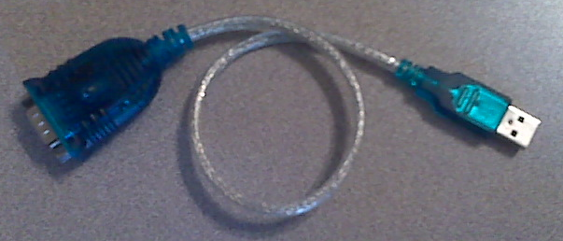
kgdbou (kgdb over usb)
It is on the mile long todo list :-)
First up is work around improved USB console support
  2.6.31 - merged USB sysrq support
  2.6.32 - USB EHCI debug port console (supports early_printk)
  Stable USB console support is a work in progress
  kgdbou present state is considered “too much of a hack”
Kgdb integration can proceed after the console support
  On the demo machine there are if (kgdb_activate...) checks in the hot path which would need to resolved by design

Slide 19
The kernel debugger and the future
We want to unite the all the of the kernel debugger folks
Send patches to kgdb-bugreport@lists.sourceforge.net
The kgdb wiki is slated to launch in late September
http://kgdb.wiki.kernel.org/
Special Thanks
  Jesse Barnes - for his KMS code
  Martin Hicks - (KDB maintainer) for kdb cleanup patches

Slide 20


