Slide 1






Backporting the Linux kernel, for good
Luis R. Rodriguez
mcgrof@gmail.com
mcgrof@qca.qualcomm.com

Slide 2
Why do people backport kernel code?
No production system uses Linus rc's... except kernel.org ;)
Backport fancy new features – already done by ”Enterprise” and ”Mobile”
Enable users to get support for new hardware:
  For 2.6.35:
    Lines added per day: 7,896
    Lines deleted per day: 5,037
    Lines modified per day: 1,802
    Number of developers: 1,187
    Number of companies: 184
  Silicon companies complain: ”we have customers on 2.6.25, wahhhhh!”
  Resolution: companies get their hardware supported upstream first, and then get it automatically backported

Slide 3
Who backports and a little history
Certainly not the upstream kernel maintainer's problem!
Enterprise Linux distributions
Private Enterprise Linux distributions - Financial
Specialized LSDKs: everyone and their mother
External proprietary drivers: Nvidia, ATI
External crap out of tree drivers: MadWifi
Researchers – have the luxury to do things right
  Helped replace MadWifi with ath5k
  Intel's backport of mac80211: a fork! !!@#$%^
  Equal replacement: compat-wireless, run stable kernel + backported ath5k
  Killed Intel's fork through compat-wireless – add all wireless drivers

Slide 4
What's backported ?
Started with wireless:
  cfg80211, mac80211, all wireless drivers
Then added ethernet:
  Atheros Ethernet, patches welcomed for others
Then Atheros team added bluetooth

Slide 5





Who uses this stuff?
802.11 / Bluetooth Silicon companies: QCA, Intel, Brodacom, TI
Wireless researchers: Rutgers, Princeton, Colombia
Production testing of new drivers, from code upstream!
Production deliverables
Many Linux distributions: Ubuntu, Gentoo, Arch Linux, etc
4 MiB tarballs ~ 26 GiB / month of downloads in August 2011
Presentation query: who else?

Slide 6
How to backport, compat-wireless style Part I
4 git trees:
  linux-next.git: all foo-next.git subsystem trees merged
  linux-2.6-allstable.git: stable extraversions, 2.6.x.y and now 3.x.y
  compat.git: generic kernel compatibility module / headers
  compat-wireless.git: backports wireless, ethernet bluetooth
Philosophy:
  Divide and conquer, help share more backport work:
    Stuff into compat.git new exported symbols, headers, objects
    Separate effort for required code deltas, compat-wireless
    Split required backport patches into categories
  ”Don't be evil” (TM), formalize hatred towards non-upstream, patch categories:
    linux-next-pending/
    linux-next-cherry-picks/
    pending-stable/
    crap/

Slide 7
How to backport, compat-wireless style Part II
Simple strategy:
  Suck in the compat.git code
  Copy upstream code from the kernel
  Apply patches:
    patches/
    linux-next-pending/
    linux-next-cherry-picks/
    pending-stable/
    crap/

Slide 8
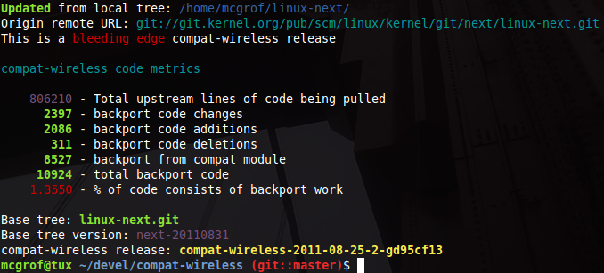
What's this look like? linux-next snapshot

Slide 9
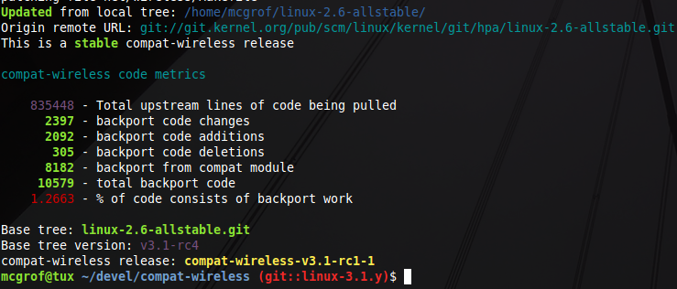
What's this look like, linux-2.6-allstable snapshot

Slide 10
Making a release
linux-next.git based:
  Assume: $HOME/linux-next.git on master branch
  Assume: $HOME/compat.git on master branch
  You are in some $FOO/compat-wireless.git on master branch
  Run: ./scripts/admin-update.sh – updates local code
linux-2.6-allstable.git based, for linux-3.0.y
  Assume: $HOME/linux-2.6-allstable.git on origin/linux-3.0.y branch
  Assume: $HOME/compat.git on origin/linux-3.0.y branch
  You are in some $FOO/compat-wireless.git on origin/linux-3.0.y branch
  Two options:
    Run: ./scripts/admin-update.sh – updates local code
    Run: ./scripts/gen-stable-release.sh – tarball

Slide 11
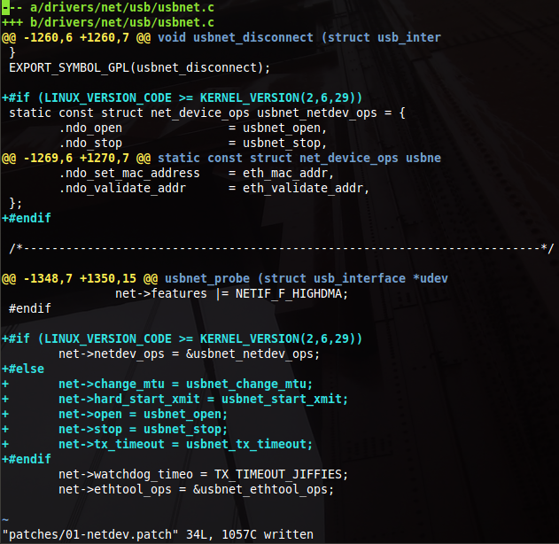
Example 1: 01-netdev.patch part I
WTF is this ?
Can we do better?
”Yes we can!”
I'll prove it next

Slide 12
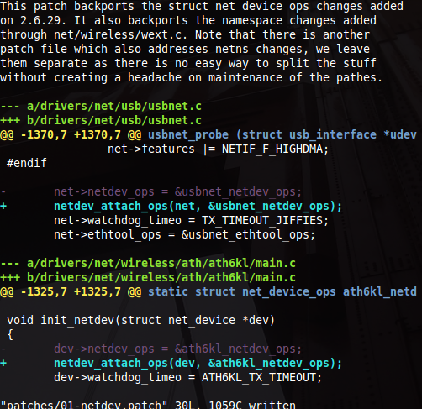
Example 1 – 01-netdev.patch part II
Following the philosophy
Ensure to document why this is code is required in this patch and not in compat.git
The #ifdef nightmare over the new netdev_ops is large and simply not necessary
Simply replace one line with another. Can we do better? Yes, add a simple static inline upstream that defines a netdev_attach_ops() and then on compat.git just backport what that means for older kernels.

Slide 13
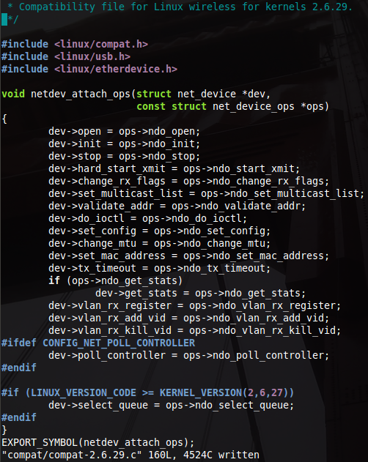
Example 1: netdev-01.patch Part III
compat.git accepts #idef nightmare
What are the possible issues with this?
Up to what kernel do you support?
compat.git aims to support at the very least down to the latest supported stable kernel but patches are welcomed to go beyond.
compat.git has stuff even for kernels older than 2.6.14:
typedef unsigned int gfp_t;

Slide 14
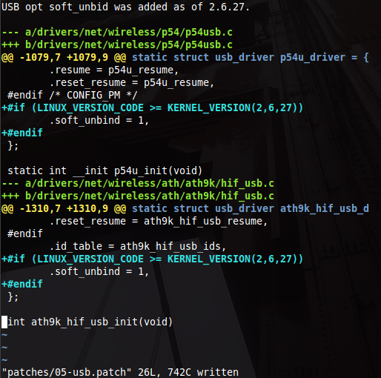
Example 2: 05-usb.patch
Why is this not in compat.git?
Its a data struture change!
Tough luck – we need these.
Rhetorical question:
Can we do better? You tell me.
I don't think so.

Slide 15
How about updating patches?
There's two ways:
  Automatic hunk offset updates, use quilt refresh:
    QUILT_DIFF_OPTS="-p" quilt refresh -p ab --no-index –no-timestamp
  Hunk no longer applies: manual intervension
    Happens only about 4-6 times between each kernel release!
What does automatic updates looks like:
  ./scripts/admin-updates.sh refresh
  git commit -a -s -m ”compat-wireless: refresh patches”

Slide 16
Compat-wirleess tarball code breakdown

Slide 17
Inspection of code changes (+/-)

Slide 18
Compat module Vs code changes (+/-)

Slide 19
How much effort is this?

Slide 20
Conclusions based on code metrics
Backport code is minimal compared to sucked in upstream kernel code
The more you put into a shared compat.git the more kernel subsystems you can backport at a hugely reduced cost
We are always adding more code Vs deleting code – we can do better! How:
  Stuff even more into compat.git
  Add static inlines upstream which can be replaced with older compat replacements in compat.git, this reduces the amount of code changes required, specifically additions

Slide 21
Can we do better?
Backport more subsystems? How? Backport subsystem maintainers. At this point I mostly accept patches, Hauke Mehrtens is the top contributor. I was asked about USB 3.0, send me patches
  compat-alsa: proof of concept, ALSA already backported
  compat-video: but then saw Ubuntu's work
Are some upstream maintainers willing to accept static inlines upstream to help with backport ?
Avoid major data structure changes when not necessary, in the future aim to use static inlines when this does happen
How about using coccinelle spatch? Next slide!

Slide 22
spatch, spdiff, holy grail of backporting
Learning curve for contributors
Resolution: spdiff
  Jesper Andersen & Julia L. Lawall - Generic Patch Inference
  http://www.diku.dk/~julia/andersen_ase08.pdf
  One single properly written patch to backport one kernel API change can enable you to backport all API changes for all drivers.
  Implications: Learning curve not an issue
  Two sets of patches for backporting:
    spatch files
    target patches

