Slide 1

Thunderbolt Technology
What is it and what are the Open Source Implications
(formerly Light Peak Technology)
John Ronciak
Intel Wired Ethernet

Slide 2
Thunderbolt Technology – What is it?
Performance, Simplicity & Flexibility
Fastest Connection to Your PC Experience*
Performance: Fastest PC connection at 10Gbps gives you ultimate responsiveness.
Simplicity: Connecting your PC to multiple devices with data & display on a single cable makes getting and seeing what you want when you want it easier.
Flexibility: High performance expansion is just a cable away for new and novel uses now and in the future.
Notes:
Benefits apply to all PCs
Performance, simplicity and flexibility are the keys
Performance – 10Gbps on two channels, both ways
Simplicity – one cable, data and display
Flexibility – “in the box performance expansion” over a cable

Slide 3
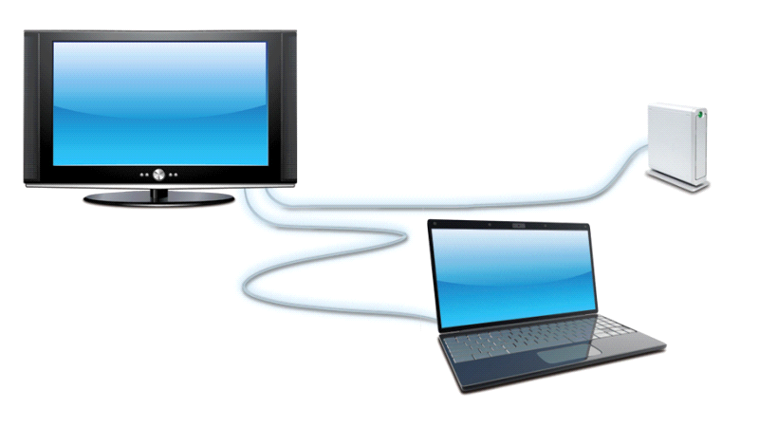
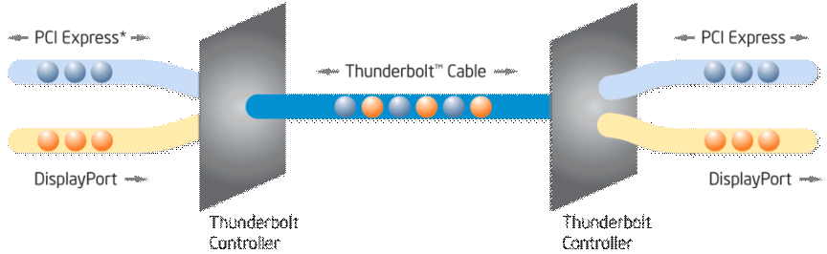
Thunderbolt Technology Overview
Transformational high-speed, dual-protocol, PC I/O delivering performance, simplicity, and flexibility
Leading Performance in PC I/O
Faster speed & multi-tasking with bidirectional, dual-channel, 10Gbps per port
Pro class A/V creation with time-synchronized low latency streaming
Simple & Flexible
Connect more devices with data + display on ONE cable
Add more devices simply with daisy chaining
Thunderbolt
Controller
Thunderbolt
Controller
Fastest Connection to Your PC Experience*
Notes:
10Gbps is faster than any other PC I/O technology, with 2 channels of full 10Gbps flowing BOTH ways (upstream and downstream) at the same time
Thunderbolt technology allows synchronizing all devices across 7 hops to within 8 nanoseconds of each other – for reference the Audio Video Bridge specification defines the minimum synchronization needed for liver performance or gaming applications as 2 milliseconds. Source - AVnu™ Alliance White Paper, “No-excuses Audio/Video Networking: the Technology Behind Avnu”
Thunderbolt supports daisy chaining of devices together downstream from a host PC
Diagrams show:
Example simple daisy chain of thin and light laptop connected over Thunderbolt cable to a high resolution native-Thunderbolt technology display, daisy chained to a Thunderbolt technology enabled storage array. In this example full 10Gbps could be provided to and from the storage array at the same as a high definition signal is driven to the display – over the same cable.
Diagram showing the connection of PCI Express and DisplayPort interfaces to a Thunderbolt controller, Thunderbolt protocol traffic passing over the Thunderbolt cable to another Thunderbolt controller, which provides interconnect to PCI Express and DisplayPort in the device on the “other end of the wire”

Slide 4
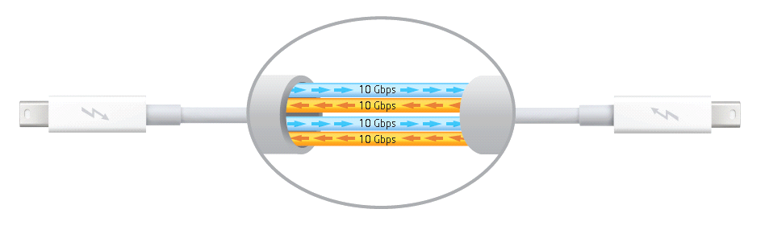
Thunderbolt Cables
• 2x channels per cable – 10Gbps bidirectional per channel
• Each direction in each channel can be data and / or display
• Active cables (circuitry in cable ends) enables cable length of 3m
• DisplayPort cables will NOT work as Thunderbolt cable replacement

Slide 5
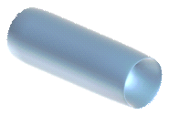
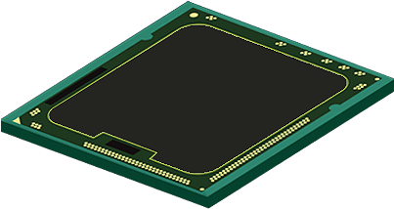
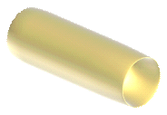
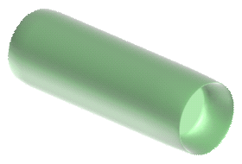




Thunderbolt Technology – How it Works
What is it?
PCIe and Display Port on one cable simultaneously
  Full bandwidth in both directions at the same time
Benefits for users
More bandwidth and low overhead = better responsiveness
Dual protocols allows connectivity to more devices and to multi-function devices
PCIe
(on PC PCB)
Thunderbolt Controller
PCIe
(on Peripheral PCB)
DisplayPort
(on PC PCB)
Thunderbolt Controller
PC (Host)
Thunderbolt Cable
DisplayPort
(on Peripheral PCB)
Peripheral (Device)
Notes:
Animation showing a visual of how the Thunderbolt technology controllers work. This is one possible example, each implementation may be a little different depending on both which Thunderbolt controller is used, and how it’s connected in a given product.
In this example a PCI Express bus (bidirectional traffic by nature) is connected to the Thunderbolt controller on the left, along with a DisplayPort input signal (unidirectional by nature). Traffic from both busses are packetized and transmitted over the Thunderbolt cable to a controller in a downstream device. You can see in this example that traffic flows both ways at the same time, and you can see visually how Thunderbolt protocol is a very light “wrapper” on the native PCI Express and DisplayPort traffic, applying a minimal degree of overhead.

Slide 6
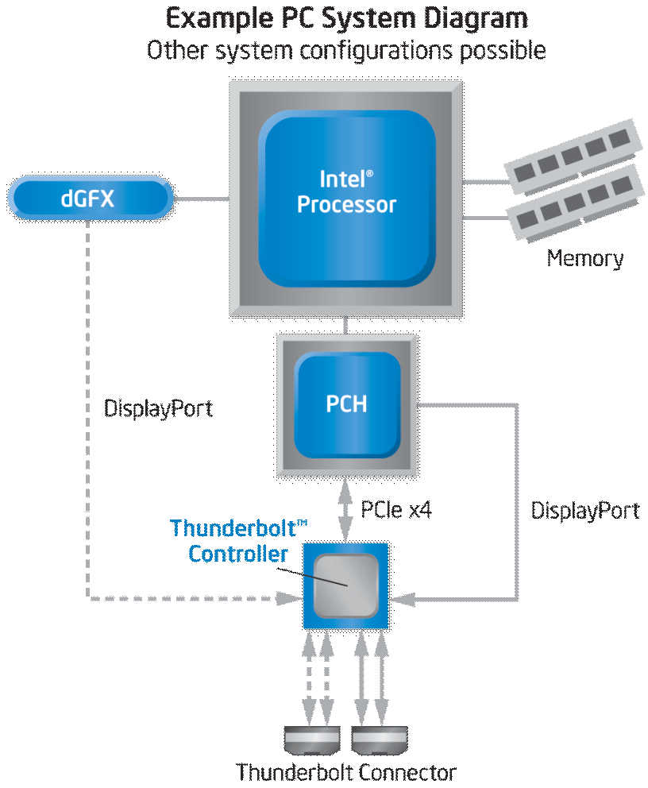
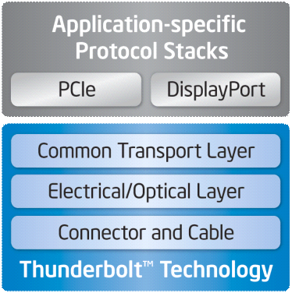
Technology Architecture
10Gbps per channel, bidirectional, dual-protocol, PC interconnect
Native PCIe and DisplayPort protocols transported
  PCIe enables off-the-shelf controller use in devices
  DP enables 2k displays w/ HDCP
Compatible with standard DisplayPort
  Compatible with existing DP devices (e.g. displays, adapters)
Small connector with cable options
  Active electrical cable ( up to 3m) w/ 10W power, or can be extended with…
  Active optical cable (up to tens of meters)
Daisy chain topologies
8ns accuracy time sync across 7 hops
Uses native PCIe and DP drivers
Notes:
The diagram on the right shows an example PC system design with basic bus connections to a Thunderbolt controller. For PCs there are typically two channel or four channel controllers, so we are showing one set of channels to a connector as dashed lines (if a 2 channel controller were used, only one connector would be present and only two channels would be connected to the one connector). Additionally at least one DisplayPort input must be connected from a display source inside the PC (that source can be any DisplayPort 1.1a compliant graphics engine; some Thunderbolt controllers actually have multiple DP inputs so we’re showing a possible connection of an internal and external graphics signal source. This is only one of many possible configurations, the specifics will be driven by the OEM design, and Thunderbolt brand requirements.
The lower diagram shows a simple architecture representation of how the Thunderbolt technology is the underlying transport for the two mapped protocols PCI Express and DisplayPort – those two protocols are natively passed and thus supported by the PC operating system without additional software. Because all the devices that will connect in Thunderbolt technology enabled products will be built using PCI Express controllers or as internal DisplayPort sink devices, the native operating system drivers for those devices will work directly with them, no extra application or driver development is required.

Slide 7
Daisy Chaining + Native Display
• Up to 6 Thunderbolt devices can be connected to a single Thunderbolt connector on a PC
– A native DisplayPort (DP++) display can be connected at the end of the daisy chain*
– Vision is for downstream TBT ports to behave as a PC extension
Native Thunderbolt Devices
Native DisplayPort

Slide 8
Thunderbolt Technology - Where are we today
HW is shipping on the new MACBOOK
Only electrical cables, longer distance optical cables will come later
Limited number of devices currently available, lots more coming
Work on other system enablement has started

Slide 9
Thunderbolt Technology
What does this mean for SW
Hot plug PCIe (BIOS/ACPI/OS) - BIOS issues being worked
Time management unit – 1588 hi-res clock running which can be accessed by SW/OS
QoS – credit based flow control – can be changed from initial EERPOM values by SW/OS

Slide 10
Thunderbolt Technology
Open Source considerations
Will just work for PCIe and DP
Will need enablement for other types of devices and services
LAD will work to enable first service (peer-to-peer)
Enablement code could be used for all other device and service enablement
More to come.....

Slide 11
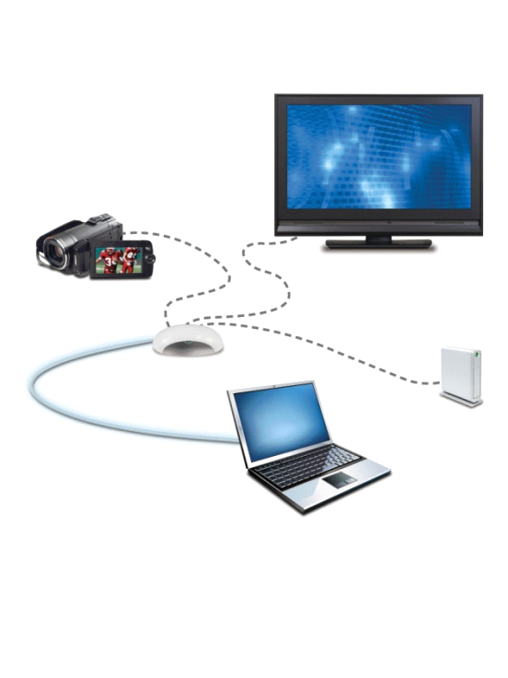
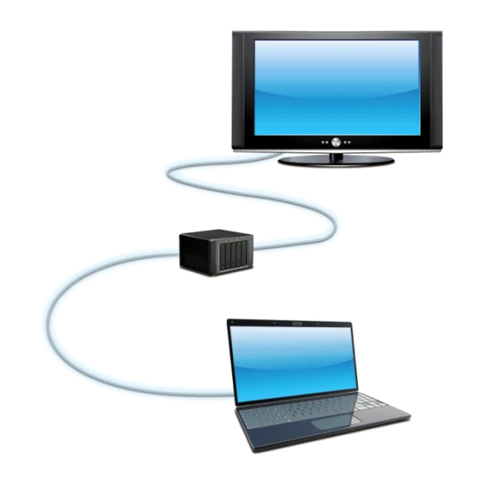
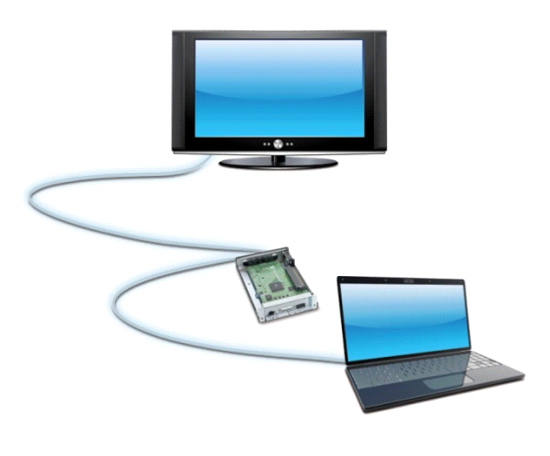
Flexible System Designs and Thinner Form Factors
Workstation I/O performance on mobile & AIO
Extended capabilities while retaining sleek form factor
Connect your PC to your
existing devices with a single cable
Move add-in cards,
storage, etc. to device
Connect displays, storage,
cameras, and more
USB3
External
Graphics
DP or HDMI
with HDCP
eSATA
Choice of system configurations
Enthusiast level gaming
Buy with confidence
Notes:
A few examples shown of flexible system design.
High performance expansion features that used to only be available as add-in cards in a workstation or desktop can now be built as stand alone products connectable with Thunderbolt technology to any Thunderbolt technology enabled PC.
A unique capability that applies to thin and light laptops is an external graphics engine that can be added over a Thunderbolt cable to provide increased graphics performance.
And buying a Thunderbolt technology enabled PC does not mean having to buy all new peripherals. Adaptors can be easily built using off the shelf PCI Express controllers to connect other I/O enabled products over a Thunderbolt cable to a Thunderbolt technology enabled PC.

Slide 12
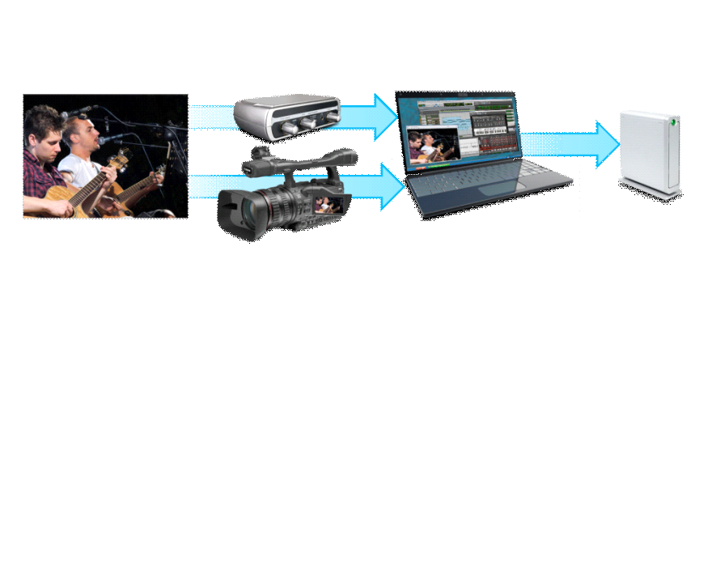

Media Connectivity
and Creation for the Pros
Bandwidth to capture 2K, 3D HD video and beyond on your PC
Mobile audio and video creation, mixing, and editing without I/O limitations
Capture video from cameras and other imaging sources
Capture high quality video for on-line or traditional broadcasting
More DSP headroom
Lowest latency
High sync accuracy
Dedicated bandwidth
Better multi-tasking
One cable for data and display connections
Notes:
PC users now create and consume more video content than ever,² however, working with video content and converting it for different uses can be time-consuming. Intel Quick Sync Video reduces that wait time significantly. e-Marketer.com

Slide 13
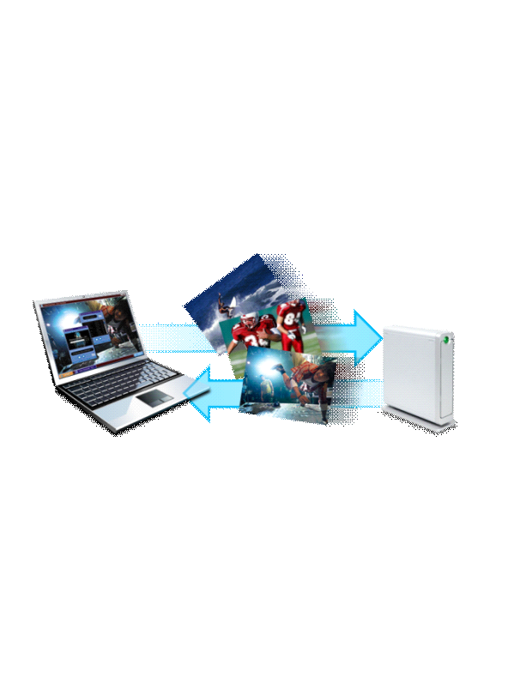
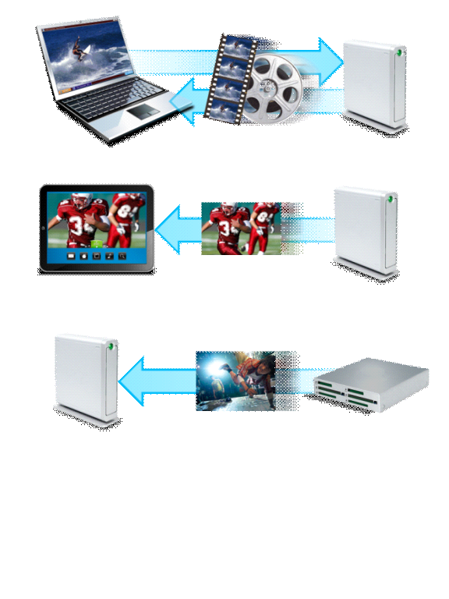
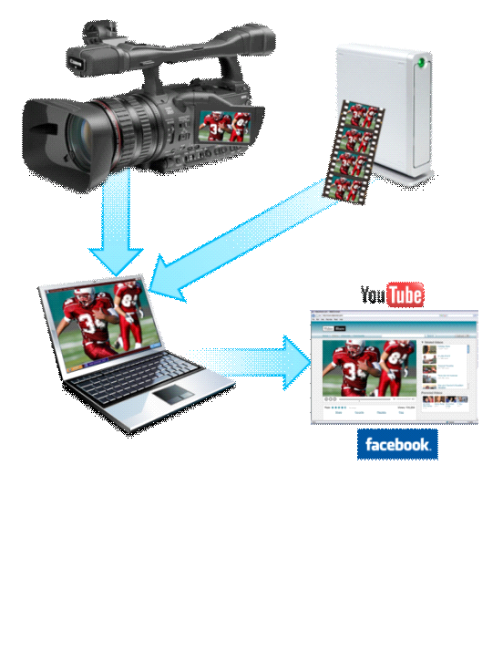
Faster, More Efficient Media Transfer and Sync n’ Go
Move big media files faster
Fastest I/O for
Intel® Quick Sync Video
Faster, expandable backup and restore
or
60% of consumers back up PC data, 38% use external storage
Source: 2010 National Cyber Security Alliance
Average household digital media storage will approach 1 TB by 2014
Source: 2010 Parks Associates
Media Transcode
Transfer a HD movie*
in less than 30 seconds
Instead of waiting for
your video, your video
is waiting for you
Quickly protect your data
* High speed storage required to achieve full transfer speeds; typical full length 1080p HD movie file size of 10-20GB
Notes:
Second, consumers have driven an explosion in high-definition Web video and digital photo sharing. By some forecasts, video will account for about 90 percent of all consumer Internet traffic by 2013. Facebook says that people upload more than 100 million photos a day to its site alone.
Upgradeable, more flexible storage solutions; including device-to-device
Low overhead reduces system power and provides better multi-tasking
Higher transfer speeds deliver shorter sync times and quicker transfers of big media files
Dedicated, low overhead I/O bandwidth provides better multi-tasking

Slide 14

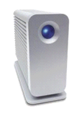
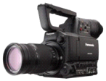
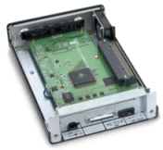
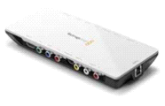
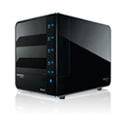
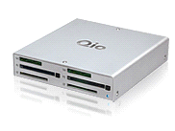

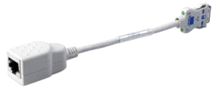

Targeted Devices
Flexible System Designs
High-Perf Storage
Media Creation, Transfer
I/O, Card
Expanders
Desktop Storage
Mobile Storage
Video Capture Interfaces
Cameras
Multi-Function Monitors
Card Readers
Dongles
Audio, Video Creation Interfaces
“LaCie is excited to support the advancement of Intel’s ground-breaking Thunderbolt technology. The new interface promises to deliver superior performance that we believe will create a new class of even faster, higher capacity storage solutions to keep up with the explosion of digital media.”
- Erwan Girard, Business Unit Manager for Professional Solutions, LaCie
“Avid is impressed by the performance Intel Thunderbolt technology delivers, and believes it will enable workstation-level media creation on mobile for the first time.”
- Max Gutnik, Director, Audio Product Management, Avid Technology
Notes:
Intel industry enabling plans span peripheral devices for the range of usage models enabled by Thunderbolt technology. From smart displays and I/O expansion products, to extremely high speed storage devices to audio / video capture and creation products, we’re working with the industry to enable value for and with Thunderbolt technology.

Slide 15
Questions?

