Slide 1
Depths of the Cloud: How Linux Networking needs to evolve
Peter (PJ) Waskiewicz
Shannon Nelson

Slide 2
Overview
Putting our heads into The Cloud
Crossing the streams when we get there
Levitating The Cloud by offloading the work
Advanced hardware capabilities
Where Linux needs to evolve

Slide 3

The Fractal Cloud
I've looked at clouds from both sides now, From up and down, and still somehow It's cloud illusions I recall. I really don't know clouds at all. - Joni Mitchell

Slide 4
The Fractal Cloud
Amazon
Rackspace
Salesforce
Google
Dropbox
SGI/Cyclone
Your Name Here

Slide 5
The Fractal Cloud
Amazon
EU
Singapore
US West
Tokyo
US East
Sao Paulo

Slide 6
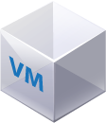

The Fractal Cloud
Peter’s Ghost Finders
Web
DB

Slide 7
The Fractal Cloud
Egon’s Spirit Chasers
Peter’s Ghost Finders
DB
Web
Web
DB

Slide 8
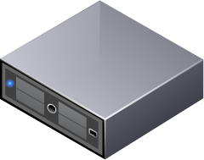
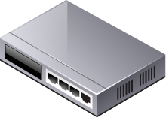
VM Hosting implements the Cloud
Egon’s
DB
Web
Peter’s
DB
Web

Slide 9

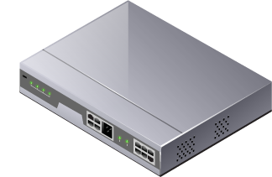
Plumbing the VMs
Web VM
DB VM
Host

Slide 10
VM Management moves things…
Egon’s
DB
Web
Peter’s
DB
Web

Slide 11
Egon’s
… maybe near …
Peter’s
DB
DB
Web
Web

Slide 12
… maybe far…
Web
DB
DB
Web

Slide 13
Something strange in the neighborhood…
Web VM
Web VM
DB VM
DB VM
Host
Host
Host

Slide 14
Something strange in the neighborhood…
Web VM
Web VM
DB VM
DB VM
Swindon
Host
Host
Host
Oregon
Virginia

Slide 15

Puffy problems
VM’s sniffing each other’s packets
Host doing lots of work to direct traffic
One VM’s traffic can overwhelm the pipe and block out other VM’s traffic
Unexpected network/address changes when VM gets moved
… and other sticky things.
Who ya gonna call?

Slide 16

Obligatory “Don’t cross the streams” reference

Slide 17
The NIC can help
Basic traffic offloads
Checksum and CRC validation
Header/data splitting for better memory management
VLAN id insert and strip

Slide 18
The NIC can help
Basic traffic offloads
Checksum and CRC validation
Header/data splitting for better memory management
VLAN id insert and strip
More advanced work
HW switching functionality
Bandwidth management
Traffic tunneling

Slide 19

Linux and the Cloud

Slide 20

Advanced hardware capabilities
Many advanced features in
existing and future hardware
VEBs
VSIs
Port Aggregators
Port Extenders
EVB (IEEE draft)
Switch management is complex
Integrate with existing SW switch and bridge tools if possible
Make it seamless!

Slide 21
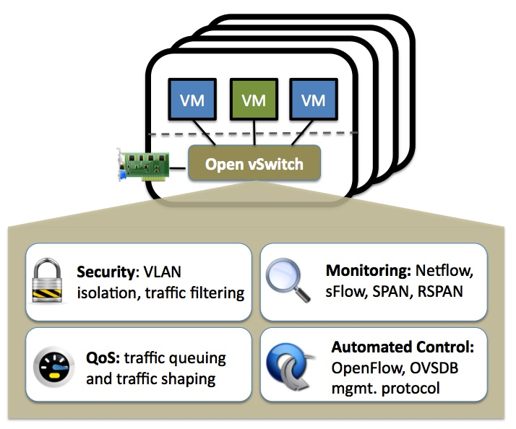
Open vSwitch (OVS)
Alternative to native L2 bridge
http://openvswitch.org
Manages multi-system environment
Ease of VM state migration
Supports OpenFlow
(Somewhat) Platform agnostic
Offload support lacking
Limited existing offload support
Basic switch offloads, Cisco Nexus 1000V
VxLAN tunneling patches in progress

Slide 22
Tunneling overview
Web VM
Web VM
DB VM
DB VM
Host
Host
Host

Slide 23
Tunneling overview
Web VM
Web VM
DB VM
DB VM
Host
Host
Host

Slide 24
Tunneling overview
Web VM
Web VM
DB VM
DB VM
Host
Host
Host

Slide 25
Why tunnels matter
Cloud relies on tunnels
Allows transparent migration of VM’s
Secures traffic from other VM’s
Tunneling can be expensive
Software overhead to manage routing/forwarding
Not very scalable at big I/O
10GbE, 40GbE
We can do better!

Slide 26
Tunnel types we target
VxLAN
Looks to be headed into OVS
IP in IP tunneling
NVGRE
IP in GRE
MAC in GRE

Slide 27
How to accelerate?
Inner packet is the important one
Checksum offloads
CRC offloads
Segmentation offloads
Need offsets to inner headers
Tell hardware where to compute offloads
Kernel interface required to pass information

Slide 28
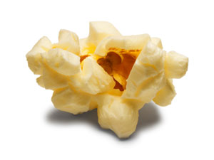
Evolving the kernel
Add fields to skb for inner header information
Wrap with CONFIG_NET_TUNNEL_OFFLOAD for generic support for all devices
Add offload netdev bit to identify devices
Populate in bridge or OVS kernel space
Rest of stack oblivious to changes

Slide 29
Future work
Making Linux smarter
VxLAN offloads being scoped
NVGRE offloads scoping to follow VxLAN
Should share most of the same codebase
Don’t mess with ABI
Avoid impacting tools at all costs
No custom one-off tools please…
Offloaded or not, must be transparent to user

Slide 30
Wrap up
The Cloud isn’t new!
Combination of many existing technologies
Buzzwords make it sound new and scary
Don’t be afraid of the Cloud
The secret is in the ease of management
Tunnels are the workhorse of the Cloud
Must have good offload abilities to scale

Slide 31

Questions?

