Slide 1
Limits of Computation
10 - Partial evaluation & self-referencing programs
Bernhard Reus

Slide 2
But first
one thing I owe you
from last week

Slide 3
Busy Beaver
a non-computable function on numbers
“Can we compute the function BB that for every input number n returns the greatest number that can be outputted by any WHILE-program that is (as syntactic string) at most n characters long (when run with input 0)?”
T. Radó in his 1962 paper "On Non-Computable Functions" (using Turing-Machines where n is the number of states)
Tibor Radó (1895 -1965)

Slide 4
Busy Beaver Research
In theoretical computer science the Busy Beaver Problem for Turing Machines has been a challenge some researchers could not keep away from.
Marxen and Bundtrock “Attacking the Busy Beaver 5”, Bulletin of the EATCS, No. 40, 1990, pp. 247-251, used a significant amount of resources to compute BB(5) for TMs:

Slide 5
BB(5) Attack
They used a brute-force simulation technique going through 99.7% of all 88 million 5-state TMs but spending much thought on how to speed up simulation (using “macro-machines” that can simulate several steps in one).
C program of about 8,000 lines
it took 10 days to run on a 33MHz CPU
Result: BB(5) ≥ 4098

Slide 6
So far ...
... we have seen how programs can be encoded as objects to be used as input to other programs.
Example: self-interpreter to show semi-decidability of Halting Problem.

Slide 7
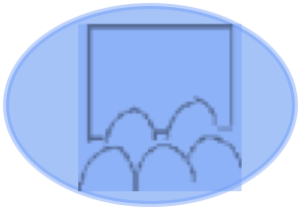
Question:
Can we write a Java program that prints itself or a While program that returns its own AST (without using its input)?

Slide 8

Other uses of programs-as-data
Partial Evaluation (Kleene’s S-m-n Theorem)
Use of partial evaluation for Optimisation and Compiler Generation
Self-referencing Programs (Kleene’s Recursion Theorem)
Use of Recursion Theorem for Recursion Elimination
public class Quine
{
public static void main(String[] args)
{
char q = 34; // Quotation mark character
String[] l = { // Array of source code
"public class Quine",
"{",
" public static void main(String[] args)",
" {",
" char q = 34; // Quotation mark character",
" String[] l = { // Array of source code",
" ",
" };",
" for(int i = 0; i < 6; i++) // Print opening code",
" System.out.println(l[i]);",
" for(int i = 0; i < l.length; i++) // Print string array",
" System.out.println(l[6] + q + l[i] + q + ',');",
" for(int i = 7; i < l.length; i++) // Print this code",
" System.out.println(l[i]);",
" }",
"}",
};
for(int i = 0; i < 6; i++) // Print opening code
System.out.println(l[i]);
for(int i = 0; i < l.length; i++) // Print string array
System.out.println(l[6] + q + l[i] + q + ',');
for(int i = 7; i < l.length; i++) // Print this code
System.out.println(l[i]);
}
}
THIS TIME
an interesting Java program: what does it do?

Slide 9
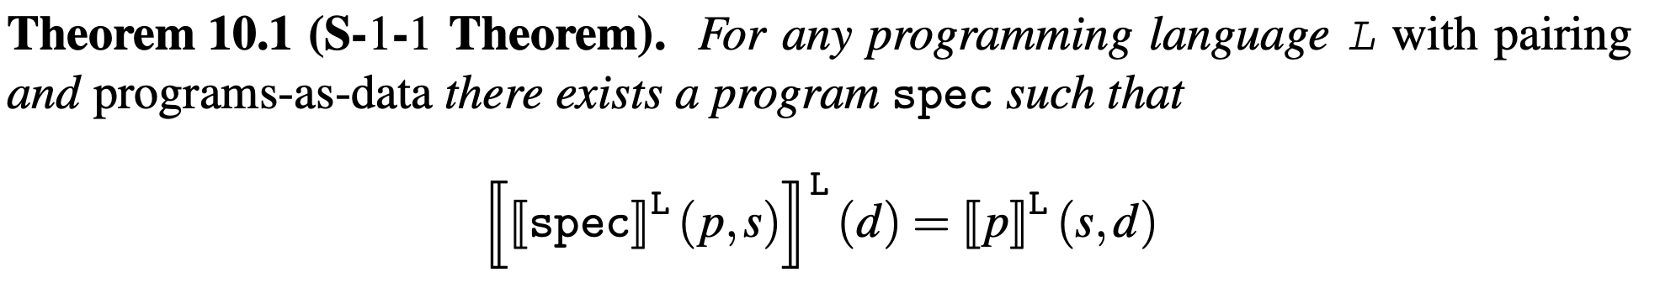
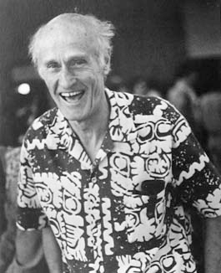
Simple Version of S-m-n Theorem
(_,_) notation for generic pairing
Program with 2 inputs (as pair)
P
partial (1st) input
remaining (2nd) input
both inputs as pair
It can be generalised to programs with m+1 (not just 2) input and providing n concrete values (not just 1) thus the name (Kleene’s) S-m-n Theorem.
Stephen Cole Kleene (1909-1994)
American mathematician
(also did regular expressions!)

Slide 10
S-m-n describes Specialiser
The resulting program spec is a specialiser (that takes a program as input and returns a new program).
The concrete code for a simple spec is relatively straightforward and will be given in notes / as program on Canvas site.
The partial input provides opportunities for optimisations in the code of program p.

Slide 11





Optimisation Example
p read XY {
X := hd XY;
Y := hd tl XY;
A := <add>[X,4]
}
write A
p
… read XY{
A:=7
}
write A
[p,3]
X:= 3;
newp read XY
XY:= [3,XY];
X:= hd XY;
Y:= hd tl XY;
A:= <add>[X,4]
write A
A:=<add>[3,4]
A := 7

Slide 12
“Efficient program specialisation
=
partial evaluation”

Slide 13
Self-referencing Programs
Can we write programs that refer to their own source or Abstract syntax tree?
Can we give them a well-defined semantics?
For instance, a program that prints its own source or returns its own AST?
Try it, it’s not that simple!! What is the problem here?

Slide 14
Acceptable Prog. Language
A programming language as discussed before, defined by syntax, data type, and semantics, having also programs-as-data and pairing, is called “acceptable” iff
it has a universal program
it has specialisers (S-m-n theorem holds)
all functions computed by Turing machines or While-programs are also computed by one of its programs.

Slide 15
Limits of Computation
10 - Partial evaluation & self-referencing programs
Bernhard Reus
continued

Slide 16
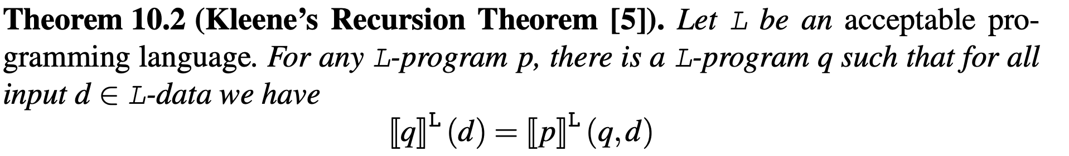

Recursion Theorem
q is the self-referential program
defined by program p that has extra parameter q
before we prove it, look at example usage

Slide 17
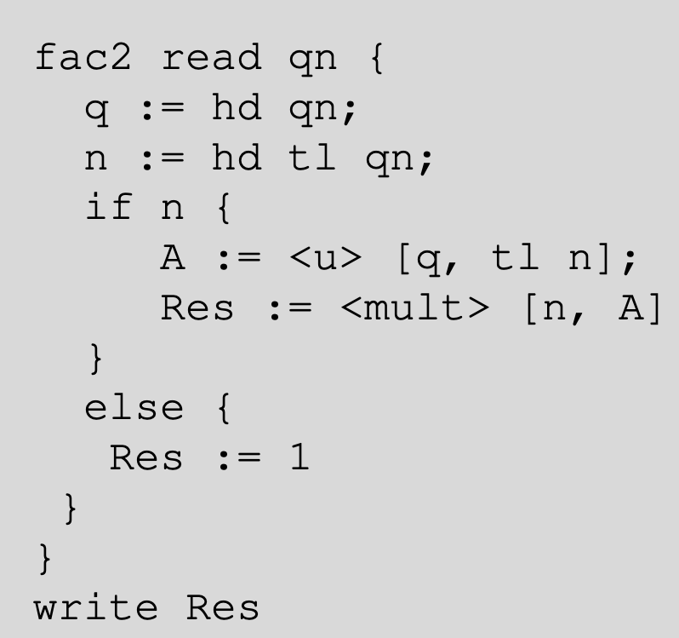
Eliminate Recursion
Factorial recursively:
0! = 1
n! = n*(n-1)!
u is self-interpreter
factorial2 has argument [q,n] so extra argument q
Recursion Theorem gives us (existence of) facRefl such that

Slide 18
1st Impact of Theorem
Any acceptable programming language is already “closed under recursion”. [Neil Jones]
Usage in interpreted languages: needs a new self-interpreter called for each recursive call, leading to stacks of self-interpreters running each other,
leading to exponential runtime,
thus built-in “reflection” mechanisms to avoid this problem.

Slide 19
2nd Impact of Theorem
Reflection in compiled languages is difficult as there is no source code or AST.
So no reflection in C or C++.
But in Java as there is a ByteCode interpreter. The Reflection library allows to introspect classes/methods.
This allows one to circumvent static type checking to work with “unknown” classes
Frameworks like Spring heavily use reflection.
“Plug-in” technology needs reflection!

Slide 20
Limits of Computation
10 - Partial evaluation & self-referencing programs
Bernhard Reus
- sample application of recursion theorem
- proof of recursion theorem
Part II

Slide 21
Kleene’s Recursion Theorem semantically validates the principle
of reflection in programming

Slide 22
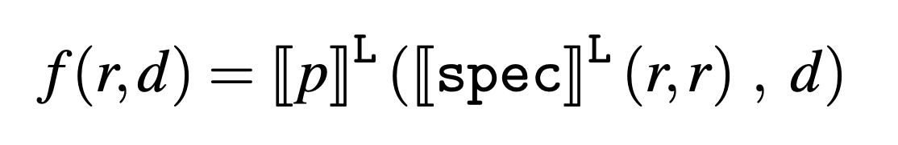
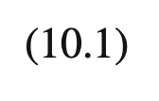
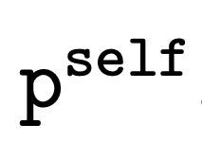
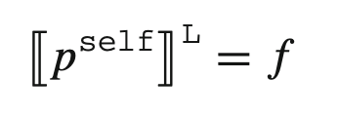
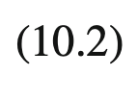
Proof of Recursion Theorem
Main technique: again self-application!
We can apply a program to itself and still get a program (S-1-1 Theorem i.e. specialiser)
and can plug that into given program p:
f is L-computable by a program

Slide 23
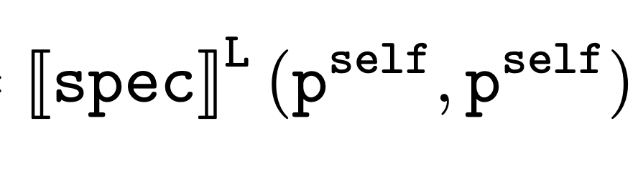
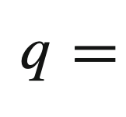
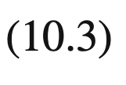
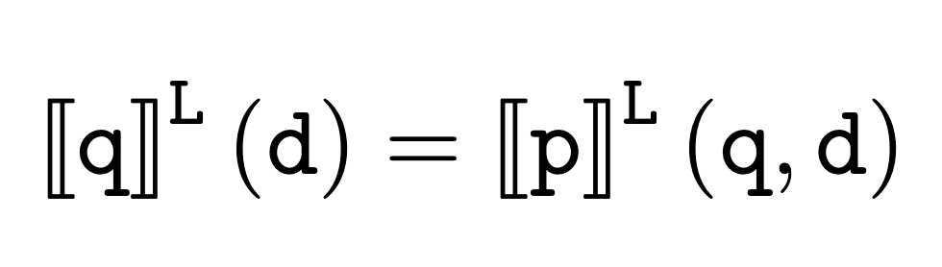
Proof of Recursion Theorem
Now we consider another self-application:
which returns an L-program which is our desired program q ;
it remains to show that for this program q:

Slide 24


Proof of Recursion Theorem
We compute the required equation just by using the definitions we made:

Slide 25
END
© 2008-25. Bernhard Reus, University of Sussex
Next time:
Why non-computable problems remain non-computable when using different notions of “effective procedure”.

