Slide 1
Limits of Computation
11 - Church-Turing Thesis
Bernhard Reus

Slide 2
The story so far
We have found problems that cannot be solved by a WHILE program (Halting, Busy-Beaver, Tiling, Ambiguity of CFGs, etc).
But this does not mean yet they could not be solved by a different machine model (different definition of “effective procedure”).

Slide 3


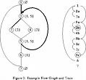


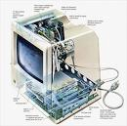
More ‘notions of computation’
Evidence for the
Church-Turing Thesis
by looking at other notions of computation:
Register machines
Counter machines
Turing machines
Goto language
Cellular Automata
and showing (or stating) that they are all equivalent.
THIS TIME
all these ‘models of computation’ are equivalent w.r.t the problems that are computable in them

Slide 4
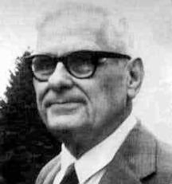
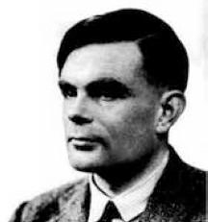
Church-Turing Thesis
reasonable formalisations of the intuitive notion of effective computability
All reasonable computation models are equivalent.
no restrictions on memory size and execution time are assumed
So it does not matter what model we use. It was alright to use WHILE.
We cannot prove this as it refers to informal entities (reasonable computation models). It is thus only a “thesis”. But we provide some evidence for it.

Slide 5
Models of computation
Random Access Machines (register machines): RAM
Turing machines: TM
Counter machines: CM
Flowchart language: GOTO
Cellular Automata: CA
While language: WHILE ✔
Church’s λ-Calculus (see course Comparative Prog. Languages)

Slide 6
Machine instructions
TM, GOTO, CM, RAM have the following in common:
A program is a sequence of instructions with labels
a state or configuration during execution of the program is of the form (l,σ) where l is the current instruction’s label and σ is the “store” which varies from machine to machine.
l1:I1; l2:I2; ... ln:In
WHILE does not have ‘machine flavour’, it’s more abstract
CA quite different

Slide 7
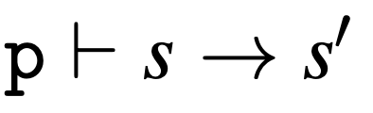
Semantic Framework for Machines
definition of store
function Readin producing initial store
function Readout producing output
description of semantics of the instructions,
program p transits from configuration s into s’ in one step

Slide 8
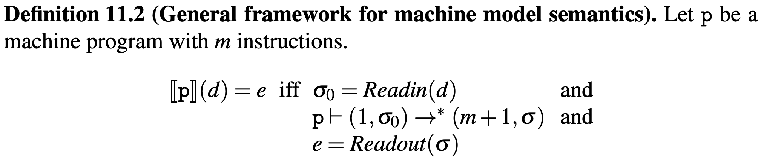

Semantic Framework for machines
“many-step” operational semantics for machine language, zero, one, or several steps of the “one-step” semantics
We will now show how semantics of other languages/machines are an instance of this framework.

Slide 9
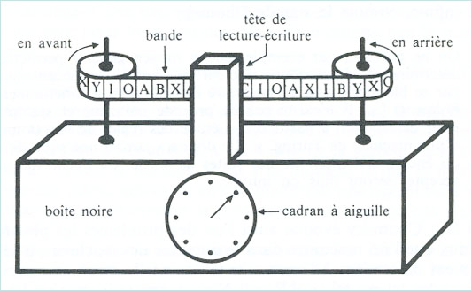
Turing Machine
tape
read/write head
forward
backward
in this example:
we have 1 tape
T
tape symbols from a given finite alphabet; special symbol B (blank)
current instruction counter
IC:
4
program 1: … 2: …
3: …
…
https://www.youtube.com/watch?v=cYw2ewoO6c4

Slide 10
Limits of Computation
11 - Church-Turing Thesis
Bernhard Reus
part II

Slide 11
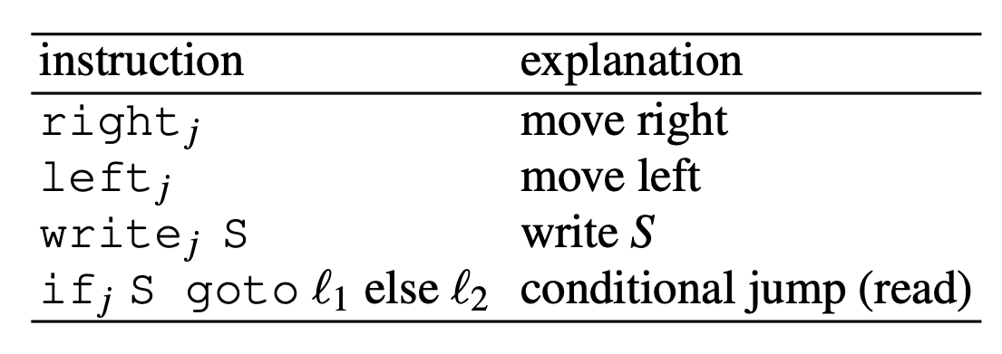

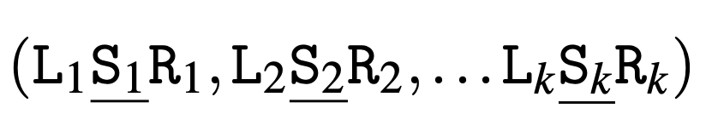

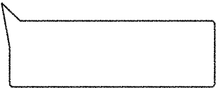
Turing Machine
presented in a way to fit our machine model
j is number of tape
we have k tapes
Store (= Tapes)
_ denotes position of read/write head
Li, Ri are strings of symbols

Slide 12
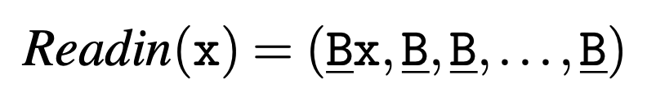
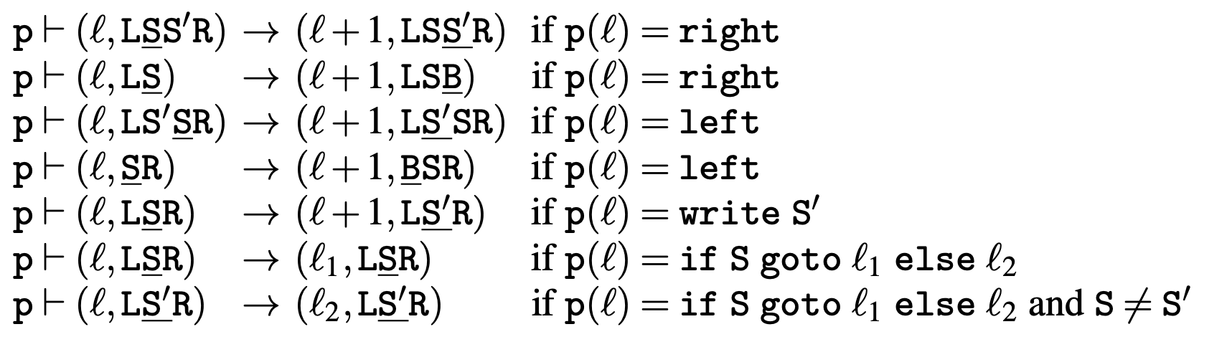
Turing Machine
Readin (input)
in both cases: non-blank string right of head on tape 1
Readout (output)
One-step operational semantics for 1-tape machine (no subscripts)
ℓ-th instruction

Slide 13
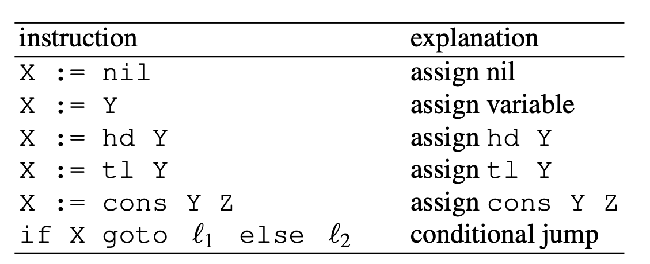
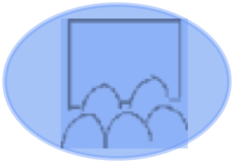
GOTO
Unconditional jump can be
expressed as well
How?
uses the tree data type we know from WHILE
does only permit operations on variables
if X tests whether X is not nil and then jumps according to a label
store as for WHILE, ReadIn and Readout like in WHILE semantics of programs.
?

Slide 14
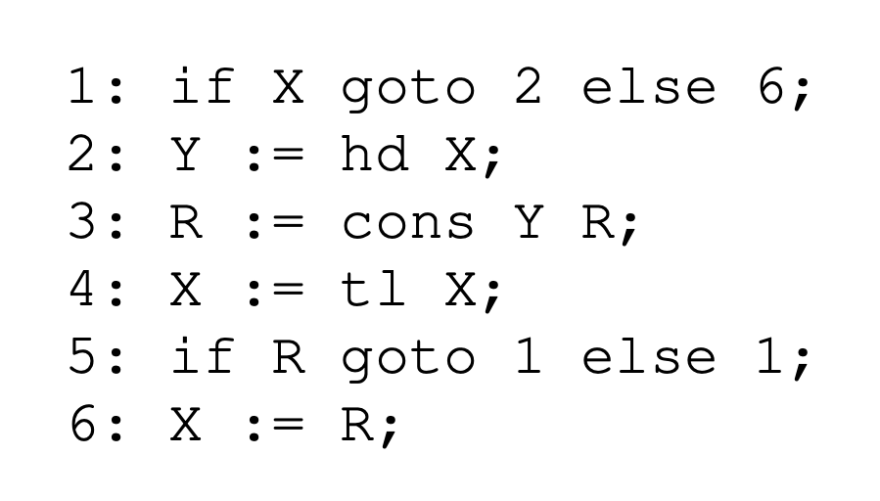
Sample Program
GOTO programs not as readable as WHILE programs
What does it compute?
reverse

Slide 15
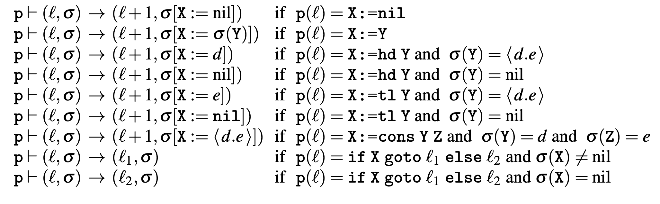
Semantics of GOTO (cont’d)
store σ (sigma) where variable X is assigned value nil
ℓ-th instruction

Slide 16
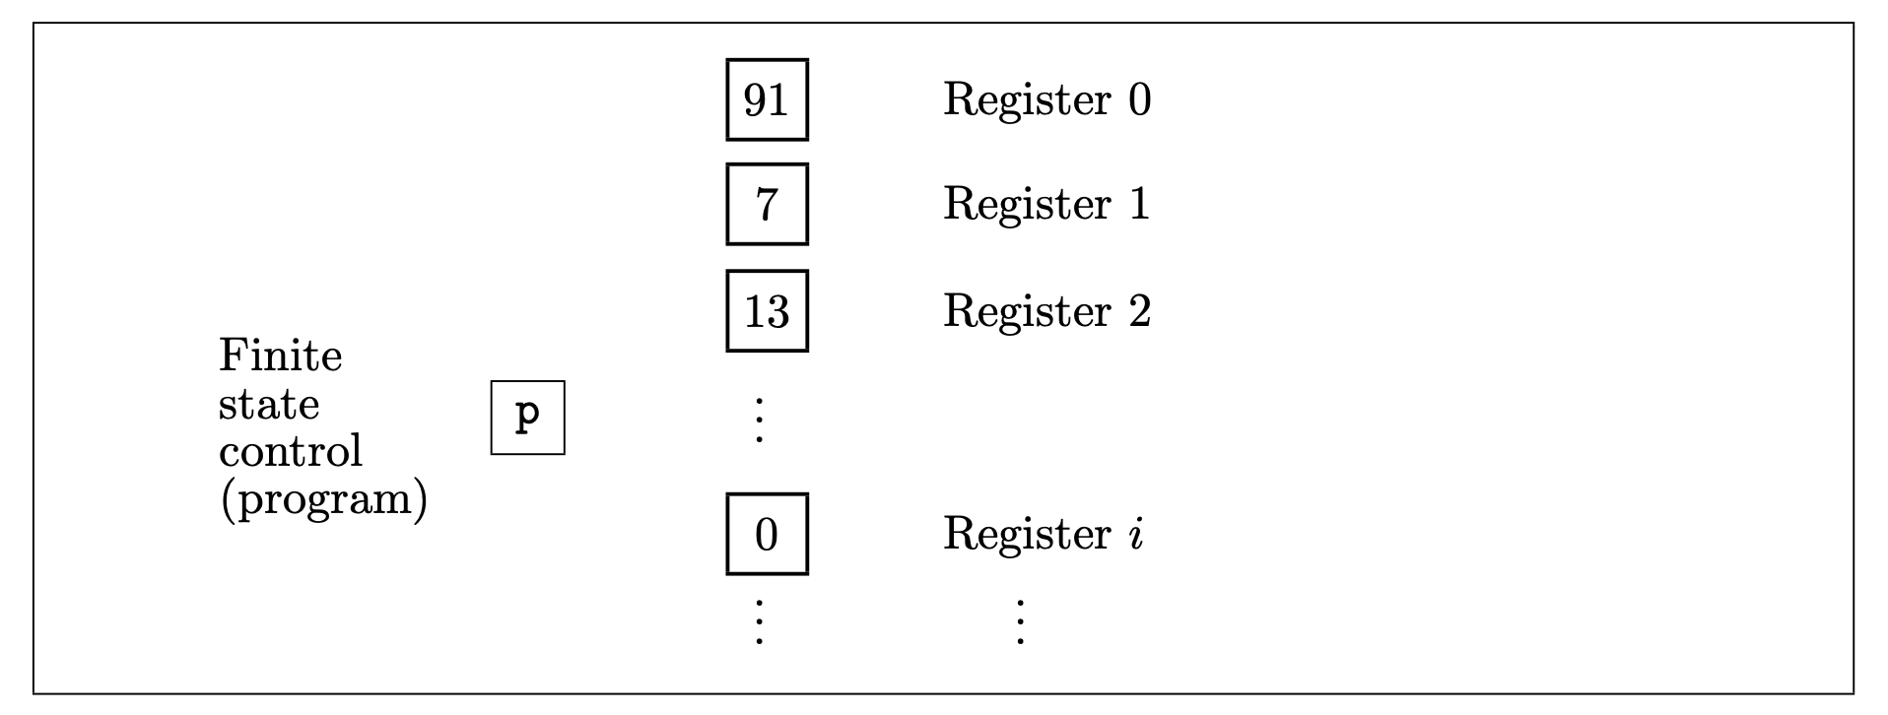
RAM model
uses arbitrarily many registers containing arbitrarily big numbers.

Slide 17
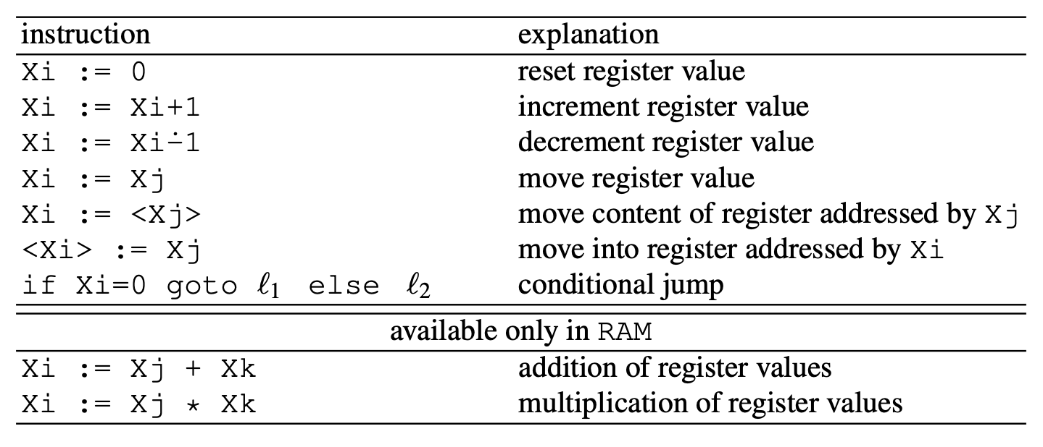
(S)RAM instruction set
SuccessorRAM is like RAM but without binary operations
data type of natural numbers
angle brackets < > indirect addressing
if-goto-else tests whether X is 0 and then jumps accordingly.
indirect addressing

Slide 18

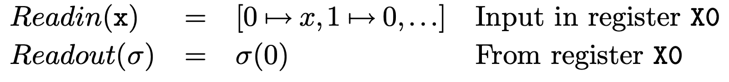
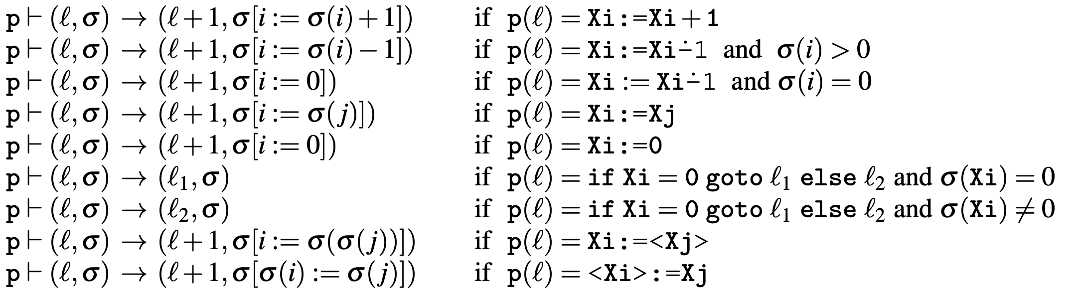
Semantics SRAM
{0:x, 1:0, 2:0,...}

Slide 19
Counter Machine CM
Counter machines are much simpler than register machines.
They contain several registers, called counters as they can only be incremented or decremented and tested for zero.
We have that 2CM is like CM but with 2 counters only.
Semantics as for register machines.

Slide 20
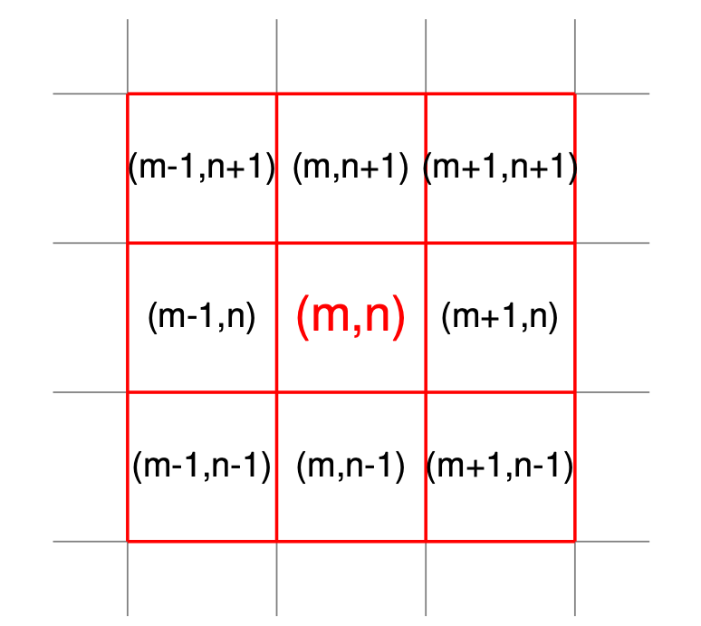
Cellular Automata CA
we just focus one specific version the famous 2-dimensional CA called (Conway’s) Game of Life
neighbourhood of (m,n) = 8 cells
John Conway (Cambridge Mathematician)
cell lattice (grid)
the value of a cell changes every “time tick” and the new value is determined only by the values of the neighbourhood cells
each cell contains 0 or 1

Slide 21

Rules of Game of Life
alive = 1 (solid line/filled)
dead = 0 (no colour)
-
-
+
Underpopulation
Survival
Overcrowding
Reproduction
die if fewer than two neighbours are alive
survive (stay alive) if two or three neighbours are alive
die if more than three neighbours are alive
become alive if exactly three neighbours are alive

Slide 22
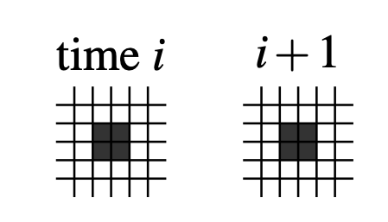
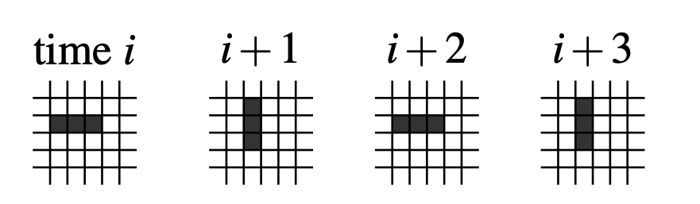
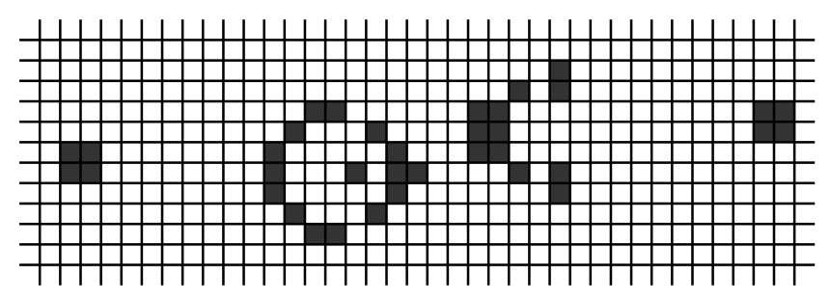
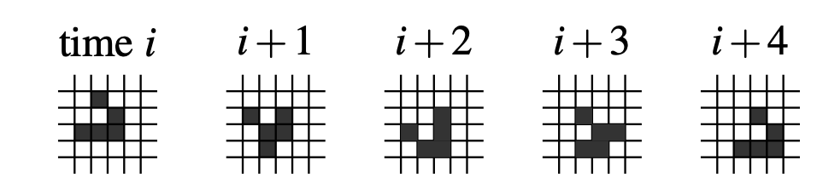

Patterns of Game of Life
https://www.youtube.com/watch?v=OrCTmfQWCmQ
static
oscillating (dynamic)
https://www.youtube.com/watch?v=GrIO5RJ76D0
productive: Gosling’s Glider Gun
one-cell diagonal movement of glider (dynamic)

Slide 23
Cellular Automata
Fun, but can they compute in our sense?
Yes, one has to:
encode input and program as starting grid
obtain a result when a predefined cell changes its state to a predefined “accepting state”
“accepting state” must be left alone in further grid changes (guaranteeing termination).

Slide 24
Limits of Computation
11 - Church-Turing Thesis
Bernhard Reus
PART III

Slide 25
Robustness of Computability
Church-Turing Thesis

Slide 26
Robustness of Computability
We justify the Church-Turing thesis ...
... by showing that all the above notions of computation are equivalent to WHILE.
Proof technique:
compile one program of language X into an equivalent one of language Y ...
... if X is not a sub-language of Y anyway.
compose compilers appropriately to avoid having to write n² compilers:

Slide 27
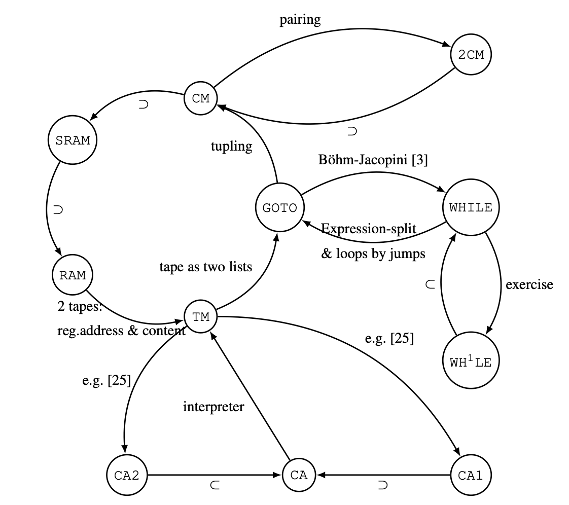
Diagram of Equivalences
The label of each arrow is either ⊂ if one language is included in the other or the name/idea of the required compilation.
to compile from one language to another just compose the compilers on the arrows you have to travel along
Details of compilations in N. Jones’ book, Chapter 8, exercises.
two-dimensional CA
one-dimensional CA
https://www.youtube.com/watch?v=My8AsV7bA94
https://www.youtube.com/watch?v=xP5-iIeKXE8

Slide 28
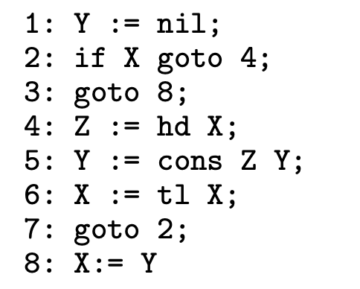
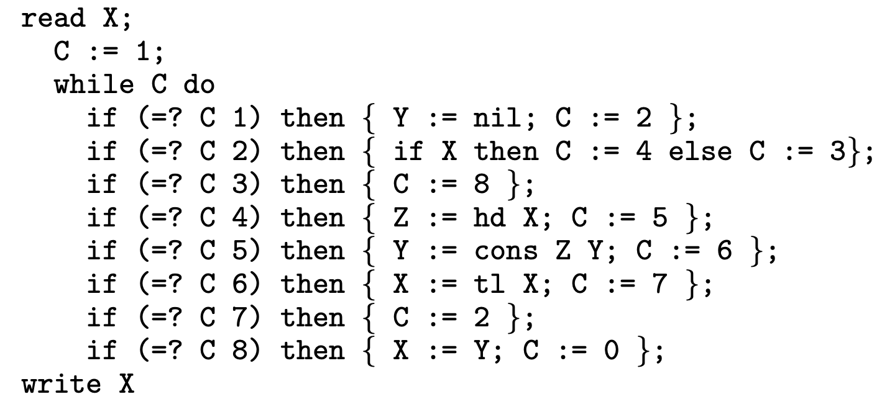
Böhm Jacopini Translation
GOTO ➝ WHILE
construct program with just one while loop
and one extra variable C: instruction counter

Slide 29
Compilers
we may discuss some of those compilations in exercises
or read details in Jones’ book Chapter 8.

Slide 30
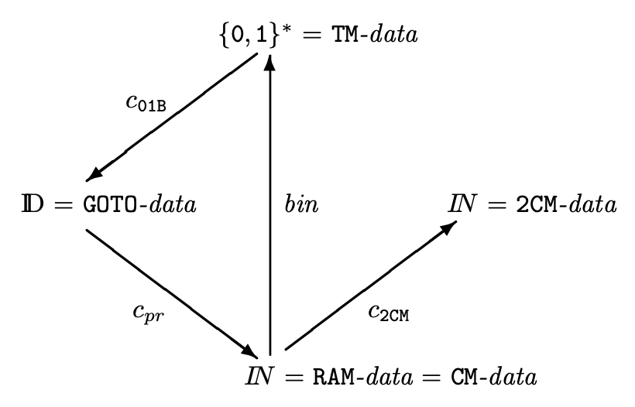
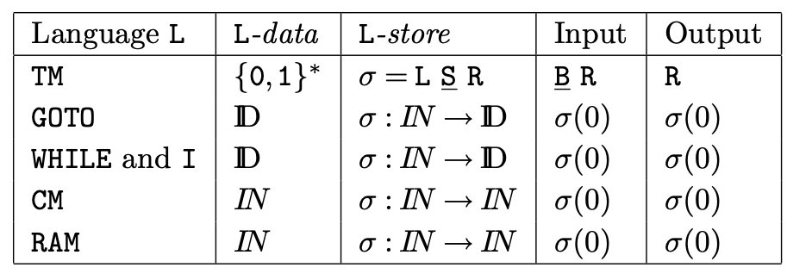
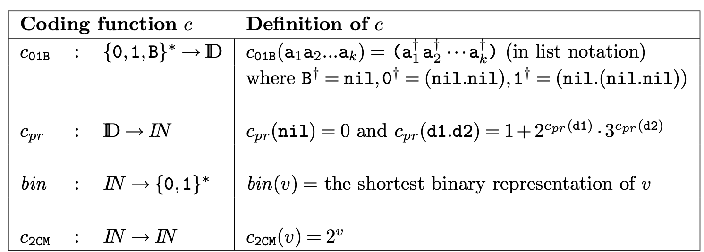
Compiling Data Types
Recall that in WIDE output can be any variable, not just (var 0)
1st counter encodes all variable’s values: 2^{v} 3^{x} 5^{y} 7^{z} so 2^{v} represents first variable = input variable

Slide 31
END
© 2008-25 Bernhard Reus, University of Sussex
Next time:
?
Next time:
Moving on to Complexity. How do we measure time usage?

