Slide 1
Limits of Computation
12 - Measuring Time Usage
Bernhard Reus

Slide 2
The story so far
We have discussed “computability”,
encountered computable and non-computable problems,
discussed Church-Turing Thesis.

Slide 3

Time Complexity
THIS TIME
From now on restrict interest to computable, i.e. decidable, problems
measuring the running time of programs
compare language (simulation up to certain factor in runtime)
image: mindhacks.com/blog

Slide 4
Time Complexity
THIS TIME
From now on restrict interest to computable, ie decidable, problems
measuring the running time of programs
complexity classes for problems (according to upper bounds for running time)
robustness of complexity classes w.r.t. machine models (Cook’s Thesis).
image: mindhacks.com/blog
N. Jones: Chap. 16

Slide 5
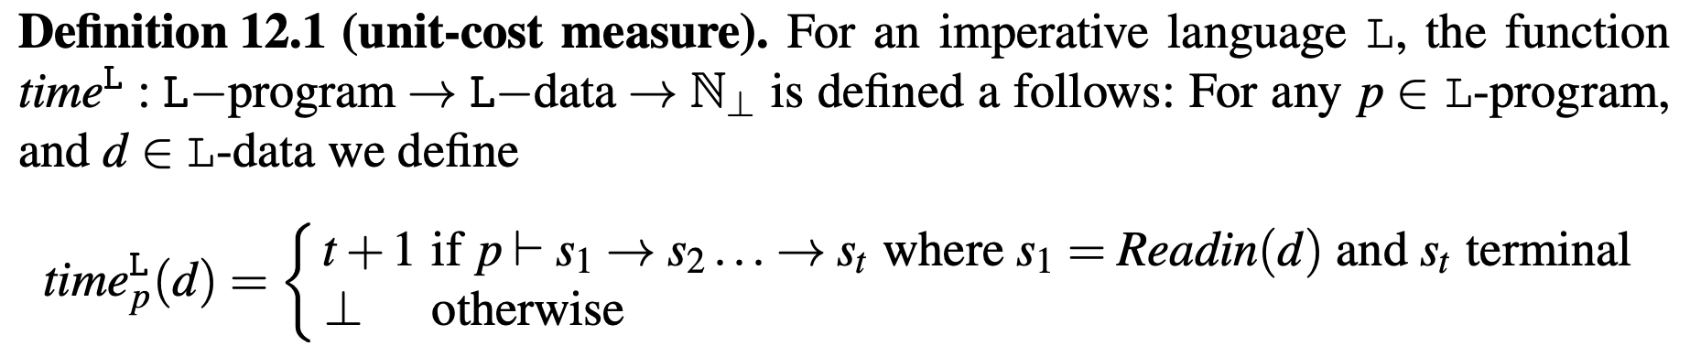
Unit-cost time measure
IN means natural numbers
operational semantics (need something different for WHILE)
With any completed program execution associate the number of its transition steps (according to its semantic description); “read input” & “write output” is implicitly one step each;

Slide 6
Time measures are functions
Note that for each program its running time measure is a function: running time depends on data input.
Time measure function is a partial function: the program may not terminate on some input in which case there is nothing to measure.

Slide 7
Is this measure really “fair”?
What counter arguments are there?
what about complexity of expressions (like equality = or cons) in WHILE?
what about unbounded size of numbers in RAM registers?
thus transition step (unit cost) measure in use for TM, GOTO and CM but not for language WHILE with tree expressions (GOTO does not use nested expressions just variables, so it’s fine).
SRAM/RAM/CM needs some more discussion:

Slide 8
Measuring RAM & CM
is unit measure ok for those models?
length of addresses and byte representation of numbers, shouldn’t they be considered?
in most machines fixed length (32bit, 64bit) so maybe not. But this is ok only for small numbers (no register overflow).
problematic if larger numbers are computed, so for RAM a logarithmic cost model is needed that takes length of addresses and content into account. Interested students are referred to Neil Jones’s book.
But SRAM does only allow +1 in one step, so unit measure is fine.
CM model fine but measure does not give much insight as costs always extremely high.

Slide 9
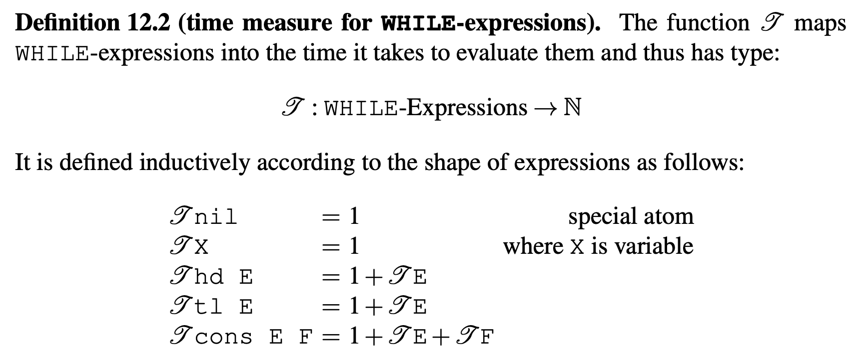
Time ’cost’ for WHILE expressions
Slogan: count operations and constants in expressions.
Example: T(cons hd X tl nil) = 1+(1+1)+(1+1) = 5

Slide 10
Time ’cost’ for WHILE – Discussion
Consider: T(cons X Y) = 1+1+1= 3
Is this fair?
Variables X and Y may contain large trees and cons means building an even larger tree, and this in only 3 time steps??
Justified by the fact that the interpreter does not have to re-build the large tree from scratch but can use references to existing trees (for X and Y):
So-called DAG semantics (DAG directed acyclic graphs)
More details if desired in Neil Jones’ book.

Slide 11
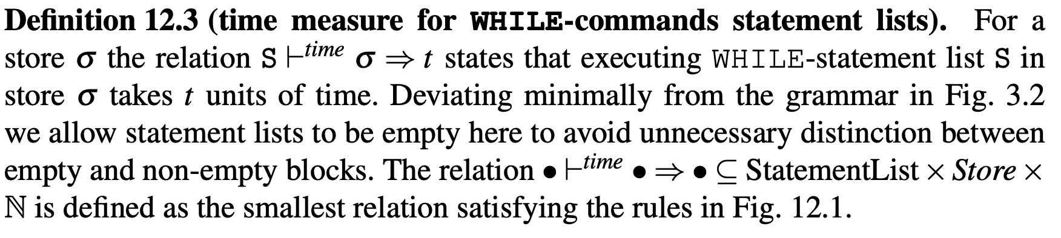
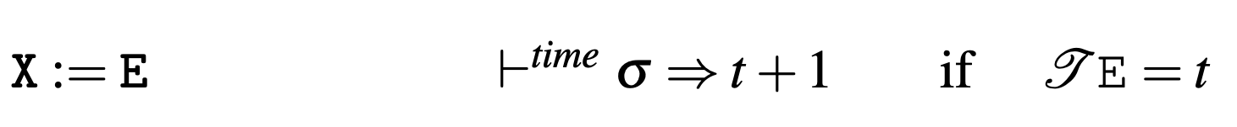
Time cost for WHILE (cont’d)
Lecture 3
below.

Slide 12
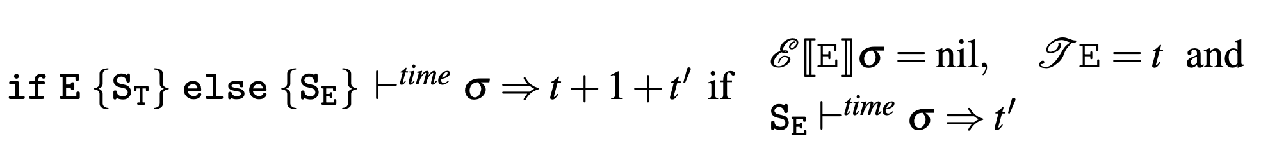
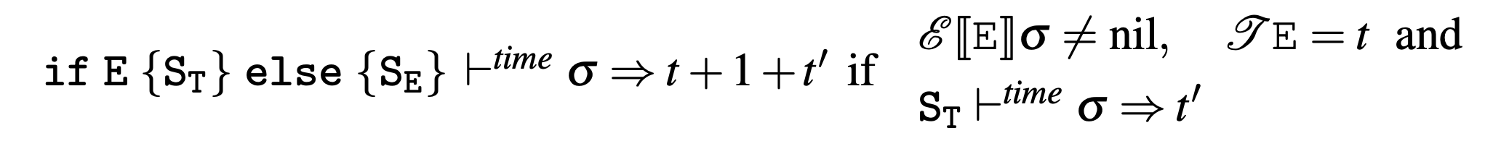
Time cost for WHILE (cont’d)
Meaning of expression E

Slide 13
Limits of Computation
12 - Measuring Time (Part II)
Bernhard Reus
continued

Slide 14
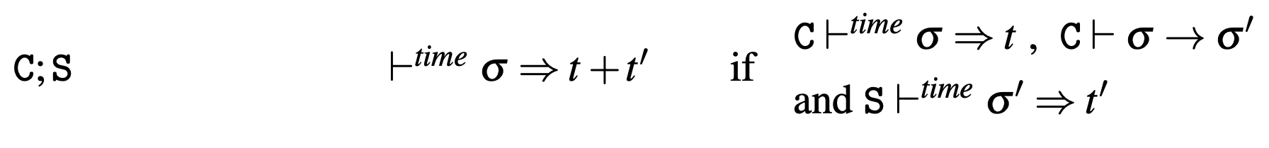
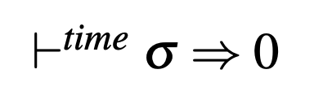
Time cost for WHILE (cont’d)
statement lists for blocks
for empty blocks

Slide 15
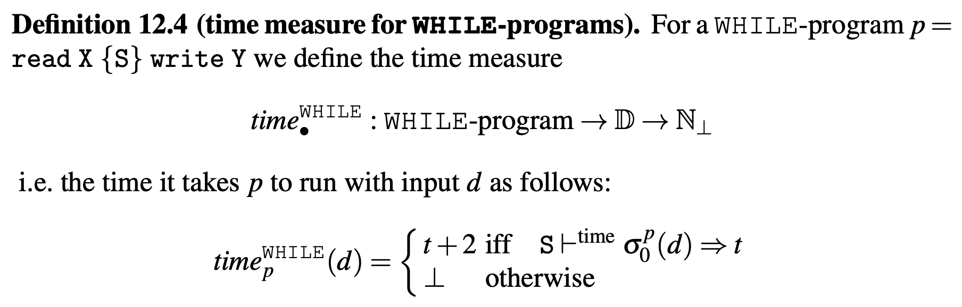
Time cost for WHILE (cont’d)
In other words, the runtime of a program p with input d is the time it takes to execute the body of the program in the corresponding initial state plus two for reading the input and writing the output.

Slide 16
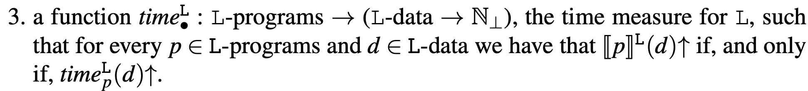
Timed Prog. Language
syntax of programs and (semantics of) data type
program semantics
time measure

Slide 17
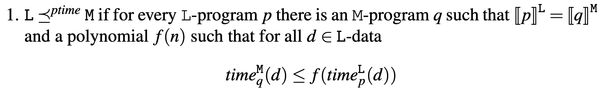
Comparing Languages
M can simulate L up to polynomial difference in time

Slide 18
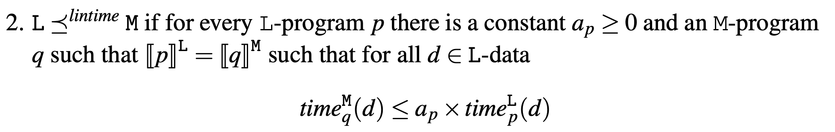
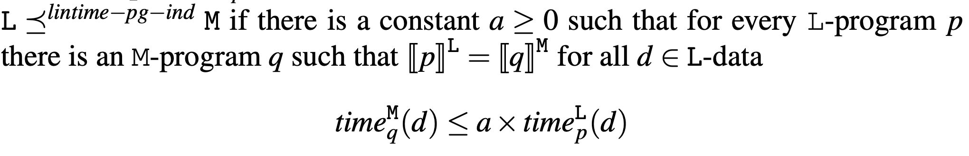
Comparing Languages II
M can simulate L up to linear difference in time
one constant for all programs
M can simulate L up to a program-independent linear time difference

Slide 19
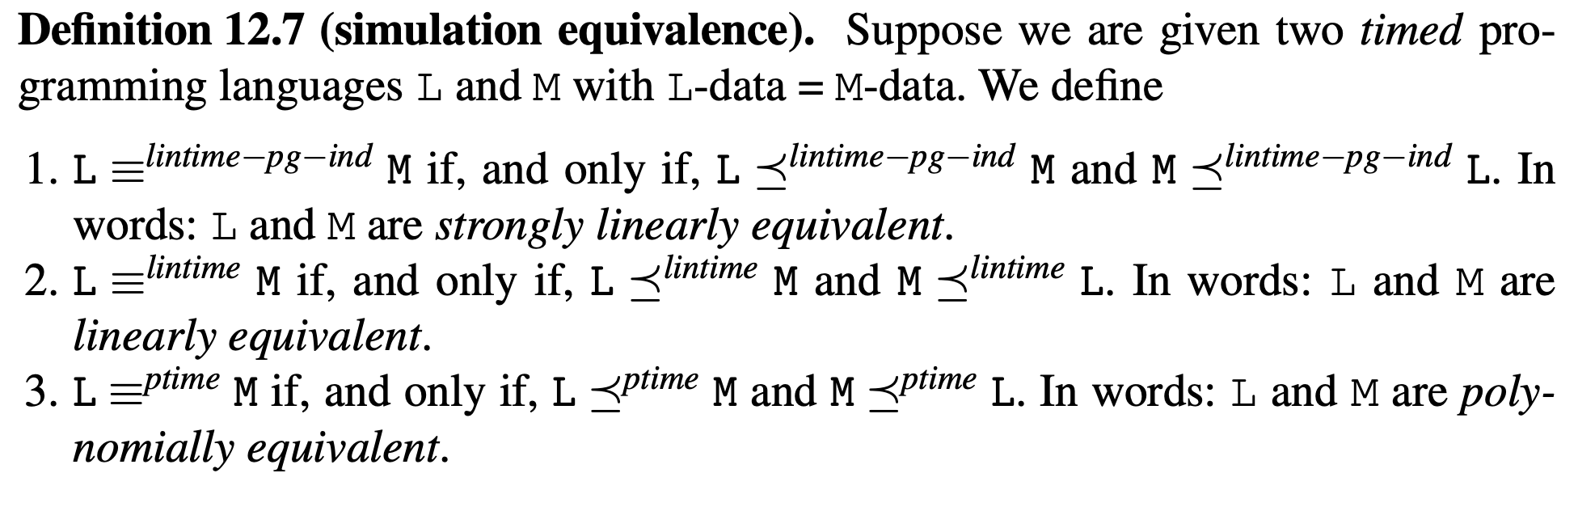
Comparing Languages III
We can now define “equivalent up to ... simulation”

Slide 20
Comparing Languages III
The simulation relation (of languages) is transitive (Exercises).
The equivalence relation (of languages) is transitive (follows from the definition and above).
Simulation is shown by compiling and comparing runtime of compiled vs original program.

Slide 21
END
© 2008-25. Bernhard Reus, University of Sussex
Next time:
?
Next time:
Defining complexity classes

