Slide 1
Limits of Computation
9 - More non-computable problems
Bernhard Reus

Slide 2
Last time
we have seen that the Halting Problem for WHILE-programs cannot be decided by a WHILE-program, but ...
... can we say something at least?

Slide 3
More undecidable problems
we show that Halting Problem is semi-decidable (and explain what that means)
next, we generalise the Halting Problem and the proof of its undecidability
to prove Rice’s Theorem
Other undecidable problem:
Tiling Problem
and non-computable function:
Busy Beaver
THIS TIME
(c) computerworkscentral.com

Slide 4
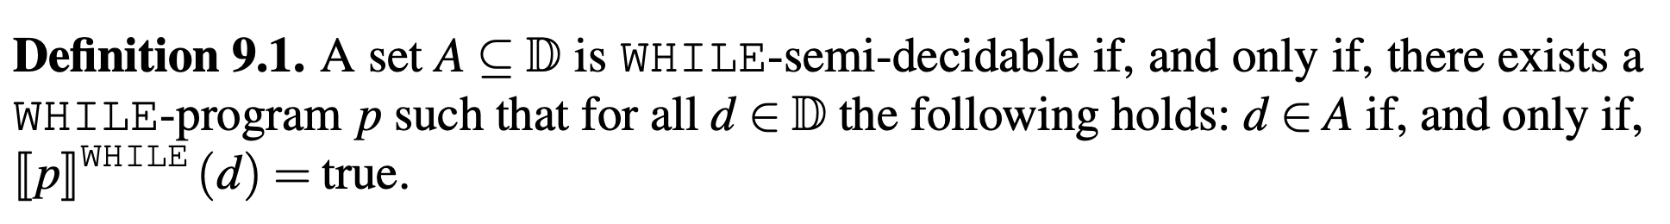
WHILE Semi-Decidability
So the “membership test” may not terminate
if the answer is “false”, it only works reliably for “half” of the cases, hence the term “semi-decidability”.

Slide 5
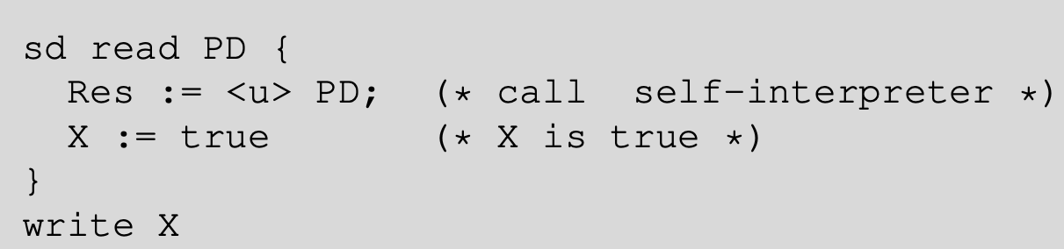
HALT is WHILE semi-decidable
Proof
The “semi-decision procedure” is as follows:
u is universal WHILE-program (self-interpreter)

Slide 6
Decidable V Semi-decidable
\ is “set difference”
read: “then so is its complement”
Proofs as exercise!

Slide 7
Generalising the Halting Problem
We have shown (by contradiction) that the Halting Problem cannot be decided by a WHILE program.
The Halting Problem is a problem about a property of WHILE-programs, namely whether they terminate (for specific input).
We now generalise to all (”interesting”) properties (of a certain kind) of WHILE-programs.

Slide 8
“Interesting” Properties of Programs
informally
“interesting” here means: non-trivial & extensional .
A non-trivial property is one that not all programs have, but that at least one program has.
An extensional program property is one that depends exclusively on the input-output behaviour of the program, i.e. its semantics.

Slide 9
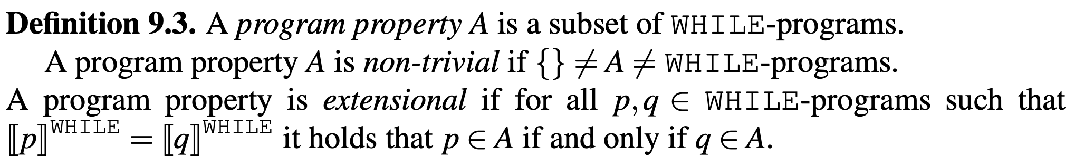
“Interesting” Properties of Programs
formally
This says that: if p has property A and its semantics is the same as that of q, then also q must have property A. If p does not have property A, and its semantics is the same as that of q, then also q does not have property A.

Slide 10

Rice’s Theorem
Rice’s Theorem:
Henry Gordon Rice (1920–2003)
Proof by contradiction:
Assume A is decidable, then show that the Halting Problem is decidable.
contradiction

Slide 11
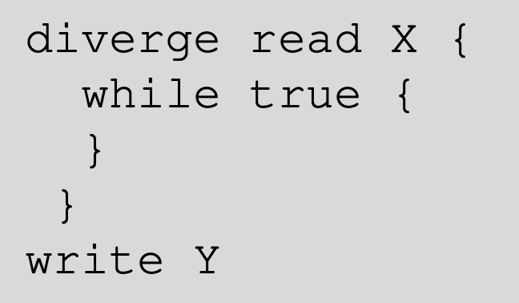


Proof of Rice's Thm.
First we define two programs we need:
By non-triviality of A we know that there is a program that is not in A.
Let us call this program comp.
if not, swap role of A and its complement

Slide 12
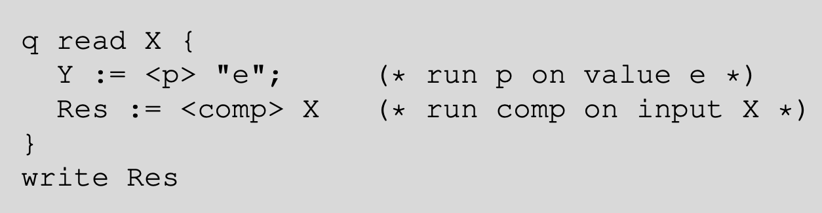

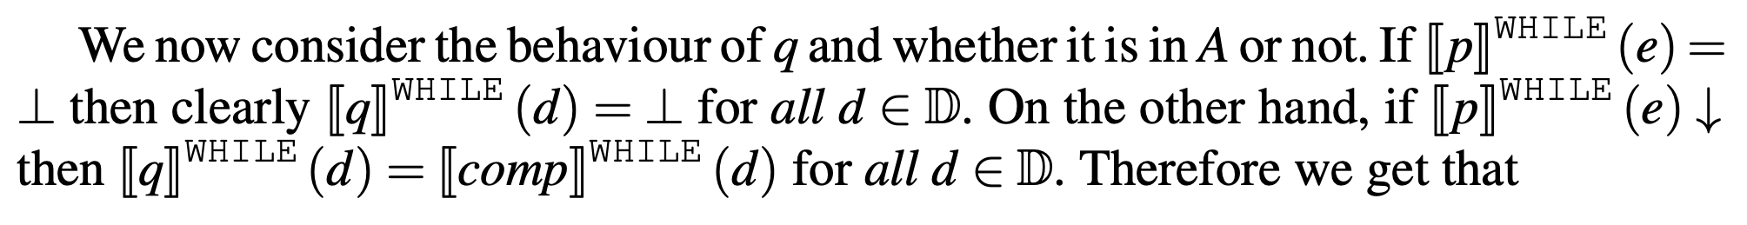
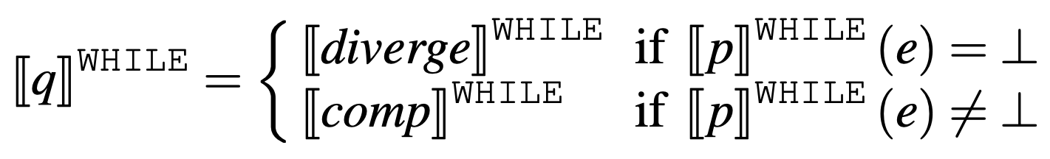
Proof of Rice’s Thm (II)
e as tree literal

Slide 13
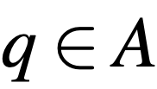
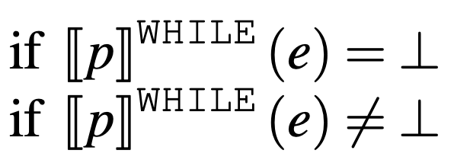


Proof of Rice’s Thm (III)
implies
iff
iff
because A is extensional
because of our assumptions
contradiction
So if we can decide A, we can decide HALT

Slide 14
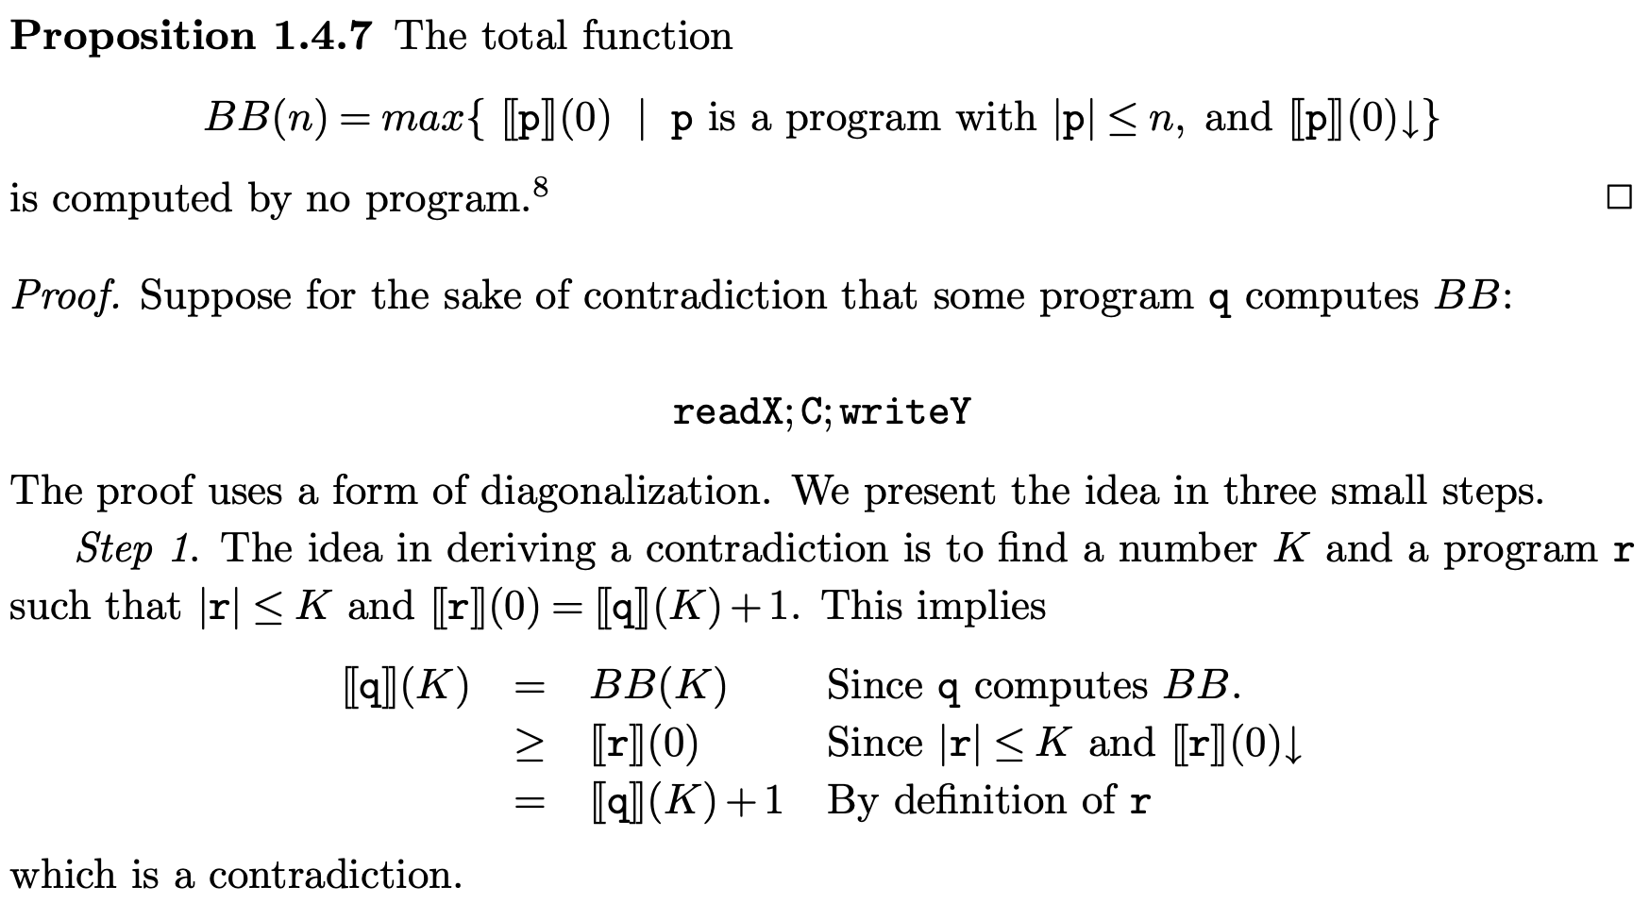
Busy Beaver Problem
string length

Slide 15
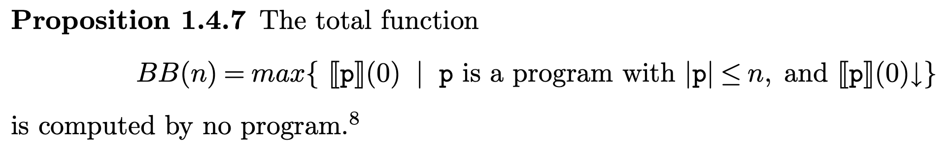

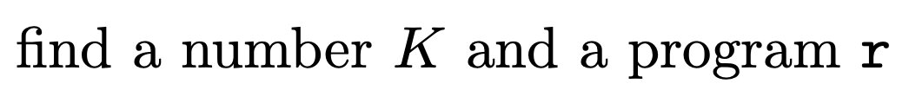
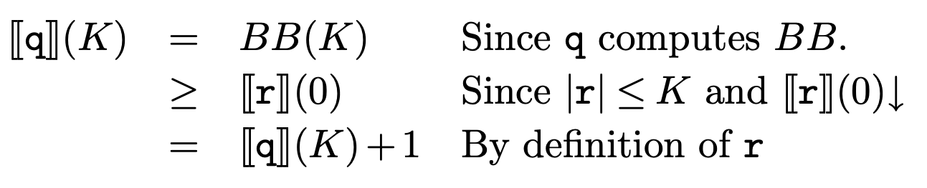
Busy Beaver Problem
string length
Proof by contradiction:
This can be achieved. For details see Jones Chapter 1.4.5

Slide 16
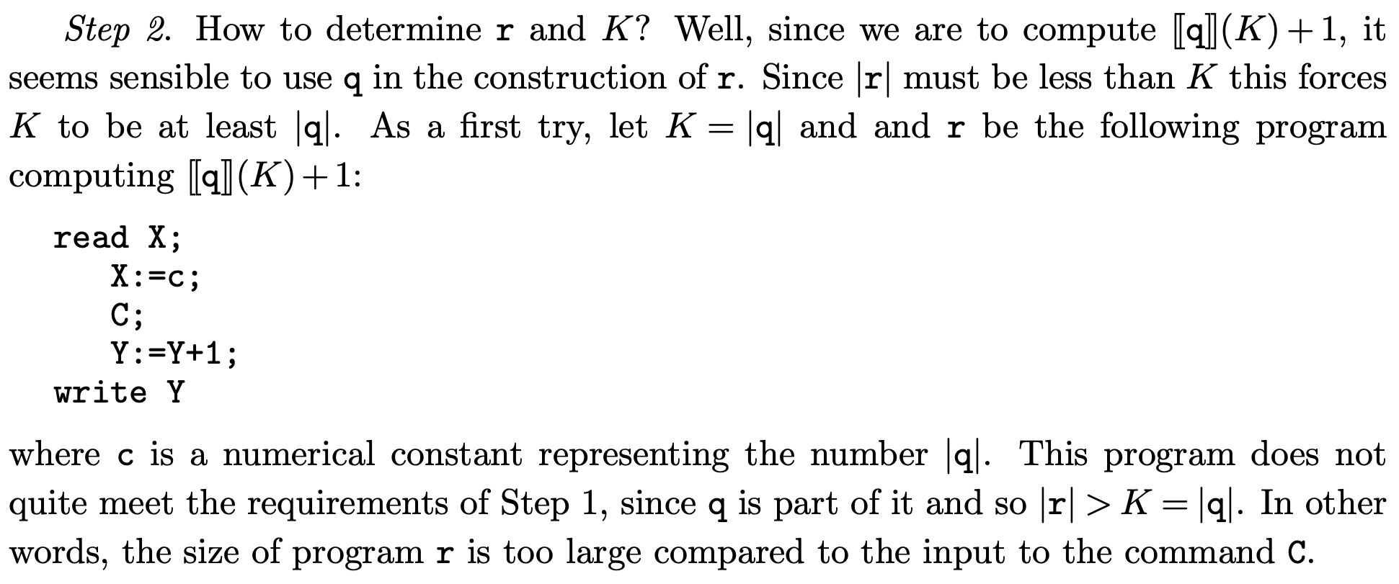
Busy Beaver II
c = K = |q|
r

Slide 17
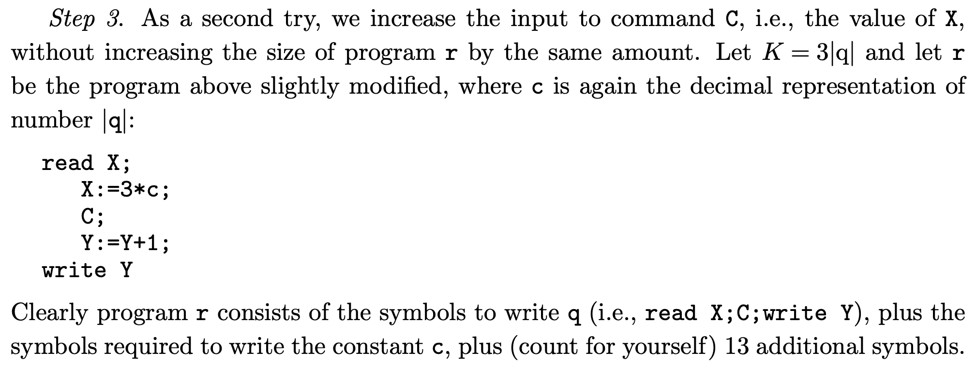
Busy Beaver III
c = |q| = K/3 so X=K
r

Slide 18
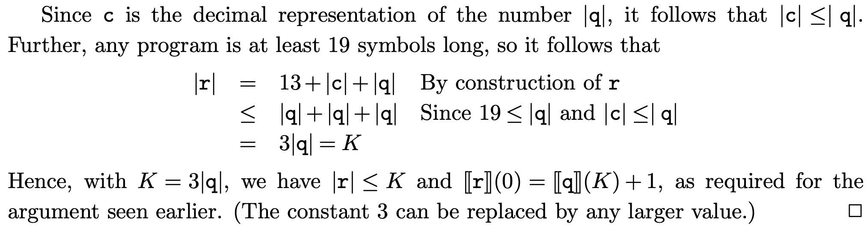
Busy Beaver IV

Slide 19
BB(n) Attacks
#states
output length
#steps
Those results refer to a n-state Turing Machine with 2 symbols and one two-way infinite tape.
NEW: Jan 08
on course webpages link to TM simulator with BB programs

Slide 20
Midterm Feedback
5/54 returns should mean most students are happy;
Liked: interesting subject, lectures engaging
Not Liked: notation, semantics, lack of examples

Slide 21

Tiling Problem
1
2
Given an infinite supply of tiles that are of a finite type (here:1,2), can we tile any arbitrary large quadratic floor (i.e. the plane) so that the patterns of all tiles match (in all 4 directions)?
you are not allowed to rotate the tiles, rotation requires a new tile type
DECISION PROBLEM

Slide 22
Tiling Problem (cont’d)
old
Note that swapping South-facing colours of tile type 2 and 3 as above will mean we cannot even tile a 3x3 square. (Try it out yourself! Exercises.)
The tiling problem for arbitrary finite sets of tile types is undecidable.

Slide 23
Tiling Problem is Hard
1961: H. Wang presents an algorithm that decides whether any given finite set of tile types can tile the plane. In his proof he assumed that any set that could tile the plane would be able to do so periodically (ie with a repeating pattern like a wallpaper)
1966: Robert Berger proved Wang’s conjecture wrong. He presented a case where the tiles would only tile the plane without repeating pattern, allegedly using 20,426 distinct tile shapes! ”Undecidability of the domino problem”, Memoirs of the AMS in 1966.
current record is using only 13 tiles

Slide 24
Undecidability of Tiling the Plane
tiling problem for a fixed size floor, n×n, is clearly decidable (check all tilings);
infinity of the plane alone is not the reason why tiling of the plane is undecidable;
How to prove undecidability? if the Tiling Problem was decidable so would be the Halting Problem for Turing Machines (encode sequence of Turing Machine states by tiles which match if they are successor states in a step).

Slide 25
Limits of Computation
9 - More non-computable problems
Bernhard Reus
Part II

Slide 26
Reduction
already several times this principle was used: to show that a problem is undecidable (non-computable), argue that if it was decidable (computable) then we could decide (compute) the Halting Problem.
Halting Problem is “at most as hard” than these other problems.
This is called a (computable) problem reduction.
We have seen that the Halting Problem can be reduced to any non-trivial & extensional program property or the Tiling problem. Thus those can’t be decidable either.

Slide 27

Reduction
informally
x∈A?
from A to B
Assume A⊆X and B⊆Y.
The decision problem x∈A? can be reduced to the decision problem y∈B? ...
...if we find a computable (total) function f: X → Y such that
f
f(x)
∈B?
==
decision
procedure for B
decision procedure for A
yes/no
x∈A “holds exactly if” f(x)∈B
iff

Slide 28
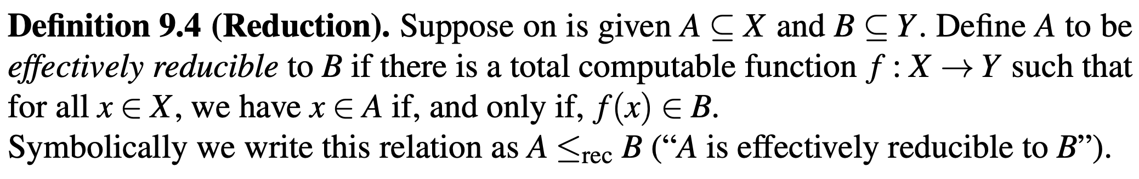
Reduction
formally
one is
B is at least as hard as A
Proof in Exercises.

Slide 29
Limits of Computation
9 - More non-computable problems
Bernhard Reus

Slide 30
Other undecidable Problems
Decision Problem: do languages accepted by two given context free grammars (CFGs) overlap?
Decision Problem: is a CFG ambiguous?
Decision Problem: does a CFG generate all words over a given alphabet?
Rewriting problem (does one string rewrite into another one using a set of given rewrite rules)
Type Checking/Inference for functional languages with polymorphic types, where the type of all types is a type itself, is undecidable.
Haskell avoids this “type of all types”
Joe Wells: “Typability and Type-checking in System F are equivalent and undecidable”, Annals of Pure and Applied Logic, 1999.

Slide 31
Limits of Computation
9 - More non-computable problems:
non-computable function into natural numbers
(Part II)
Bernhard Reus

Slide 32
Other (famous) undecidable Problems in Mathematics
Given a system of Diophantine (i.e. polynomial) equations with integer coefficients, does it have an integer solution?
word problem for groups
Hilbert’s Entscheidungsproblem (is a given formula valid in arithmetic?)
proved undecidable by
Matiyasevic in 1977
There are many others...

Slide 33
Dealing with Undecidability
use approximation of problem (if appropriate)
give up on uniformity (restricted input)
give up on (full) automation
be content solving a simpler problem

Slide 34
Busy Beaver
a non-computable function on numbers
“Can we compute the function BB that for every input number n returns the greatest number that can be outputted by any WHILE-program that is (as syntactic string) at most n characters long (when run with input 0)?”
T. Radó in his 1962 paper "On Non-Computable Functions" (using Turing-Machines where n is the number of states)
Tibor Radó (1895 -1965)

Slide 35
Busy Beaver Research
In theoretical computer science the Busy Beaver Problem for Turing Machines has been a challenge some researchers could not keep away from.
Marxen and Bundtrock “Attacking the Busy Beaver 5”, Bulletin of the EATCS, No. 40, 1990, pp. 247-251, used a significant amount of resources to compute BB(5) for TMs:

Slide 36
BB(5) Attack
They used a brute-force simulation technique going through 99.7% of all 88 million 5-state TMs but spending much thought on how to speed up simulation (using “macro-machines” that can simulate several steps in one).
C program of about 8,000 lines
it took 10 days to run on a 33MHz CPU
Result: BB(5) ≥ 4098

Slide 37
END
© 2008-25. Bernhard Reus, University of Sussex
Next time:
Is there a program that can return “itself”?

