Slide 1
Breadcrumbs:
Unaliasing in Reinforcement Learning
Philip Raeisghasem

Slide 2
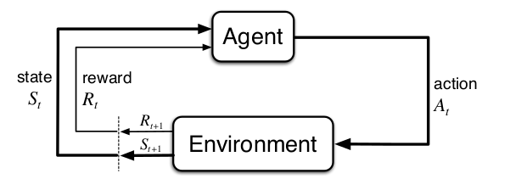
Reinforcement Learning
Figure from Sutton and Barto, 2018

Slide 3
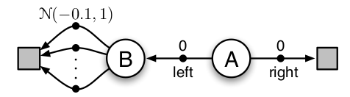
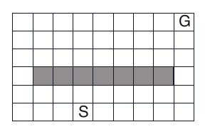
Exploration
Figures from Sutton and Barto, 2018

Slide 4
Intrinsic Motivation
A way to provide agents with a denser reward signal (more feedback).
Curiosity- Rewarding agents for having new experiences.
Random Network Distillation (RND) – Curiosity algorithm.
RND: arxiv.org/abs/1810.12894

Slide 5
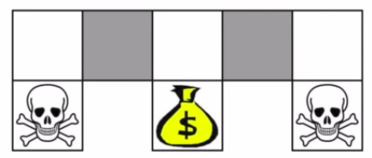
Aliased States
Due to partial observability
Currently solved with:
  Memory
  Redefining “state” in MDP
Figure from lecture by David Silver

Slide 6
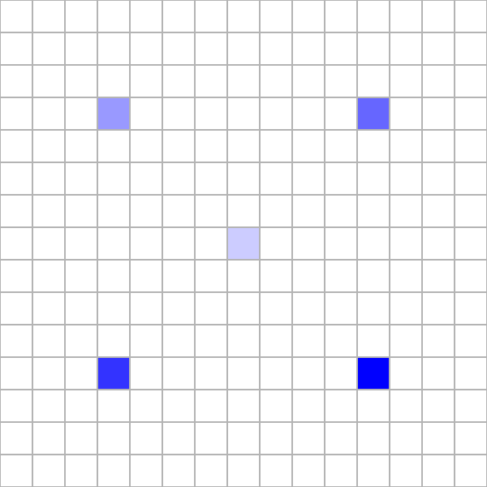
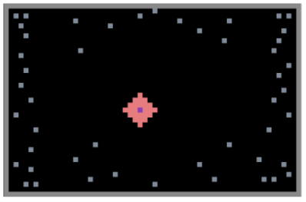

Experiments
Top left figure: arxiv.org/abs/1812.07019v1

Slide 7
Results
Random variable is final return (Normal)
 | Feature | Reward | Feature + Curiosity | Reward + Curiosity
sample mean | 3.03 | 3.49 | 2.51 | 3.75
sample variance | 1.76 | 1.71 | 1.17 | 2.22
Random variable is success rate (Bernoulli)
 | Feature | Reward | Feature + Curiosity | Reward + Curiosity
p | 18/40 | 28/40 | 8/40 | 29/40

Slide 8
Discussion
Reward trails were significantly better than feature trails
Curiosity did not significantly improve upon either method
Both unaliasing methods performed better than pure curiosity, which failed every time

Slide 9
Future Work
Hyperparameter search
Try other approaches
Compare to RNN memory methods
Test in multi-agent scenarios

